Slide 2
Unit
7
TRAFFIC
LESSON 5: SKILLS 1
ROAD SAFETY
READING
HOW TO AVOID TRAFFIC ACCIDENTS
SPEAKING
Unit

Slide 3
OBJECTIVES
By the end of the lesson, students will be able to:
+ Reading:
read for specific information about some rules about road safety
+ Speaking:
talk about how to avoid traffic accidents.

Slide 4
LESSON 5: SKILLS 1
WARM-UP
Game: Hangman
* Vocabulary
* Discussion
* Practice
Task 1: Read the following text and choose the correct answer
Task 2: Read the text again and answer the questions
READING
Task 3: Work in groups. Ask and answer the following question. Make a list.
Task 4: Read the following sentences about these people. Then work in groups. Discuss who is being safe, and who isn’t
SPEAKING
PRODUCTION
Task 5: Give the advices on dangerous situations on the road
CONSOLIDATION
Wrap-up
Home work

Slide 5
LESSON 1: GETTING STARTED
WARM-UP
Game:Hangman
Aims of the stage:
To introduce the topic of reading.

Slide 6
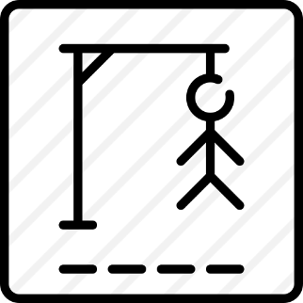
WARM-UP
D A N G E R O U S

Slide 7
LESSON 5: SKILLS 1
WARM-UP
Game: Hangman
* Vocabulary
* Discussion
* Practice
Task 1: Read the following text and choose the correct answer
Task 2: Read the text again and answer the questions
READING
Aims of the stage:
To provide students with some lexical items before reading the text.

Slide 8
PRE-READING - VOCABULARY
pedestrian (n)
/pəˈdestrēən/
người đi bộ

Slide 9
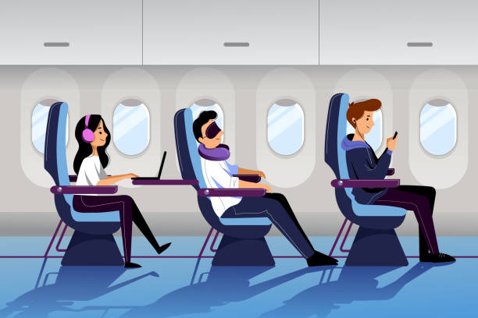
PRE-READING - VOCABULARY
passenger (n)
/ˈpasinjər/
hành khách

Slide 10
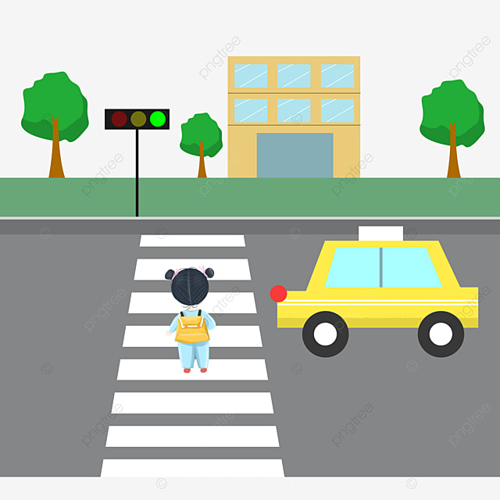
PRE-READING - VOCABULARY
(to) obey
/ōˈbā/
tuân thủ

Slide 11
PRE-READING - VOCABULARY
seatbelt (n)
/ˈsēt ˌbelt/
dây an toàn

Slide 12
PRE-READING - VOCABULARY
New words | Pronunciation | Meaning
pedestrian (n) | /pəˈdestrēən/ | người đi bộ
passenger (a) | /ˈpasinjər/ | hành khách
(to) obey | /ōˈbā/ | tuân thủ
seatbelt (n) | /ˈsēt ˌbelt/ | dây an toàn

Slide 13
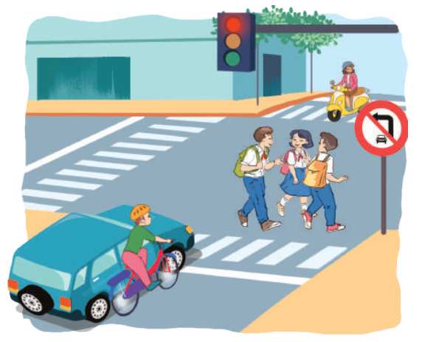
PRE-READING
1
Dicussion. Look at the pictures:
Can you see anything that is dangerous?

Slide 14
LESSON 5: SKILLS 1
WARM-UP
Game: Hangman
* Vocabulary
* Discussion
* Practice
Task 1: Read the following text and choose the correct answer
Task 2: Read the text again and answer the questions
READING

Slide 15
WHILE-READING
2
Read the following text and choose the correct answer.
Aim of the task:
To help Ss develop their reading skill for main ideas

Slide 16
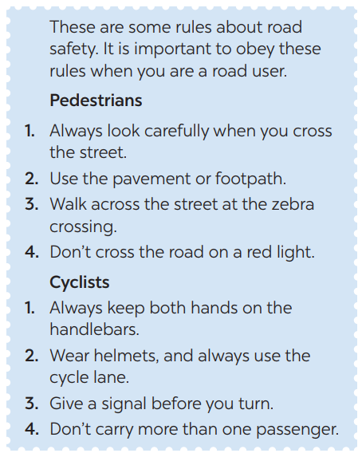
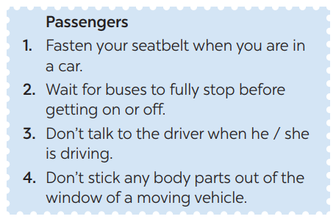
WHILE-READING
2
Read the following text and choose the correct answer.
This text is about ______.
A. rules for pedestrians
B. traffic lights
C. traffic rules

Slide 17
WHILE-READING
2
Read the following text and choose the correct answer.
This text is about ______.
A. rules for pedestrians
B. traffic lights
C. traffic rules

Slide 18
WHILE-READING
3
Read the passage again and choose the correct answer A, B, or C.
Aim of the task:
To help Ss further develop their reading skill for specific information (scanning).

Slide 19
√
WHILE-READING
3
Read the text again and answer the questions:
1. Where should pedestrians cross the street?
2. Which lane should you use when riding a bike?
3. What should you do before you turn while riding a bike?
4. What must you do when you get on or off a bus?
5. What mustn’t you do when you are in a moving vehicle?
They shoud cross the street at the zebra crossing.

Slide 20
√
WHILE-READING
3
Read the text again and answer the questions:
1. Where should pedestrians cross the street?
2. Which lane should you use when riding a bike?
3. What should you do before you turn while riding a bike?
4. What must you do when you get on or off a bus?
5. What mustn’t you do when you are in a moving vehicle?
They shoud cross the street at the zebra crossing.
We should always use the cycle lane.
We should give a signal before we turn while riding a bike.
We must wait for buses to fully stop when you get on or off a bus.
We mustn’t stick any body parts out of the window
when you are in a moving vehicle.

Slide 21
LESSON 5: SKILLS 1
WARM-UP
Game: Hangman
* Vocabulary
* Discussion
* Practice
Task 1: Read the following text and choose the correct answer
Task 2: Read the text again and answer the questions
READING
Task 3: Work in groups. Ask and answer the following question. Make a list.
Task 4: Read the following sentences about these people. Then work in groups. Discuss who is being safe, and who isn’t
SPEAKING

Slide 22
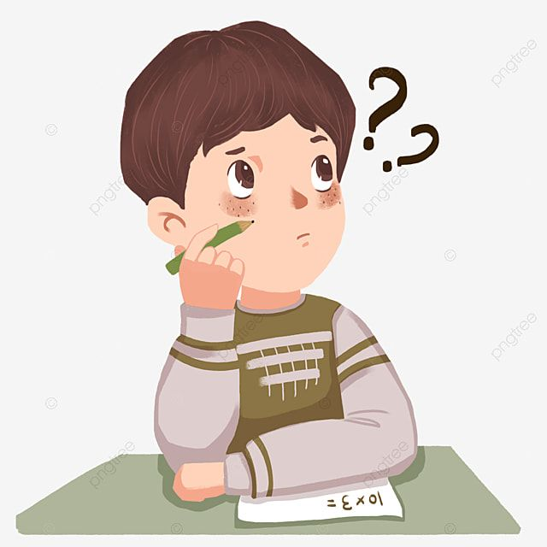
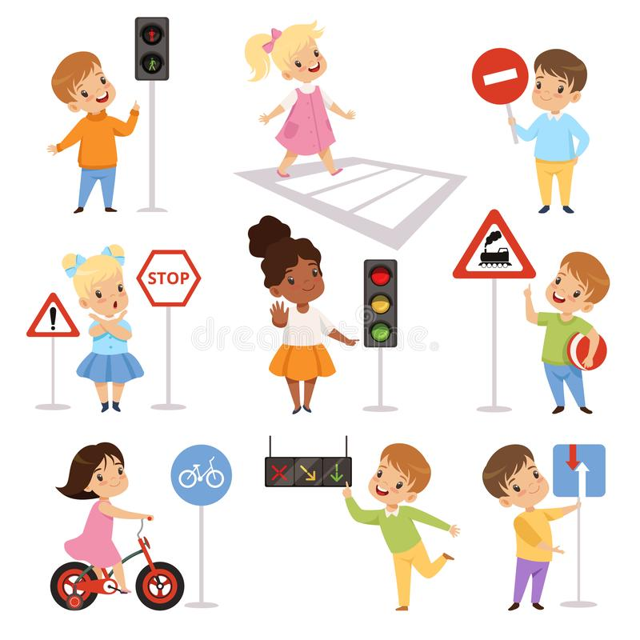
SPEAKING
4
Work in groups. Ask and answer the following question:
When you are a road user, what should you NOT do?

Slide 23
SPEAKING
5
Read the following sentences about these people.
Then work in groups. Discuss who is being safe, and who isn’t
Aim of the task:
To provide Ss an opportunity to practise giving advices on dangerous situations on the road.

Slide 24
SPEAKING
5
Read the following sentences about these people.
Then work in groups. Discuss who is being safe, and who isn’t
1. Hoang is riding a bike, and he is wearing a helmet. 2. It is raining hard, but Mr. Long is driving quickly. 3. The students are standing in a line to get on the school bus. 4. Mr. Binh is taking his daughter to school on his motorbike. She is sitting in front of him. 5. Michelle is cycling to school and she is waving and shouting to her friends.

Slide 25
SPEAKING
5
Read the following sentences about these people.
Then work in groups. Discuss who is being safe, and who isn’t
1. Hoang is riding a bike, and he is wearing a helmet. 2. It is raining hard, but Mr. Long is driving quickly. 3. The students are standing in a line to get on the school bus. 4. Mr. Binh is taking his daughter to school on his motorbike. She is sitting in front of him. 5. Michelle is cycling to school and she is waving and shouting to her friends.

Slide 26
LESSON 5: SKILLS 1
WARM-UP
Game: Hangman
* Vocabulary
* Discussion
* Practice
Task 1: Read the following text and choose the correct answer
Task 2: Read the text again and answer the questions
READING
Task 3: Work in groups. Ask and answer the following question. Make a list.
Task 4: Read the following sentences about these people. Then work in groups. Discuss who is being safe, and who isn’t
SPEAKING
PRODUCTION
Task 5: Give the advices on dangerous situations on the road
CONSOLIDATION
Wrap-up
Home work

Slide 27
CONSOLIDATION
1
WRAP-UP
READING
SPEAKING

Slide 28
CONSOLIDATION
2
HOMEWORK
Prepare for the next lesson: Skills 2

