Slide 2
Unit
7
TRAFFIC
LESSON 2: A CLOSER LOOK 1
VOCABULARY
PRONUNCIATION
Unit
HOBBIES

Slide 3
OBJECTIVES
By the end of the lesson, students will be able to:
Vocabulary:
+ the verbs to use means of transport
+ Vocabulary to read the road signs.
Pronunciation: pronounce and recognize the sounds /aɪ/ and /eɪ/

Slide 4
LESSON 2: A CLOSER LOOK 1
WARM-UP
Game: Jumbled words
Vocabulary
Task 1: Match the words in A with the phrases in B.
Task 2: Look at these road signs. Then write the correct phrases under the signs.
Task 3: Work in pairs. Take turns to say which of the signs in 2 you see on the way to school.
and repeat
VOCABULARY
PRONUNCIATION
Pronunciation
Task 4: Listen and repeat. Pay attention to the sounds /aɪ/ and /eɪ/.
Task 5: Underline the words with the sound /aɪ/ and circle the words with the sound /eɪ/. Then listen, check
CONSOLIDATION
Wrap-up
Home work

Slide 5
LESSON 2: A CLOSER LOOK 1
WARM-UP
Game: Jumble words
Aims of the stage:
To activate students’ prior knowledge and vocabulary related to the topic, the targeted vocabulary, and its pronunciation.

Slide 6
WARM-UP: JUMBLED WORDS
MEANS OF TRANSPORT
1- OTBA -> BOAT
2- ITANR -> TRAIN
3- NPEILAPRA -> AIRPLANE
4- RSOTRPCA -> SPORT CAR
5- OTMIROEKB -> MOTORBIKE

Slide 7
LESSON 2: A CLOSER LOOK 1
WARM-UP
Game: Jumbled words
Vocabulary
Task 1: Match the words in A with the phrases in B.
Task 2: Look at these road signs. Then write the correct phrases under the signs.
Task 3: Work in pairs. Take turns to say which of the signs in 2 you see on the way to school.
and repeat
VOCABULARY
Aims of the stage:
To introduce visually some nouns related to the topic

Slide 8
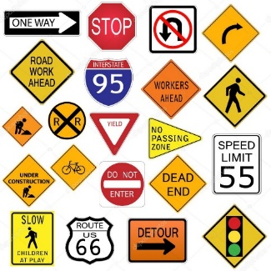
PRESENTATION
road sign (n):
/ˈrəʊd saɪn/
BIỂN BÁO
GIAO THÔNG

Slide 9
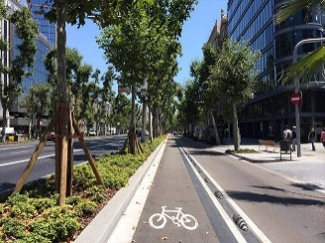
PRESENTATION
cycle lane (n)
/ˈsaɪkl leɪn/
LÀN ĐƯỜNG
DÀNH RIÊNG CHO XE ĐẠP

Slide 10
PRESENTATION
traffic light
/ˈtræfɪk laɪt/
ĐÈN GIAO THÔNG

Slide 11
PRESENTATION
New words | Pronunciation | Meaning
1. road sign (n) | /ˈrəʊd saɪn/ | biển báo giao thông
2. cycle lane (n) | /ˈsaɪkl leɪn/ | làn đường dành riêng cho xe đạp
3. traffic light (n) | /ˈtræfɪk laɪt/ | đèn giao thông

Slide 12
LESSON 2: A CLOSER LOOK 1
WARM-UP
Game: Jumbled words
Vocabulary
Task 1: Match the words in A with the phrases in B.
Task 2: Look at these road signs. Then write the correct phrases under the signs.
Task 3: Work in pairs. Take turns to say which of the signs in 2 you see on the way to school.
and repeat
VOCABULARY

Slide 13
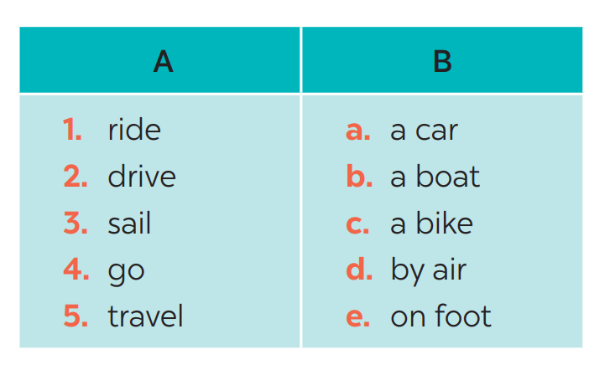
VOCABULARY
1
Match the words in A with the phrases in B.
1. c
2. a
3. b
4. e
5. d

Slide 14
VOCABULARY
2
Look at these road signs. Then write the correct phrases under the signs.
traffic lights

Slide 15
VOCABULARY
2
Look at these road signs. Then write the correct phrases under the signs.
No right turn
cycle lane
traffic lights
Hospital ahead
School ahead
No cycling

Slide 16
VOCABULARY
3
Work in pairs. Take turns to say which of the signs in 2 you see on the way to school.
A: On the way to school, there are crossroads, so I see several traffic lights.
B: On my way to school, there is a hospital, so I see a “hospital ahead sign”.

Slide 17
LESSON 2: A CLOSER LOOK 1
WARM-UP
Game: Jumbled words
Vocabulary
Task 1: Match the words in A with the phrases in B.
Task 2: Look at these road signs. Then write the correct phrases under the signs.
Task 3: Work in pairs. Take turns to say which of the signs in 2 you see on the way to school.
and repeat
VOCABULARY
PRONUNCIATION
Pronunciation
Task 4: Listen and repeat. Pay attention to the sounds /aɪ/ and /eɪ/.
Task 5: Underline the words with the sound /aɪ/ and circle the words with the sound /eɪ/. Then listen, check

Slide 18
PRONUNCIATION
aɪ/ and /eɪ/
Aims of the stage:
To help Ss identify the and classify the sounds
To give students authentic practice in using pronouncing sounds in common words

Slide 19
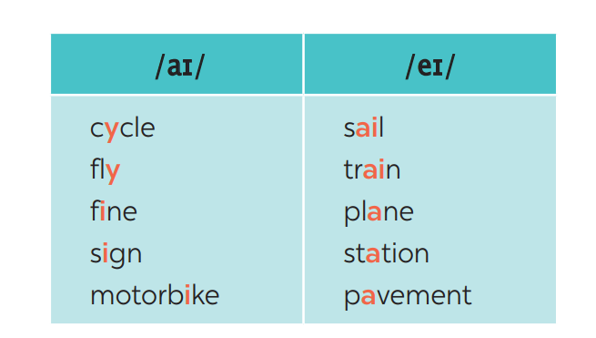
PRONUNCIATION
4
Listen and repeat. Pay attention to the sounds /aɪ/ and /eɪ/.

Slide 20
PRONUNCIATION
5
Underline the words with the sound /aɪ/ and circle the words with the sound /eɪ/. Then listen, check and repeat
1. The bus station is far from my house.
2. Remember to ride your bike carefully.
3. We must obey traffіc rules for our safety.
4. You have to get there in time for the train.
5. Don’t ride on the pavement.

Slide 21
PRONUNCIATION
5
Underline the words with the sound /aɪ/ and circle the words with the sound /eɪ/. Then listen, check and repeat
1. The bus station is far from my house.
2. Remember to ride your bike carefully.
3. We must obey traffіc rules for our safety.
4. You have to get there in time for the train.
5. Don’t ride on the pavement.

Slide 22
LESSON 2: A CLOSER LOOK 1
WARM-UP
Game: Jumbled words
Vocabulary
Task 1: Match the words in A with the phrases in B.
Task 2: Look at these road signs. Then write the correct phrases under the signs.
Task 3: Work in pairs. Take turns to say which of the signs in 2 you see on the way to school.
and repeat
VOCABULARY
PRONUNCIATION
Pronunciation
Task 4: Listen and repeat. Pay attention to the sounds /aɪ/ and /eɪ/.
Task 5: Underline the words with the sound /aɪ/ and circle the words with the sound /eɪ/. Then listen, check
CONSOLIDATION
Wrap-up
Home work

Slide 23
CONSOLIDATION
1
WRAP-UP
VOCABULARY
PRONUNCIATION

Slide 24
CONSOLIDATION
2
HOMEWORK
Exercises in the workbook

