Slide 2
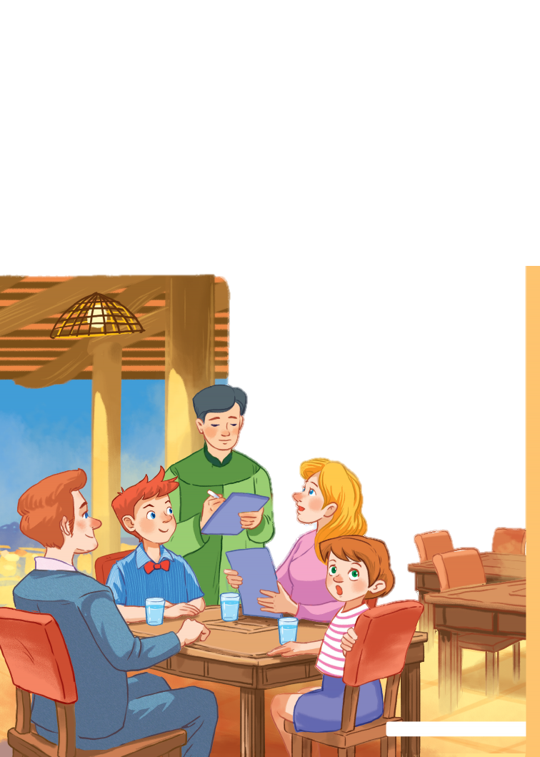
Unit
5
FOOD AND DRINK
LESSON 1: GETTING STARTED
At a Vietnamese restaurant
HOBBIES

Slide 3
OBJECTIVES
By the end of this lesson, Ss will be able to gain:
1. Knowledge
An overview about the topic Food and Drink
Vocabulary to talk about food and drink
2. Core competence
Develop communication skills and cultural awareness
Be collaborative and supportive in pair work and teamwork
Actively join in class activities
3. Personal qualities
Develop healthy eating habits and awareness of balanced diets
Be proud of the homeland

Slide 4
LESSON 1: GETTING STARTED
WARM-UP
Mini game
PRESENTATION
Vocabulary
LEAD-IN
Task 1: Answer the questions.
Task 2: Find the words and phrases about food and drink and write them in the correct columns.
Task 3: Read the conversation again and tick (✓) T or F.
PRACTICE
PRODUCTION
Task 4: Work in pairs. Think about your favourite food and drink. Then ask your partner about his or her favourite food and drink.
CONSOLIDATION
Wrap-up
Homework

Slide 5
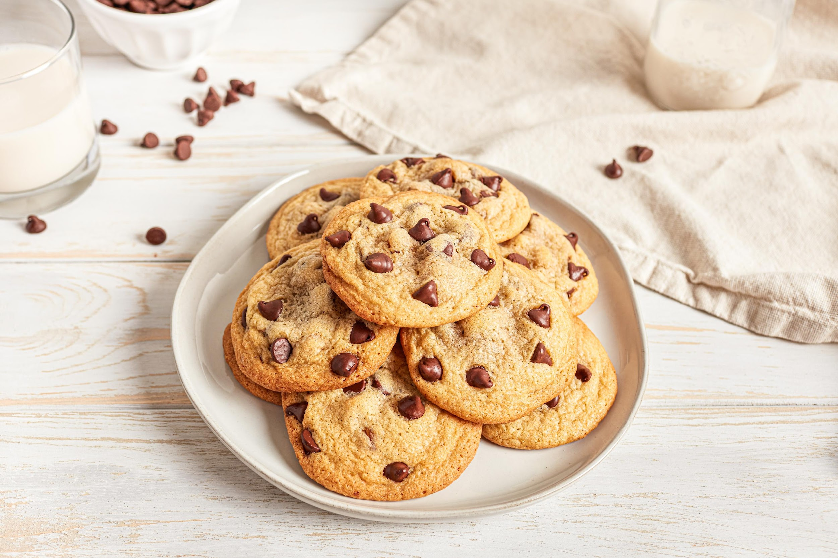
LESSON 1: GETTING STARTED
WARM-UP
Mini game
Aims of the stage:
To activate students’ knowledge on the topic of the unit
To enhance students’ skills of cooperating with teammates

Slide 6
Mini game
In pairs:
Sit facing each other.
Take turns to throw a ball of paper to your partner as saying a noun.
When your partner catches the ball, say immediately if the noun is edible or inedible, then repeat the procedure.
Example:
A (throwing) - Egg.
B (catching) - Edible. (throwing) - Book.
A (catching) - Inedible. (throwing) House …

Slide 7
LESSON 1: GETTING STARTED
WARM-UP
Mini game
PRESENTATION
Vocabulary
Aims of the stage:
To help students use key language more appropriately before the reading & listening task

Slide 8
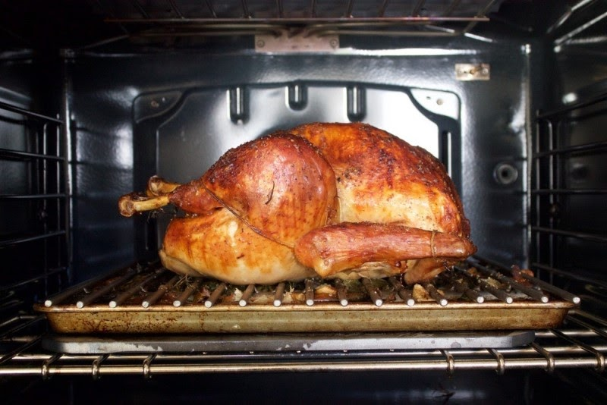
VOCABULARY
roast (v)
/rəʊst/
quay, nướng (thịt..)

Slide 9
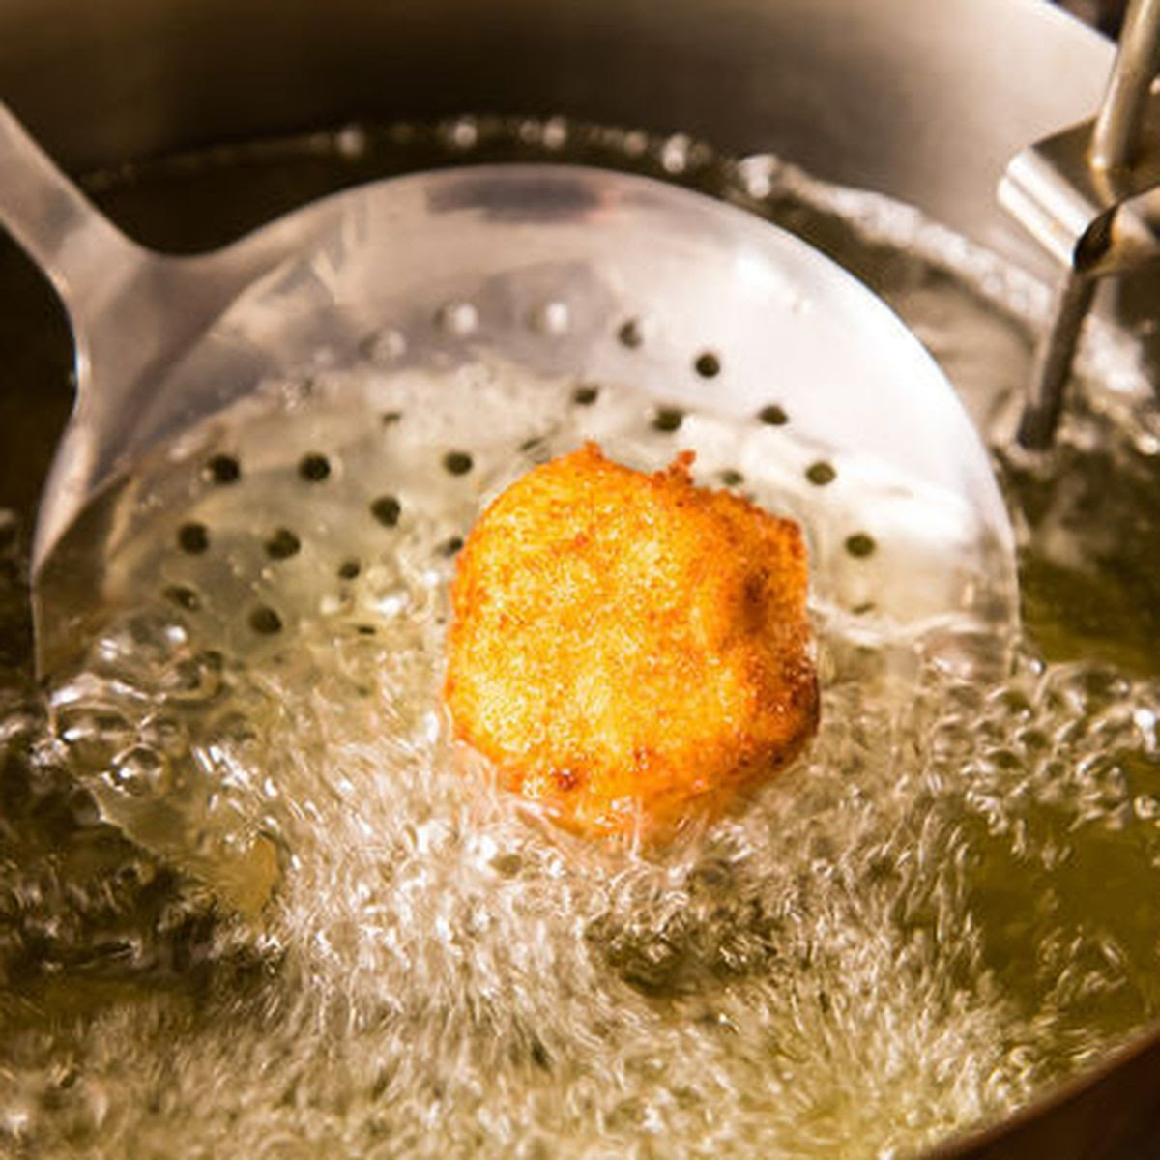
VOCABULARY
fry (v)
/fraɪ/
rán

Slide 10
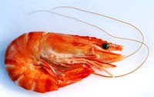
VOCABULARY
shrimp (n)
/ʃrɪmp/
con tôm

Slide 11
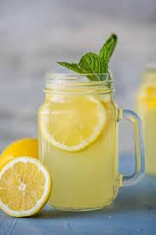
VOCABULARY
lemonade (n)
/leməˈneɪd/
nước chanh

Slide 12
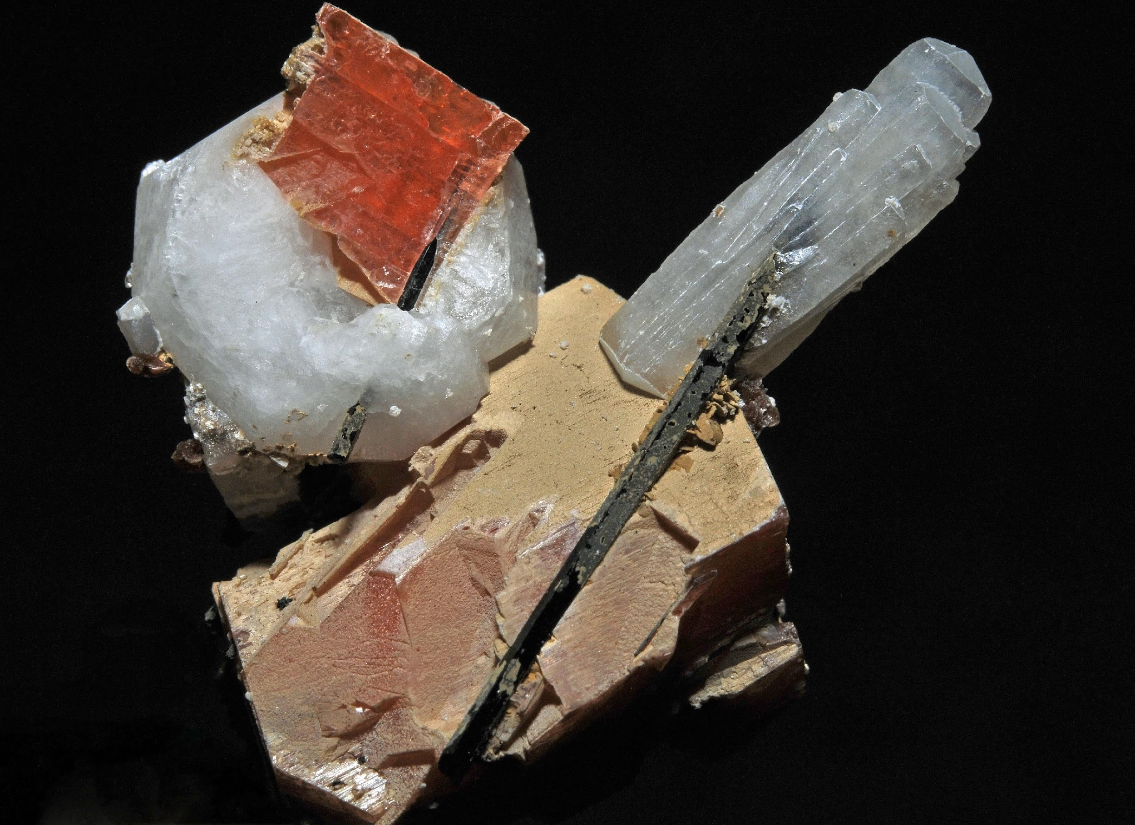
VOCABULARY
mineral (n)
/ˈmɪnərəl/
khoáng (chất)

Slide 13
VOCABULARY
New words | Pronunciation | Meaning
roast | /rəʊst/ | quay, nướng (thịt..)
fry | /fraɪ/ | rán
shrimp | /ʃrɪmp/ | con tôm
lemonade | /leməˈneɪd/ | nước chanh
mineral | /ˈmɪnərəl/ | khoáng (chất)

Slide 14
LESSON 1: GETTING STARTED
WARM-UP
Mini game
PRESENTATION
Vocabulary
LEAD-IN
Task 1: Answer the questions.

Slide 15
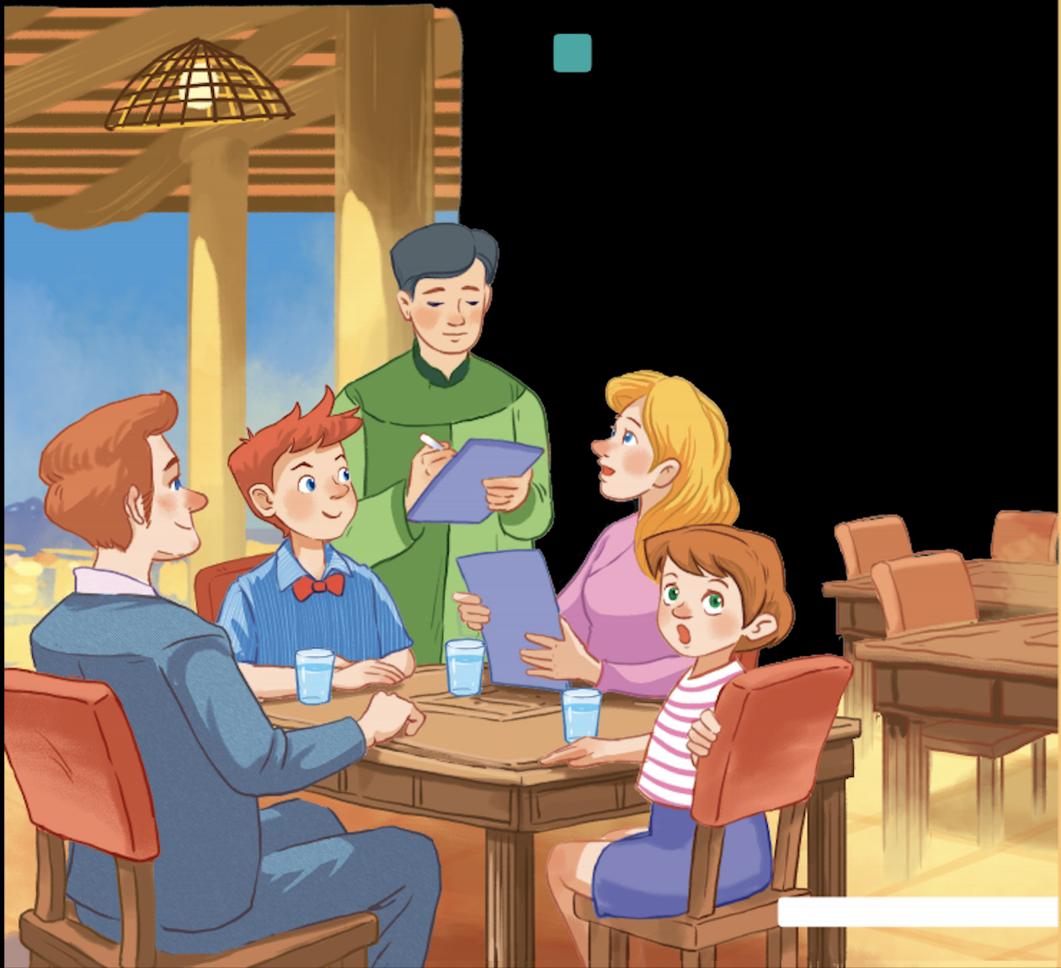
LEAD-IN
1
Look at the pictures and answer the questions.
Aim of the task:
To get students interested in the topic
To set the context
To help Ss understand the main idea of the text

Slide 16
LEAD-IN
1
Look at the pictures and answer the questions
What is Mark's family doing?
A. Ordering food for dinner.
B. Preparing for their dinner.
C. Talking about their favourite food.

Slide 17
LESSON 1: GETTING STARTED
WARM-UP
Mini game
PRESENTATION
Vocabulary
LEAD-IN
Task 1: Answer the questions.
Task 2: Find the words and phrases about food and drink and write them in the correct columns.
Task 3: Read the conversation again and tick (✓) T or F.
PRACTICE

Slide 18
PRACTICE
2
Find the words and phrases about food and drink in the conversation and write them in the correct columns.
Aim of the task:
To practise reading and listening for specific information
To practise scanning
To develop Ss' vocabulary of food and drink

Slide 19
PRACTICE
2
Find the words and phrases about food and drink in the conversation and write them in the correct columns.
rice
Waiter: Good evening. What can I get you today? Mark's mum: We'd like rice with some pork cooked in fish sauce. Oh, could we also have an order of roast chicken and fried vegetables?
Mark: And I'd like some fried tofu and spring rolls too.
Waiter: OK. Would you like any canh? It's a kind of Vietnamese soup. We often have it with rice.
Mark's dad: Let me see ... I think we'll try some canh.
Waiter. With shrimp or fish?
Mark's dad: With shrimp, please.
Waiter: Would you like anything to drink? We have a lot of drinks: juice, lemonade, green tea, mineral water, ...
Mark's mum: Mineral water for me, green tea for my husband, and juice for my children.
Waiter: What kind of juice would you like?
Mark's sister: Do you have winter melon juice?
Waiter: Let me see. Er, yes. How many cans would you like?
Mark's sister: One ... No, wait, two please. By the way, how much is a can of winter melon juice?
Mark: The menu says it's 10,000 dong.
Waiter: That's right. I'll be right back with your order.
Food | Drink
pork
fish sauce
roast chicken
fried vegetables
rice
pork
fish sauce
juice
lemonade
fried tofu
spring rolls
roast chicken
canh
green tea
fried vegetables
mineral water
fried tofu
spring rolls
winter melon juice
fish
canh (soup)
shrimp
shrimp
fish
lemonade
mineral water
green tea
juice
winter melon juice

Slide 20
PRACTICE
3
Read the conversation again and tick (✓) T (True) or F (False).
Aim of the task:
To help Ss deeply understand the text
To practise scanning and intensive reading

Slide 21
PRACTICE
3
Read the conversation again and tick (✓) T (True) or F (False).
Waiter: Good evening. What can I get you today? Mark's mum: We'd like rice with some pork cooked in fish sauce. Oh, could we also have an order of roast chicken and fried vegetables?
Mark: And I'd like some fried tofu and spring rolls too.
Waiter: OK. Would you like any canh? It's a kind of Vietnamese soup. We often have it with rice.
Mark's dad: Let me see ... I think we'll try some canh.
Waiter: With shrimp or fish?
Mark's dad: With shrimp, please.
Waiter: Would you like anything to drink? We have a lot of drinks: juice, lemonade, green tea, mineral water, ...
Mark's mum: Mineral water for me, green tea for my husband, and juice for my children.
Waiter: What kind of juice would you like?
Mark's sister: Do you have winter melon juice?
Waiter: Let me see. Er, yes. How many cans would you like?
Mark's sister: One ... No, wait, two please. By the way, how much is a can of winter melon juice?
Mark: The menu says it's 10,000 dong.
Waiter: That's right. I'll be right back with your order.
a Vietnamese
restaurant
1. Mark's family is at a Vietnamese restaurant.
2. Mark wants fried tofu and beef for dinner.
3. They don't order canh.
4. Mark's mum wants mineral water.
5. His mum doesn't allow her children to drink juice during dinner.
TRUE
Mark
fried tofu
spring rolls
Vietnamese
Mark
fried tofu
beef
FALSE
we'll try some canh
don't order canh
FALSE
mum
mineral water
mum
Mineral water
juice for my
TRUE
children
mum
doesn't allow
drink
juice
FALSE

Slide 22
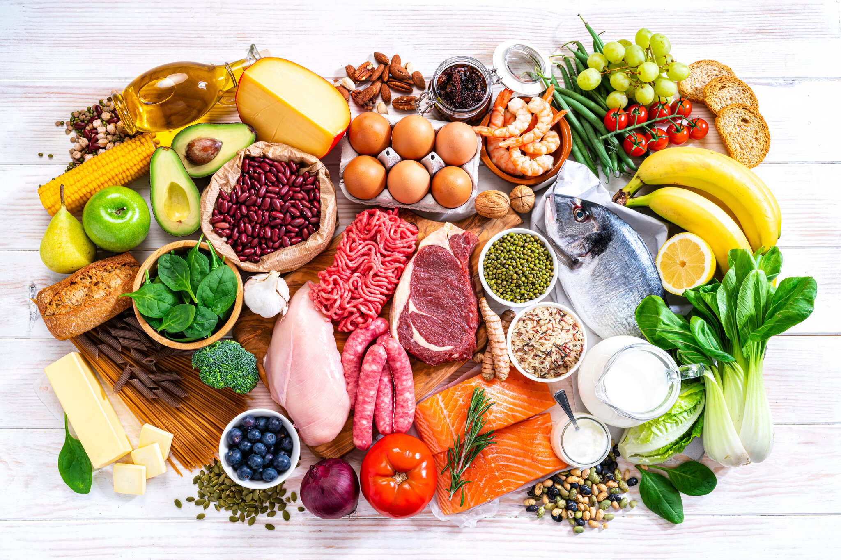
PRACTICE
4
Work in pairs. Think about your favorite food and drink. Then ask your partner about his or her favorite food and drink.
Aim of the task:
To help Ss practise talking about favourite food and drink
To practise team working
To give students authentic practice in using target language

Slide 23
PRACTICE
4
Work in pairs. Think about your favorite food and drink. Then ask your partner about his or her favorite food and drink.
Divide the class into 2 main groups:
Group 1: Vietnamese tour guide
Discuss and list all of the favourite food in Ha Noi/ Viet Nam, using some suggested questions (What kinds of food are most popular? What ingredients are there? What is the food like? …)
Group 2: French visitors (who visit Vietnam for the 1st time)
Think of, discuss and list as many questions to ask about the most favourite Vietnamese food as possible.
Each tour guide pairs with a French visitor. Role play talking about the most favourite food in Viet Nam.

Slide 24
CONSOLIDATION
1
WRAP-UP
Food and Drink
Favourite food and drink
Topic of the unit
Vocabulary

Slide 25
CONSOLIDATION
2
HOMEWORK
Talk about your favourite food (for a minute)
Do the exercises in the workbook

Slide 26
Website: sachmem.vn Fanpage: www.facebook.com/sachmem.vn

