Slide 1


Slide 2



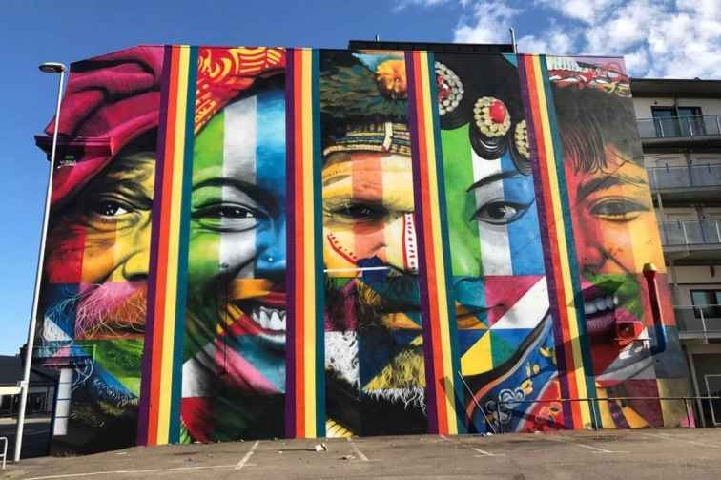
Unit
4
MUSIC AND ARTS
LESSON 6: SKILLS 2

Slide 3

OBJECTIVES
By the end of the lesson, students will be able to:
listen for specific information about street painting
write an informal letter of invitation

Slide 4
LESSON 6: SKILLS 2
WARM-UP
Brainstorming
Vocabulary
Task 1: Discuss the question below with a partner.
Task 2: Listen to a man talking about street painting and tick the words you hear.
Task 3: Listen to the passage again and choose the correct answers.
Task 4: Retell
LISTENING
Task 5: Read the following letter and choose the correct answers.
Task 6: Write a letter to invite someone to a street painting festival, using the following cues.
WRITING
POST-LISTENING
& WRITING
Class gallery
CONSOLIDATION
Wrap-up
Homework

Slide 5

LESSON 6: SKILLS 2
WARM-UP
Brainstorming
Aims of the stage:
to activate students’ prior knowledge and vocabulary related to the lesson

Slide 6
WARM-UP
Traditional arts around the world
Suggested ideas:
Lam vong dance of Laos, Chinese Opera, ballet of France and Russia, Origami in Japan, Kite making and flying in India, Watchmaking in Switzerland …

Slide 7

LESSON 6: SKILLS 2
WARM-UP
Brainstorming
Vocabulary
Task 1: Discuss the question below with a partner.
Task 2: Listen to a man talking about street painting and tick the words you hear.
Task 3: Listen to the passage again and choose the correct answers.
Task 4: Retell
LISTENING
Aims of the stage:
To provide students with some lexical items before listening the text

Slide 8
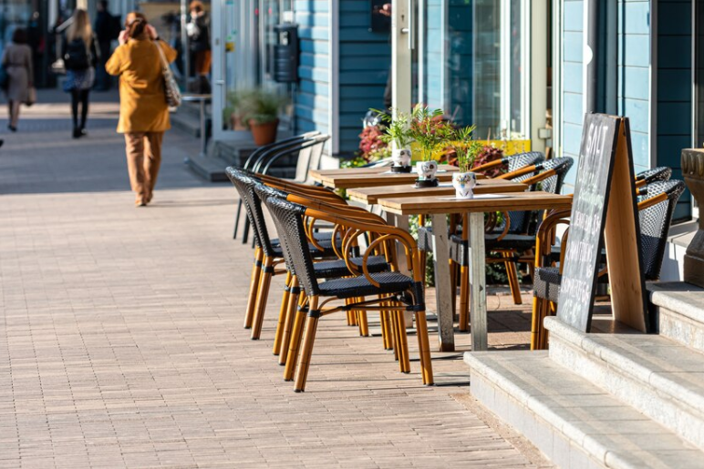
PRE-LISTENING - VOCABULARY
pavement (n)
/ˈpeɪvmənt/
vỉa hè, đường cho người đi bộ

Slide 9

PRE-LISTENING - VOCABULARY
occur (v)
/əˈkɜːr/
xảy ra, diễn ra

Slide 10

PRE-LISTENING - VOCABULARY
support (n)
/səˈpɔːt/
sự ủng hộ

Slide 11

PRE-LISTENING - VOCABULARY
huge (a)
/hjuːdʒ/
to lớn

Slide 12
PRE-LISTENING - VOCABULARY
New words | Pronunciation | Meaning
pavement (n) | /ˈpeɪv.mənt/ | vỉa hè, đường cho người đi bộ
occur (v) | /əˈkɜːr/ | xảy ra, diễn ra
support (n) | /səˈpɔːt/ | sự ủng hộ
huge (a) | /hjuːdʒ/ | to lớn

Slide 13
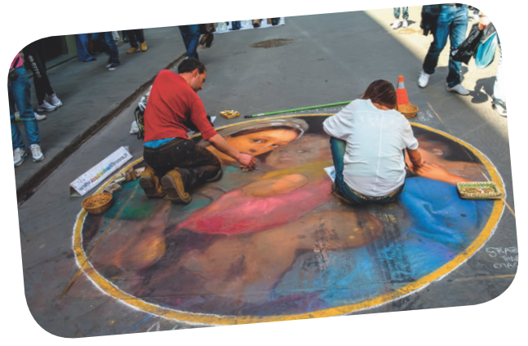
PRE-LISTENING
1
Discuss the question below with a partner.
- Do you know about street painting?
- Where do artists paint their pictures?
- Do they have to pay to paint there?

Slide 14


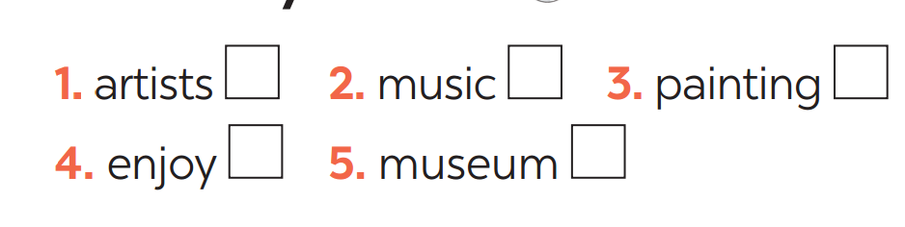

WHILE-LISTENING
2
Listen to a man talking about street painting and tick the words you hear.

Slide 15
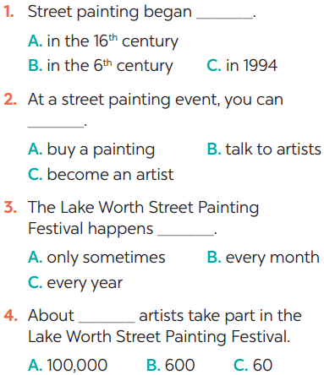
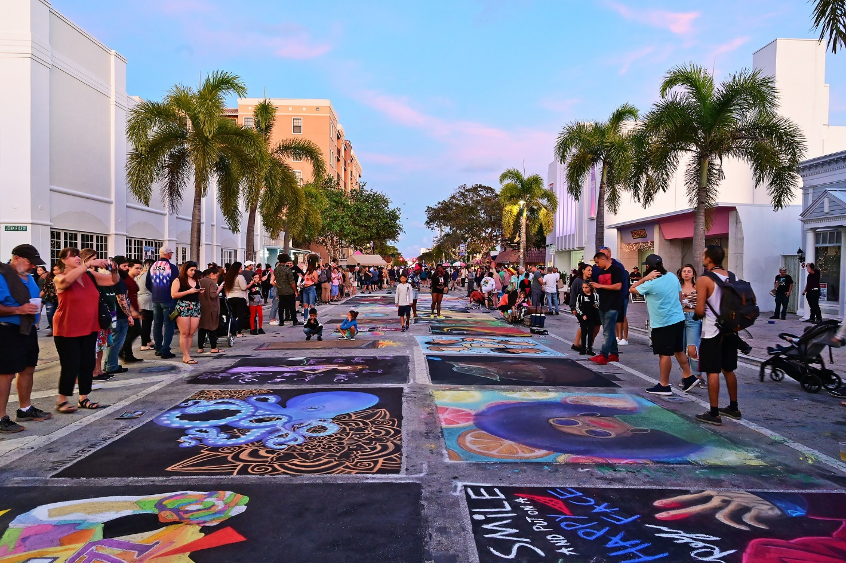
WHILE-LISTENING
3
Listen to the passage again and choose the correct answers.

Slide 16
POST-LISTENING
4
Retell.
STREET PAINTING

Slide 17

LESSON 6: SKILLS 2
WARM-UP
Brainstorming
Vocabulary
Task 1: Discuss the question below with a partner.
Task 2: Listen to a man talking about street painting and tick the words you hear.
Task 3: Listen to the passage again and choose the correct answers.
Task 4: Retell
LISTENING
Task 5: Read the following letter and choose the correct answers.
Task 6: Write a letter to invite someone to a street painting festival, using the following cues.
WRITING
Aims of the stage:
to help Ss prepare ideas to write a passage

Slide 18
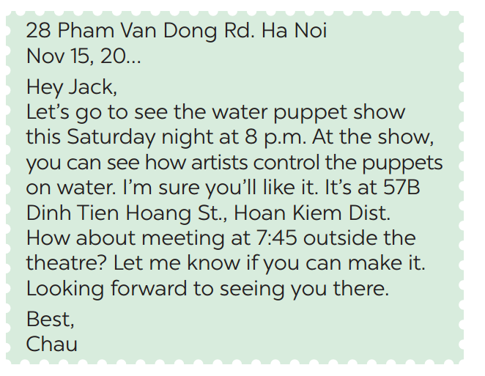
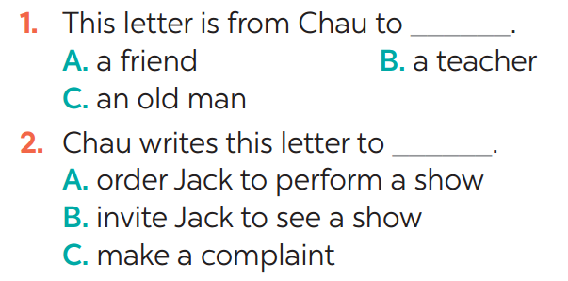
PRE-WRITING
5
Read the following letter and choose the correct answers.

Slide 19
PRE-WRITING
5
Read the following letter and choose the correct answers.
+ Is it an invitation letter?
+ Is it formal or informal?
+ What is the event?
+ What time does the show begin?
+ Where does it take place?
+ What time do Chau want to meet Jack for the show?
Yes. Because it invites Jack to see the water puppet show.
It is informal because Jack is Chau’s friend.
The water puppet show.
At 8p.m.
At 57 B Dinh Tien Hoang St, Hoan Kiem Dist.
At 7: 45.

Slide 20
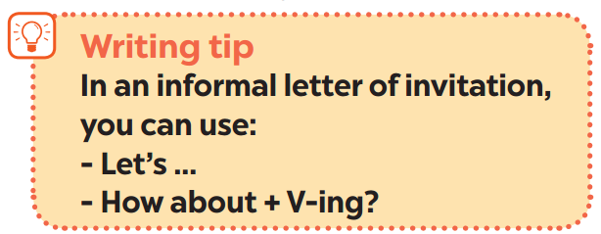
PRE-WRITING
The format of informal letter of invitation:
Event:
Start time:
Place:
Activities:
Time to meet

Slide 21
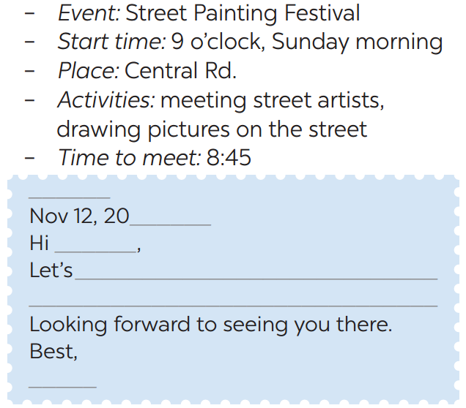

WHILE-WRITING
6
Write a letter to invite someone to a street painting festival, using the following cues.

Slide 22
LESSON 6: SKILLS 2
WARM-UP
Brainstorming
Vocabulary
Task 1: Discuss the question below with a partner.
Task 2: Listen to a man talking about street painting and tick the words you hear.
Task 3: Listen to the passage again and choose the correct answers.
Task 4: Retell
LISTENING
Task 5: Read the following letter and choose the correct answers.
Task 6: Write a letter to invite someone to a street painting festival, using the following cues.
WRITING
POST-LISTENING
& WRITING
Class gallery

Slide 23

POST-WRITING
CLASS GALLERY
Students can:
go and see other’s work
give comments to each other

Slide 24
LESSON 6: SKILLS 2
WARM-UP
Brainstorming
Vocabulary
Task 1: Discuss the question below with a partner.
Task 2: Listen to a man talking about street painting and tick the words you hear.
Task 3: Listen to the passage again and choose the correct answers.
Task 4: Retell
LISTENING
Task 5: Read the following letter and choose the correct answers.
Task 6: Write a letter to invite someone to a street painting festival, using the following cues.
WRITING
POST-LISTENING
& WRITING
Class gallery
CONSOLIDATION
Wrap-up
Homework

Slide 25

CONSOLIDATION
1
WRAP-UP
In this lesson, we have learnt to:
listen for special information about street painting
write an informal letter of invitation

Slide 26

CONSOLIDATION
2
HOMEWORK
Prepare for the next lesson: Looking back & Project

Slide 27

Website: sachmem.vn
Fanpage: facebook.com/sachmem.vn/

