Slide 2
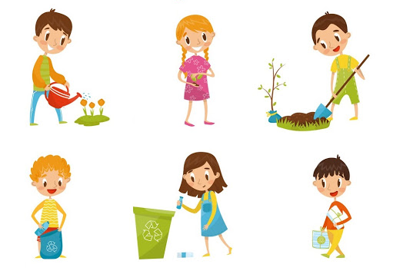
Unit
3
COMMUNITY SERVICE
LESSON 5: SKILLS 1
READING
SPEAKING
Unit
Projects in Bright Future School
What project you can do?

Slide 3
OBJECTIVES
By the end of the lesson, students will be able to:
develop reading skill for specific information about community activities at a school
develop speaking skill: talking about the reasons why students join different community activities

Slide 4
LESSON 5: SKILLS 1
WARM-UP
Game: Who is faster?
Vocabulary
Task 1: Circle the activities you would like to do at your school.
Task 2: Read the passage and match the highlighted words with their meanings.
Task 3: Read the passage again and tick True or False.
READING
Task 4: Read about these students. Write the names of the projects you think they should join in the Projects column.
Task 5: Discuss which project in Task 4 you would like to join, and why. Report to the class.
SPEAKING
POST-READING
& SPEAKING
Evaluation
CONSOLIDATION
Wrap-up
Homework

Slide 5
LESSON 5: SKILLS 1
WARM-UP
Game: Who is faster?
Aims of the stage:
To introduce the topic of reading.
To enhance students’ skills of cooperating with team mates

Slide 6
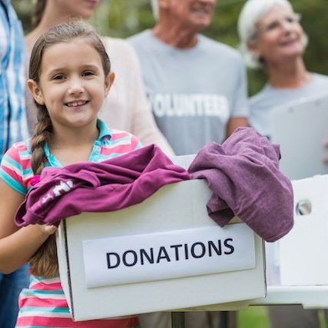
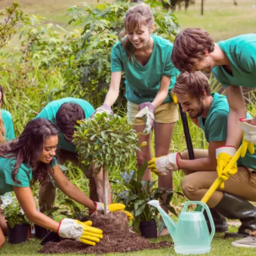
WARM-UP
collecting rubbish
donating clothes
planting trees
1.
2.
3.

Slide 7
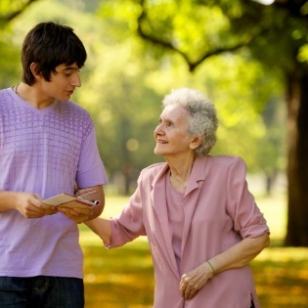
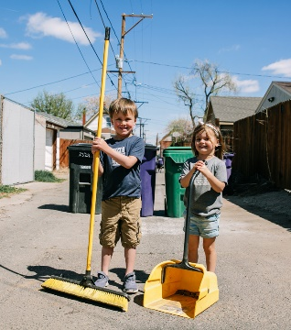
WARM-UP
tutoring homeless children
6.
4.
cleaning the street
5.
helping old people

Slide 8
LESSON 5: SKILLS 1
WARM-UP
Game: Who is faster?
Vocabulary
Task 1: Circle the activities you would like to do at your school.
Task 2: Read the passage and match the highlighted words with their meanings.
Task 3: Read the passage again and tick True or False.
READING
Aims of the stage:
to provide students with some lexical items before reading the text

Slide 9
VOCABULARY
monthly (adj/adv)
/ˈmʌnθli/
hằng tháng

Slide 10
VOCABULARY
proud (adj)
/praʊd/
hài lòng, tự hào

Slide 11
VOCABULARY
New words | Pronunciation | Meaning
monthly (adj/adv) | /ˈmʌnθli/ | hằng tháng
proud (adj) | /praʊd/ | hài lòng, tự hào

Slide 12
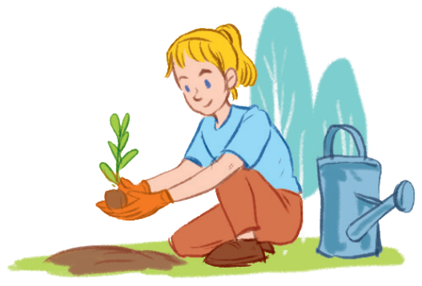
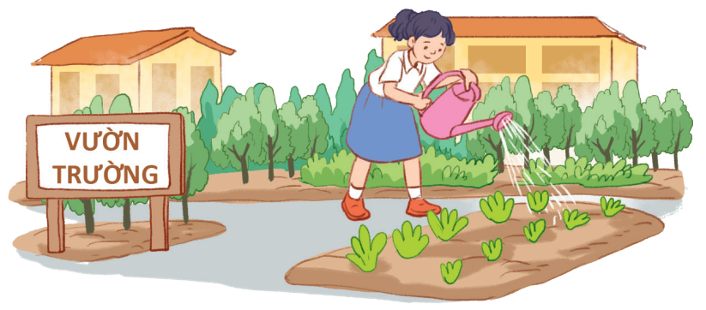
PRE-READING
1
Work in pairs. Circle the activities you would like to do at your school.
A. growing vegetables in the school garden B. tutoring other students C. collecting books for the school library

Slide 13
WHILE-READING
2
Read the passage and match the highlighted words with their meanings.
1. give 2. give and receive 3. every month 4. pleased 5. teach
Bright Future school has many community activities for students. The school believes that a good way for students to develop themselves is through community service. All students can join any of these different projects:
- Tutoring: Upper grade students tutor lower grade students.
- Postcard-to-Help: Students make and sell postcards to raise money for local children.
- Visit-to-Read: Students visit a nursing home monthly and read books to the elderly.
- Garden-to-Give: Students grow vegetables and donate them to local schools.
- Paper-Plant-Exchange: Students collect paper and exchange it for plants. They then look after the plants in their school garden. Students learn that they can help people and the world around them when they do community service. They feel useful and proud because they do good things.

Slide 14
WHILE-READING
2
Read the passage and match the highlighted words with their meanings.
1. give
donate
2. give and receive
exchange
3. every month
monthly
4. pleased
proud
5. teach
tutor

Slide 15
WHILE-READING
3
Read the passage again and tick True or False.
 | True | False
1. Community service allows students to develop themselves.
2. Each student can join only one project.
3. They tutor younger students.
4. Local children receive postcards from the Postcard-to-Help project.
5. Students receive plants when they give paper.

Slide 16
LESSON 5: SKILLS 1
WARM-UP
Game: Who is faster?
Vocabulary
Task 1: Circle the activities you would like to do at your school.
Task 2: Read the passage and match the highlighted words with their meanings.
Task 3: Read the passage again and tick True or False.
READING
Task 4: Read about these students. Write the names of the projects you think they should join in the Projects column.
Task 5: Discuss which project in Task 4 you would like to join, and why. Report your group’s answers to the class.
SPEAKING

Slide 17
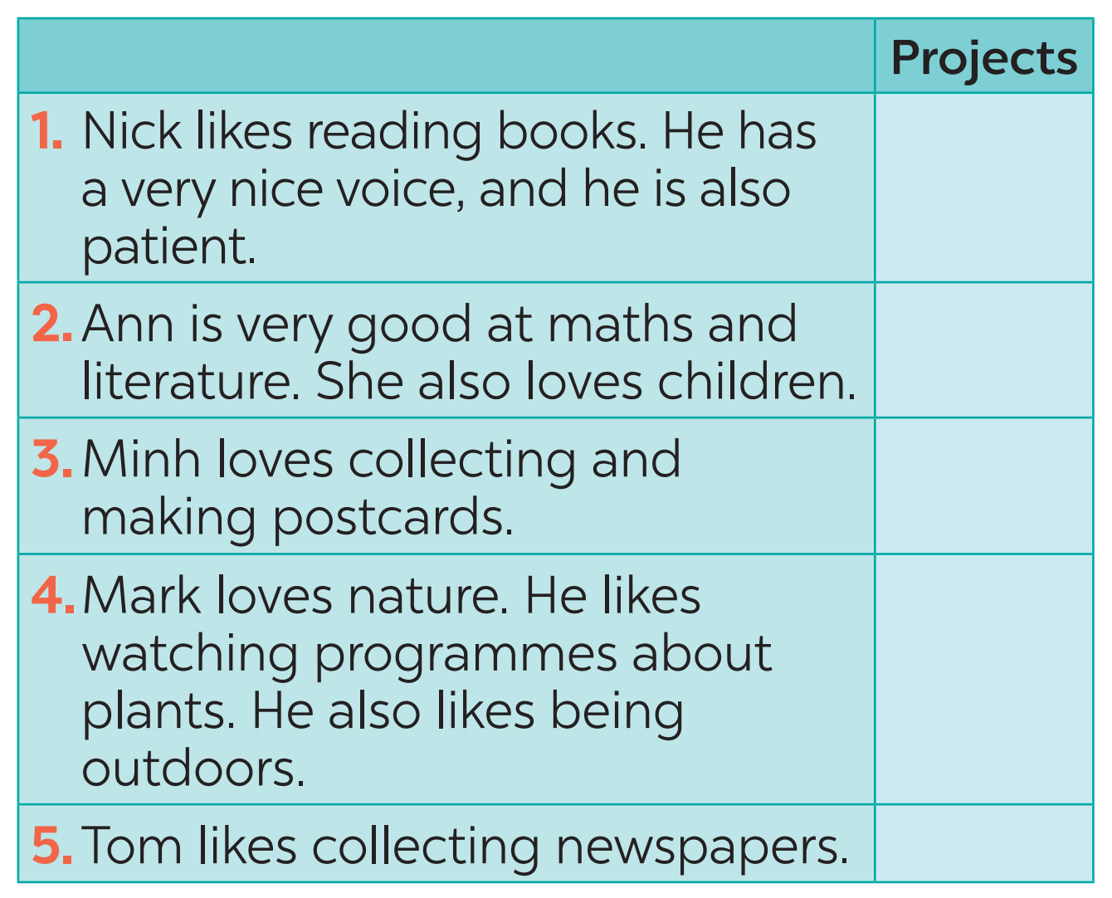
PRE-SPEAKING
4
Read about these students. Write the names of the projects you think they should join in the Projects column.
C
A
B
D
E

Slide 18
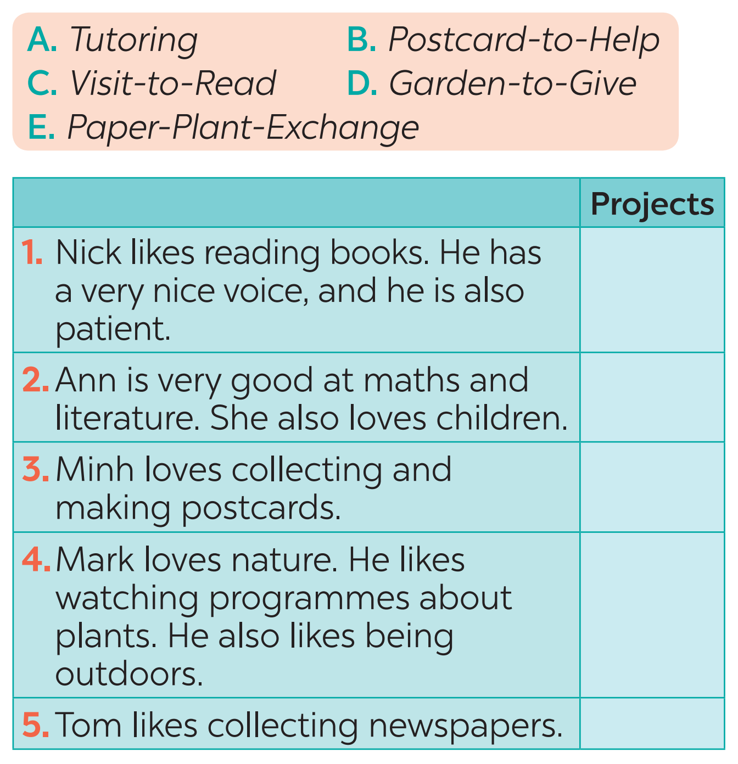
WHILE-SPEAKING
5
Discuss which project in Task 4 you would like to join, and why. Report your group’s answers to the class.
Example: Lan will join the Tutoring project because she is good at maths and English. She also loves children.

Slide 19
LESSON 5: SKILLS 1
WARM-UP
Game: Who is faster?
Vocabulary
Task 1: Circle the activities you would like to do at your school.
Task 2: Read the passage and match the highlighted words with their meanings.
Task 3: Read the passage again and tick True or False.
READING
Task 4: Read about these students. Write the names of the projects you think they should join in the Projects column.
Task 5: Discuss which project in Task 4 you would like to join, and why. Report your group’s answers to the class.
SPEAKING
POST-READING
& SPEAKING
Evaluation

Slide 20
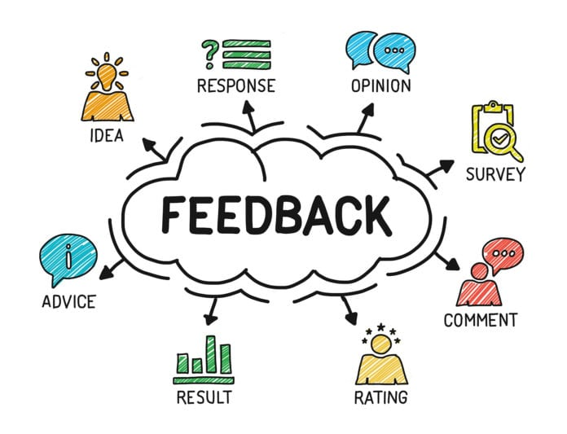
POST-READING & SPEAKING
Let’s give comments for your friends and vote for the most interesting and informative presentation.

Slide 21
LESSON 5: SKILLS 1
WARM-UP
Game: Who is faster?
Vocabulary
Task 1: Circle the activities you would like to do at your school.
Task 2: Read the passage and match the highlighted words with their meanings.
Task 3: Read the passage again and tick True or False.
READING
Task 4: Read about these students. Write the names of the projects you think they should join in the Projects column.
Task 5: Discuss which project in Task 4 you would like to join, and why. Report your group’s answers to the class.
SPEAKING
POST-READING
& SPEAKING
Evaluation
CONSOLIDATION
Wrap-up
Homework

Slide 22
CONSOLIDATION
1
Wrap-up
READING
SPEAKING
Projects in Bright Future School
What project you can do?

Slide 23
CONSOLIDATION
2
Homework
Plan some school activities for next summer holiday.

Slide 24
Website: sachmem.vn
Fanpage: facebook.com/sachmem.vn/

