Slide 2
Unit
3
COMMUNITY SERVICE
LESSON 4: COMMUNICATION
Unit
HOBBIES

Slide 3
OBJECTIVES
By the end of the lesson, students will be able to:
know how to give compliments
discuss and present the benefits of community activities

Slide 4
LESSON 4: COMMUNICATION
WARM-UP
Alphabet game
EVERYDAY ENGLISH
Task 1: Listen and read the dialogue between Lan and Mark. Pay attention to the highlighted parts.
Task 2: Work in pairs. Make similar conversations.
Task 3: Read the poster. Write the project number (1-3) next to its benefits (A-E).
Task 4: Ask and answer which activities in Task 3 you want to join. Give reasons.
Task 5: Discussion
CHANGING OUR NEIGHBOURHOOD
CONSOLIDATION
Wrap-up
Homework

Slide 5
LESSON 4: COMMUNICATION
WARM-UP
Alphabet game
Aims of the stage:
to review students’ knowledge of the past simple tense

Slide 6
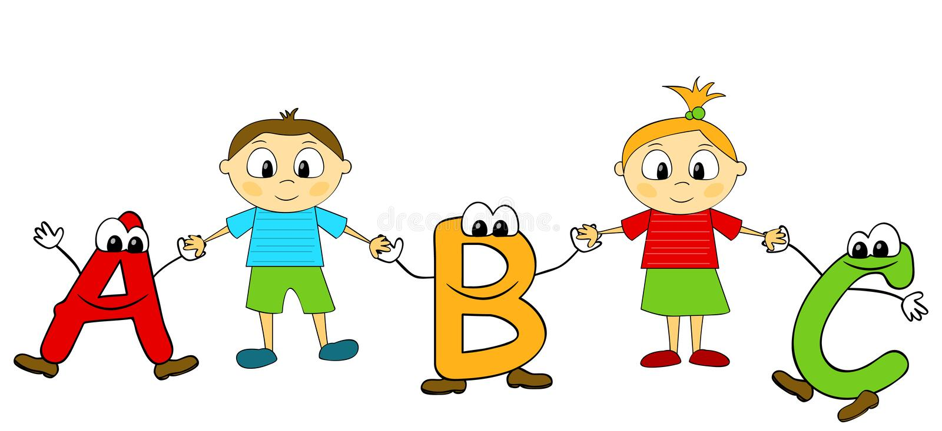
WARM-UP
ALPHABET GAME
Example:
A: He asked me my name.
B: I bought a hat.
C: I came here last month

Slide 7
LESSON 4: COMMUNICATION
WARM-UP
Alphabet game
Task 1: Listen and read the dialogue between Lan and Mark. Pay attention to the highlighted parts.
Task 2: Work in pairs. Make similar conversations.
EVERYDAY ENGLISH

Slide 8
EVERYDAY ENGLISH
1
Listen and read the dialogue between Lan and Mark. Pay attention to the highlighted parts.
Lan: What did you do to help your community last summer, Mark? Mark: We planted some trees in the schoolyard and picked up a lot of rubbish along the nearby roads. Lan: Sounds like great work! We collected books and warm clothes for our friends in the mountainous areas. Mark: Wonderful!
2 ways to give compliments:
Sounds like great work!
Wonderful!

Slide 9
EVERYDAY ENGLISH
2
Work in pairs. Make similar conversations.
1. Mi helped lonely elderly people. 2. Tom and his friends cleaned and decorated parts of their neighbourhood.

Slide 10
Mi: What did you do to help your community last summer, Tom? Tom: My friends and I cleaned and decorated parts of our neighbourhood. Mi: Sounds like great work! I helped lonely elderly people in the area. Tom: Wonderful!

Slide 11
LESSON 4: COMMUNICATION
WARM-UP
Alphabet game
EVERYDAY ENGLISH
Task 1: Listen and read the dialogue between Lan and Mark. Pay attention to the highlighted parts.
Task 2: Work in pairs. Make similar conversations.
Task 3: Read the poster. Write the project number (1-3) next to its benefits (A-E).
Task 4: Ask and answer which activities in Task 3 you want to join. Give reasons.
Task 5: Discussion
CHANGING OUR NEIGHBOURHOOD

Slide 12
CHANGING OUR NEIGHBOURHOOD
Work in pairs.
Read the poster about the volunteer activities for teenagers at Lending Hand.
3
Benefits
______ A. making the elderly less lonely
______ B. making the neighbourhood greener
______ C. helping feed children
______ D. helping children have a better future
______ E. making the neighbourhood cleaner

Slide 13
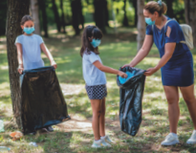
CHANGING OUR NEIGHBOURHOOD
3
Write the project number (1 – 3) next to its benefit (A – E)
Benefits
______ A. making the elderly less lonely
______ B. making the neighbourhood greener
______ C. helping feed children
______ D. helping children have a better future
______ E. making the neighbourhood cleaner
3
1
2
2
1

Slide 14
CHANGING OUR NEIGHBOURHOOD
4
Ask and answer which activities in Task 3 you want to join. Give reasons.
Example: Minh: Which activity do you want to join? Lan: I want to join some clean-up activities. Minh: Why do you want to join these activities? Lan: Because they make the neighbourhood cleaner

Slide 15
CHANGING OUR NEIGHBOURHOOD
5
Discuss which activity each member of your group chooses and the benefit(s) of the activity.
4
Example: Mai wants to donate food to street children because this helps feed them. Lan wants to join clean-up activities because these activities make our neighbourhood cleaner …

Slide 16
LESSON 4: COMMUNICATION
WARM-UP
Alphabet game
EVERYDAY ENGLISH
Task 1: Listen and read the dialogue between Lan and Mark. Pay attention to the highlighted parts.
Task 2: Work in pairs. Make similar conversations.
Task 3: Read the poster. Write the project number (1-3) next to its benefits (A-E).
Task 4: Ask and answer which activities in Task 3 you want to join. Give reasons.
Task 5: Discussion
CHANGING OUR NEIGHBOURHOOD
CONSOLIDATION
Wrap-up
Homework

Slide 17
CONSOLIDATION
1
WRAP-UP
In this lesson, we have learn to:
know how to give compliments
discuss and present the benefits of community activities

Slide 18
CONSOLIDATION
2
HOMEWORK
Think about some environmental problems in your neighbourhood and the activities you want to do to solve those problems.

Slide 19
Website: sachmem.vn
Fanpage: facebook.com/sachmem.vn/

