Slide 2
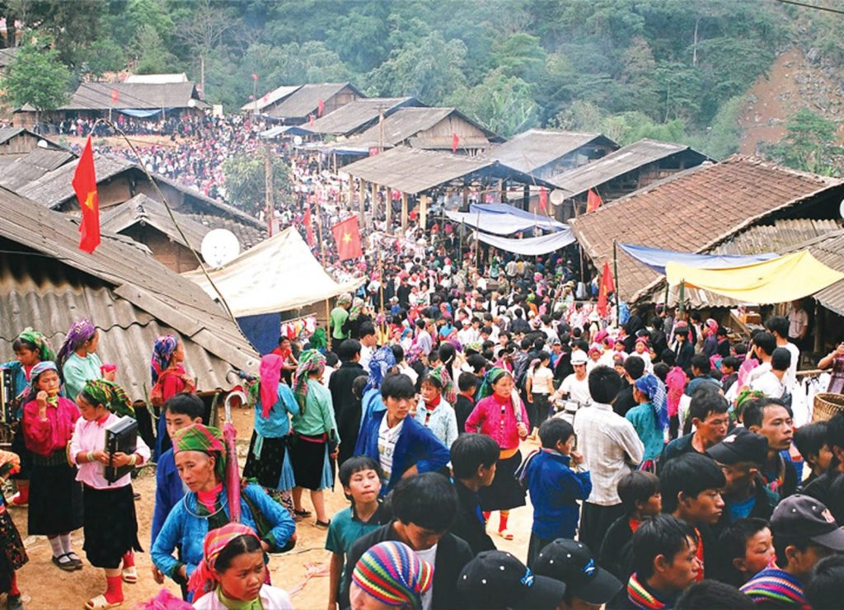
Unit
8
SHOPPING
LESSON 1: GETTING STARTED
My favourite shopping place
1

Slide 3
LESSON 1: GETTING STARTED
WARM-UP
Chatting
PRESENTATION
Vocabulary
Task 1: Listen and read.
Task 2: Mai and Alice mentioned four places where they can buy things. Complete the list.
Task 3: Match the types of markets with the features
Task 4: Complete the sentences with words and phrases from the box.
PRACTICE
PRODUCTION
Task 5: Game: Listing
CONSOLIDATION
Wrap-up
Homework

Slide 4
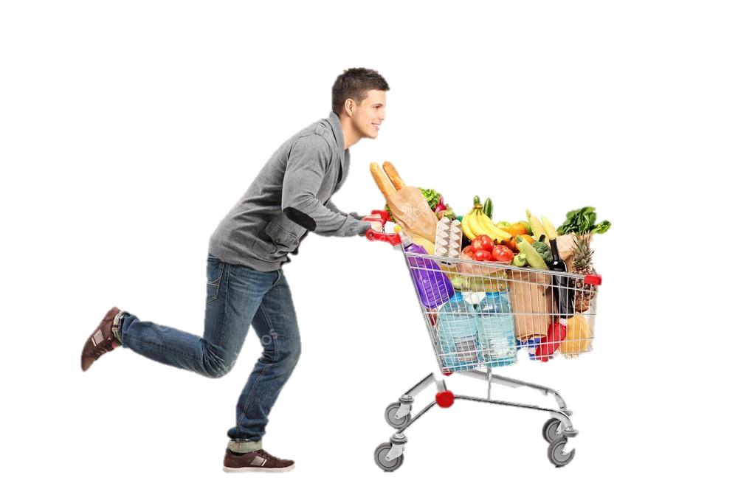
WARM-UP
SHOPPING
Answer the questions:
1. Do you like shopping?
2. Where do you often go shopping?
3. Can you name some markets or supermarkets that you know?
4. Do you prefer shopping in an open-air market or in a supermarket?

Slide 5
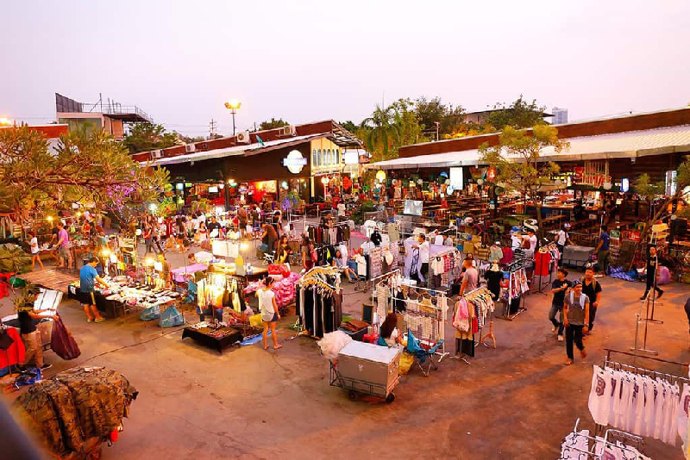
PRESENTATION
VOCABULARY
open-air market (n)
/ˌəʊpən ˈeə ˈmɑːkɪt/
chợ họp ngoài trời

Slide 6
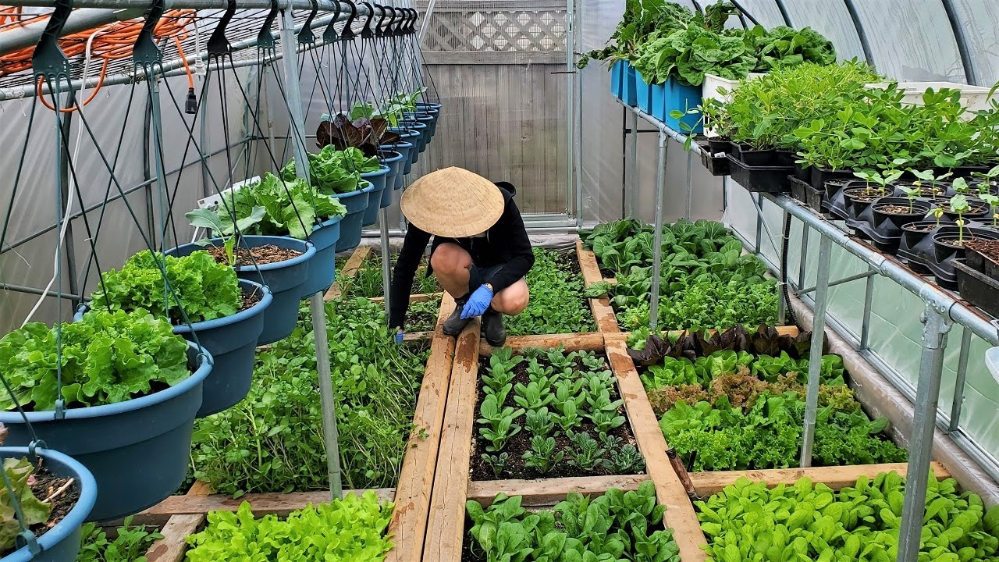
PRESENTATION
VOCABULARY
home-grown (adj)
/ˌhəʊm ˈɡrəʊn/
tự trồng

Slide 7
PRESENTATION
VOCABULARY
home-made (adj)
/ˌhəʊm ˈmeɪd/
tự làm

Slide 8
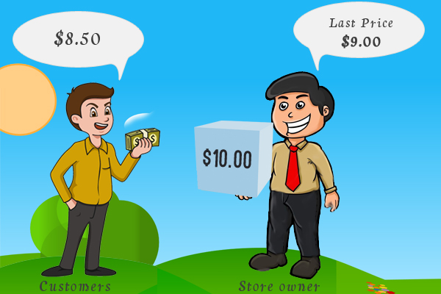
PRESENTATION
VOCABULARY
bargain (v)
/ˈbɑːɡən/
mặc cả

Slide 9
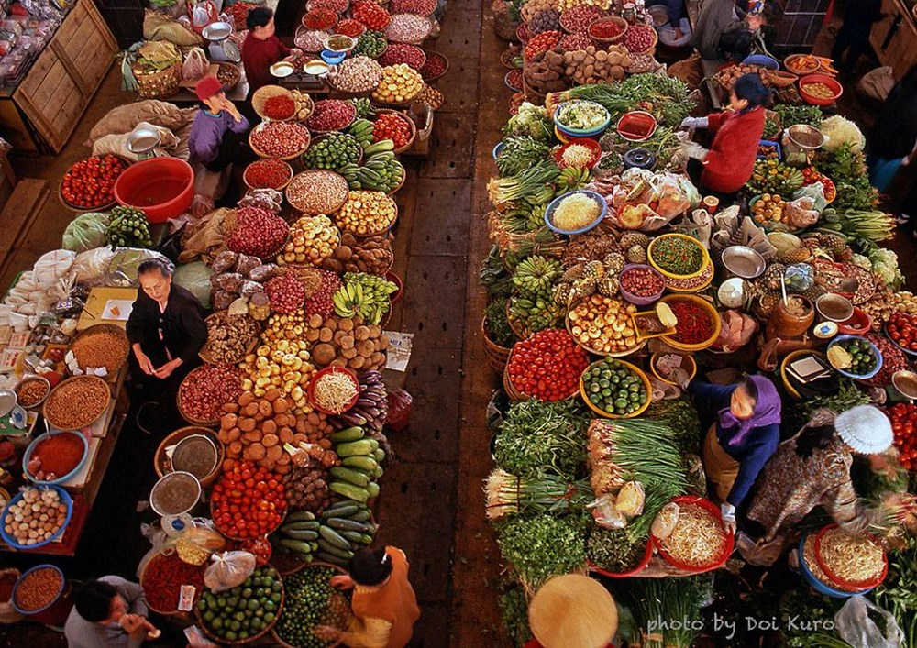
PRESENTATION
VOCABULARY
farmers’ market (n)
/ˈfɑːməz mɑːkɪt/
chợ nông sản

Slide 10
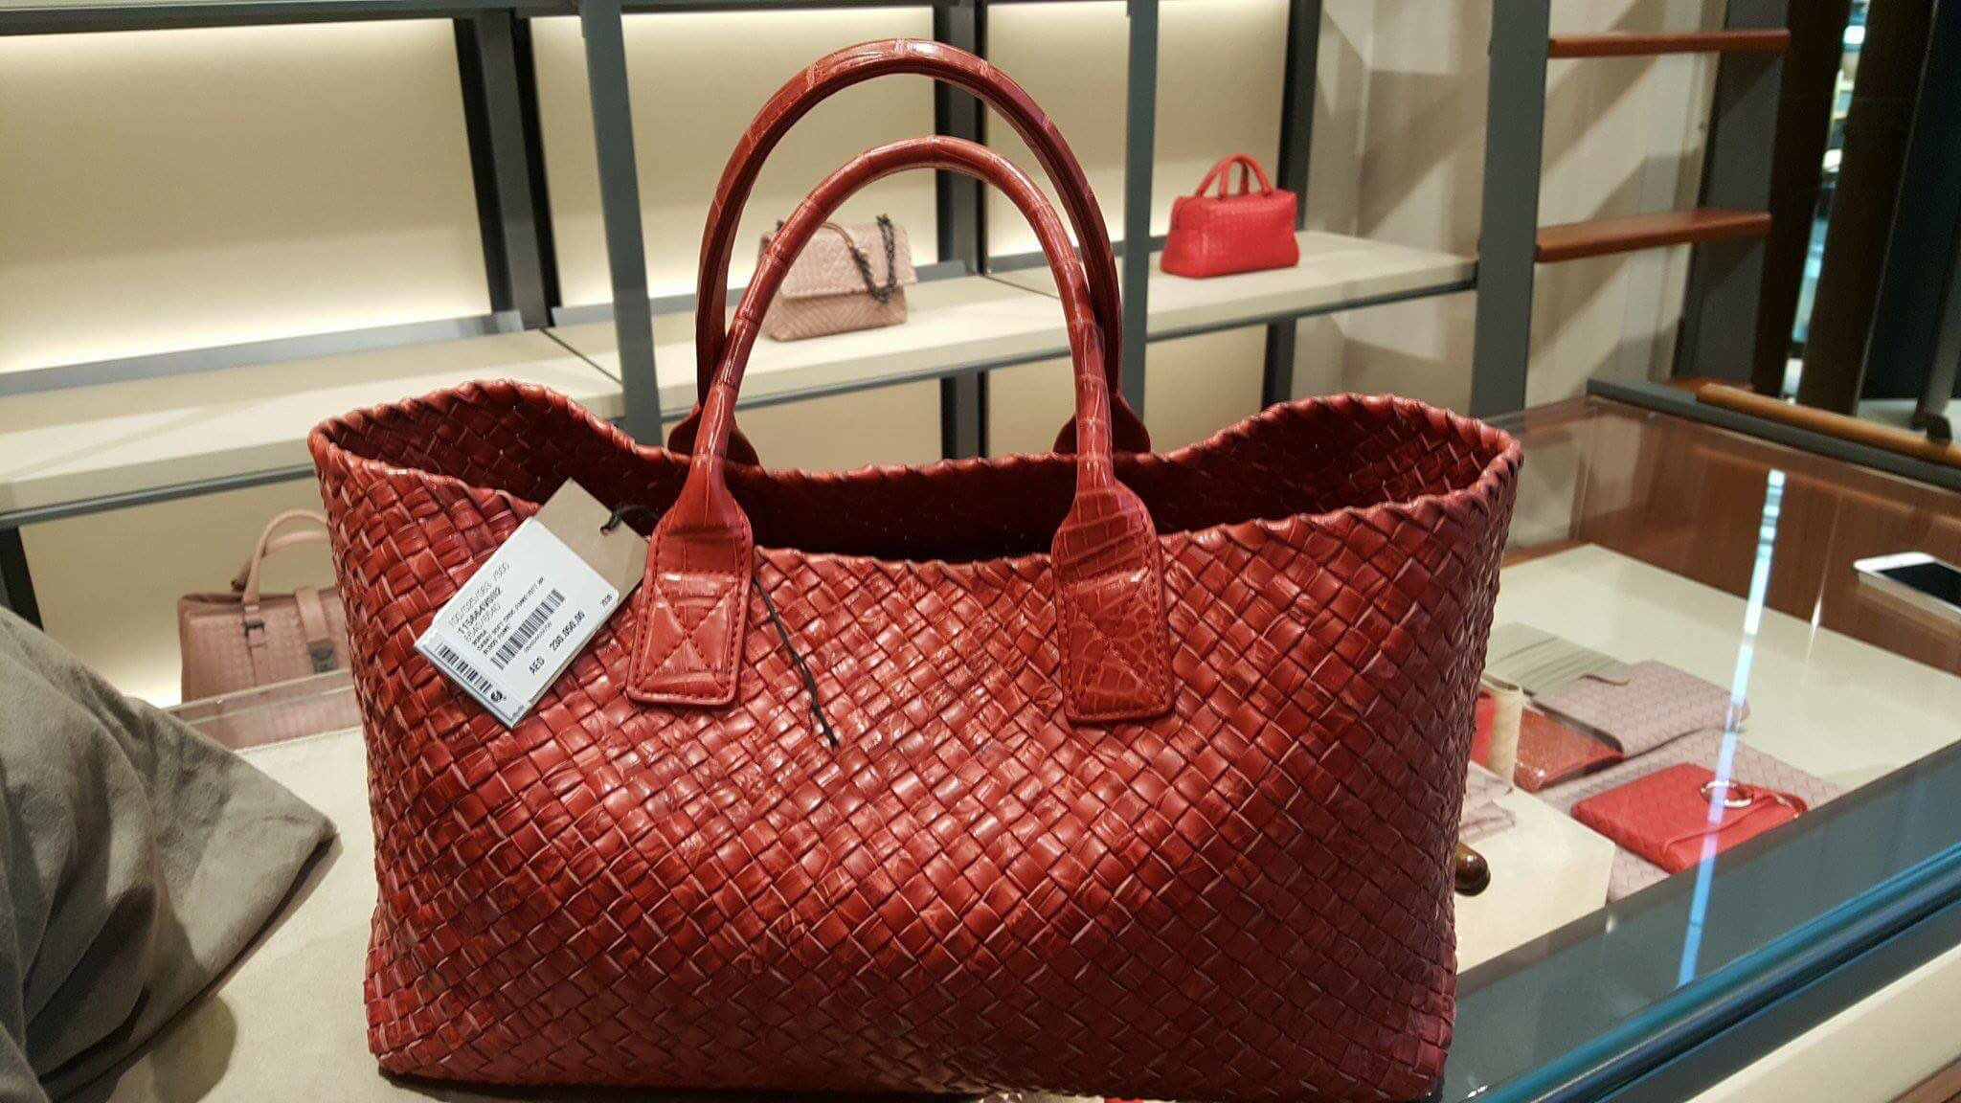
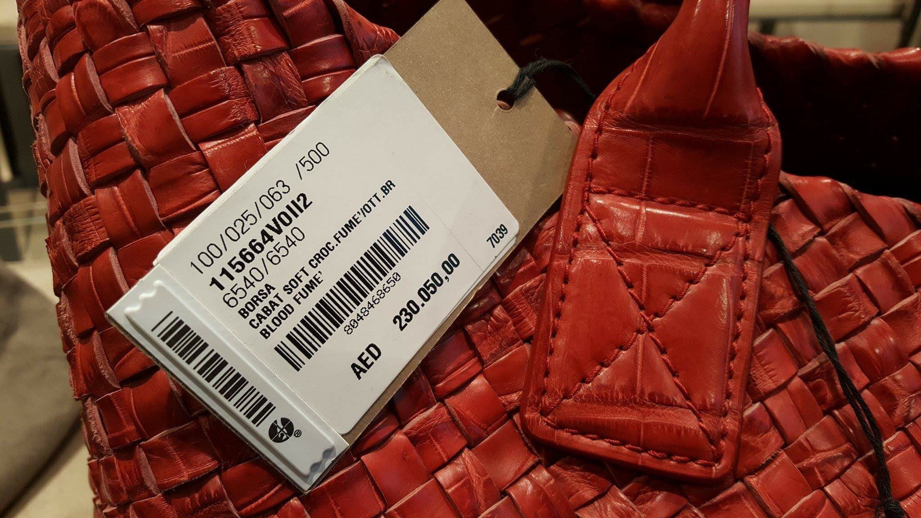
PRESENTATION
VOCABULARY
price tag (n)
/ˈpraɪs tæɡ/
nhãn ghi giá mặt hàng

Slide 11
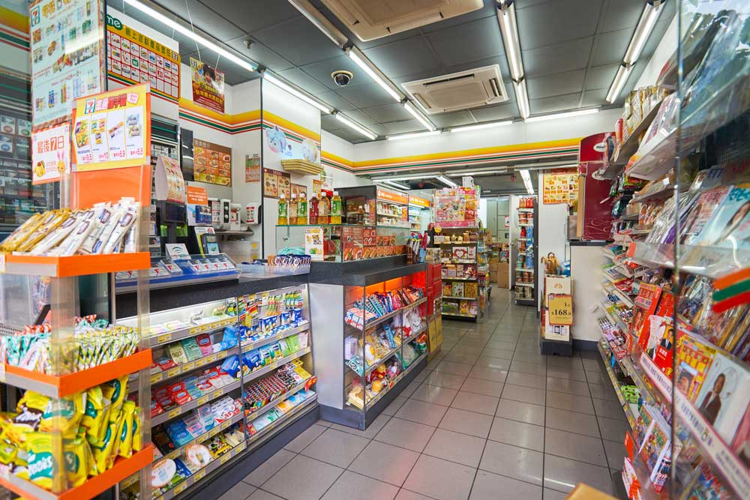
PRESENTATION
VOCABULARY
convenience store (n)
/kənˈviːniəns stɔː/
cửa hàng tiện lợi

Slide 12
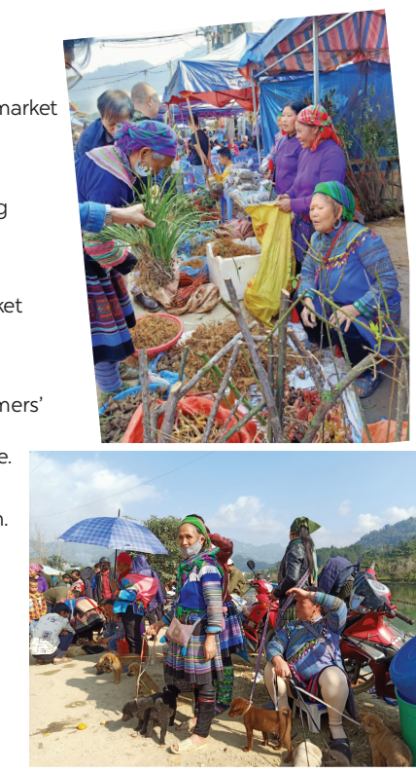
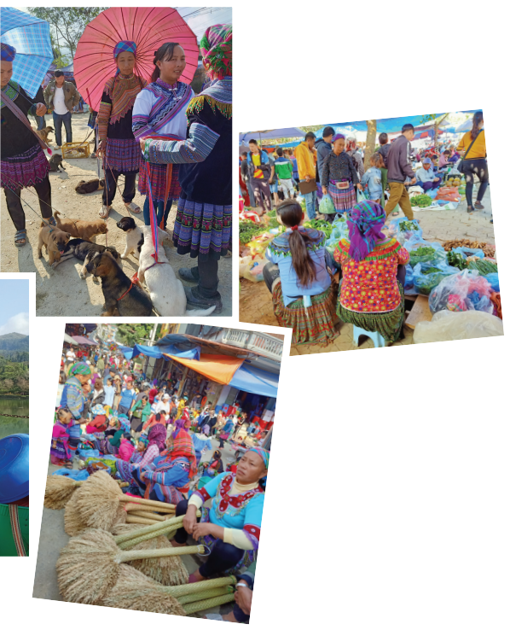
CHATTING
LEAD-IN
Answer the questions:
1. What are the pictures about?
2. What are the people in the pictures doing?

Slide 13
PRACTICE
1
Listen and read.
Mai: How was your trip to Bac Ha, Alice? Alice: It’s awesome. I like Bac Ha Fair. It’s an open-air market in Lao Cai. Mai: What do you like about it? Alice: Many things. Theo people at the market were wearing really colourful costumes. Mai: Yeah…They came from different minority groups. Alice: I think so, and most of the products sold at the market were home-grown and home-made. I love it. Mai: Do you have similar markets in New Zealand? Alice: Yes, we do. Back in my city, Auckland, we have a farmers’ market every Saturday where farmers sell their products. My mother loves shopping there, and she rarely misses one. Mai: I prefer shopping at the supermarket. I can find almost everything I need there, I don’t have to bargain. All the items have fixed prices on their price tags. Alice: Right. It’s more convenient. Mai: Yeah…Oh, I’ve got to go. My art lesson starts at one o’clock, and I want to go to a convenience store on the way. See you later.
Alice: See you.

Slide 14
PRACTICE
2
Mai and Alice mentioned four places where they can buy things. Complete the list.
1. open-air market
2. ______________________
3. ______________________
4. ______________________
farmers’ market
supermarket
convenience store

Slide 15
PRACTICE
3
Match the types of markets with the features.
Types of markets | Features
open-air market supermarket | It’s outdoor. Goods are displayed on shelves. Shoppers can bargain. All items have fixed prices. The weather does not affect shopping.

Slide 16
PRACTICE
4
Complete the sentences with the words and phrases from the box.
home -grown
bargaining
home-made
price tag
convenience store
1. - What is ‘_____________’?
- It’s when buyers talk to the sellers to get a lower price.
2. A _______________ is a small shop and is usually open 24/7.
3. This salad is made of ___________ vegetables.
4. How much is this T-shirt? I cannot see the ___________.
5. Try our ___________ bread, Mai. My mother made it this morning.

Slide 17
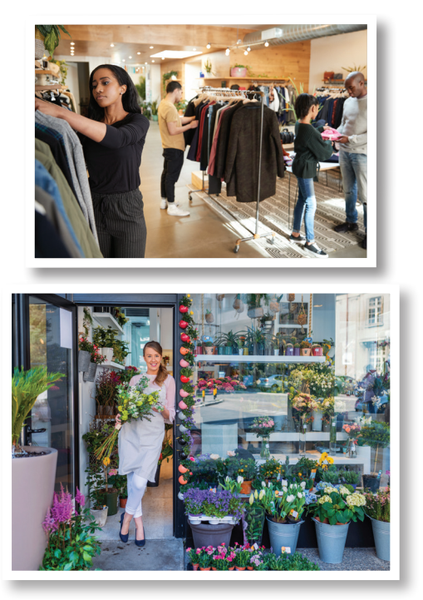
PRODUCTION
5
Work in groups. Quickly write down the names of some speciality shops. The group with the most correct answers wins.
speciality shop
Example:
- clothes shop
- florist’s
/ˌspeʃiˈæləti ʃɒp/
cửa hàng bán đồ chuyên dụng

Slide 18
PRODUCTION
Suggested answers:
clothes shop
florist’s
bakery
butcher’s
bookshop
greengrocer’s
stationer’s
café
candy shop
music shop
computer shop
barber’s
hairdresser’s
gift shop
pet shop
shoe shop

Slide 19
CONSOLIDATION
1
Wrap-up
What have we learnt in this lesson?
identify the topic of the unit
use lexical items related to shopping
identify the language features that are covered in the unit

Slide 20
CONSOLIDATION
2
Homework
- Name some places for shopping they have learnt about in the lesson.
- Learn new words and phrases by heart.
- Start preparing for the Project of the unit:

Slide 21
Website: hoclieu.vn
Fanpage: facebook.com/www.tienganhglobalsuccess.vn/

