Slide 1
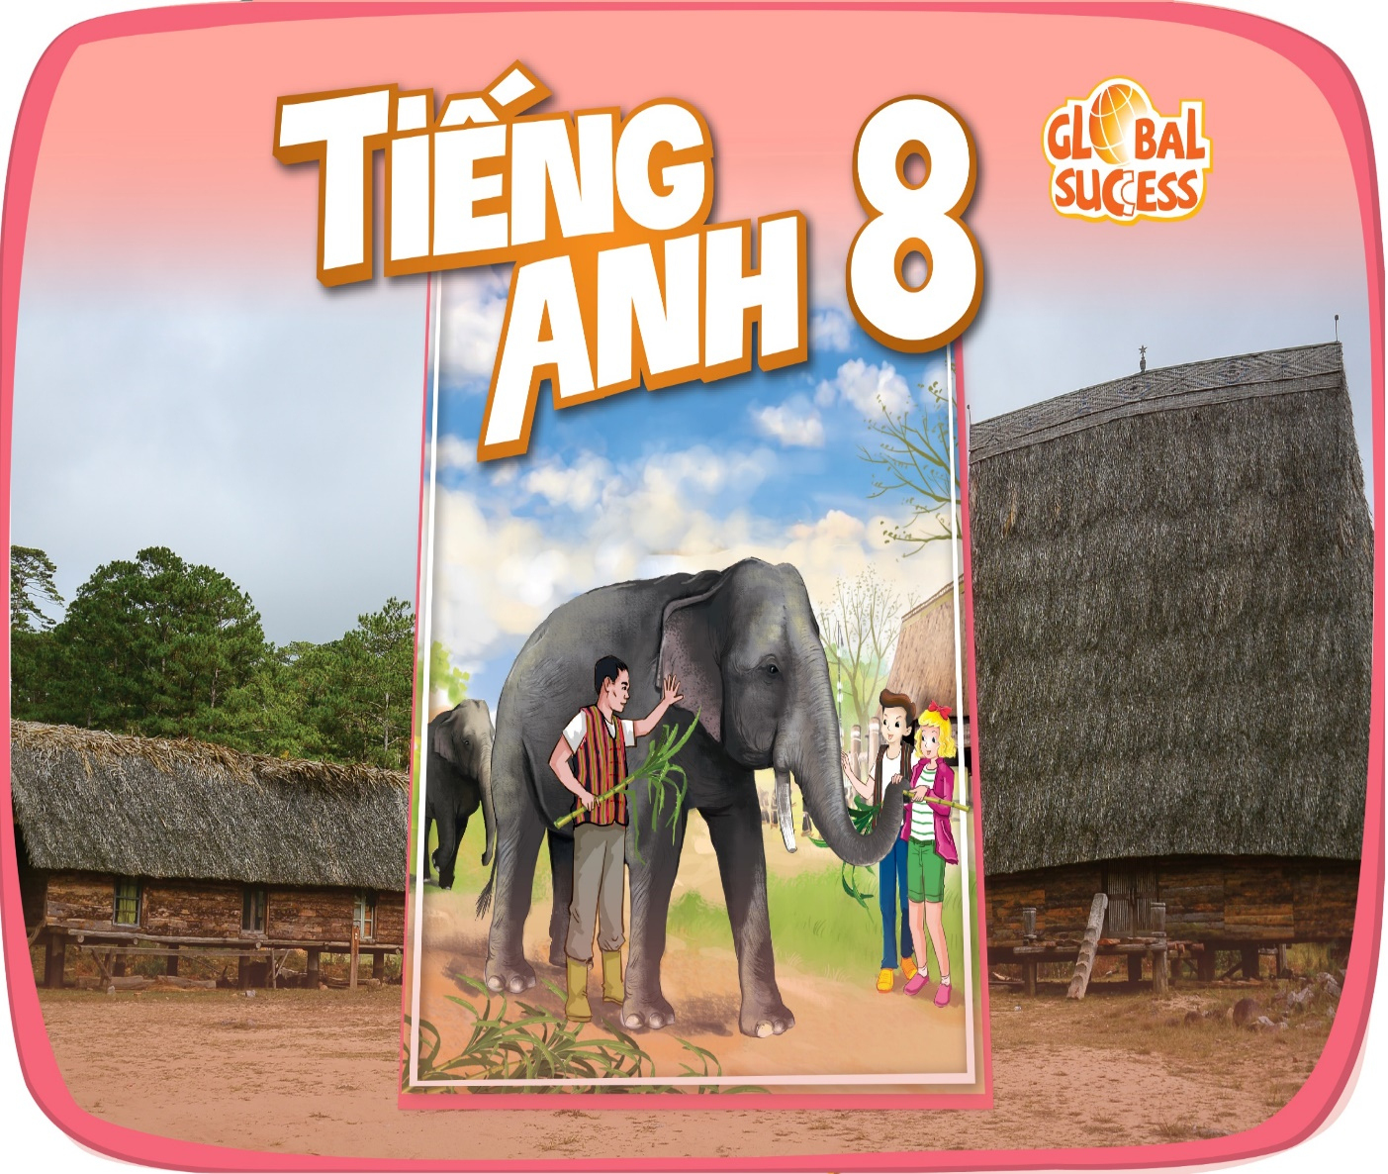
WELCOME
OUR TEACHERS
TO
CLASS 8A1

Slide 2
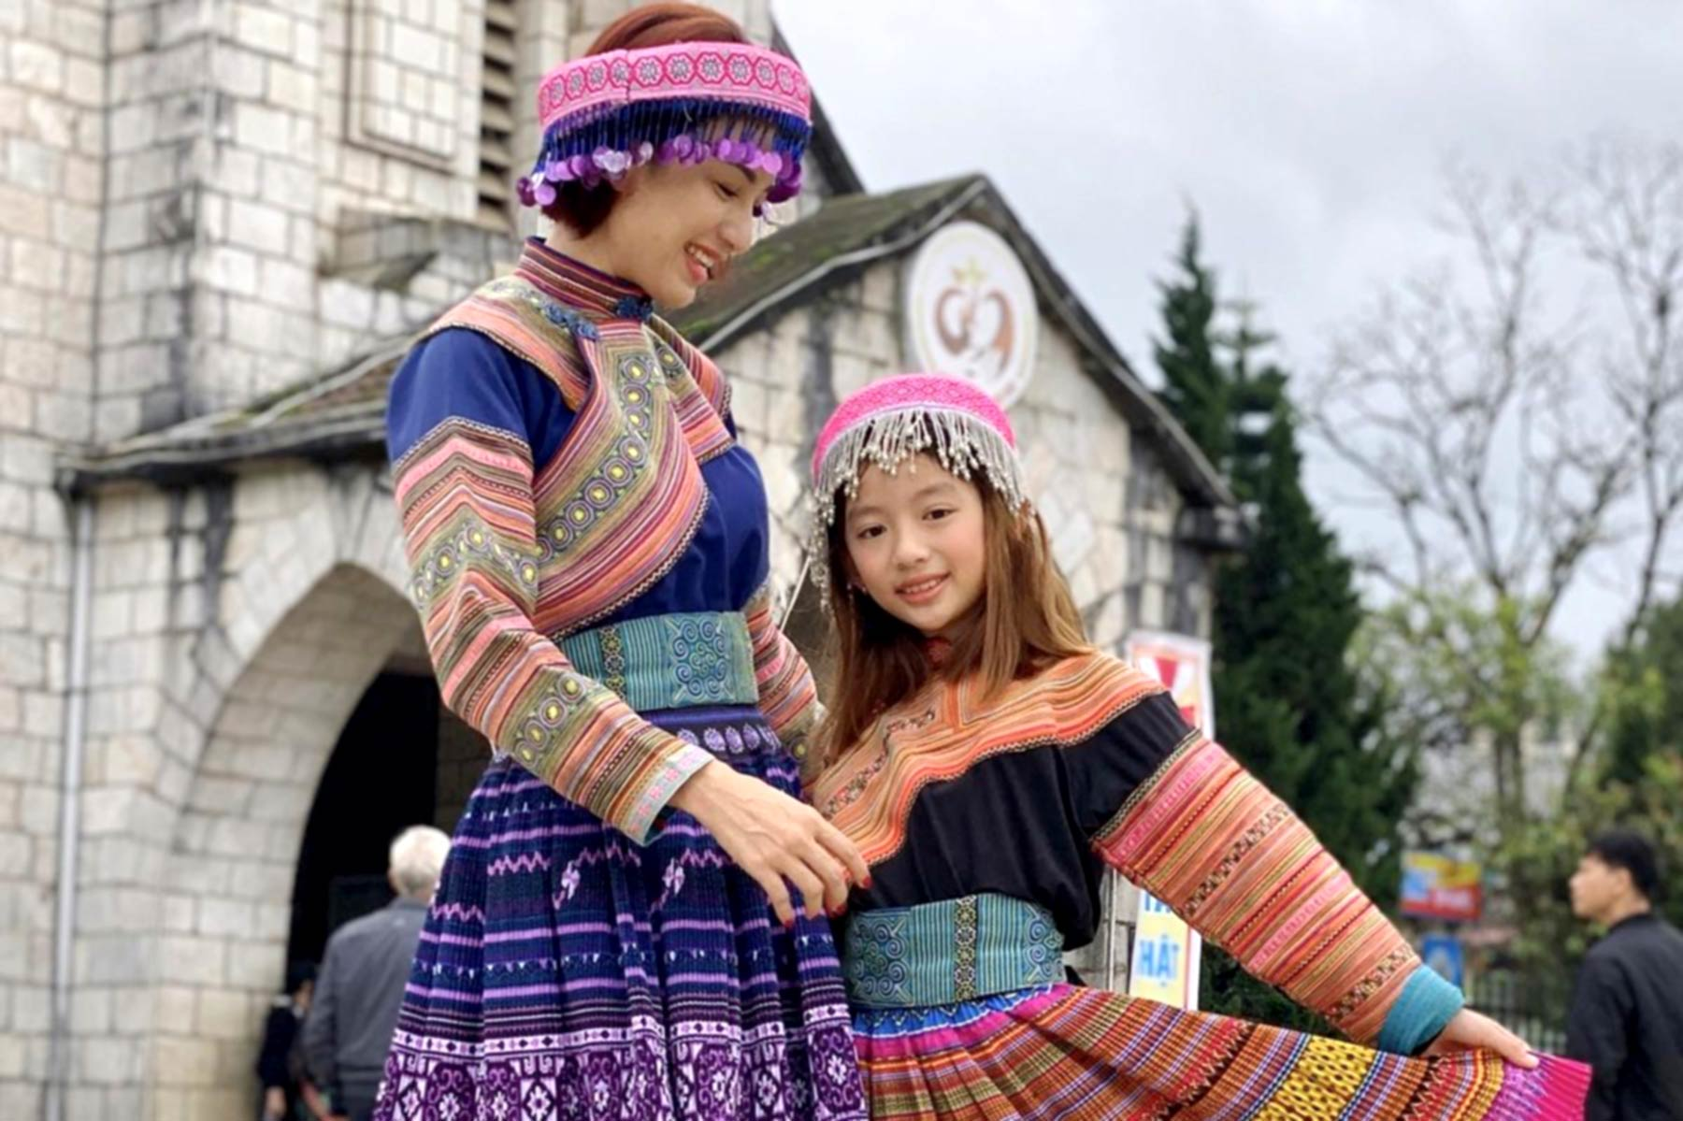
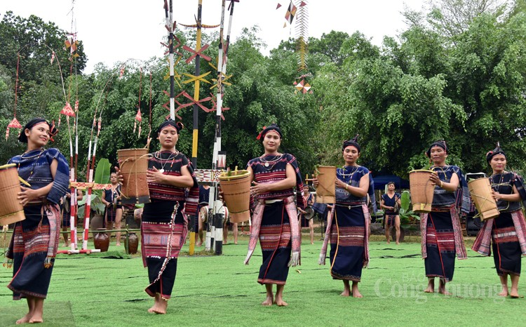
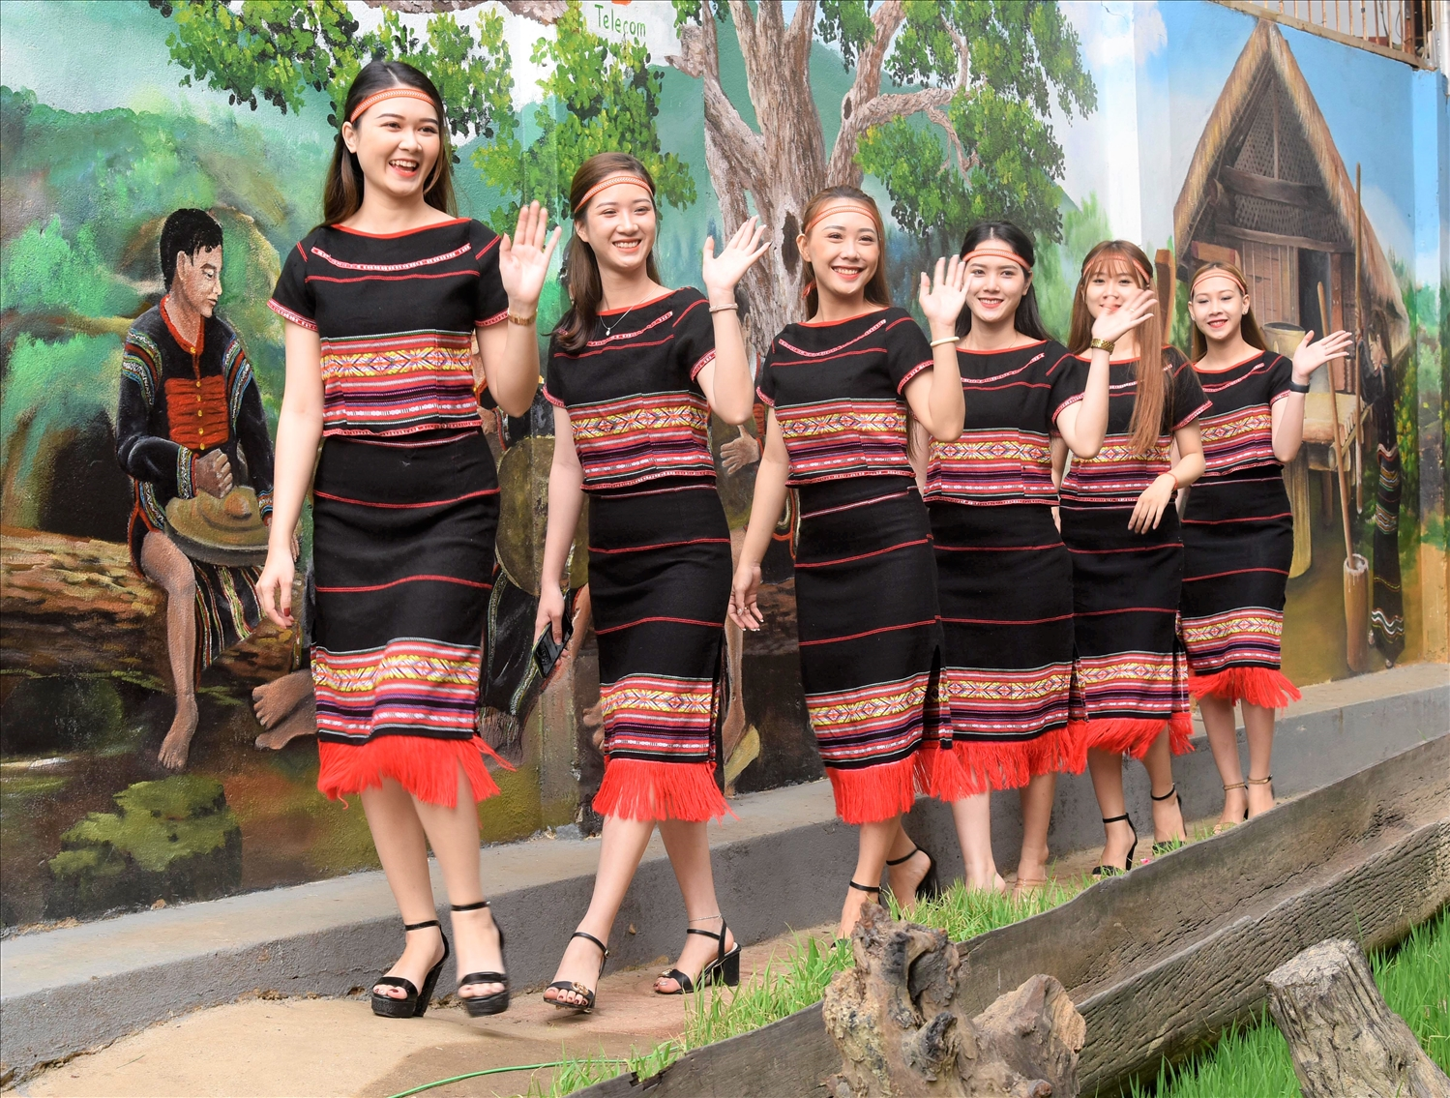
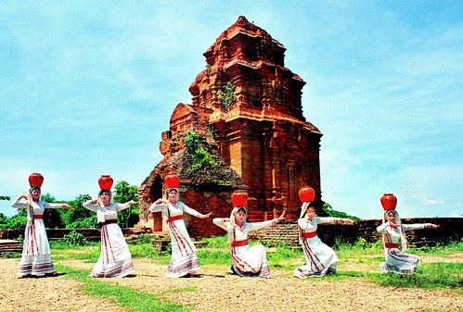
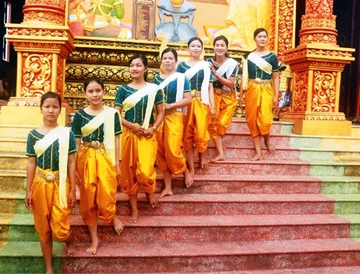
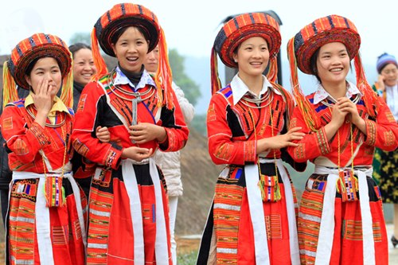
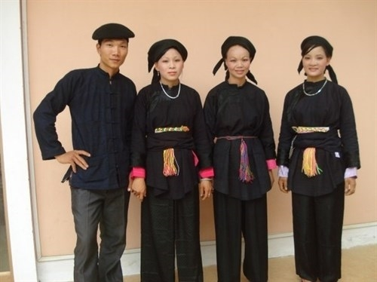
Nung
H’mong
Ede
Cham
Khmer
Bahnar

Slide 4
H’mong
Ede
Khmer
Bahnar
Nung
Cham

Slide 5
Unit
4
ETHNIC GROUPS OF VIET NAM
Unit
ETHNIC GROUPS OF VIET NAM
LESSON 1: GETTING STARTED
I’m from the Tay ethnic group
Unit

Slide 6
LESSON 1: GETTING STARTED
WARM-UP
Name the pictures
PRESENTATION
Vocabulary
Task 1: Listen and read.
Task 2: Read the conversation again and circle the best answers.
Task 3: Match the pictures with the word and phrases from the conversation.
Task 4: Complete the sentences with the words and phrases from the box.
PRACTICE
FURTHER PRACTICE
Task 5: Game: Where are they?
CONSOLIDATION
Wrap-up
Homework

Slide 7
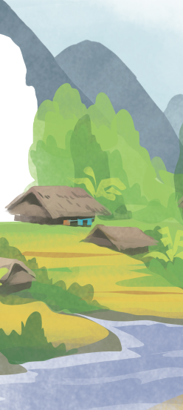
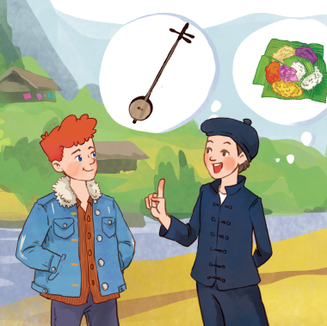
1
Listen and read.

Slide 8
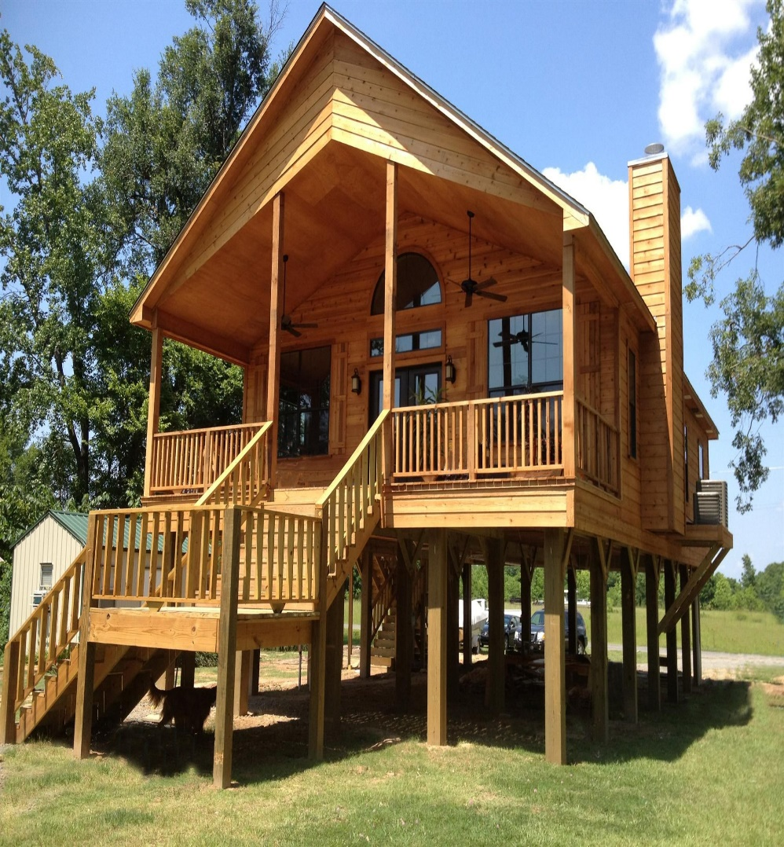
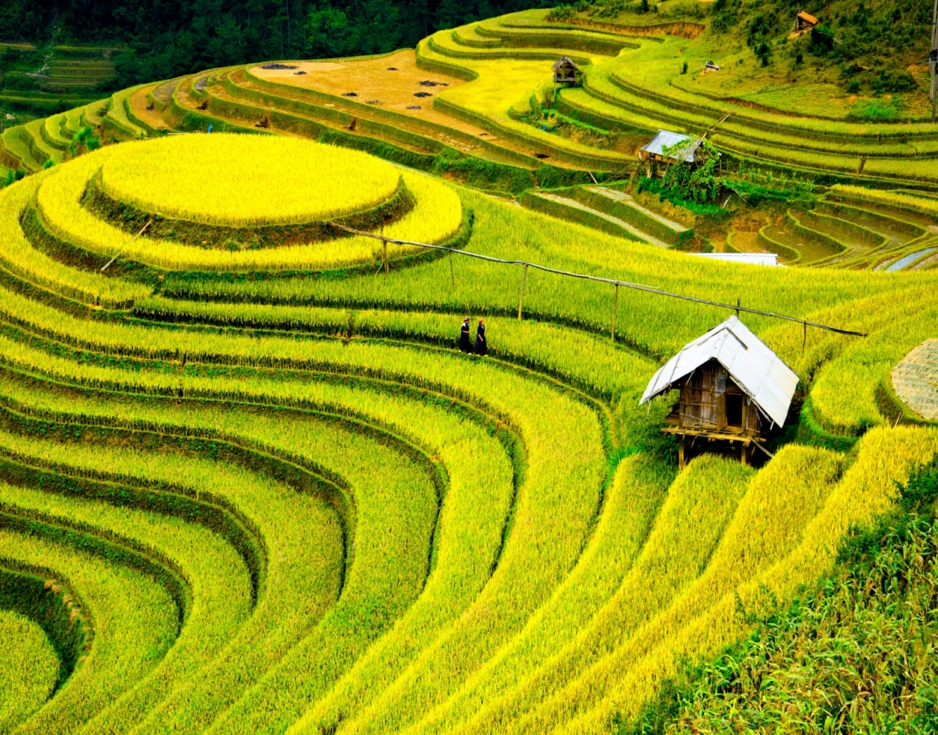
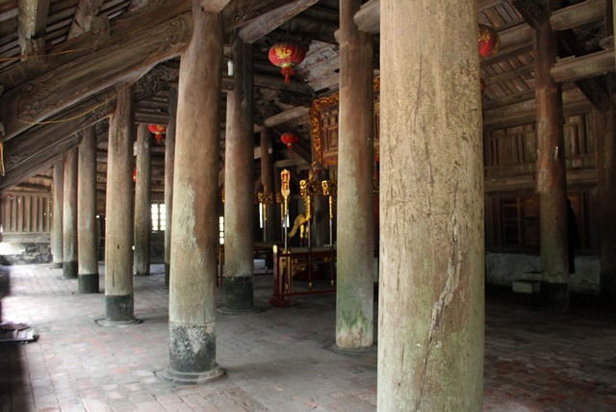
1
Listen and read.
Tom: Hi, I’m Tom. You look new here.
Lai: I am. I’m Lai from Ha Giang.
Tom: Oh, I’ve heard about beautiful Ha Giang. Do you live in the mountains?
Lai: Yes, I do. I’m from the Tay ethnic group. We are the second largest ethnic group in Viet Nam, only after the Kinh.
Tom: Oh … I once saw a bamboo house on high posts in a travel brochure. Do you live in a home like that?
Lai: Yes, we call it a “stilt house”. Our house overlooks terraced fields.
Tom: Awesome. What is life in your village like?
Lai: It’s peaceful. There are 16 houses in my village. We live very close to nature.
Tom: I love it. Can you tell me something about your culture?
Lai: Certainly. We have our own culture. You can see it in our folk dances, musical instruments like the dan tinh, and our special five-colour sticky rice.
Tom: It sounds interesting. I hope to visit Ha Giang one day.

Slide 10
1
Listen and read.
Tom: Hi, I’m Tom. You look new here.
Lai: I am. I’m Lai from Ha Giang.
Tom: Oh, I’ve heard about beautiful Ha Giang. Do you live in the mountains?
Lai: Yes, I do. I’m from the Tay ethnic group. We are the second largest ethnic group in Viet Nam, only after the Kinh.
Tom: Oh … I once saw a bamboo house on high posts in a travel brochure. Do you live in a home like that?
Lai: Yes, we call it a “stilt house”. Our house overlooks terraced fields.
Tom: Awesome. What is life in your village like?
Lai: It’s peaceful. There are 16 houses in my village. We live very close to nature.
Tom: I love it. Can you tell me something about your culture?
Lai: Certainly. We have our own culture. You can see it in our folk dances, musical instruments like the dan tinh, and our special five-colour sticky rice.
Tom: It sounds interesting. I hope to visit Ha Giang one day.

Slide 12
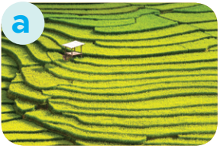
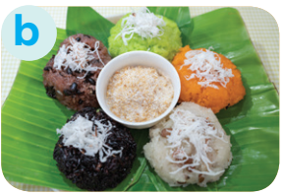
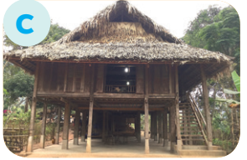
3
Match the pictures with the word and phrases from the conversation.
1. stilt house
2. terraced fields
3. bamboo
4. five-colour sticky rice

Slide 14
4
Complete the sentences with the words and phrases from the box.
overlooks musical instrument ethnic groups
folk dance traditional
1. I love mua sap, a popular _________ of the Thai people.
2. Their beautiful stilt house _________ a large rice field.
3. A: What is the name of a popular Tay’s __________________?
B: It’s dan tinh.
4. Every ethnic group has their own __________ culture.
5. Of the 54 ______________ in Viet Nam, the Kinh is the largest
folk dance
overlooks
musical instrument
traditional
ethnic groups

Slide 15
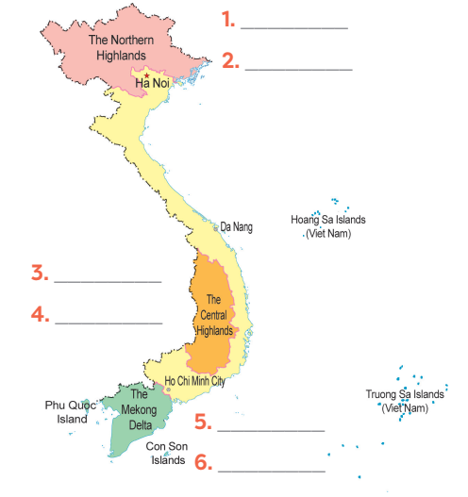
5
Game: Where are they?
H’mong
Nung
Ede
Bahnar
Khmer
Cham

Slide 16
CONSOLIDATION
1
Wrap-up
ETHNIC GROUPS OF VIET NAM
About ethnic groups
Topic of the unit
Vocabulary

Slide 17
Homework
- Learn by heart all the learnt words.
- Prepare next lesson: A Closer Look 1

Slide 18
THANKS FOR YOUR ATTENTION

