Slide 2
WARM-UP
Answer the questions:
1. Can you name some natural disasters in Viet Nam?
2. Are there often natural disasters in Viet Nam?
3. How can you know when there is an incoming natural disaster?
4. What would you do if you were notified of an incoming earthquake?
NATURAL DISASTERS

Slide 3
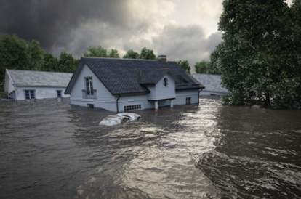
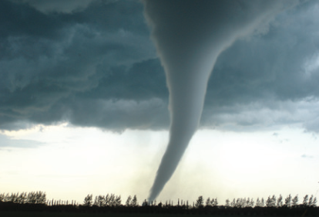
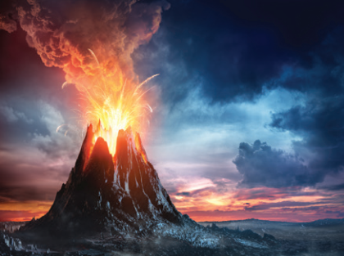
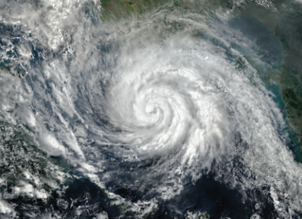
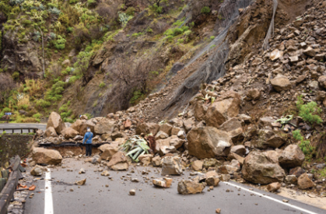
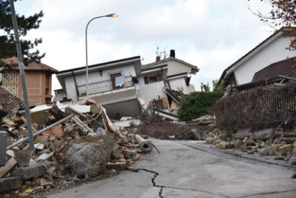
Write the natural disasters from the box under the pictures. Then listen, check, and repeat.
volcanic eruption
earthquake
landslide
storm
tornado
flood
1. ………………………....
2. ………………………....
3. ………………………....
4. ………………………....
5. ………………………....
6. …………………………..

Slide 4
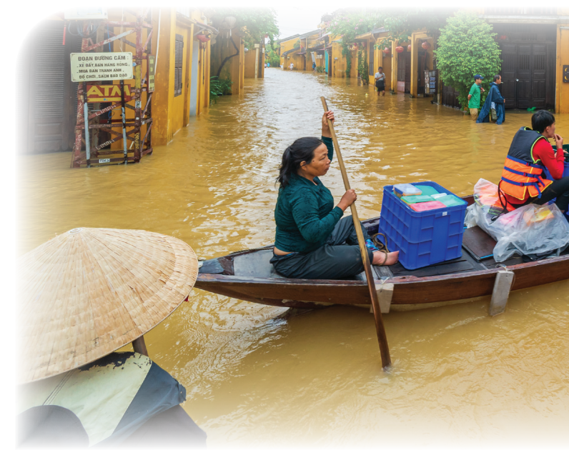
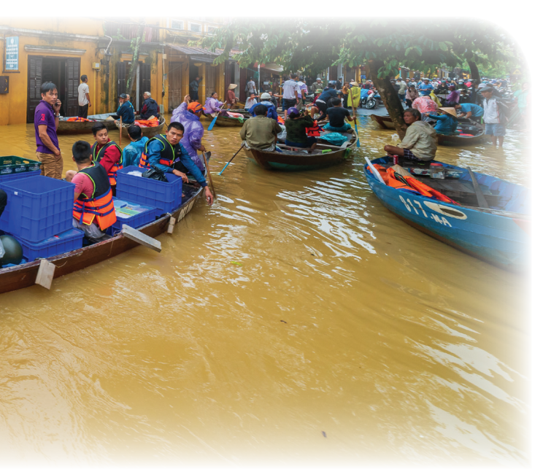
- What can you see in the picture?
- What natural disaster is it?

Slide 5
Listen and read.
Tom: You look pretty sad, Mi. What’s the matter?
Mi: My uncle called us this morning. Our home town has been affected by a flood. It’s the second time this year.
Tom: I’m sorry to hear that. How are things there now?
Mi: My uncle, his wife, and his children are all safe. They moved everything to the second floor of their house last night. Are there natural disasters in your home town in the US?
Tom: Yes, we sometimes have tornadoes.
Mi: Tornadoes? Sounds strange. What’s a tornado?
Tom: It’s a violent storm that moves in a circle with very strong winds. I still remember the tornado we had last year.
Mi: What happened?
Tom: One evening my parents and I were having dinner. Suddenly we heard a very loud noise. When we looked out of the window, we saw a big funnel of wind moving towards us.
Mi: Did it cause any damage?
Tom: Yes, a lot. It damaged the roof of our house and pulled up some trees in our yard. Fortunately, no one was hurt.

Slide 6
Read the conversation again. Complete each sentence with no more than TWO words from it.
1. There is a _____ in Mi’s home town.
2. Her uncle’s family had to move everything to the ___________ last night.
3. A tornado is an example of a _______________.
4. Tom’s family ___________ dinner when the tornado came.
5. The tornado damaged their roof and _______ up some trees in their yard.
flood
second floor
natural disaster
was having
pulled

Slide 7
4
1. When there is a(n) earthquake / volcanic eruption, hot gases and liquid rock pour out from a mountain.
2. Oh, the house is shaking! I think we’re having a(n) earthquake / flood.
3. We wanted to travel to Ha Giang, but there was a tornado / landslide. Some big rocks and mud came down the mountains.
4. Every year more than ten floods / storms with strong winds and rain cause damage in our country.
5. A tornado / storm looks like a huge funnel and causes a lot of damage. Its strong winds can reach 480 km per hour.

Slide 8
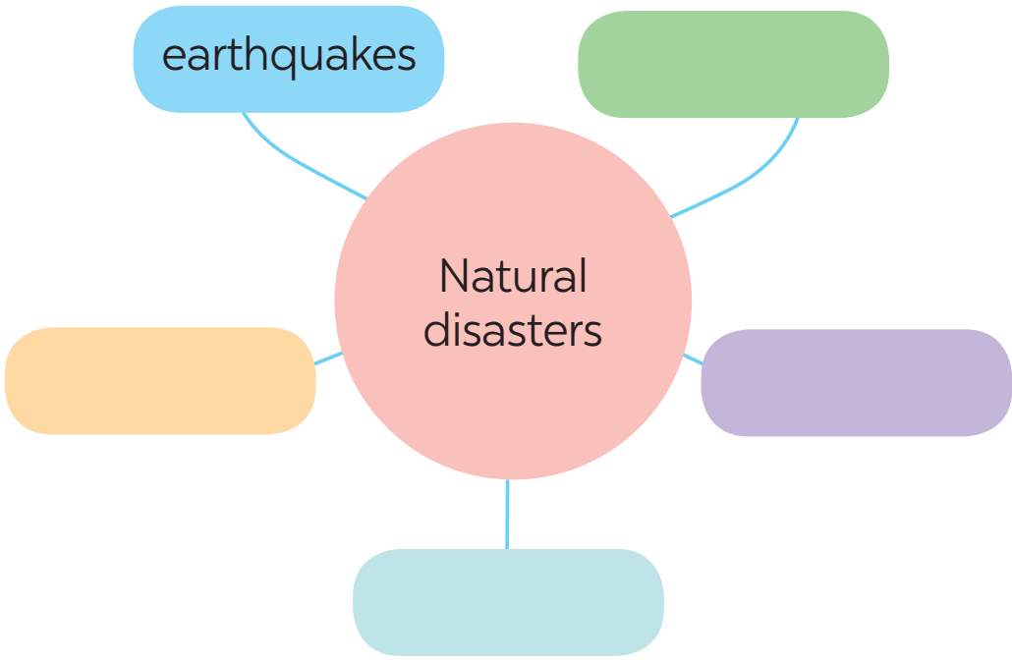
Work in groups. Complete the web with all of the words and phrases related to natural disasters you know.

Slide 9
Homework
- Learn by heart all the words that you have just learnt.
- Do exercises in the workbook.
- Start preparing for the Project of the unit.

Slide 10
Website: hoclieu.vn
Fanpage: facebook.com/tienganhglobalsuccess.vn/

