Slide 1

Work in groups: List some activities you often do before and during Tet?
Rules: Work in 2 minutes, each group member will take turn going up to the board and tick your answer. The team that answer most correctly, fastest and most will be winner.

Slide 2

Making or buying traditional foods
Shopping for Tet items
Activities before and during Tet
Visiting flower markets
Giving and receiving lucky money
Visiting relatives and friends
Cleaning and decorating the house

Slide 3
Unit 5:
Our customs and traditions
Lesson 1: Getting Started
(page 50-51)

Slide 4
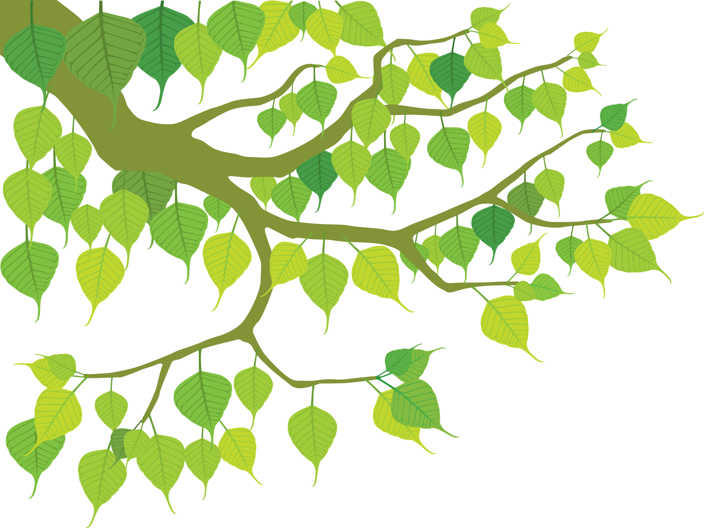
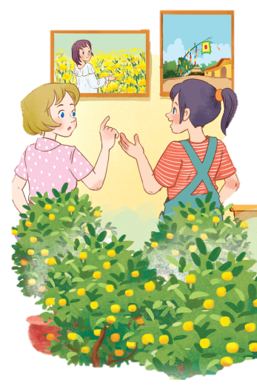
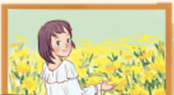
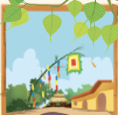
Exercise 1. Listen and read (pg 50)
1. What can you see in each picture?
2. Can you guess the places that the picture show?

Slide 5
Exercise 1. Listen and read.
Elena: Wow, this girl looks so cute.
Trang: Yeah ... She’s my cousin. She’s at Sa Dec Flower Village. Tet is coming soon, so many people visit flower villages to take pictures with the blooming flowers.
Elena: Oh, I’m fond of admiring the flowers. Does your family visit places like this too?
Trang: Yes, we do. We usually visit Nhat Tan Village to buy kumquat trees and peach blossoms.
Elena: I see flowers and ornamental trees everywhere these days. What are they for?
Trang: We, Vietnamese, use plants and flowers for decorations and for oﬀerings. They are an important part of our Tet tradition.
Elena: And what’s that tall tree in the photo?
Trang: Well, it’s actually a bamboo pole. People place it in the yard of the communal house. They hang decorative items like small bells and lanterns on it. They want to chase away bad luck and pray for a lucky new year.
Elena: Interesting! I didn’t know that.

Slide 6
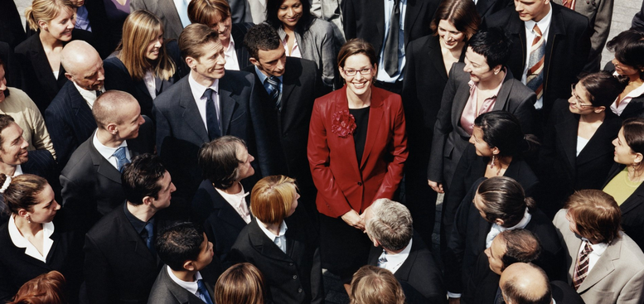
PRESENTATION
1. admire (v)
/ədˈmaɪr/
khâm phục, ngưỡng mộ
Elena: Wow, this girl looks so cute.
Trang: Yeah ... She’s my cousin. She’s at Sa Dec Flower Village. Tet is coming soon, so many people visit flower villages to take pictures with the blooming flowers.
Elena: Oh, I’m fond of admiring the flowers. Does your family visit places like this too?
Trang: Yes, we do. We usually visit Nhat Tan Village to buy kumquat trees and peach blossoms.

Slide 7
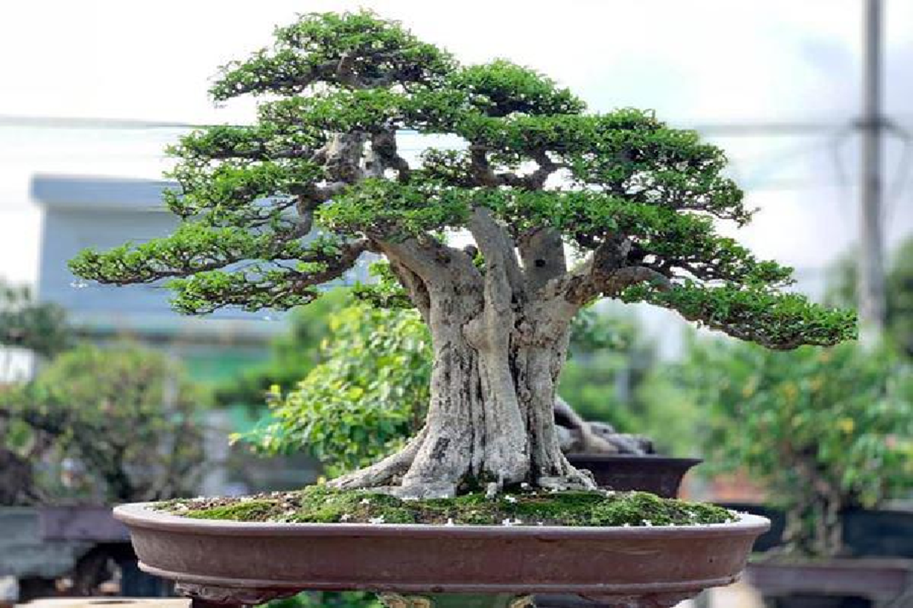
ornamental tree (n)
/ɔːnəˈmentl triː/
cây cảnh
Elena: I see flowers and ornamental trees everywhere these days. What are they for?

Slide 8
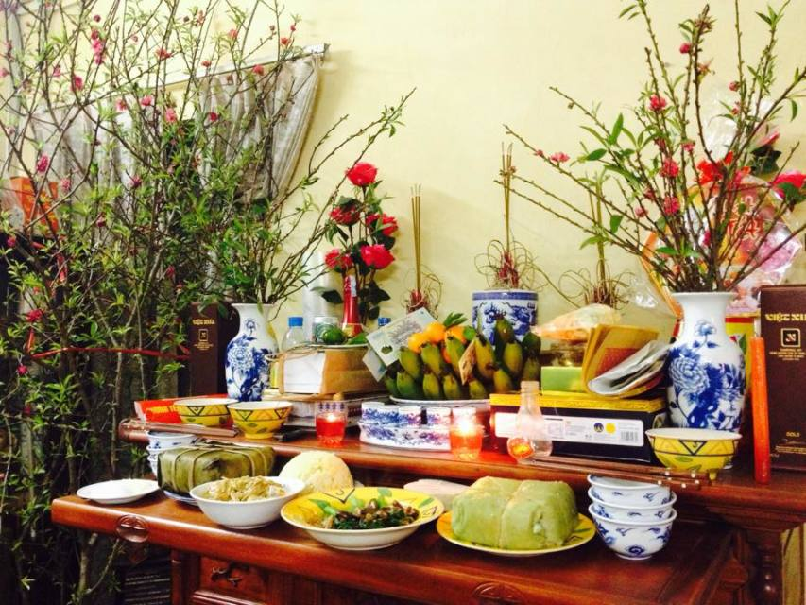
offering (n)
/ˈɒfərɪŋ/
đồ thờ cúng
Trang: We, Vietnamese, use plants and flowers for decorations and for oﬀerings. They are an important part of our Tet tradition.

Slide 9
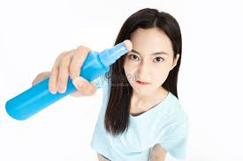
PRESENTATION
2. chase away
/tʃeɪs əˈweɪ/
xua đuổi
Trang: Well, it’s actually a bamboo pole. People place it in the yard of the communal house. They hang decorative items like small bells and lanterns on it. They want to chase away bad luck and pray for a lucky new year.

Slide 10
PRESENTATION
New words | Pronunciation | Meaning
1. admire (v) | /ədˈmaɪr/ | khâm phục
2. ornamental tree | /ɔːnəˈmentl triː/ | cây cảnh
3. offering (n) | /ˈɒfərɪŋ/ | lễ vật
4. chase away | /tʃeɪs əˈweɪ/ | xua đuổi

Slide 11
Exercise 1. Listen and read.
Elena: Wow, this girl looks so cute.
Trang: Yeah ... She’s my cousin. She’s at Sa Dec Flower Village. Tet is coming soon, so many people visit flower villages to take pictures with the blooming flowers.
Elena: Oh, I’m fond of admiring the flowers. Does your family visit places like this too?
Trang: Yes, we do. We usually visit Nhat Tan Village to buy kumquat trees and peach blossoms.
Elena: I see flowers and ornamental trees everywhere these days. What are they for?
Trang: We, Vietnamese, use plants and flowers for decorations and for oﬀerings. They are an important part of our Tet tradition.
Elena: And what’s that tall tree in the photo?
Trang: Well, it’s actually a bamboo pole. People place it in the yard of the communal house. They hang decorative items like small bells and lanterns on it. They want to chase away bad luck and pray for a lucky new year.
Elena: Interesting! I didn’t know that.

Slide 12

Exercise 2: Work in groups. Read again and tick T (true) or F (false)
Sentences | True | False
1. Elena and Trang are at Sa Dec Flower Village.
2. Many people visit flower villages to take photos.
3. Trang’s family usually buys kumquat trees and peach blossoms at Nhat Tan village.
4. Flowers are not part of any Vietnamese tradition.
5. People decorate bamboo poles with small bells and lanterns for New Years.

Slide 13

Check your answers.
Sentences | True | False
1. Elena and Trang are at Sa Dec Flower Village.
Elena: Wow, this girl looks so cute.
Trang: Yeah ... She’s my cousin. She’s at Sa Dec Flower Village. Tet is coming soon, so many people visit flower villages to take pictures with the blooming flowers.

Slide 14
Check your answers.
Sentences | True | False
2. Many people visit flower villages to take photos.
Elena: Wow, this girl looks so cute.
Trang: Yeah ... She’s my cousin. She’s at Sa Dec Flower Village. Tet is coming soon, so many people visit flower villages to take pictures (= photos) with the blooming flowers.

Slide 15
Check your answers.
Sentences | True | False
3. Trang’s family usually buys kumquat trees and peach blossoms at Nhat Tan village.
Elena: Wow, this girl looks so cute.Elena: Oh, I’m fond of admiring the flowers. Does your family visit places like this too?
Trang: Yes, we do. We usually visit Nhat Tan Village to buy kumquat trees and peach blossoms.

Slide 16
Check your answers.
Sentences | True | False
4. Flowers are not part of any Vietnamese tradition.
Elena: I see flowers and ornamental trees everywhere these days. What are they for?
Trang: We, Vietnamese, use plants and flowers for decorations and for oﬀerings. They are an important part (> < not part) of our Tet tradition.

Slide 17
Check your answers.
Sentences | True | False
5. People decorate bamboo poles with small bells and lanterns for New Years.
Elena: And what’s that tall tree in the photo?
Trang: Well, it’s actually a bamboo pole. People place it in the yard of the communal house. They hang decorative items like small bells and lanterns on it. They want to chase away bad luck and pray for a lucky new year.

Slide 18
Check your answers
Sentences | True | False
1. Elena and Trang are at Sa Dec Flower Village.
2. Many people visit flower villages to take photos.
3. Trang’s family usually buys kumquat trees and peach blossoms at Nhat Tan village.
4. Flowers are not part of any Vietnamese tradition.
5. People decorate bamboo poles with small bells and lanterns for New Years.

Slide 19
Name some more traditional decorations
at Tet

Slide 20
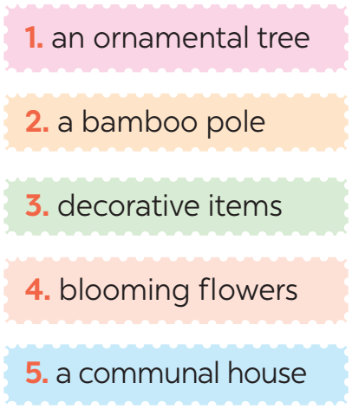
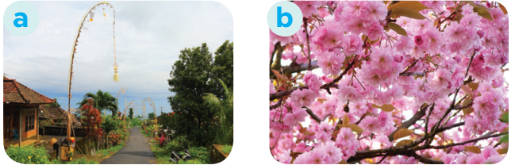
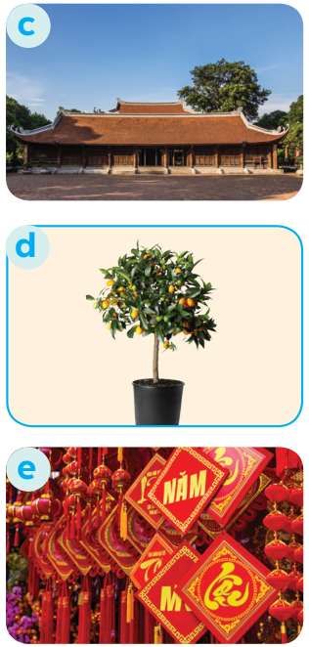
PRACTICE
3
Match the phrase with the correct pictures.

Slide 21
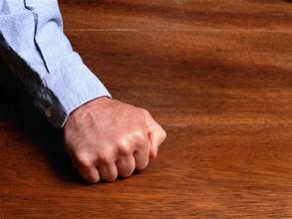
Have you heard of the phrase 'Knock on wood'? It’s a way people in many cultures avoid bad luck. Today, let’s learn more about these interesting customs and traditions!"

Slide 22
Exercise 4. Complete the sentences with the verbs from the box.
admire chase pray place
1. The British decorate their Christmas trees and ______ presents under them.
2. Tom likes to ______ the view from the hill.
3. In many cultures, knocking on wood is a way to ______ away bad spirits.
4. Many Asians go to Buddhist temples to ______ for good luck.

Slide 23
https://wordwall.net/play/81155/340/272
WORDWALL GAMES
Work in groups, the team that answers correctly and fastest will be winner.

Slide 24
Exercise 4. Check your answers
admire chase pray place
1. The British decorate their Christmas trees and ______ presents under them.
2. Tom likes to ______ the view from the hill.
3. In many cultures, knocking on wood is a way to ______ away bad spirits.
4. Many Asians go to Buddhist temples to ______ for good luck.
place
admire
chase
pray

Slide 25
Exercise 5. QUIZ: New Years around the world.
People around the world celebrate New Years differently. Choose the country with each tradition below.

Slide 26
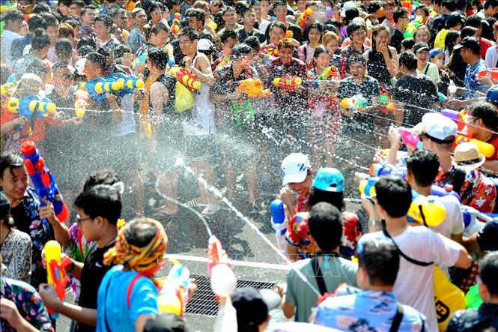
1. What is this custom?
And which country does it come from? A. Thailand B. Japan

Slide 27
It is about throwing water at each other. It comes from Thailand
It is called Songkran. Songkran is one of Thailand’s most famous and exciting festivals.

Slide 28
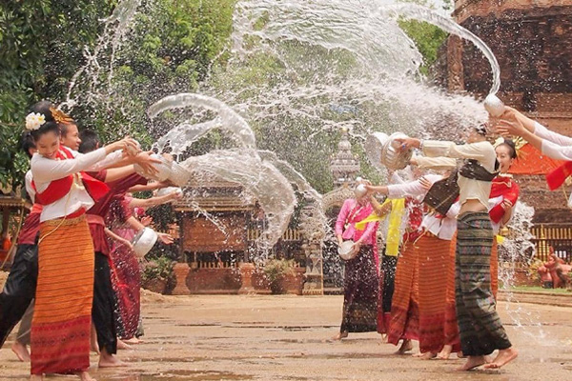
Songkran: The Water Festival of Thailand
It is celebrated as the Thai New Year from April 13th to 15th every year.

Slide 29
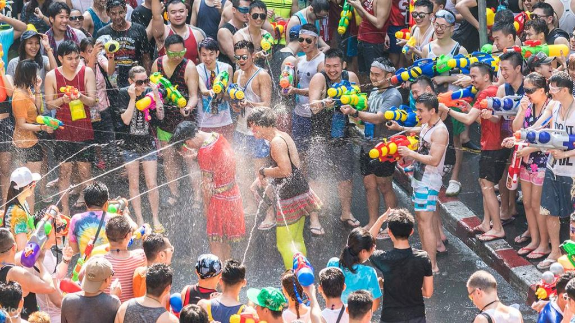
Songkran: Enjoy the Water War
People splash water on each other to have fun and wash away bad things, preparing for the good things in the New Year..

Slide 30
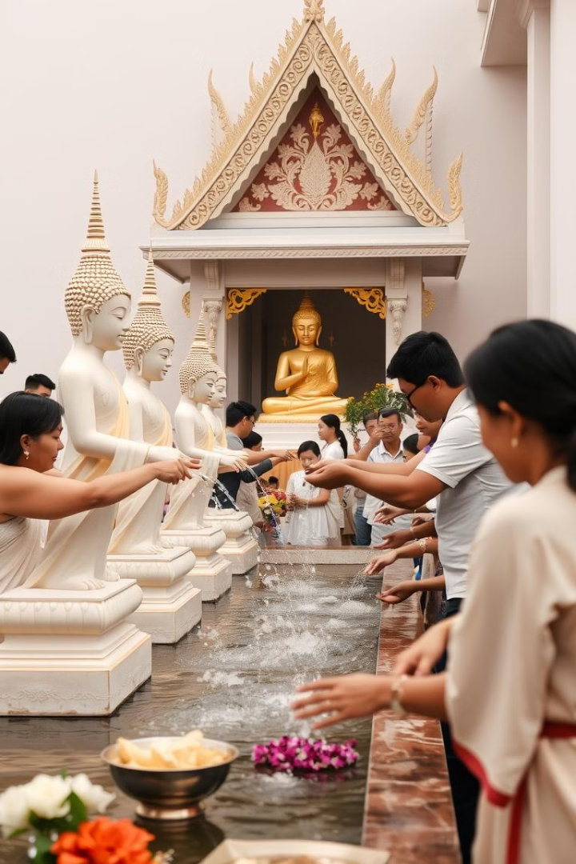
Songkran: Spiritual Side
Water symbolizes
Washing away
bad luck and
welcoming
positivity into life

Slide 31
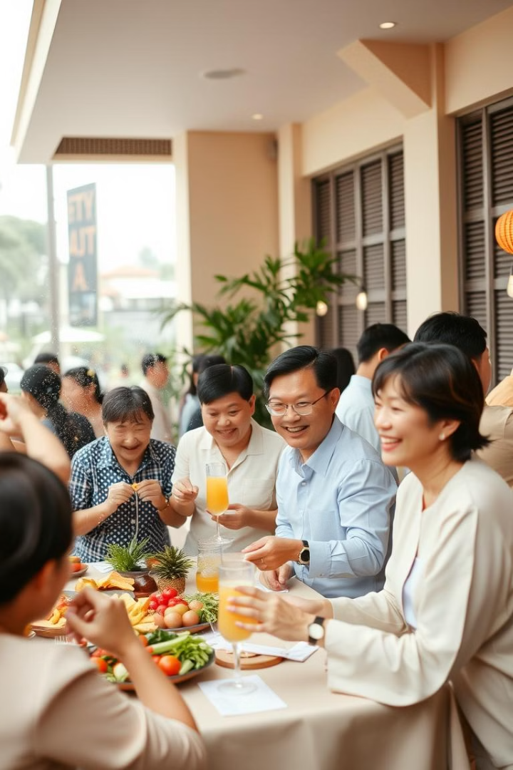
Songkran: The Festival of Happiness
Songkran is a time
for family reunions,
spending time with
friends, and bonding
with loved ones.
1

Slide 32

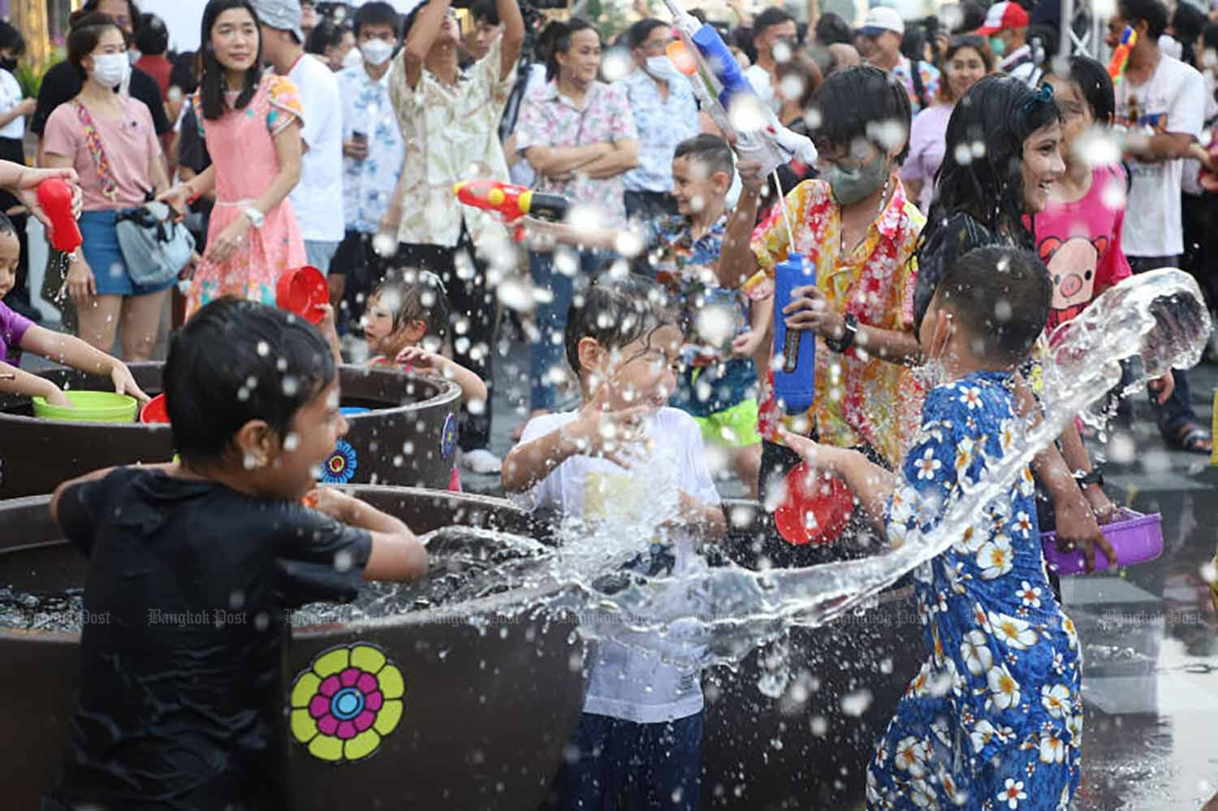

Songkran: A Unique Experience
Fun and Joy
Songkran is a festival of happiness and excitement.

Slide 33
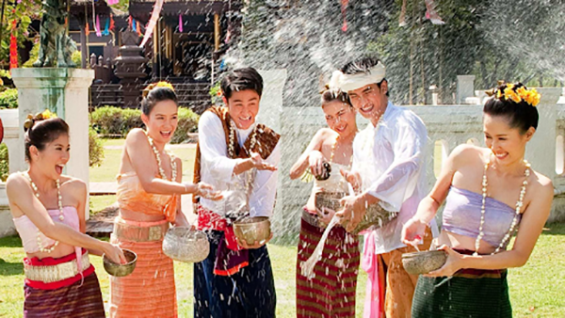
Songkran: A Celebration of Joy
Happiness Songkran
brings joy, fun,
Togetherness and
new beginnings.

Slide 34
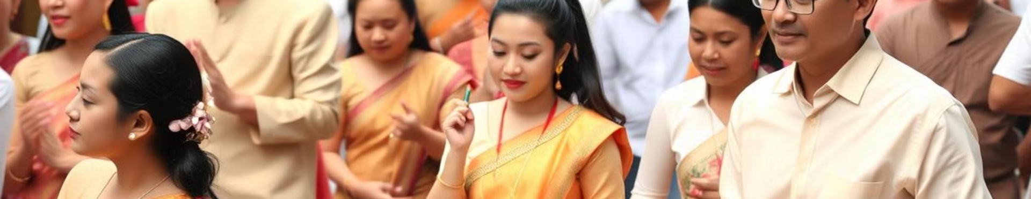
Songkran: A Festival Worth Experiencing
If you have the chance to visit Thailand during Songkran,
you will experience an exciting and uniquely, joyful celebration of
Thai culture.

Slide 35
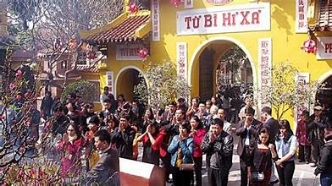
2. What is this custom, and which country does it come from?
A. The US B. Viet Nam
B

Slide 36
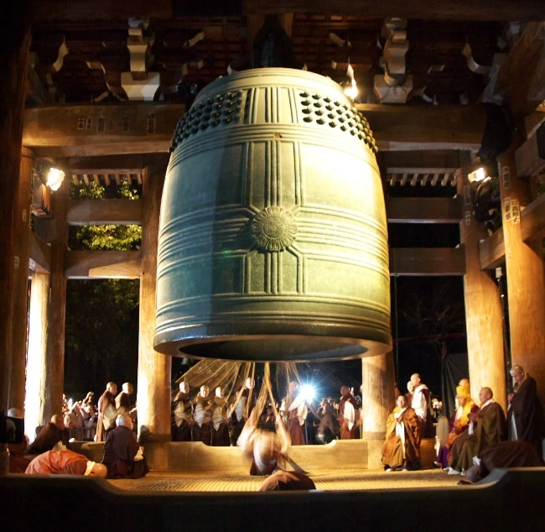
3. What is this custom and which country does it come from?
A. Japan B. Viet Nam
A

Slide 37
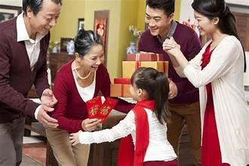
4. What is this custom and which country does it come from?
A. The US B. Viet Nam
B

Slide 38
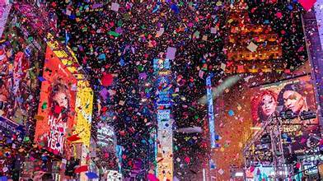
4. What is this custom and which country does it come from?
A. Thailand B. The US
B

Slide 39
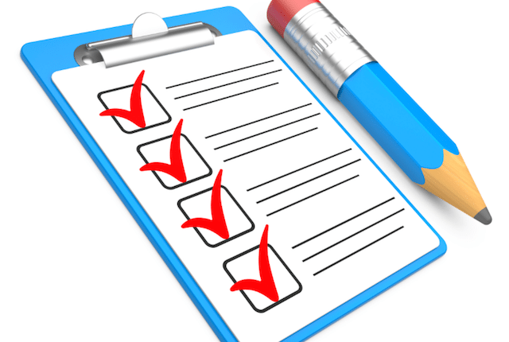
CONSOLIDATION
1
Wrap-up
What have we learnt in this lesson?

Slide 40

CONSOLIDATION
In this lesson we have learnt:
Wrap- up
The topic of the unit is Tet holiday (Vietnamese Lunar New Year)
Vocabulary related to Tet, such as traditions, activities, and customs of the holiday.
Grammar: Structures used to talk about events or plans for Tet.
Understanding the significance and practices of Tet.

Slide 41
Homework
1. Learn by heart new words.
2. Do exercises in Workbook.
3. Choose one festival in Ex 5 to find information about (choose something that you do not know about) or search for a new one on the Internet.

Slide 42
Thanks!
Do you have any questions?
youremail@freepik.com
+34 654 321 432
yourwebsite.com
Please keep this slide for attribution

