Slide 1
UNIT 2: LIFE IN THE COUNTRYSIDE
LESSON 2: A CLOSER LOOK 1

Slide 2

OBJECTIVES
By the end of the lesson, students will be able to:
1
VOCABULARY
use the lexical items related to Life in the countryside.
2
PRONUNCIATION
correctly pronounce words that contain the sounds: /ə/ and /ɪ/

Slide 3
UNSCRAMBLE
Groups of 4
Write unscrambled words in note book
Raise hand and say out “FINISH” if you finish
LET’S PLAY!

Slide 4

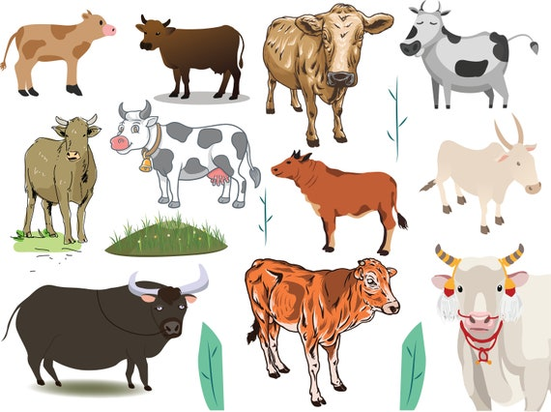
UNSCRAMBLE THE WORD
TELTAC
CATTLE

Slide 5
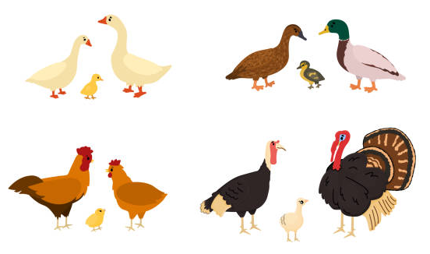
UNSCRAMBLE THE WORD
TRYLUPO
POULTRY

Slide 6
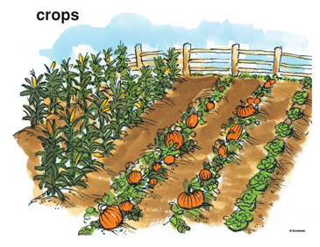
UNSCRAMBLE THE WORD
SRCOP
CROPS

Slide 7
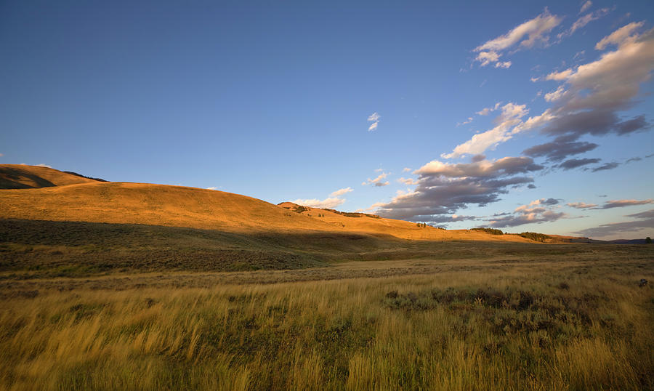
UNSCRAMBLE THE WORD
SAVT
VAST

Slide 8

UNSCRAMBLE THE WORD
TABLEHOSPI
HOSPITABLE

Slide 9
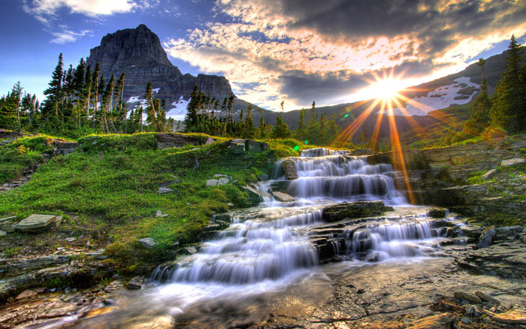
UNSCRAMBLE THE WORD
QUERESPICTUR
PICTURESQUE

Slide 10
UNSCRAMBLED WORDS
CATTLE
POULTRY
CROPS
VAST
HOSPITABLE
PICTURESQUE

Slide 11
VOCABULARY
1

Slide 12

cattle (n)
/ˈkætl/
gia súc

Slide 13
poultry (n)
/ˈpəʊltri/
gia cầm

Slide 14
crops (n)
/krɒp/
mùa, vụ, hoa màu

Slide 15
vast (adj)
/vɑːst/
mênh mông

Slide 16
hospitable (adj)
/hɒˈspɪtəbl/
/ˈhɒspɪtəbl/
UK
US
hiếu khách
Notes:
Ấn vào chữ US UK để phân biệt

Slide 17
picturesque (adj)
/ˌpɪktʃəˈresk/
đẹp (như tranh vẽ)
Notes:
Ấn vào chữ US UK để phân biệt

Slide 18
VOCABULARY
New words | Pronunciation | Vietnamese equivalent
1. cattle (n) | /ˈkæt(ə)l/ | gia súc
2. poultry (n) | /ˈpəʊltri/ | gia cầm
3. crop (n) | /krɒp/ | hoa màu
4. vast (adj) | /vɑːst/ | mênh mông
5. hospitable (adj) | /hɒˈspɪtəbl/ /ˈhɒspɪtəbl/ | hiếu khách
6. picturesque (adj) | /ˌpɪktʃəˈresk/ | đẹp như tranh vẽ

Slide 19
PRACTICE
2

Slide 20
Ex 1. Circle the correct words to complete the sentences.
1. We helped the farmers herd cattle / poultry.
2. They are helping their parents pick plants / fruit in the orchard.
3. At harvest time farmers are busy cutting and collecting food / crops.
4. The driver loaded / unloaded the rice from the back of the truck.
5. People here live by catching / holding fish from nearby lakes
and ponds.

Slide 21
Ex 2. Match the following adjectives with their definitions.
a. pretty, especially in a way that looks old-fashioned
b. having something near or around
c. extremely large in area, size, amount, etc.
d. pleased to welcome guests; generous and friendly to visitors
e. having received good or thorough training
a. pretty, especially in a way that looks old-fashioned
b. having something near or around
c. extremely large in area, size, amount, etc.
d. pleased to welcome guests; generous and friendly to visitors
e. having received good or thorough training
1. vast
5. picturesque
2. hospitable
4. surrounded
3. well-trained
1. vast
4. surrounded
2. hospitable
5. picturesque
3. well-trained

Slide 22
Ex 3. Complete the sentences with the words from 2.
vast
hospitable
well-trained
surrounded
picturesque
1. The local people are kind and __________ to visitors.
2. Our factory needs a lot of ____________ workers.
3. While travelling up the mountain, people always stop and take photos of the ___________ scenery.
4. The Sahara is a ______ desert that covers parts of eleven countries in Northern Africa.
5. The lake is _____________ by a lot of trees.
local people
kind
hospitable
visitors
factory
needs
well-trained
workers
always stop
take photos
picturesque
scenery
vast
desert
covers parts of eleven countries
lake
surrounded
by a lot of trees

Slide 23
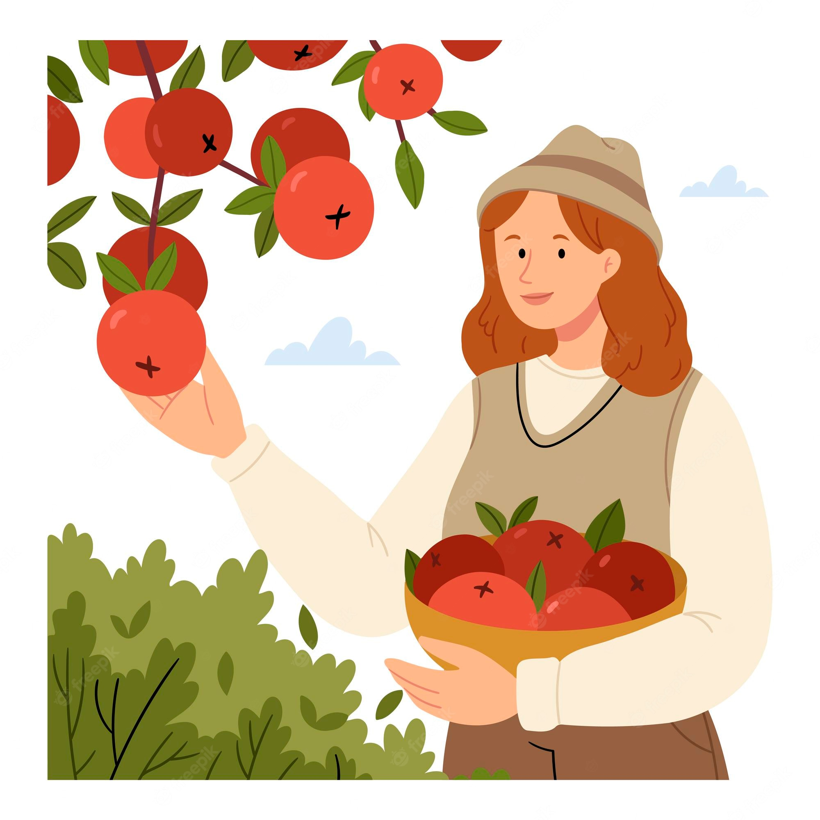
What are they doing?
What are the sounds?
collect
collect
pick
pick
/ə/
/ɪ/

Slide 24
PRONUNCIATION
3
/ə/ and /ɪ/

Slide 25

Watch and pay attention to the sounds

Slide 26
Ex 4. Listen and repeat the words. Pay attention to the sounds /ə/ and /ɪ/.
/ə/ | /ɪ/
activity hospitable garden picturesque collect | pick village harvest busy cottage

Slide 27
Ex 5. Listen and practise.
Underline the bold words with /ə/, and circle the bold words with /ɪ/.
1. There is a lot of water in the bottle.
2. The farmers here are hard-working.
3. They are picking fruits in the orchard.
4. People in my village usually gather at weekends.
5. Please buy some milk and pasta at the supermarket.

Slide 28
RECAP
1
They trained the dog to _____ sheep.
herd
collect
pick
2
People in my village grow rice in the ____ paddy fields.
hospitable
well-trained
vast
3
Choose the different word.
A. activity
B. fishing
C. milking
/ækˈtɪv.ə.ti/
/ˈfɪʃ.ɪŋ/
/mɪlkɪŋ /

Slide 29
HOMEWORK
Learn by heart vocabulary
Practice pronouncing /ə/ and /i/
Do exercises in Workbook P.11&12

Slide 30
THANKS!
Do you have any questions?

