Slide 1
Unit 5:
OUR EXPERIENCES
Lesson 6: Skills 2

Slide 2
Objectives
Listening
01
Writing
02
Listen for information about a bad experience at school
Write a paragraph about their most pleasant / unpleasant experience at school

Slide 3
01
Listening
Listen for information about a bad experience at school

Slide 4
Ex 1: Which of the following is a bad experience?
 | 1. failing an exam
 | 2. being bullied
 | 3. winning a competition
 | 4. lacking confidence

Slide 5


Vocabulary
confidence (n)
/ˈkɒnfɪdəns/
niềm tin, sự tin tưởng, sự tự tin

Slide 6
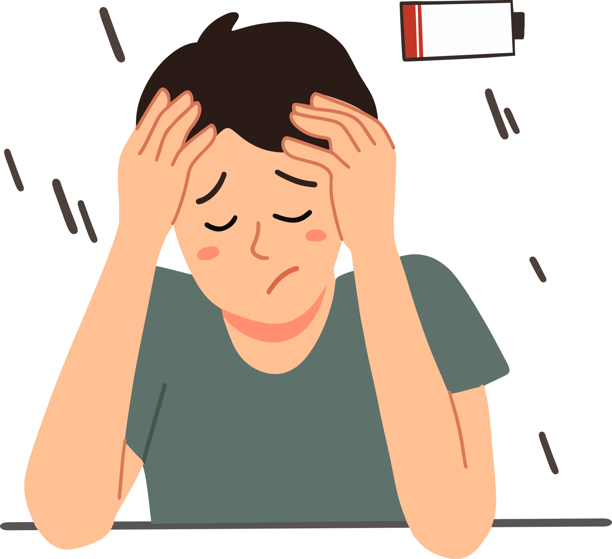
Vocabulary
lack (v)
/læk/
thiếu

Slide 7
Ex 2: Listen to the conversation between Minh and his dad and tick T (True) or F (False).
 | T | F
1. Minh’s peers bullied him.
2. Dad could always get things back.
3. Dad’s peers got his money.
4. Minh had an embarrassing experience.
5. Minh understood the lesson well.

Slide 8
 | T | F
1. Minh’s peers bullied him.
2. Dad could always get things back.
3. Dad’s peers got his money.
4. Minh had an embarrassing experience.
5. Minh understood the lesson well.
Minh’s peers
Dad: A classmate bullied me.

Slide 9
 | T | F
1. Minh’s peers bullied him.
2. Dad could always get things back.
3. Dad’s peers got his money.
4. Minh had an embarrassing experience.
5. Minh understood the lesson well.
Dad
always get things back
Dad: A big boy in my class was always taking my things. I could never get anything back.

Slide 10
 | T | F
1. Minh’s peers bullied him.
2. Dad could always get things back.
3. Dad’s peers got his money.
4. Minh had an embarrassing experience.
5. Minh understood the lesson well.
Dad’s peers
got his money
Dad: Once he and his friends waited for me
outside the school and snatched my backpack. They got all my money.

Slide 11
 | T | F
1. Minh’s peers bullied him.
2. Dad could always get things back.
3. Dad’s peers got his money.
4. Minh had an embarrassing experience.
5. Minh understood the lesson well.
Minh
embarrassing experience
Minh: I stood there and couldn't say anything. I felt so embarrassed!

Slide 12
 | T | F
1. Minh’s peers bullied him.
2. Dad could always get things back.
3. Dad’s peers got his money.
4. Minh had an embarrassing experience.
5. Minh understood the lesson well.
Minh
understood the lesson well
Minh: I did. But I actually learnt it by rote without really understanding the lesson.

Slide 13
Audio Script
Dad: He was totally surprised. But then he returned my money and went away ... What about you?
Minh: Well, it was just last week. My biology teacher checked our understanding of the previous lesson. My mind suddenly went
blank. I stood there and couldn't say anything. I felt so embarrassed!
Dad: So what happened then?
Minh: I got a zero.
Dad: Sorry about that.
Minh: It was such a terrible experience.
Dad: Didn't you revise the lesson?
Minh: I did. But I actually learnt it by rote without really understanding the lesson.
Minh: Dad, what was your worst experience at school?
Dad: A classmate bullied me.
Minh: Really? What happened, dad?
Dad: A big boy in my class was always taking my things. I could never get anything back. Once he and his friends waited for me
outside the school and snatched my backpack. They got all my money.
Minh: What did you do then?
Dad: I was so angry that I fought back.
Minh: Wow. What happened next?

Slide 14
Ex 3: Listen again and choose the correct answer A, B, or C.
1. Dad and Minh are talking about ______.
A. dad’s experiences
B. Minh’s experiences
C. experiences of Minh and his dad
2. Dad’s classmates often ______ him.
A. bullied B. helped C. argued with
3. Minh’s dad ______ the bullies.
A. ran away from B. shouted at C. fought
4. Minh got a low mark because he ______.
A. reviewed the lesson
B. learnt the lesson by rote
C. learnt the lesson by heart
Dẫn chứng: Minh: Dad, what was your worst experience at school?
Dẫn chứng: Dad: A classmate bullied me.
Dẫn chứng: Dad: I was so angry that I fought back.
Dẫn chứng: Minh: I did. But I actually learnt it by rote without really understanding the lesson.
Dad and Minh
talking about
Dad’s classmates
Minh’s dad
the bullies
got a low mark
because

Slide 15
02
Writing
Write a paragraph about their most pleasant / unpleasant experience at school

Slide 16
Ex 4: Work in pairs.
Put the phrases from the box in the correct column.
a. taking wrong things
b. doing community service
c. not revising lessons
d. winning a competition
e. arguing with a friend
f. coming to school late
Pleasant experience | Unpleasant experience

Slide 17
Ex 4: Work in pairs.
Put the phrases from the box in the correct column.
b. doing community service
c. not revising lessons
d. winning a competition
e. arguing with a friend
f. coming to school late
Pleasant experience | Unpleasant experience
a. taking wrong things

Slide 18
Ex 4: Work in pairs.
Put the phrases from the box in the correct column.
c. not revising lessons
d. winning a competition
e. arguing with a friend
f. coming to school late
Pleasant experience | Unpleasant experience
b. doing community service
a. taking wrong things

Slide 19
Ex 4: Work in pairs.
Put the phrases from the box in the correct column.
d. winning a competition
e. arguing with a friend
f. coming to school late
Pleasant experience | Unpleasant experience
b. doing community service
a. taking wrong things
c. not revising lessons

Slide 20
Ex 4: Work in pairs.
Put the phrases from the box in the correct column.
e. arguing with a friend
f. coming to school late
Pleasant experience | Unpleasant experience
b. doing community service
a. taking wrong things
d. winning a competition
c. not revising lessons

Slide 21
Ex 4: Work in pairs.
Put the phrases from the box in the correct column.
f. coming to school late
Pleasant experience | Unpleasant experience
b. doing community service
a. taking wrong things
d. winning a competition
c. not revising lessons
e. arguing with a friend

Slide 22
Ex 4: Work in pairs.
Put the phrases from the box in the correct column.
Pleasant experience | Unpleasant experience
b. doing community service
a. taking wrong things
d. winning a competition
c. not revising lessons
e. arguing with a friend
f. coming to school late

Slide 23

Ex 5: Write a paragraph (100 – 120 words) about the most pleasant OR unpleasant experience you have had at school.
Start as follows:
I had very pleasant experiences at my school.
It was

Slide 24
CHECKED
Example:
I had very pleasant experiences at my school.
It was
when I did community service last year. I joined the school English club and tutored some primary school students for a semester. Their English became better, and they were much more confident in English lessons. The second memorable experience I had was going on a camping trip with my classmates. We went to a village about 20 km from our school. Here, we put up tent, decorated it and we also won the competition of tent decoration. We sang and danced and took a lot of photos. I also remember winning the first prize in the school chess competition that year. The school then presented me with a chess set. All these pleasant experiences will go with me forever.

Slide 25
SWAP AND CHECK
Check for spelling
Do the words spell correctly?
Check for ideas
Do you write about the most pleasant OR unpleasant experience you have had at school?
Check for comprehension
Does the writing make sense?
Check for grammar
Does the writing use the correct tenses and structures?

Slide 26
Wrap-up
What have you learnt in this lesson?
Listening
Listen for information about a bad experience at school
Writing
Write a paragraph about their most pleasant / unpleasant experience at school

Slide 27
Homework
01
02
03
04

Slide 28
Thanks!
WELL DONE
Do you have any questions?

