Slide 1
Unit 5:
OUR EXPERIENCES
Lesson 5: Skills 1

Slide 2
Objectives
By the end of the lesson, students will be able to:
Reading
Read for general and specific information about experiences in a summer course.
Speaking
Talk about their experiences of a course.

Slide 3
01
Reading
Read for general and specific information about experiences in a summer course.

Slide 4
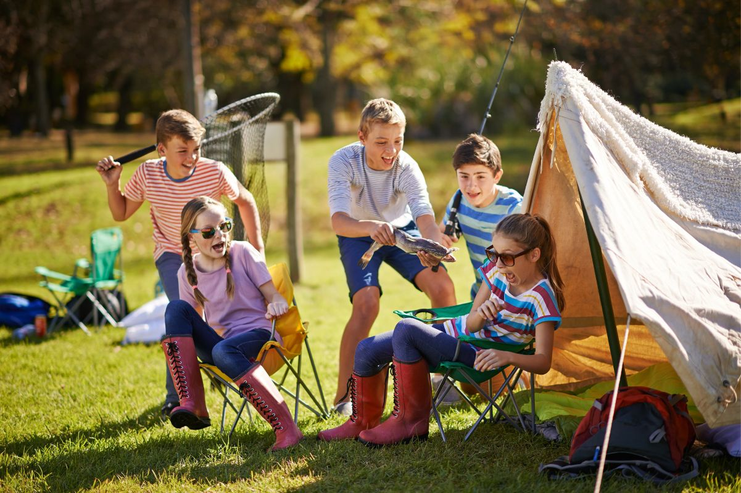
Ex 1: Tick (V) the experiences you have had.
 | Joining a performance
 | Attending an army course
 | Travelling to a new place without parents

Slide 5
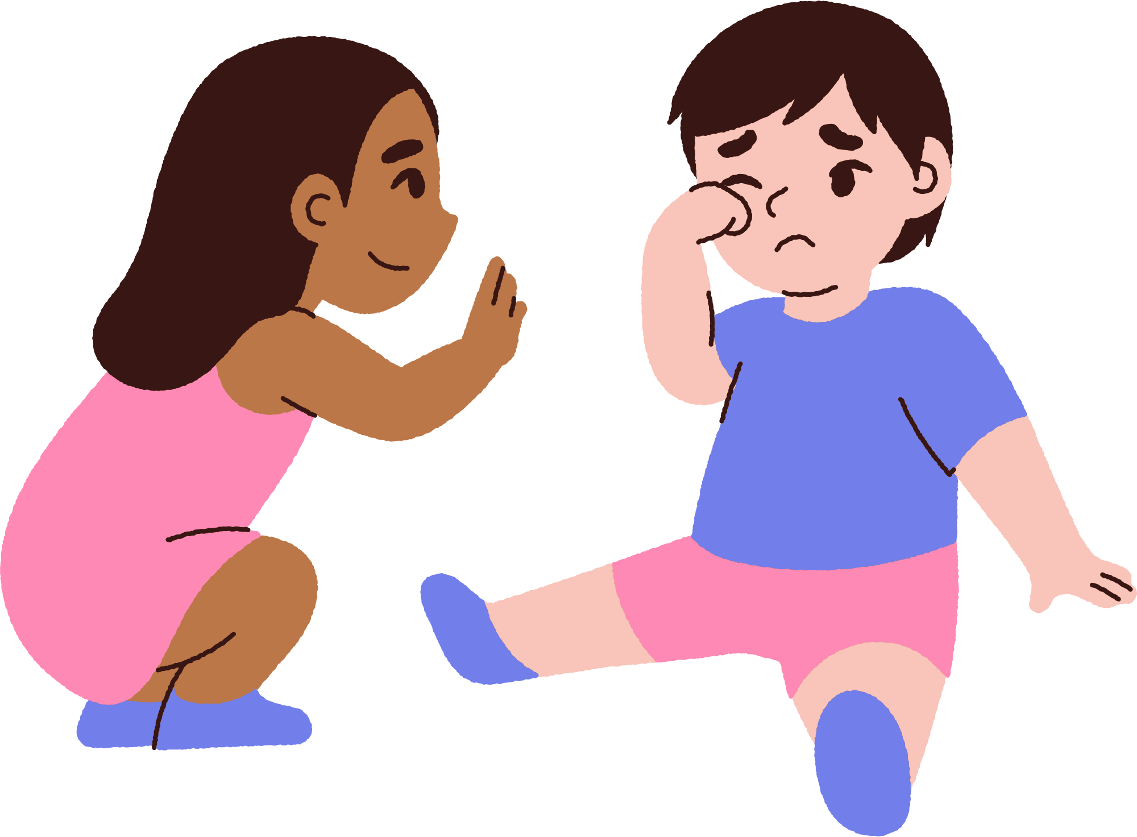

Vocabulary
Touching (adj)
/ˈtʌtʃɪŋ/
gây xúc động,
tạo cảm giác đồng cảm

Slide 6
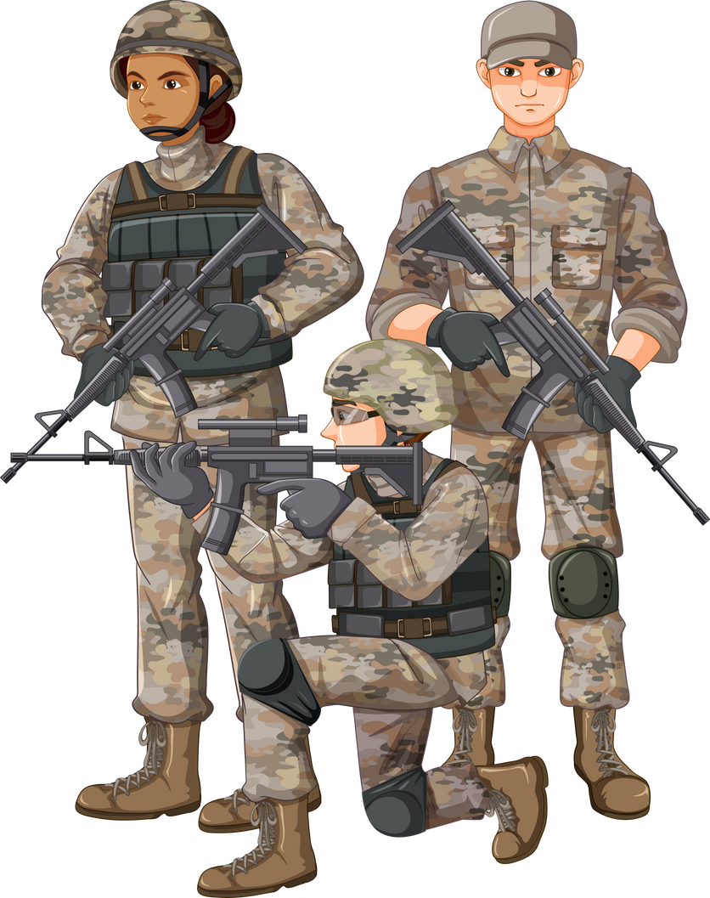
Vocabulary
Soldier (n)
/ˈsəʊldʒər/
người lính

Slide 7
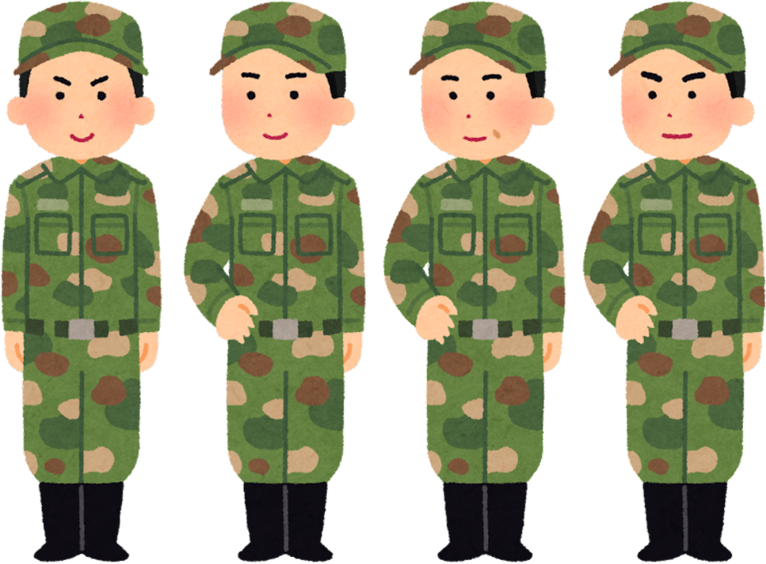
Vocabulary
Army-like (adj)
/ɑːmi laɪk/
như trong quân đội

Slide 8
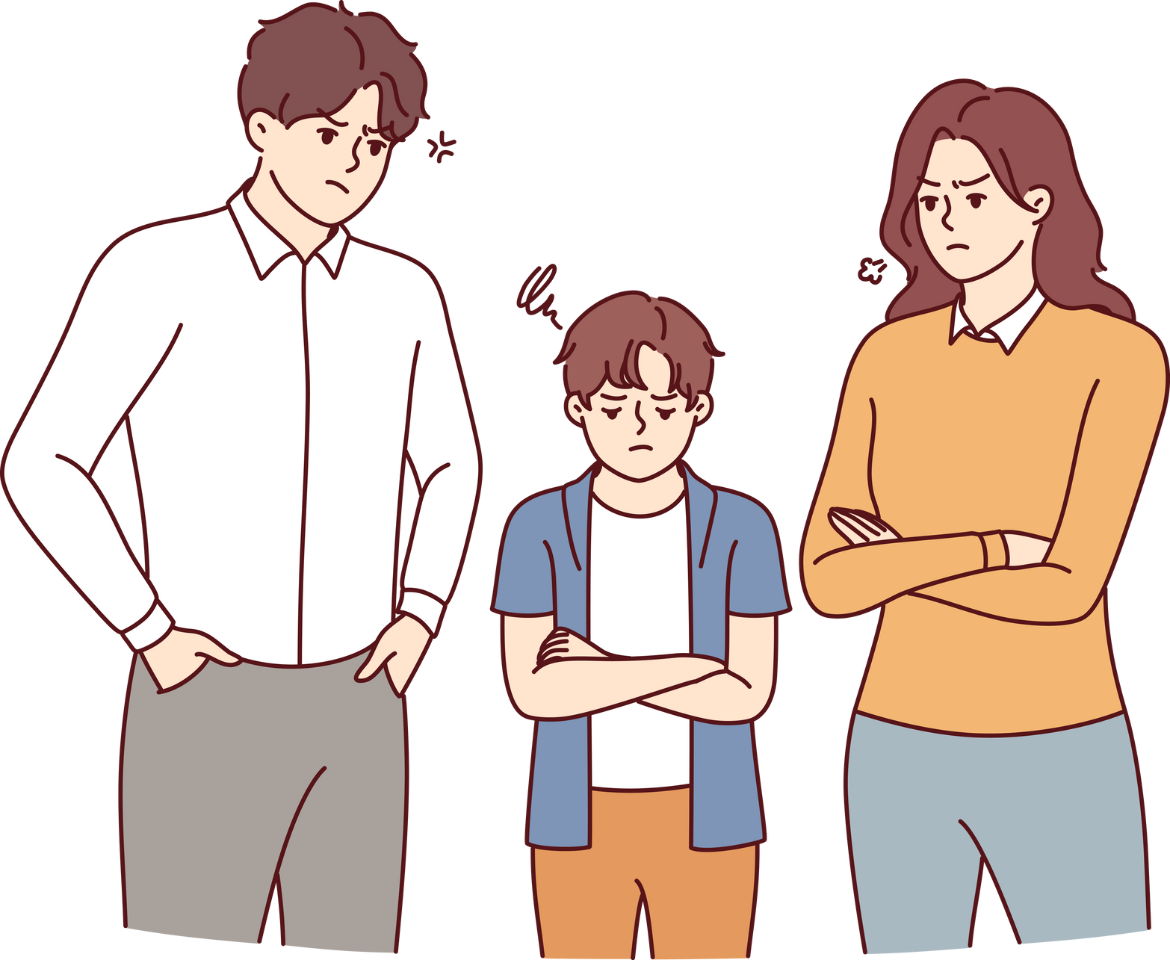
Vocabulary
Strict (adj)
/strɪkt/
nghiêm khắc

Slide 9

Vocabulary
Theme (n)
/θiːm/
chủ đề, đề tài

Slide 10
Ex 2: Read the texts and choose the correct answer A, B, C, or D.
Duong: I had a hard 10-day course in an army camp in Son Tay last summer. Everything was different from my life at home. We had to wake up at 5 a.m. and attended classes which were like training courses for soldiers. In the evening, we read books or worked in teams. The team leaders walked us through many exciting activities. We also joined a performance that had the theme: environment protection. We could only call our parents once a day.
We also had touching moments when we received letters from our parents. I have never attended such a strict but exciting course like this.

Slide 11
Ex 2: Read the texts and choose the correct answer A, B, C, or D.
Akiko: I have been on an unforgettable summer course in America.
I stayed in Thornwood campus on the outskirts of New York City for three weeks. We had an enjoyable campus tour, attended English classes, and joined team activities. We all tried to communicate in English. In the evening, we played board games and billiards. The most special experience was my visit to the top of Rockefeller Centre. From there, I could view the whole city below.
That was the first time I travelled without my parents, so I felt like I grew up a lot after the trip.

Slide 12
Ex 2: Read the texts and choose the correct answer A, B, C, or D.
1. Duong and Akiko talked about ______.
A. their English summer courses B. experiences at summer courses
C. activities in summer D. their army training
2. What didn’t Duong do during his course?
A. Get up early. B. Work as a leader.
C. Receive letters from home. D. Work in teams.
3. The word “theme” means ______.
A. performance B. environment C. activity D. topic
4. The experience at Rockefeller Centre was ______ for Akiko.
A. unforgettable B. enjoyable C. special D. touching
5. The word “that” refers to ______.
A. travelling to America B. touring the Thornwood campus
C. visiting Rockefeller Centre D. viewing the city below

Slide 13
Ex 2: Read the texts and choose the correct answer A, B, C, or D.
1. Duong and Akiko talked about ______.
A. their English summer courses B. experiences at summer courses
C. activities in summer D. their army training
Giải thích:
Duong: I had a hard 10-day course in an army camp in Son Tay last summer.
Akiko: I have been on an unforgettable summer course in America.
2. What didn’t Duong do during his course?
A. Get up early. B. Work as a leader.
C. Receive letters from home. D. Work in teams.
Giải thích:
Duong: The team leaders walked us through many exciting activities.
talked about
didn’t Duong do

Slide 14
Ex 2: Read the texts and choose the correct answer A, B, C, or D.
3. The word “theme” means ______.
A. performance B. environment C. activity D. topic
Giải thích: theme (n): chủ đề = topic: chủ đề
4. The experience at Rockefeller Centre was ______ for Akiko.
A. unforgettable B. enjoyable C. special D. touching
Giải thích: The most special experience was my visit to the top of Rockefeller Centre.
5. The word “that” refers to ______.
A. travelling to America B. touring the Thornwood campus
C. visiting Rockefeller Centre D. viewing the city below
Giải thích: That was the first time I travelled without my parents, so I felt like I grew up a lot after the trip.
Rockefeller Centre

Slide 15

Ex 3: Read the texts again and tick Duong or Akiko.
Experiences | Duong | Akiko
1. attending an English course
2. attending an army-like course
3. joining a performance
4. touring a campus
5. receiving letters from home
English course
Akiko: We had an enjoyable campus tour, attended English classes, and joined team activities.

Slide 16
Ex 3: Read the texts again and tick Duong or Akiko.
Experiences | Duong | Akiko
1. attending an English course
2. attending an army-like course
3. joining a performance
4. touring a campus
5. receiving letters from home
army-like course
Duong: We had to wake up at 5 a.m. and attended classes which were like training courses for soldiers.

Slide 17
Ex 3: Read the texts again and tick Duong or Akiko.
Experiences | Duong | Akiko
1. attending an English course
2. attending an army-like course
3. joining a performance
4. touring a campus
5. receiving letters from home
performance
Duong: We also joined a performance that had the theme: environment protection.

Slide 18
Ex 3: Read the texts again and tick Duong or Akiko.
Experiences | Duong | Akiko
1. attending an English course
2. attending an army-like course
3. joining a performance
4. touring a campus
5. receiving letters from home
touring a campus
Akiko: We had an enjoyable campus tour, attended English classes, and joined team activities.

Slide 19
Ex 3: Read the texts again and tick Duong or Akiko.
Experiences | Duong | Akiko
1. attending an English course
2. attending an army-like course
3. joining a performance
4. touring a campus
5. receiving letters from home
letters from home
Duong: We also had touching moments when we received letters from our parents.

Slide 20
02
Speaking

Slide 21
Ex 4: Match the questions in A with the answers in B. Share your answers with a classmate.
A |  | B
1. What course did you attend? |  | a. It was in June.
2. When was that? |  | b. I felt that I grew up a lot after that course.
3. What did you do? |  | c. I attended a course on soft skills with a group of young trainers.
4. What do you remember most about it? |  | d. We worked in groups on different projects. We also learned to solve problems. We had various experiences.
5. How did you feel? |  | e. I remember being so embarrassed at first. But the trainers and my peers were great and they helped me a lot.
course
attend
in June
felt that
When
attended a course on
What
you do
worked in groups
remember most
learned
had various experiences
remember being so embarrassed
you feel

Slide 22

Ex 5: Work in pairs. Ask and answer about a course you have experienced. Use the questions in 4 as cues. Then report your partner’s answers to the class.
1. What course did you attend?
2. When was that?
3. What did you do?
4. What do you remember most about it?
5. How did you feel?

Slide 23
Ex 5: Work in pairs. Ask and answer about a course you have experienced. Use the questions in 4 as cues. Then report your partner’s answers to the class.
Example:
Minh attended a memorable summer course last year. It was a presentation skill course. He learnt how to organise the talk, and how to use visual aids. He also practised using gestures, and having eye contacts with the audience. He felt that the course was so impressive and memorable.

Slide 24
Wrap-up
What have you learnt in this lesson?
Reading
Read about Duong and Akiko’s experiences in their last summer
Talk about a course you have experienced.
Speaking

Slide 25
Homework
01
02
03

Slide 26
Thanks!
Do you have any questions?

