Slide 1
UNIT 5
OUR EXPERIENCES
9th Grade
Hello!
Lesson 3: A closer look 2

Slide 2
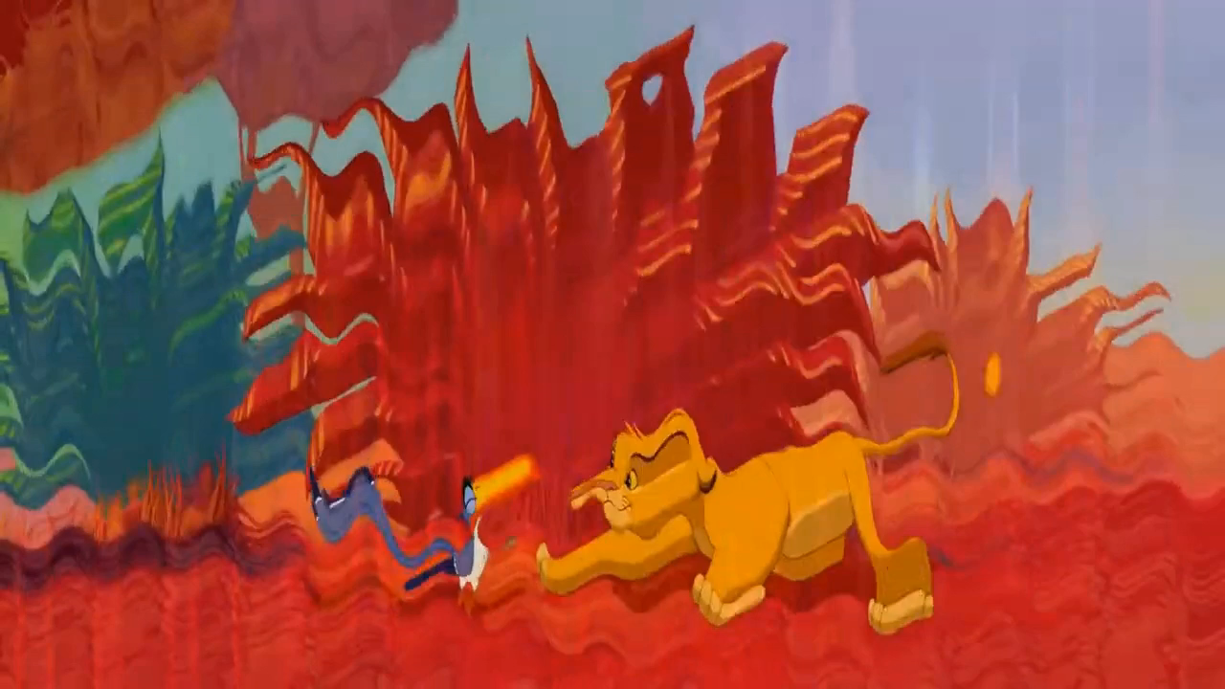
Watch and guess
What tense are we going to learn today?

Slide 3
OBJECTIVE
After this lesson, students will be able to use the present
perfect correctly

Slide 4




PRESENT PERFECT
Tom is looking for his key. He can’t find it.
He has lost his key.
= He lost it recently.
And he still doesn't have it now.
We use the present perfect to express an action which happened at an unstated time in the past and is completed in the present.
(Diễn tả một hành động đã xảy ra trong quá khứ nhưng không rõ thời điểm, để lại kết quả ở hiện tại)
NOW
Notes:
Example: He has listened to this piece of music. She has read an article about Cu Lan Village. We also use the present perfect to express our experiences. Example: I have tried skydiving. Have you ever taken an eco-tour? - No, I haven't.

Slide 5

PRESENT PERFECT
I first tried skydiving many years ago.
I tried skydiving again last month.
I have tried skydiving twice.
We also use the present perfect to express our experiences.
(Diễn tả trải nghiệm, đã từng làm gì, làm bao nhiêu lần cho đến hiện tại)
NOW

Slide 6
PRESENT PERFECT
He
has
lost
his key.
I
have
tried
skydiving twice.
(+) S
+ have/has
+ PII
He
has NOT
lost
his key.
(-) S
+ have/has NOT
+ PII
Have
you
tried
skydiving
?
(?) Have / Has
+ S
+ PII
?

Slide 7
1 (p.53) Write the correct forms of the verbs in the table.
Verbs | Past simple | Past participle
work | worked | worked
join
play
be
go
do
joined
joined
played
played
was/were
been
went
gone
did
done

Slide 8
2 (p.53) Complete the sentences with the correct forms of the verbs in the PRESENT PERFECT.
have joined
1. We (join) ___________ that project.
2. I (play) __________ a computer game at his house once.
3. She ______ never (work) ______ in such an unpleasant workplace.
4. He ______ never (be) ______ a class monitor.
5. They (go) __________ birdwatching several times.
1. HĐ bắt đầu tại 1 thời điểm trong QK và hoàn thành ở HT
have played
has
worked
HTHT have/has PII
has
been
2-5. Trải nghiệm đã từng làm trong QK
have gone

Slide 9
3 (p.53) Choose the correct answer A, B, C, or D to complete each sentence.
1. We ______ in our school’s sports competition once.
A. participate B. have participated
C. has participated D. are participating
2. Nam ______ any photos of his village for two years.
A. has not taken B. have not taken
C. does not take D. is taking
3. They ______ detective stories several times.
A. were reading B. read C. has read D. have read
4. I ______ never ______ that film before.
A. did; watched B. has; watched
C. have; watched D. was; watching
5. She ______ her cousin since she left school.
A. haven’t met B. doesn’t meet C. hasn’t met D. didn’t meet
1. We ______ in our school’s sports competition once.
A. participate B. have participated
C. has participated D. are participating
2. Nam ______ any photos of his village for two years.
A. has not taken B. have not taken
C. does not take D. is taking
3. They ______ detective stories several times.
A. were reading B. read C. has read D. have read
4. I ______ never ______ that film before.
A. did; watched B. has; watched
C. have; watched D. was; watching
5. She ______ her cousin since she left school.
A. haven’t met B. doesn’t meet C. hasn’t met D. didn’t meet
HTHT have/has PII

Slide 10

4 (p.53) Write sentences about Mai’s experiences, using the information in the table.
Experiences | Mai
0. visit a village of an ethnic group | ✗
1. climb a mountain | ✗
2. See an elephant | ✓
3. Join a tribal dance | ✗
4. Take a photo of a forest | ✗
5. Go on an eco-tour | ✓
Example:
Mai hasn’t visited a village of an ethnic group.

Slide 11
4 (p.53) Write sentences about Mai’s experiences, using the information in the table.
Experiences | Mai
0. visit a village of an ethnic group | ✗
1. climb a mountain | ✗
2. see an elephant | ✓
3. join a tribal dance | ✗
4. take a photo of a forest | ✗
5. go on an eco-tour | ✓
1. Mai hasn’t climbed a mountain.
2. Mai has seen an elephant.
3. Mai hasn’t joined a tribal dance.
4. Mai has taken a photo of the forest.
5. Mai has gone on an eco-tour.

Slide 12
5 (p.53) Work in pairs.
Ask and answer questions about your experiences using the present perfect
Yes, I have. / No, I haven’t.
Have you visited a village of an ethnic group?

Slide 13
“HAVE YOU EVER …?” BINGO
There is a list of about 20 irregular verbs (infinitive forms) on the board.
Choose and write 9 verbs in PII on your BINGO card
Work in whole class. Ask and answer
Have you ever …?
Student who get a cross first will be winner
Yes, I do
Notes:
https://www.teachingenglish.org.uk/teaching-resources/teaching-secondary/activities/intermediate-b1/have-you-ever

Slide 14
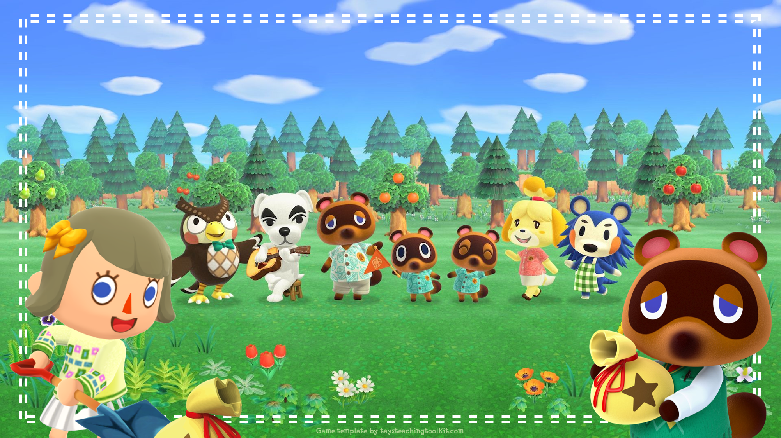

Notes:
This template is for educational, non-commercial purposes only. For more free game templates like this one, visit https://www.taysteachingtoolkit.com
------
Game adapted from ”Rabbit Hole” by Adam Zero https://adamzero.wixsite.com/main

Slide 15
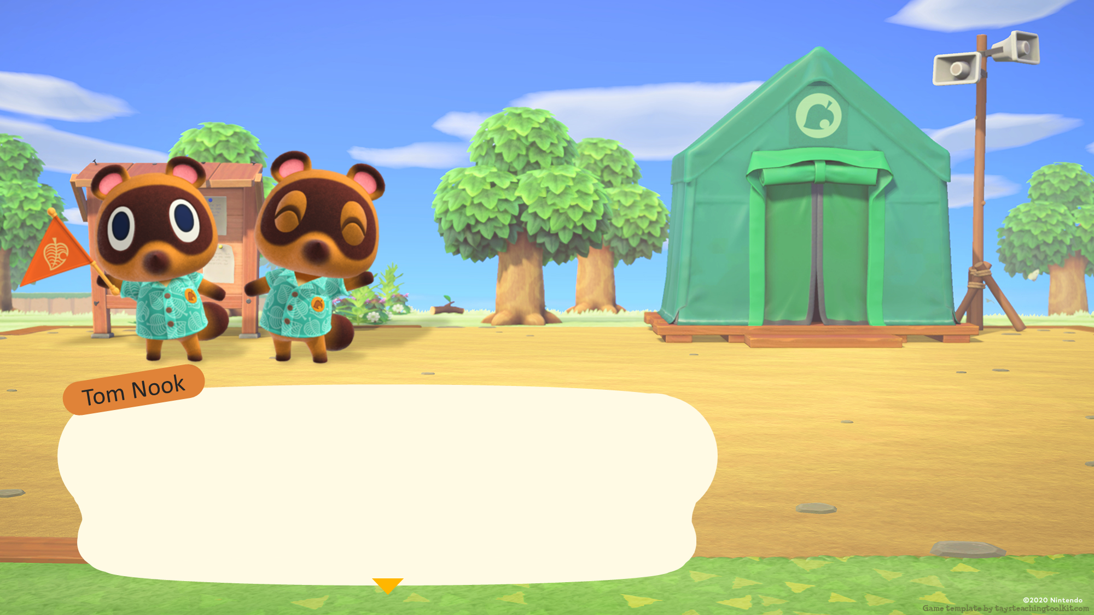
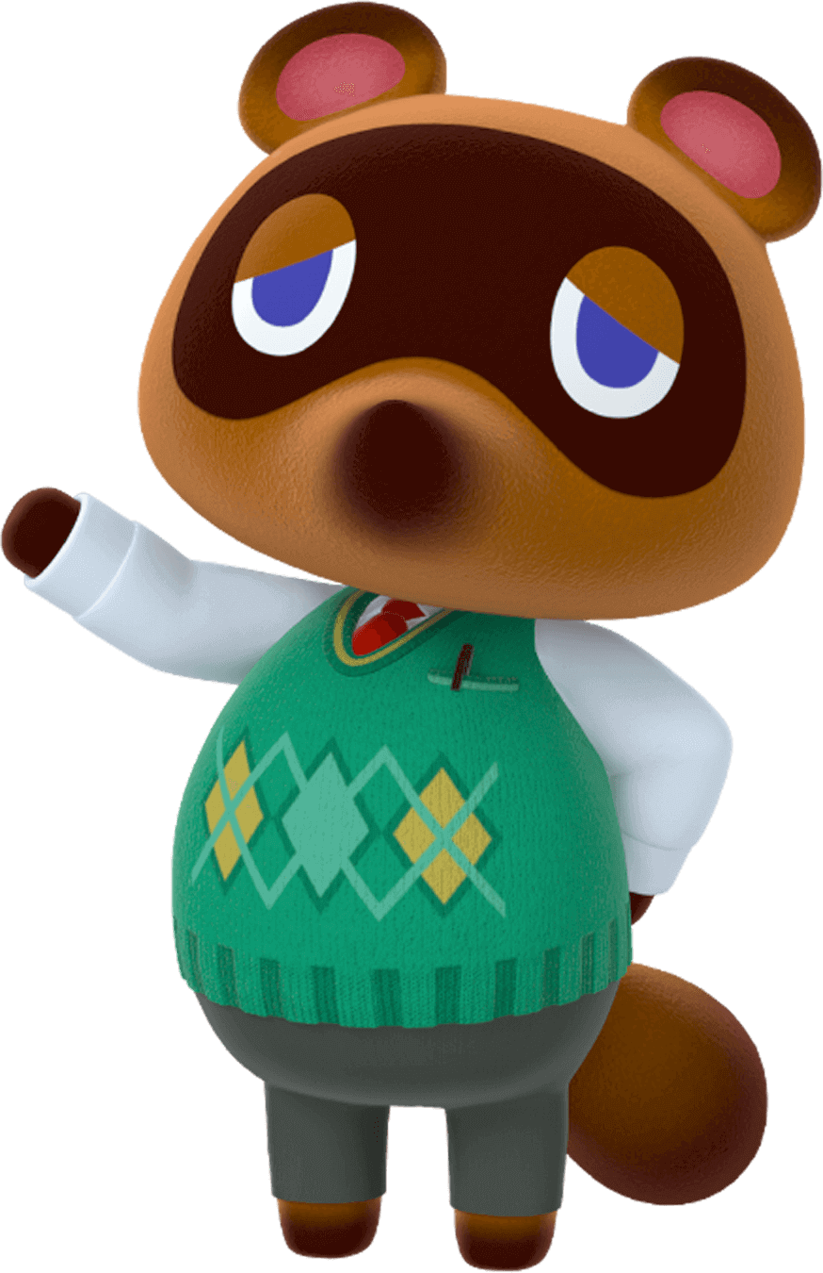
Welcome, everyone. Welcome to the game, Buried Bells. We are excited to have you here.
Notes:
TEACHER’S NOTES:
Before the game starts, split your class into teams. The amount of students that are on each team is up to you. Students can also play in pairs or individually depending on how many students you have.

Slide 16
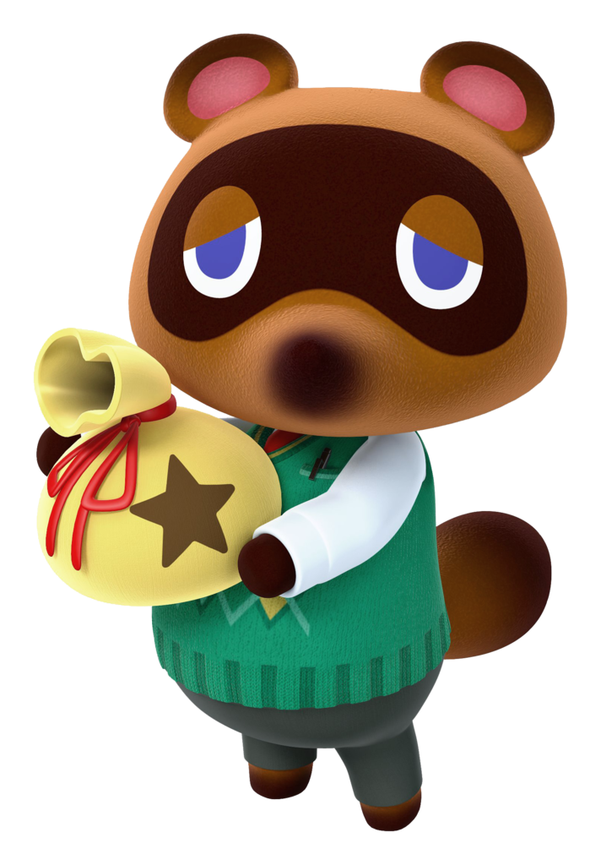
Bell bags are buried on this island. See if you can find them!

Slide 17
But…first things first. Yes, yes! Let me tell you how to play the game.

Slide 18
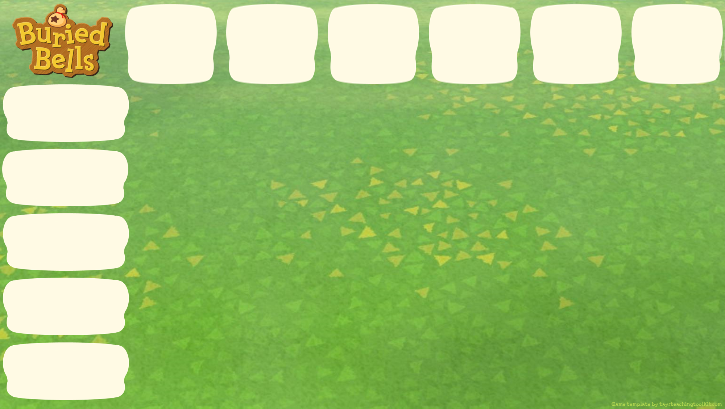



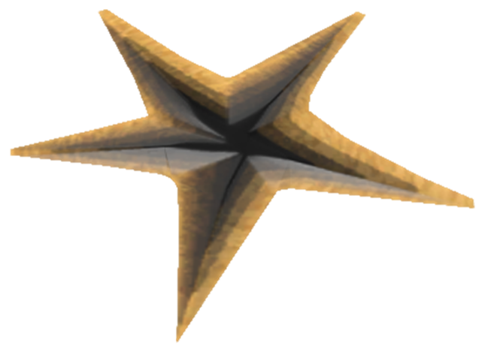

A
B
C
D
E
F
climb a mountain
see an elephant
Say a sentence to choose a crack in the ground.
join a tribal dance
take a photo of a forest
go on an eco-tour
Notes:
TEACHER’S NOTES:
HS chọn ô và hàng để tạo thành 1 câu hoàn chỉnh sửu dụng thì HTHT
Note, the current text and images on the signs are just an example. Replace them with the target language or vocabulary you will use in the game.

Slide 19

A
B
C
D
E
F
climb a mountain
see an elephant
join a tribal dance
“Mai hasn’t seen an elephant.”
take a photo of a forest
go on an eco-tour
Notes:
TEACHER’S NOTES:
Ví dụ: con chọn 2C, thì câu cần viết sẽ là “Mai hasn’t seen an elephant.”
Note, the current text and images on the signs are just an example. Replace them with the target language or vocabulary you will use in the game.

Slide 20

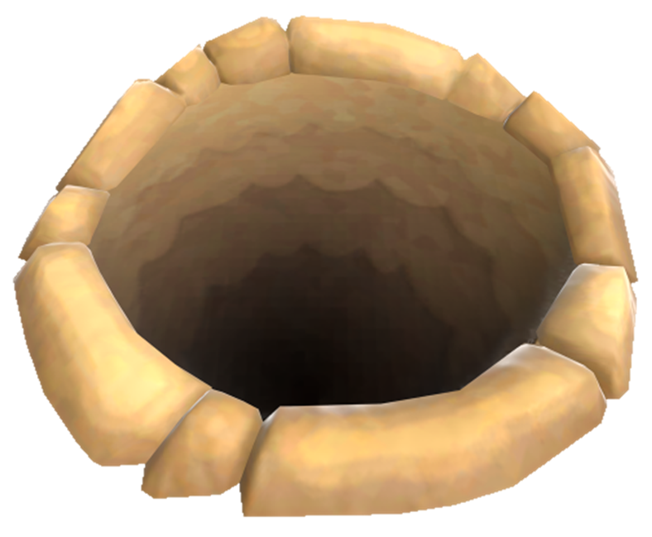

A
B
C
D
E
F
climb a mountain
see an elephant
join a tribal dance
take a photo of a forest
Oops! Looks like you didn’t find the bell bag.
go on an eco-tour
Notes:
TEACHER’S NOTES:
Sau khi đặt câu đúng thì con sẽ được đào cái hố lên. Ví dụ, chiếc hố này không chôn cái túi nào cả, nhưng nó lại có chứa gợi ý để dẫn đến túi vàng.
Số 2 ở đây, là cái túi đang ở cách hố này HAI HÀNG
Note, the current text and images on the signs are just an example. Replace them with the target language or vocabulary you will use in the game.

Slide 21
A
B
C
D
E
F
climb a mountain
see an elephant
join a tribal dance
take a photo of a forest
But! The number is a hint.
go on an eco-tour
Notes:
TEACHER’S NOTES:
Sau khi đặt câu đúng thì con sẽ được đào cái hố lên. Ví dụ, chiếc hố này không chôn cái túi nào cả, nhưng nó lại có chứa gợi ý để dẫn đến túi vàng.
Note, the current text and images on the signs are just an example. Replace them with the target language or vocabulary you will use in the game.

Slide 22
A
B
C
D
E
F
climb a mountain
see an elephant
join a tribal dance
take a photo of a forest
The bell bag is 2
spaces away.
go on an eco-tour
Notes:
TEACHER’S NOTES:
Sau khi đặt câu đúng thì con sẽ được đào cái hố lên. Ví dụ, chiếc hố này không chôn cái túi nào cả, nhưng nó lại có chứa gợi ý để dẫn đến túi vàng.
Số 2 ở đây, là cái túi đang ở HÀNG SỐ 2 kể từ cái hố này
Note, the current text and images on the signs are just an example. Replace them with the target language or vocabulary you will use in the game.

Slide 23
A
B
C
D
E
F
climb a mountain
2
1
1
1
2
3
see an elephant
2
1
1
2
3
join a tribal dance
2
1
1
1
2
3
take a photo of a forest
2
2
2
2
2
3
go on an eco-tour
3
3
3
3
3
3
Notes:
TEACHER’S NOTES:
Sau khi đặt câu đúng thì con sẽ được đào cái hố lên. Ví dụ, chiếc hố này không chôn cái túi nào cả, nhưng nó lại có chứa gợi ý để dẫn đến túi vàng.
Số 2 ở đây, là cái túi đang ở HÀNG SỐ 2 kể từ cái hố này
Đây là cách tính hàng, 1,2,3
Note, the current text and images on the signs are just an example. Replace them with the target language or vocabulary you will use in the game.

Slide 24
A
B
C
D
E
F
climb a mountain
2
2
see an elephant
2
2
join a tribal dance
2
2
take a photo of a forest
2
2
2
2
2
go on an eco-tour
Notes:
TEACHER’S NOTES:
Sau khi đặt câu đúng thì con sẽ được đào cái hố lên. Ví dụ, chiếc hố này không chôn cái túi nào cả, nhưng nó lại có chứa gợi ý để dẫn đến túi vàng.
Số 2 ở đây, là cái túi đang ở HÀNG SỐ 2 kể từ cái hố này
Vây là túi vàng đang ở các hố được đánh số 2
Note, the current text and images on the signs are just an example. Replace them with the target language or vocabulary you will use in the game.

Slide 25
A
B
C
D
E
F
climb a mountain
see an elephant
join a tribal dance
take a photo of a forest
Let’s try again.
go on an eco-tour
Notes:
TEACHER’S NOTES:
Sau khi xác định được hàng, HS được lựa chọn tiếp để tìm ra hố chứa vàng
Note, the current text and images on the signs are just an example. Replace them with the target language or vocabulary you will use in the game.

Slide 26
A
B
C
D
E
F
climb a mountain
see an elephant
join a tribal dance
take a photo of a forest
go on an eco-tour
Notes:
TEACHER’S NOTES:
Have students try to come up with the sentence without the prompts before you dig.
Note, the current text and images on the signs are just an example. Replace them with the target language or vocabulary you will use in the game.

Slide 27

A
B
C
D
E
F
climb a mountain
see an elephant
Oh no! Now the
bell bag is 3 or more spaces away!
join a tribal dance
take a photo of a forest
go on an eco-tour
Notes:
TEACHER’S NOTES:
Note, the current text and images on the signs are just an example. Replace them with the target language or vocabulary you will use in the game.

Slide 28
A
B
C
D
E
F
climb a mountain
3
3
see an elephant
3
2
join a tribal dance
3
1
take a photo of a forest
3
2
1
1
go on an eco-tour
Notes:
TEACHER’S NOTES:
Note, the current text and images on the signs are just an example. Replace them with the target language or vocabulary you will use in the game.

Slide 29
A
B
C
D
E
F
climb a mountain
3
3
see an elephant
3
join a tribal dance
3
take a photo of a forest
3
go on an eco-tour
Notes:
TEACHER’S NOTES:
Note, the current text and images on the signs are just an example. Replace them with the target language or vocabulary you will use in the game.

Slide 30
A
B
C
D
E
F
climb a mountain
see an elephant
join a tribal dance
Let’s dig here!
take a photo of a forest
go on an eco-tour
Notes:
TEACHER’S NOTES:
Have students try to come up with the sentence without the prompts before you dig.
Note, the current text and images on the signs are just an example. Replace them with the target language or vocabulary you will use in the game.

Slide 31

A
B
C
D
E
F
climb a mountain
see an elephant
join a tribal dance
take a photo of a forest
go on an eco-tour
Notes:
TEACHER’S NOTES:
Note, the current text and images on the signs are just an example. Replace them with the target language or vocabulary you will use in the game.

Slide 32
A
B
C
D
E
F
climb a mountain
see an elephant
So close! The bell bag is only 1 space away. Where is it?
join a tribal dance
take a photo of a forest
go on an eco-tour
Notes:
TEACHER’S NOTES:
Note, the current text and images on the signs are just an example. Replace them with the target language or vocabulary you will use in the game.

Slide 33
A
B
C
D
E
F
climb a mountain
see an elephant
join a tribal dance
take a photo of a forest
go on an eco-tour
Notes:
TEACHER’S NOTES:
Before you reveal the yellow box, see if students can come up with the answer on their own and then have them make a sentence.
Note, the current text and images on the signs are just an example. Replace them with the target language or vocabulary you will use in the game.

Slide 34
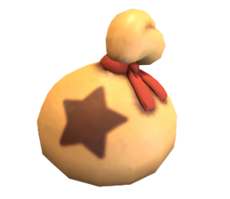

A
B
C
D
E
F
climb a mountain
see an elephant
join a tribal dance
Great job! You found the bell bag!
take a photo of a forest
go on an eco-tour
Notes:
TEACHER’S NOTES:
Note, the current text and images on the signs are just an example. Replace them with the target language or vocabulary you will use in the game.

Slide 35
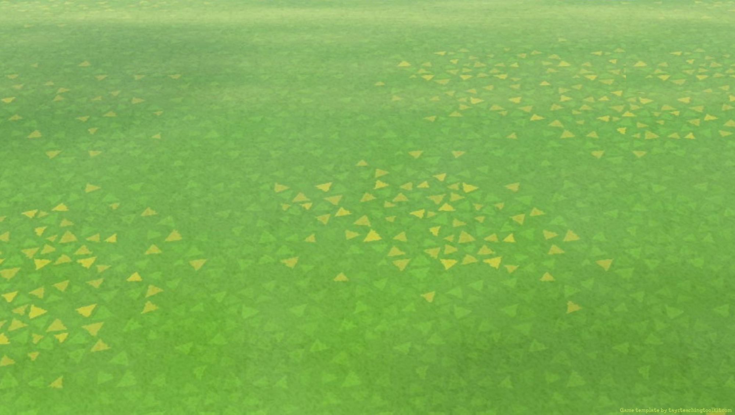
There are 3 types of
special signs:

Slide 36
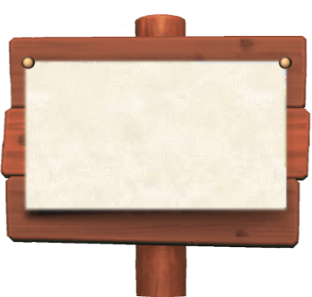




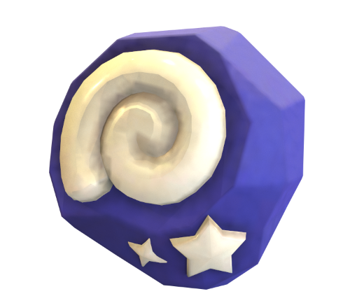
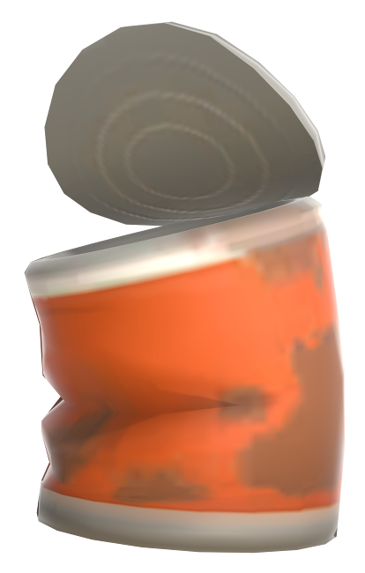

Watch out for special objects!
1
3+
1 space away & choose again
3+ spaces away & lose
a turn
Your team gets 1 point!
Notes:
TEACHER’S NOTES:
These are in addition to the regular 1, 2, and 3+ signs.

Slide 37
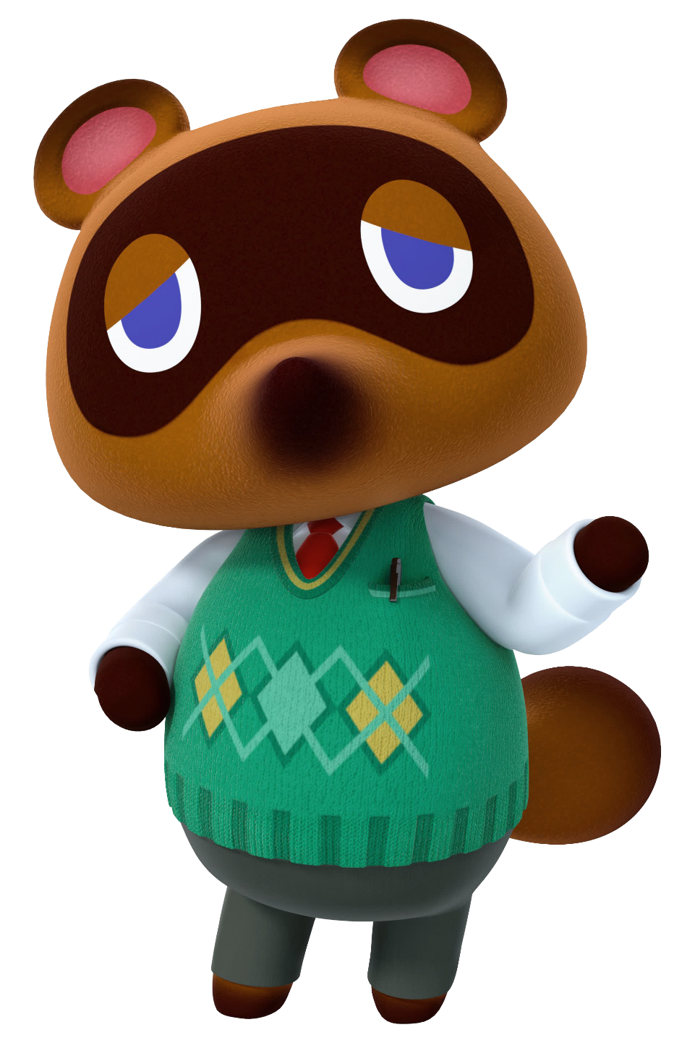
Now, is that everything…Yes, yes, I believe it is! Let’s get started with the game!

Slide 38

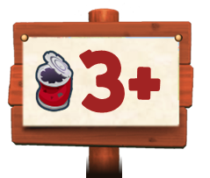




A
B
C
D
E
F
climb a mountain
see an elephant
join a tribal dance
take a photo of a forest
go on an eco-tour
Notes:
TEACHER’S NOTES:
Replace the default text with the target language or vocabulary from your own classes (can be text or images).
After you insert the top row of text/images make sure you send them to the back (under the arrange menu) so they are behind the top row of signs.
After a student/pair/team chooses a crack, click on it to dig.
There are 30 game boards total for each of the 30 holes the bell bag can be in. So, if playing the game more than once with the same students, all you have to do is rearrange the game boards.

Slide 39

Text/
Image
Text/
Image
Text/
Image
Text/
Image
Text/
Image
Text/
Image
Text/Image
Text/Image
Text/Image
Text/Image
Text/Image
Notes:
TEACHER’S NOTES:
Replace the default text with the target language or vocabulary from your own classes (can be text or images).
After you insert the top row of text/images make sure you send them to the back (under the arrange menu) so they are behind the top row of signs.
After a student/pair/team chooses a crack, click on it to dig.
There are 30 game boards total for each of the 30 holes the bell bag can be in. So, if playing the game more than once with the same students, all you have to do is rearrange the game boards.

Slide 40
Text/
Image
Text/
Image
Text/
Image
Text/
Image
Text/
Image
Text/
Image
Text/Image
Text/Image
Text/Image
Text/Image
Text/Image
Notes:
TEACHER’S NOTES:
Replace the default text with the target language or vocabulary from your own classes (can be text or images).
After you insert the top row of text/images make sure you send them to the back (under the arrange menu) so they are behind the top row of signs.
After a student/pair/team chooses a crack, click on it to dig.
There are 30 game boards total for each of the 30 holes the bell bag can be in. So, if playing the game more than once with the same students, all you have to do is rearrange the game boards.

Slide 41
WRAP UP
After this lesson, students have been able to use the present perfect correctly
I’ve been

Slide 42
Thanks for your attention!
Thank you!

