Slide 1
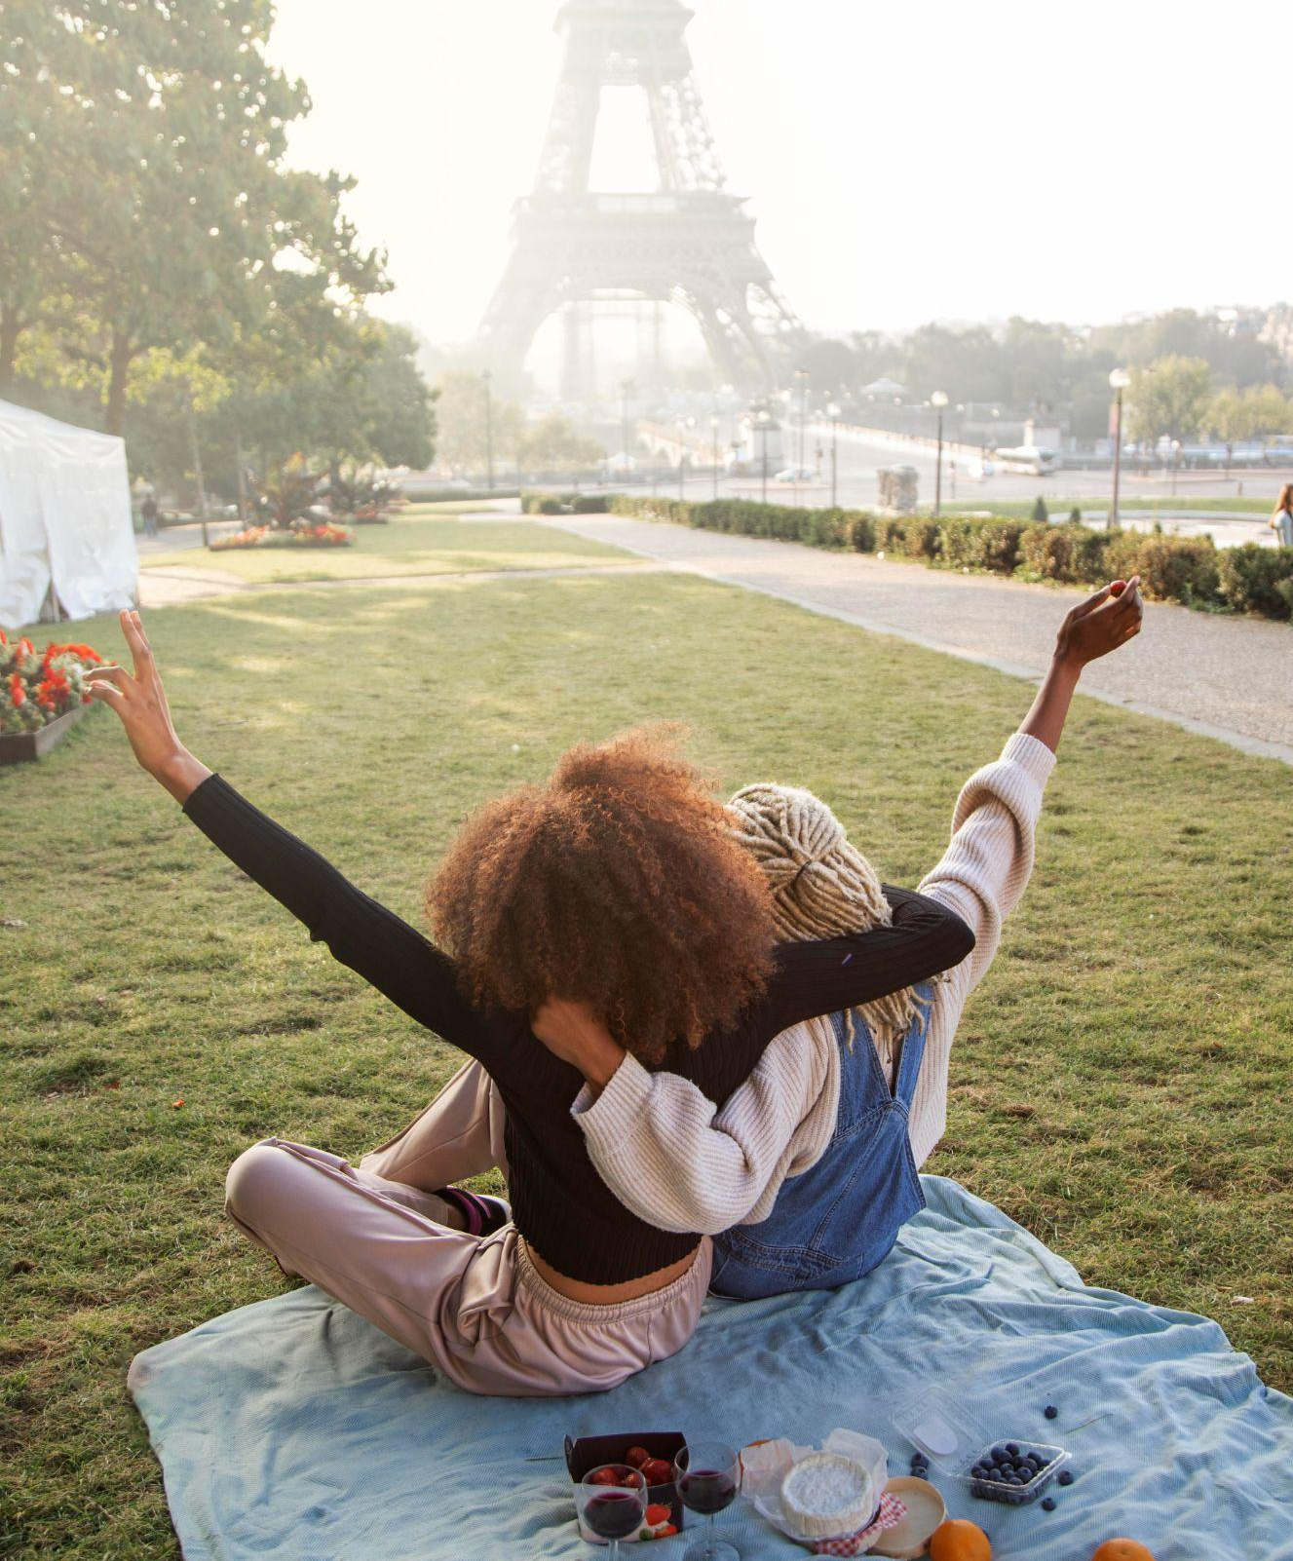

UNIT 5
OUR EXPERIENCES
9th Grade
Lesson 2: A closer look 1

Slide 2



OBJECTIVES
01
02
After this lesson, students will be able to
LANGUAGE
PRONUNCATION
use the words related to experiences and adjectives describing experiences
pronounce the sounds /j/ and /w/ correctly in words and sentences;

Slide 3


01
Language
use the words related to experiences and adjectives describing experiences

Slide 4
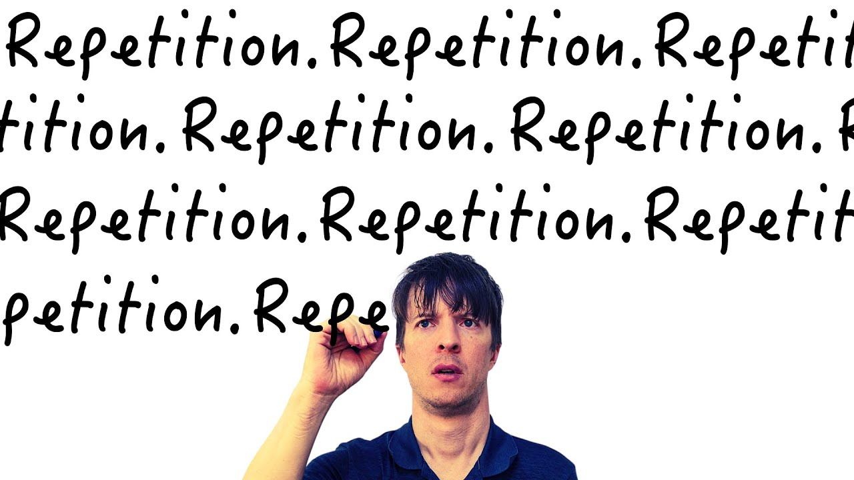

Language
learning by rote (phr)
/ˈlɜːnɪŋ baɪ rəʊt/
học đi học lại

Slide 5

Language
campus (n)
/ˈkæmpəs/
khuôn viên
trường học

Slide 6

Language
snorkelling (n)
/ˈsnɔːkəlɪŋ/
lặn với ống thở

Slide 7
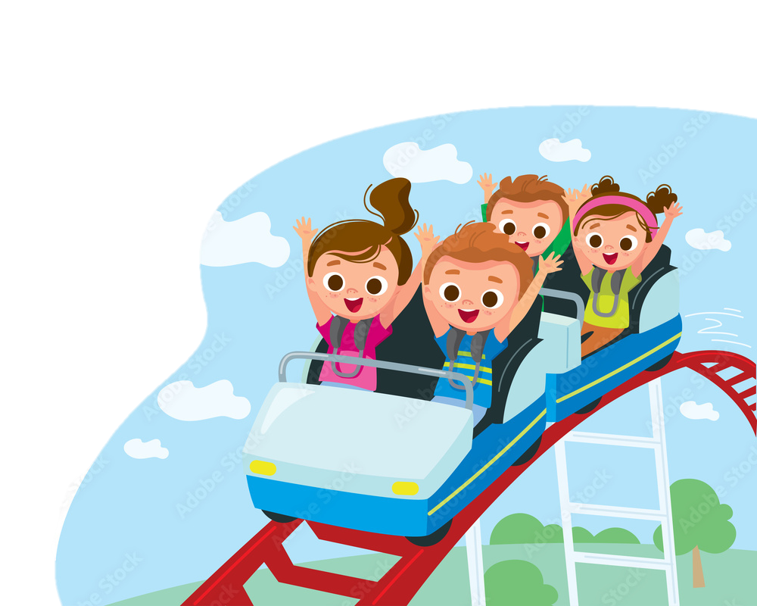
Language
exhilarating (adj)
/ɪɡˈzɪləreɪtɪŋ/
đầy phấn khích

Slide 8
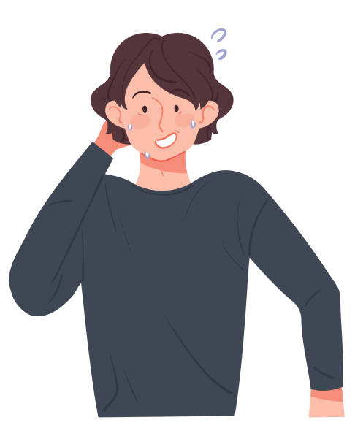
Language
embarrassing
(adj)
/ɪmˈbærəsɪŋ/
làm ai bối rối, ngượng ngùng.

Slide 9
New words | Pronunciation | Meaning
1. learning by rote (phr) | /ˈlɜːnɪŋ baɪ rəʊt/ | học thuộc lòng
2. campus (n) | /ˈkæmpəs/ | khuôn viên trường học
3. snorkelling (n) | /ˈsnɔːkəlɪŋ/ | lặn với ống thở
5. exhilarating (adj) | /ɪɡˈzɪləreɪtɪŋ/ | đầy phấn khích
6. embarrassing (adj) | /ɪmˈbærəsɪŋ/ | làm ai bối rối, ngượng ngùng.

Slide 10
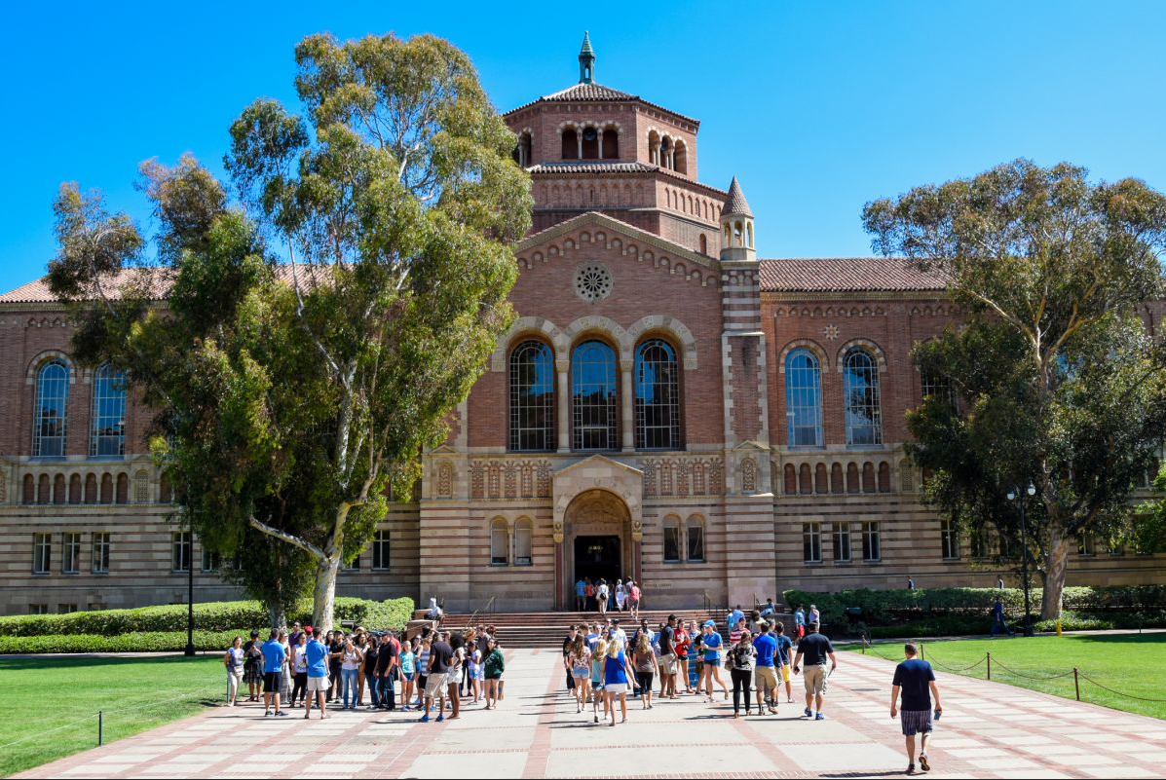
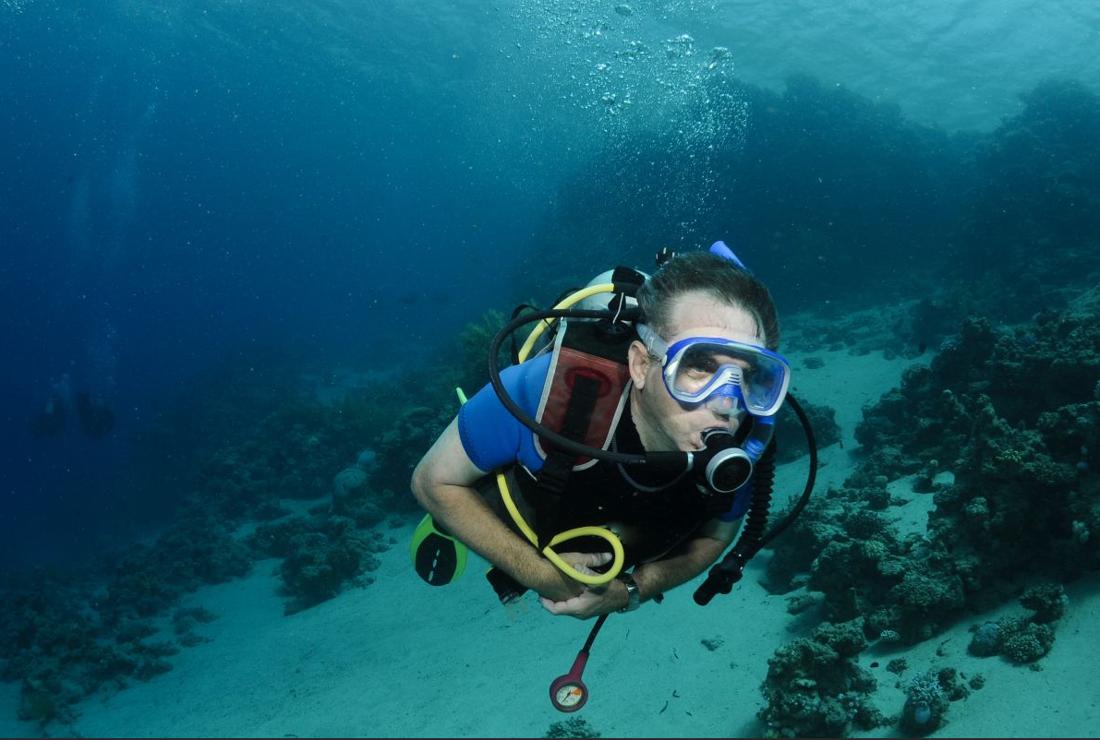
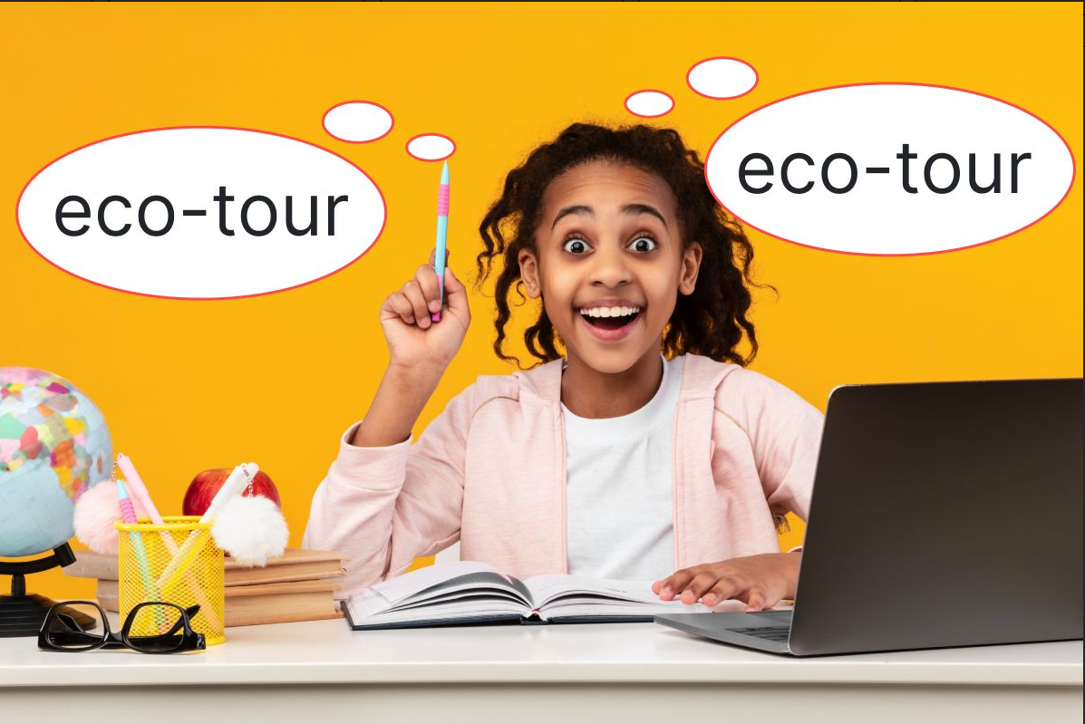
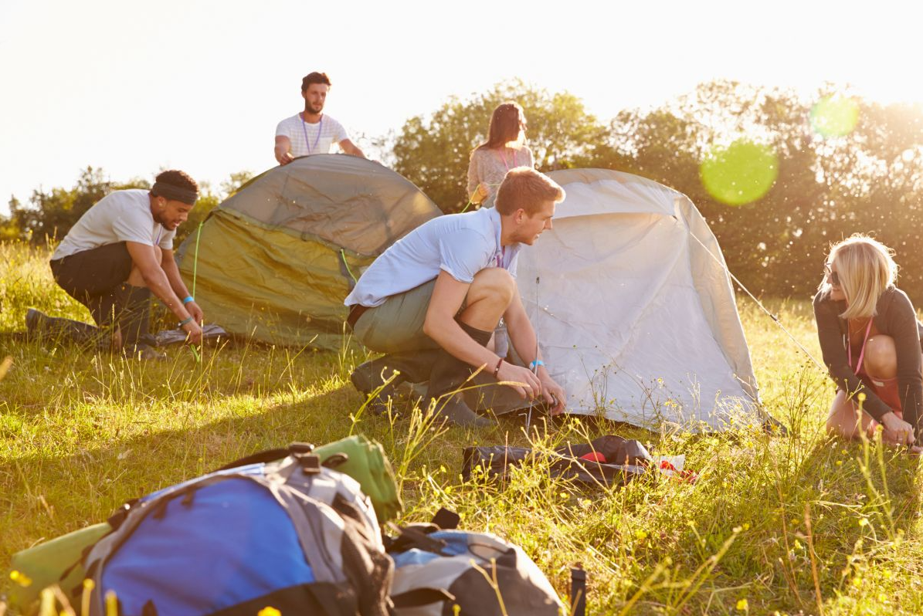
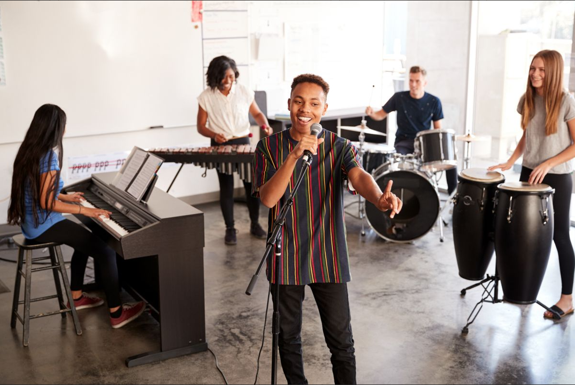
1 (p.52) Write an activity next to each picture.
learning by rote touring a campus giving a performance putting up tents going snorkelling
touring a campus
going snorkelling
learning by rote
1. _________________
2. _________________
3. _________________
touring a campus
giving a performance
4. _________________
5. _________________

Slide 11
2 (p.52) Complete each sentence with an adjective in the box.
amazing exhilarating unpleasant helpless embarrassing
1. He felt ______________ when he couldn’t protect himself from bullying.
2. The parachute jump was a(n) ______________ experience for the boy. He was so excited.
3. It was so ______________ to view the mountain range from the distance.
4. I had a(n) _________________ experience when I took her bag by mistake.
5. The Tom had a(n) ______________ experience putting up a tent in the rain.
1. He felt ______________ when he couldn’t protect himself from bullying.
2. The parachute jump was a(n) ______________ experience for the boy. He was so excited.
3. It was so ______________ to view the mountain range from the distance.
4. I had a(n) ______________ experience when I took her bag by mistake.
5. The Tom had a(n) ______________ experience putting up a tent in the rain.
helpless
helpless: vô dụng
exhilarating
exhilarating: đầy phấn khích
amazing
amazing: tuyệt vời
embarrassing
embarrassing: ngượng ngùng
unpleasant
unpleasant: không vui vẻ, không hài lòng

Slide 12
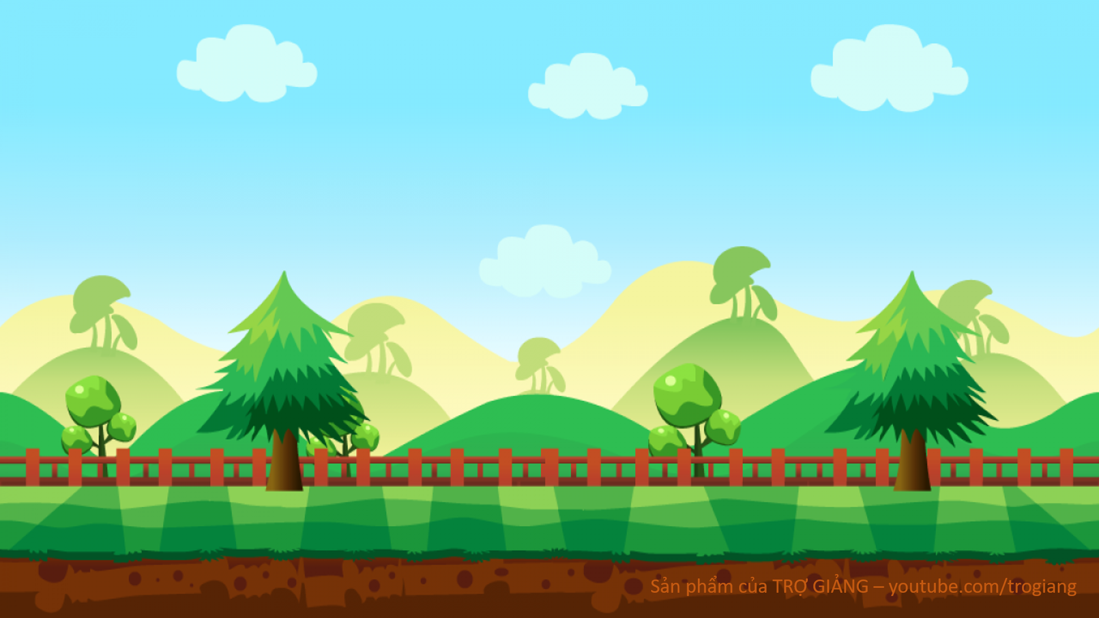



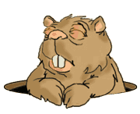

GOLD MINER
START

Slide 13
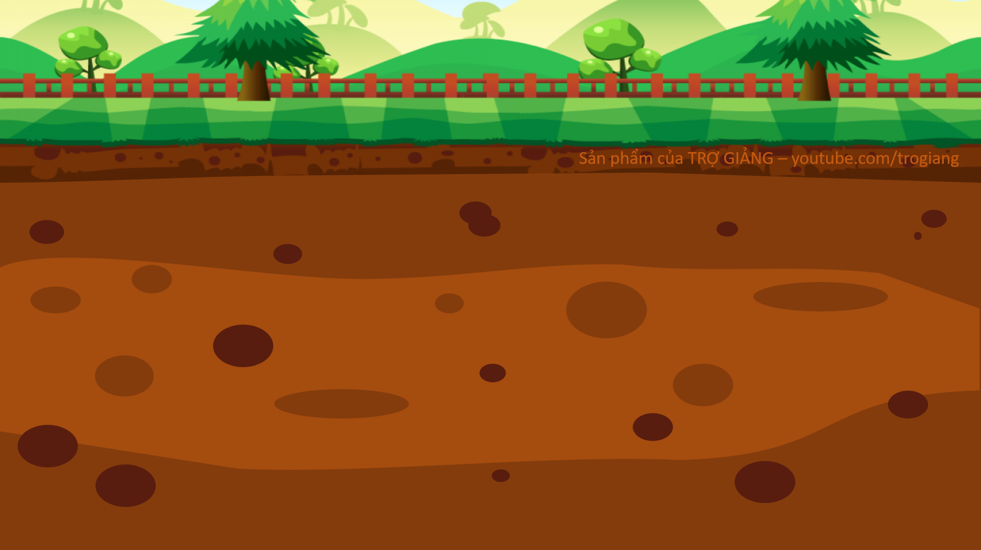
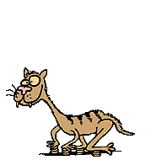





100$
150$
50$
20$
10$
100$
10$
150$
50$
20$

Slide 14
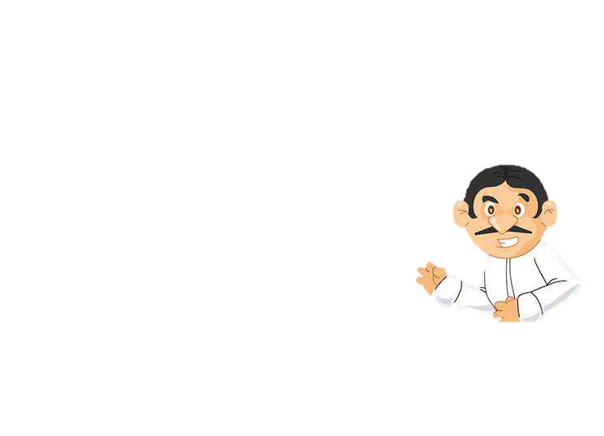
His mind ______ when I asked him how to do the homework.
A. went blank
B. went empty
C. became exhausted
D. put up

Slide 15
Students could see the university’s facilities when they ______.
A. took an excursion
B. toured the campus
C. gave a performance
D. took an eco-tour

Slide 16
Snorkelling in the coral reef is a(n) ______.
A. touching moment
B. happy time
C. exciting experience
D. embarrassing moment

Slide 17
4. Nam and his friends felt ______ when they couldn’t put up a tent by themselves.
A. pleasant
B. embarrassing
C. embarrassed
D. pleased

Slide 18
I didn’t understand the lesson.
I learnt it ______.
A. on purpose
B. by chance
C. with memory
D. by rote

Slide 19

02
Prnonunciation
pronounce the sounds /j/ and /w/ correctly in words and sentences;

Slide 20

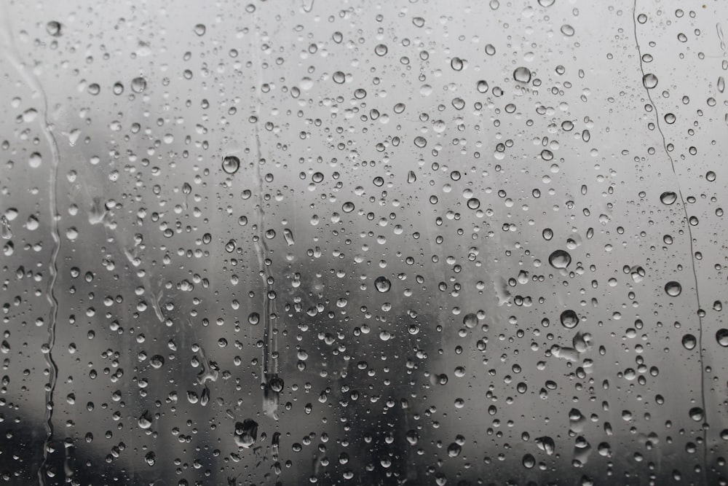
Listen and fill in the blank
___ es
w
y
___ et
/jes/
/wet/

Slide 21

/j/ and /w/

Slide 22
4 (p.52) Listen and repeat the words. Pay attention to the sounds /j/ and /w/.
/j/ | /w/
yellow yesterday yahoo yogurt yield | watching sandwich highway crossword forward

Slide 23
5 (p.52) Listen to the sentences. Underline the words with /j/ and circle the words with /w/. Practise the sentences.
He tried sailing a yacht, and he did it well.
We’ve made a class yearbook. It looks wonderful.
They awarded him a gold medal yesterday.
Youngsters should be aware of their responsibilities.
5. They haven’t yet understood the role of wildlife.

Slide 24
WRAP UP
Choose the correct options
After this lesson, students have been able to
words related to experiences
adjectives describing personality
words related to travel
stress
adjectives describing experiences
the sounds /j/ and /w/
words related to experiences
adjectives describing experiences
the sounds /j/ and /w/

Slide 25




Thanks for your attention!

