Slide 1
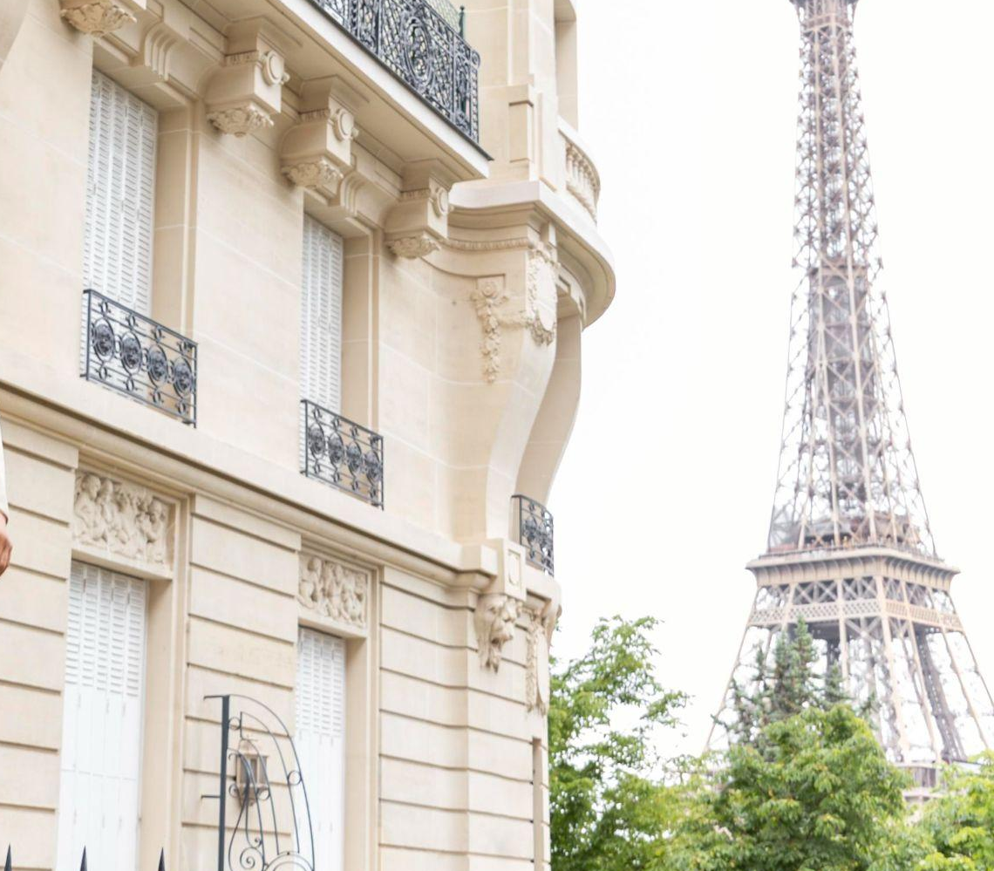
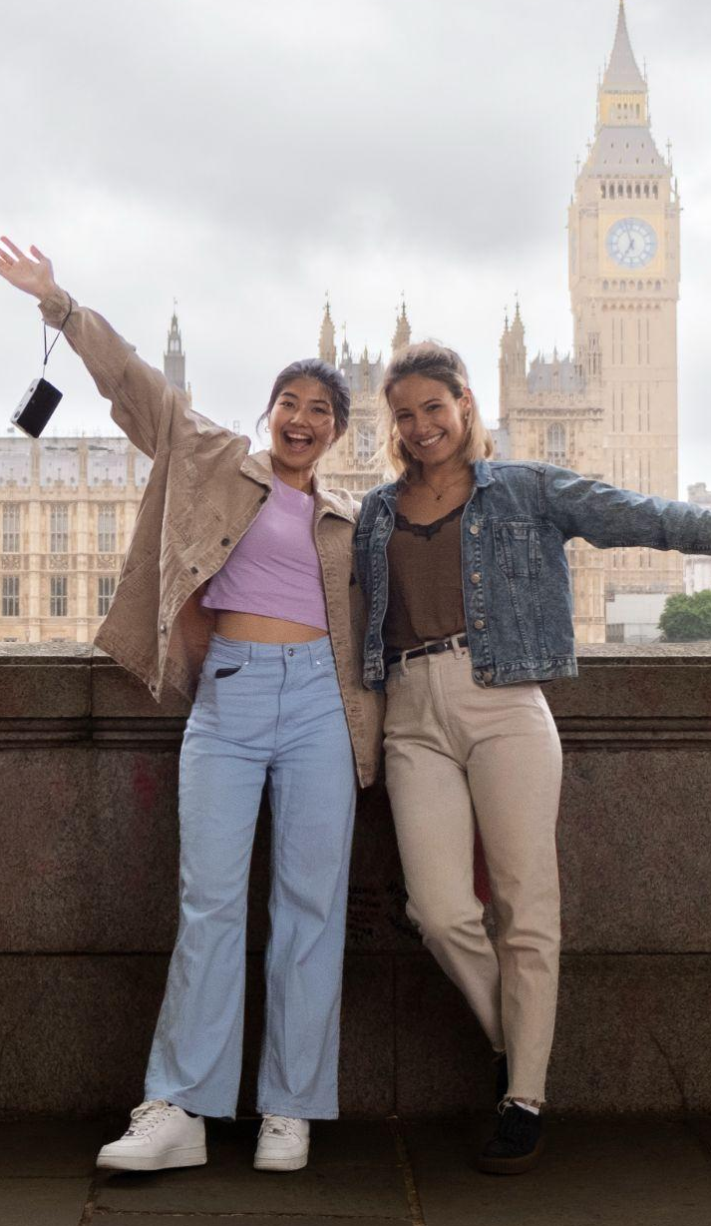
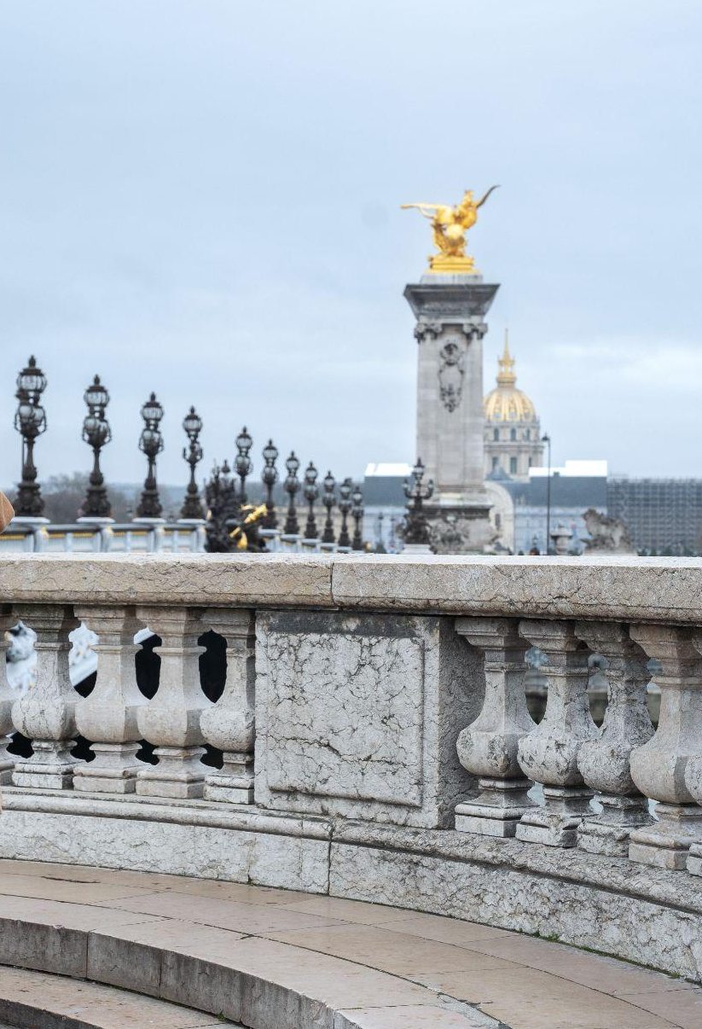
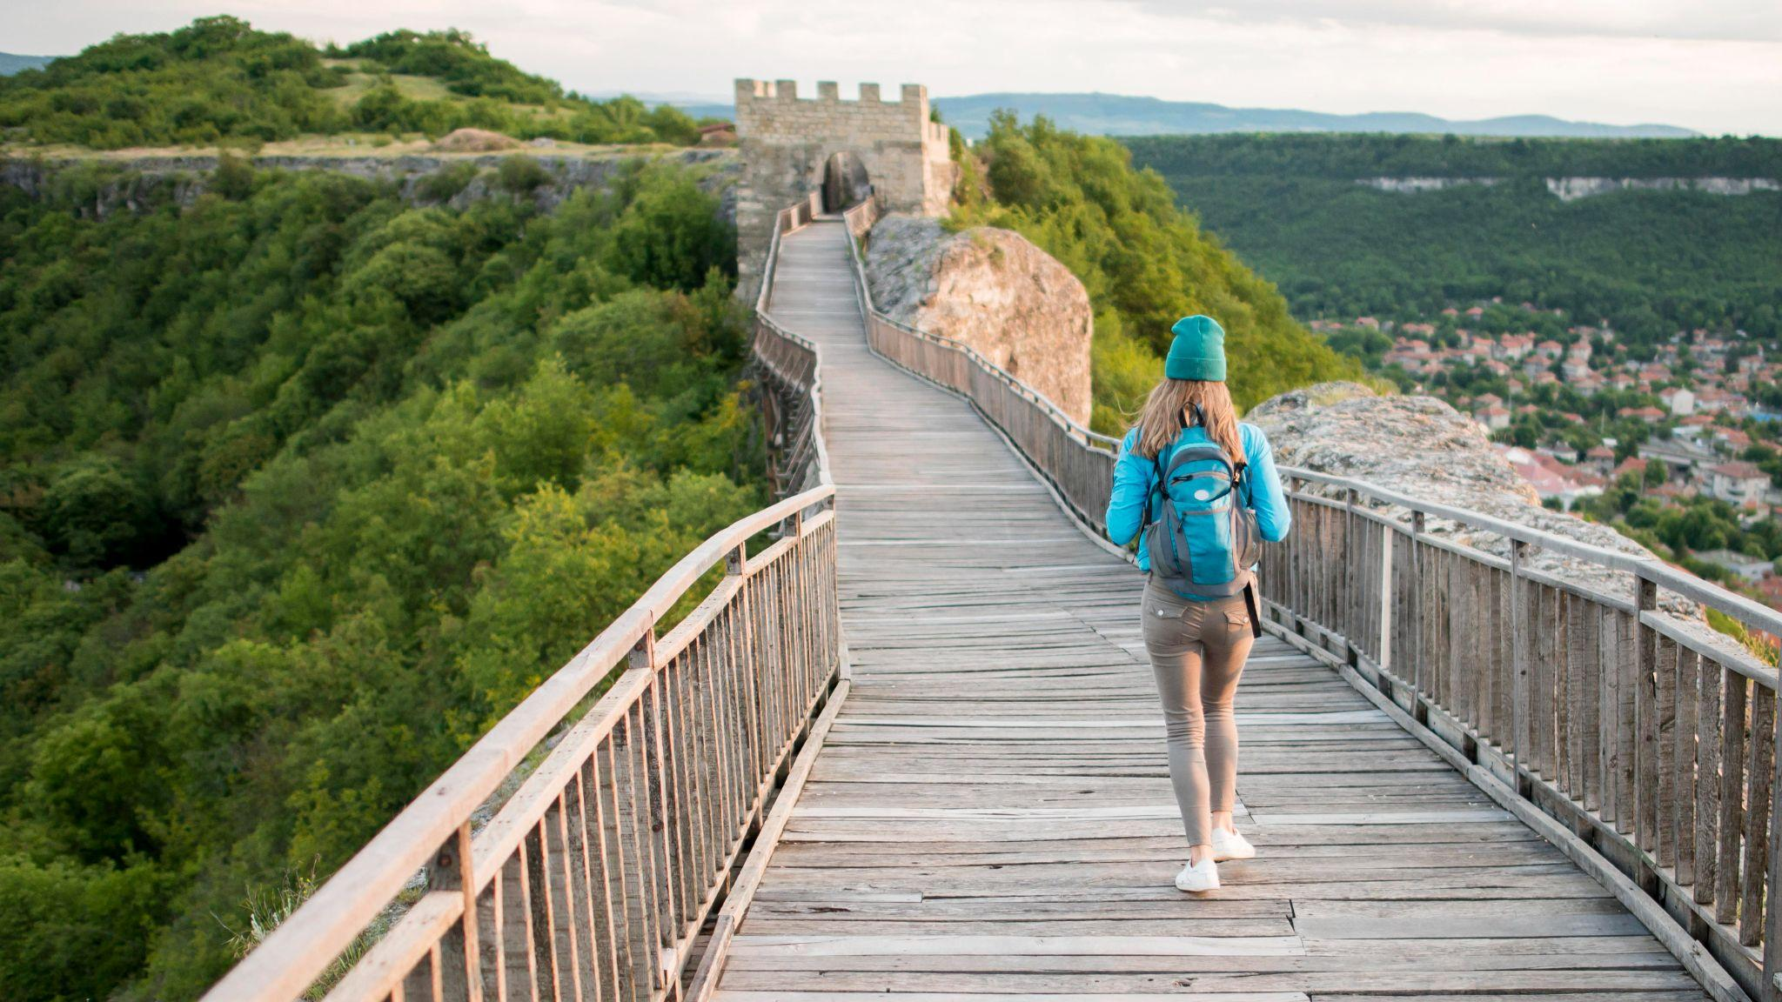
UNIT 5
OUR EXPERIENCES
Lesson 1: Getting stated

Slide 2
OBJECTIVES
01
02
After this lesson, students will be able to
Have an overview about the topic
OUR EXPERIENCES
use lexical items related to
OUR EXPERIENCES

Slide 3
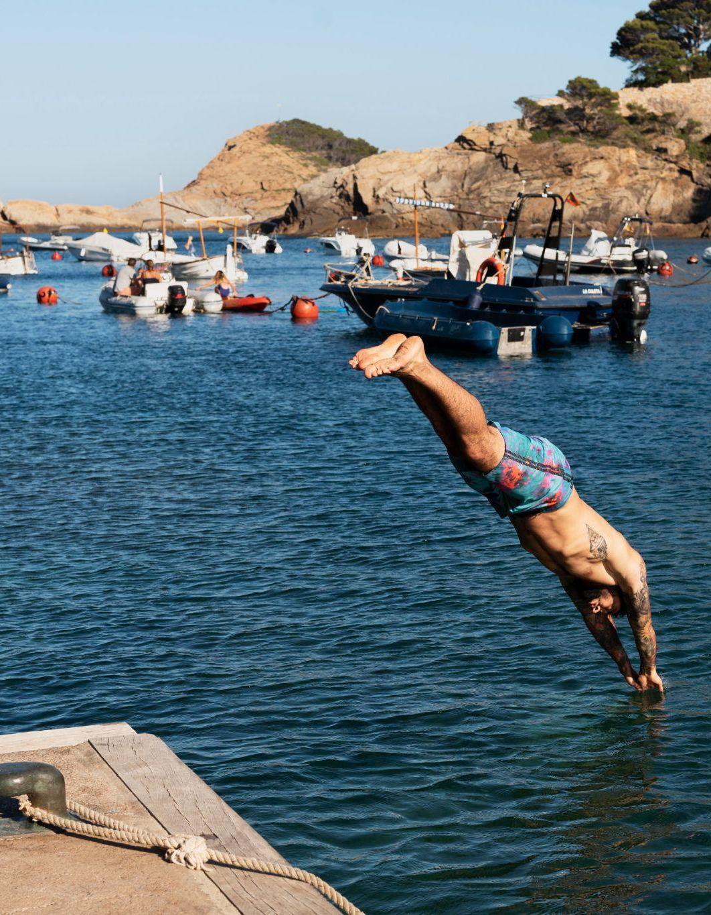
01
Listen and read

Slide 4
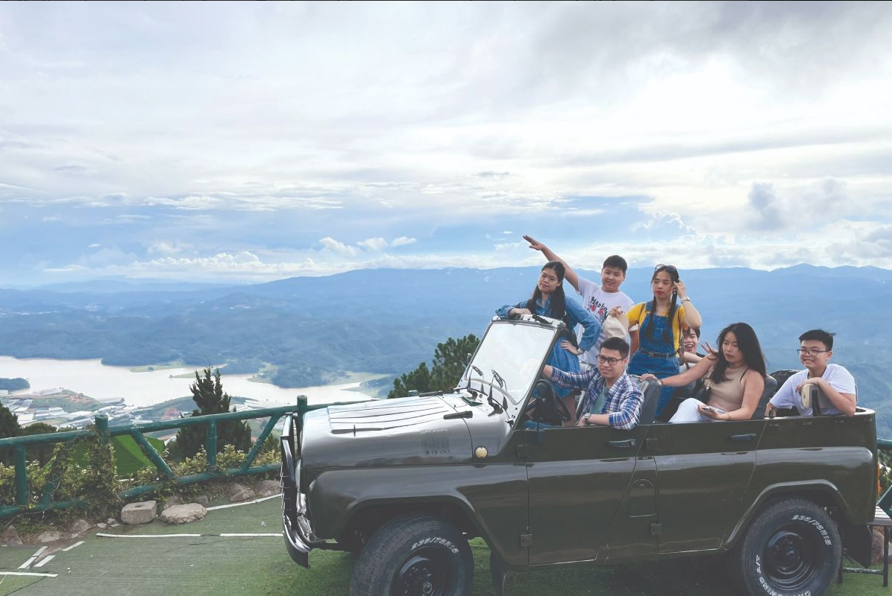
Look and answer
1. How many people can you see in the picture?
2. What type of vehicle are they riding?
3. Where are they?
6 people
A jeep
Tom
Da Lat /Langbiang mountain
Experiences in Da Lat

Slide 5


Vocabulary
experience (n)
/ɪkˈspɪəriəns/
sự trải nghiệm

Slide 6
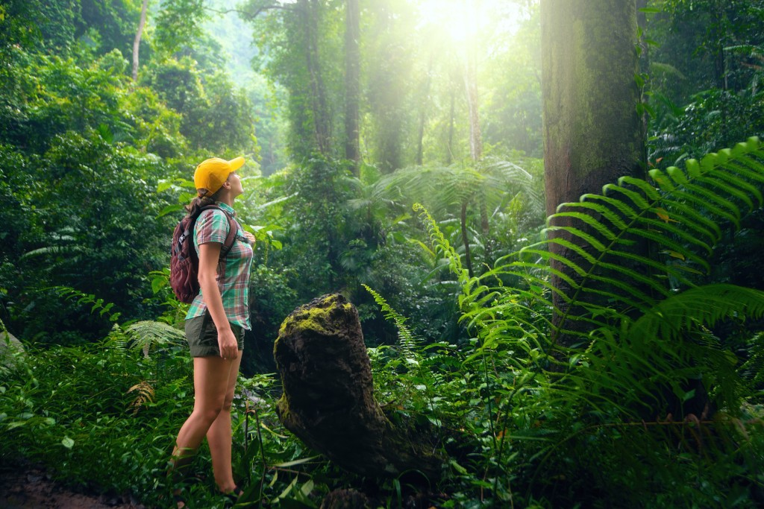
Vocabulary
eco-tour (n)
/ˈiːkə-tʊə(r)/
du lịch sinh thái

Slide 7

Vocabulary
flora (n)
/ˈflɔːrə/
tất cả thực vật của một khu vực

Slide 8
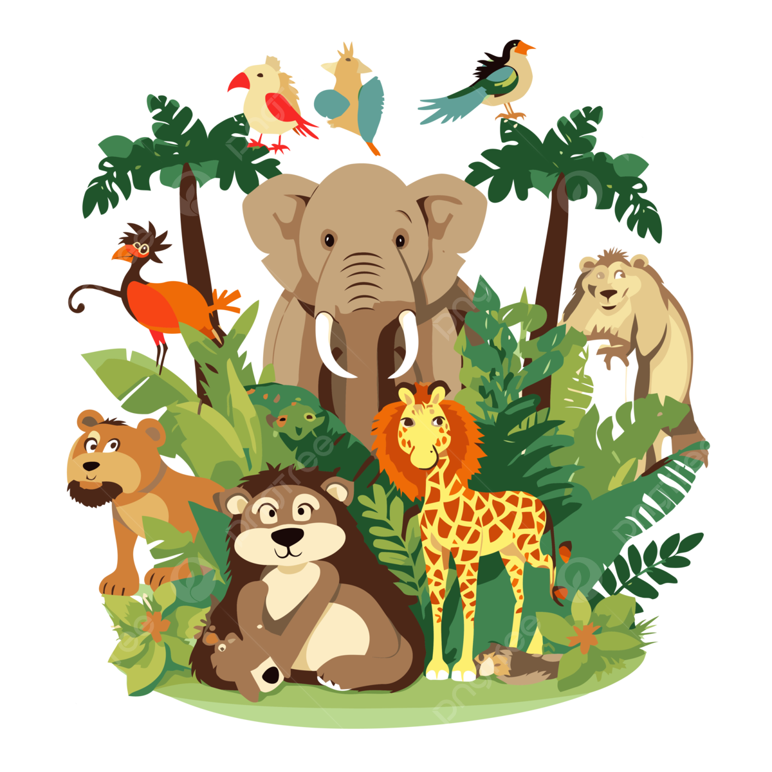
Vocabulary
fauna (n)
/ˈfɔːnə/
tất cả động vật của một khu vực

Slide 9
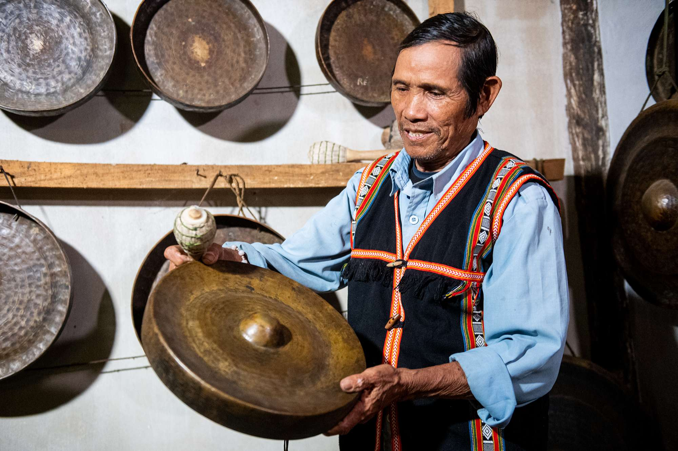

Vocabulary
gong (n)
/ɡɒŋ/
cồng chiêng

Slide 10

Vocabulary
site (n)
/saɪt/
địa điểm, nơi chốn

Slide 11
Vocabulary
New words | Pronunciation | Meaning
1. experience (n) | /ɪkˈspɪəriəns/ | sự trải nghiệm
2. eco-tour (n) | /ˈiːkə-tʊə(r)/ | du lịch sinh thái
3. flora (n) | /ˈflɔːrə/ | tất cả thực vật của 1 khu vực
4. fauna (n) | /ˈfɔːnə/ | tất cả động vật của 1 khu vực
5. gong (n) | /ɡɒŋ/ | cồng chiêng
6. site (n) | /saɪt/ | địa điểm, nơi chốn

Slide 12
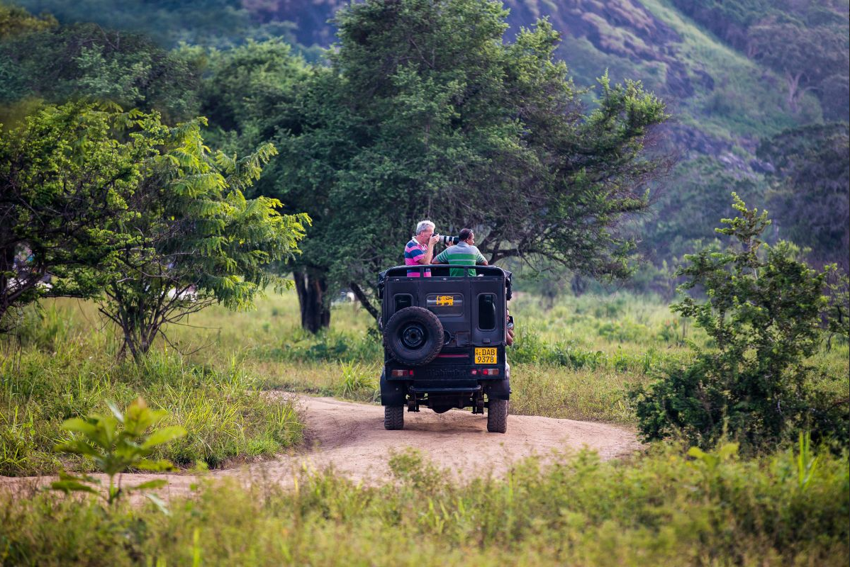
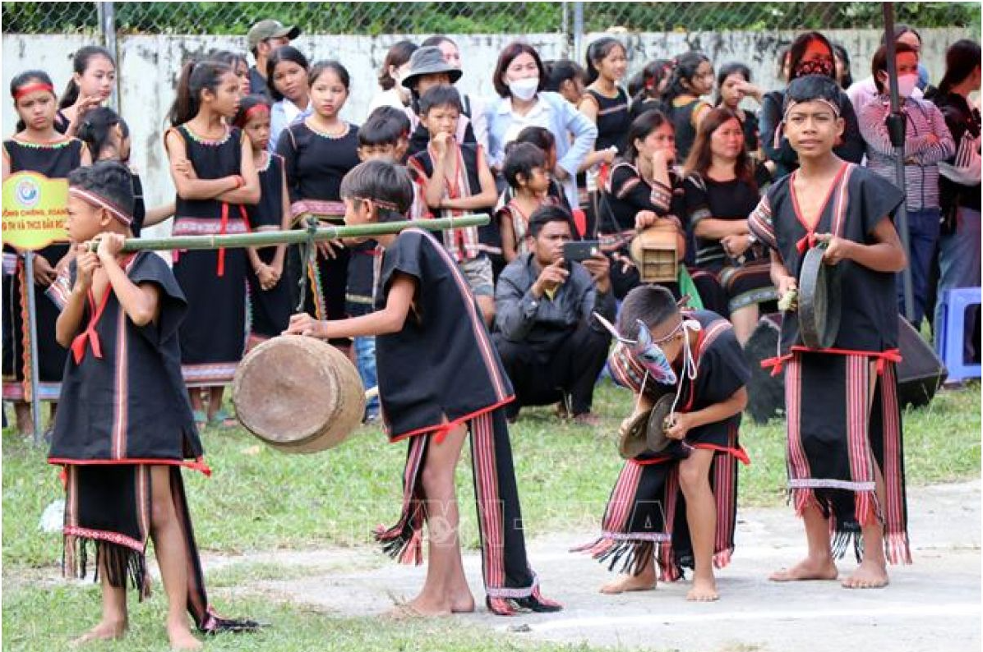
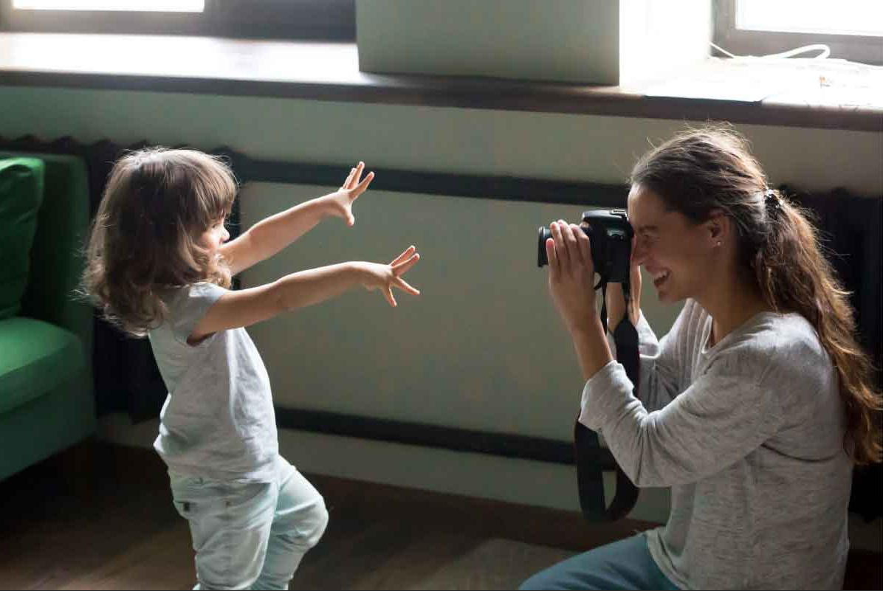
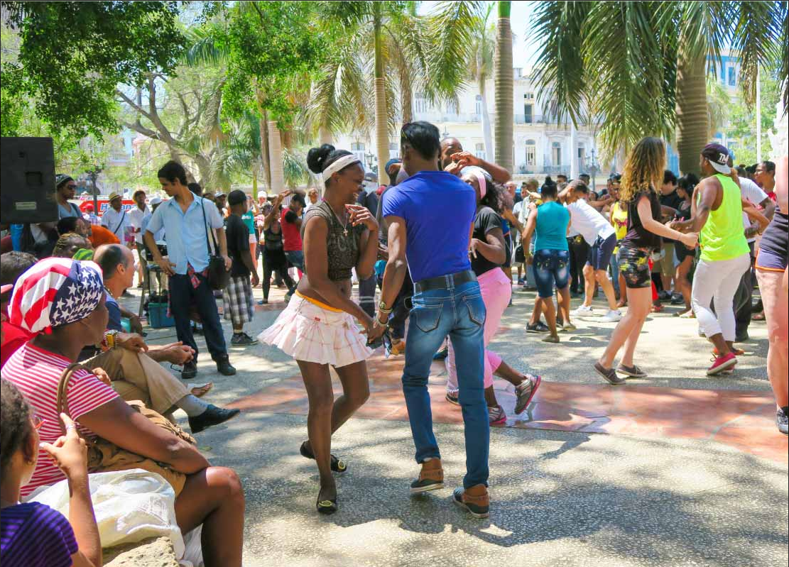
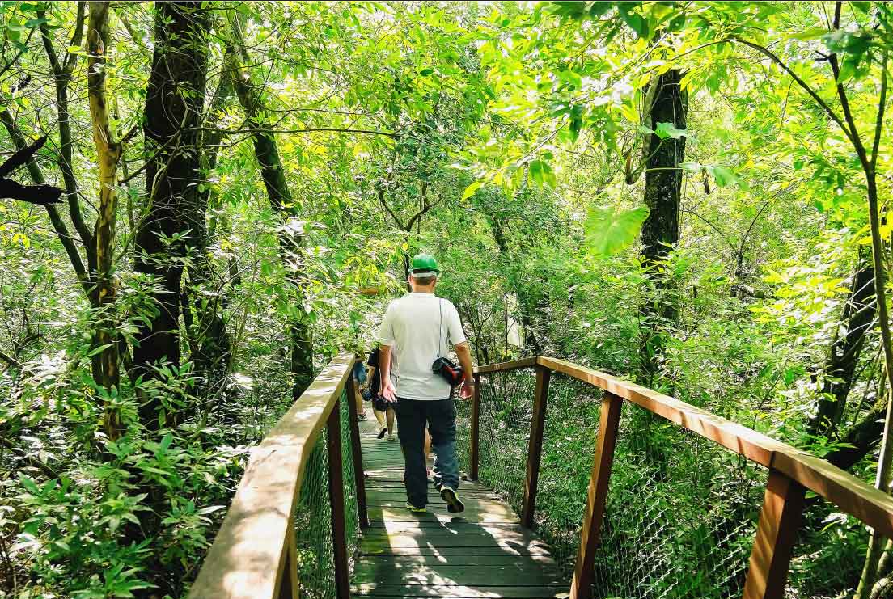
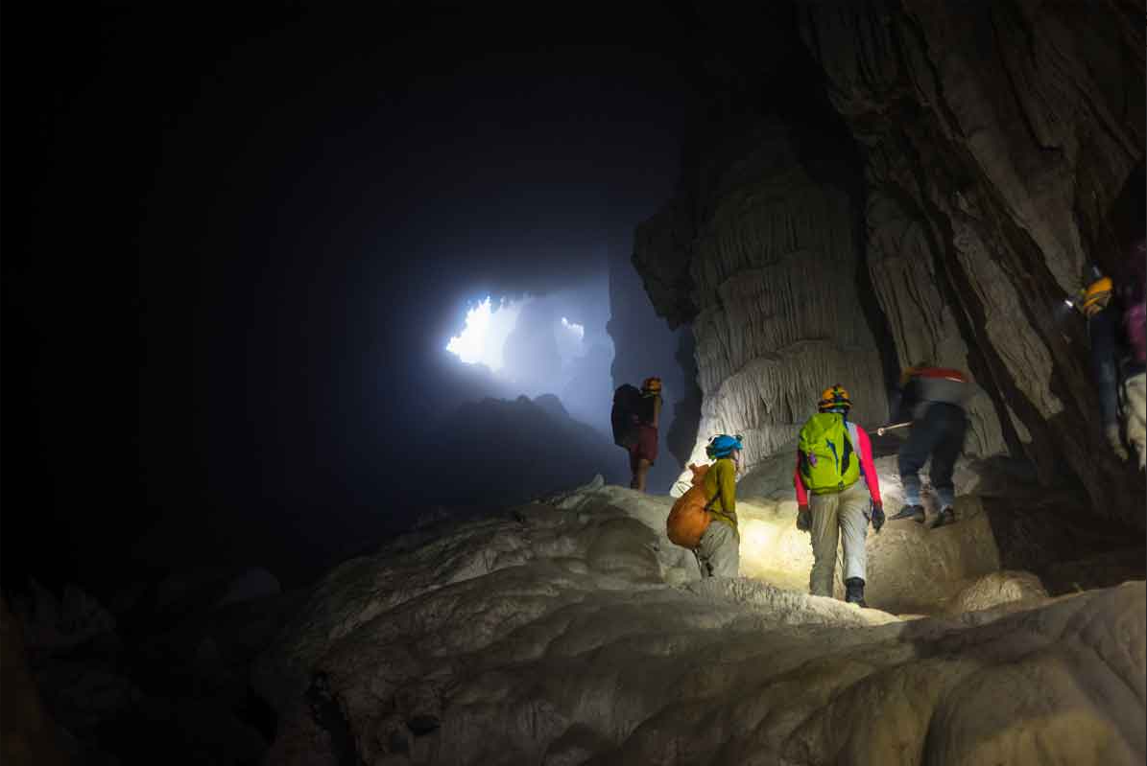
3 (p.51) Write activities under the pictures.
taking photos exploring a site riding a jeep
dancing with local people taking an eco-tour seeing a gong show
1
2
3
1. riding a jeep
2. seeing a gong show
3. taking photos
4
5
6
4. dancing with local people
5. taking an eco-tour
6. exploring a site

Slide 13
GUESS
What activities can Tom do in Da Lat?
1
2
3
1. riding a jeep
2. seeing a gong show
3. taking photos
4
5
6
4. dancing with local people
5. taking an eco-tour
6. exploring a site

Slide 14
Listen and check
What activities can Tom do in Da Lat?
1
2
3
✓
✓
✓
1. riding a jeep
2. seeing a gong show
3. taking photos
4
5
6
✓
✓
4. dancing with local people
5. taking an eco-tour
6. exploring a site

Slide 15
2 (p.51) Read the conversation again and write T (true) or F (False).
Tom: Hi Mi, I’m back from Da Lat now. I have some local specialities for you.
Mi: Thanks Tom. I guess you and your family had a great time there.
Tom: Yeah. We visited LangBiang Mountain, and Cu Lan Village. We saw a gong show in the evening.
Mi: What did you do on LangBiang Mountain?
Tom: We rode a jeep to the top. It was a thrilling ride up there. Then we took an eco-tour of LangBiang Mountain. They said that the area is rich in flora and fauna with more than 150 plant and animal species.
Mi: Sounds amazing! What did you do then?
Tom: We took pictures of the magnificent scenery. It was really enjoyable!
Mi: Then did you explore Cu Lan Village?
Tom: Yes. We had a brilliant tour around the village. We also rode horses and a jeep along a stream.
Mi: That must have been exciting, Tom.
Tom: It definitely was. In the evening we saw an interesting gong show. We danced and sang with the locals. And we tried grilled pork. It was a really memorable evening. I’ll show you some pictures I took there.

Slide 16
2 (p.51) Underline key words in these statements.
1. Mi and Tom had a great time in Da Lat. ______
2. Tom had an eco-tour of Langbiang Mountain. ______
3. There are more than 150 plant and animal species ______
on Langbiang Mountain.
4. Tom didn’t like his experiences in Cu Lan Village. ______
5. Tom danced and sang with the local people ______
at a gong show.

Slide 17
2 (p.51) Read the conversation again and write T (true) or F (False).
1. Mi and Tom had a great time in Da Lat. ______
F
Mi : Thanks Tom. I guess you and your family had a great time there.
Tom: Yeah. We visited LangBiang Mountain, and Cu Lan Village. We saw a gong show in the evening.
2. Tom had an eco-tour of Langbiang Mountain. ______
T
Tom: We rode a jeep to the top. It was a thrilling ride up there. Then we took an eco-tour of LangBiang Mountain.

Slide 18
2 (p.51) Read the conversation again and write T (true) or F (False).
3. There are more than 150 plant and animal species ______
on Langbiang Mountain.
T
Tom: …Then we took an eco-tour of LangBiang Mountain. They said that the area is rich in flora and fauna with more than 150 plant and animal species.
4. Tom didn’t like his experiences in Cu Lan Village. ______
F
Mi: Then did you explore Cu Lan Village?
Tom: Yes. We had a brilliant tour around the village.

Slide 19
2 (p.51) Read the conversation again and write T (true) or F (False).
5. Tom danced and sang with the local people ______
at a gong show.
T
Tom: It definitely was. In the evening we saw an interesting gong show. We danced and sang with the locals.

Slide 20
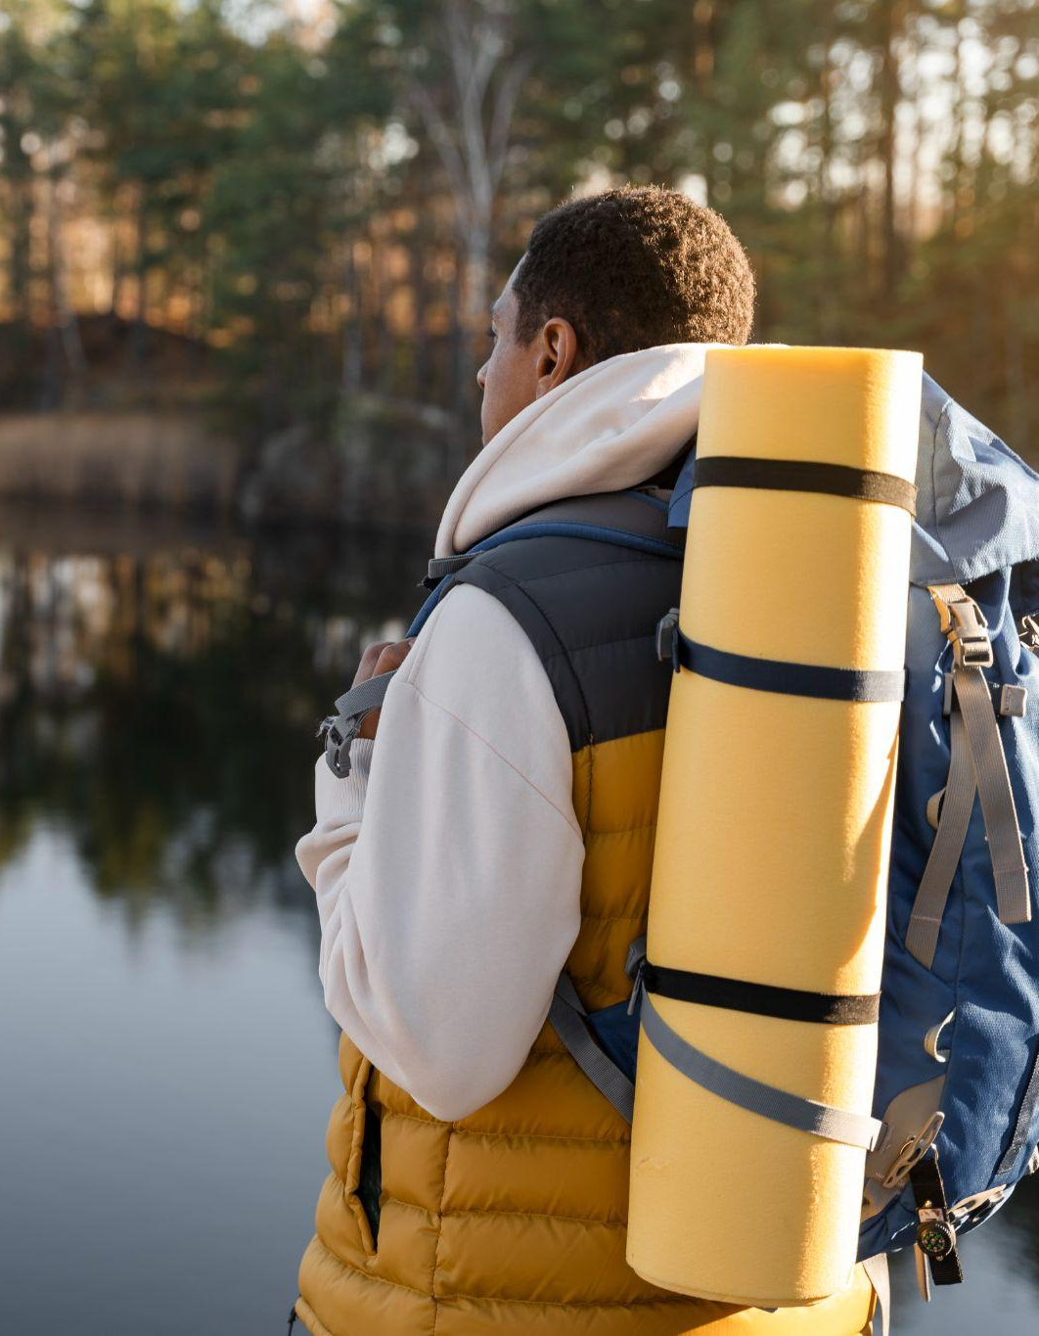
02
Vocabulary

Slide 21
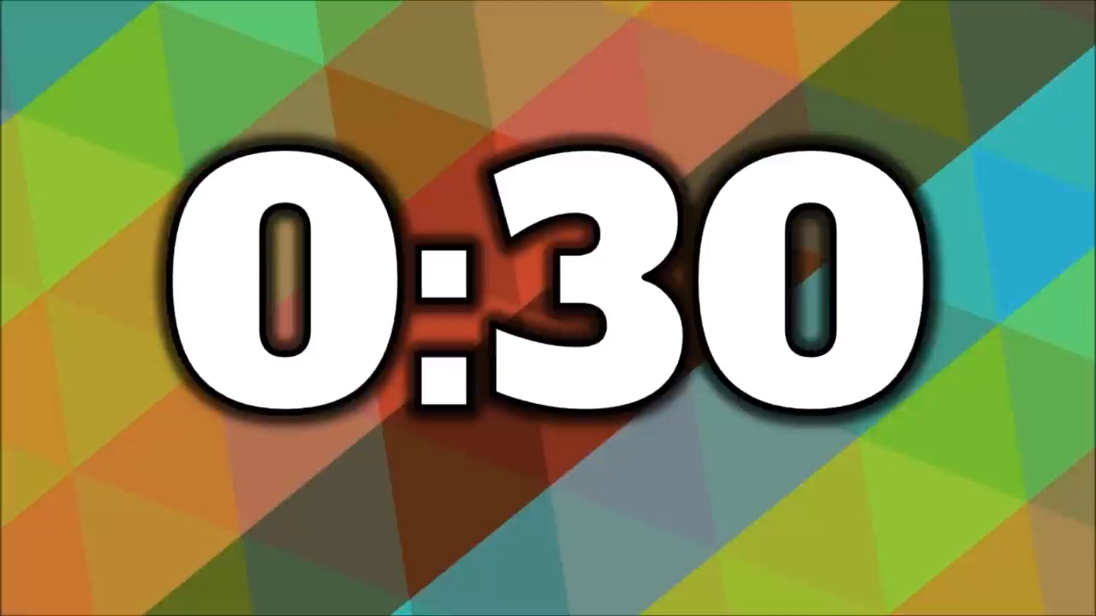
CHECK YOUR MEMORY
What activities did Tom do in Da Lat?
1. riding a jeep
2. seeing a gong show
3. taking an eco-tour
4. exploring a site
5. taking pictures
Notes:
1. riding a jeep
2. seeing a gong show
3. taking an eco-tour
4. exploring a site
5. taking pictures

Slide 22
4 (p.51) Read the conversation again and match the activities with the adjectives.
Mi: Then did you explore Cu Lan Village?
Tom: Yes. We had a brilliant tour around the village. We also rode horses and a jeep along a stream.
Tom: We took pictures of the magnificent scenery. It was really enjoyable!
Tom: …Then we took an eco-tour of LangBiang Mountain. They said that the area is rich in flora and fauna with more than 150 plant and animal species.
Mi: Sounds amazing!
1. riding a jeep
a. enjoyable
Tom: We rode a jeep to the top. It was a thrilling ride up there.
2. seeing a gong show
b. thrilling
Tom: It definitely was. In the evening we saw an interesting gong show.
3. taking an eco-tour
c. amazing
4. exploring a site
d. interesting
5. taking pictures
e. brilliant
Notes:
a. enjoyable b. thrilling c. amazing e. brilliant

Slide 23
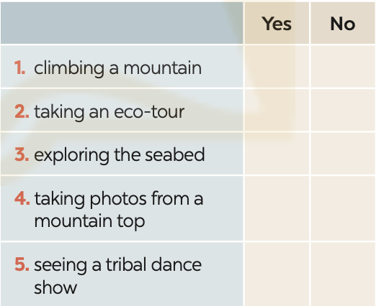

5 (p.51) Work in groups. Carry out a survey.
 | Yes | No
1. climbing a mountain
2. taking an eco-tour
3. exploring the seabed
4. taking photos from a mountain top
5. seeing a tribal dance show
Yes, I do/ No, I don’t
Do you like ...?

Slide 24
5 (p.51) Then report your group’s findings to the class. .
Example:
I did a survey with 3 peers. Two like climbing a mountain, 3 like taking eco-tours, nobody likes exploring the seabed….
 | Yes | No
1. climbing a mountain
2. taking an eco-tour
3. exploring the seabed
4. taking photos from a mountain top
5. seeing a tribal dance show

Slide 25
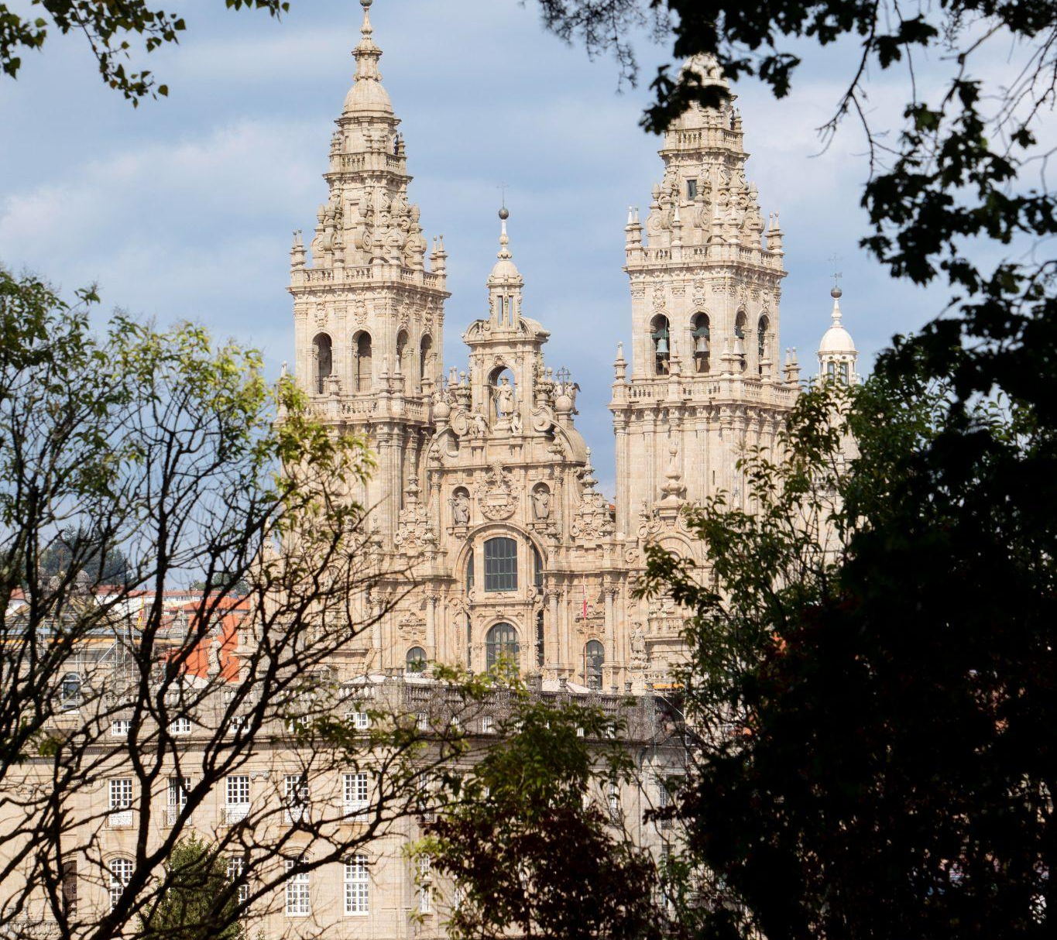
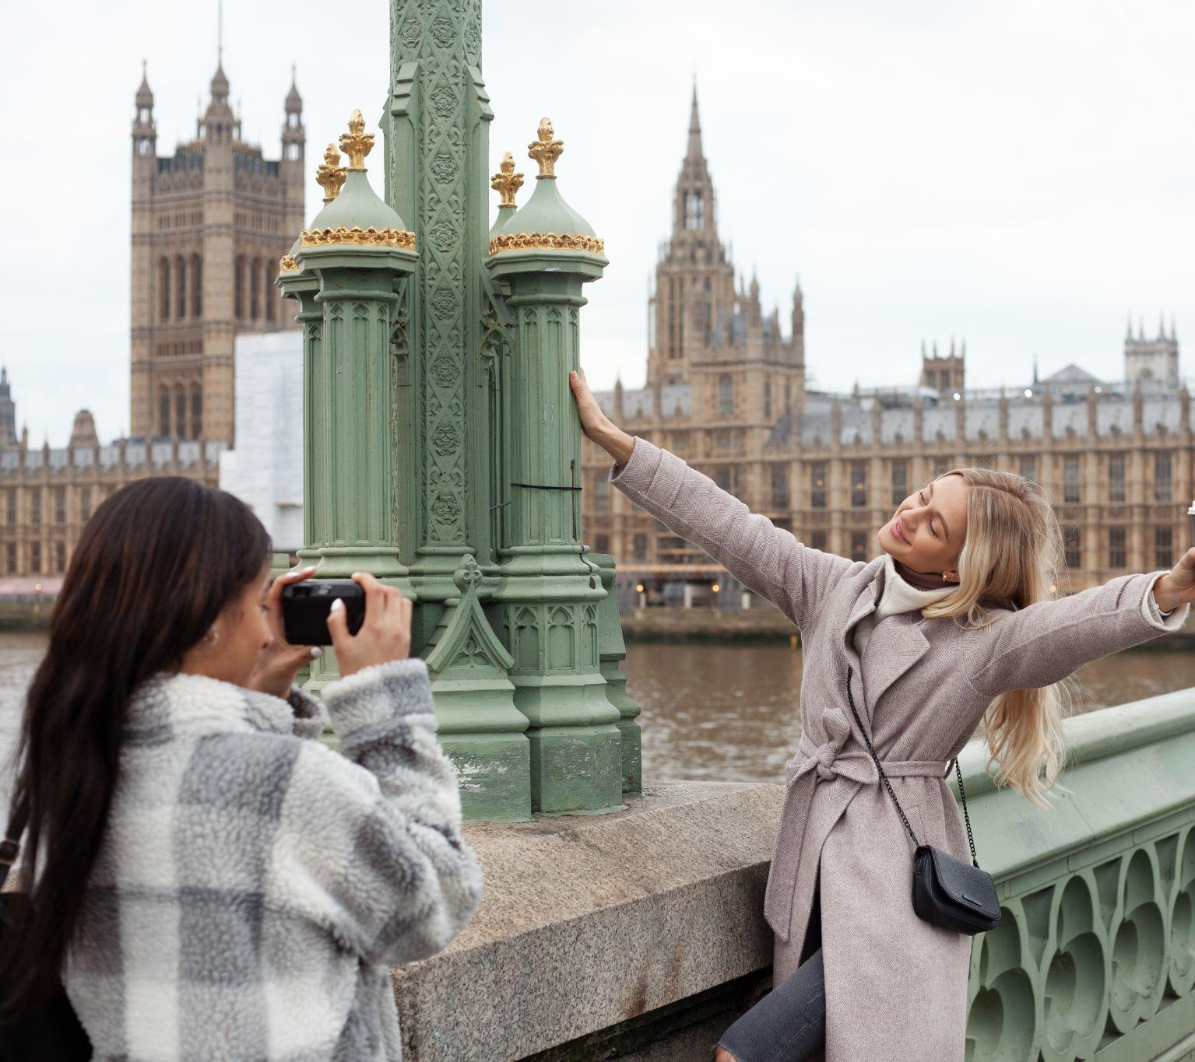
OBJECTIVES
After this lesson, students have been able to
Have an overview about the topic
OUR EXPERIENCES
use lexical items related to
OUR EXPERIENCES

Slide 26
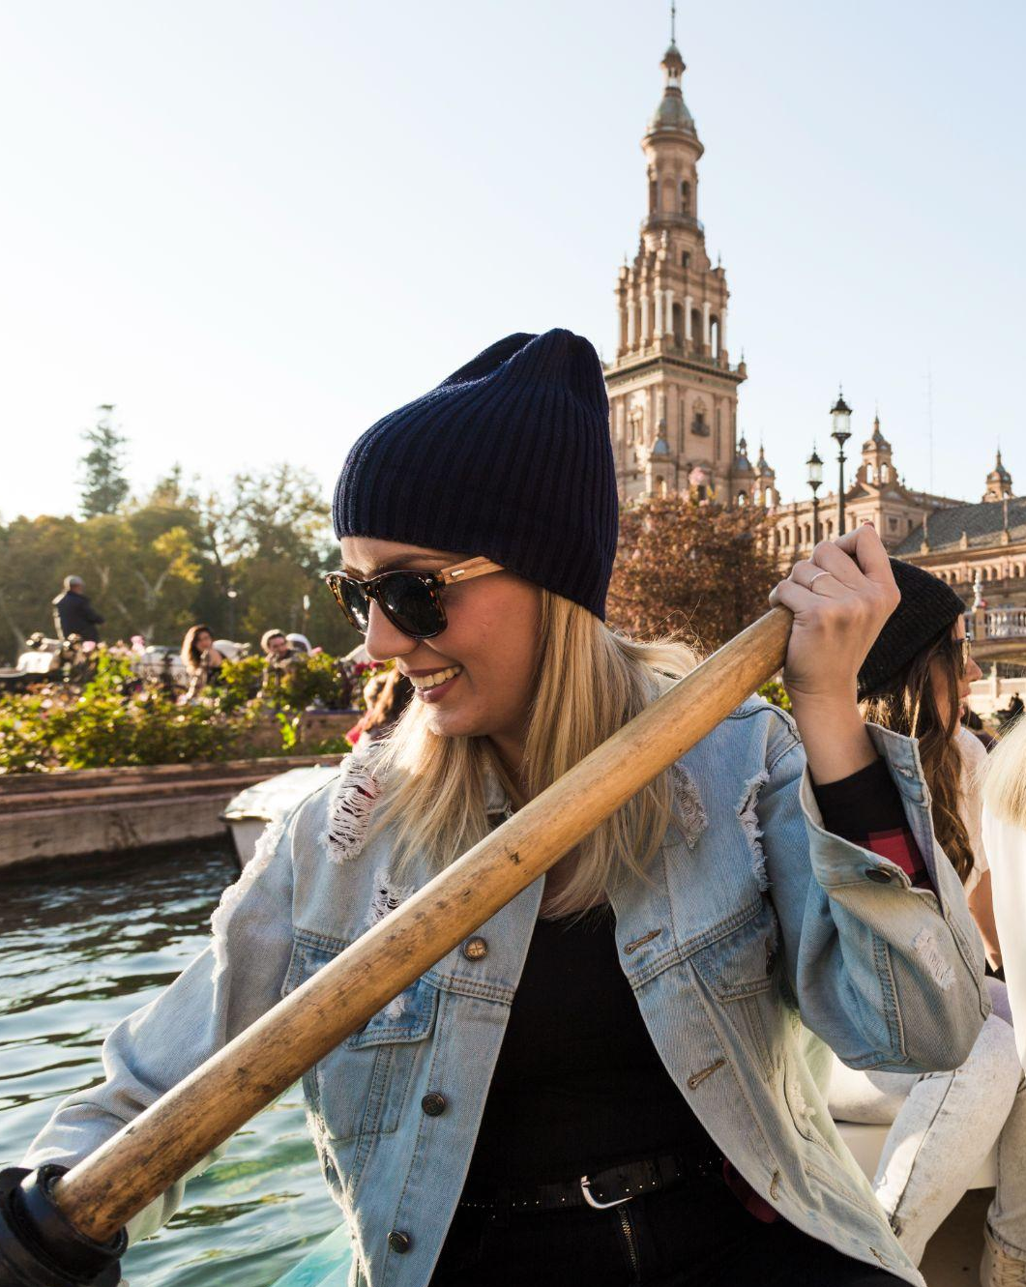
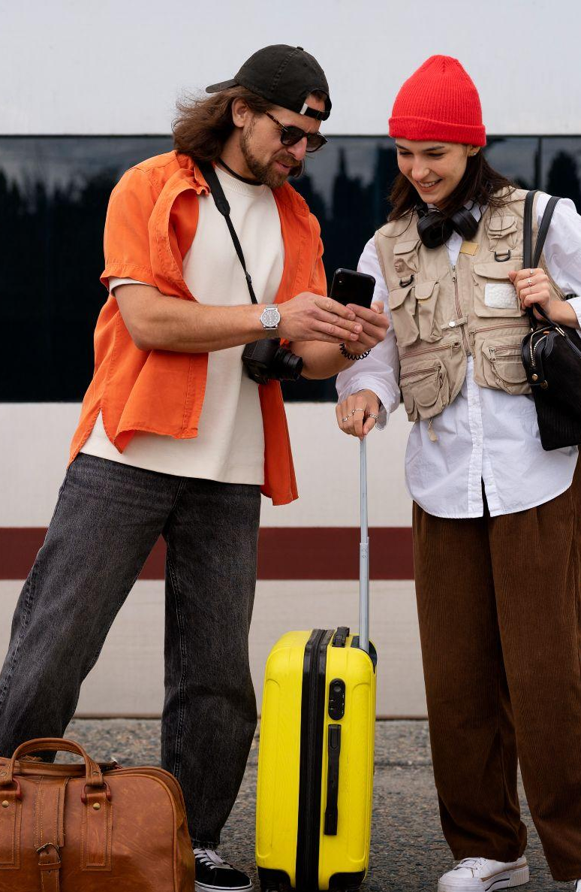
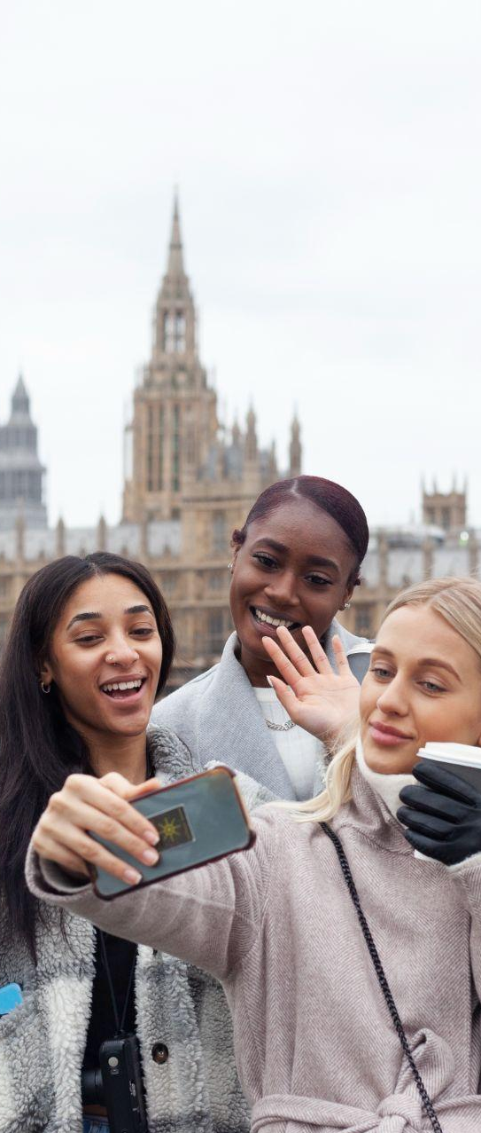
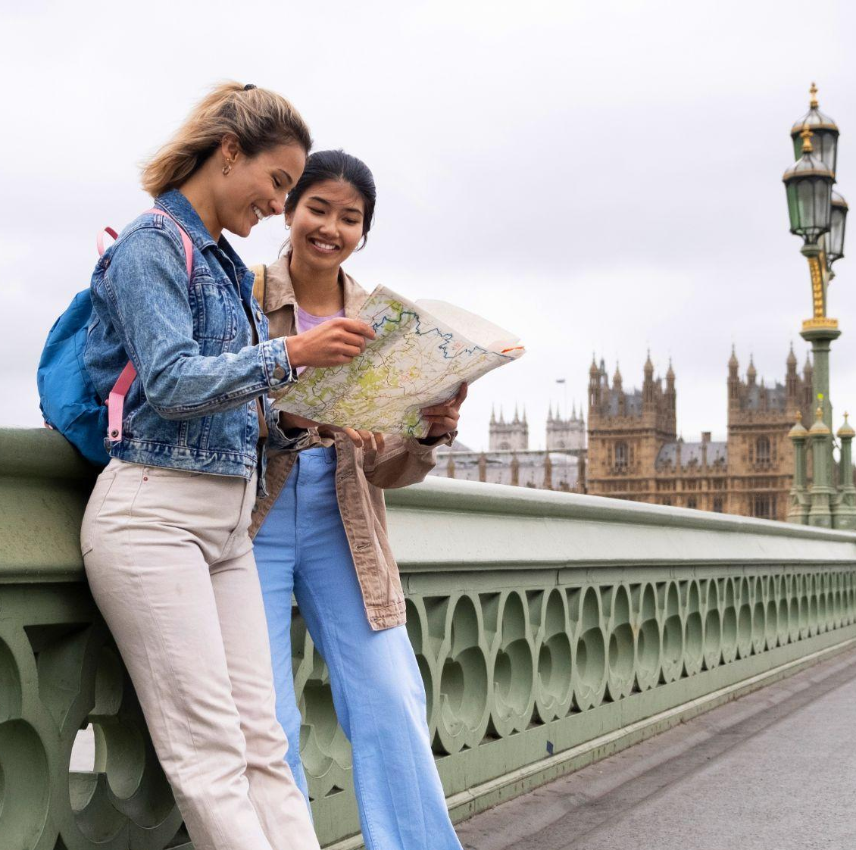
Thanks for your attention!

