Slide 1

Teacher: Trang Thi Hương Lan
School: Cam Binh Secondary School

Slide 2




Period 12 Unit
2
HEALTHY LIVING
LESSON 4: COMMUNICATION
Unit
HOBBIES

Slide 3
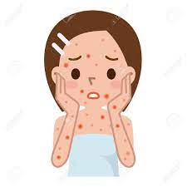

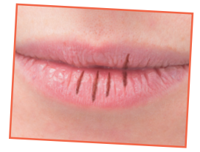

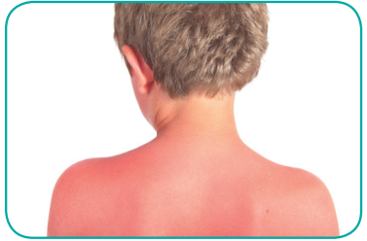
HEALTH PROBLEMS
WARM-UP
chapped lips
acne
dry hair
sunburn
red spots

Slide 4

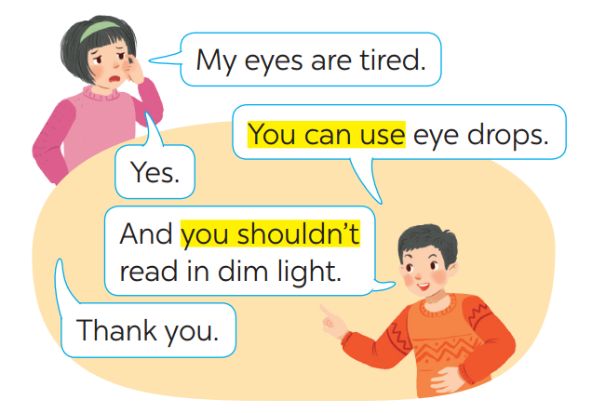
EVERYDAY ENGLISH
1
Listen and read the conversations. Pay attention to the highlighted sentences.
Giving tips for health problems
Giving tips for health problems
Models verbs:
S + can/ could/ should/ must + Vo …
(+) Yes./
Thank you.

Slide 5

EVERYDAY ENGLISH
2
Work in pairs. Make similar conversations with the following situations.
I’m tired.
Tom
Jack
Y
You can take a rest.
Yes
You shouldn’t go out.
Thank you.

Slide 6

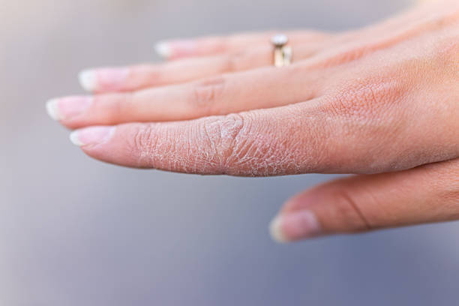
EVERYDAY ENGLISH
2
Work in pairs. Make similar conversations with the following situations.
I have acne.
My hands are chapped.
You shouldn’t touch your face.
You should wash your face.
… use chemical soaps.
… use hand cream.

Slide 7
TIPS FOR A HEALTHY LIFE
3
Read the passage and choose the correct title for it.
The Japanese live long lives. The main reason is their diet. They eat a lot of fish and vegetables. They cook fish with little cooking oil. They also eat a lot of tofu, a product from soybeans. Tofu has vegetable protein and vitamin B. It doesn’t have any fat. The Japanese work hard and do a lot of outdoor activities too. This helps them keep fit.
A. How to live long
B. What food to eat

Slide 8


TIPS FOR A HEALTHY LIFE
4
Discuss and make a list for the tips which help the Japanese live long lives.
- Eat a lot of fish and vegetables.
- Cook fish with a little cooking oil.
- Go to bed eraly.
Do a lot of outdoor activities.
Don’t get up late.

Slide 9
TIPS FOR A HEALTHY LIFE
Discuss and make a list for the tips which help the Japanese live long lives.
4
The Japanese live long lives. The main reason is their diet. They eat a lot of fish and vegetables. They cook fish with little cooking oil. They also eat a lot of tofu, a product from soybeans. Tofu has vegetable protein and vitamin B. It doesn’t have any fat. The Japanese work hard and do a lot of outdoor activities too. This helps them keep fit.
- Eat a lot of fish and vegetables.
- Cook fish with a little cooking oil.
- Eat a lot of tofu.
- Do a lot of outdoor activities.

Slide 10
FUTHER PRACTICE
5
Discuss and make a list for the tips that the Vietnamese can do to live longer.

Slide 11
FUTHER PRACTICE
5
List of the tips that the Vietnamese do to live longer:
- Go to bed early.
- Drink fresh water.
- Get daily exercise.
- Eat a lot of fresh vegetables.
- Laugh a lot.

Slide 12
CONSOLIDATION
2
HOMEWORK
Do exercises in the workbook.
Prepare Skills 1 P. 23
Review the lesson

Slide 13

Website: sachmem.vn
Fanpage: facebook.com/sachmem.vn/

