Slide 1

Teacher: Trang Thi Hương Lan
School: Cam Binh Secondary School

Slide 2




Unit
2
HEALTHY LIVING
LESSON 3: A CLOSER LOOK 2
Grammar: Simple sentences
Unit
HOBBIES

Slide 3

OBJECTIVES
By the end of the lesson, students will be able to:
know how to recognize and write simple sentences

Slide 4
LESSON 3: A CLOSER LOOK 2
WARM-UP
Game: Jumbled sentences
PRESENTATION
Simple sentences
Task 1: Tick the simple sentence.
Task 2: Underline and write S for the subject and V for the verb in each simple sentence.
Task 3: Rearrange the words and phrases to make simple sentences.
Task 4: Write complete sentences from the prompts. You may have to change the words or add some.
Task 5: Discuss and write a simple sentence from the two given sentences.
PRACTICE
CONSOLIDATION
Wrap-up
Homework

Slide 5

LESSON 3: A CLOSER LOOK 2
WARM-UP
Game: Jumbled sentences
Aims of the stage:
to activate students’ prior knowledge and vocabulary related to the targeted grammar

Slide 6
Vocabulary
acne /ˈækni/ (n): mụn trứng cá
fast food /fɑːst/ /fuːd/ (n): thức ăn nhanh
vegetarian /ˌvedʒəˈteəriən/ (n): người ăn chay
pimple /ˈpɪmpl/ (n): mụn nhọt
sports centre /spɔːts ˈsɛntə / (n.phr): trung tâm thể thao
cheesecake /ˈtʃiːzkeɪk/ (n): bánh phô mát
clean up / kli:n ʌp / (phr.v): dọn dẹp
sweetened food /ˈswiːtnd fuːd/ (n): đồ ngọt
soybean / ˈsɔɪbiːn/ (n): đậu nành

Slide 7

WARM-UP
1. books/ I/ science/ read /.
___________________________________________
I read science books.
2. games/ children/ love/ outdoor /.
Children love outdoor games.
___________________________________________
3. their/ every day/ they/ clean/ house /.
They clean their house every day.
___________________________________________
4. night/ watched/ I/ T.V/ last /.
I watched T.V last night.
___________________________________________
5. learn/ words/ every day/ You/ should/ the/ new
You should learn the new words every day.
___________________________________________

Slide 8
LESSON 3: A CLOSER LOOK 2
WARM-UP
Game: Jumbled sentences
PRESENTATION
Simple sentences

Slide 9
LESSON 3: A CLOSER LOOK 2
WARM-UP
Game: Jumbled sentences
PRESENTATION
Simple sentences
Task 1: Tick the simple sentence.
Task 2: Underline and write S for the subject and V for the verb in each simple sentence.
Task 3: Rearrange the words and phrases to make simple sentences.
Task 4: Write complete sentences from the prompts. You may have to change the words or add some.
Task 5: Discuss and write a simple sentence from the two given sentences.
PRACTICE

Slide 10
PRESENTATION
A subject and a verb
E.g: It rained.
There are 3 types
of simple sentences
A subject, a verb and an object.
E.g: I read science books.
A subject, a verb, and object and an adverb.
E.g: I watched T.V last night.

Slide 11

PRACTICE
1
Tick the simple sentences.
Aim of the task:
To help students identify the correct form of simple sentences.

Slide 12

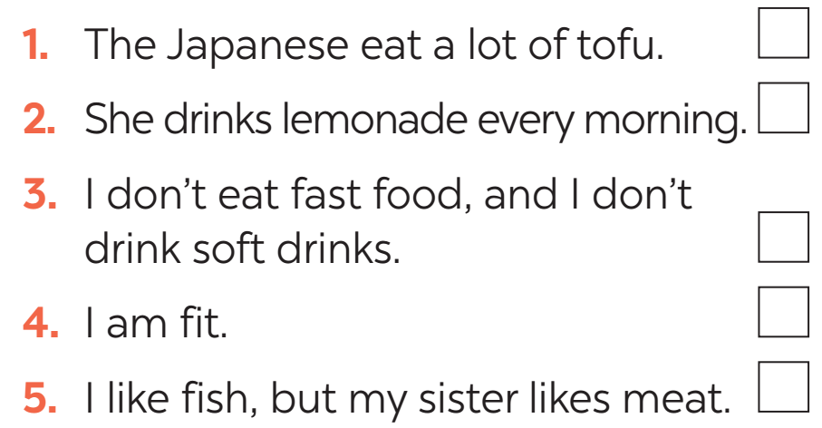

PRACTICE
1
Tick the simple sentences.

Slide 13


PRACTICE
2
Underline and write S for the subject and V for the verb in each simple sentence.
Aim of the task:
to help students identify the missing part in a simple sentence.

Slide 14
PRACTICE
2
Underline and write S for the subject and V for the verb in each simple sentence.
1. Vegetarians eat a lot of vegetables and fruit.
2. Acne causes black and white pimples on the face.
3. On Saturdays, my brother often spends two hours exercising at the sports center.
4. My mother didn’t buy my favourite cheesecake.
5. We are not cleaning up our community library.
S
V
S
V
S
V
S
V
S
V

Slide 15

PRACTICE
3
Rearrange the words and phrases to make simple sentences.
soft drinks/ never/ my sister/ drinks/.
affects/ acne/ 80% of young people/.
has/ he/ for breakfast/ bread and eggs/.
don’t eat/ we/ much fast food/.
a lot of vitamins/ fruit and vegetables/ have/.
→ My sister never drinks soft drinks.
→ Acne affects 80% of young people.
→ He has bread and eggs for breakfast.
→ We don’t eat much fast food.
→ Fruit and vegetable have a lot of vitamins.

Slide 16
LESSON 3: A CLOSER LOOK 2
WARM-UP
Game: Jumbled sentences
PRESENTATION
Simple sentences
Task 1: Tick the simple sentence.
Task 2: Underline and write S for the subject and V for the verb in each simple sentence.
Task 3: Rearrange the words and phrases to make simple sentences.
PRACTICE
Task 4: Write complete sentences from the prompts. You may have to change the words or add some.
Task 5: Discuss and write a simple sentence from the two given sentences.
PRODUCTION

Slide 17

PRODUCTION
4
Write complete sentences from the prompts. You may have to change the words or add some.
tofu/ be/ healthy
many/ Vietnamese/ drink/ green tea.
she/ not/ use/ suncream.
father/ not/ exercise/ every morning.
most children/ have/ chapped lips and skin/ winter.
→ Tofu is healthy.
→ Many Vietnamese drink green tea.
→ She does not use suncream.
→ My father does not exercise every morning.
→ Most children have chapped lips and skin in winter.

Slide 18
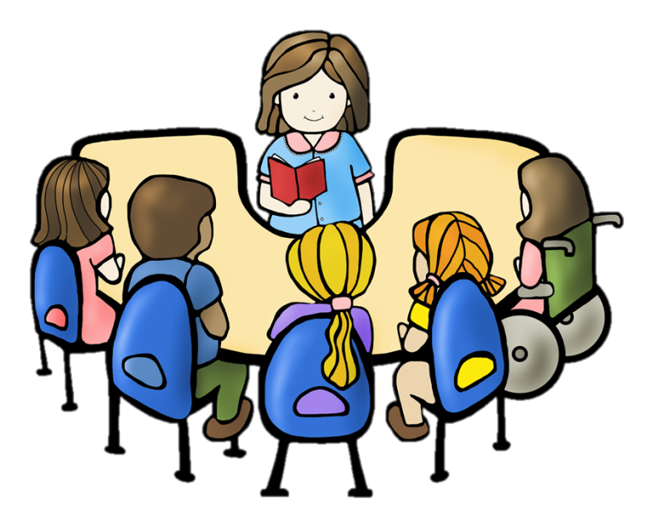
PRACTICE
5
Discuss and write a simple sentence from the two given sentences.
We avoid sweetened food. We avoid soft drinks.
→ We avoid _______________________________ .
2. My dad loves outdoor activities. I love outdoor activities.
→ My ____________ love outdoor activities
3. You should wear a hat. You should wear suncream.
→ You should wear ___________________________ .
4. My mother read the health tips. My mother downloaded the health tips.
→ My mother ________________________________.
sweetened food and soft drinks
dad and I
a hat and suncream
read and downloaded the health tips

Slide 19
LESSON 3: A CLOSER LOOK 2
WARM-UP
Game: Jumbled sentences
PRESENTATION
Simple sentences
Task 1: Tick the simple sentence.
Task 2: Underline and write S for the subject and V for the verb in each simple sentence.
Task 3: Rearrange the words and phrases to make simple sentences.
Task 4: Write complete sentences from the prompts. You may have to change the words or add some.
Task 5: Discuss and write a simple sentence from the two given sentences.
PRACTICE
CONSOLIDATION
Wrap-up
Homework

Slide 20
CONSOLIDATION
1
WRAP-UP
Grammar: Simple sentences

Slide 21

CONSOLIDATION
2
HOMEWORK
Do exercises in the workbook.

Slide 22

Website: sachmem.vn
Fanpage: facebook.com/sachmem.vn/

