Slide 1

Teacher: Trang Thi Hương Lan
School: Cam Binh Secondary School

Slide 2



Unit
2
HEALTHY LIVING
LESSON 2: A CLOSER LOOK 1
VOCABULARY
PRONUNCIATION
Unit
HOBBIES

Slide 3

OBJECTIVES
By the end of the lesson, students will be able to:
Vocabulary:
+ use the lexical items related to the topic Healthy living
+ use the words about healthy activities and health problems
Pronunciation: pronounce and recognize the sounds /f/ and /v/

Slide 4
LESSON 2: A CLOSER LOOK 1
WARM-UP
Game: Face to face
Task 1: Match the phrase with the correct pictures.
Task 2: Complete the sentences.
Task 3: Discuss and tick each activity in the table as H (Healthy) or U (Unhealthy).
VOCABULARY
Task 4: Listen and repeat. Practice pronouncing.
Task 5: Listen and repeat. Pay attention to the underlined words.
PRONUNCIATION
PRODUCTION
Game: Tongue twister
CONSOLIDATION
Wrap-up
Homework

Slide 5
LESSON 2: A CLOSER LOOK 1
WARM-UP
Game: Face to face
Aims of the stage:
to activate students’ prior knowledge and vocabulary related to the topic, the targeted vocabulary, and its pronunciation

Slide 6

WARM-UP: FACE TO FACE
HEALTHY ACTIVITIES

Slide 7

LESSON 2: A CLOSER LOOK 1
WARM-UP
Game: Face to face
Task 1: Match the phrase with the correct pictures.
Task 2: Complete the sentences.
Task 3: Discuss and tick each activity in the table as H (Healthy) or U (Unhealthy).
VOCABULARY
Aims of the stage:
to introduce visually some nouns related to the topic

Slide 8

VOCABULARY
dim light (n)
/dɪm lait/
ánh sáng lờ mờ

Slide 9
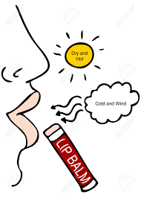
VOCABULARY
lip balm (n)
/ˈlɪp ˌbɑːm/
son dưỡng môi

Slide 10
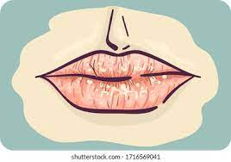
VOCABULARY
chapped lips (n)
/tʃæpt lɪps /
môi nứt nẻ

Slide 11
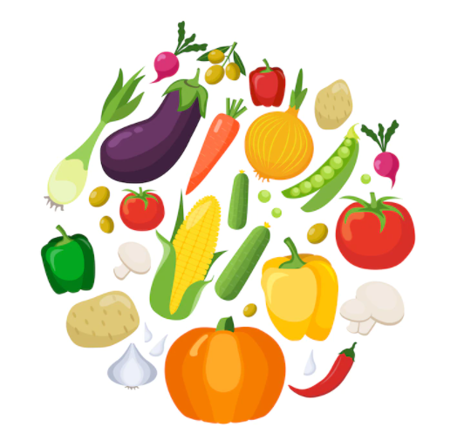
VOCABULARY
coloured vegetables (n)
/ ˈkʌləd ˈvedʒtəbəl/
rau có màu sắc

Slide 12
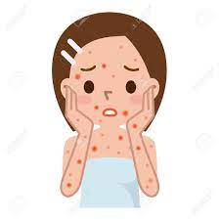
VOCABULARY
red spots (n)
/red spɒt/
đốm đỏ

Slide 13
VOCABULARY
New words | Pronunciation | Meaning
1. dim light (n) | /dɪm lait/ | ánh sáng lờ mờ
2. lip balm (n) | /ˈlɪp ˌbɑːm/ | son dưỡng môi
3. chapped lips (n) | /tʃæpt lɪps / | môi nứt nẻ
4. coloured vegetables (n) | / ˈkʌləd ˈvedʒtəbəl/ | rau có màu sắc
5. red spots (n) | /red spɒt/ | đốm đỏ
6. skin |  | da
7. condition |  | điều kiện
8. soft drink |  | nước ngọt

Slide 14
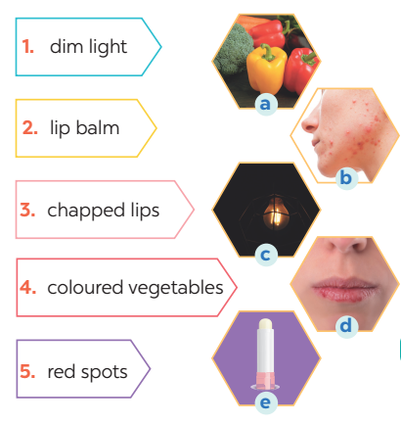
VOCABULARY
1
Match the phrase on the left with the correct pictures on the right.
1. c
2. e
3. d
4. a
5. b

Slide 15
VOCABULARY
2
Complete the sentences with the correct words and phrases.
skin condition soft drinks coloured vegetables sunburn fit
coloured vegetables
1. - Please name some ________________________.
- Carrots and tomatoes.
2. ___________ are not good for your health.
3. My parents go cycling every Sunday. It keeps them _______.
4. The weather may affect our ________________.
5. - How do we get _________?
- When we spend a long time in the sun without a hat or suncream.
Soft drinks
fit
skin condition
sunburn

Slide 16


VOCABULARY
3
Discuss and tick each activity in the table as H (Healthy) or U (Unhealthy).
 | H | U
1. washing your hands often
2. reading in dim light
3. eating tofu and coloured vegetables
4. brushing your teeth twice a day
5. touching your face with dirty hands

Slide 17
LESSON 2: A CLOSER LOOK 1
WARM-UP
Game: Face to face
Task 1: Match the phrase with the correct pictures.
Task 2: Complete the sentences.
Task 3: Discuss and tick each activity in the table as H (Healthy) or U (Unhealthy).
VOCABULARY
Task 4: Listen and repeat. Practice pronouncing.
Task 5: Listen and repeat. Pay attention to the underlined words.
PRONUNCIATION

Slide 18

PRONUNCIATION
/f/ and /v/
Aims of the stage:
to help students identify how to pronounce the final sounds /f/ and /v/ at the end of the words

Slide 19

PRONUNCIATION
/f/ and /v/
Notes:
Chèn clip phát âm của HEID

Slide 20
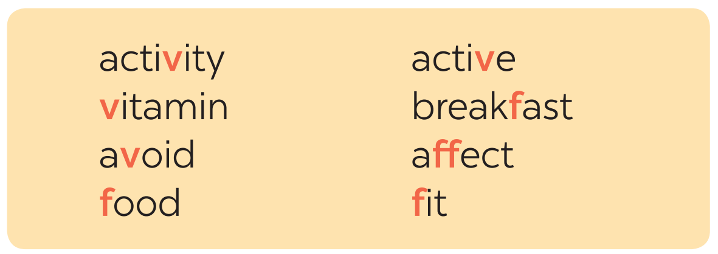

PRONUNCIATION
4
Listen and repeat the words. Pay attention to the sounds /f/ and /v/.

Slide 21
PRONUNCIATION
5
Listen and repeat, paying attention to the underlined words.
1. Coloured vegetables are good food.
2. My favorite outdoor activity is cycling.
3. We need vitamin A for our eyes.
4. Being active helps keep you fit.
5. Jack never eats fish.
/f/ and /v/

Slide 22
LESSON 2: A CLOSER LOOK 1
WARM-UP
Game: Face to face
Task 1: Match the phrase with the correct pictures.
Task 2: Complete the sentences.
Task 3: Discuss and tick each activity in the table as H (Healthy) or U (Unhealthy).
VOCABULARY
Task 4: Listen and repeat. Practice pronouncing.
Task 5: Listen and repeat. Pay attention to the underlined words.
PRONUNCIATION
PRODUCTION
Game: Tongue twister

Slide 23

PRODUCTION
Game: Tongue twister
Aims of the stage:
to give students chance to apply what they have learnt

Slide 24
PRODUCTION
Game: Tongue twister
Victoria fried some fresh fish.
2. Van fried the fish in half a vat of fat.

Slide 25
CONSOLIDATION
1
WRAP-UP
VOCABULARY
PRONUNCIATION

Slide 26
CONSOLIDATION
2
HOMEWORK
Find 5 more words with the sound /f/ and 5 more words with the sound /v/. Write them down and practice pronouncing the words.

Slide 27

Website: sachmem.vn
Fanpage: facebook.com/sachmem.vn/

