Slide 1

Teacher: Trang Thi Hương Lan
School: Cam Binh Secondary School

Slide 2




Unit
2
HEALTHY LIVING
LESSON 1: GETTING STARTED
Let’s go out!
Unit
HOBBIES

Slide 3

OBJECTIVES
By the end of the lesson, students will be able to:
Use the lexical items related to the topic Healthy living
Identify and talk about the daily activities and decide if they are good or bad for health

Slide 4
LESSON 1: GETTING STARTED
WARM-UP
Brainstorming
PRESENTATION
Vocabulary
Listen and read.
Task 1: Circle the correct answer.
Task 2: Write a word or phrase from the box under its picture.
Task 3: Complete each sentence with a word from the conversation.
PRACTICE
PRODUCTION
Task 4: Survey: Good or bad for health.
CONSOLIDATION
Wrap-up
Homework

Slide 5

LESSON 1: GETTING STARTED
WARM-UP
Brainstorming
Aims of the stage:
to create an active atmosphere in the class before the lesson
to introduce the topic

Slide 6

WARM-UP: BRAINSTORMING
HEALTH

Slide 7

LESSON 1: GETTING STARTED
WARM-UP
Brainstorming
PRESENTATION
Vocabulary
Listen and read.
Aims of the stage:
to provide students with vocabulary
to help students prepare well for the listening and reading tasks

Slide 8

PRESENTATION
popular (a)
/ˈpɒpjələ(r)/
phổ biến, nổi tiếng

Slide 9

PRESENTATION
fresh (a)
/freʃ/
tươi, mới

Slide 10
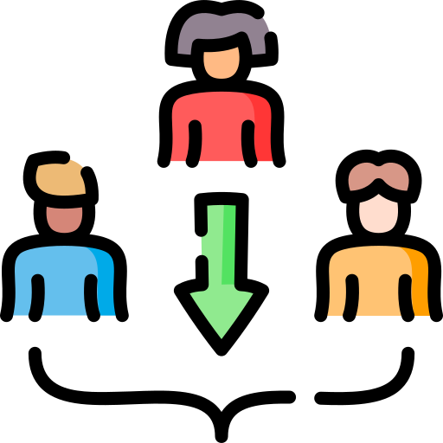
PRESENTATION
join (v)
/dʒɔɪn/
tham gia

Slide 11
PRESENTATION
New words | Pronunciation | Meaning
1. popular (a) | /ˈpɒpjələr/ | phổ biến, nổi tiếng
2. fresh (a) | /freʃ/ | tươi, mới
3. join (v) | /dʒɔɪn/ | tham gia
4. play sports | /pleɪ spɔːt / | Chơi
5. run through | /rʌn θruː/ (phr.v): | chảy qua
6. divide into | /dɪˈvaɪd ˈɪn.tuː/ (v.phr): | chia thành
7. sunburn |  | cháy nắng
8. suncream |  | kem chống nắng

Slide 12
LESSON 1: GETTING STARTED
WARM-UP
Brainstorming
PRESENTATION
Vocabulary
Listen and read.
Aims of the stage:
to have students get to know the topic

Slide 13


LISTEN AND READ.
Mi: This is a nice picture, Mark.
Mark: That’s my dad and I boating at Yen So Park.
Mi: I also see a lot of people exercising there.
Mark: Yes, it’s a popular place for people in my neighbourhood.
Mi: Outdoor activities are good for our health. My family often goes cycling in the countryside. It’s quiet and there’s a lot of fresh air.
Mark: It sounds interesting.
Mi: Yes, it’s lots of fun. We also bring fruit, water, and a lunch box with us.
Mark: I’d love to join you next time.
Mi: Sure. Bring along a hat and suncream.
Mark: Why suncream?
Mi: It’s really hot and sunny at noon so you might get sunburn.
Mark: I see.

Slide 14
LESSON 1: GETTING STARTED
WARM-UP
Brainstorming
PRESENTATION
Vocabulary
Listen and read.
Task 1: Circle the correct answer.
Task 2: Write a word or phrase from the box under its picture.
Task 3: Complete each sentence with a word from the conversation.
PRACTICE

Slide 15

PRACTICE
2
Circle the correct answer.
What are Mark and Mi talking about?
A. Health problems
B. Healthy activities
C. Sports and games
Mi: I also see a lot of people exercising there.
Mark: Yes, it’s a popular place for people in my neighbourhood.

Slide 16
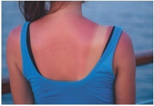
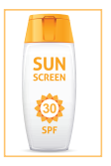
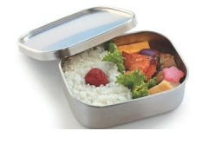
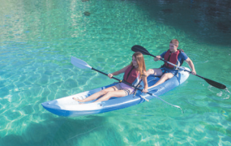
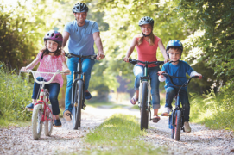
PRACTICE
3
Write a word or phrase from the box under its picture.
boating suncream lunch box sunburn cycling
1.
sunburn
2.
suncream
3.
lunch box
4.
boating
5.
cycling

Slide 17
PRACTICE
4
Complete each sentence with a word from the conversation.
1. In the picture, Mark and his father are __________.
boating
Mi: This is a nice picture, Mark.
Mark: That’s my dad and I boating at Yen So Park.
2. The people in Mark’s neighbourhood love to go to the _________ .
park
Mi: It also see a lot of people exercise there.
Mark: Yes, it’s a popular place for people in my neighbourhood.

Slide 18
PRACTICE
4
Complete each sentence with a word from the conversation.
3. Mi’s family often goes cycling in the ___________.
countryside
Mi: Outdoor activities are good for our health. My family often goes cycling in the countryside. It’s quiet and there’s a lot of fresh air.
4. - I don’t want to get sunburn.
- Wear a hat and use __________.
suncream
Mi: Sure. Bring along a hat and suncream.
Mark: Why suncream?
Mi: It’s really hot and sunny at noon so you might get sunburn.

Slide 19
PRACTICE
4
Complete each sentence with a word from the conversation.
5. Fruit and water are good for our _________ .
health
Mi: Yes, it’s lots of fun. We also bring fruit, water, and a lunch box with us.

Slide 20
LESSON 1: GETTING STARTED
WARM-UP
Brainstorming
PRESENTATION
Vocabulary
Listen and read.
Task 1: Circle the correct answer.
Task 2: Write a word or phrase from the box under its picture.
Task 3: Complete each sentence with a word from the conversation.
PRACTICE
PRODUCTION
Task 4: Survey: Good or bad for health.

Slide 21

PRODUCTION
5
Survey: Good or bad for health.
Example:
A: I walk to school.
B: I think it’s good for your health.
A: I rarely eat breakfast.
B: It’s not good. Breakfast is very important. It gives us energy for the day.

Slide 22
PRODUCTION
5
Survey: Good or bad for health.
Daily activities | How often | Good | Bad
Walking to school | Every day | √

Slide 23
LESSON 1: GETTING STARTED
WARM-UP
Brainstorming
PRESENTATION
Task 1
Vocabulary
Listen and read.
Task 2: Circle the correct answer.
Task 3: Write a word or phrase from the box under its picture.
Task 4: Complete each sentence with a word from the conversation.
PRACTICE
PRODUCTION
Task 5: Survey: Good or bad for health.
CONSOLIDATION
Wrap-up
Homework

Slide 24
CONSOLIDATION
1
WRAP-UP
HEALTHY LIVING
Things to go out
Healthy activities
Topic of the unit
Vocabulary

Slide 25
CONSOLIDATION
2
HOMEWORK
Prepare the vocabulary for the next lesson:
A closer look 1.

Slide 26

Website: sachmem.vn
Fanpage: facebook.com/sachmem.vn/

