Slide 2

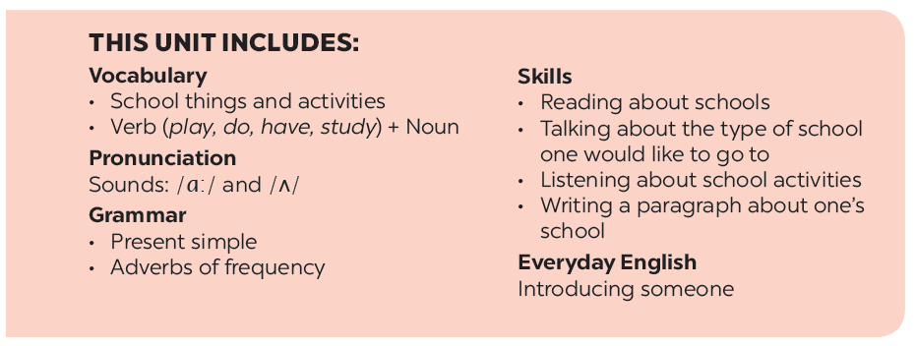
Teacher: Trang Thi Hương Lan
School: Cam Binh Secondary School

Slide 3







Grammar
The present simple
Adverbs of frequency
Fill the blanks with usually, sometimes or never.
Choose the correct answer A, B, or C.
Choose the correct answer A or B to complete each sentence.
Miss Nguyet is interviewing Duy for the school newsletter. Write the correct form of the verbs.
Work in pairs. Make questions, and then interview your partner.

Slide 4

Grammar
The present simple
We use the present simple to talk about actions or events that often happen, or are fixed.
Example:
We usually go to school by bus.
I don’t like school lunch very much.

Slide 5

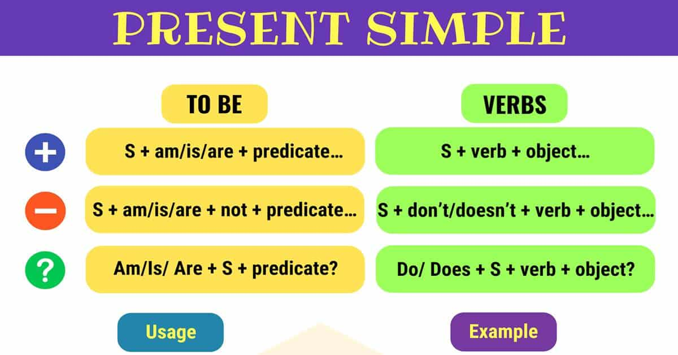
PRESENTATION

Slide 6


Choose the correct answer A, B, or C.
1.
We new subjects for this school year.
A.
B.
has
C.
having
have
2.
Duy to school every day.
A.
cycling
B.
cycle
C.
cycles
3.
My new school in the centre of the village.
B.
C.
doesn’t
A.
not
isn’t
4.
I live near here. Where live?
A.
B.
you
C.
are you
do you
5.
My friend has a sister, but she a brother.
A.
B.
don’t have
C.
doesn’t have
not has

Slide 7
Grammar
The present simple
The present simple verbs with he / she / it need an s / es.

Slide 8

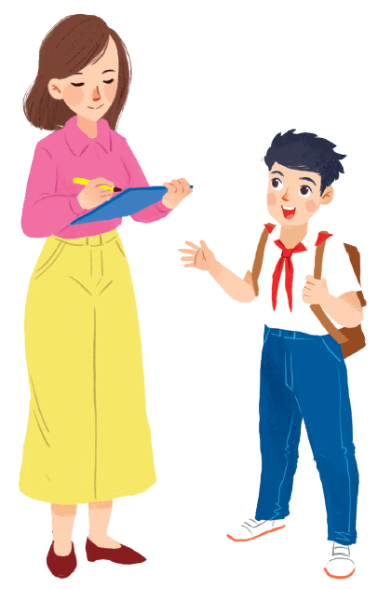
Miss Nguyet is interviewing Duy for the school newsletter. Write the correct form of the verbs.
Miss Nguyet: Tell us about your new school, Duy.
has
Duy: Sure! My school (1.have) a large playground.
Do
have
Mis Nguyet: you (2. have) any new friends?
like
Duy: Yes. And I (3. like) my new friends, Vy and Phong.
Does
walk
Mis Nguyet: Vy (4. walk) to school with you?
ride
Duy: Well, we often (5. ride) our bicycles to school.
Mis Nguyet: What time do you go home?
Duy: I (6. go) home at 4 p.m. every day.
go
Mis Nguyet: Thank you!

Slide 9
Grammar
Adverbs of frequency
We use adverbs of frequency to show how often something happens.
We often use them with the present simple.
We usually place the adverb of frequency before the main verb.
Example:
Tom usually takes the bus to school.
They don’t often go to the cinema.

Slide 10

Fill the blanks with usually, sometimes or never.
1.
always
2.
3.
4.
rarely
5.

Slide 11
Fill the blanks with usually, sometimes or never.
1.
always
2.
usually
3.
sometimes
4.
rarely
5.
never

Slide 12
1.
always
2.
usually
3.
sometimes
4.
rarely
5.
never
Write a sentence with one of these adverbs.
1.
She always gets up early.
2.
3.
4.
5.

Slide 13

Choose the correct answer A or B to complete each sentence.
1.
I late on Saturdays.
A.
get up usually
B.
usually get up
2.
My mum to work late.
A.
rarely goes
B.
goes rarely
3.
at weekends?
A.
Do you often travel
B.
Often do you travel
4.
What kind of music ?
A.
Usually does Susan listen to
B.
does Susan usually listen to?
5.
When go on holiday each year?
A.
do you usually
B.
you usually

Slide 14

Choose the correct word to complete the sentences.
1.
you / often / ride your bicycle / to school
Do you often ride your bicycle to school?
2.
you / sometimes / study / in the school libraby
Do you sometimes study in the school library?
3.
you / like / your new school
Do you like your new school?
4.
your friends / always / go to school / with you
Do your friends always go to school with you?
5.
you / usually / do homework / after school
Do you usually do homework after school?

Slide 15







