Slide 1


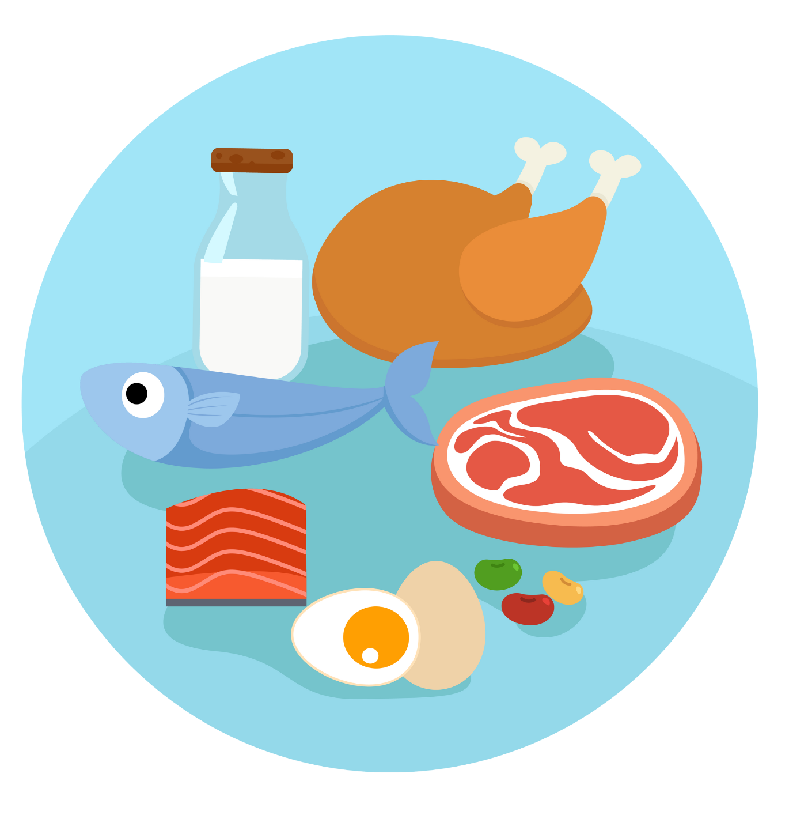
UNIT 2 – PICNIC TIME!
Lesson 3A – Vocabulary and Grammar 1

Slide 2
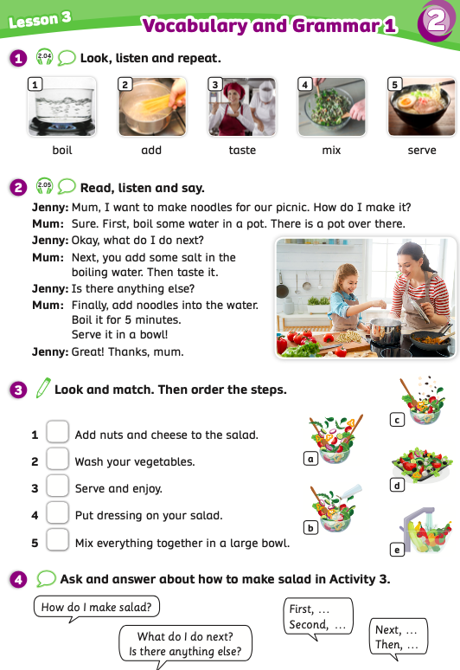
UNIT 2 – Lesson 3A
We’re learning…
to read and pronounce the verb used in cooking.
- PB p.25
- AB p.20

Slide 3
WARM-UP ACTIVITY
Activity: CROSSWORDS GAME
Divide the class into groups of 4. Each group takes out a sheet of paper.
Show the slide with 6 numbers and 6 lines. Students look at, discuss and complete 6 words.
Each member takes a turn writing a word. After finishing, they raise the paper to check the answers.
The fastest group with all the correct answers receives 2 points.

Slide 4
WARM-UP ACTIVITY
1
S
A
L
A
D
2
N
O
O
D
L
E
S
3
C
U
P
C
A
K
E
S
4
C
R
I
S
P
S
5
S
A
N
D
W
I
C
H
E
S
6
C
E
R
E
A
L
- Click on “Number” to show the answer word.

Slide 5
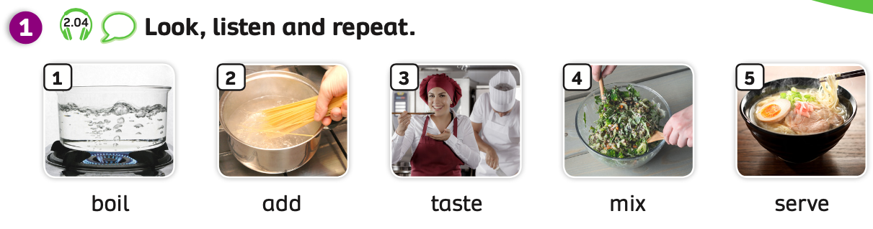

VOCABULARY
Have students look at the pictures and explain that in this lesson they will learn some verbs used in cooking.
Students listen and point to each picture.

Slide 6
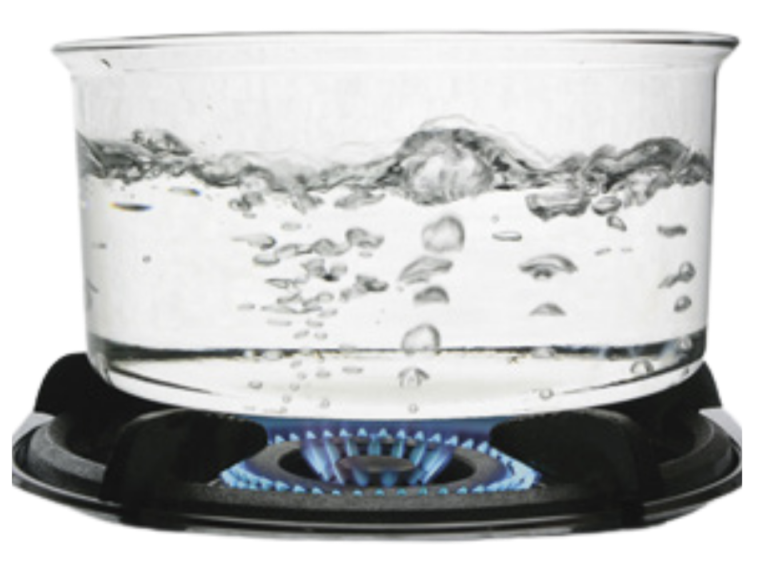

VOCABULARY
Let’s spell!
c
boil
b
o
i
l
Have students look at the pictures, listen, repeat and spell the word.

Slide 7
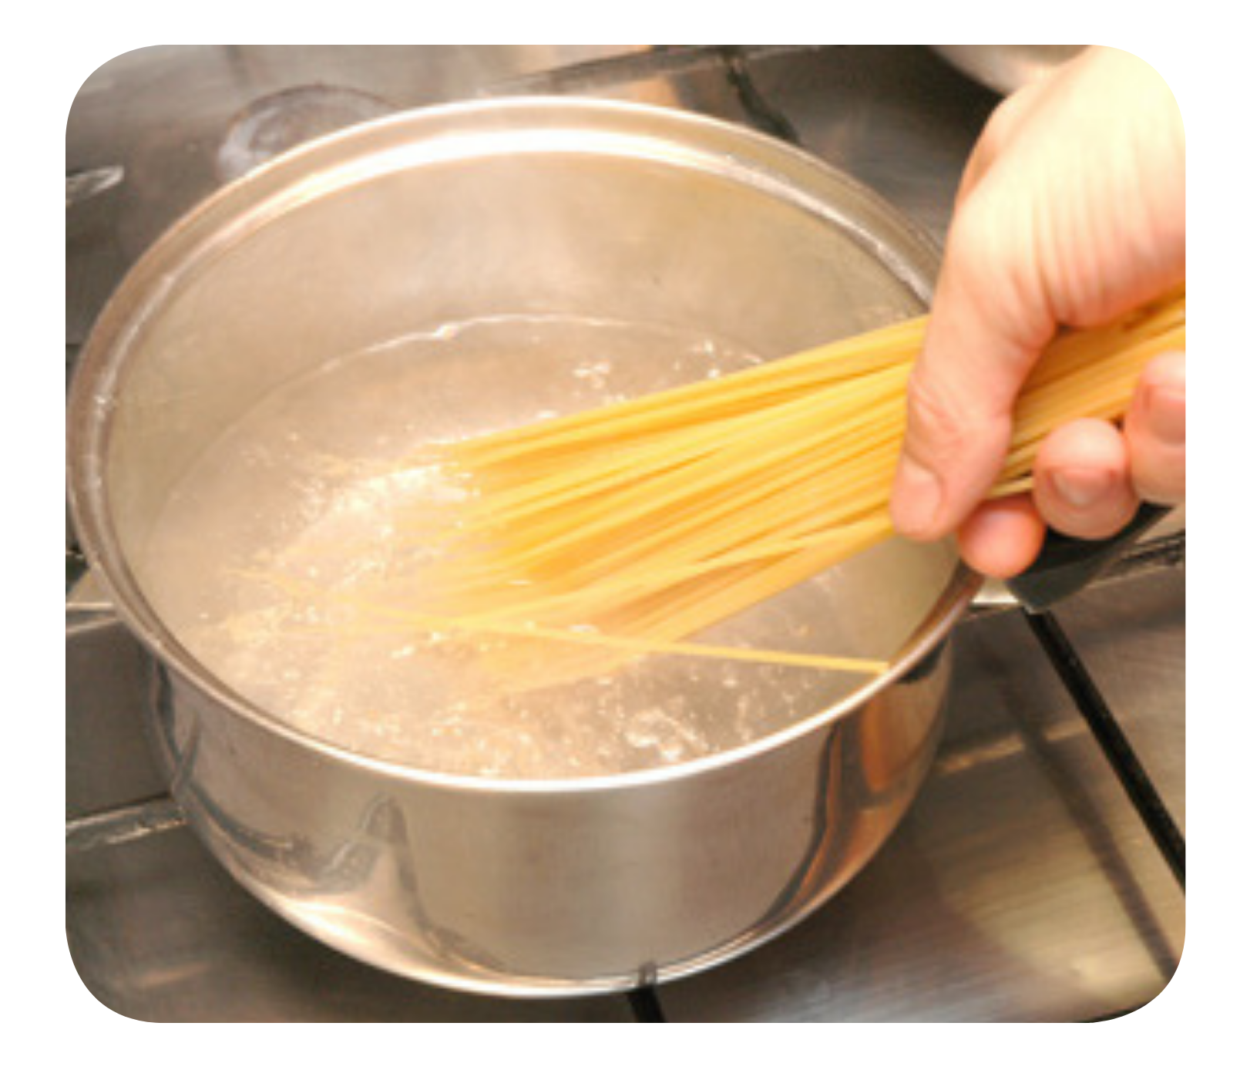
VOCABULARY
Let’s spell!
c
add
a
d
d
Have students look at the pictures, listen, repeat and spell the word.

Slide 8
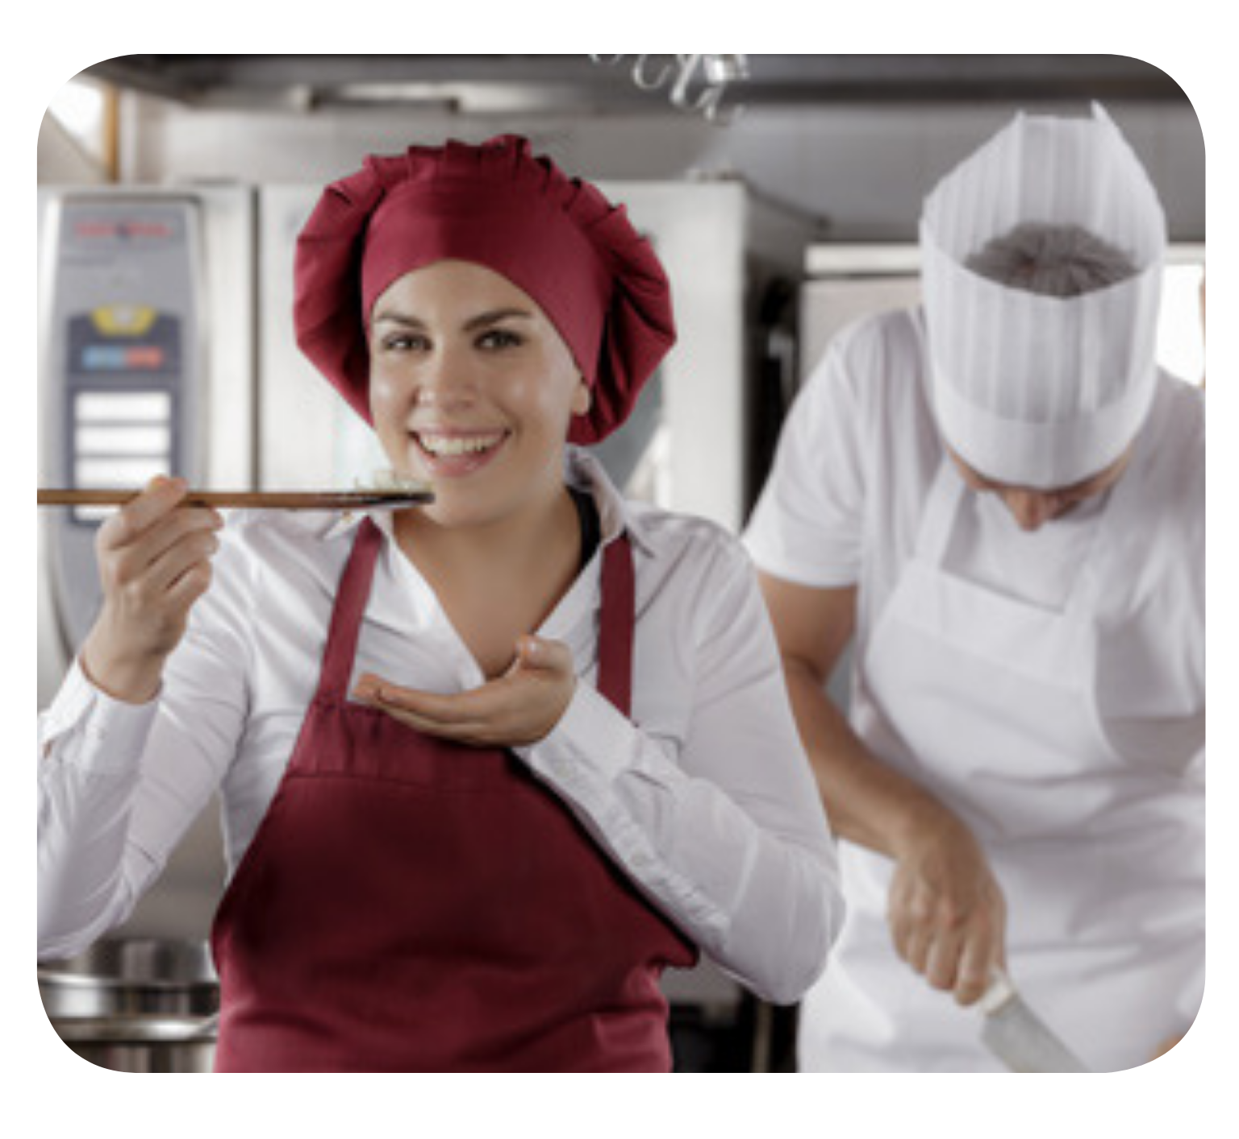
VOCABULARY
Let’s spell!
c
taste
t
a
s
t
e
Have students look at the pictures, listen, repeat and spell the word.

Slide 9
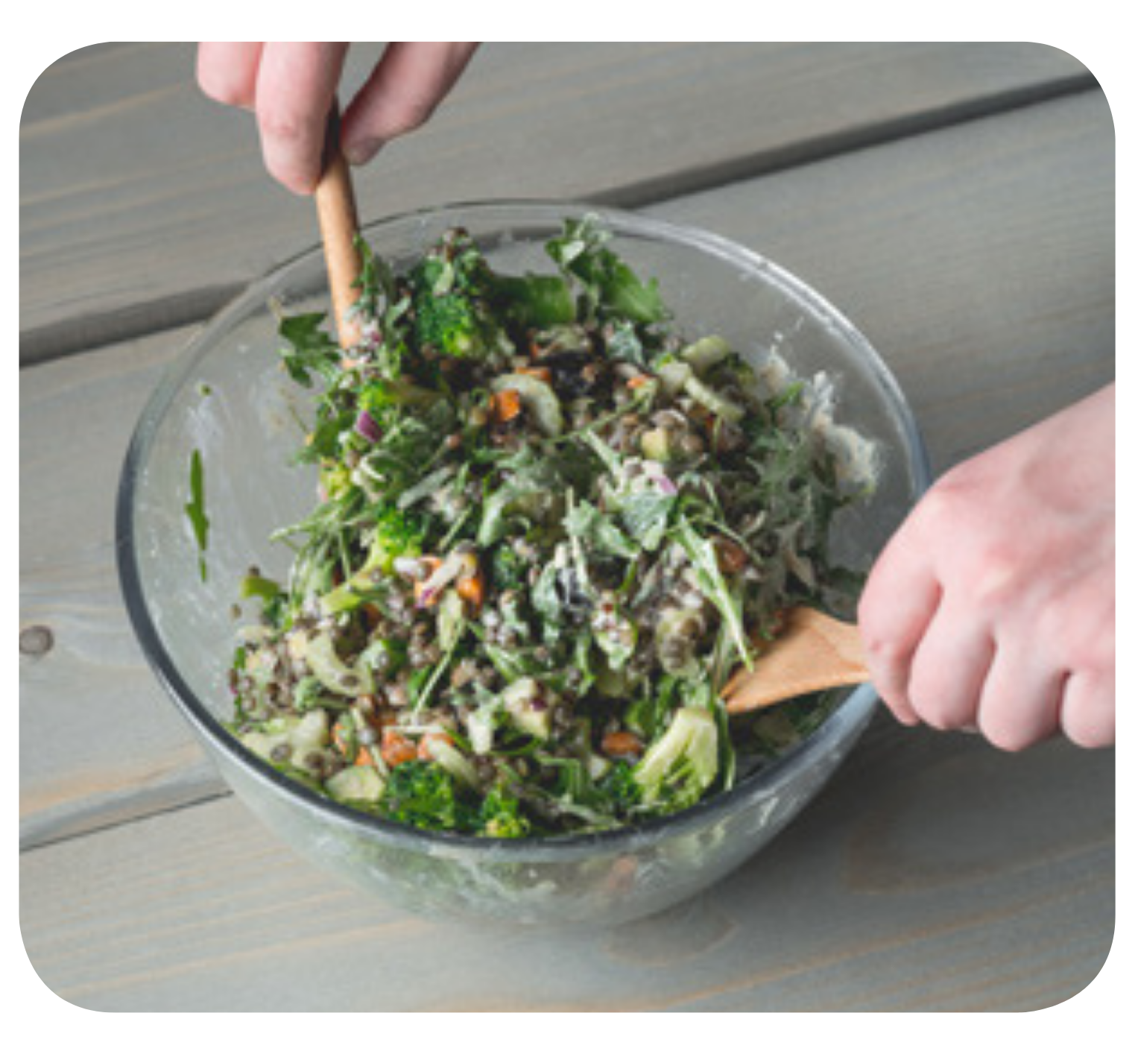
VOCABULARY
Let’s spell!
c
mix
m
i
x
Have students look at the pictures, listen, repeat and spell the word.

Slide 10
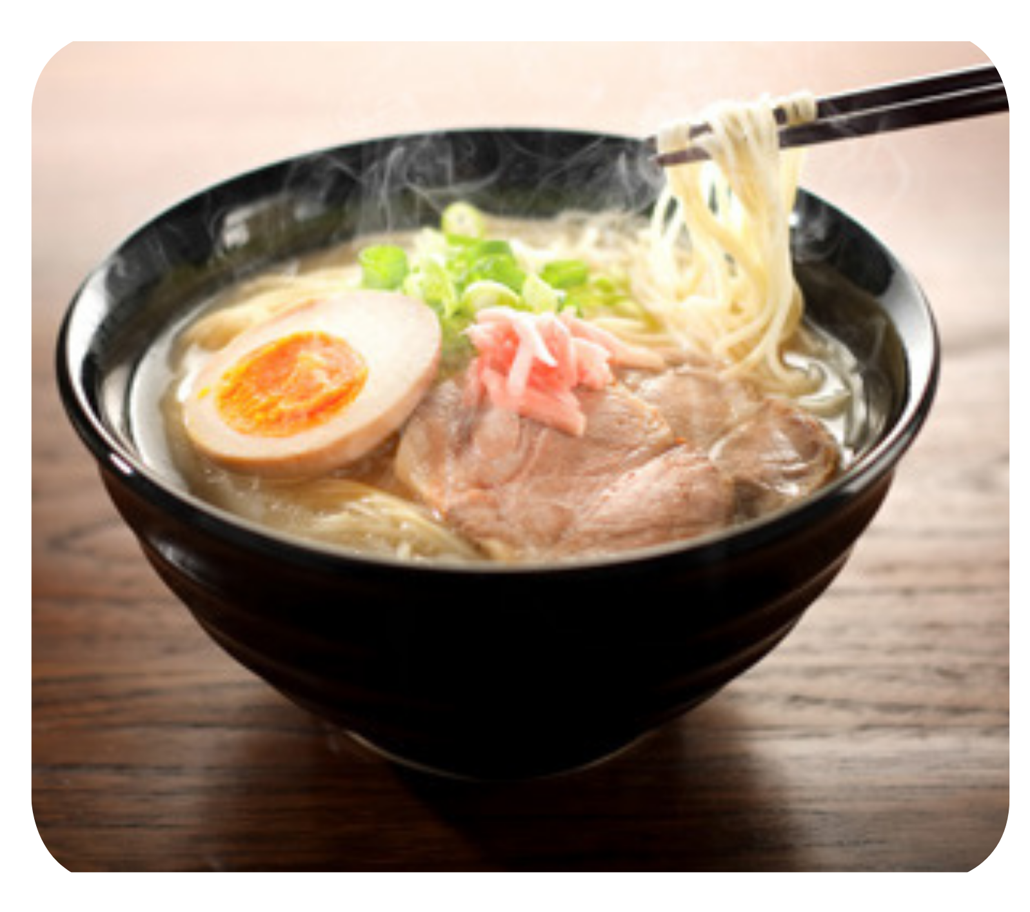
VOCABULARY
Let’s spell!
c
serve
s
e
r
v
e

Slide 11
VOCABULARY - REVIEW
1
2
3
4
5
boil
add
taste
mix
serve
The teacher says a number and the students say a word.
Click on “Number” to show the word to check.

Slide 12
VOCABULARY - Practice
Activity: LISTEN AND WRITE
Put students work in groups of 4. Each group takes out a mini-board.
Each member takes a turn coming to play the game.
The teacher spells a word. Ex: “m-i-x”
Students listen and write a correct word on the board. After finishing, they raise their board to check the answers.
The fastest student with the correct word receives 2 points for the team.

Slide 13





VOCABULARY - Practice
m – i – x
mix
mix
mex
mxi

Slide 14
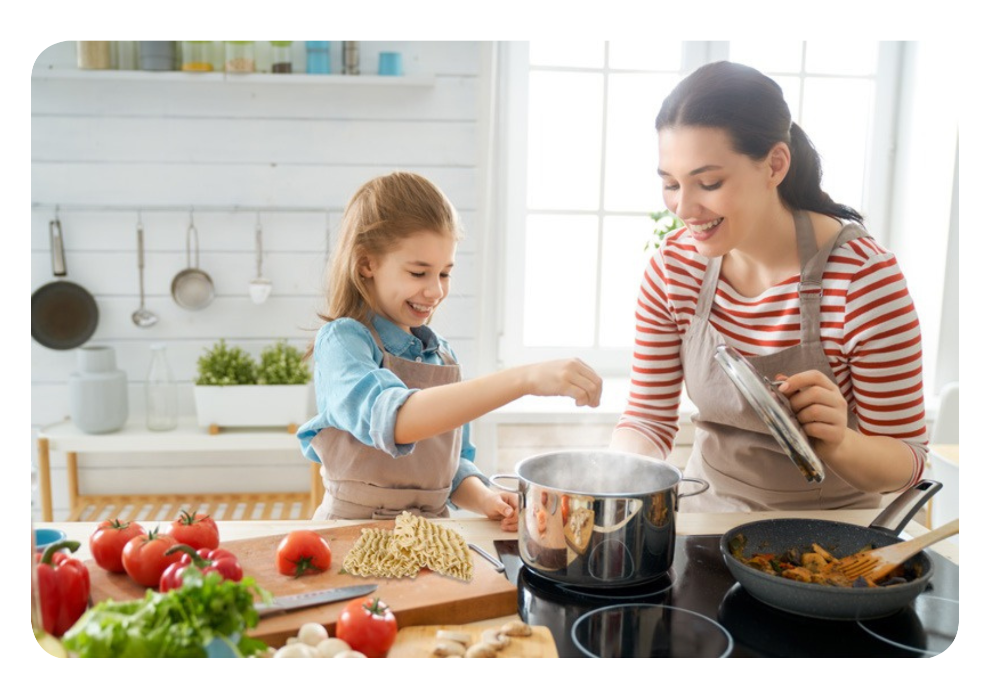
GRAMMAR
Let’s listen to the conversation between mum and Jenny!
What are they doing?
Look at the picture!
They’re cooking.

Slide 15
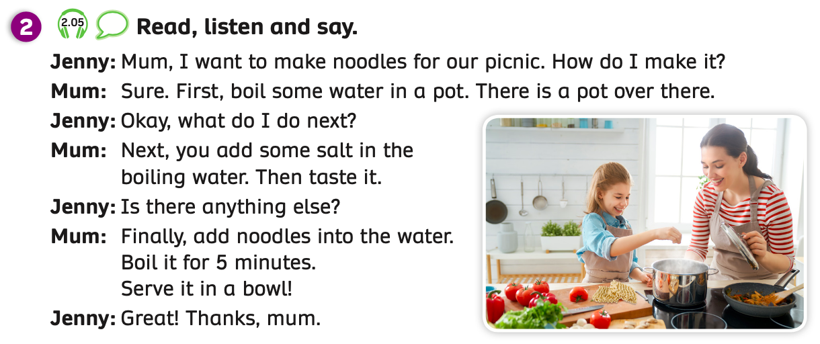
GRAMMAR
Have students look at the conversation.
Play the audio, students listen to the dialogue.

Slide 16


GRAMMAR
Mum, I want to make noodles for our picnic.
Sure. First, boil some water in a pot.
How do I make it?
There is a pot over there.
Have students look at the example bubbles.
They listen and repeat.

Slide 17
GRAMMAR
Next, you add some salt in the boiling water. Then taste it.
Okay, what do I do next?
Have students look at the example bubbles.
They listen and repeat.

Slide 18
GRAMMAR
Finally, add noodles into the water. Boil it for 5 minutes.
Serve it in a bowl!
Great! Thanks, mum.
Is there anything else?
Have students look at the example bubbles.
They listen and repeat.

Slide 19
GRAMMAR
STRUCTURE – QUESTION?
Ask these questions when you want to make a meal.
- How do I make it?
- What do I do next?
- Is there anything else?

Slide 20
GRAMMAR
STRUCTURE – ANSWERS
We will use:
First, ……………………
Next, ……………………
Then, …………………..
Finally, ………...........

Slide 21
GRAMMAR - Practice
Activity: READ AND MATCH
Ask students to close their books and take out a mini-board.
Students look at the words and sentences on the slide and write the answers on the board. Ex: a - 1, b – 2, ….
After finishing, students raise their boards to check.
The 5 first students with the correct answer receive 2 points.

Slide 22
GRAMMAR - Practice
How to make noodles
a – First,……..
1. You add some salt in the boiling water and taste it.
b – Next,……..
2. You add noodles into the water.
3. You boil some water in a pot.
c – Then,……..
d – Finally,……..
4. You boil it for 5 minutes and serve it in a bowl.
ANSWER

Slide 23
GRAMMAR - Practice
Activity: ARRANGE THE WORDS
Ask students to take out a mini-board. Put students into groups of 4.
Students look at a question with the unscrambled words and write them into the correct sentence. All students in the group have to write the sentence on the board.
After finishing, students raise their boards to check.
The fastest group with the correct answer receives 2 points.
Divide the class into 2 teams. One team asks and one team answers the question.

Slide 24




The little penguins
MsPham-0936082789
PLAY
Notes:
MsPham-0936082789

Slide 25
How do I make noodles?
water/boil/a/in/pot/,/First/ some/you/.
MsPham-0936082789
First, you boil some water
in a pot.
Next
Start
Check
Notes:
MsPham-0936082789

Slide 26
What do I do next?
you/some/Next/salt/the/boiling/, add/in/water/./
MsPham-0936082789
Next, you add some salt in the boiling water.
Next
Start
Check
Notes:
MsPham-0936082789

Slide 27
Is there anything else?
into/add/noodles/you/./Finally/the/,/water
MsPham-0936082789
Finally, you add noodles into the water.
Next
Start
Check
Notes:
MsPham-0936082789

Slide 28
Is there anything else?
noodles/for/boil/5 minutes/it/ You/serve/bowl/a/in/./and
MsPham-0936082789
You boil noodles for 5 minutes and serve it in the bowl.
Next
Start
Check
Notes:
MsPham-0936082789

Slide 29
Good job!
MsPham-0936082789
EXIT
Notes:
MsPham-0936082789

Slide 30
PRODUCE
Activity: PAIR CONVERSATIONS
Put students into pairs.
Ask students to look at the bubbles.
One student asks the questions and one student answers. Then, they switch roles.
After finishing, they say Bingo.
Call out some pairs to present in front of the class.

Slide 31


PRODUCE
Activity: PAIR CONVERSATIONS
How do you make noodles?
First, I ………….
Next, I …………
Then, …………
Finally, …………

Slide 32

HOMEWORK
Review vocabulary and grammar.
Do exercises in the Activity Book (page 20).
Check answers in the Teacher’s Book (page 46) or Active Teach.

Slide 33
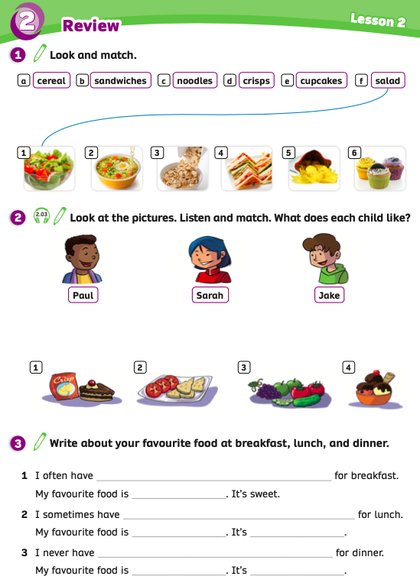
UNIT 2 – Lesson 3A
We’ve learned…
to read and pronounce the verb used in cooking.
- PB p.25
- AB p.20

