Slide 1

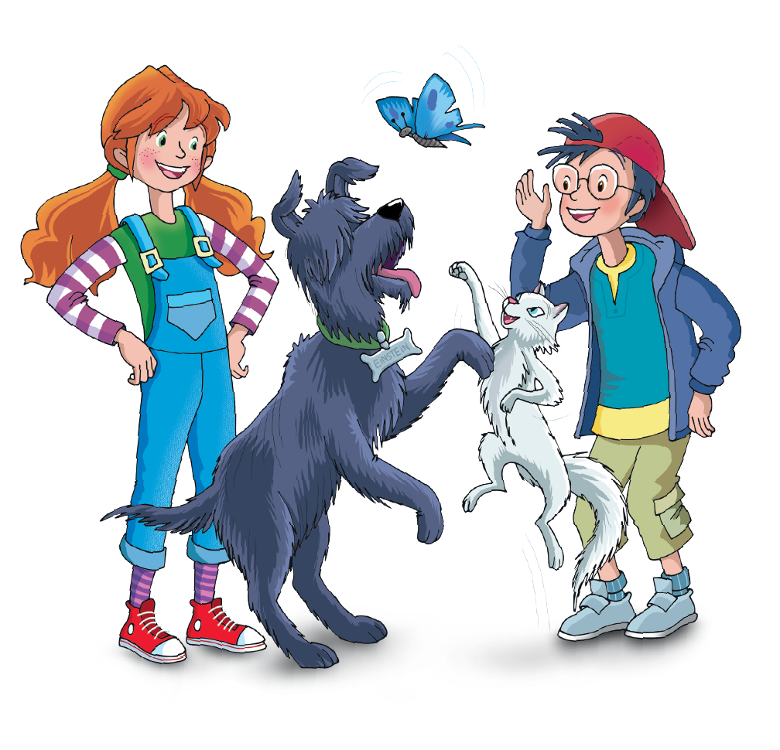

UNIT STARTER – BACK TO SCHOOL
Lesson 1 – Common Greetings

Slide 2

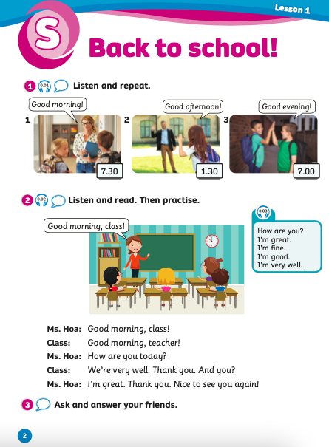
UNIT STARTER
Lesson 1
We’re learning…
- the common greetings
- PB p.2
- AB p.4

Slide 3
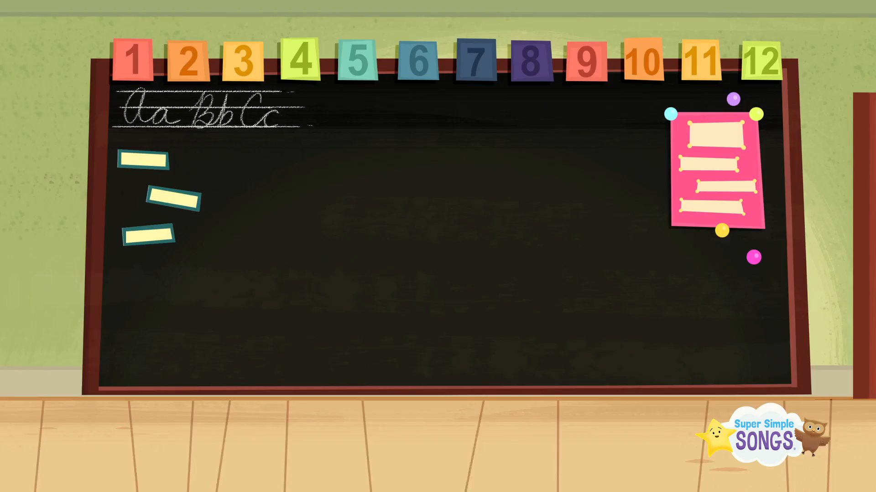
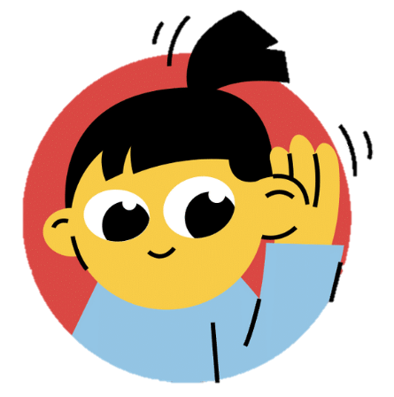
Song: The Hello Song
WARM-UP
Stand up.
Listen to the song.
Raise your hands and sing along.

Slide 4
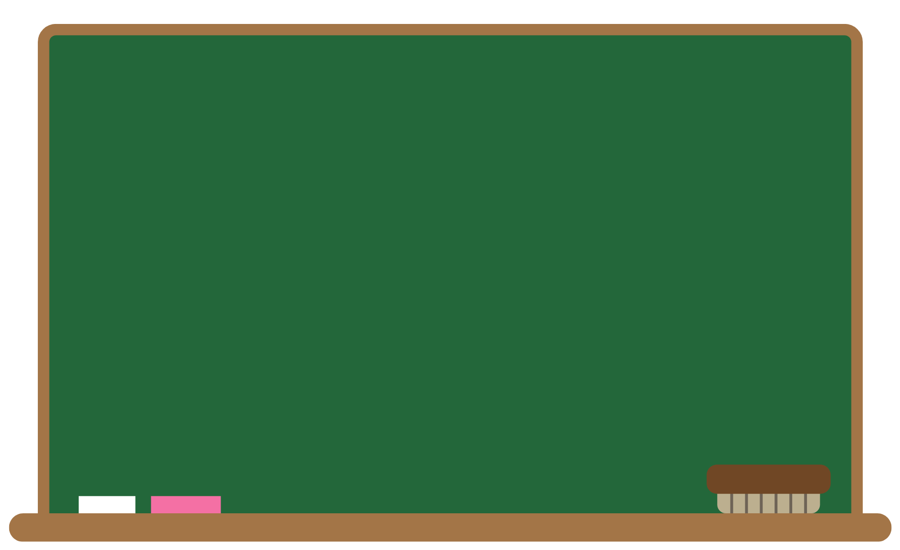
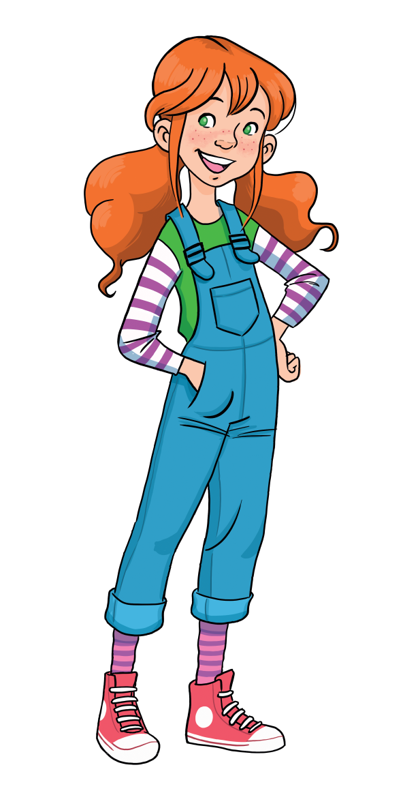
LEAD-IN
What time is it?
7.00
It’s seven o’clock.
Notes:
The teacher asks and students answer.

Slide 5
LEAD-IN
What time is it?
7.30
It’s seven thirty.
Notes:
The teacher asks and students answer.

Slide 6
LEAD-IN
What time is it?
8.30
It’s eight thirty.
Notes:
The teacher asks and students answer.

Slide 7
LEAD-IN
What time is it?
12.00
It’s twelve o’clock.
Notes:
The teacher asks and students answer.

Slide 8
LEAD-IN
What time is it?
10.30
It’s half past ten.
Notes:
The teacher asks and students answer.

Slide 9

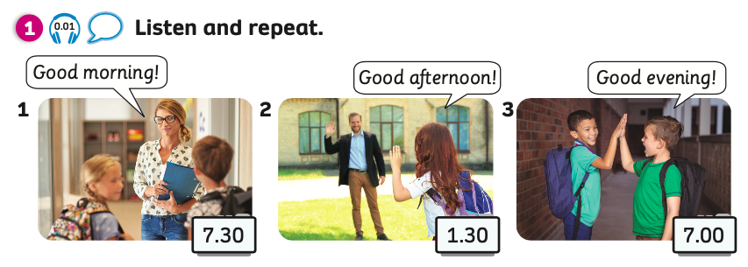
PUPIL’S BOOK (p.2)
Notes:
Teacher plays an audio. Ss look at the picture and repeat.

Slide 10
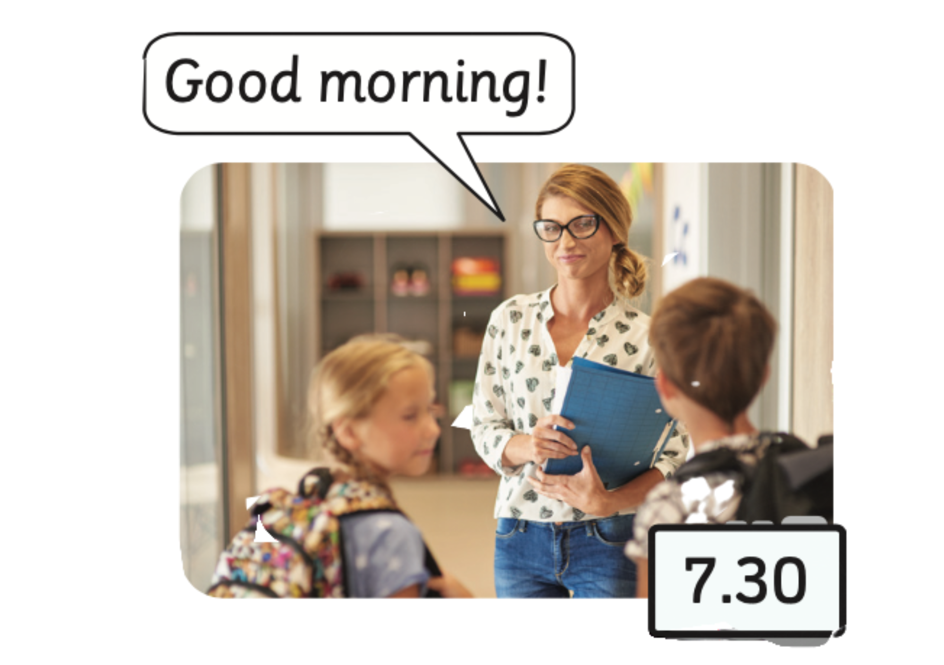

COMMON GREETINGS
Listen and repeat
Good morning!

Slide 11
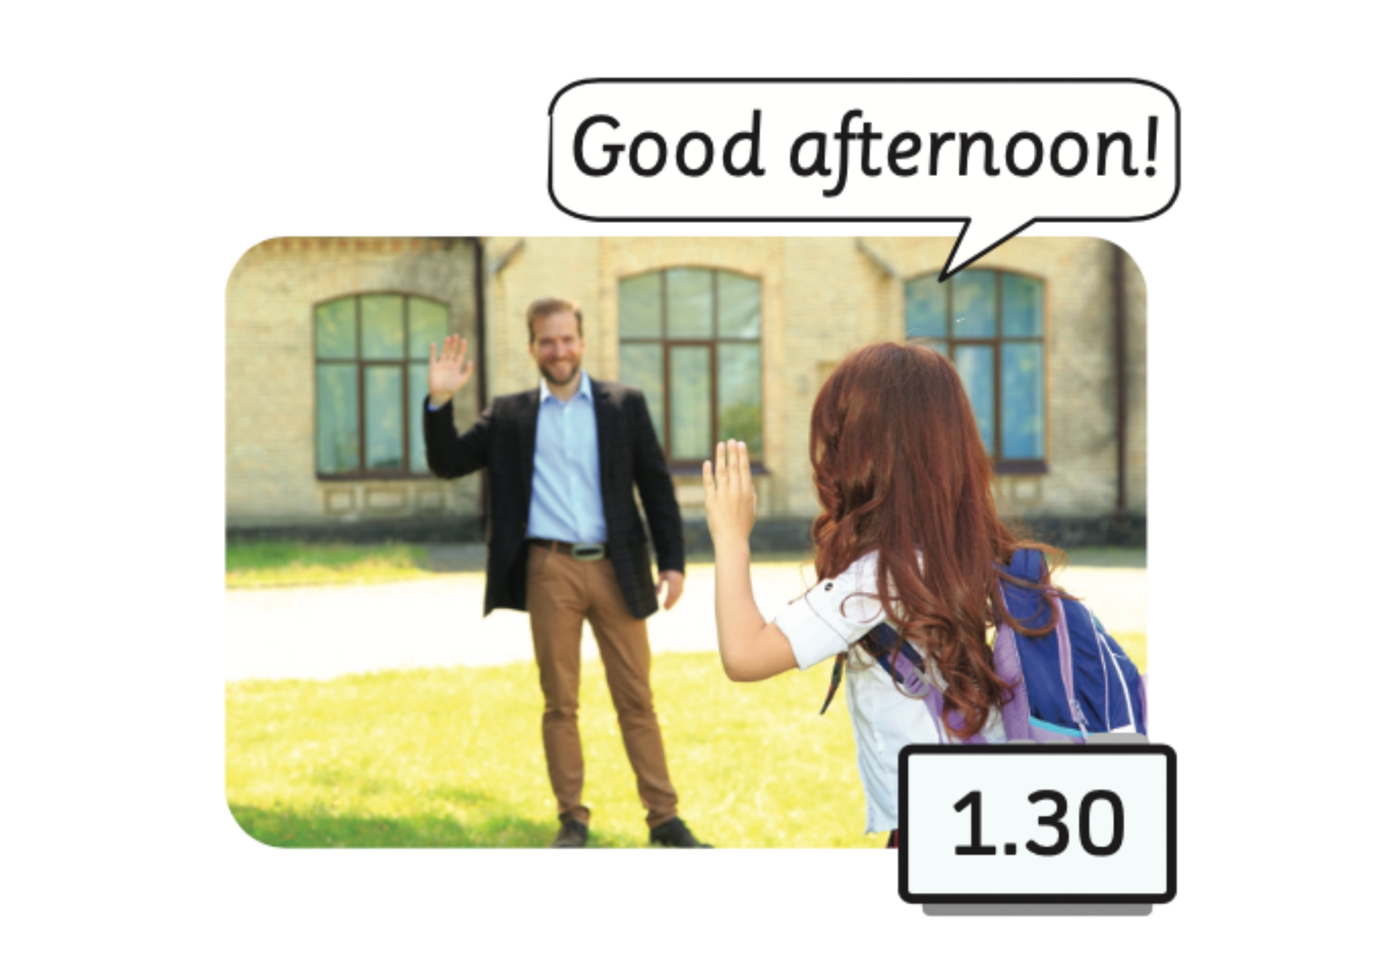

Listen and repeat
COMMON GREETINGS
Good afternoon!

Slide 12
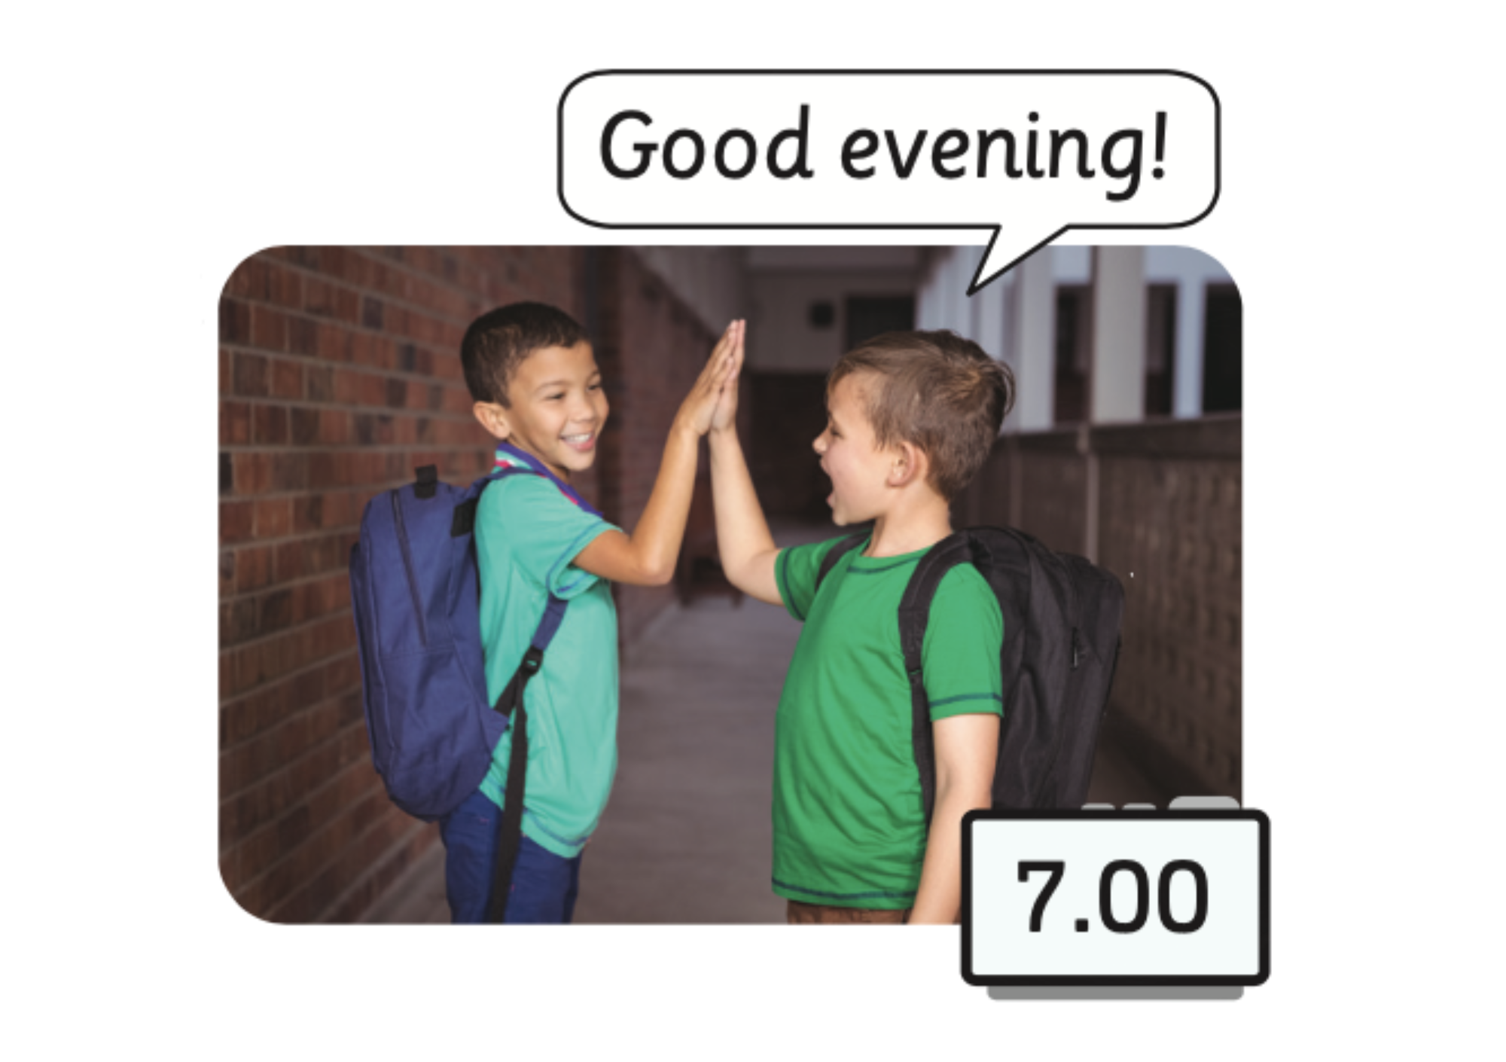

Listen and repeat
COMMON GREETINGS
Good evening!

Slide 13

PRACTICE
1
✩ ✩
2
✩ ✩ ✩
3
✩
4
✩ ✩
5
✩ ✩
6
✩ ✩ ✩
Choose a square by saying its number.
Look at the picture and say the correct common greeting.
Click “Show all” to check the answer.
Get your stars on the square you choose.
7
✩ ✩
8
✩
9
✩ ✩

Slide 14
PRACTICE
1
✩ ✩
2
✩
3
✩ ✩ ✩
Good morning!
4
✩ ✩
5
✩ ✩
6
✩ ✩ ✩
7
✩ ✩
8
✩
9
✩ ✩

Slide 15
PRACTICE
1
✩ ✩
2
✩
3
✩
Good evening!
4
✩ ✩ ✩
5
✩ ✩
6
✩ ✩ ✩
7
✩ ✩
8
✩
9
✩ ✩

Slide 16
PRACTICE
1
✩ ✩
2
✩
3
✩ ✩ ✩
Good morning!
4
✩ ✩
5
✩
6
✩ ✩
7
✩ ✩
8
✩
9
✩ ✩

Slide 17
PRACTICE
1
✩ ✩
2
✩ ✩
3
✩
Good afternoon!
4
✩
5
✩ ✩
6
✩ ✩
7
✩ ✩
8
✩ ✩
9
✩ ✩

Slide 18
PRACTICE
1
✩
2
✩
3
✩✩ ✩
Good evening!
4
✩ ✩
5
✩ ✩
6
✩ ✩ ✩
7
✩
8
✩ ✩
9
✩ ✩

Slide 19
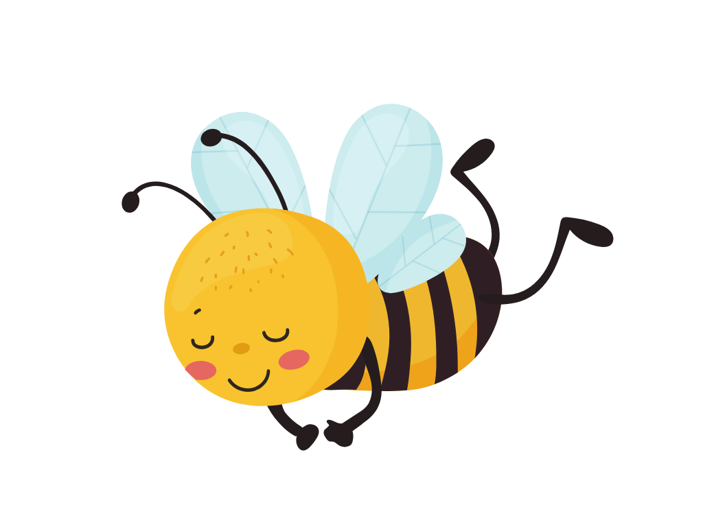
PRACTICE
How to play:
Divide class into teams.
Choose the correct bee.
Receive 2 points if they have a correct answer.
Good morning!

Slide 20

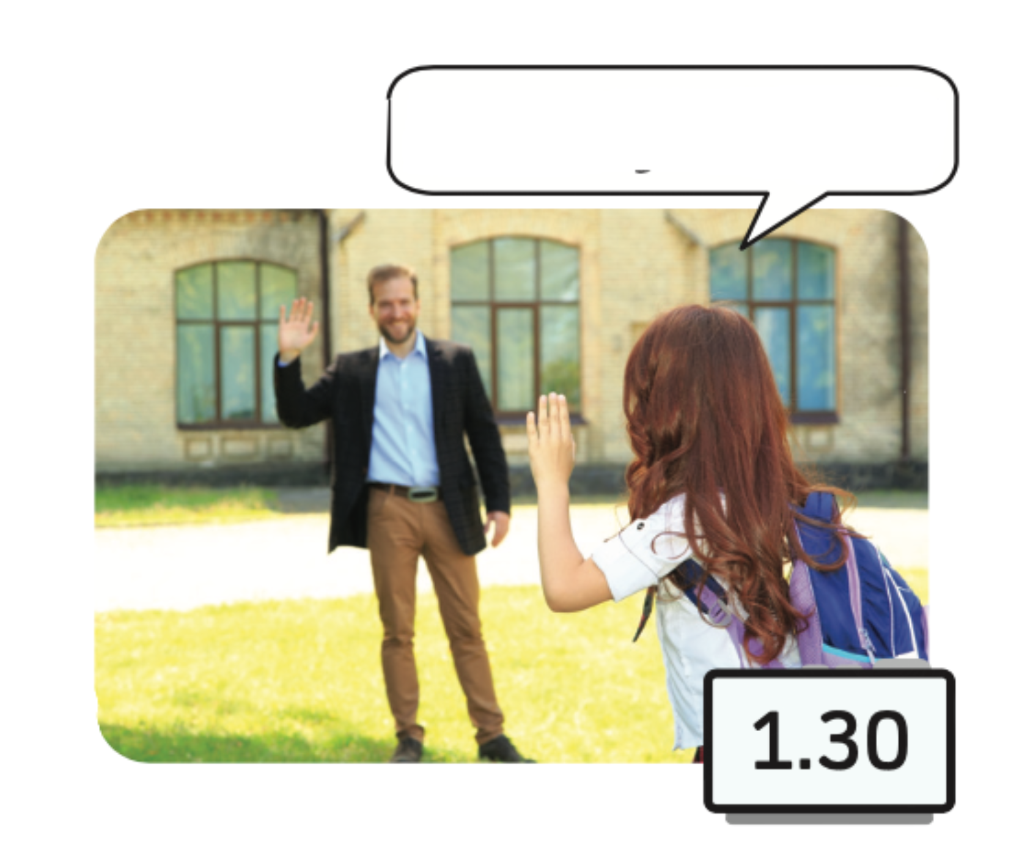
PRACTICE
Good afternoon!
Good morning!
Good evening!
Good afternoon!
Notes:
Click to the bee to choose the correct answer.

Slide 21
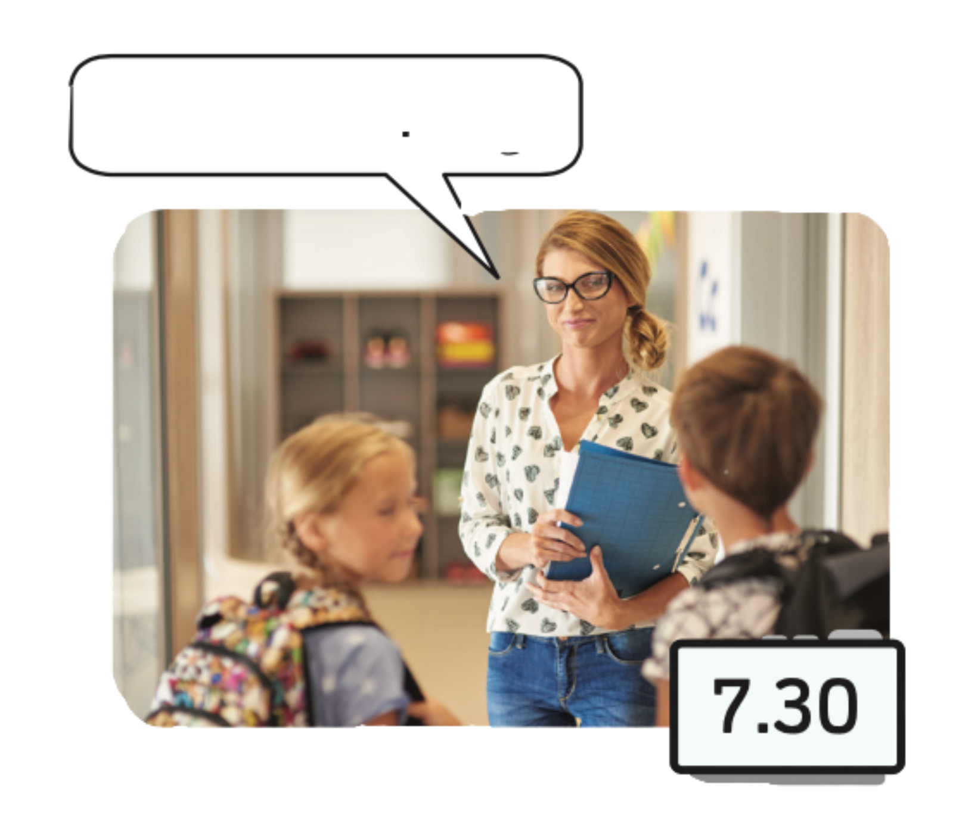
PRACTICE
Good morning!
Good morning!
Good evening!
Good afternoon!
Notes:
Click to the bee to choose the correct answer.

Slide 22
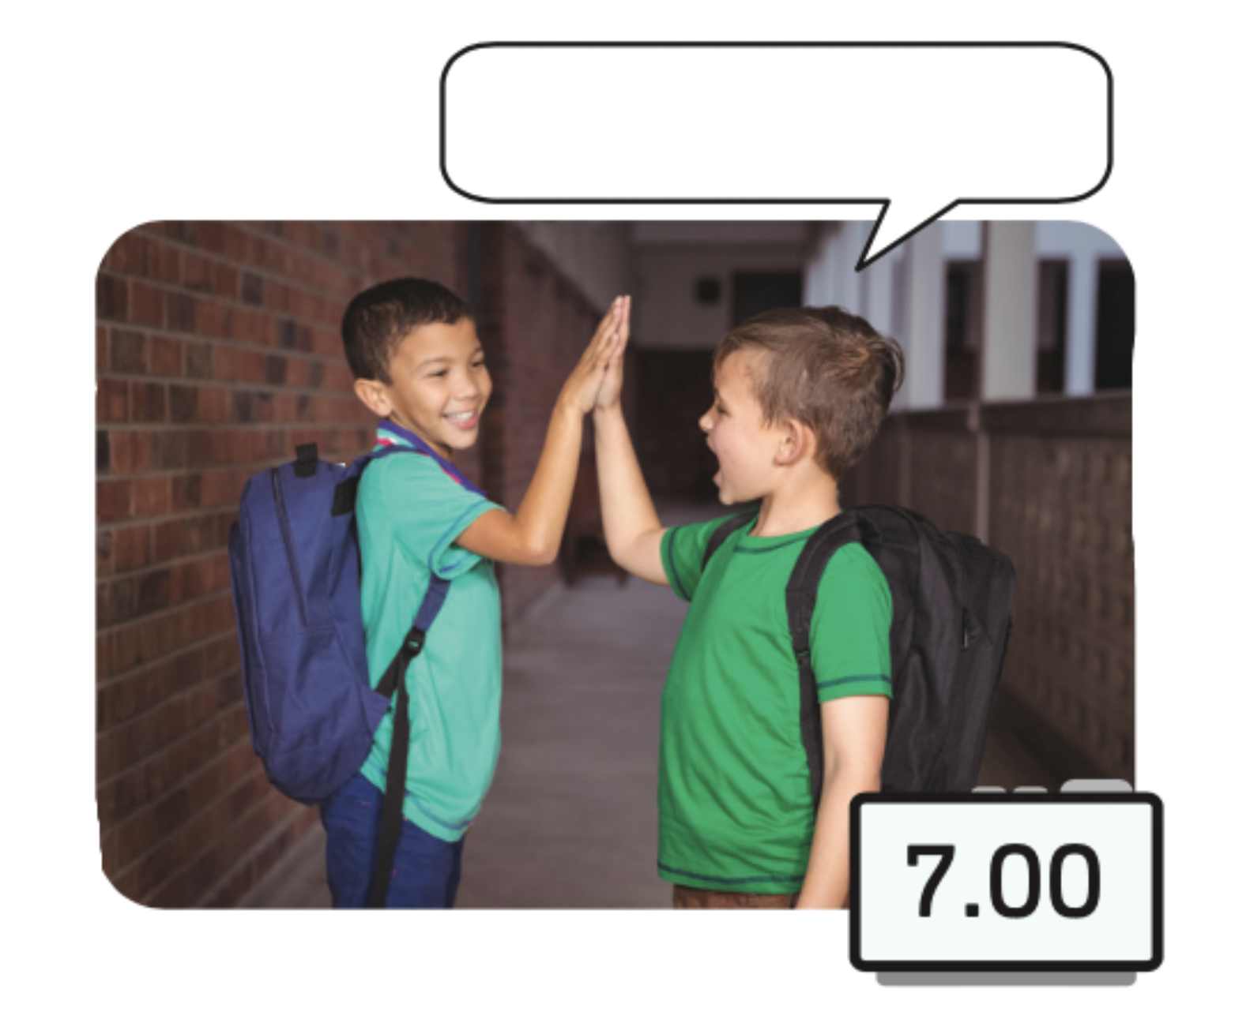
PRACTICE
Good evening!
Good morning!
Good evening!
Good afternoon!
Notes:
Click to the bee to choose the correct answer.

Slide 23
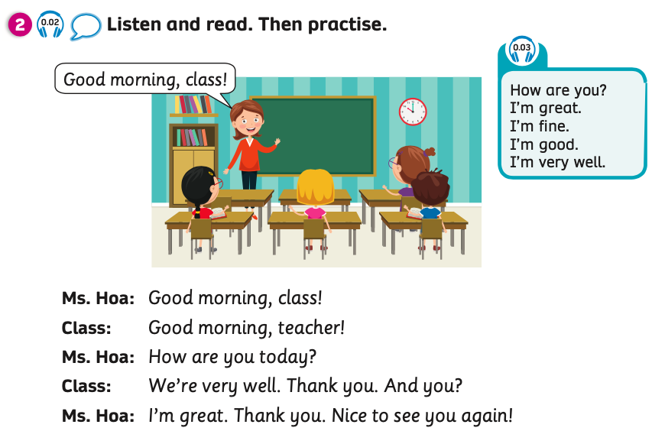
PUPIL’S BOOK (p.2)

Slide 24


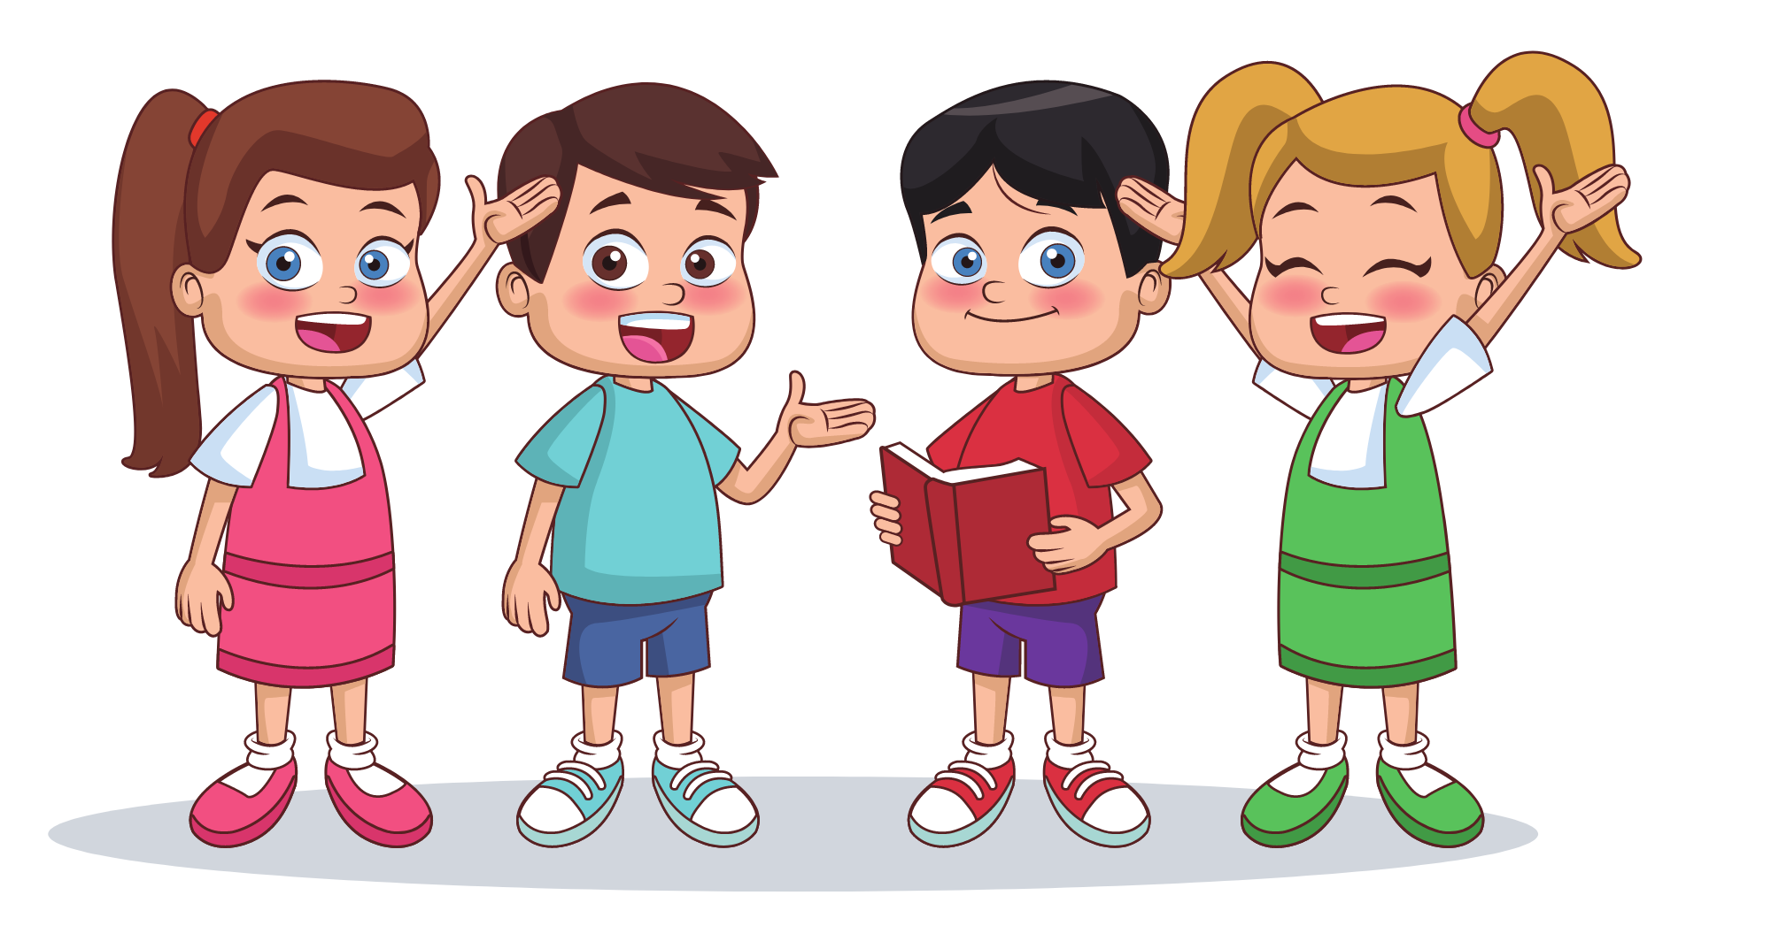
ROLE - PLAY
Put students into groups of four. Choose a teacher for each group.
The groups role-play the dialogue.
Have students switch roles and repeat.

Slide 25
ROLE - PLAY
Good morning, class!
Good morning, teacher!
Notes:
Put students into groups of four.
Choose a teacher for each group.
The groups role-play the dialogue.
Have students switch roles and repeat.

Slide 26
ROLE - PLAY
How are you today?
We’re very well. Thank you. And you?

Slide 27
ROLE - PLAY
I’m great. Thank you. Nice to see you again!

Slide 28
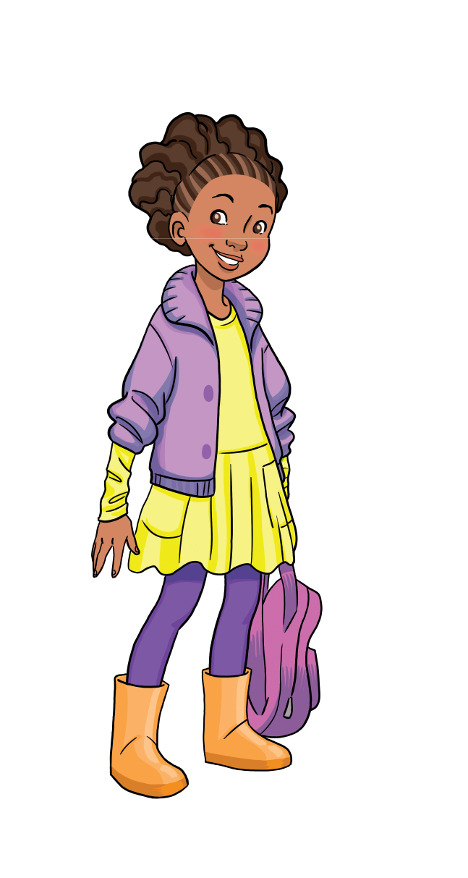
FURTHER PRACTICE
Activity: Read Your Phrase
How to play:
Hand out strips of paper for each student. They write one phrase on each strip.
Put students into groups. They put all their strips together. One group member picks and reads a strip. The others do action.
Continue with all strips of paper.

Slide 29

FURTHER PRACTICE
Suggested Phrases
Good morning!
Good evening!
How are you?
Good afternoon!
I’m great!
Nice to see you again!
I’m very well.
I’m fine!

Slide 30
WRAP-UP
What have you learnt today?
How are you?
Good morning!
Students call out all the phrases of the common greetings.

Slide 31
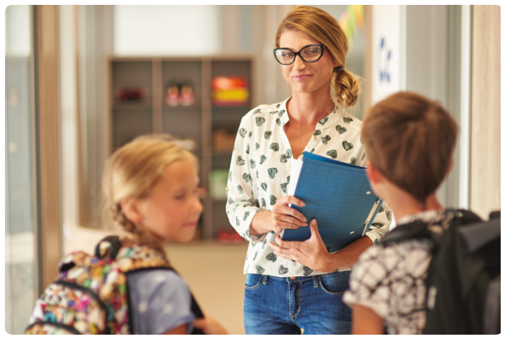
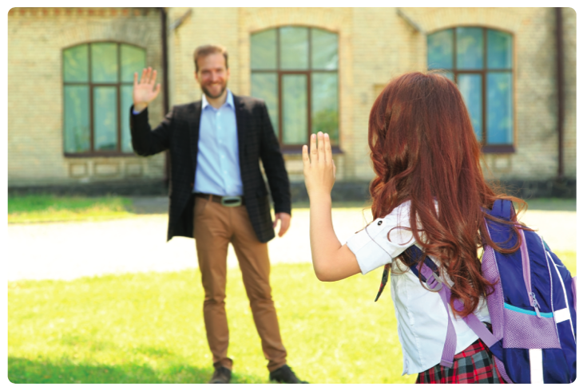
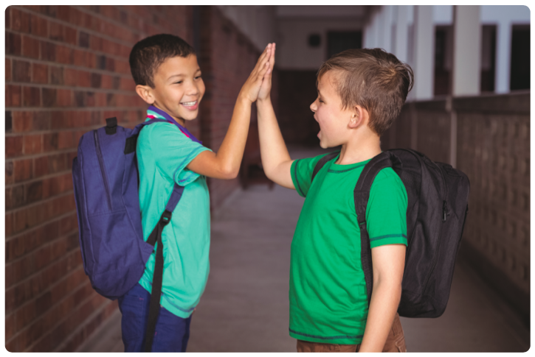
WRAP-UP
Good morning!
Good afternoon!
Good evening!

Slide 32
WRAP-UP
How are you today?
We’re very well. Thank you. And you?

Slide 33
WRAP-UP
I’m great. Thank you. Nice to meet you again!

Slide 34

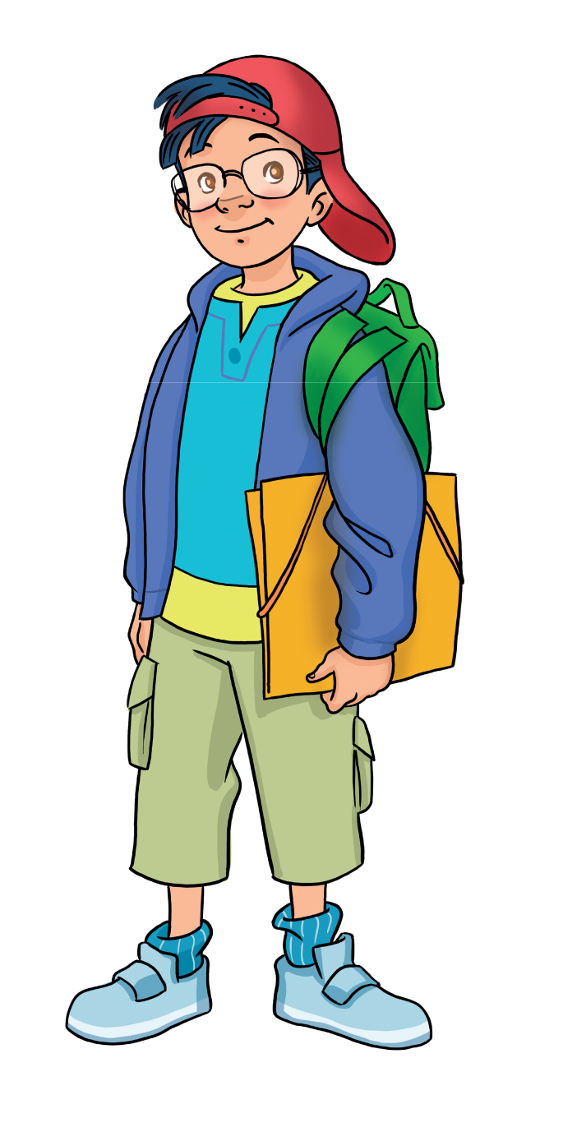

HOMEWORK
Review vocabulary and grammar.
Do exercises in the Activity book (page 4).
Check answers in the Teacher’s book (page 22) or Active Teach.

Slide 35
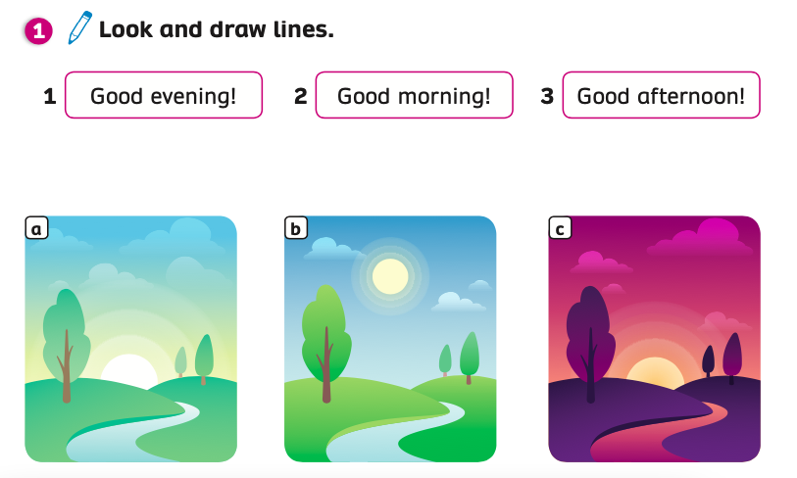
ACTIVITY BOOK (p.4)
Answers

Slide 36

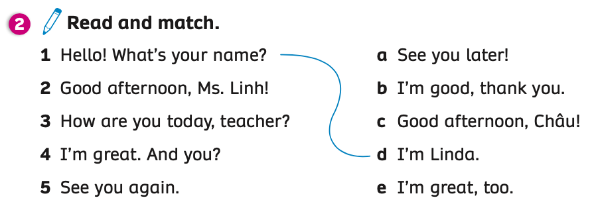
ACTIVITY BOOK (p.4)
Match

Slide 37


ACTIVITY BOOK (p.4)
Nice to see you again.

Slide 38

ACTIVITY BOOK (p.4)
How are you?

Slide 39
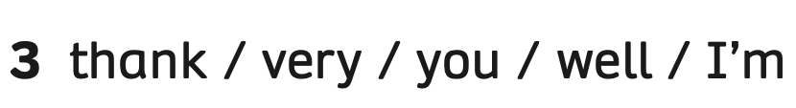
ACTIVITY BOOK (p.4)
I’m very well, thank you.

Slide 40

UNIT STARTER
Lesson 1
We’ve learned…
The Common Greetings

