Slide 1
UNIT 3: WHERE’S MY PEN?
Lesson 5A – Vocabulary and Grammar 3

Slide 2
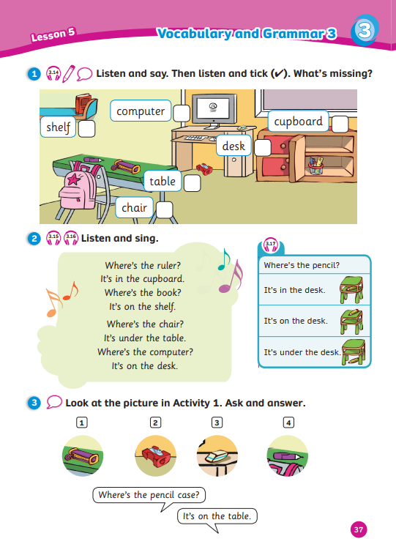
UNIT 3: WHERE’S MY PEN?
We’re learning…
- classroom objects
- to ask and answer about where things are
- SB p.37
- AB p.33

Slide 3
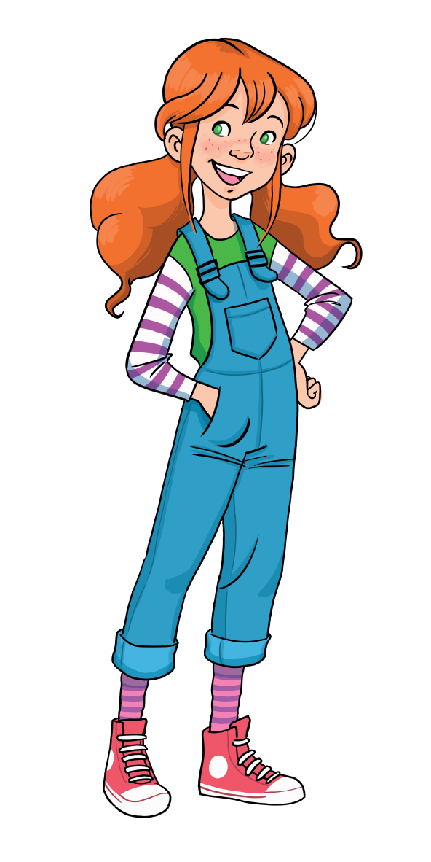
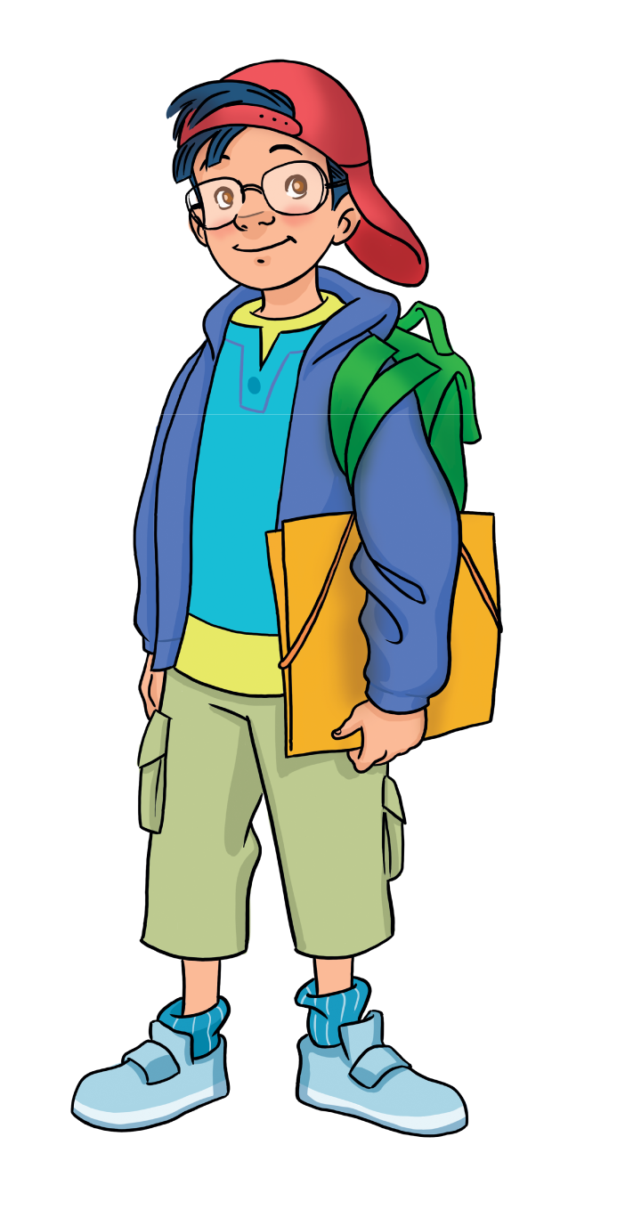
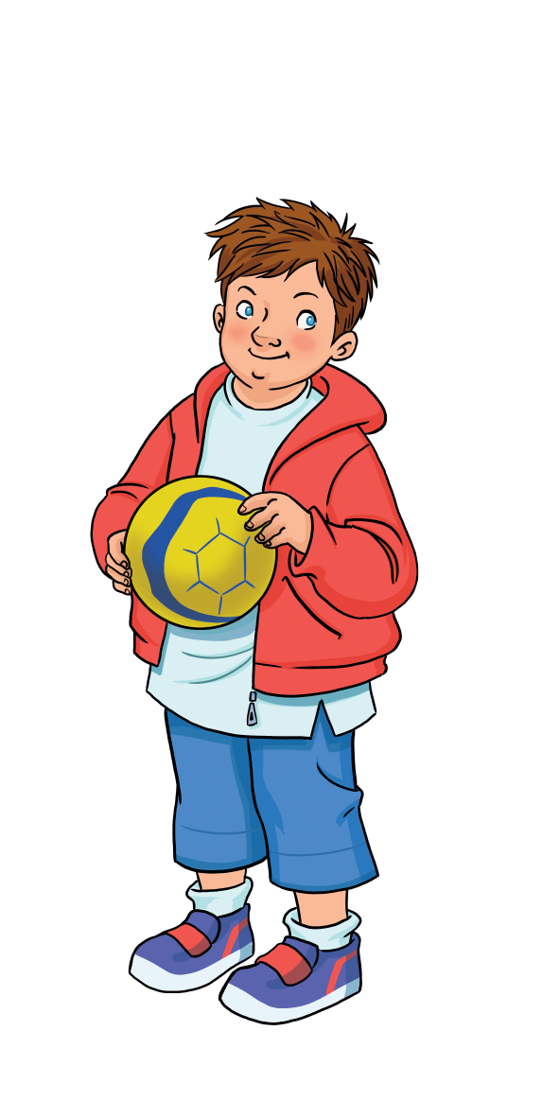
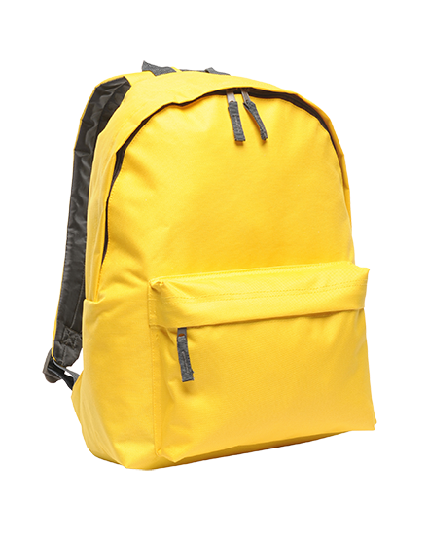
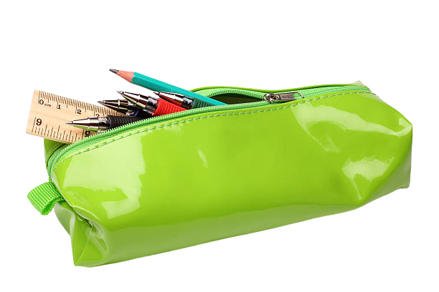
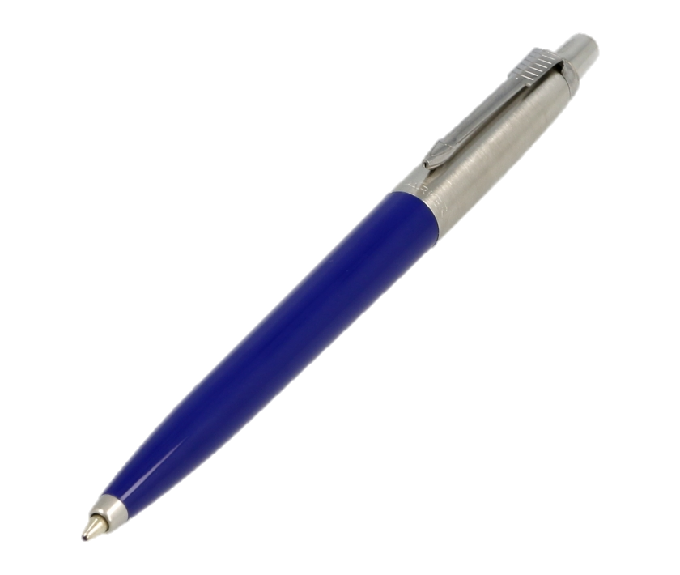
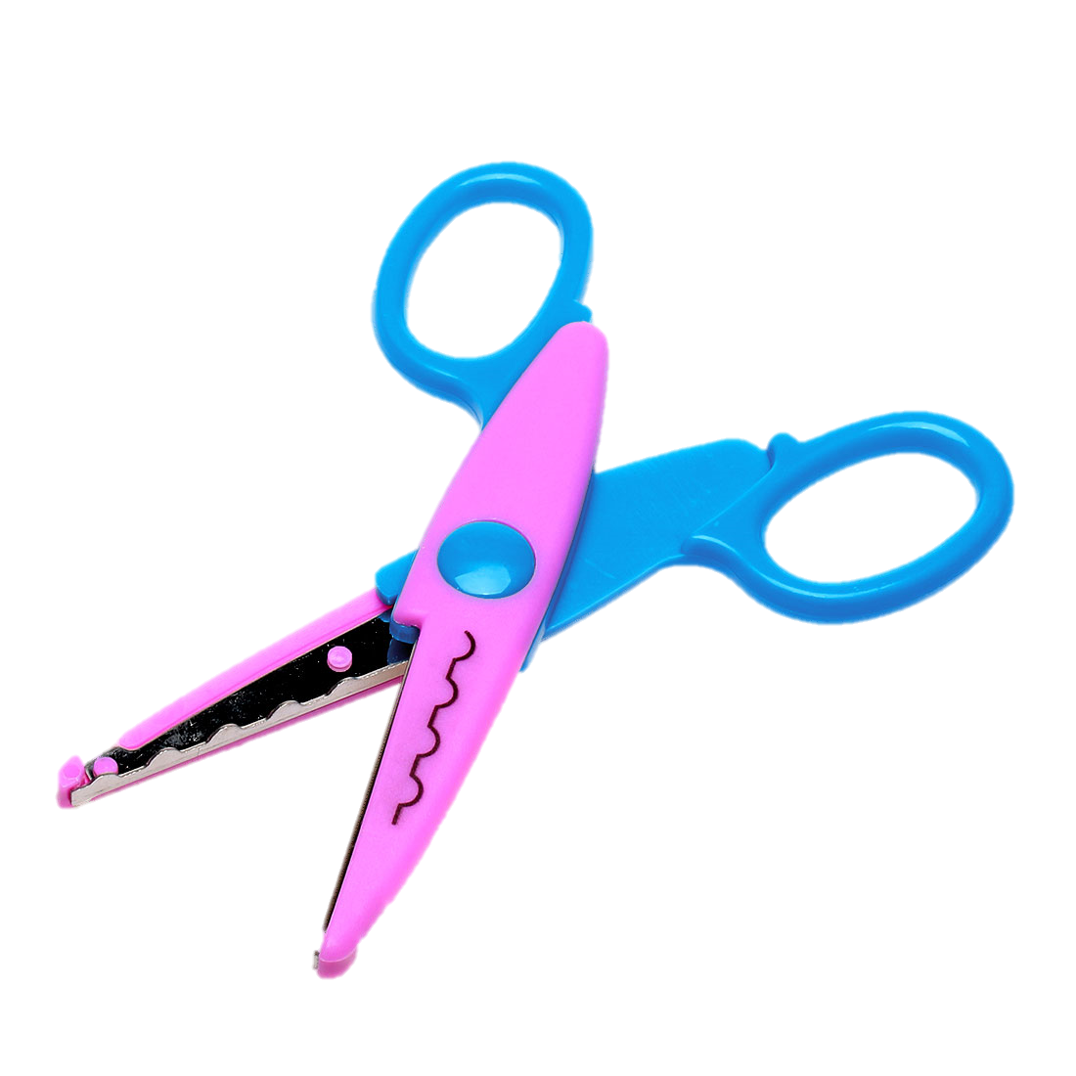
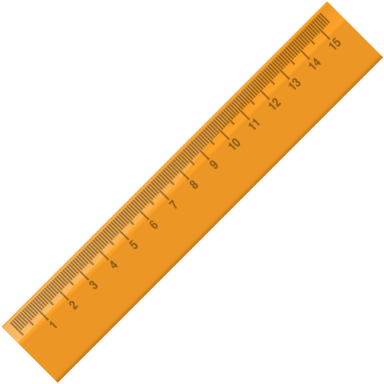
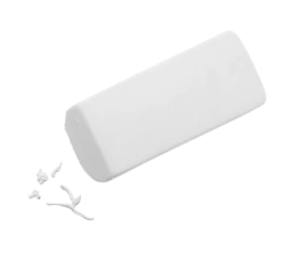
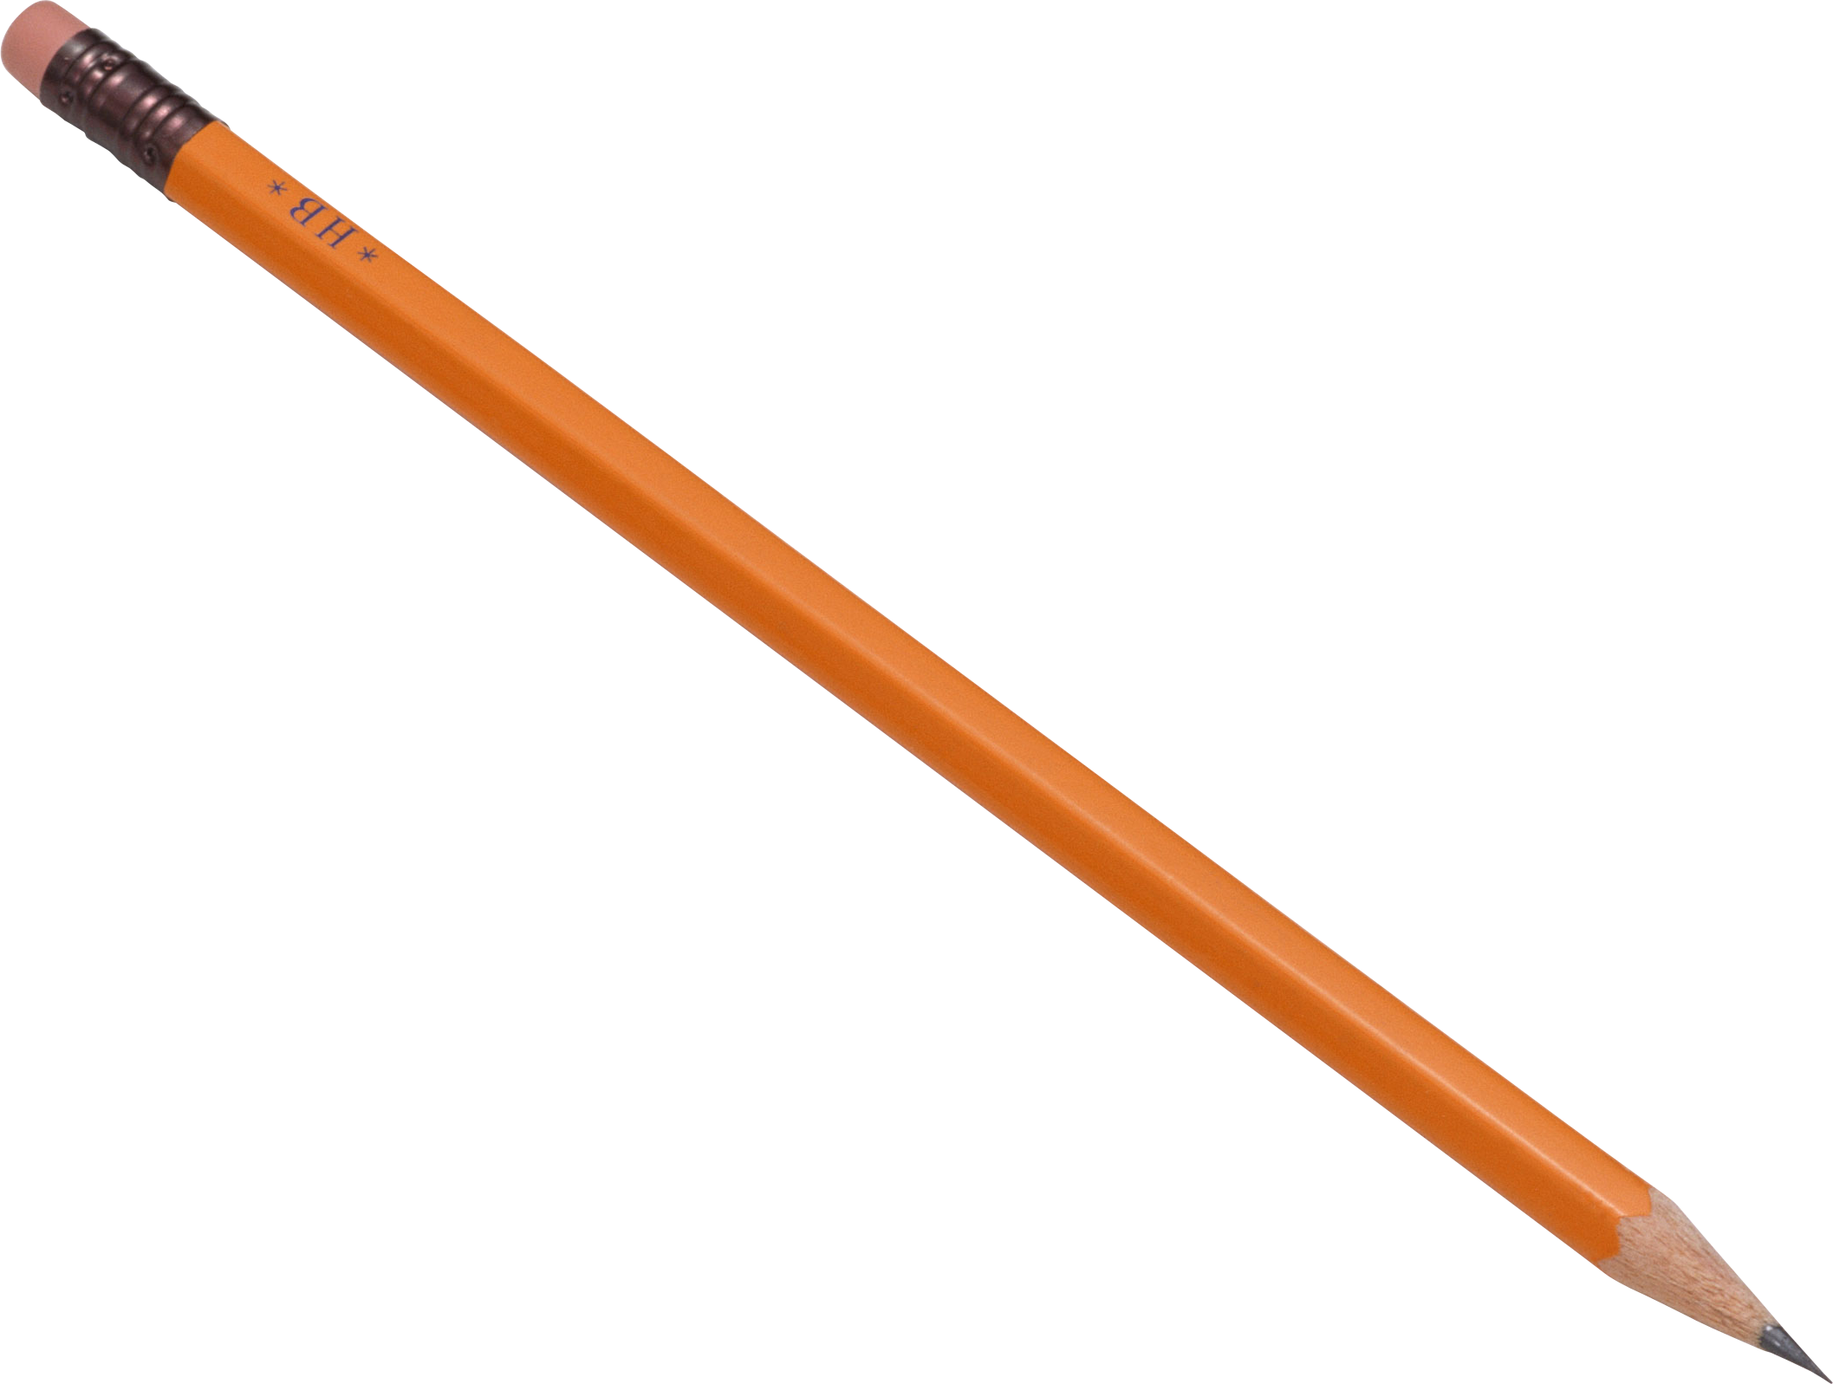
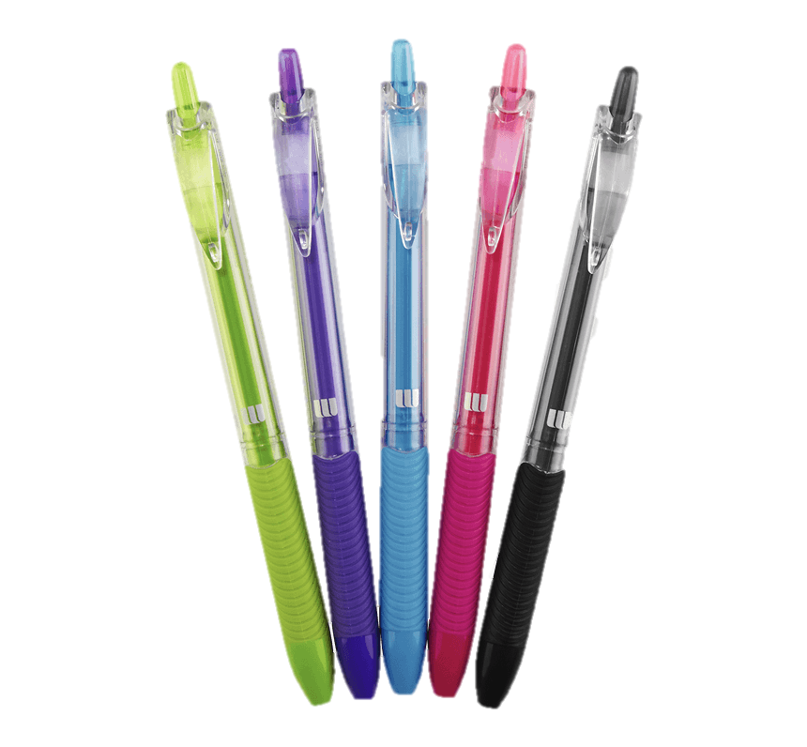
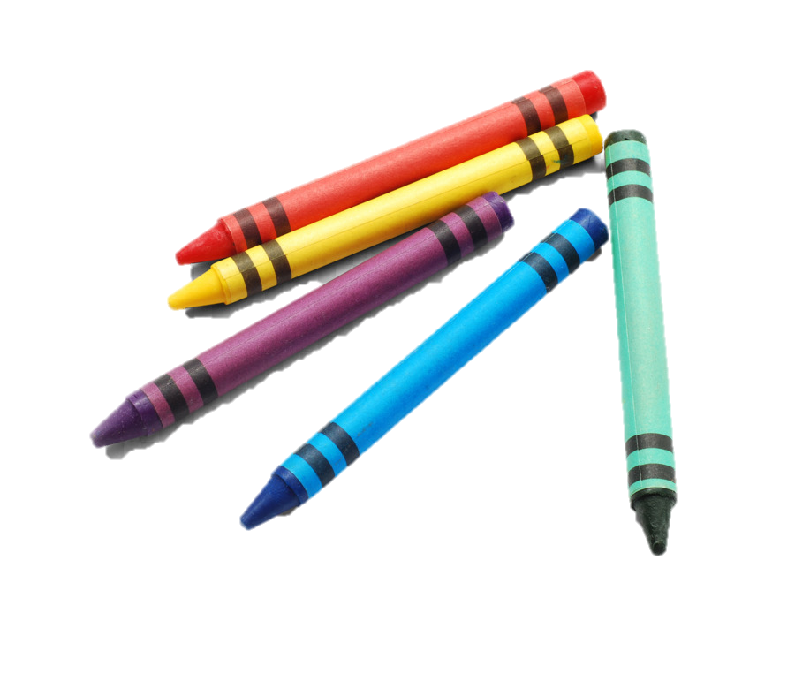
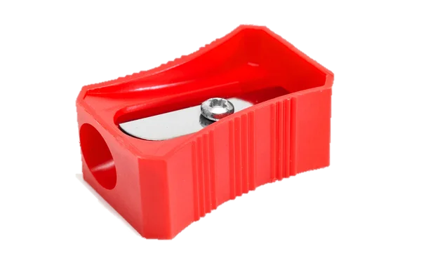
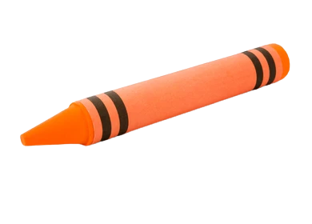
REVIEW: Classroom objects
What’s this?
This is a …
What are these?
These are …
bag
pencil case
pen
scissors
books
ruler
rubber
pencil
book
crayon
pencil sharpener
pens
crayons

Slide 4
VOCABURALY: Classroom objects
What’s this?
This is a …
shelf
Let’s spell!
s
h
e
l
f

Slide 5
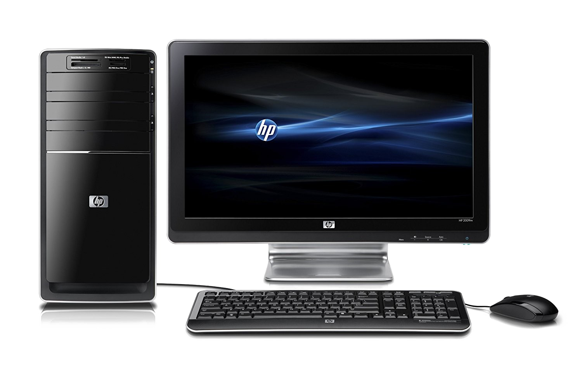
VOCABURALY: Classroom objects
What’s this?
This is a …
computer
Let’s spell!
c
o
m
p
u
t
e
r

Slide 6
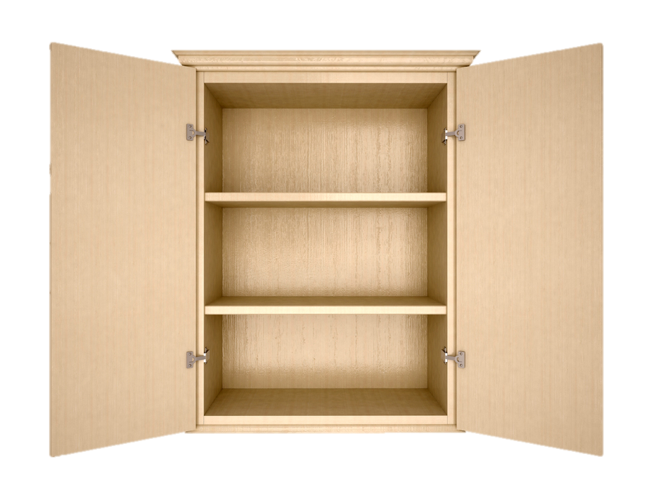
VOCABURALY: Classroom objects
What’s this?
This is a …
cupboard
Let’s spell!
c
u
p
b
o
a
r
d

Slide 7
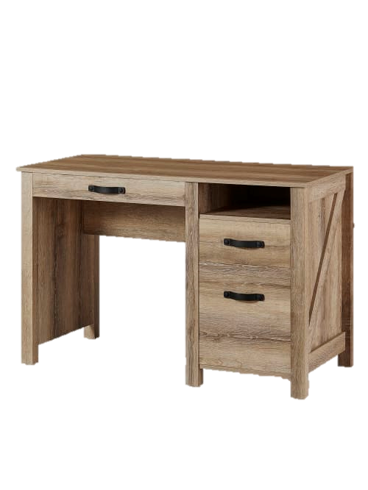
VOCABURALY: Classroom objects
What’s this?
This is a …
desk
Let’s spell!
d
e
s
k

Slide 8
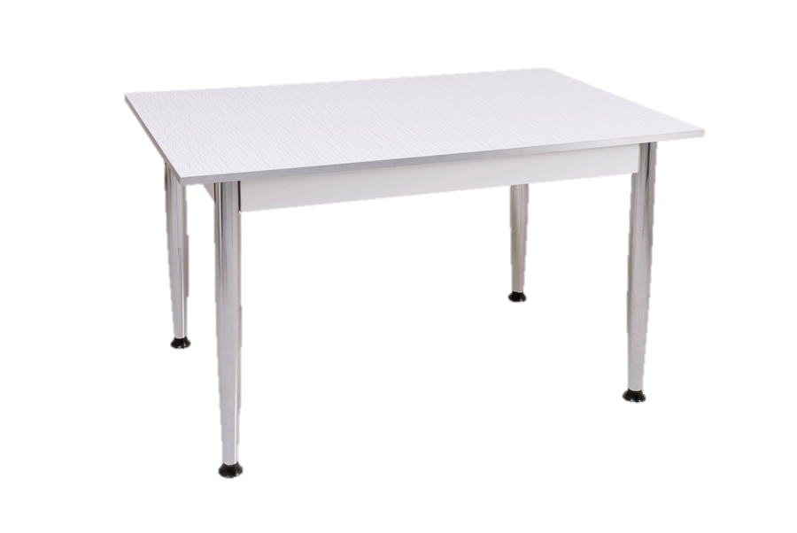
VOCABURALY: Classroom objects
What’s this?
This is a …
table
Let’s spell!
t
a
b
l
e

Slide 9
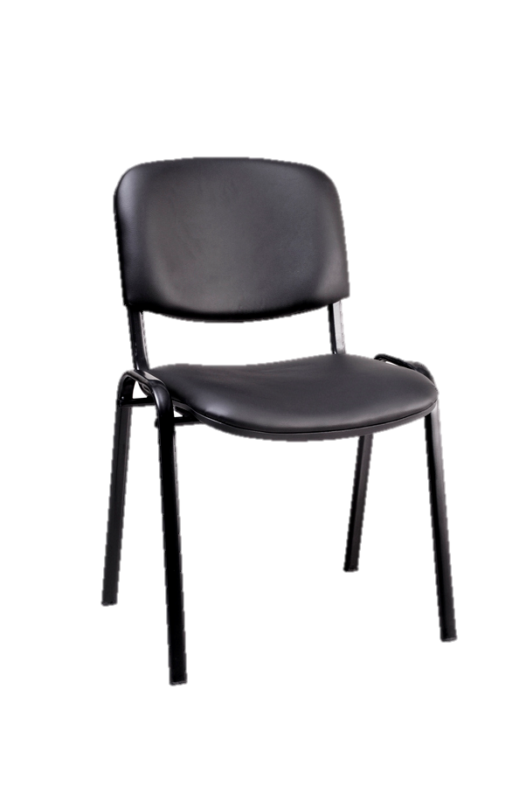
VOCABURALY: Classroom objects
What’s this?
This is a …
chair
Let’s spell!
c
h
a
i
r

Slide 10
VOCABURALY: Classroom objects
shelf
computer
cupboard
desk
table
chair

Slide 11
GAME
RULES
There is 1 classroom object behind each brick wall
Students from each team try to guess the toy
Students say “Bricks down” to drop the bricks
Students say “Bingo” to gain the right to answer
1 correct answer = 2 points
Note:
Click on the bricks to drop them down
Click “Check” to drop all the bricks down
Click “Next” to move to the next slide

Slide 12
chair
NEXT
CHECK

Slide 13
shelf
NEXT
CHECK

Slide 14
desk
NEXT
CHECK

Slide 15
computer
NEXT
CHECK

Slide 16
table
NEXT
CHECK

Slide 17
cupboard
NEXT
CHECK

Slide 18
Song: On In Under Song For Kids
GRAMMAR: in/ on/ under
All students stand up.
Listen to the song.
Dance along.

Slide 19
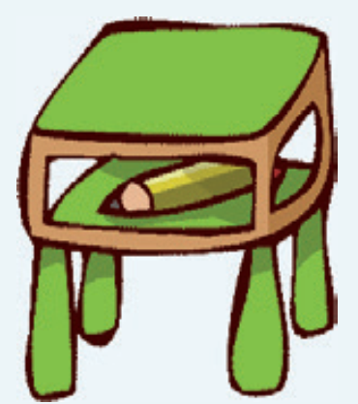
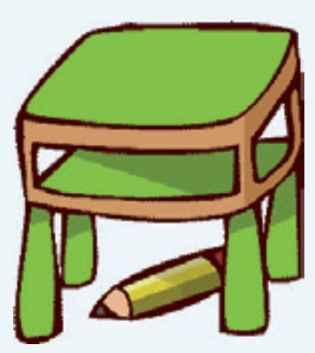
GRAMMAR: in/ on/ under
Where’s the pencil?
in
on
under
It’s in the desk.
It’s on the desk.
It’s under the desk.
Notes:
Set the scene:
Marie and Lucy are looking for a pencil. Marie asks Lucy “Where’s the pencil?”.
Show the prepositions and have Ss recall the words from the song in the previous slide.
Then show the sentences and have all Ss say aloud.

Slide 20
PRACTICE
START

Slide 21
RULES
There are 6 questions.
Students look at a picture and raise fingers 1, 2 or 3 to answer.
1 student says aloud the answer.
1 correct answer = 1 point.
All students repeat the question and answer.
Note:
Click on the red button on the camera to show the questions.
Click CHECK to show the answer.
Click NEXT to continue.
NEXT

Slide 22
CHECK
Where is the book?
1. It’s in the shelf.
2. It’s under the shelf.
3. It’s on the shelf.
NEXT

Slide 23
CHECK
Where is the pencil case?
1. It’s on the chair.
2. It’s under the chair.
3. It’s in the chair.
NEXT

Slide 24
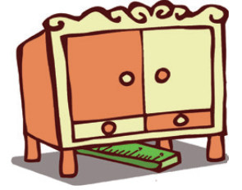
CHECK
Where is the ruler?
1. It’s in the cupboard.
2. It’s under the cupboard.
3. It’s on the cupboard.
NEXT

Slide 25
CHECK
Where is the computer?
1. It’s under the desk.
2. It’s on the desk.
3. It’s in the desk.
NEXT

Slide 26
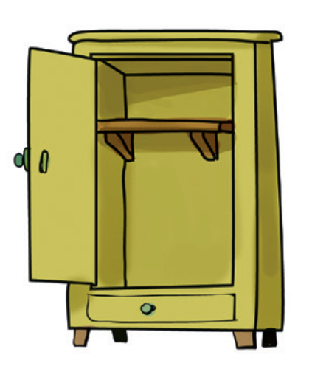
CHECK
Where is the shelf?
1. It’s in the cupboard.
2. It’s on the cupboard.
3. It’s under the cupboard.
NEXT

Slide 27
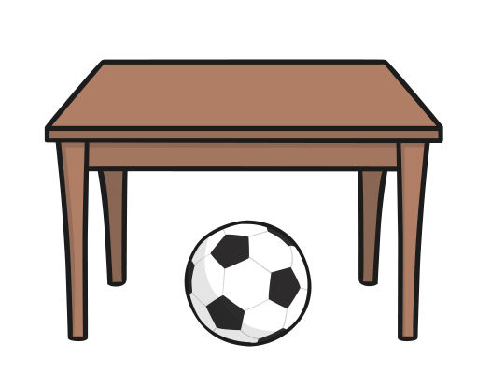
CHECK
Where is the ball?
1. It’s in the desk.
2. It’s under the desk.
3. It’s under the table.
END

Slide 28
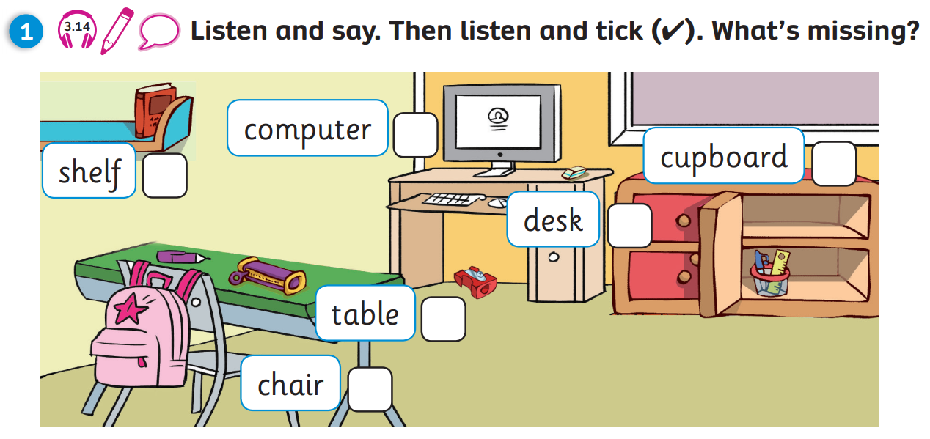
Pupil’s Book (p.37)
Answers
Click on “Answers” to show the answers

Slide 29
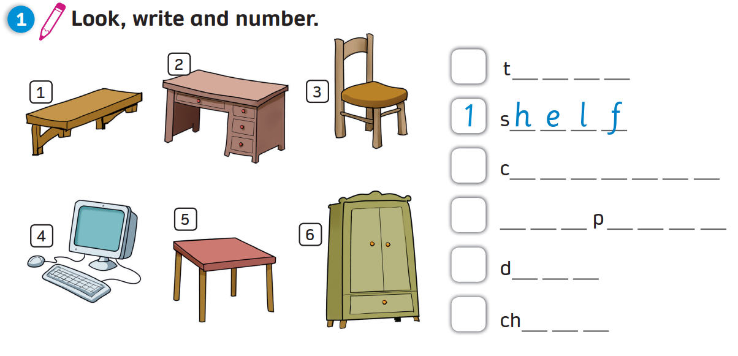
Activity Book (p.33)
Answers
5
a b l e
6
u p b o a r d
4
c o m u t e r
2
e s k
3
a i r
Click on “Answers” to show the answers

Slide 30
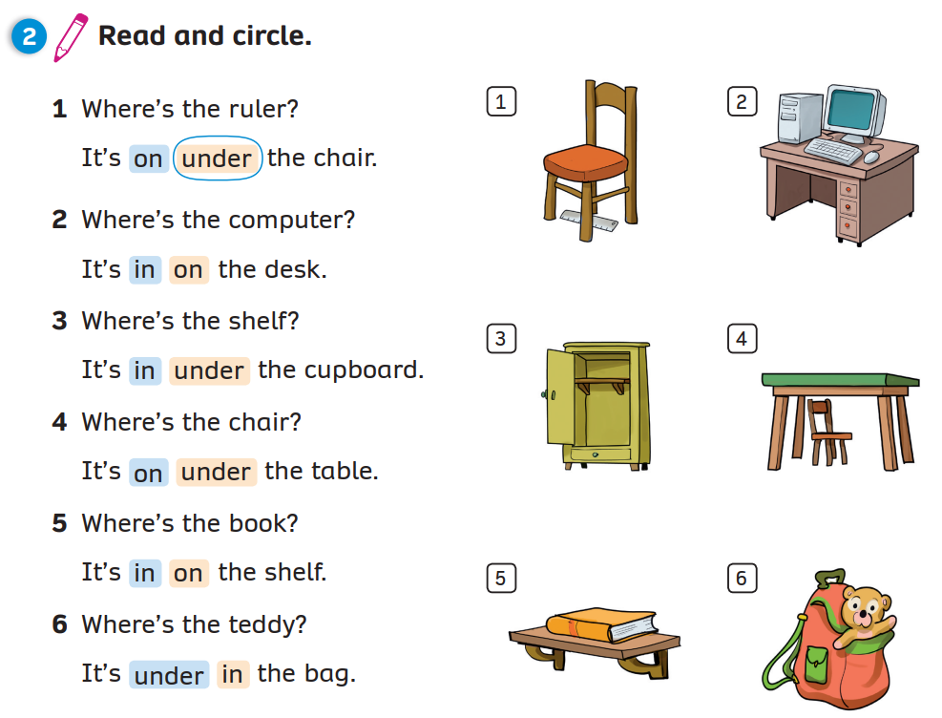
Activity Book (p.33)
Cirlce
Click on “Circle” to show the answers

Slide 31
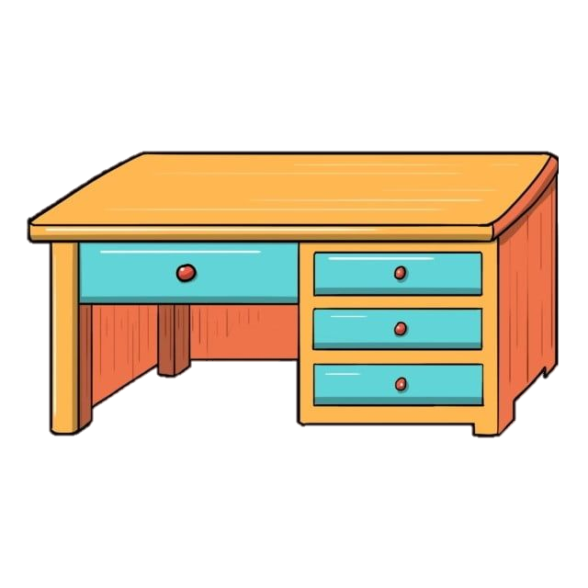
PRODUCTION
Choose a classroom object.
Draw and say where it is.
This is my ________.
It’s ______________.
crayon
under the desk
Notes:
Give Ss instructions and show them an example.
Ask Ss to choose one classroom object and its position in the classroom.
Give each Ss a sheet of paper to draw. After they finish, have them write the sentences about their picture.
Then call on some volunteers to come to the front, show the class their classroom object and talk about it.

Slide 32
WRAP-UP
shelf
computer
cupboard
What’s this?
-> This is a …
desk
table
chair

Slide 33
WRAP-UP
Where’s the pencil?
in
on
under
It’s in the desk.
It’s on the desk.
It’s under the desk.

Slide 34
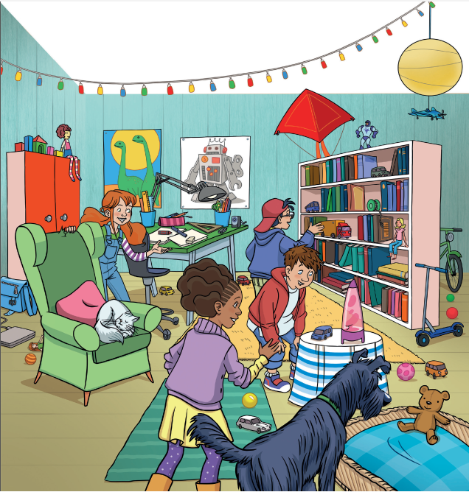
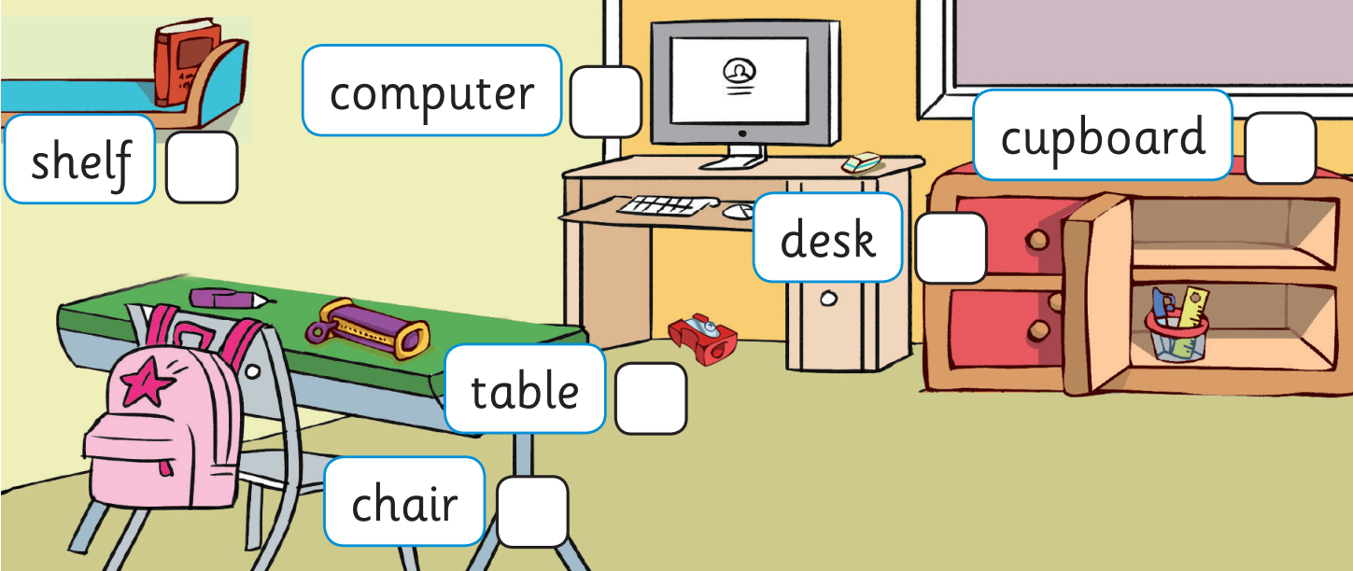
UNIT 3: Lesson 5A
We’ve learnt…

