Slide 1
FUN KIDS ENGLISH CENTRE
ENGLISH GRADE 4

Slide 2
Unit 12
MsPham
0936082789
Jobs

Slide 3
WARM - UP
FUN KIDS ENGLISH CENTRE

Slide 5
Topic 12
jobs

Slide 6
Vocabulary

Slide 7
a farmer
MsPham
0936082789
Nông dân

Slide 8
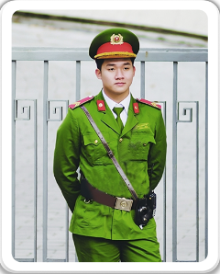
a policeman
MsPham
0936082789
Cảnh sát (nam)

Slide 9
a teacher
MsPham
0936082789
Giáo viên

Slide 10
an office worker
MsPham
0936082789
Nhân viên văn phòng

Slide 11
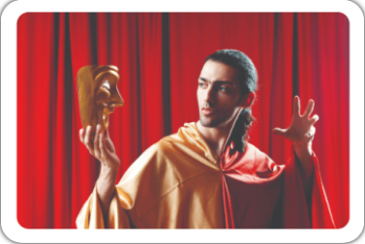
an actor
MsPham
0936082789
Diễn viên (nam)

Slide 12
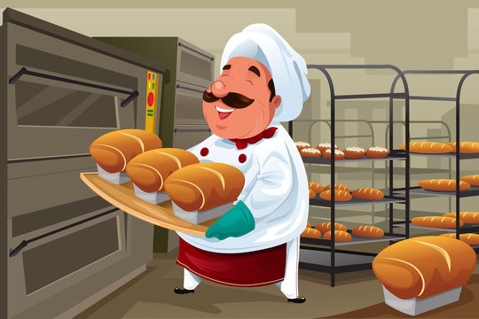
a baker
Thợ làm bánh

Slide 13
a chef
Đầu bếp

Slide 14
Vocabulary
a policeman
: Cảnh sát
a teacher
: Giáo viên
a farmer
: Nông dân
an office worker
: Nhân viên văn phòng
an actor
: Diễn viên nam
a baker
: Thợ làm bánh
A chef
: Đầu bếp

Slide 15
Sentence
pattern

Slide 16
1
Cách hỏi một người nào đó làm nghề gì:
What does he/she/name do?
(Anh ấy/cô ấy làm nghề gì?)
He’s/She’s a/an + job.
(Anh ấy / cô ấy là một ______)
Ex:

Slide 17
PRACTICE

Slide 18
What does he/she do?
MsPham
0936082789
He’s/She’s _____.
a baker
a chef
an actor
an office worker
a policeman
a farmer
a teacher

Slide 19
GAME

Slide 20
Notes:
Ms Huyền Phạm - 0936.082.789 – YOUTUBE: MsPham. Facebook: Dạy và học cùng công nghệ.

Slide 21
+5
she
What does ____ do?
She is a farmer.
-1
he
-1
you
Notes:
Ms Huyền Phạm - 0936.082.789 – YOUTUBE: MsPham. Facebook: Dạy và học cùng công nghệ.

Slide 22
-1
she
What does ____ do?
He is a policeman.
+5
he
-1
you
Notes:
Ms Huyền Phạm - 0936.082.789 – YOUTUBE: MsPham. Facebook: Dạy và học cùng công nghệ.

Slide 23
+5
chef
What does he do?
He is a ___.
-1
baker
-1
farmer
Notes:
Ms Huyền Phạm - 0936.082.789 – YOUTUBE: MsPham. Facebook: Dạy và học cùng công nghệ.

Slide 24
+5
baker
What does he do?
He is a ____.
-1
chef
-1
teacher
Notes:
Ms Huyền Phạm - 0936.082.789 – YOUTUBE: MsPham. Facebook: Dạy và học cùng công nghệ.

Slide 25
-1
an actor
What does he do?
He is ________.
+5
an office worker
-1
an nurse
Notes:
Ms Huyền Phạm - 0936.082.789 – YOUTUBE: MsPham. Facebook: Dạy và học cùng công nghệ.

Slide 26
-1
a teacher
What does she do?
She is ________.
-1
a teacher
+5
a farmer
Notes:
Ms Huyền Phạm - 0936.082.789 – YOUTUBE: MsPham. Facebook: Dạy và học cùng công nghệ.

Slide 27
+5
an actor
What does he do?
He is ________.
-1
a policeman
-1
a teacher
Notes:
Ms Huyền Phạm - 0936.082.789 – YOUTUBE: MsPham. Facebook: Dạy và học cùng công nghệ.

Slide 28
+5
a policeman
What does he do?
He is ________.
-1
a farmer
-1
an office worker
Notes:
Ms Huyền Phạm - 0936.082.789 – YOUTUBE: MsPham. Facebook: Dạy và học cùng công nghệ.

Slide 29
-1
an actor
What does he do?
He is ________.
-1
a policeman
+5
a teacher
Notes:
Ms Huyền Phạm - 0936.082.789 – YOUTUBE: MsPham. Facebook: Dạy và học cùng công nghệ.

Slide 30
Great job!
Exit
Notes:
Ms Huyền Phạm - 0936.082.789 – YOUTUBE: MsPham. Facebook: Dạy và học cùng công nghệ.

Slide 31
Vocabulary

Slide 32
at a nursing home
Ở viện dưỡng lão
MsPham
0936082789

Slide 33
at a factory
Ở nhà máy
MsPham
0936082789

Slide 34
at a school
Ở trường học
MsPham
0936082789

Slide 35
on a farm
Ở trang trại/
Ở cánh đồng
MsPham
0936082789

Slide 36
in a bakery
: ở tiệm bánh

Slide 37
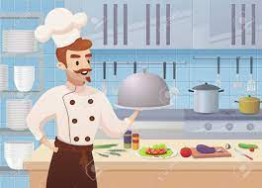
in a restaurant
: ở nhà hàng

Slide 38
Vocabulary
at a nursing home
: ở viện dưỡng lão
at a farm
: trang trại
at a factory
: nhà máy
at a school
: trường học
in a bakery
: ở tiệm bánh
in a restaurant
: ở nhà hàng

Slide 39
Sentence
pattern

Slide 40
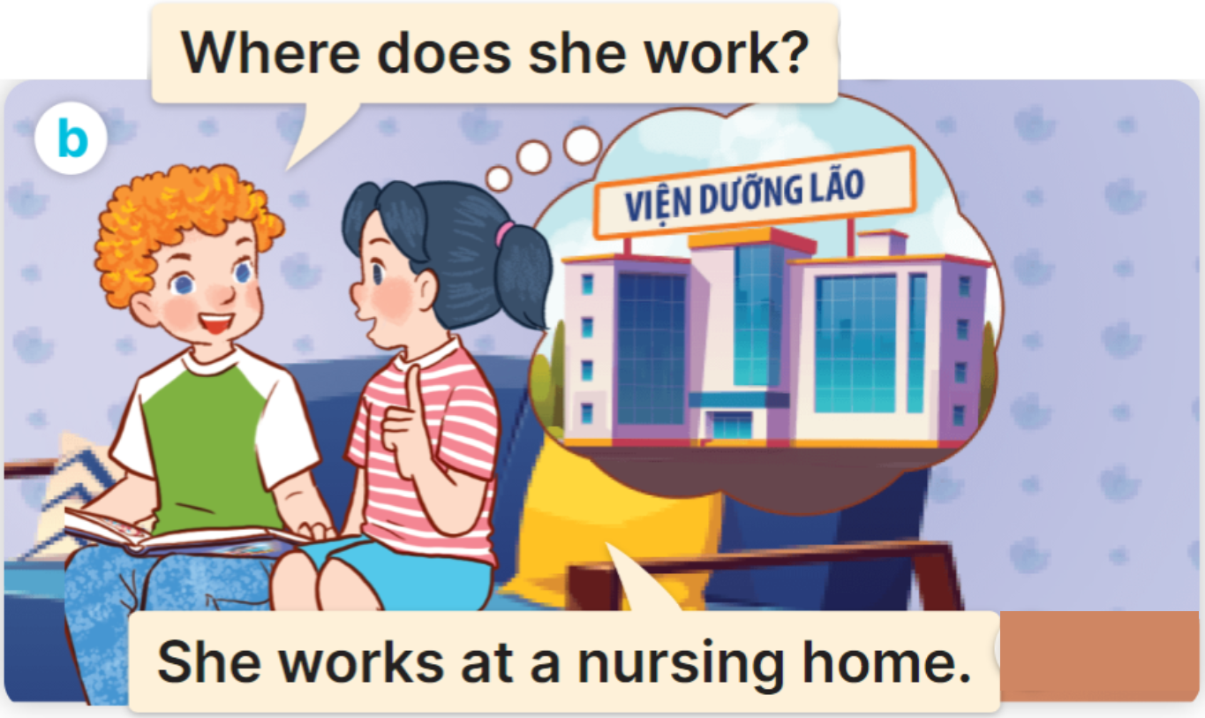
2
Cách hỏi một người nào đó làm việc ở đâu:
Where does he/she/name work?
(Anh ấy/cô ấy làm việc ở đâu?)
He/She works ________.
(Anh ấy / cô ấy làm ở ______)
Ex:

Slide 41
Cách hỏi một người nào đó làm việc ở đâu đó phải không:
3
Does he/she/name work….?
(Có phải anh ấy/cô ấy làm việc ở,, không?)
Yes, He/She does.
No, He/She doesn’t.
( Đúng vậy)
( Không phải)

Slide 42
PRACTICE

Slide 43
What does he/she do?
He/She works _____.
Does he/she work_____?
Yes, He/She does.
No, He/She doesn’t.
in a bakery
in a restaurant
at a
nursing home
at a school
at a factory
on a farm

Slide 44
GAME

Slide 45
BALLOONS
START
Notes:
Click quả bóng để chọn câu trả lời đúng, sai quả bóng sẽ nổ. Đúng dc cộng điểm

Slide 46
at a factory
at a
nursing home
at a school
Where does he work?
He works _________.
face

Slide 47
at a school
on a farm
at a factory
Where does she work?
She works _________.
ears

Slide 48
at a factory
at a
nursing home
on a farm
Where does he work?
He works _________.
blond hair.

Slide 49
at a school
on a farm
at a
nursing home
Where does he work?
He works _________.
nose

Slide 50
Where does
he work?
Does
she work in a restaurant?
Does
he work in a restaurant?
Yes, he does.
brown eyes

Slide 51
Does
he work at a school?
Where does
she work?
Does
he work in a hospital?
Yes, he does.
ears

Slide 52
Does
he work in a nursing home?
Does
she work at a school?
Does
he work at a school?
No, she doesn’t.
mouth

Slide 53
Where does
he work?
Does
he work in a restaurant?
Does
he work in a bakery?
No, he doesn’t.
nose

Slide 54
Well done!
END

Slide 55
HOME LINK

Slide 56
GOODBYE CLASS!

