Slide 1
FUN KIDS ENGLISH CENTRE
ENGLISH GRADE 3

Slide 2
WARM - UP
FUN KIDS ENGLISH CENTRE

Slide 4
Unit 12
Jobs

Slide 5
Part 1: Review

Slide 6
VOCABULARY

Slide 7
MsPham-0936082789
Vocabulary
MsPham-0936082789
MsPham-0936082789
a doctor
bác sĩ
MsPham-0936082789

Slide 8
MsPham-0936082789
Vocabulary
MsPham-0936082789
MsPham-0936082789
a driver
Lái xe
MsPham-0936082789

Slide 9
MsPham-0936082789
Vocabulary
MsPham-0936082789
MsPham-0936082789
a teacher
Thầy giáo, cô giáo
MsPham-0936082789

Slide 10
MsPham-0936082789
Vocabulary
MsPham-0936082789
MsPham-0936082789
a worker
Công nhân
MsPham-0936082789

Slide 11
MsPham-0936082789
Vocabulary
A doctor
: bác sĩ
A driver
: lái xe
MsPham-0936082789
MsPham-0936082789
A teacher
: giáo viên
A worker
: công nhân
MsPham-0936082789

Slide 12
SENTENCE PATTERN

Slide 13
MsPham-0936082789
Cách hỏi và trả lời về nghề nghiệp:
MsPham-0936082789
MsPham-0936082789
What’s her/his job?
(Nghề nghiệp của cô ấy/ anh ấy là gì?)
She / he’s + a/ an + (job).
(Cô ấy / anh ấy là một _______.)
MsPham-0936082789

Slide 14
PRACTICE

Slide 15
MsPham-0936082789
What’s her/his job?
She’s / He’s _______.
MsPham-0936082789
MsPham-0936082789
a doctor
a driver
a teacher
a worker
MsPham-0936082789

Slide 16
GAME

Slide 17
MsPham-0936082789
Let’s play!
MsPham-0936082789
MsPham-0936082789
MsPham-0936082789
MsPham-0936082789

Slide 18
MsPham-0936082789
What’s her jobs?
She’s _________.
MsPham-0936082789
MsPham-0936082789
a doctor
MsPham-0936082789
Answer
MsPham-0936082789

Slide 19
What’s his jobs?
He’s _________.
a driver
Answer

Slide 20
MsPham-0936082789
What’s his jobs?
He’s _________.
MsPham-0936082789
MsPham-0936082789
a worker
MsPham-0936082789
Answer
MsPham-0936082789

Slide 21
MsPham-0936082789
What’s her jobs?
She’s _________.
MsPham-0936082789
MsPham-0936082789
a teacher
MsPham-0936082789
Answer
MsPham-0936082789

Slide 22
MsPham-0936082789
What’s ____ job?
She’s a teacher.
her
MsPham-0936082789
MsPham-0936082789
MsPham-0936082789
Answer
MsPham-0936082789

Slide 23
MsPham-0936082789
his
What’s ____ job?
He’s a driver.
MsPham-0936082789
MsPham-0936082789
MsPham-0936082789
Answer
MsPham-0936082789

Slide 24
MsPham-0936082789
What’s his job?
_____ a doctor.
MsPham-0936082789
MsPham-0936082789
He’s
MsPham-0936082789
Answer
MsPham-0936082789

Slide 25
MsPham-0936082789
What’s her job?
_____ a worker.
MsPham-0936082789
MsPham-0936082789
She’s
MsPham-0936082789
Answer
MsPham-0936082789

Slide 26
MsPham-0936082789
Great!
MsPham-0936082789
MsPham-0936082789
MsPham-0936082789
MsPham-0936082789

Slide 27
Part 2

Slide 28
VOCABULARY

Slide 29
MsPham-0936082789
Vocabulary
MsPham-0936082789
MsPham-0936082789
a pupil
Học sinh
MsPham-0936082789

Slide 30
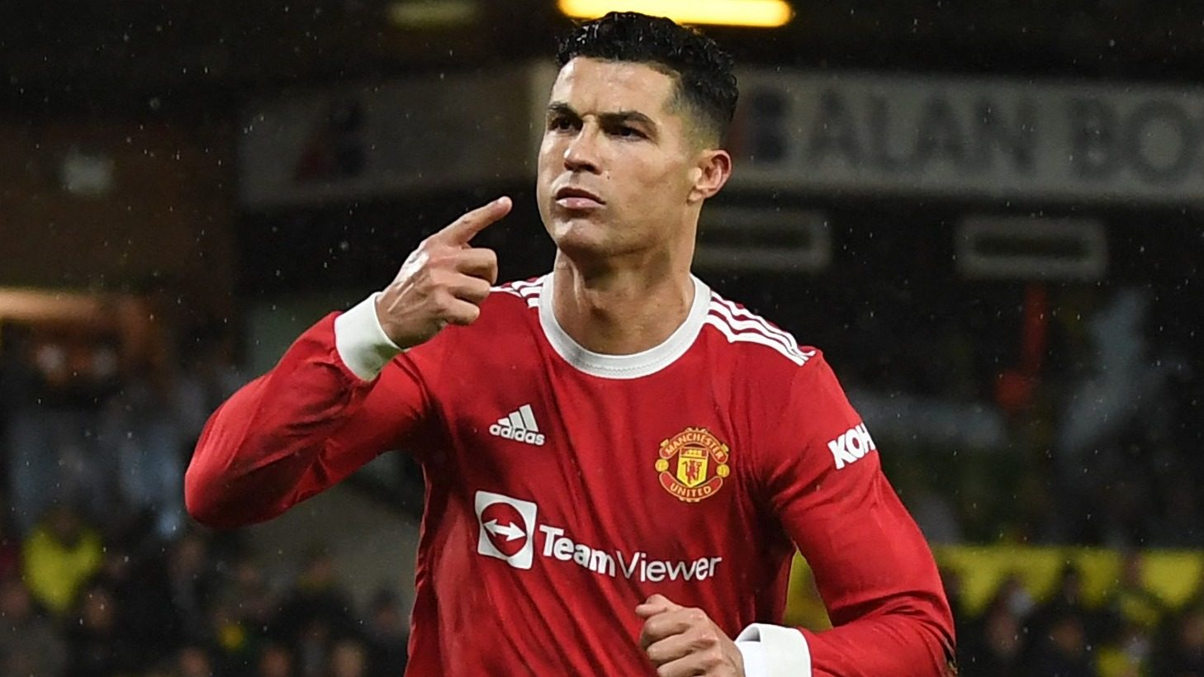
MsPham-0936082789
Vocabulary
MsPham-0936082789
MsPham-0936082789
a footballer
Cầu thủ bóng đá
MsPham-0936082789

Slide 31
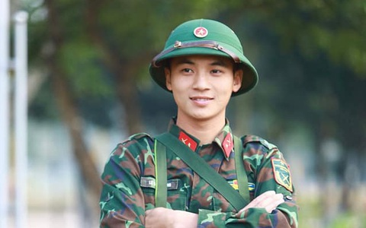
MsPham-0936082789
Vocabulary
MsPham-0936082789
MsPham-0936082789
a solider
Bộ đội
MsPham-0936082789

Slide 32
MsPham-0936082789
Vocabulary
A pupil
: học sinh
A footballer
: cầu thủ bóng đá
MsPham-0936082789
MsPham-0936082789
A soldier
: bộ đội
MsPham-0936082789

Slide 33
SENTENCE PATTERN

Slide 34
MsPham-0936082789
Cách hỏi và trả lời về nghề nghiệp:
MsPham-0936082789
MsPham-0936082789
What’s your job?
(Nghề nghiệp của bạn là gì?)
I’m+ a/ an + (job).
(Tôi là một _______.)
MsPham-0936082789

Slide 35
PRACTICE
ASK AND ANSWER ABOUT JOB

Slide 36
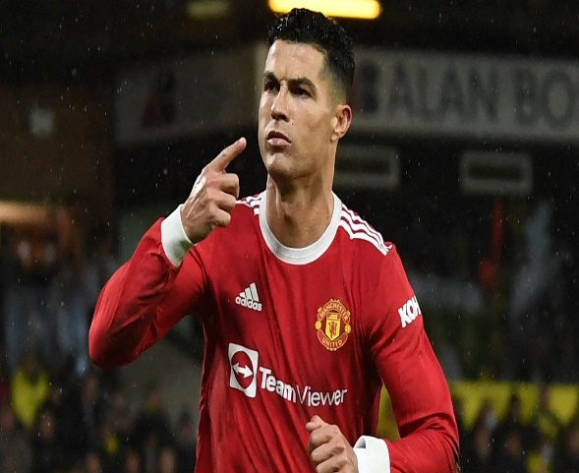
MsPham-0936082789
What’s your job?
I’m _______.
a pupil
a footballer
a solider
MsPham-0936082789

Slide 37
GAME

Slide 38
MsPham-0936082789
MsPham-0936082789
MsPham-0936082789
MsPham-0936082789
Ms Huyền Phạm
0936.082.789
MsPham-0936082789

Slide 39
MsPham-0936082789
What’s ____ job?
I’m a teacher.
your
her
MsPham-0936082789
MsPham-0936082789
MsPham-0936082789
Ms Huyền Phạm
0936.082.789
MsPham-0936082789

Slide 40
MsPham-0936082789
What’s your job?
I’m a…….
teacher
doctor
MsPham-0936082789
MsPham-0936082789
MsPham-0936082789
Ms Huyền Phạm
0936.082.789
MsPham-0936082789

Slide 41
MsPham-0936082789
What’s your job?
I’m a____.
solider
pupil
MsPham-0936082789
MsPham-0936082789
MsPham-0936082789
Ms Huyền Phạm
0936.082.789
MsPham-0936082789

Slide 42
MsPham-0936082789
What’s your job?
I’m a____.
footballer
solider
MsPham-0936082789
MsPham-0936082789
MsPham-0936082789
Ms Huyền Phạm
0936.082.789
MsPham-0936082789

Slide 43
MsPham-0936082789
What’s your job?
I’m ________.
a teacher
a footballer
MsPham-0936082789
MsPham-0936082789
MsPham-0936082789
Ms Huyền Phạm
0936.082.789
MsPham-0936082789

Slide 44
MsPham-0936082789
What’s your job?
I’m ________.
driver
a driver
MsPham-0936082789
MsPham-0936082789
MsPham-0936082789
Ms Huyền Phạm
0936.082.789
MsPham-0936082789

Slide 45
MsPham-0936082789
What’s your job?
I’m ________.
a worker
a footballer
MsPham-0936082789
MsPham-0936082789
MsPham-0936082789
Ms Huyền Phạm
0936.082.789
MsPham-0936082789

Slide 46
MsPham-0936082789
Good job!
MsPham-0936082789
MsPham-0936082789
MsPham-0936082789
Ms Huyền Phạm
0936.082.789
MsPham-0936082789

Slide 47
HOME LINK

Slide 48
GOODBYE CLASS!

