Slide 2
Unit
2
1
Unit
FAMILY LIFE
HUMANS AND THE ENVIRONMENT
LESSON 8
LOOKING BACK AND PROJECT

Slide 3
Unit
1
1
FAMILY LIFE
Family Life
Unit
OBJECTIVES
By the end of the lesson, students will be able to:
revise the consonant blends /kl/, /pl/, /gr/, /pr/ correctly;
revise words and phrases related to humans and the environment learnt in the unit;
revise how to use will and be going to, and passive voice correctly;
plan activities for a Go Green Weekend and give a group presentation about the event.

Slide 4
LESSON 8
LOOKING BACK AND PROJECT
Unit
GETTING STARTED
Game: The last man standing
WARM-UP
Pronunciation: Listen and underline.
Vocabulary: Complete the sentences.
Grammar: Choose the best answers.
LOOKING BACK
PROJECT
Go Green Weekend
CONSOLIDATION
Wrap-up
Home work

Slide 5
LESSON 8
LOOKING BACK AND PROJECT
Unit
GETTING STARTED
Game: The last man standing
WARM-UP

Slide 6
WARM-UP
Game: The last man standing

Slide 7
WARM-UP
Game: The last man standing
Rules:
10 students form a circle
Teacher stands at a center with a ball.
Teacher speaks out a word related to the topic Humans and the environment and pass the ball to one student.
That student tosses it to another student as he/she name the word related to the theme.
If someone repeats a word or can’t say any more words, he/she needs to sit down.
The last student standing wins the game.

Slide 8
LESSON 8
LOOKING BACK AND PROJECT
Unit
GETTING STARTED
Game: The last man standing
WARM-UP
Pronunciation: Listen and underline.
Vocabulary: Complete the sentences.
Grammar: Choose the best answers.
LOOKING BACK

Slide 9
LOOKING BACK
1
PRONUNCATION
Listen and underline the words with the consonant blends /kl/, /pl/, /gr/ or /pr/. Then practise reading the sentences.
1. The professor is proud of the results of our project.
2. Grass is growing on the ground.
3. Those toy planes are made of plastic.
4. Click the button to become a member of the club.

Slide 10
LOOKING BACK
2
VOCABULARY
Complete the sentences. Use the words and phrases in the box.
appliances, green lifestyle, carbon footprint, eco-friendly
More and more people adopt a(n) ____________ because it is good for the environment.
We should cut down on electricity usage to reduce your _______________.
Many modern houses today are built from ___________ materials.
Modern household __________ make housework much easier.
green lifestyle
carbon footprint
eco-friendly
appliances

Slide 11
LOOKING BACK
3
GRAMMAR
Choose the best answers.
Wind energy is used/ use to produce electricity.
More trees are planted/ plant around the school
I’m sure you are going to pass/ will pass your driving test. Don’t worry.
- Mai has won the first price in the speaking contest.
- Really? I will/ am going to phone her to give her my congratulations.
5. My parents have made their holiday plans. They will travel/ are going to travel to the south of the country.
6. Do you hear the thunder? It is going to rain/ will rain heavily.

Slide 12
LESSON 8
LOOKING BACK AND PROJECT
Unit
GETTING STARTED
Game: The last man standing
WARM-UP
Pronunciation: Listen and underline.
Vocabulary: Complete the sentences.
Grammar: Choose the best answers.
LOOKING BACK
PROJECT
Go Green Weekend

Slide 13
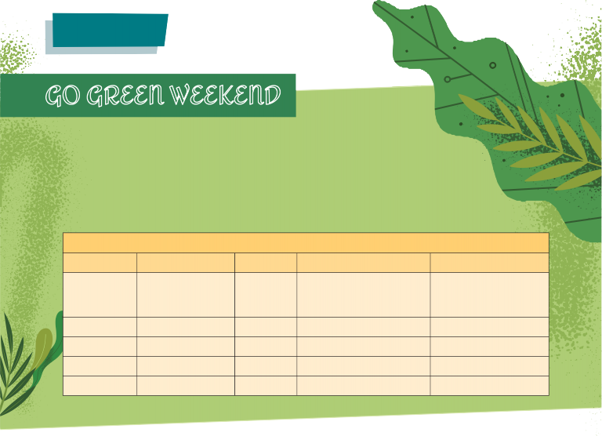
PROJECT

Slide 14
PROJECT
 | Tick where appropriate | Comments (in English or Vietnamese)
DELIVERY
- The presenters greeted the audience.
- The presenters spoke clearly and naturally.
- The presenters cooperated when delivering their talk.
- The presenters interacted with the audience.
- The presenters used some photos /pictures to illustrate their ideas.
- The presenters concluded their talk appropriately.
CONTENT: The presentation includes the following information about their plan for the Go Green Weekend event.
activity
time
place
reason
expected result
Checklist for peer assessment

Slide 15
PROJECT
 | Tick where appropriate | Comments (in English or Vietnamese)
DELIVERY
- I greeted the audience.
- I spoke clearly and naturally.
- I cooperated with my group members when delivering the talk.
- I interacted with the audience.
- I used some photos / pictures to illustrate my ideas.
- I concluded my part of the talk appropriately.
CONTENT: Our presentation includes the following information about our plan for Go Green Weekend event.
activity
time
place
reason
expected result
Checklist for self-assessment

Slide 16
LESSON 8
LOOKING BACK AND PROJECT
Unit
GETTING STARTED
Game: The last man standing
WARM-UP
Pronunciation: Listen and underline.
Vocabulary: Complete the sentences.
Grammar: Choose the best answers.
LOOKING BACK
PROJECT
Go Green Weekend
CONSOLIDATION
Wrap-up
Home work

Slide 17
CONSOLIDATION
1
Wrap-up
Revise the consonant blends /kl/, /pl/, /gr/ and /pr/.
Revise words/ phrases related to the topic Humans and the environment.
Revise will and be going to and passive voice.

Slide 18
CONSOLIDATION
2
Homework
Do exercises in the workbook
Prepare for Unit 3 – Lesson 1

Slide 19
Website: sachmem.vn
Fanpage: facebook.com/sachmem.vn/

