Slide 1


Slide 2

Unit
1
1
FAMILY LIFE
Unit
FAMILY LIFE
LESSON 7
COMMUNICATION AND CULTURE / CLIL

Slide 3

OBJECTIVES
1. Knowledge
- Express their opinions in a conversation about whether family members should spend time together;
- Understand British family values.
2. Core competence
- Be collaborative and supportive in pair work and team work;
- Access and consolidate information from a variety of sources;
- Actively join in class activities.
3. Personal qualities
- Be more respectful of Vietnamese and British family values;
- Be able and willing to embrace those family values.

Slide 4
LESSON 7
COMMUNICATION AND CULTURE/CLIL
Unit
GETTING STARTED
WARM-UP
List pros & cons of sharing housework
EVERYDAY ENGLISH
Task 1: Listen & complete the conversation
Task 2: Make similar conversations.
CULTURE
New words
Task 1: Read the text and complete the table.
Task 2: Discussion.
CONSOLIDATION
Wrap-up
Home work

Slide 5
LESSON 7
COMMUNICATION AND CULTURE/CLIL
Unit
GETTING STARTED
WARM-UP
List pros & cons of sharing housework

Slide 6
WARM-UP
COMMUNICTION
Unit
GETTING STARTED
LIST PROS AND CONS OF SHARING HOUSEWORK
Advantages | Disadvantages
2 teams
Take turns to run to the board and write the advantages and disadvantages of sharing housework
The highest score: the winner
Ex: Strengthen family bonds

Slide 7
LESSON 7
COMMUNICATION AND CULTURE/CLIL
Unit
GETTING STARTED
WARM-UP
List pros & cons of sharing housework
EVERYDAY ENGLISH
Task 1: Listen & complete the conversation
Task 2: Make similar conversations.

Slide 8

EVERYDAY ENGLISH
1
Listen and complete the conversation with the expressions in the box. Then practise it in groups of three.
Anna: Do you guys think that teenagers should do housework?
Minh: Yes, (1) _______________________ teenagers as well as other members of the family should share the housework.
Anna: Do you mean everybody in the family has to help with the housework?
Minh: That’s right. (2) _____________________ doing household chores together helps build family bonds.
Tu: Well, (3) ______________________. Teenagers should spend all their time studying instead of doing housework. They’ll need good grades to get into top universities.
A. I strongly believe that
B. I’m not sure about that
C. I have no doubt that

Slide 9
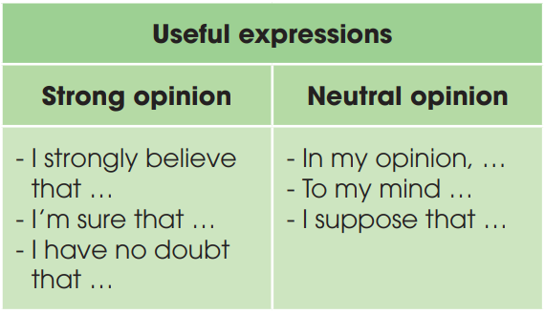
EVERYDAY ENGLISH
2
Work in groups. Have similar conversations exchanging opinions about whether family members should spend time together.

Slide 10
LESSON 7
COMMUNICATION AND CULTURE/CLIL
Unit
GETTING STARTED
WARM-UP
List pros & cons of sharing housework
EVERYDAY ENGLISH
Task 1: Listen & complete the conversation
Task 2: Make similar conversations.
CULTURE
New words
Task 1: Read the text and complete the table.
Task 2: Discussion.

Slide 11

CULTURE
NEW WORDS
pass on (sth)
(phr.v)
/pæs ɒn/
give something to someone who lives after you die, usually a person in your family

Slide 12

CULTURE
NEW WORDS
truthful
(adj)
/ˈtruːθfəl/
honest and not containing
or telling any lies

Slide 13
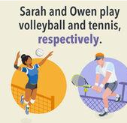
CULTURE
NEW WORDS
respectively
(adv)
/rɪˈspektɪvli/
with each relating to something previously mentioned, in the same order as first mentioned

Slide 14
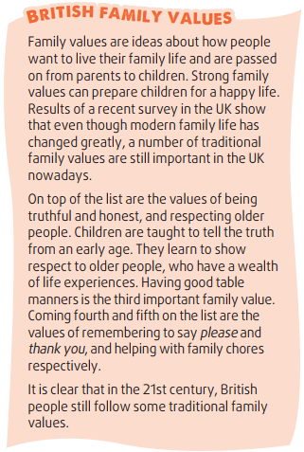
CULTURE
1
Read the text and list the five family values of British people in the 21st century in the table. (p.16)
 | Traditional British family values
1.
2.
3.
4.
5.
being truthful and honest
respecting older people
having good table manners
remembering to say please & thank you
helping with family chores

Slide 15
CULTURE
2
1
Discussion.
Write YES in the Vietnamese column if the value is also followed in Viet Nam
NO if it is not, NOT SURE if you are not sure whether it is YES or NO.
 | Traditional British family values | Traditional Vietnamese family values
1. | being truthful and honest
2. | respecting older people
3. | having good table manners
4. | remembering to say please & thank you
5. | helping with family chores

Slide 16
CONSOLIDATION
1
Wrap-up
The ways to express opinions
British and Vietnamese family values
2
Homework
Exercises in the workbook
Prepare for Looking back and Project lesson

Slide 17

Website: sachmem.vn
Fanpage: facebook.com/sachmem.vn/

