Slide 1


Slide 2

Unit
1
1
Unit
FAMILY LIFE
FAMILY LIFE
LESSON 5
LISTENING
Family support

Slide 3

Unit
1
1
Family Life
OBJECTIVES
By the end of this unit, students will be able to:
listen for details and specific information in a talk show about family life
apply the language they have learnt in the listening in a speaking task about their own experiences

Slide 4
LESSON 5
LISTENING
GETTING STARTED
WARM-UP
Web completion
PRE-LISTENING
Task 1: Look at the picture and answer the questions.
Task 2: Listen to the introduction to the talk show and check your answers.
Task 3: True or false.
Task 4: Listen and complete the sentences.
WHILE-LISTENING
POST-LISTENING
Task 5: Discussion
CONSOLIDATION
Wrap-up
Homework

Slide 5
LESSON 5
LISTENING
GETTING STARTED
WARM-UP
Web completion

Slide 6
WARM-UP
GAME: WEB COMPLETION
What are the roles of a wife and a husband in a family?
You have 1 minute to complete.
Give a birth Look after the children
Do household chores Care for family
Be a homemaker Be a breadwinner
Earn money Protect family
ROLES OF WOMEN
ROLES OF MAN

Slide 7
Be a homemaker
Earn money
Do household chores
Roles of men and women
Care for family
Protect family
Look after the children
Be a breadwinner
Except for Giving birth

Slide 8
LESSON 5
LISTENING
GETTING STARTED
WARM-UP
Web completion
PRE-LISTENING
Task 1: Look at the picture and answer the questions.

Slide 9
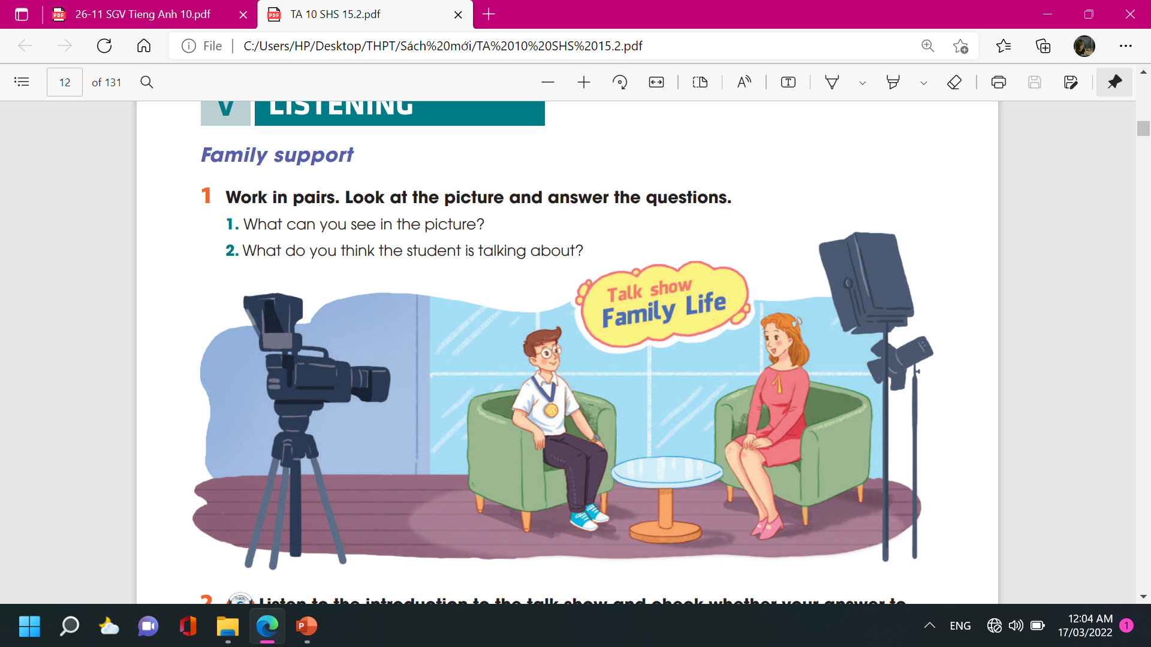





PRE-LISTENING
1
Work in pairs. Look at the picture and answer the questions.
What can you see in the picture?
Who are the people?
Where are they?
What is in the background?
What are they doing?
What’s the boy wearing around his neck?
What do you think the student is talking about?

Slide 10
LESSON 5
LISTENING
GETTING STARTED
WARM-UP
Web completion
PRE-LISTENING
Task 1: Look at the picture and answer the questions.
Task 2: Listen to the introduction to the talk show and check your answers.
Task 3: True or false.
Task 4: Listen and complete the sentences.
WHILE-LISTENING

Slide 11

PRE-LISTENING
2
Listen to the introduction to the talk show and check whether your answer to Question 2 above is correct or not.
➔ He’s talking about his family life and how his family have helped him achieve success in his studies.

Slide 12
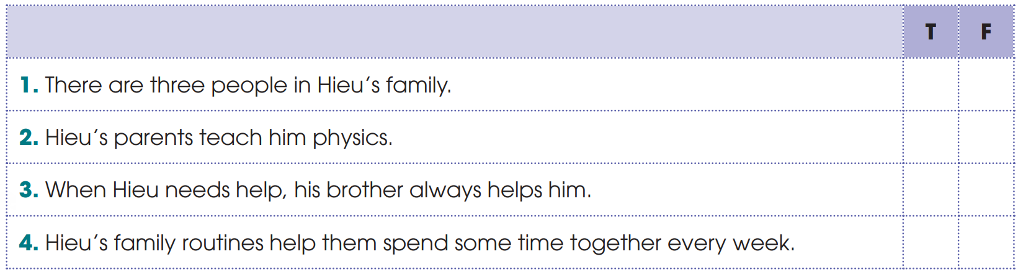
WHILE-LISTENING
3
Listen to the talk show and decide whether the statements are true (T) or false (F).
✓
✓
✓
✓

Slide 13
WHILE-LISTENING
4
4
Listen again and complete each sentence with ONE word from the recording.
1. Hieu’s parents always listen to him and cheer him up whenever he has ___________.
2. His parents’ __________ and trust give him strength to carry on.
3. Hieu’s brother is his best friend. He shares his happy and __________ moments with him.
difficulties
love
sad

Slide 14
LESSON 5
LISTENING
GETTING STARTED
WARM-UP
Web completion
PRE-LISTENING
Task 1: Look at the picture and answer the questions.
Task 2: Listen to the introduction to the talk show and check your answers.
Task 3: True or false.
Task 4: Listen and complete the sentences.
WHILE-LISTENING
POST-LISTENING
Task 5: Discussion

Slide 15
POST-LISTENING
5
Work in groups. Discuss the following question.
Discussing
How can parents help their children achieve success in their studies?

Slide 16
LESSON 5
LISTENING
GETTING STARTED
WARM-UP
Web completion
PRE-LISTENING
Task 1: Look at the picture and answer the questions.
Task 2: Listen to the introduction to the talk show and check your answers.
Task 3: True or false.
Task 4: Listen and complete the sentences.
WHILE-LISTENING
POST-LISTENING
Task 5: Discussion
CONSOLIDATION
Wrap-up
Homework

Slide 17
CONSOLIDATION
1
Wrap-up
What have we learnt today?
Listen for details and specific information in a talk show about family life
Apply the language they have learnt in the listening in a speaking task about their own experiences

Slide 18

CONSOLIDATION
2
2
Homework
- Do the exercises in Workbook.
- Prepare for the Writing Lesson

Slide 19

Website: sachmem.vn
Fanpage: facebook.com/sachmem.vn/

