Slide 2
1
REVIEW
1
FAMILY LIFE
Unit
SKILLS (2)
(Reading & Writing)
LESSON 3

Slide 3
Unit
1
1
FAMILY LIFE
Family Life
Unit
OBJECTIVES
By the end of this lesson, students will be able to:
practise reading for general and specific information about how to live a green life;
practise writing a short paragraph about ways of living green.

Slide 4
LESSON 3
SKILLS (2)
GETTING STARTED
CHECK-UP
Talk about your favourite singer or musician.
READING
Task 1: Complete the crossword.
Task 2: Read and answer the questions.
WRITING
Complete the paragraph.
Wrap-up
Homework
CONSOLIDATION

Slide 5
LESSON 3
SKILLS (2)
GETTING STARTED
CHECK-UP
Talk about your favourite singer or musician.

Slide 6
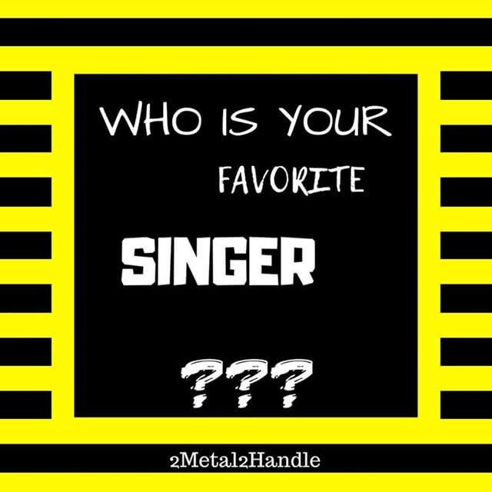
CHECK-UP
SKILL 1_ READING AND WRITING
Talk about your favourite singer or musician.

Slide 7
LESSON 3
SKILLS (2)
GETTING STARTED
CHECK-UP
Talk about your favourite singer or musician.
READING
Task 1: Complete the crossword.
Task 2: Read and answer the questions.

Slide 8
READING
1
Read the text below. Then work in pairs to complete the crossword with five words from the text.
Collect water to live a green life
Water is essential for life. Therefore, the methods of collecting water are important for meeting its growing need.
The traditional method involves collecting rainwater and storing it for later use. Rainwater is collected from a roof and sent to a container. Collected rainwater is an excellent source of water for people, animals, and plants.
There is also a new method of collecting water. It can turn the tiny drops of water in the air into drinking water. Air-to-water technology creates water from air and releases it all the time. It uses the sun’s energy and works well even in dry conditions.
In general, collecting rainwater or creating water from air will allow people to save natural resources, improve the environment, and live a green life.

Slide 9
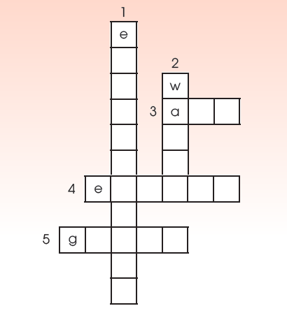
READING
1
Read the text below. Then work in pairs to complete the crossword with five words from the text.
ACROSS
3. the mixture of gases surrounding the earth that we breathe
4. a source of power that can be used to provide light and heat, or drive machines
5. a way of living that is good for the environment
DOWN
1. the natural world in which people, animals, and plants live
2. a liquid without colour or smell that falls as rain and is used for drinking, washing, etc.
Key:
1. environment
4. energy
2. water
5. green
3. air

Slide 10
READING
2
Read the text again and give short answers to the following questions.
1. What's important for meeting the growing need for water?
2. What's the traditional method of collecting rainwater?
3. What's the new method of creating water?
The methods of collecting water (are).
Rainwater is collected from a roof and sent to a container.
Tiny drops of water in the air are turned into drinking water.

Slide 11
LESSON 3
SKILLS (2)
GETTING STARTED
CHECK-UP
Talk about your favourite singer or musician.
READING
Task 1: Complete the crossword.
Task 2: Read and answer the questions.
WRITING
Complete the paragraph.

Slide 12
WRITING
Think about ways of living a green lifestyle. Complete the paragraph. Use what you have learnt and the ideas below to help you.
There are many ways you can make your life greener.
________________________________________________________________________________________________
________________________________________________________________________________________________
Living a green lifestyle is not difficult, but these small
changes will make a big difference.
Living green
- Planting more trees and plants
- Organising regular clean-up
activities
- Collecting litter, setting up
more recycling bins
- Turning off electrical devices
when not in use
- Using energy from the sun,
wind, and water

Slide 13
WRITING
Sample answer:
There are many ways you can make your life greener. First, make your area green by planting more trees and plants. Second, make your area clean by organising regular clean-up activities, collecting litter and setting up more recycling bins. Finally, turn off electrical devices when not in use and use energy from the sun, wind and water. Living a green lifestyle is not difficult, but these small changes will make a big difference.

Slide 14
LESSON 3
SKILLS (2)
GETTING STARTED
CHECK-UP
Talk about your favourite singer or musician.
READING
Task 1: Complete the crossword.
Task 2: Read and answer the questions.
WRITING
Complete the paragraph.
Wrap-up
Homework
CONSOLIDATION

Slide 15
CONSOLIDATION
1
Wrap-up
Practice reading for general and specific information about how to live a green life;
practice writing a short paragraph about ways of living green.

Slide 16
CONSOLIDATION
2
Homework
Prepare for Unit 4 – Getting started

Slide 17
Website: sachmem.vn
Fanpage: facebook.com/sachmem.vn/

