Slide 2
1
REVIEW
1
FAMILY LIFE
Unit
LESSON 1
LANGUAGE

Slide 3
Unit
1
1
FAMILY LIFE
Family Life
Unit
OBJECTIVES
- Review words related to family life, humans and environment, and music;
- Review pronouncing the consonant blends /br/, /kr/, /tr/, /gr/, /pr/;
- Apply the knowledge of grammar points learnt in the previous units to do the task;
- Review the passive voice;
- Review the coordinating conjunctions (and, or, but, so).

Slide 4
LESSON 1
LANGUAGE
Unit
GETTING STARTED
WARM-UP
Game: Finding keywords
PRONUNCIATION
Listen and write the words in the correct columns.
Task 1: Match the two parts to make complete sentences.
Task 2: Complete the following sentences.
VOCABULARY
Task 1: Complete the sentences.
Task 2: Complete the sentences.
Task 3: Match the two parts to make complete sentences.
GRAMMAR
CONSOLIDATION
Wrap-up
Homework

Slide 5
LESSON 1
LANGUAGE
Unit
GETTING STARTED
WARM-UP
Game: Finding keywords

Slide 6
WARM-UP
Unit
FINDING KEYWORDS

Slide 7
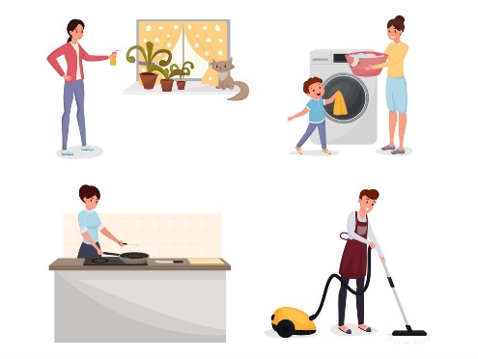
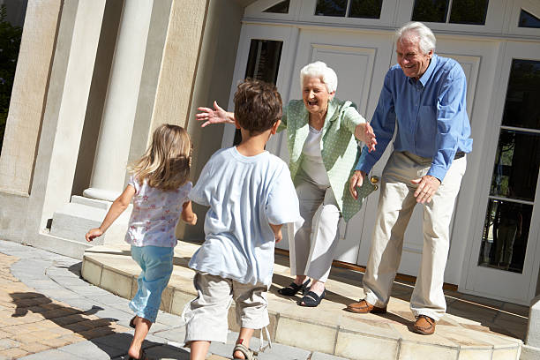
WARM-UP
FAMILY LIFE/ FAMILY

Slide 8
WARM-UP
HUMANS AND THE ENVIRONMENT/ GO GREEN/ GREEN LIFESTYLE/ LIVING GREEN

Slide 9
WARM-UP
TRADITIONAL MUSIC/ MUSIC

Slide 10
LESSON 1
LANGUAGE
Unit
GETTING STARTED
WARM-UP
Game: Finding keywords
PRONUNCIATION
Listen and write the words in the correct columns.

Slide 11
PRONUNCIATION
Listen and write the words in the correct columns. Then practise saying the words.
/br/ | /gr/ | /kr/ | /pr/ | /tr/

Slide 12
PRONUNCIATION
Listen and write the words in the correct columns. Then practise saying the words.
/br/ | /gr/ | /kr/ | /pr/ | /tr/
brain | green | crash | practise | train
breakfast | grow | create | protect | treat
breadwinner | great | cream | product | tree

Slide 13
LESSON 1
LANGUAGE
Unit
GETTING STARTED
WARM-UP
Game: Finding keywords
PRONUNCIATION
Listen and write the words in the correct columns.
Task 1: Match the two parts to make complete sentences.
Task 2: Complete the following sentences.
VOCABULARY

Slide 14
VOCABULARY
1
Match the two parts to make complete sentences.
1. My father puts
a. on a popular TV talent show.
2. Is it difficult to reduce
b. a green lifestyle.
3. He was one of the judges
c. many musical instruments?
4. Many people are trying to adopt
d. our carbon footprints?
5. Can this artist play
e. the rubbish out every day.

Slide 15
VOCABULARY
2
Complete the following sentences using the words from the box.
audience laundry
eco-friendly perform groceries
1. Viet helps his mum do the __________, clean the house, and take care of his little sister.
2. In my family, my mum does the cooking and my dad shops for __________.
3. Will you __________ in the live music concert next week?
4. The __________ clapped for 15 minutes when the band finished playing.
5. Many people in our neighbourhood are using ____________ materials to build their houses.
laundry
groceries
perform
audience
eco-friendly

Slide 16
LESSON 1
LANGUAGE
Unit
GETTING STARTED
WARM-UP
Game: Finding keywords
PRONUNCIATION
Listen and write the words in the correct columns.
Task 1: Match the two parts to make complete sentences.
Task 2: Complete the following sentences.
VOCABULARY
Task 1: Complete the sentences.
Task 2: Complete the sentences.
Task 3: Match the two parts to make complete sentences.
GRAMMAR

Slide 17
GRAMMAR
1
Complete the sentences with the correct forms of the verbs in brackets.
1. Nam often (clean) __________ the house, but he can’t now because he (help) __________his sister with her homework.
2. I wanted (improve) __________ my cooking skills, and my mum let me (take) __________
a cooking course last year.
3. My grandparents (practise) __________ singing twice a week, and they (practise) _______________at the moment.
4. Next Sunday evening, I (watch) __________________ their show live on TV. I think they (win) __________ a prize.
cleans
is helping
to improve
take
practise
are practising
am going to watch
will win

Slide 18
GRAMMAR
2
Complete the sentences. Make sure they mean the same as the sentences.
1. They collect the rubbish in the neighbourhood three times a week.
-> The rubbish _____________________________________________________________.
2. We turned off all the electrical devices in the house.
-> All the electrical devices ___________________________________________________.
3. Millions of people will watch his music videos online.
-> His music videos _________________________________________________________.
in the neighbourhood is collected three times a week.
in the house were turned off.
will be watched online (by millions of people).

Slide 19
GRAMMAR
3
Match the two parts to make complete sentences.
1. We divide household chores
equally in our family,
a. or I can buy tickets for the Vietnam
Idol Finals next week.
2. I usually do the laundry,
b. so everyone has some responsibilities.
3. Don’t throw away unwanted
items,
c. and my sister does the washing-up.
4. We can attend the V-pop Festival this week
d. but sort them and send them for
recycling.

Slide 20
LESSON 1
LANGUAGE
Unit
GETTING STARTED
WARM-UP
Game: Finding keywords
PRONUNCIATION
Listen and write the words in the correct columns.
Task 1: Match the two parts to make complete sentences.
Task 2: Complete the following sentences.
VOCABULARY
Task 1: Complete the sentences.
Task 2: Complete the sentences.
Task 3: Match the two parts to make complete sentences.
GRAMMAR
CONSOLIDATION
Wrap-up
Homework

Slide 21
CONSOLIDATION
1
Wrap-up
- Use words related to family life, humans and environment, and music;
- Pronounce the consonant blends /br/, /kr/, /tr/, /gr/, /pr/ correctly;
- Apply the knowledge of grammar points learnt in the previous units to do the task;
- Practise using the passive voice;
- Practise using the coordinating conjunctions (and, or, but, so).

Slide 22
CONSOLIDATION
2
Homework
Prepare for Review 1 – Skills (Listening and Speaking)

Slide 23
Website: sachmem.vn
Fanpage: facebook.com/sachmem.vn/

