Slide 1

YEN SON PRIMARY SCHOOL
to our class 1A
Teacher: Ngo Thi Thanh Thuy

Slide 2
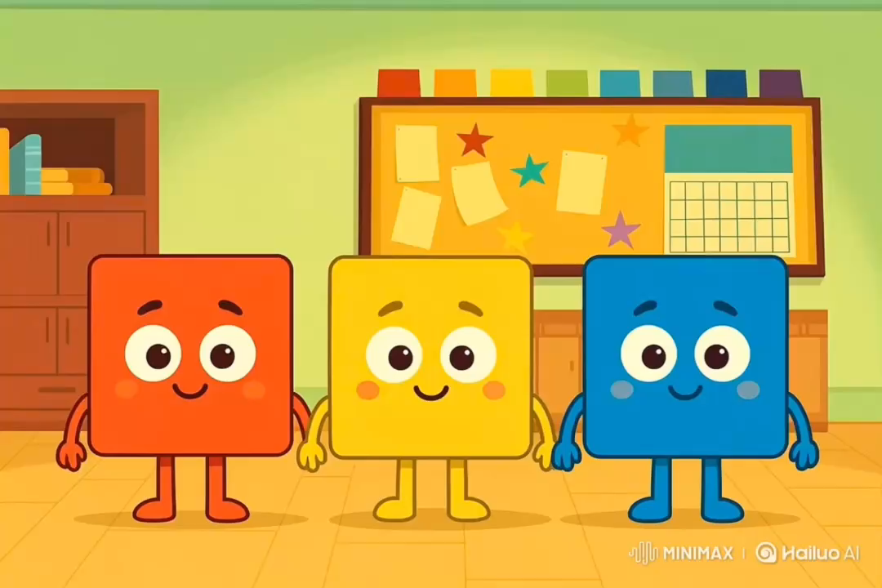

Slide 3


Unit 3: Colors
Lesson 1.1: Vocabulary & Sentence Patterns
Page: 20

Slide 4
Lesson Outline
Warm-up
Vocabulary
Structure
Practice
Consolidation

Slide 5
Objectives
By the end of this lesson, students will be able to identify and use vocabulary for colors, using the target language.
Vocabulary:
red, yellow, blue
Sentence pattern:
It’s (red).

Slide 6

WARM UP

Slide 7


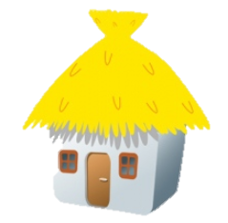


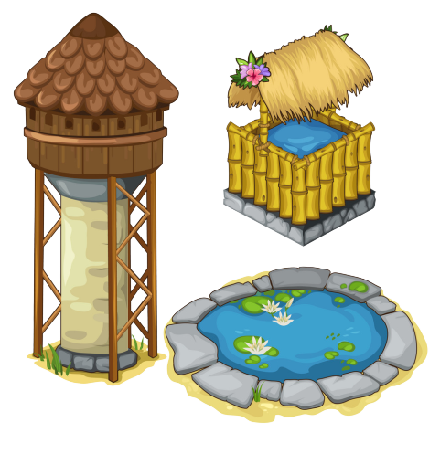
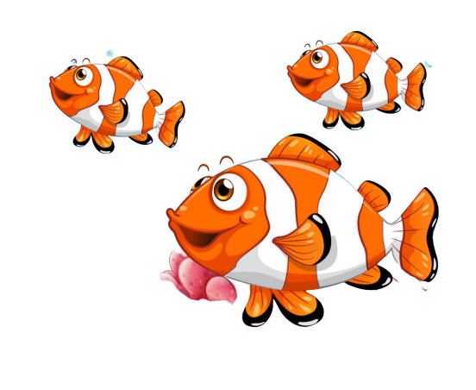
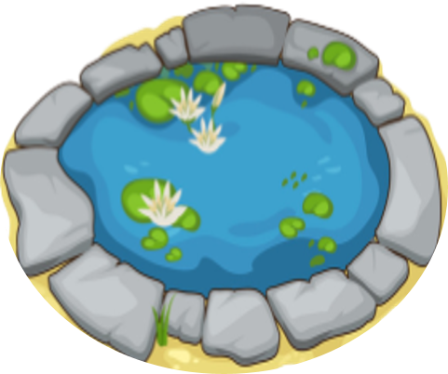
FEEDING GOLDFISH
Mỗi câu trả lời đúng là
CÂU THẦN CHÚ giúp cá Vàng
ngoi lên mặt nước nhận thức ăn.
Nào chúng mình cùng giúp
bạn nhỏ cho cá Vàng ăn nhé!
START

Slide 8


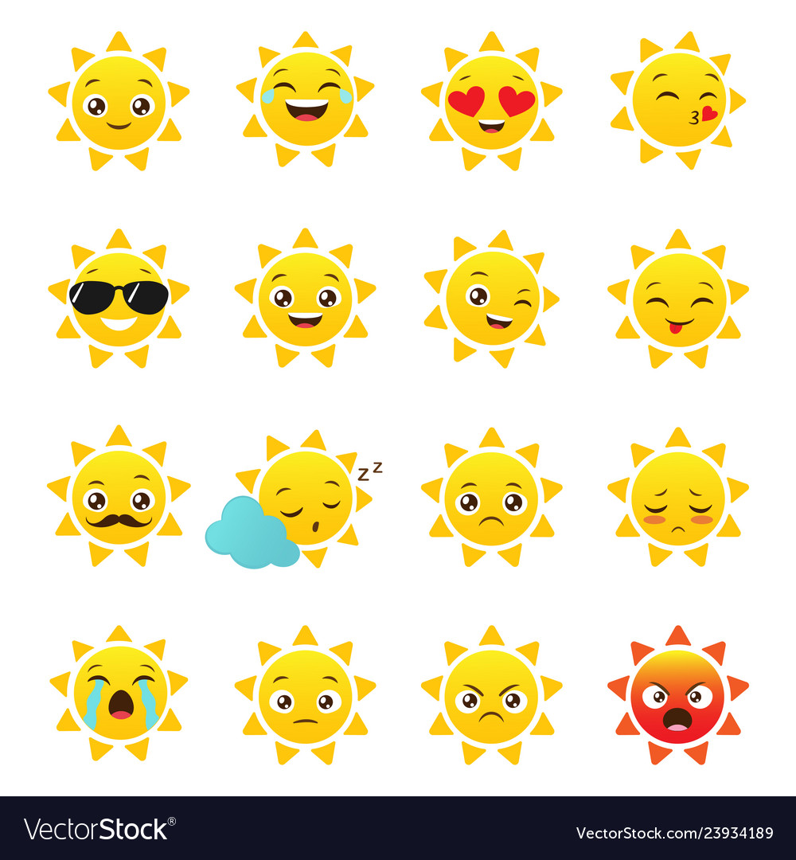
What's it?
Next
It's a dog.
It's a bag.
It's a cat.

Slide 9

What's it?
Next
It's a book.
It's a bag.
It's a door.

Slide 10

What's it?
Next
It's a door.
It's a cap.
It's a bag.

Slide 11
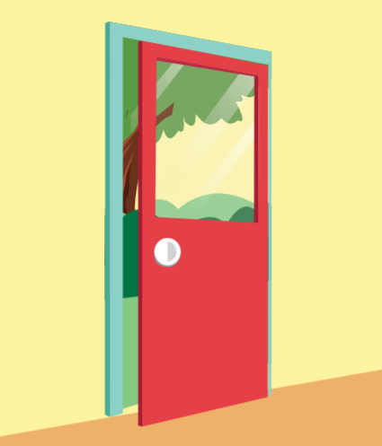
What's it?
Next
It's a book.
It's a bag.
It's a door.

Slide 12

It’s time to learn …

Slide 13

New words
red, yellow, blue

Slide 14

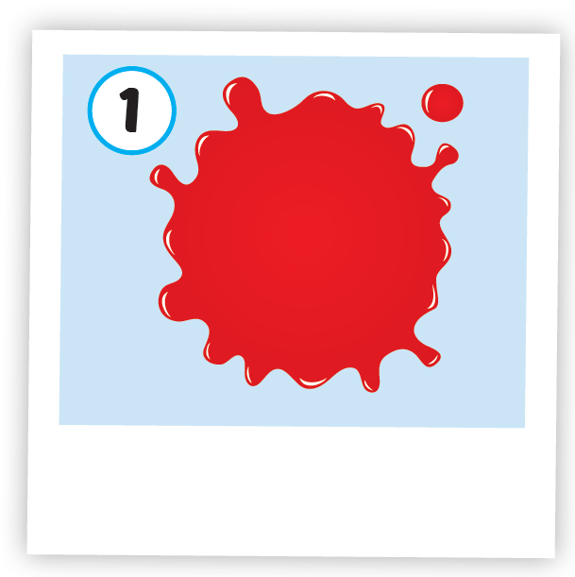
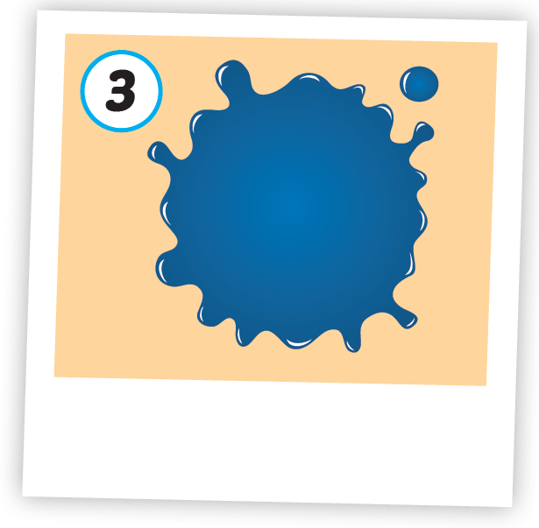
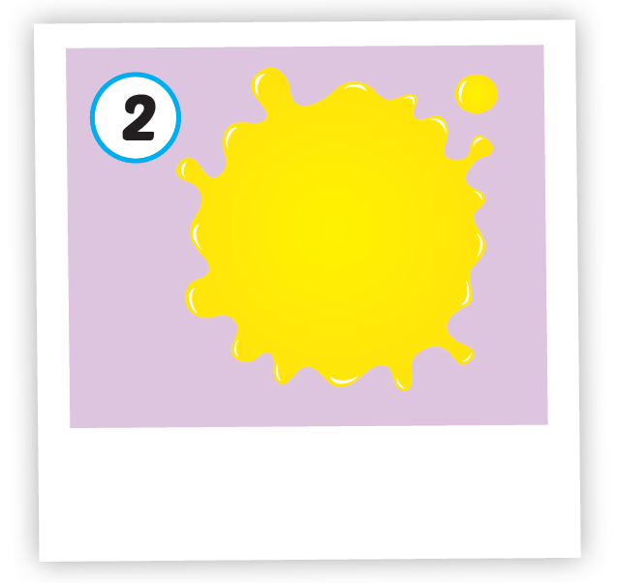



Click A to hear the sound
/red/
màu đỏ
/ˈjeloʊ/
màu vàng
/bluː/
màu xanh dương
Notes:
Click vào hình A. 1. Listen and point. Repeat để cho cả audio full chạy

Slide 15

Click on color to hear the sound
/red/
màu đỏ
Notes:
Click vào hình A. 1. Listen and point. Repeat để cho cả audio full chạy

Slide 16

Click on color to hear the sound
/ˈjeloʊ/
màu vàng

Slide 17

Click on color to hear the sound
/bluː/
màu xanh dương

Slide 18

Structures
It’s (red).

Slide 19

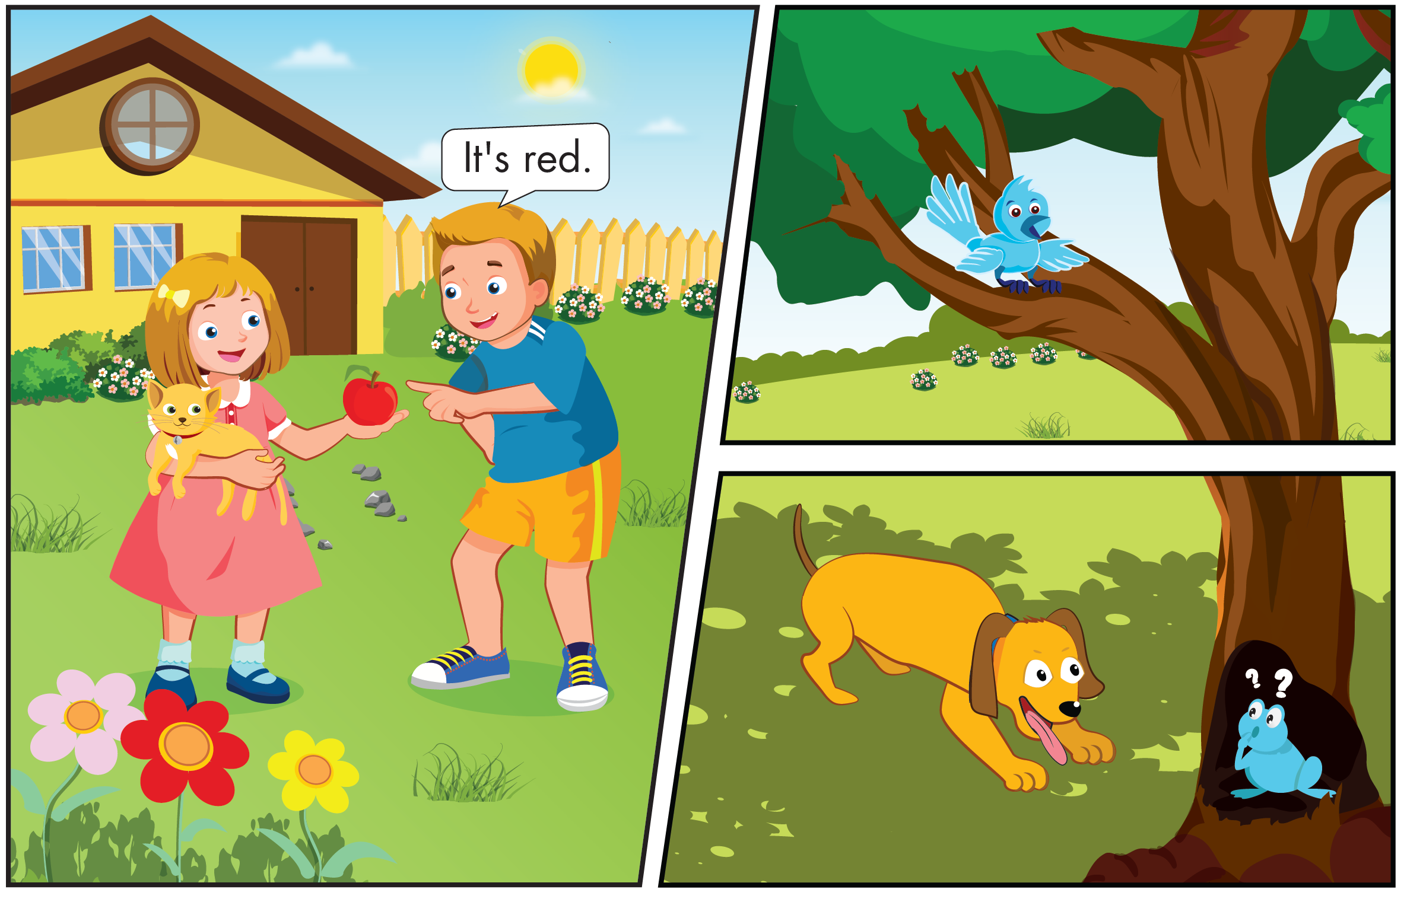
Click B to hear the sound

Slide 20
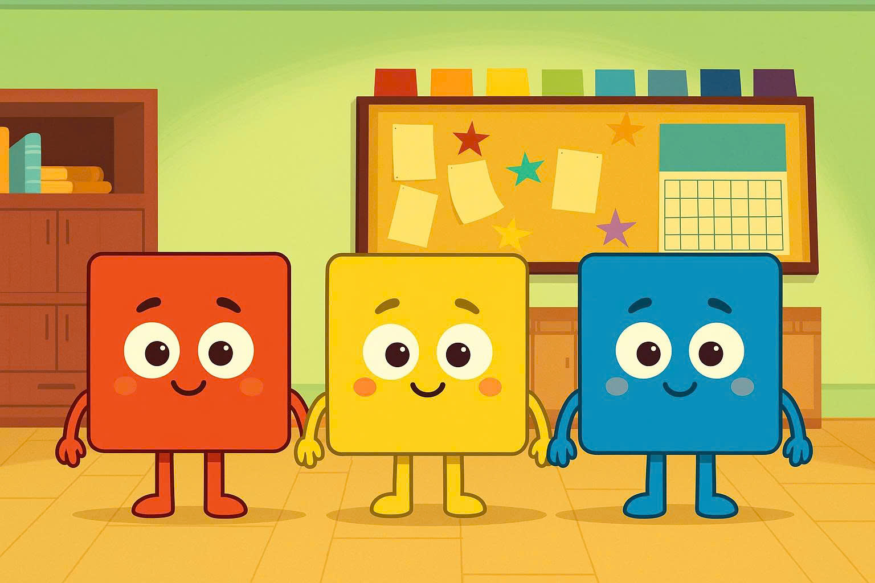

Slide 21


Click C to hear the sound
It's red.
It's red.
It's red.
It's red.
It's yellow.
It's yellow.
It's yellow.
It's yellow.
It's blue.
It's blue.
It's blue.
It's blue.

Slide 22
It’s time to play …

Slide 23



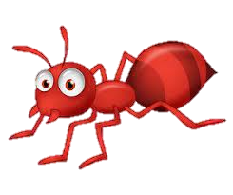
Which one is red?

Slide 24
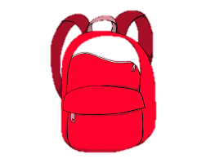
Which one is yellow?

Slide 25
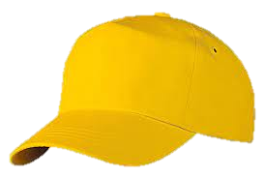
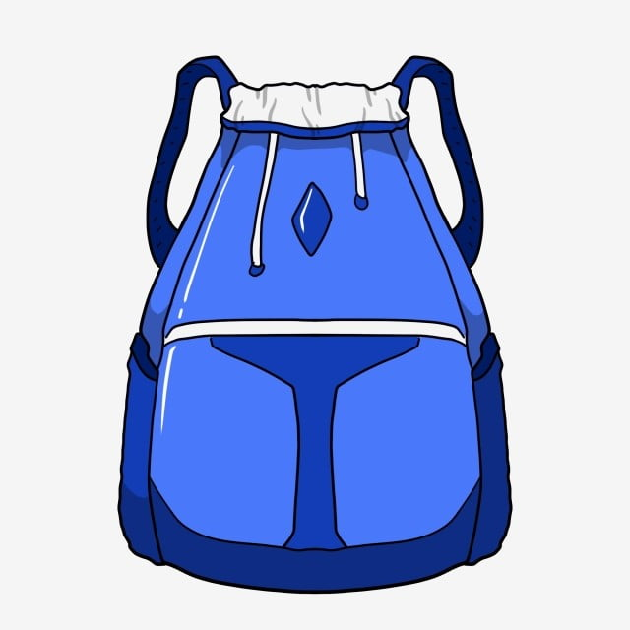
Which one is blue?

Slide 26

Which one is red?

Slide 27
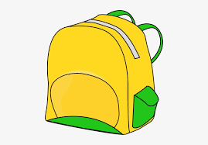
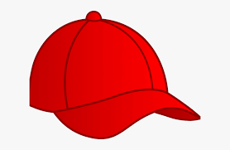
Which one is yellow?

Slide 28
Which one is blue?

Slide 29

Further Practice

Slide 30

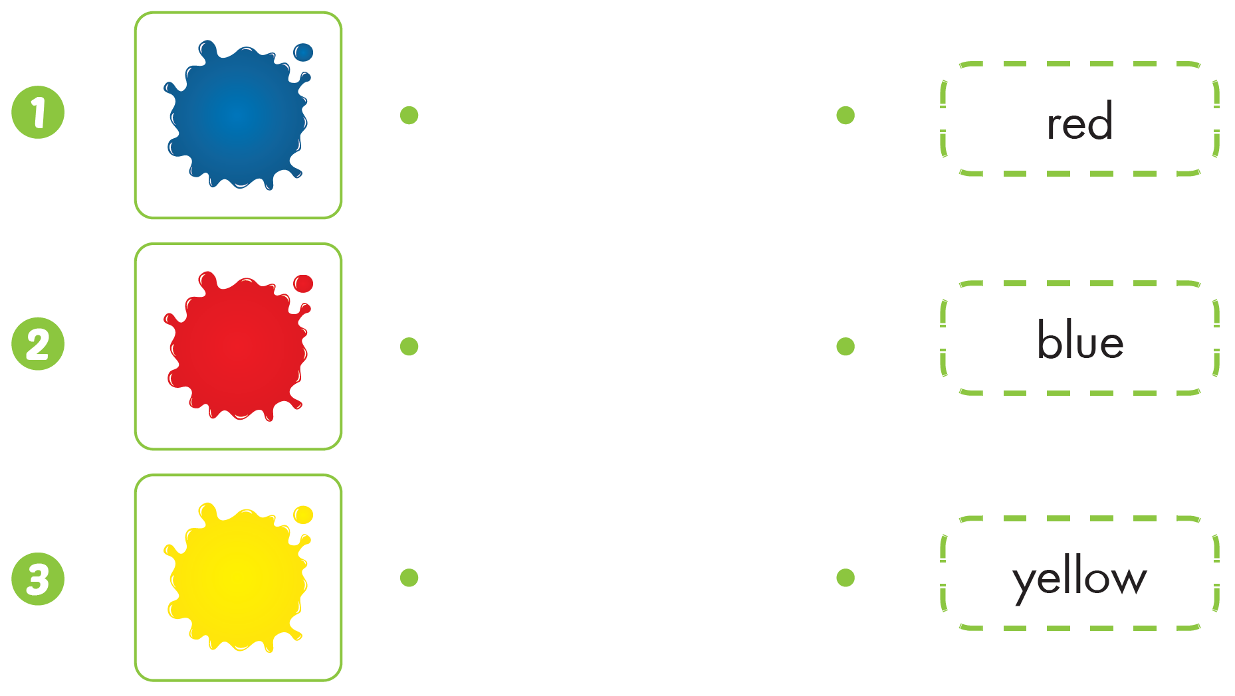

Slide 31

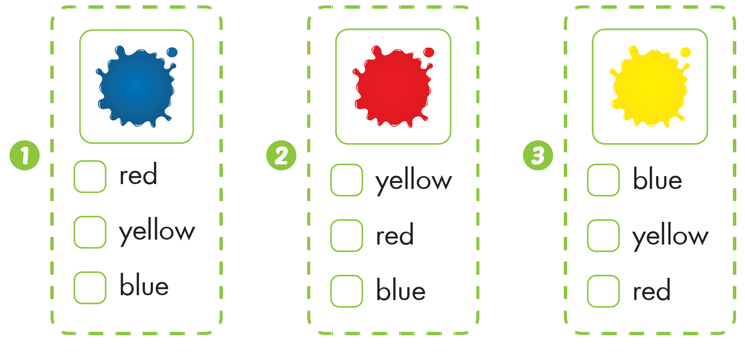


Slide 32

CONSOLIDATION

Slide 33
Today’s lesson
Structures/ Sentence patterns
It’s (red).
Vocabulary
red, yellow, blue

Slide 34
Homelink
Practice vocabularies and structure. Make sentences using them.
Practice the vocabulary and structure in Tiếng Anh 1 i-Learn Smart Start Notebook (page 14)
Play the consolidation games in Tiếng Anh 1 i-Learn Smart Start DHA App on www.eduhome.com.vn
Prepare the next lesson (page 21 SB)

Slide 35

See you again

