Slide 1
Welcome to our class 7C!
TRƯỜNG TH - THCS TÂY SƠN
GIÁO VIÊN: ĐỖ THỊ NHUNG
MÔN: TIẾNG ANH 7(UNIT 2 – TIÊT 1)

Slide 2
* Warm Up: What are your bobbies?
Play: football, tennis, badminton
Make: models, cakes
Hobbies
Build: dollhouse
Do: Judo, karate, yoga
Collect: stamps, coins, toys

Slide 3
Unit
2
HEALTHY LIVING
LESSON 1: GETTING STARTED
Let’s go out!
Unit
HOBBIES

Slide 4
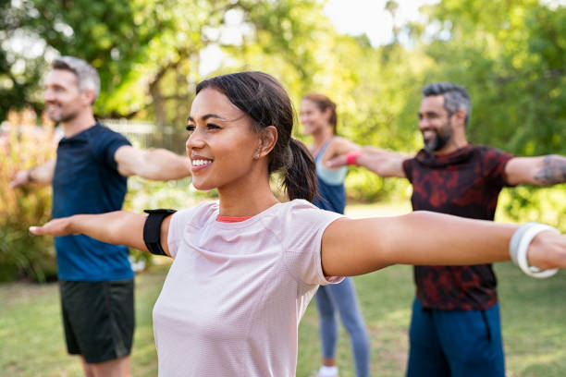
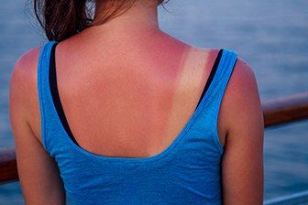
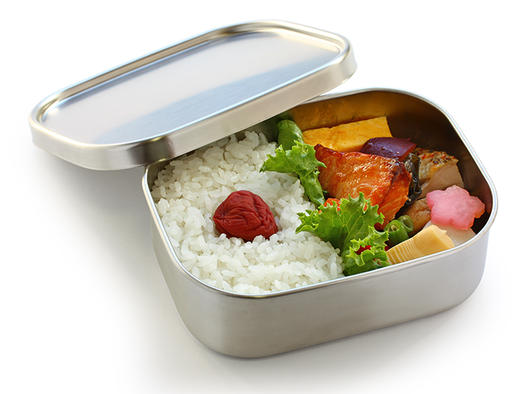
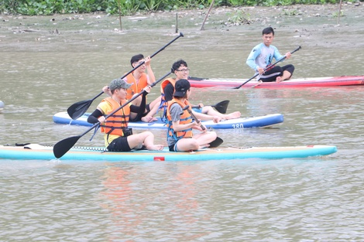
I. New words
- boat (n/v) :
thuyền, chèo thuyền
- cycle (v) :
đạp xe
- exercise (v) :
tập thể dục
- sunburn (n) :
cháy nắng
- suncream (n) :
kem chống nắng
- lunch box (n) :
hộp đựng đồ ăn trưa
- health (n)
: sức khỏe
- healthy (adj)
: sức khỏe tốt

Slide 5
Matching
boat
cycle
exercise
sunburn
suncream
lunch box
6

Slide 6
I. New words
II. Listen and read
1. Listen and answer.
What are Mark and Mi talking about?
- boat
- cycle
- exercise
- sunburn
A. Health problems
- suncream
B. Healthy activities
- lunch box
C. Sports and games

Slide 7
LISTEN AND READ.
Mi: This is a nice picture, Mark.
Mark: That’s my dad and I boating at Yen So Park.
Mi: It also see a lot of people exercise there.
Mark: Yes, it’s a popular place for people in my neighbourhood.
Mi: Outdoor activities are good for our health. My family often goes cycling in the countryside. It’s quiet and there’s a lot of fresh air.
Mark: It sounds interesting.
Mi: Yes, it’s lots of fun. We also bring fruit, water, and a lunch box with us.
Mark: I’d love to join you next time.
Mi: Sure. Bring along a hat and suncream.
Mark: Why suncream?
Mi: It’s really hot and sunny at noon so you might get sunburn.
Mark: I see.

Slide 8
PRACTICE
1
Circle the correct answer.
1. What are Mark and Mi talking about? A. Health problems B. Healthy activities C. Sports and games
Mi: I also see a lot of people exercising there. Mark: Yes, it’s a popular place for people in my neighbourhood.

Slide 9
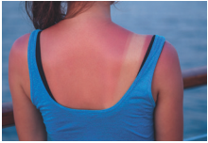
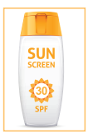
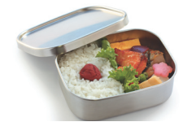
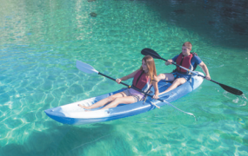
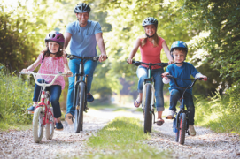
PRACTICE
2
Write a word or phrase from the box under its picture.
boating suncream lunch box sunburn cycling
1.
sunburn
2.
suncream
3.
lunch box
4.
boating
5.
cycling

Slide 10
PRACTICE
3
Complete each sentence with a word from the conversation.
1. In the picture, Mark and his father are __________.
2. The people in Mark’s neighborhood love to go to the _________ .
3. Mi’s family often goes cycling in the ___________.
4. - I don’t want to get sunburn.
- Wear a hat and use __________.
5. Fruit and water are good for our _________ .

Slide 11
PRACTICE
3
Complete each sentence with a word from the conversation.
1. In the picture, Mark and his father are __________.
boating
Mi: This is a nice picture, Mark.
Mark: That’s my dad and I boating at Yen So Park.
2. The people in Mark’s neighbourhood love to go to the _________ .
park
Mi: It also see a lot of people exercise there.
Mark: Yes, it’s a popular place for people in my neighbourhood.

Slide 12
PRACTICE
3
Complete each sentence with a word from the conversation.
3. Mi’s family often goes cycling in the ___________.
countryside
Mi: Outdoor activities are good for our health. My family often goes cycling in the countryside. It’s quiet and there’s a lot of fresh air.
4. - I don’t want to get sunburn.
- Wear a hat and use __________.
suncream
Mi: Sure. Bring along a hat and suncream.
Mark: Why suncream?
Mi: It’s really hot and sunny at noon so you might get sunburn.

Slide 13
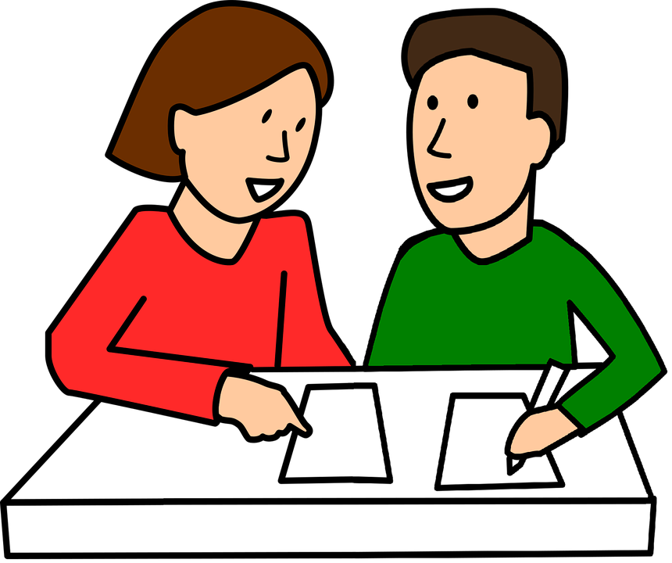
PRODUCTION
4
Survey: Good or bad for health.
Example: A: I walk to school. B: I think it’s good for your health. A: I rarely eat breakfast. B: It’s not good. Breakfast is very important. It gives us energy for the day.

Slide 14
PRODUCTION
4
Survey: Good or bad for health.
Daily activities | How often | Good | Bad
Walking to school | Every day | √
Daily activities | How often | Good | Bad
Walking to school | Every day | √
Eating breakfast
Going swimming
Sleeping

Slide 15
CONSOLIDATION
1
WRAP-UP
HEALTHY LIVING
Things to go out
Healthy activities
Topic of the unit
Vocabulary

Slide 16
CONSOLIDATION
2
HOMEWORK
Prepare the vocabulary for the next lesson:
A closer look 1.

Slide 17
CẢM ƠN QUÝ THẦY CÔ VÀ CÁC EM HỌC SINH ĐÃ CHÚ Ý LẮNG NGHE

