Slide 1
Unit 11: My home
Quang Son primary school
Lesson 3 ( 1, 2, 3)
Teacher: Le Thi Quynh

Slide 2
Warm-up

Slide 3

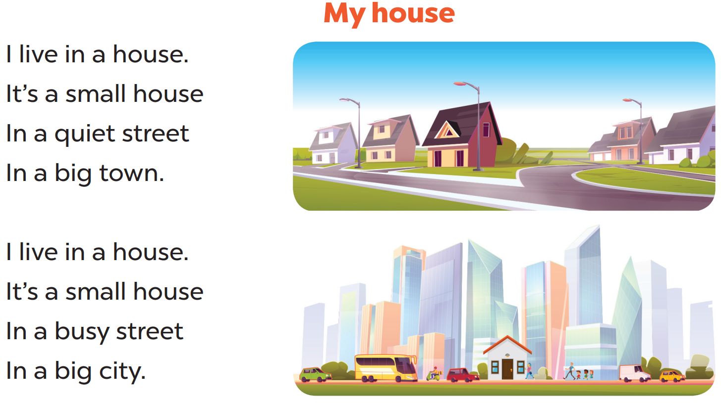

Slide 4
01
Listen and repeat.

Slide 5
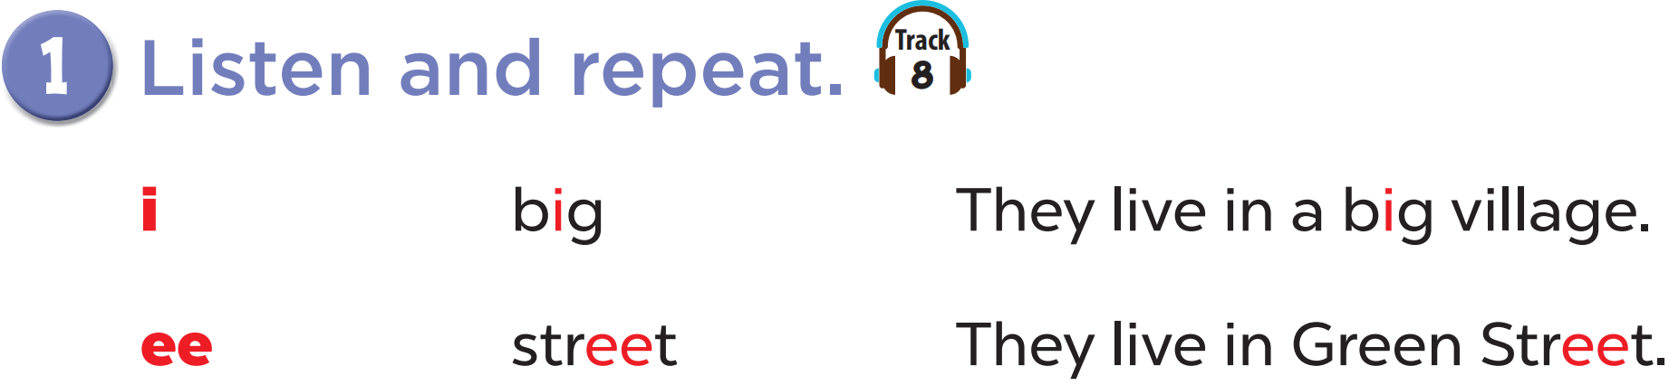

Slide 6
02
Listen and circle.

Slide 7
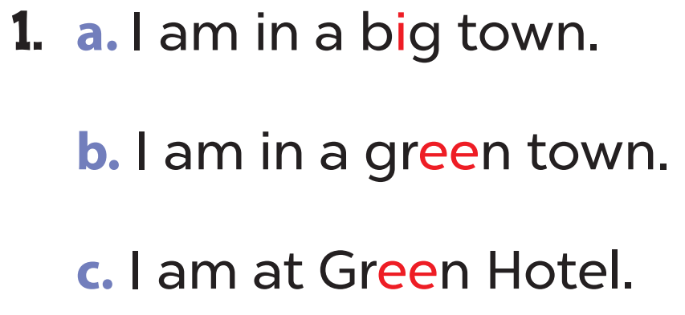
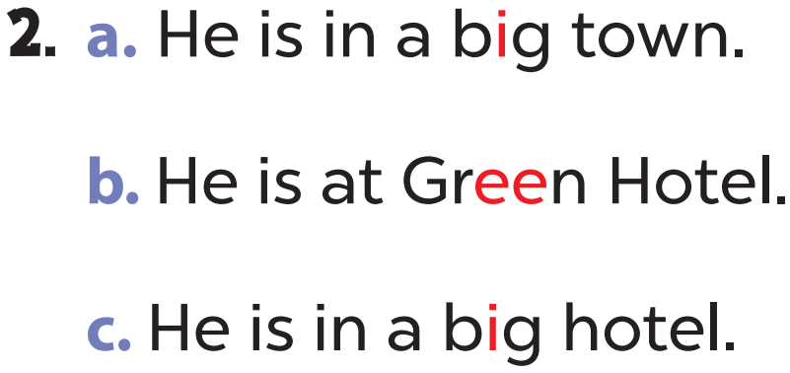

Slide 8


Slide 9
03
Let’s chant.

Slide 10
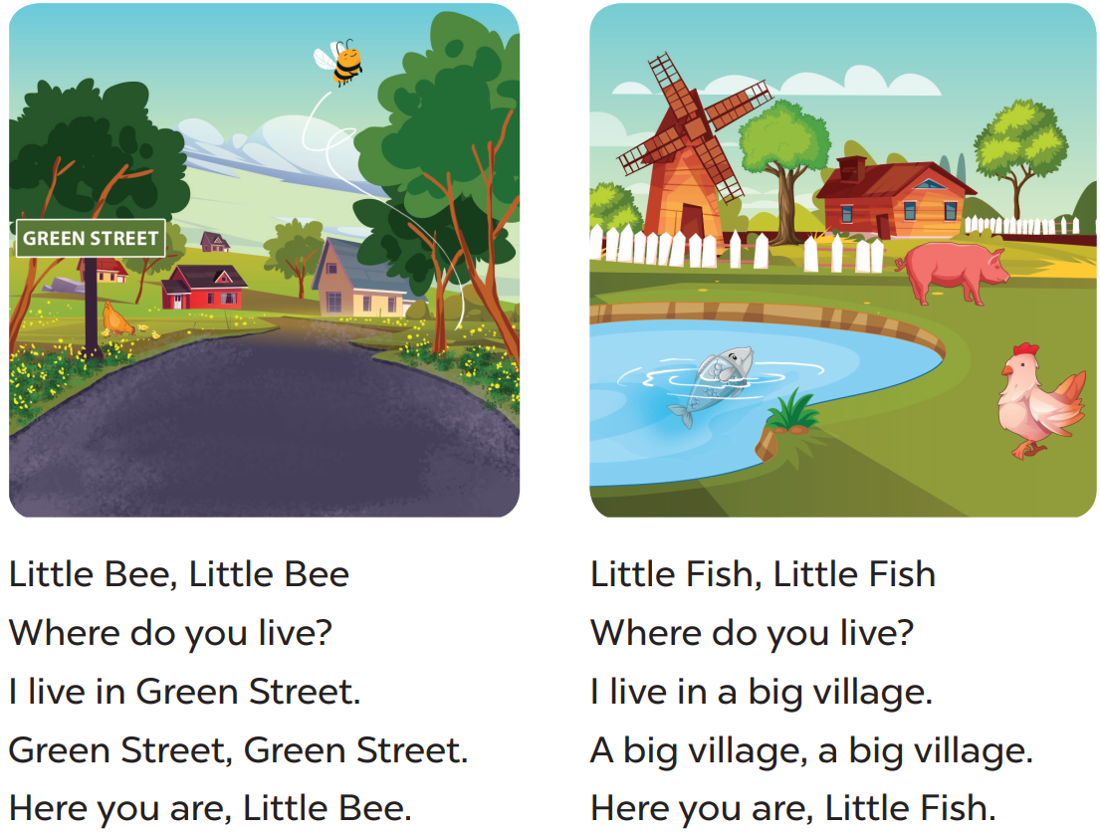

Slide 11
fun corner & wrap-up

Slide 12
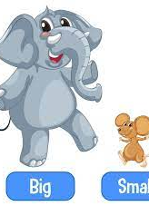
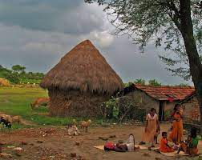
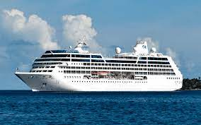
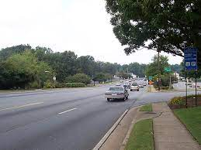
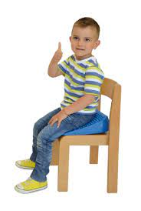

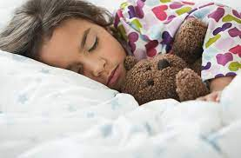
1
2
7
3
6
4
5
Start/Stop
Notes:
1- big
2- village
3- street
4- green
5- sleep
6- sit
7- ship

Slide 13
What have you learnt today?

Slide 14
THANK YOU

