Slide 1



TRƯỜNG TIỂU HỌC QUANG SƠN
TIẾNG ANH 4
Unit 5: Things we can do
Lesson 1( 1,2,3)
Giáo viên: Lê Thị Quỳnh

Slide 2
Warm-up

Slide 3

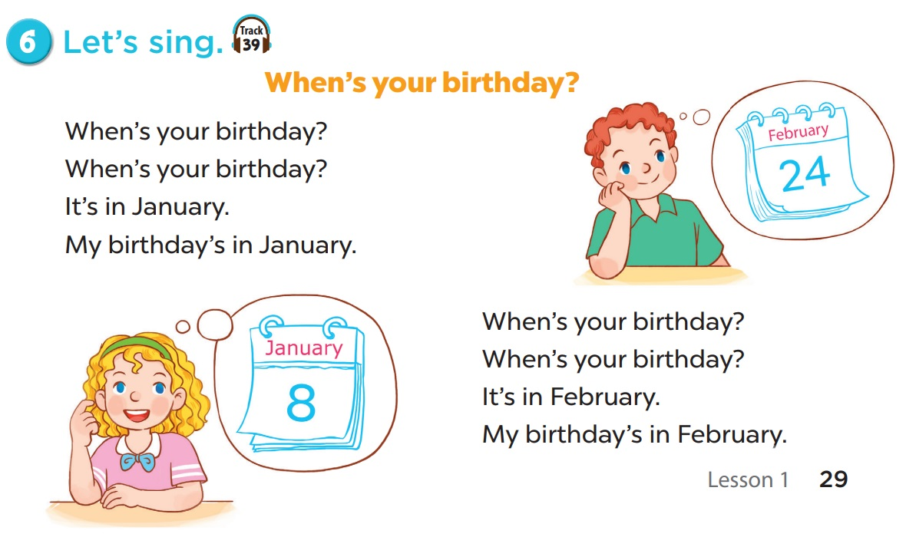

Slide 4



Things we can do
5
LESSON 1 PERIOD 1

Slide 5
Table of contents
01
02
03
Look, listen and repeat.
Listen, point and say.
Let’s talk.

Slide 6
Activity 1 Look, listen and repeat.

Slide 7
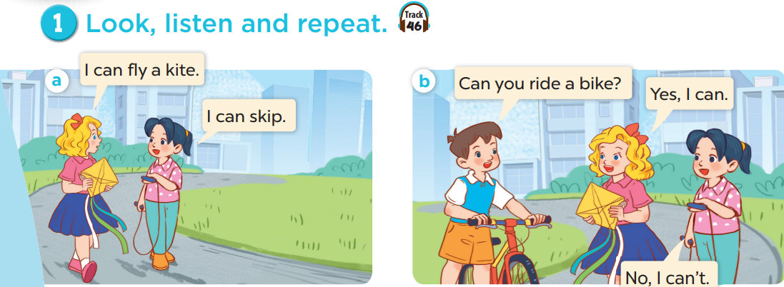
What does Mary have?
What does Mai have?
What does Minh have?

Slide 8

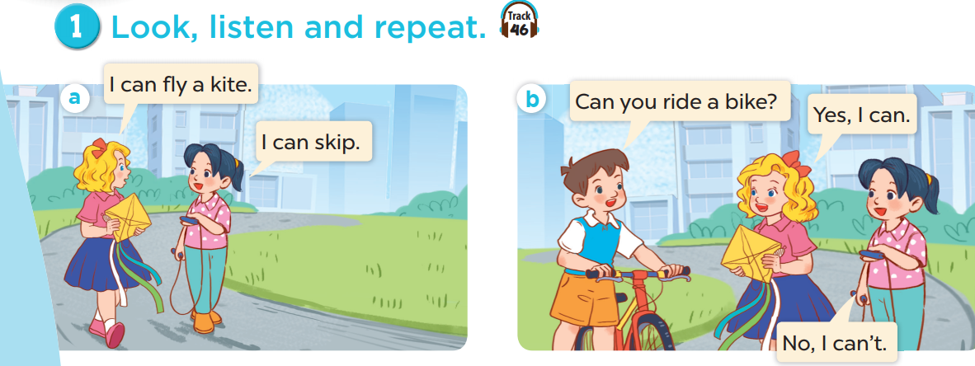
Listen.

Slide 9




Listen and repeat.

Slide 10
Listen and repeat.

Slide 12
Activity 2 Listen, point and say.

Slide 13
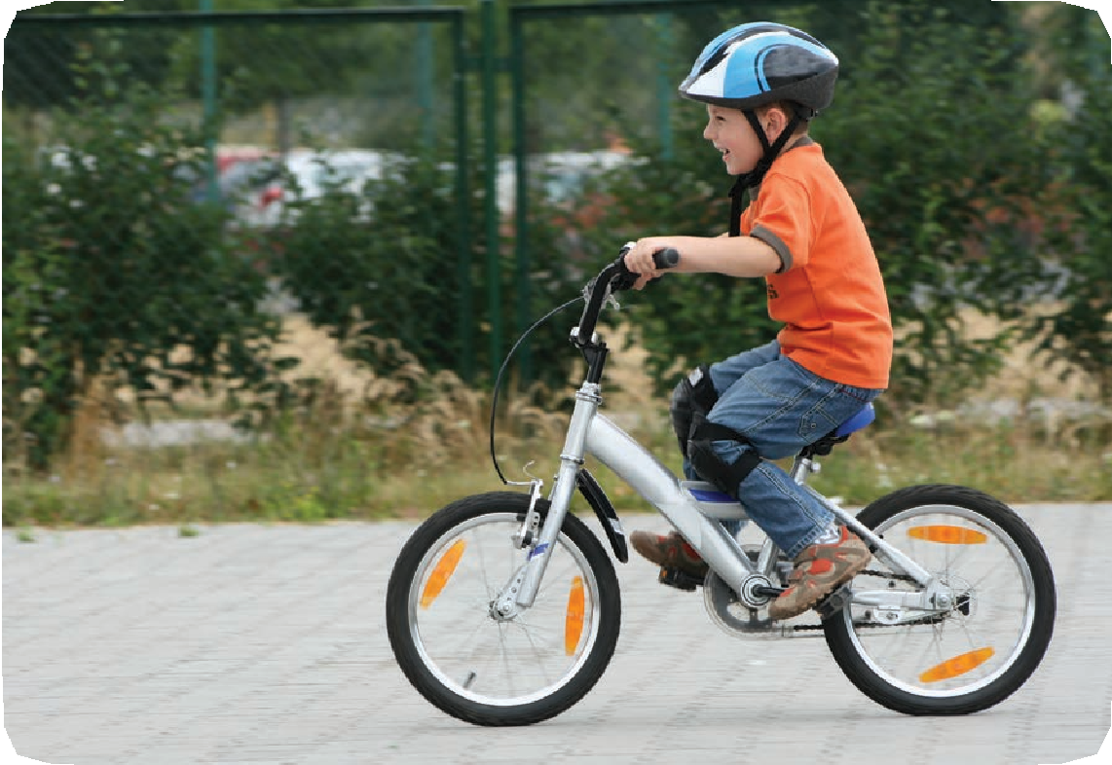
ride a bike

Slide 14
ride a bike

Slide 15
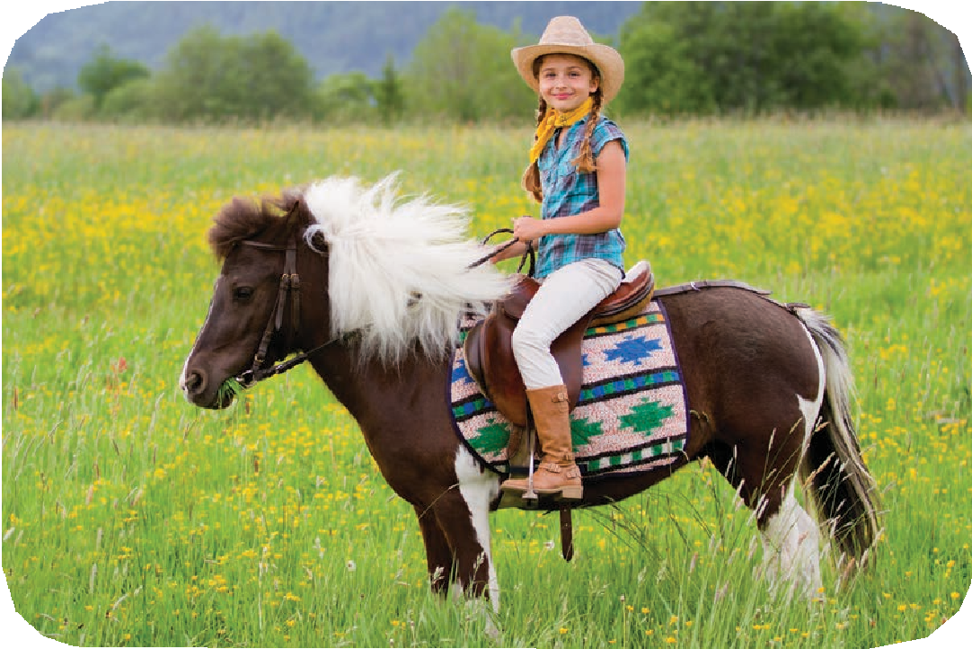
ride a horse

Slide 16
ride a horse

Slide 17
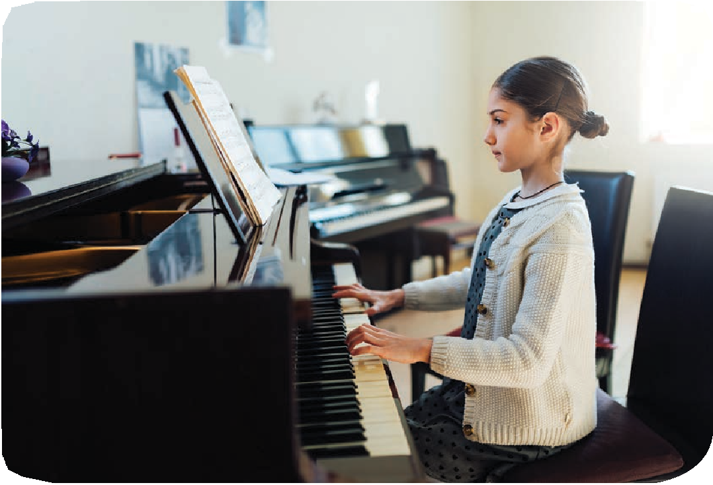
play the piano

Slide 18
play the piano

Slide 19

play the guitar

Slide 20
play the guitar

Slide 22
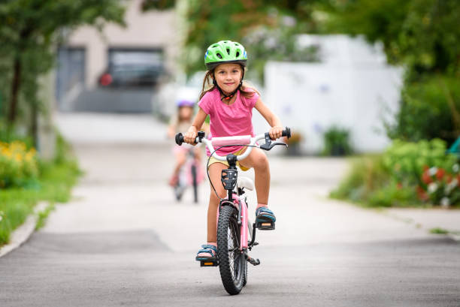

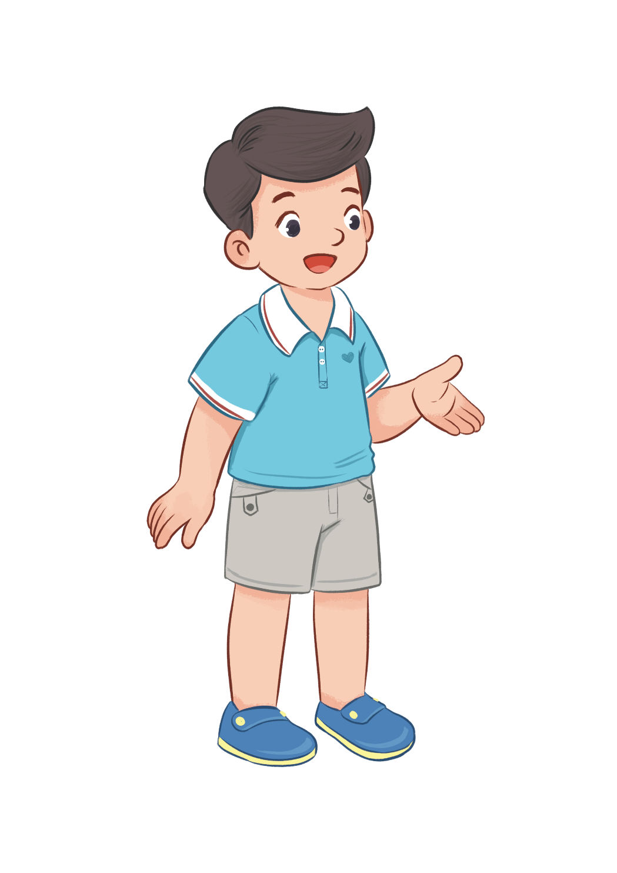
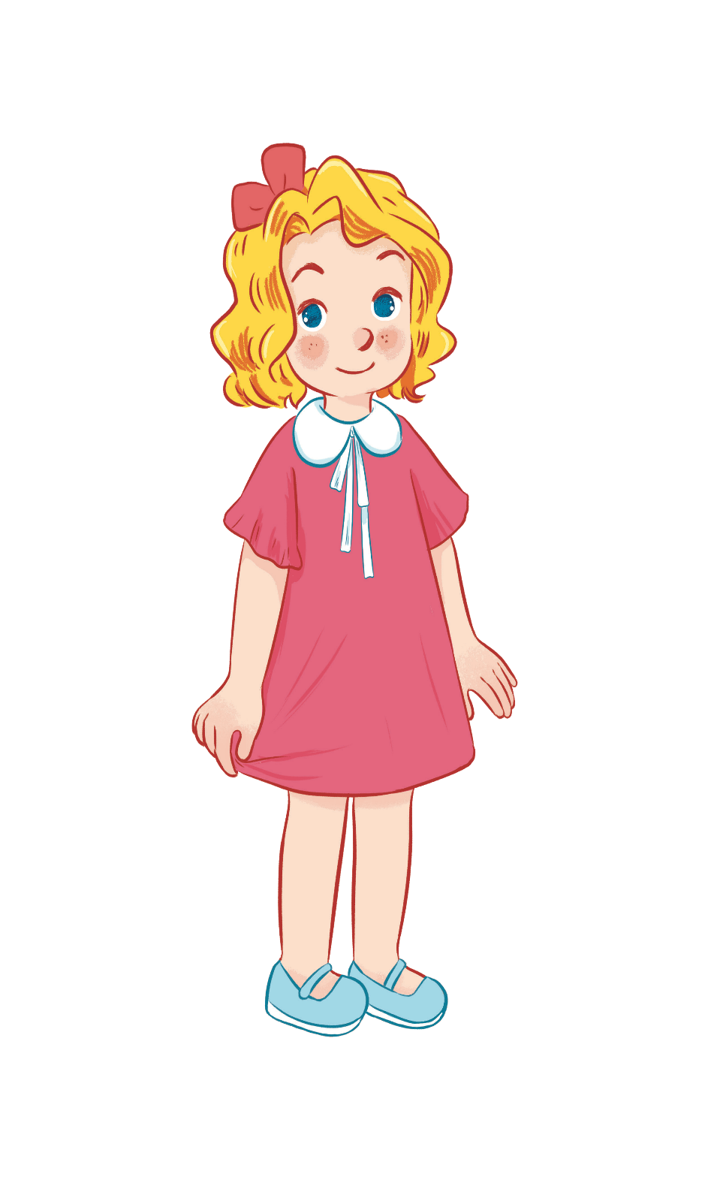
Can you ride a bike?
Yes, I can.

Slide 23
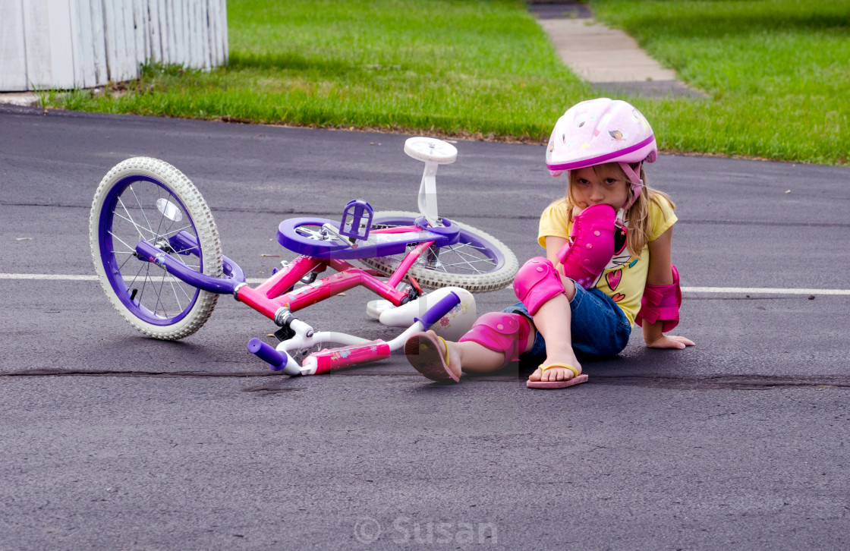

Can you ride a bike?
No, I can’t.

Slide 24
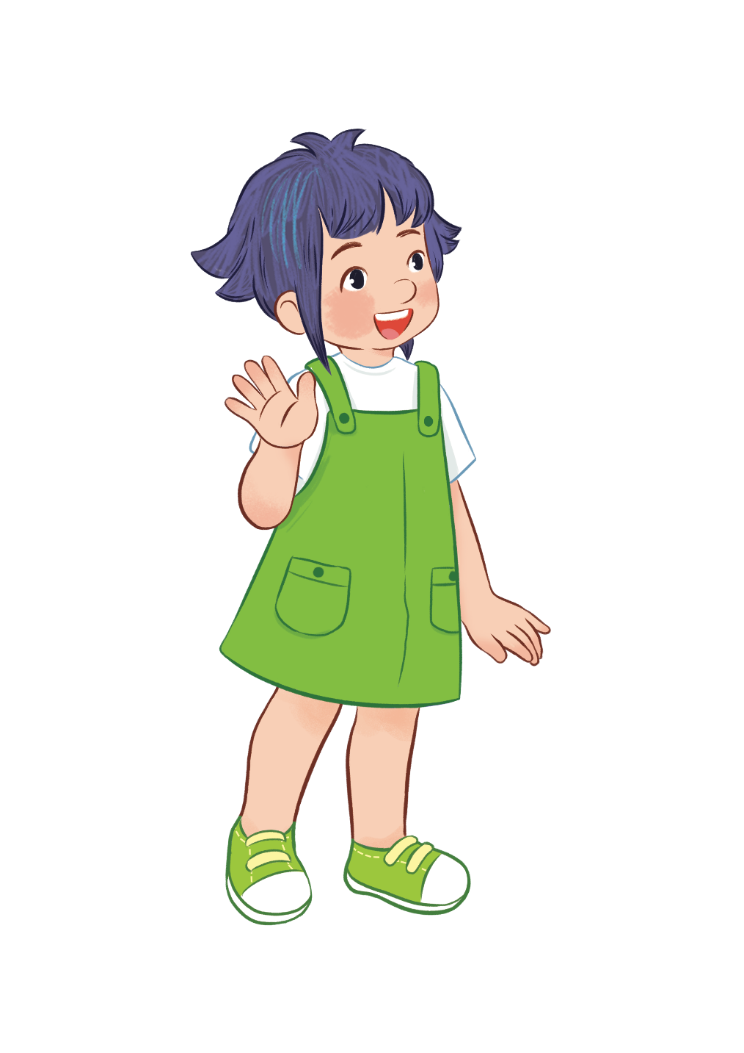

Can you play the guitar?
Yes, I can.

Slide 25
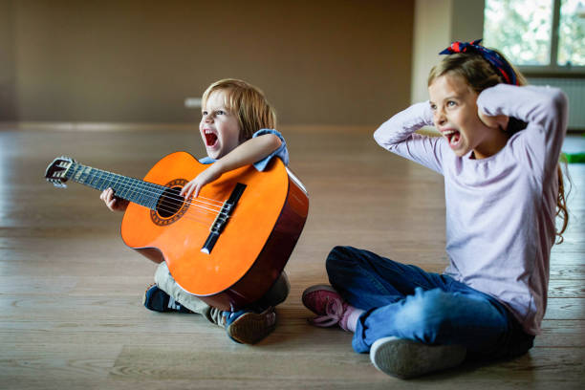
Can you play the guitar?
No, I can’t.

Slide 26
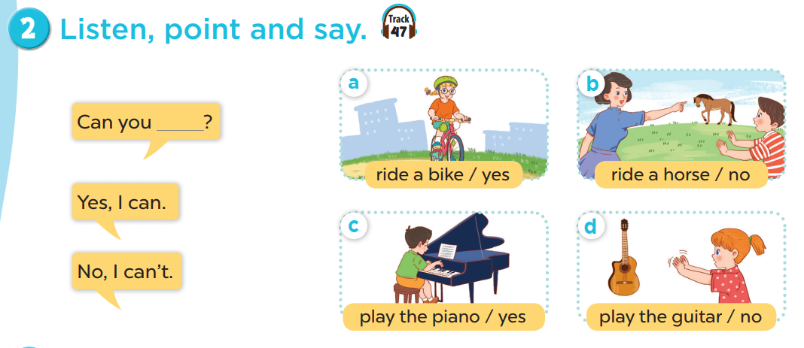







Slide 27

Work in pairs. Practise.

Slide 28
Activity 3 Let’s talk.

Slide 29
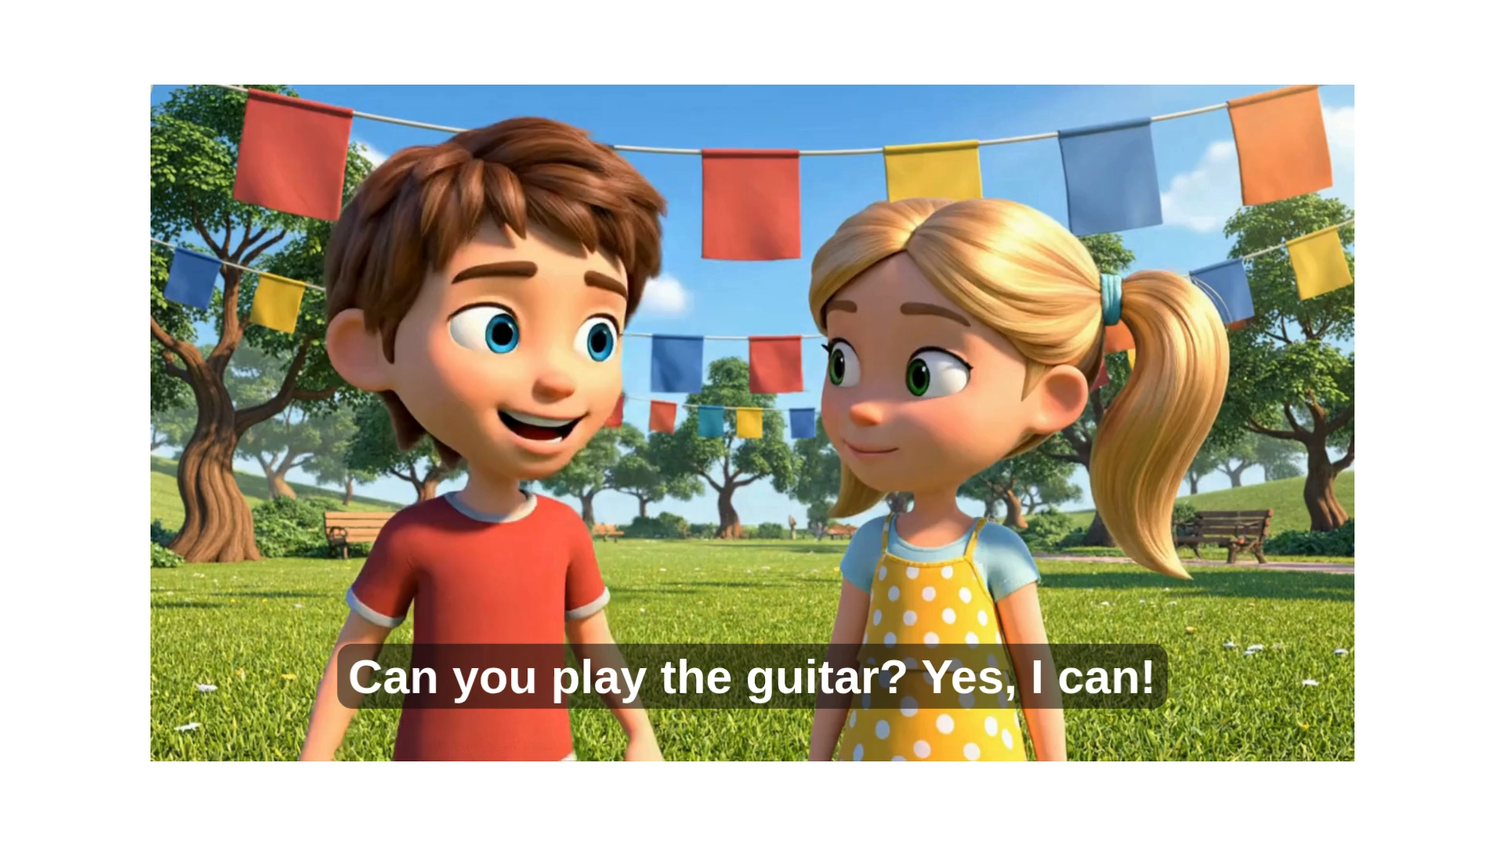

Slide 30
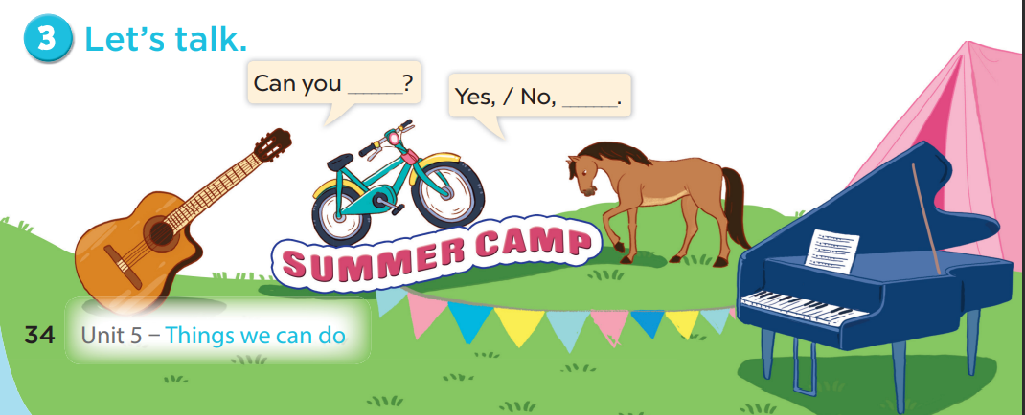

Slide 31
Games
Pass the ball

Slide 32
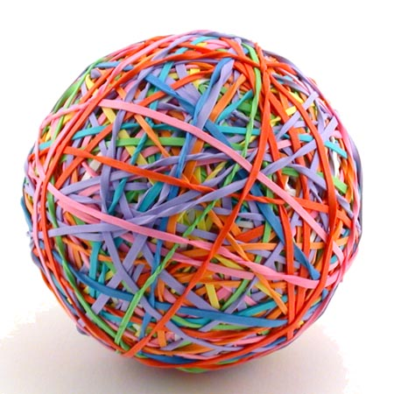

Pass the BALL!

Slide 33



Insert one question here

Slide 34
Pass the BALL!

Slide 35
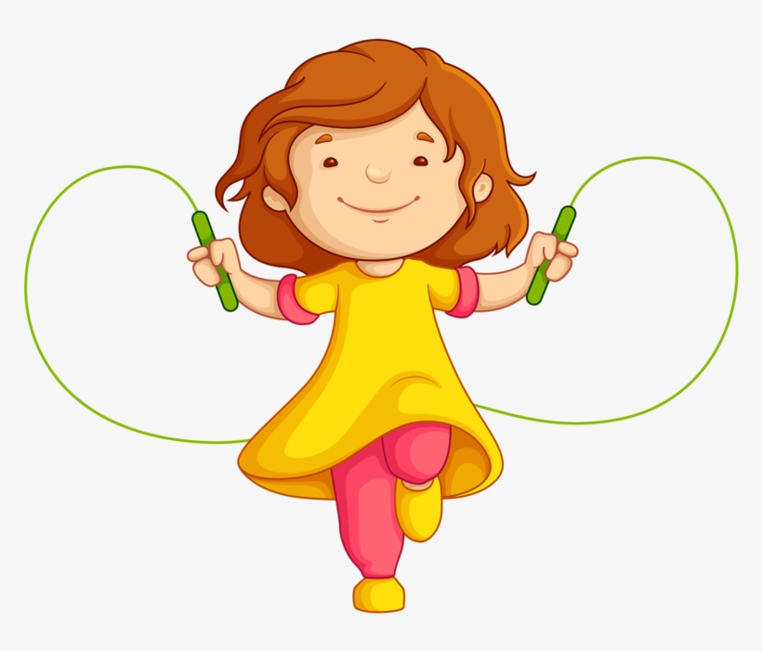
Insert one question here
Insert one question here
Insert one question here

Slide 36
Pass the BALL!

Slide 37
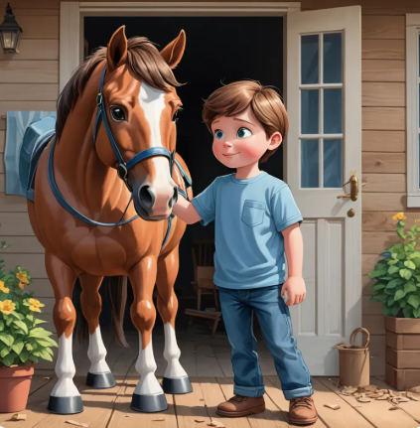

Slide 38
Pass the BALL!

Slide 39
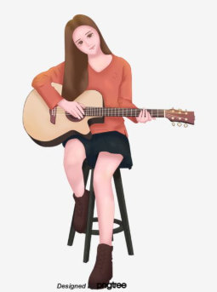
Insert one question here
Insert one question here
Insert one question here

Slide 40
Pass the BALL!

Slide 41

Insert one question here
Insert one question here
Insert one question here

Slide 42
Pass the BALL!

Slide 43

Insert one question here
Insert one question here
Insert one question here

Slide 44

Wrap up!

Slide 45
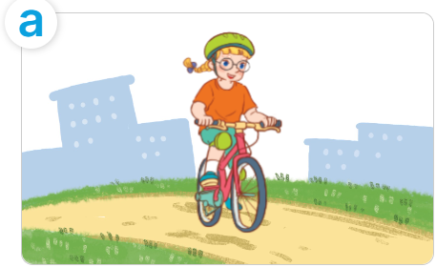
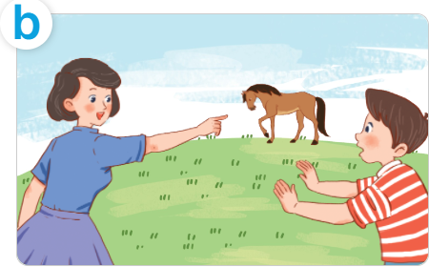


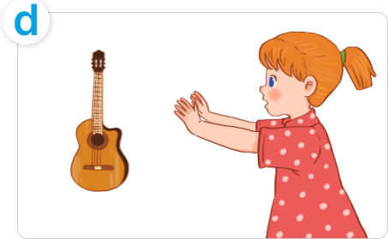
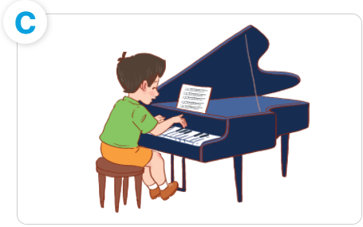
Can you___?
Yes, I can
ride a bike
ride a horse
No, I can’t
play the piano
play the guitar

Slide 46


