Slide 1
Daily activities
Welcome to our English class
14
Lesson 3 (4,5,6)
Teacher: Le Thi Quynh

Slide 2
Contents
01
Warm-up
02
03
04
Read and match.
Let’s write.
Project

Slide 3
01
Warm-up

Slide 4
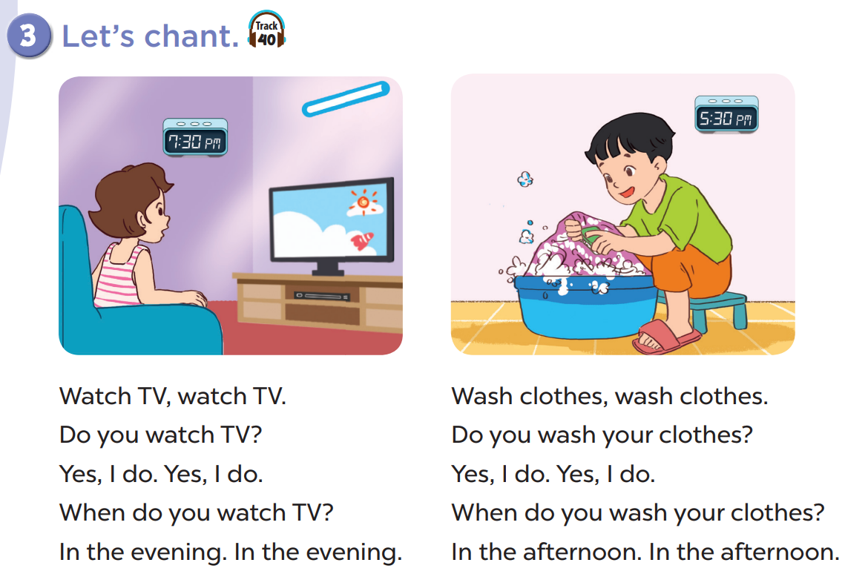

Slide 5
02
Read and match.

Slide 6
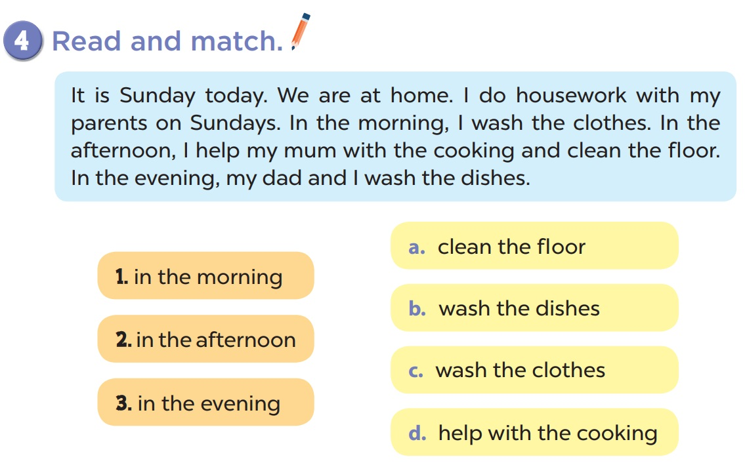

Slide 7
03
Let’s write.

Slide 9
04
Project

Slide 12
T
h
a
n
k
f
o
r
T
h
a
n
k
s
f
o
r
s
y
o
u
r
t
t
e
n
t
i
o
n
!
y
o
u
r
a
t
t
e
n
t
i
o
n
!
a

