Slide 1
Unit 13 Appearance
Welcome to our English class
Lesson 2 (4,5,6)
Teacher: Le Thi Quynh

Slide 2
Table of contents
01
Warm-up and review
04
02
03
Let's play.
Listen and number.
05
Fun corner and wrap-up
Look, read and complete.

Slide 3
Warm-up
01

Slide 4
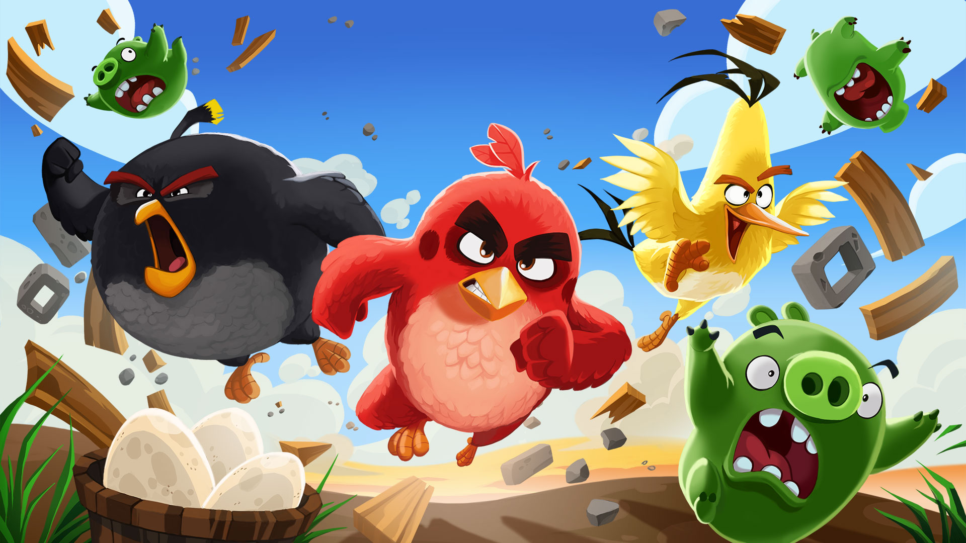

Slide 5
1
2
3
4
5
6
7
8
1
2
3
4
5
6
7
8
1 point
3 points
Take 5 points
2 points
4 points
Notes:
Click to numbers at the top to answer the questions
Click to numbers in the bricks to review points
5

Slide 6
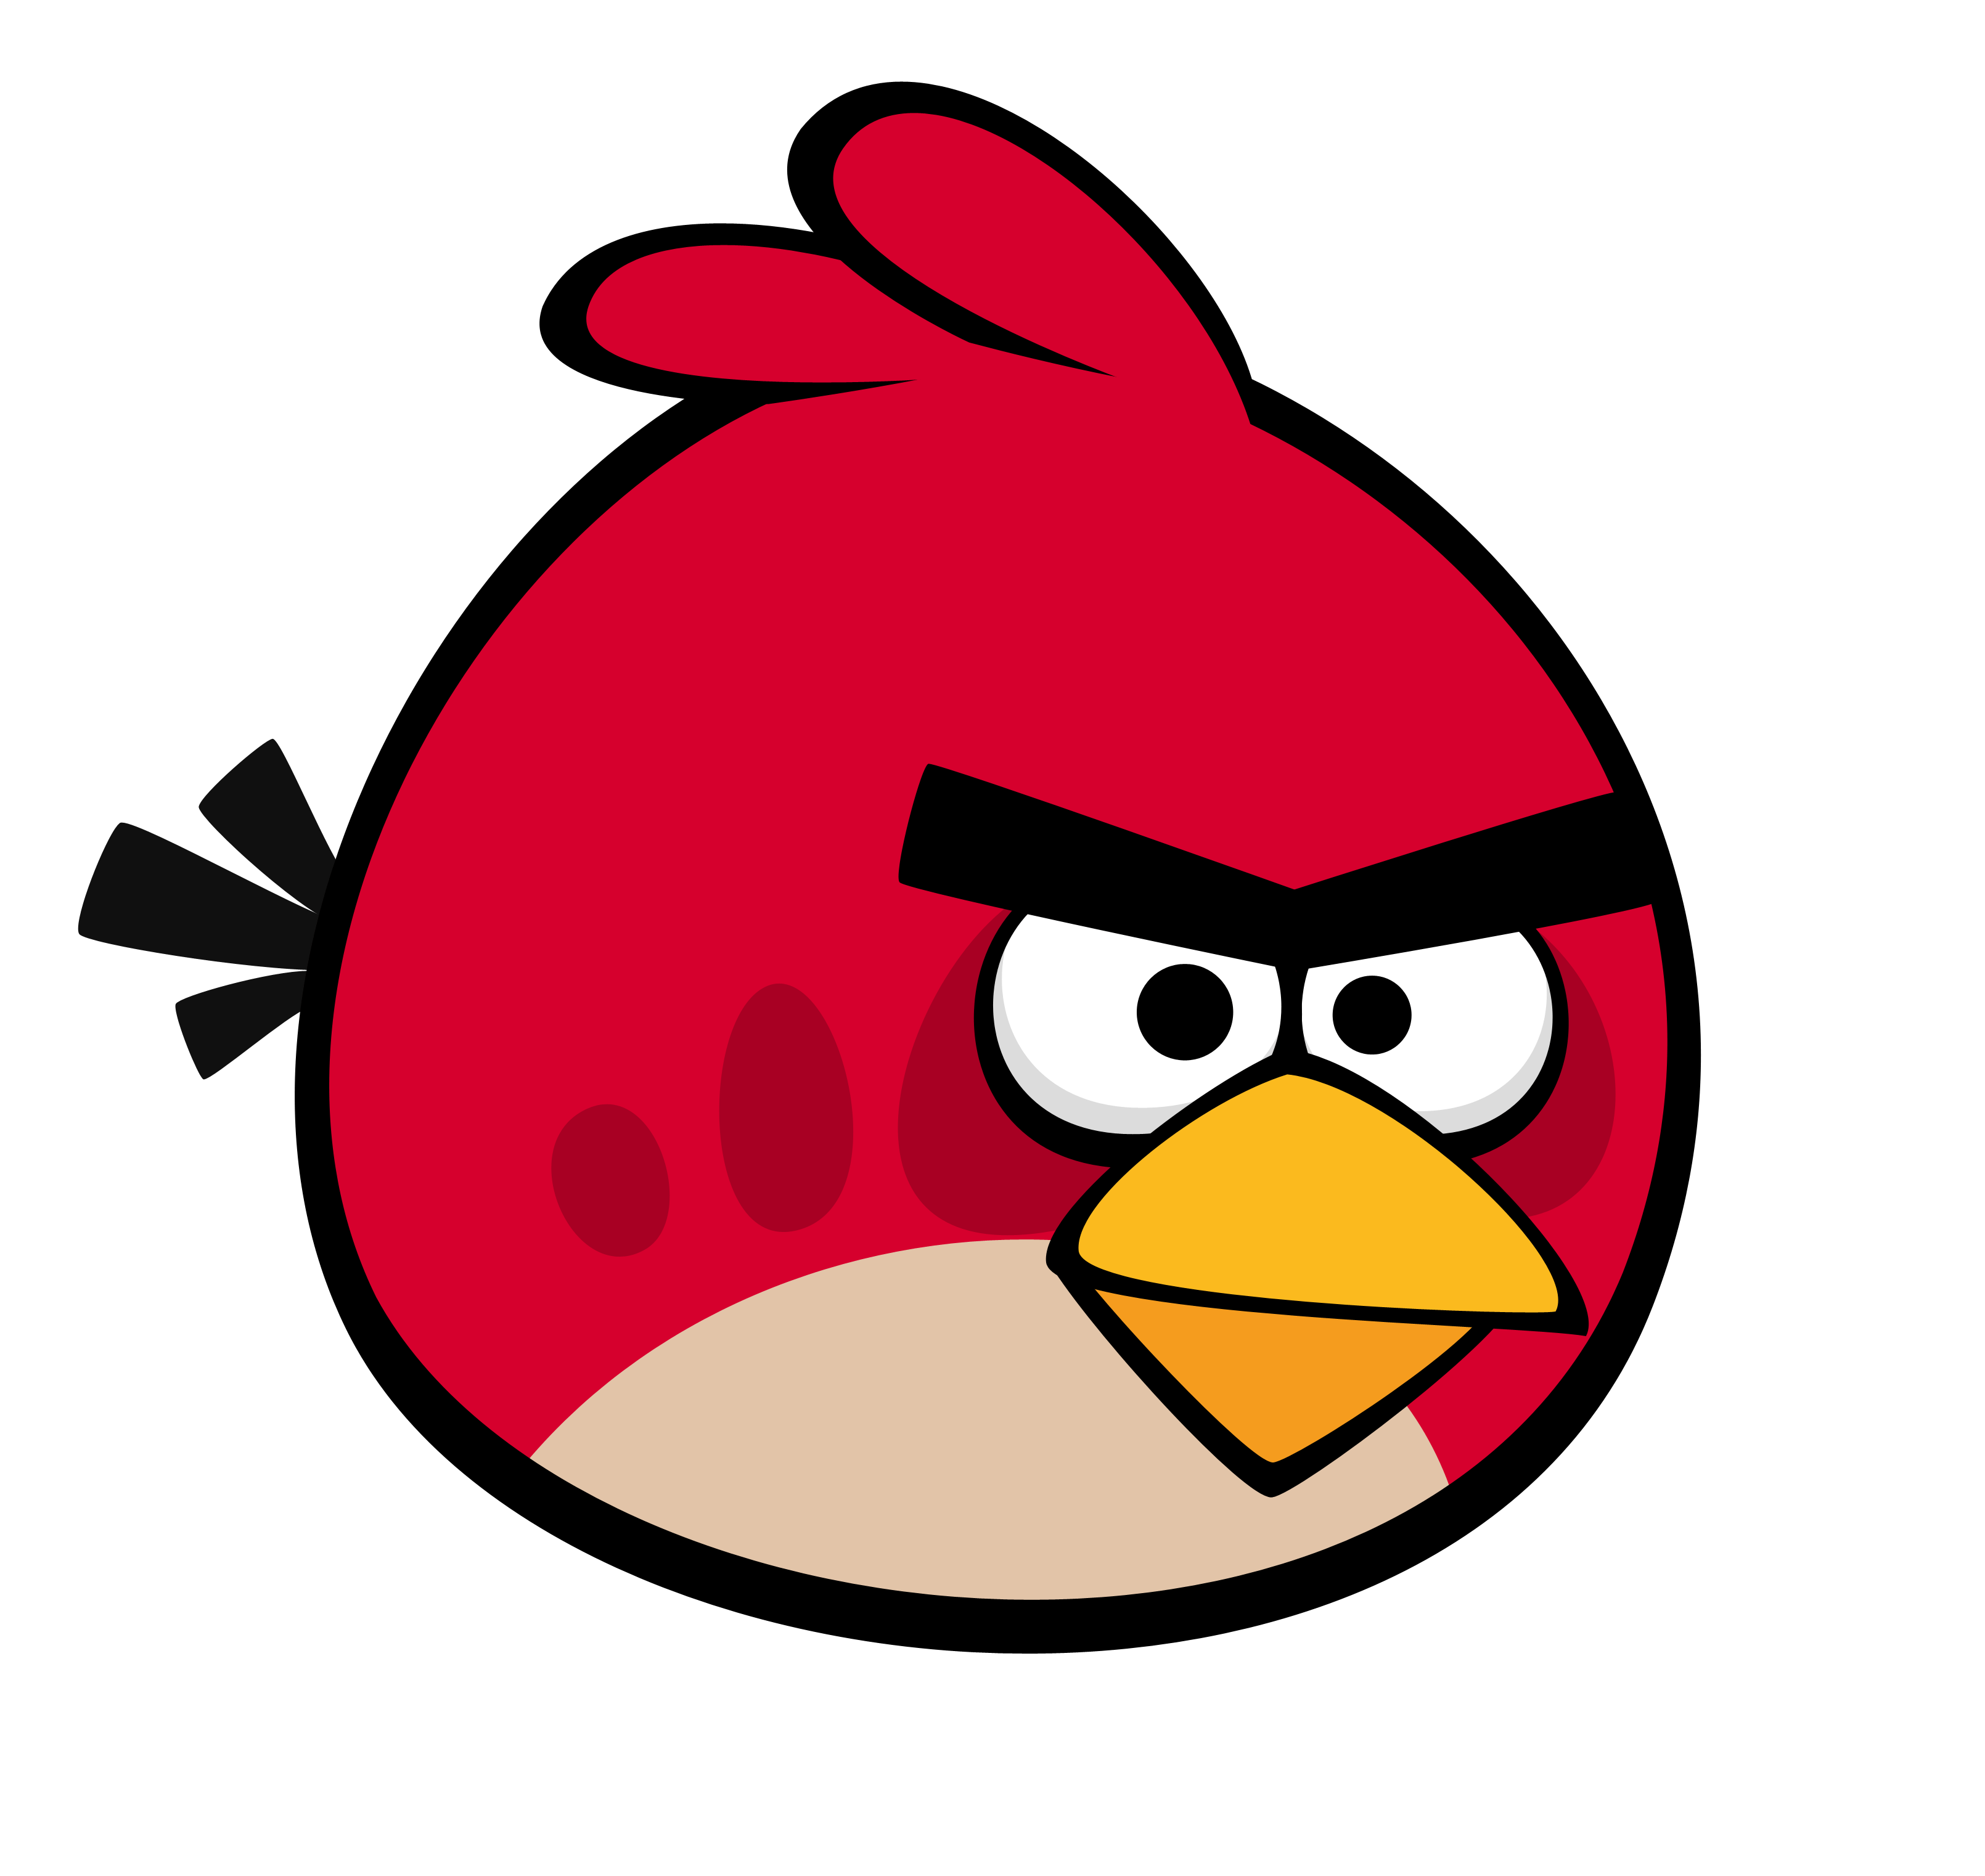
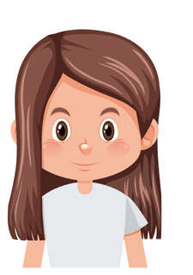
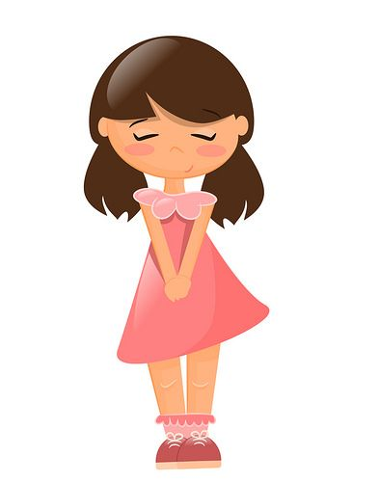
What does Mai look like?
Mai
Hoa
She has short hair.
Notes:
Other answers can be accepted if correct.
Click the red angry bird to come back

Slide 7
What does Hoa look like?
Mai
Hoa
She has long hair.
Notes:
Other answers can be accepted if correct.
Click the red angry bird to come back

Slide 8
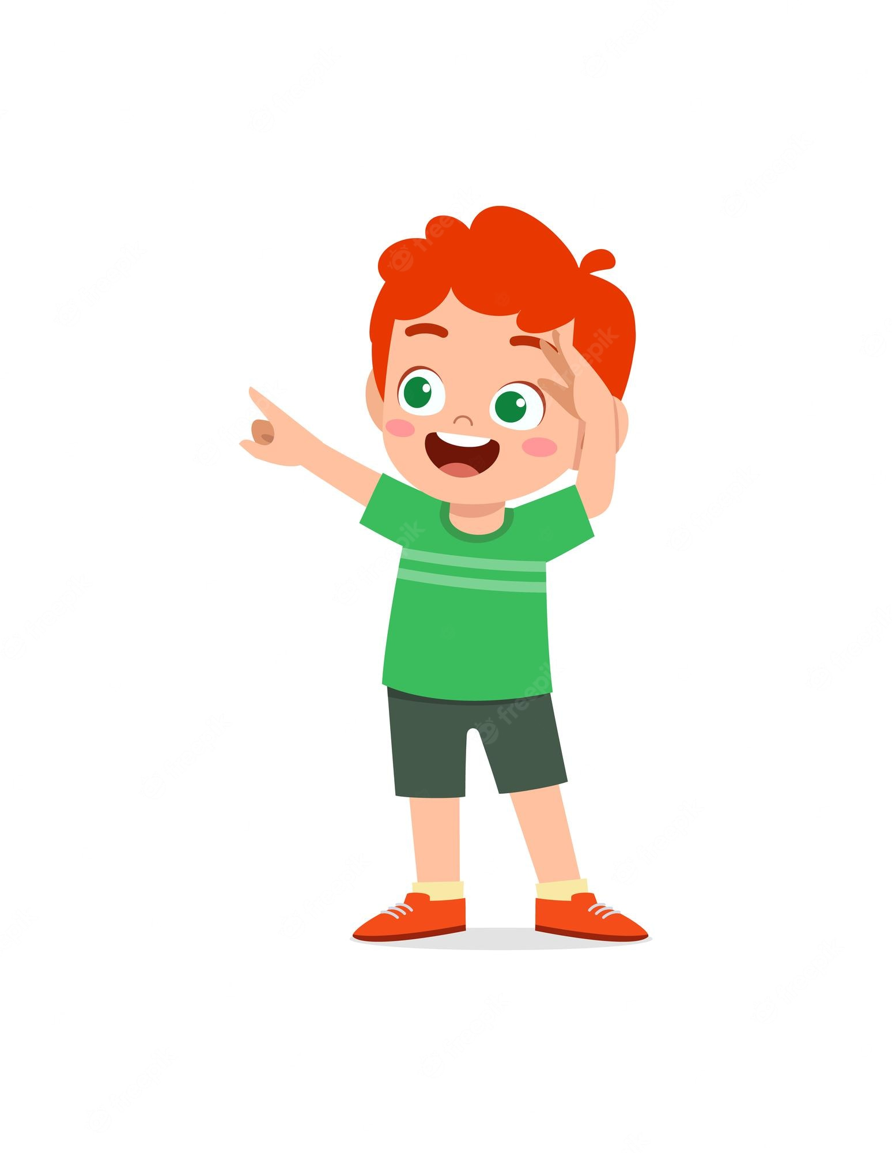
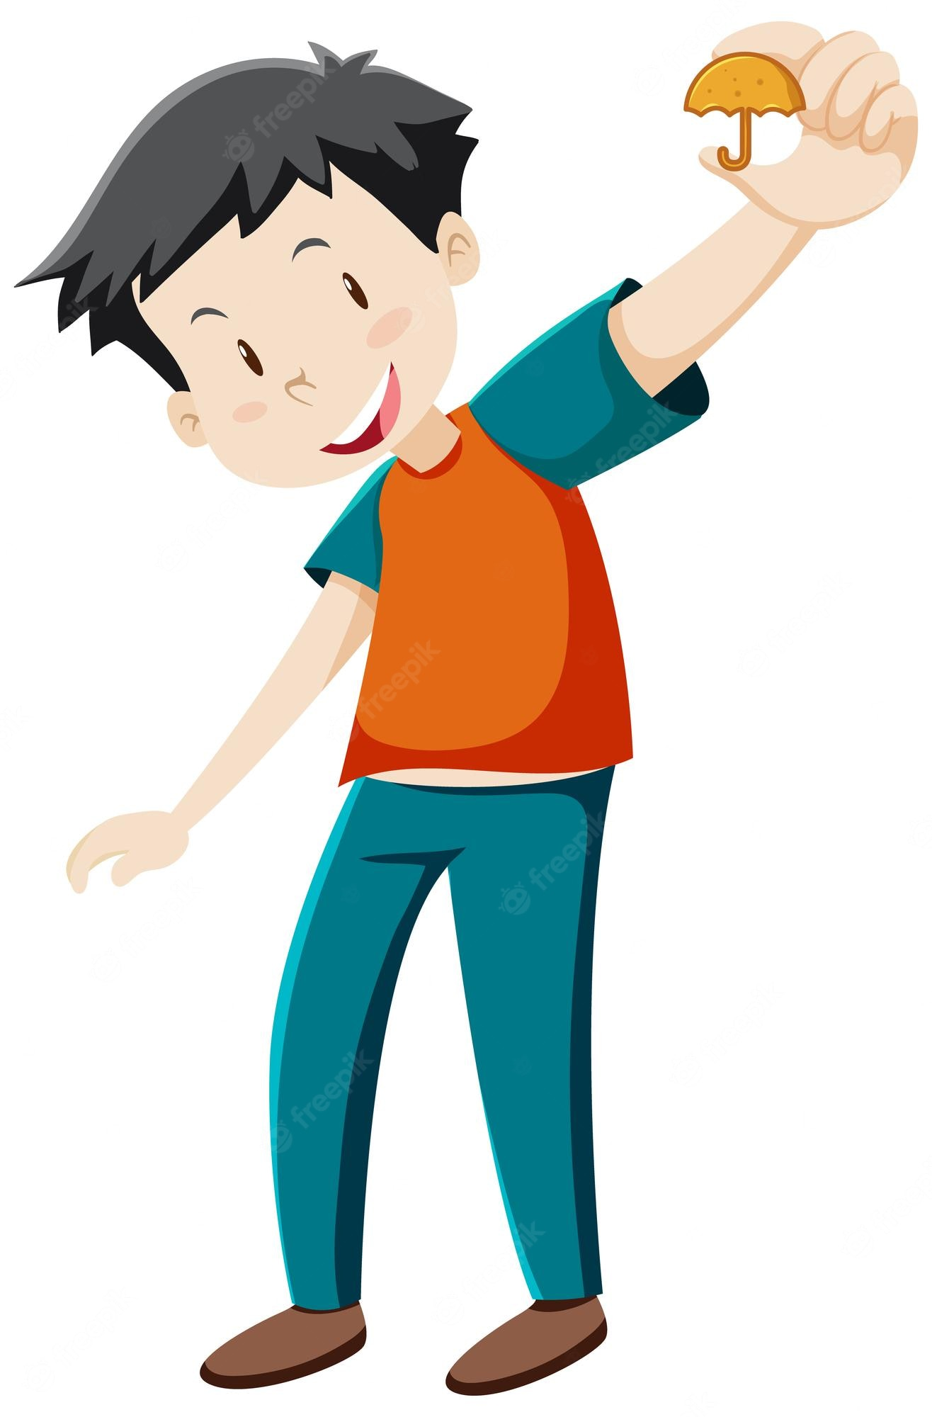
What does Ben look like?
Minh
Ben
He has big eyes.
Notes:
Other answers can be accepted if correct.
Click the red angry bird to come back

Slide 9
...........................?
What does he look like
He is slim. He has a round face.
Notes:
Other answers can be accepted if correct.
Click the red angry bird to come back

Slide 10
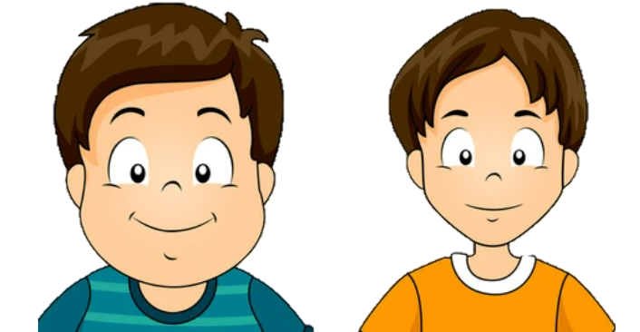
What does Peter look like?
Peter
Nam
He has a round face.
Notes:
Other answers can be accepted if correct.
Click the red angry bird to come back

Slide 11
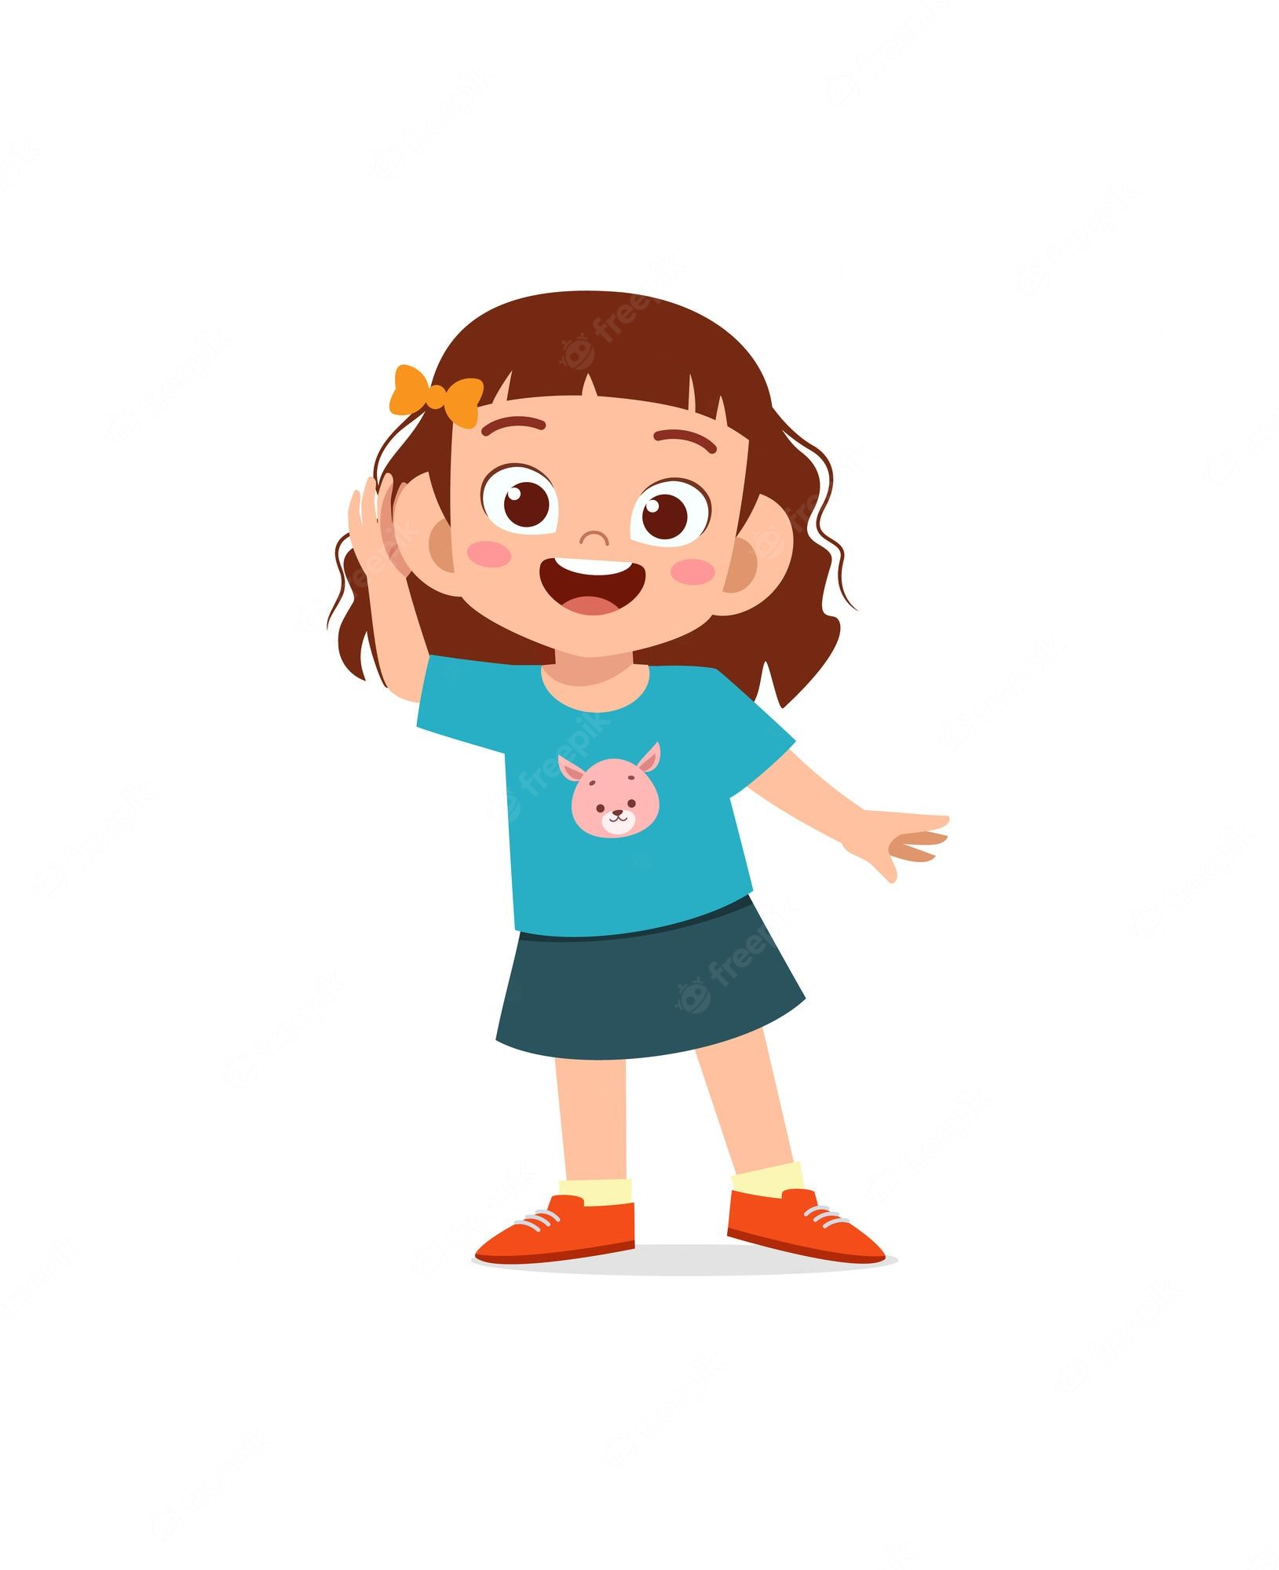
What does she look like
.........................?
She has big eyes.
Notes:
Click the red angry bird to come back

Slide 12
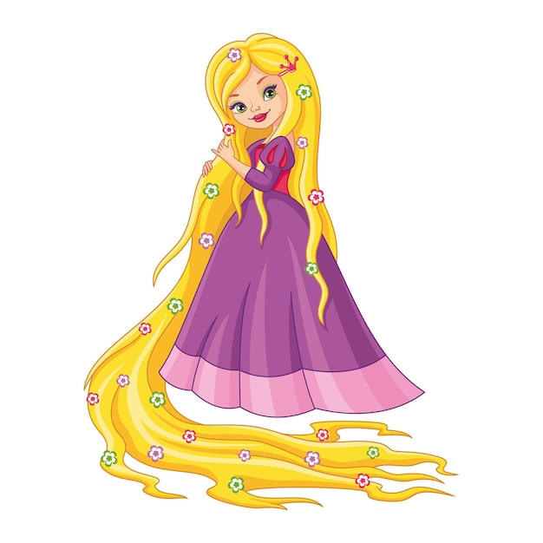
What does she look like?
She has long hair.
Notes:
Click the red angry bird to come back

Slide 13
What does Minh look like?
Minh
Ben
He has small eyes.
Notes:
Explain that student chooses to describe their mother or father.
Click the red angry bird to come back

Slide 14
02
Listen and number.

Slide 15
In pairs, look, ask and answer.
What does she look like?
START TIMER
2 : 00
1 : 59
1 : 58
1 : 57
1 : 56
1 : 55
1 : 54
1 : 53
1 : 52
1 : 51
1 : 50
1 : 49
1 : 48
1 : 47
1 : 46
1 : 45
1 : 44
1 : 43
1 : 42
1 : 41
1 : 40
1 : 39
1 : 38
1 : 37
1 : 36
1 : 35
1 : 34
1 : 33
1 : 32
1 : 31
1 : 30
1 : 29
1 : 28
1 : 27
1 : 26
1 : 25
1 : 24
1 : 23
1 : 22
1 : 21
1 : 20
1 : 19
1 : 18
1 : 17
1 : 16
1 : 15
1 : 14
1 : 13
1 : 12
1 : 11
1 : 10
1 : 09
1 : 08
1 : 07
1 : 06
1 : 05
1 : 04
1 : 03
1 : 02
1 : 01
1 : 00
0 : 59
0 : 58
0 : 57
0 : 56
0 : 55
0 : 54
0 : 53
0 : 52
0 : 51
0 : 50
0 : 49
0 : 48
0 : 47
0 : 46
0 : 45
0 : 44
0 : 43
0 : 42
0 : 41
0 : 40
0 : 39
0 : 38
0 : 37
0 : 36
0 : 35
0 : 34
0 : 43
0 : 32
0 : 31
0 : 30
0 : 29
0 : 28
0 : 27
0 : 26
0 : 25
0 : 24
0 : 23
0 : 22
0 : 21
0 : 20
0 : 19
0 : 18
0 : 17
0 : 16
0 : 15
0 : 14
0 : 13
0 : 12
0 : 11
0 : 10
0 : 09
0 : 08
0 : 07
0 : 06
0 : 05
0 : 04
0 : 03
0 : 02
0 : 01
0 : 00
TIME’S UP!
She has ____.
Notes:
After pair works, teacher calls out some pairs to check with class.

Slide 16
Listen and number.
2
4
3
1
Notes:
Click on the audio icon to play again (if needed)

Slide 17
03
Look, complete and read.

Slide 18
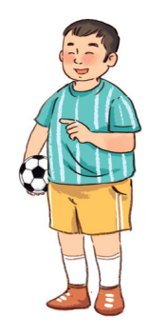
Look at the picture. Is the boy slim or big? Is his face round or slim?
What are the missing words?
big
face

Slide 19
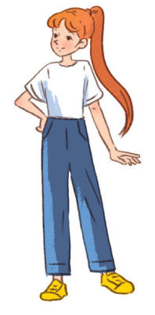
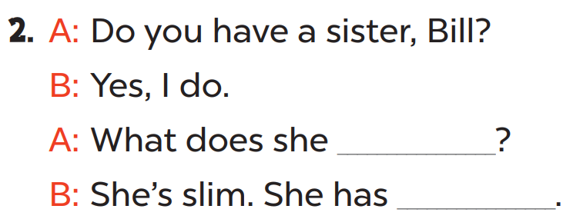
Look at the picture. Is the girl slim or big? Is her hair long or short?
What are the missing words?
look like
long hair

Slide 20
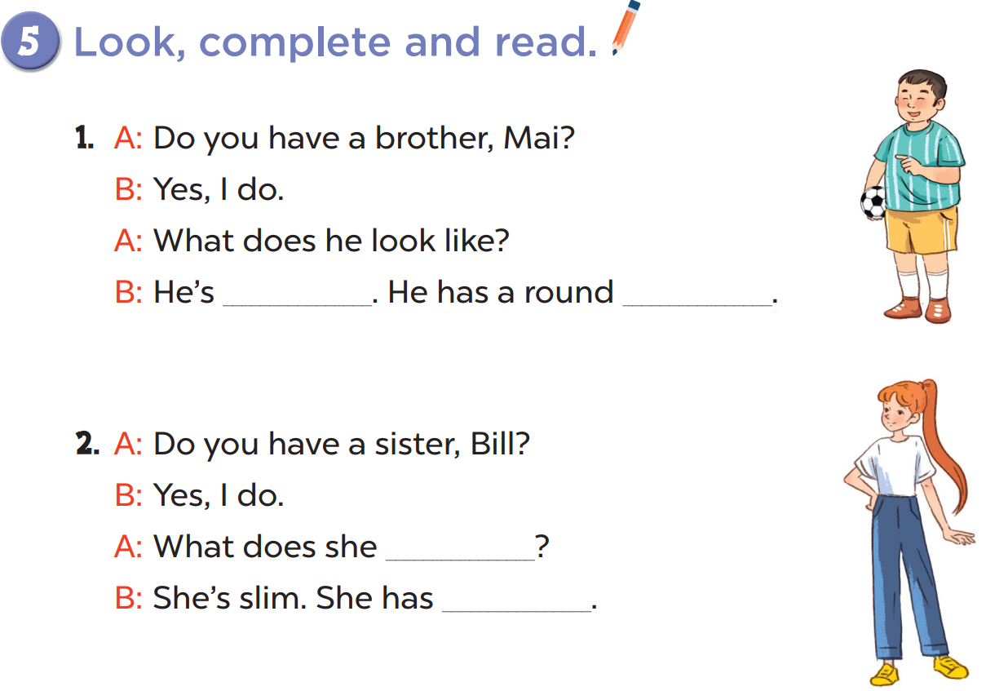
Practise in pairs.
big
face
Act it out!
look like
long hair

Slide 21
04
Let's play.

Slide 23
05
Fun corner and wrap-up

Slide 24
Find the odd one out.
long hair
tall
short
A
B
C

Slide 25
Find the odd one out.
slim
big
handsome
A
B
C

Slide 26
Find the odd one out.
big eyes
tall
a round face
A
B
C

Slide 27
Find the odd one out.
big eyes
slim
big
A
B
C

Slide 28
Find the odd one out.
has
she
is
A
B
C

Slide 29
Find the odd one out.
mother
round
sister
A
B
C

Slide 30
T
h
a
n
k
f
o
r
T
h
a
n
k
s
f
o
r
s
y
o
u
r
t
t
e
n
t
i
o
n
!
y
o
u
r
a
t
t
e
n
t
i
o
n
!
a

