Slide 1

Quang Son primary school
Welcome to our English lesson
Teacher: Tran Thi Ngoc

Slide 2

WARM UP

Slide 3
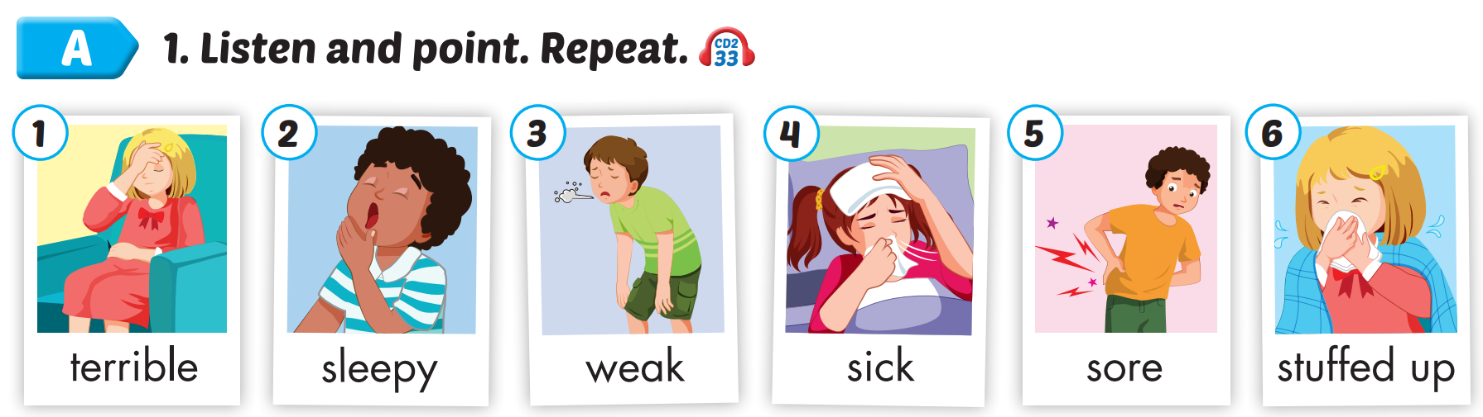

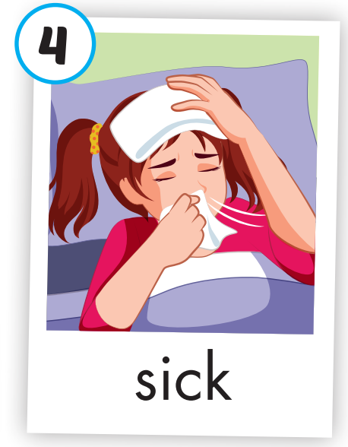
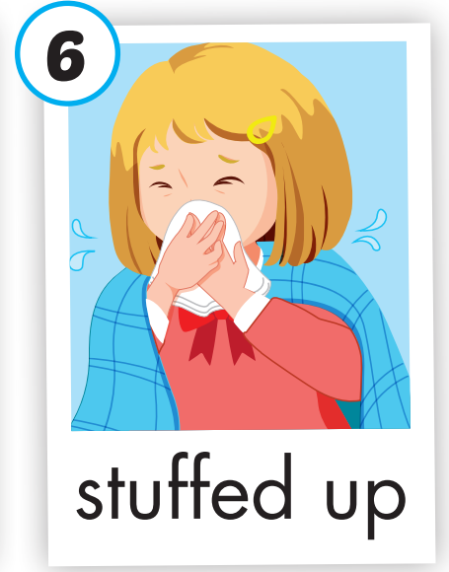
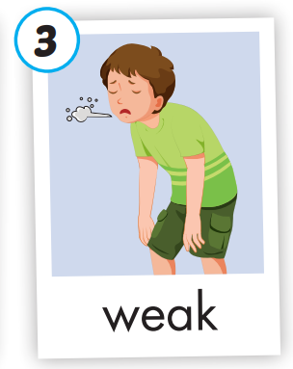
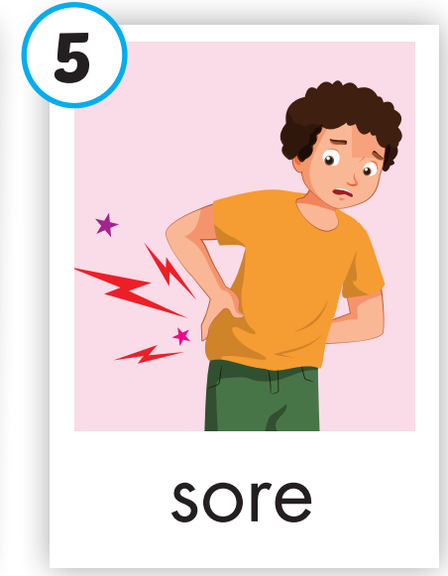
Unit 5 – Health ( Lesson 2.1-page 67)
Notes:
Click vào hình A. 1. Listen and point. Repeat để cho cả audio full chạy

Slide 4
Click on the picture to hear the sound.
terrible
/ˈterəbl/
(adj)

Slide 5
Click on the picture to hear the sound.
sleepy
/ˈsliːpi/
(adj)

Slide 6
Click on the picture to hear the sound.
weak
/wiːk/
(adj)

Slide 7
Click on the picture to hear the sound.
sick
/sɪk/
(adj)

Slide 8
Click on the picture to hear the sound.
sore
/sɔːr/
(adj)

Slide 9
stuffed up
/ˌstʌft ˈʌp/
(adj)

Slide 10
Unit 5 – Health ( Lesson 2.1-page 67)
Notes:
Click vào hình A. 1. Listen and point. Repeat để cho cả audio full chạy

Slide 11


2. Play the game “Heads up! What’s missing”

Slide 12
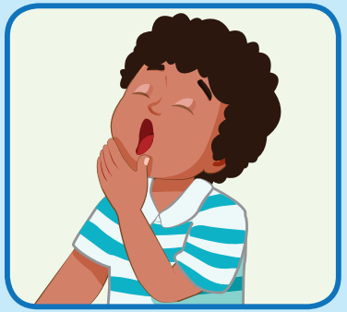
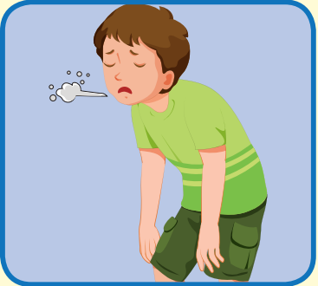
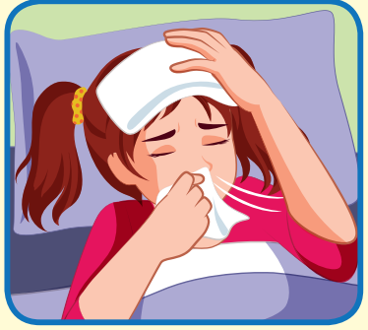
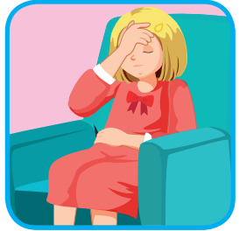
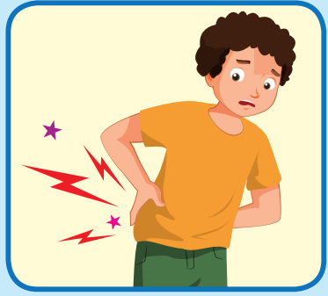
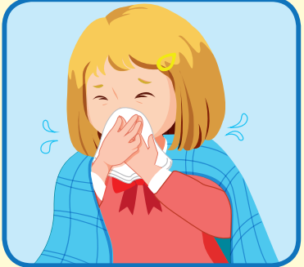

Slide 13


Slide 14

Presentation

Slide 15

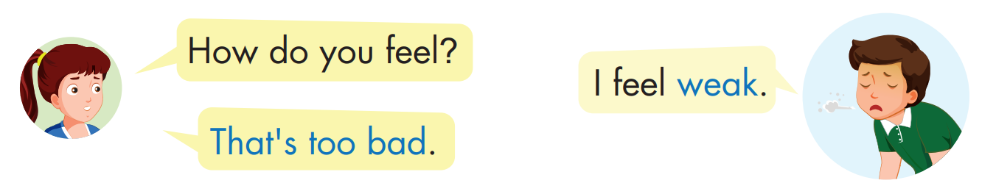
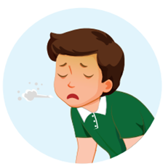

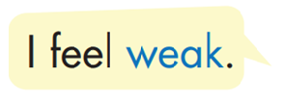


Slide 16
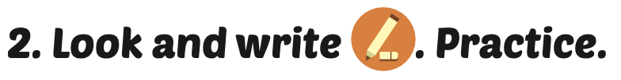

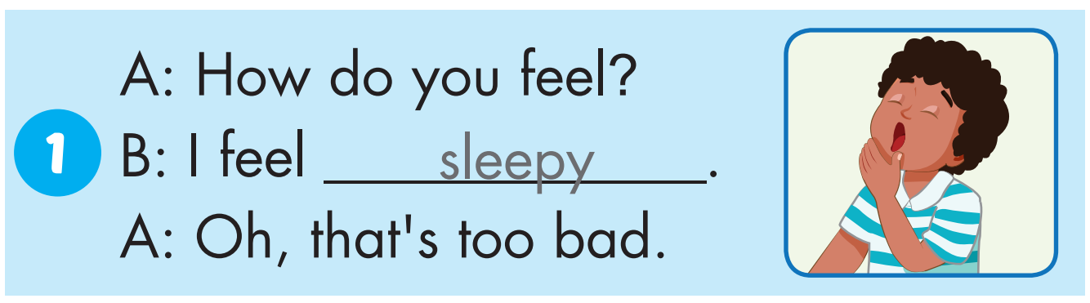
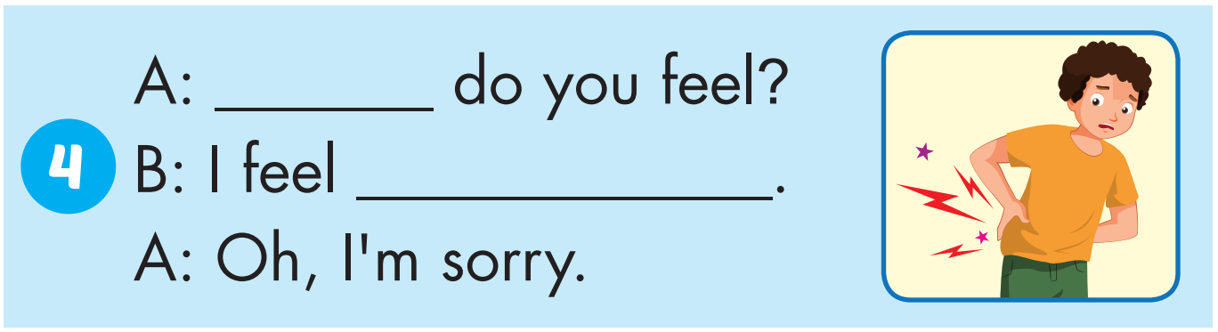
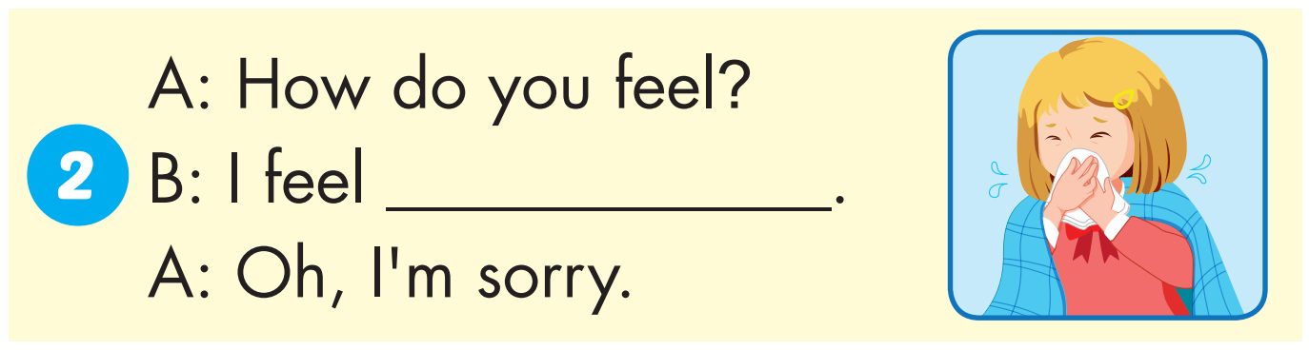
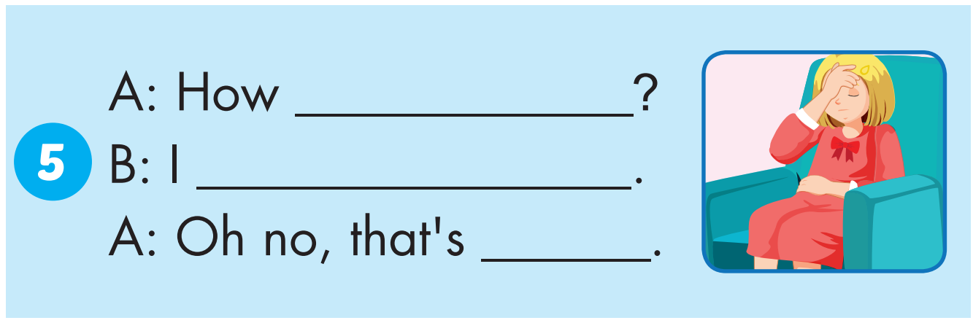
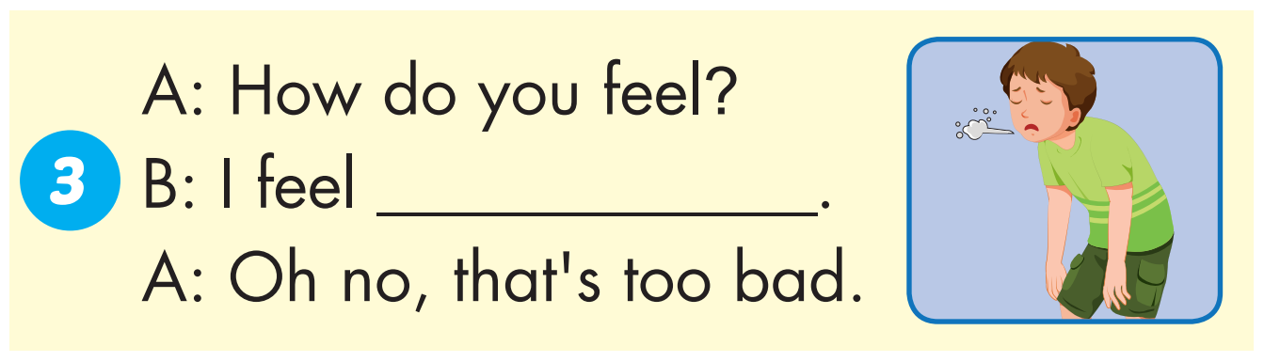
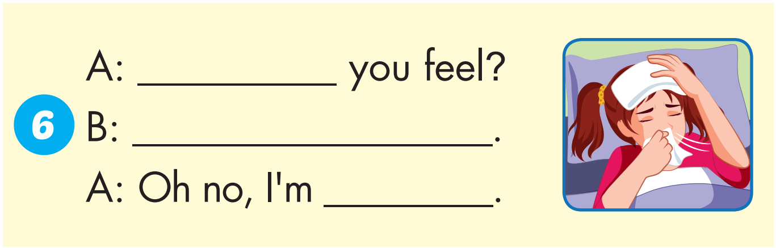
How
sore
do you feel
stuffed up
feel terrible
too bad.
How do
weak
I feel sick
sorry

Slide 17
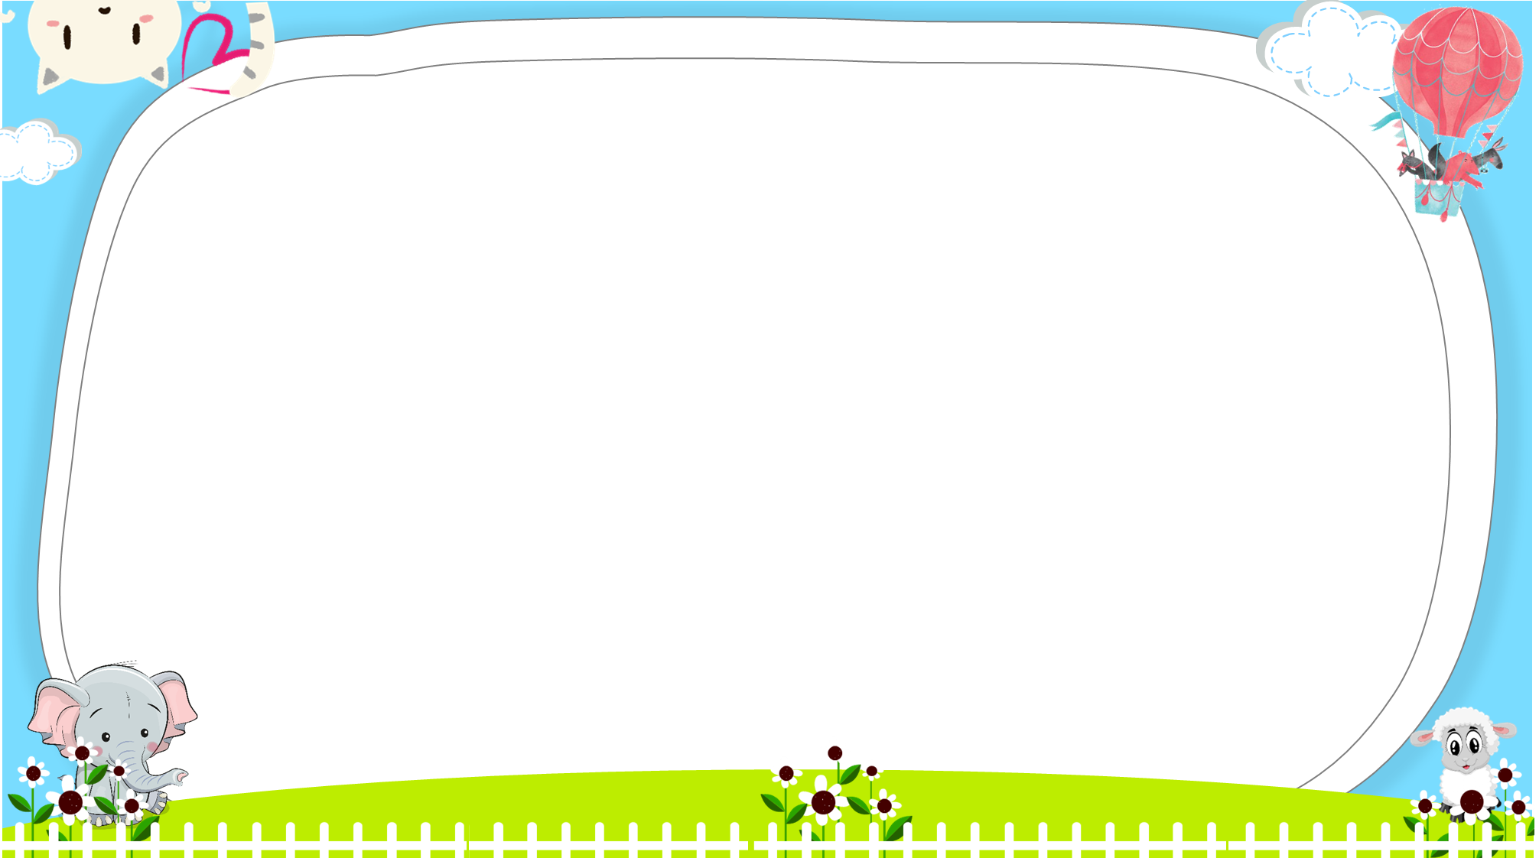




A
B

Slide 18

Look and choose
sleepy
A
B

Slide 19
Look and choose
A
B
terrible
sore

Slide 20
Look and choose
sick
A
B

Slide 21
Look and choose
A
sleepy
B
sore

Slide 22
Today’s lesson
Vocabularies
terrible, sleepy, weak, sick, sore, stuffed up.
Structures/ Sentence patterns
How do you feel?
I feel weak.
That's too bad.

Slide 23

Enjoy your day!

