Slide 1
Unit 4: Travel
(Lesson 1.1)
Teacher: La Thi Tam
Dong Son Primary School

Slide 3
Where were you?
Where were you, Mai? Where were you, Mai?
I was at the zoo. I was at the zoo.
Where were you, Ben? Where were you, Ben?
I was in the park. I was in the park.
Where were you, Tom? Where were you, Tom?
I was on the beach. I was on the beach.
I loved the zoo, the park and the beach.
I was happy. I was happy!

Slide 4
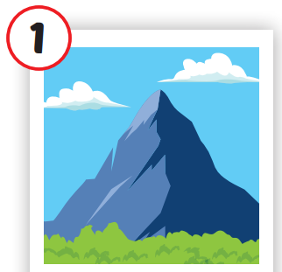
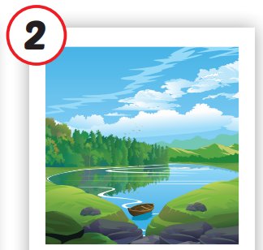
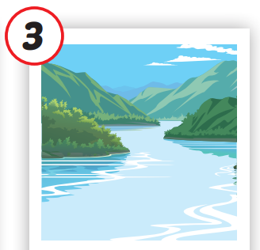
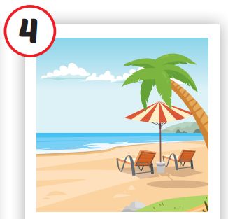
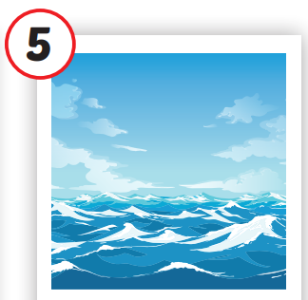
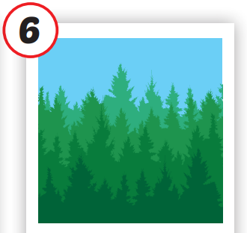
/ˌmaʊntən/
ngọn núi
/leɪk/
hồ
/ˈrɪvər/
sông
/biːtʃ/
bãi biển
/ˈoʊʃən/
đại dương
/ˈfɔrəst/
rừng
Notes:
Click vào hình A. 1. Listen and point. Repeat để cho cả audio full chạy

Slide 5
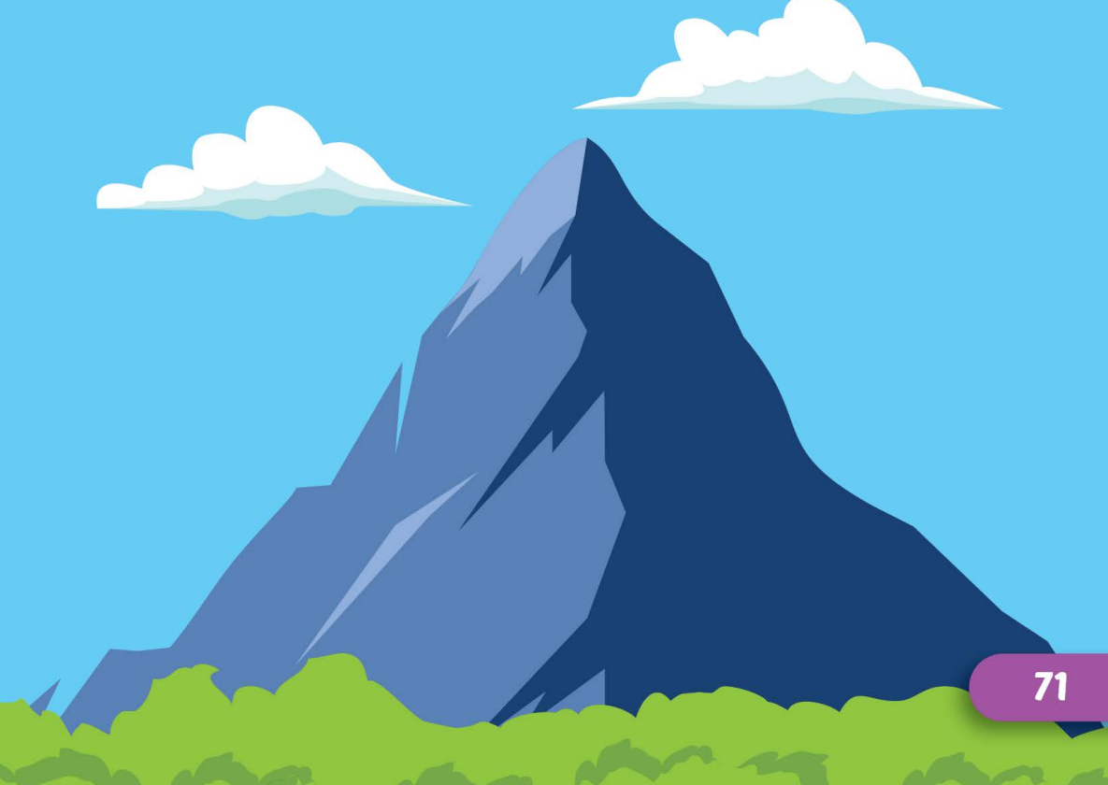
/ˌmaʊntən/

Slide 6
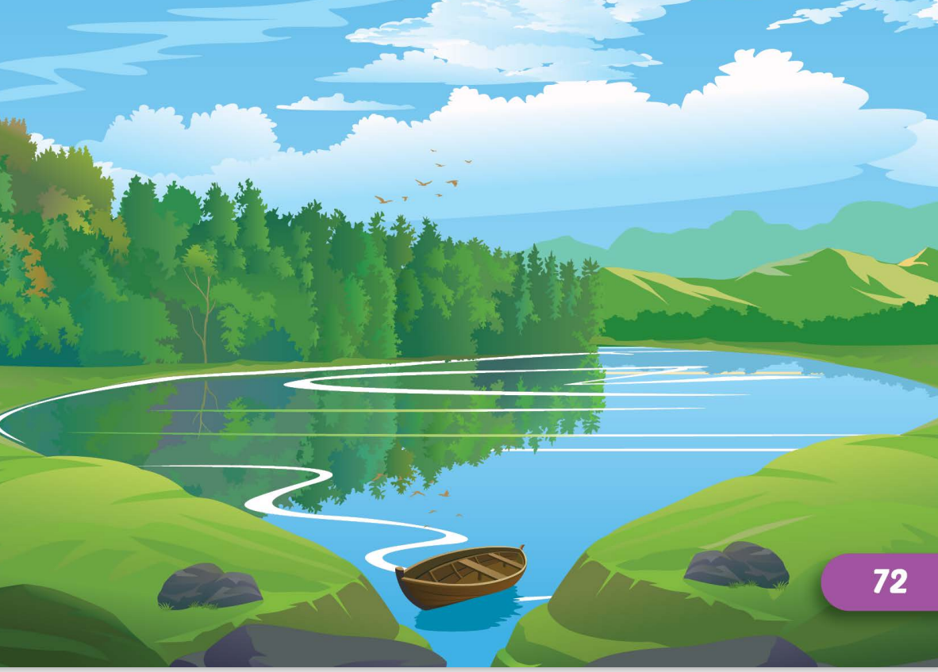
/leɪk/

Slide 7
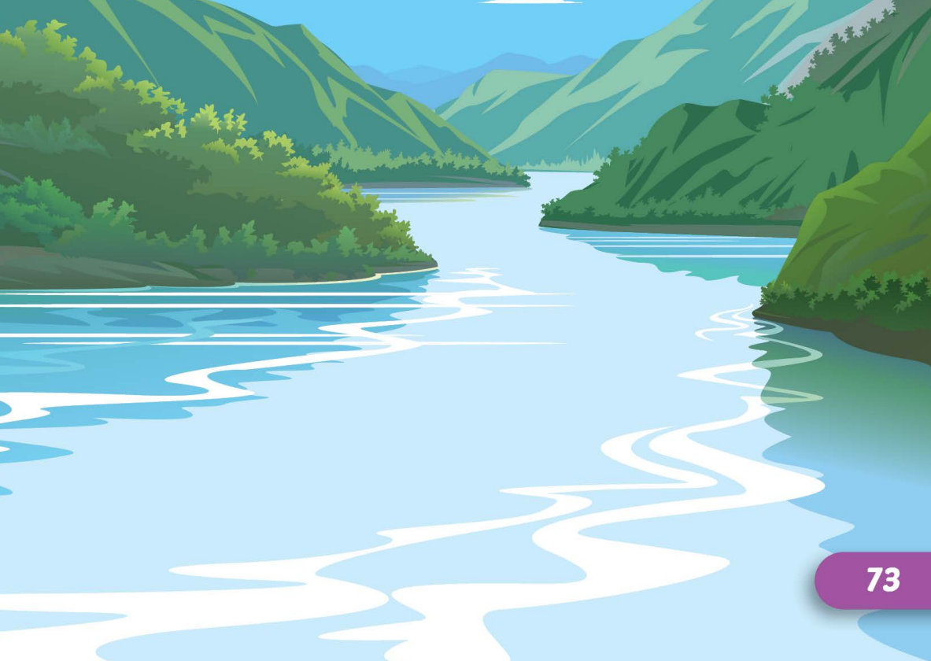
/ˈrɪvər/

Slide 8
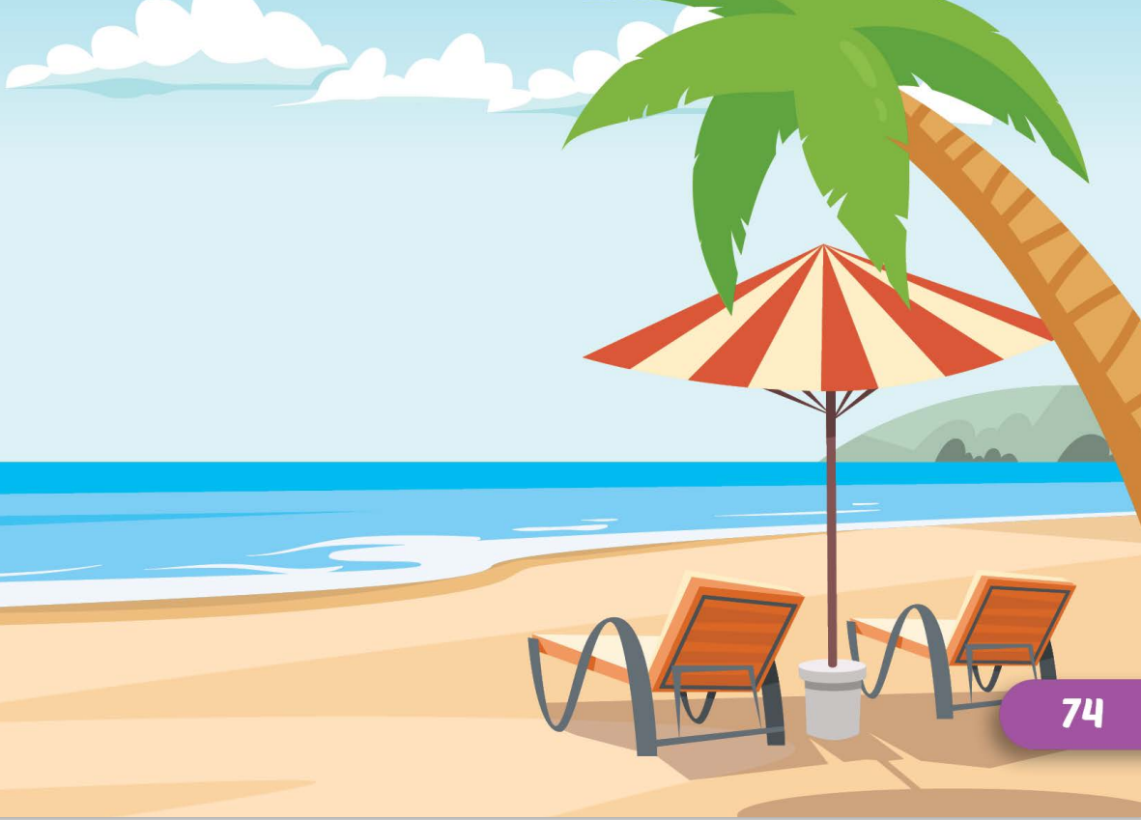
/biːtʃ/

Slide 9
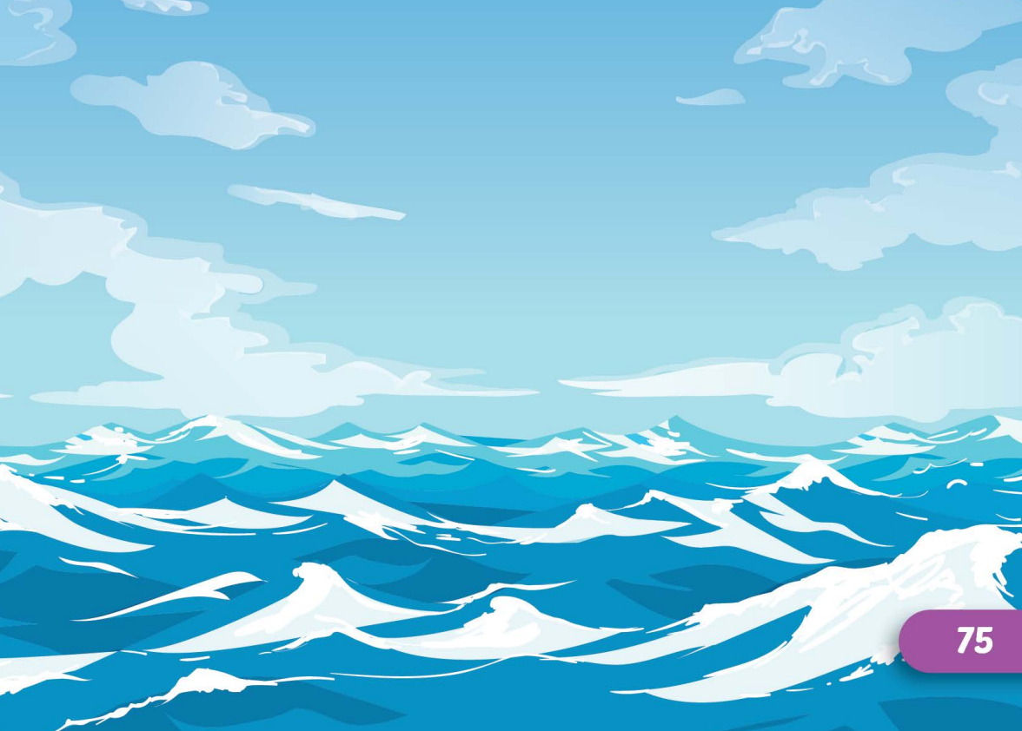
/ˈoʊʃən/

Slide 10
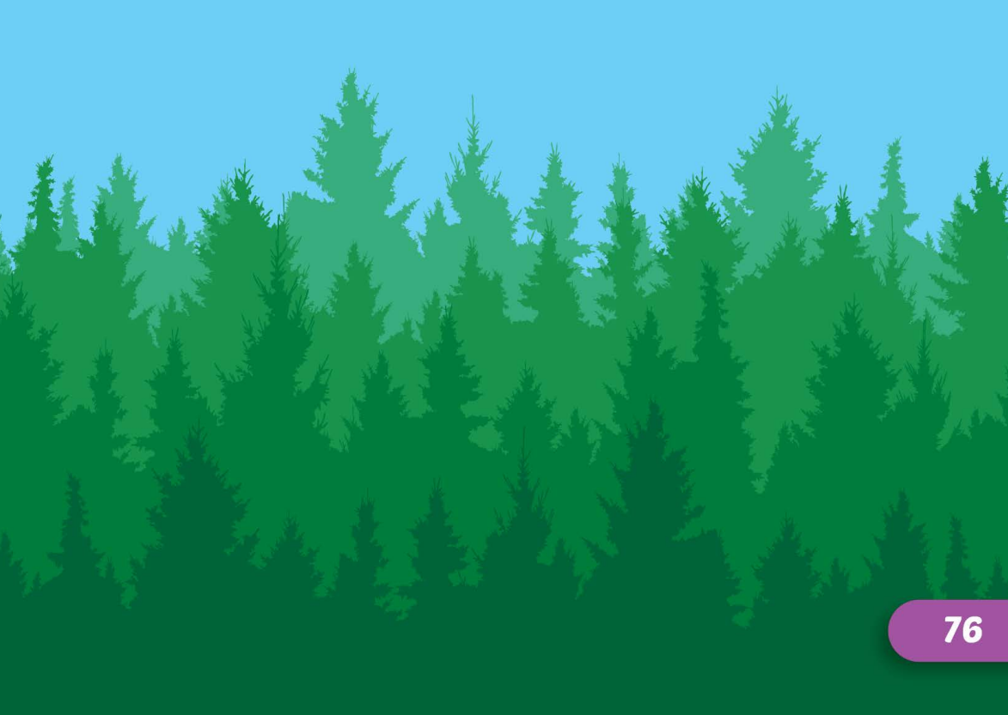
/ˈfɔrəst/

Slide 12
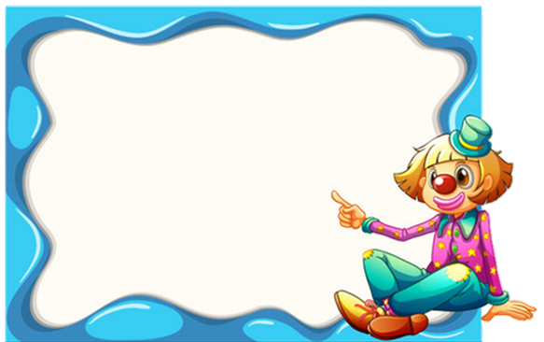
Find the best picture
A
B
C
Next
mountain

Slide 13
Find the best picture
A
B
C
Next
lake

Slide 14
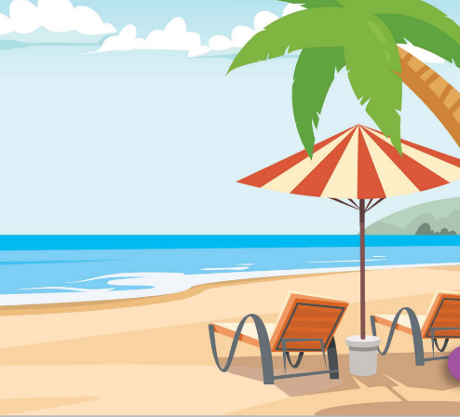
Find the best picture
A
B
C
Next
river

Slide 15
Find the best picture
A
B
C
Next
beach

Slide 16
Find the best picture
A
B
C
Next
ocean

Slide 17
Find the best picture
A
B
C
Next
forest

Slide 18
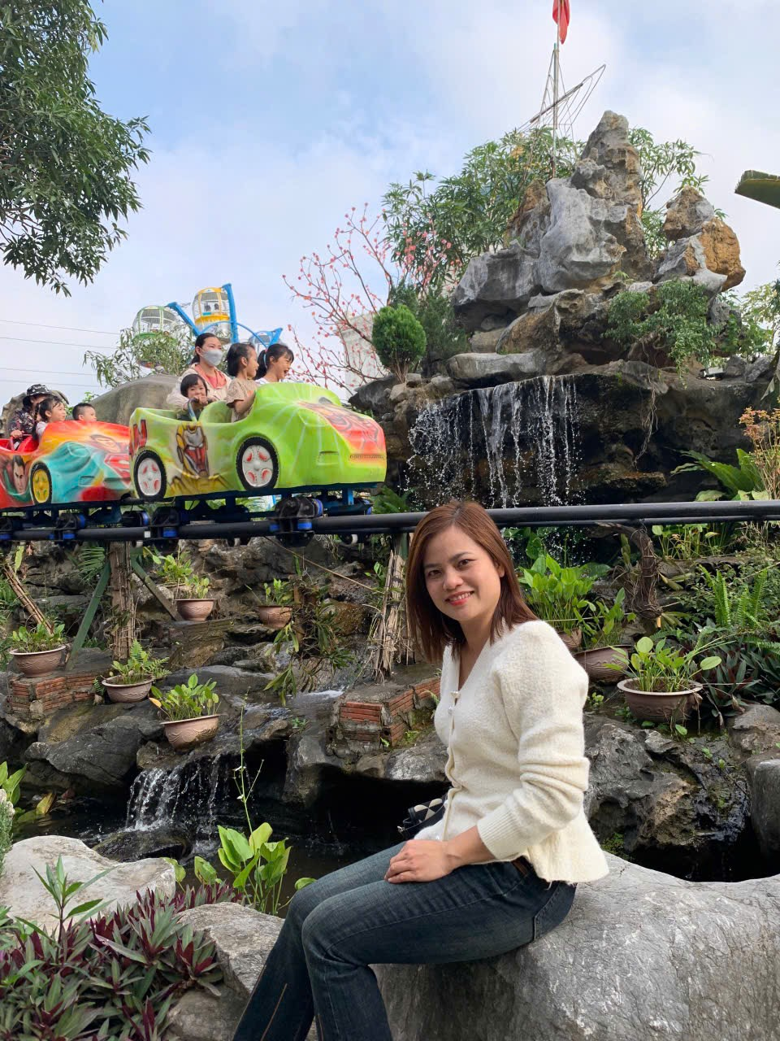
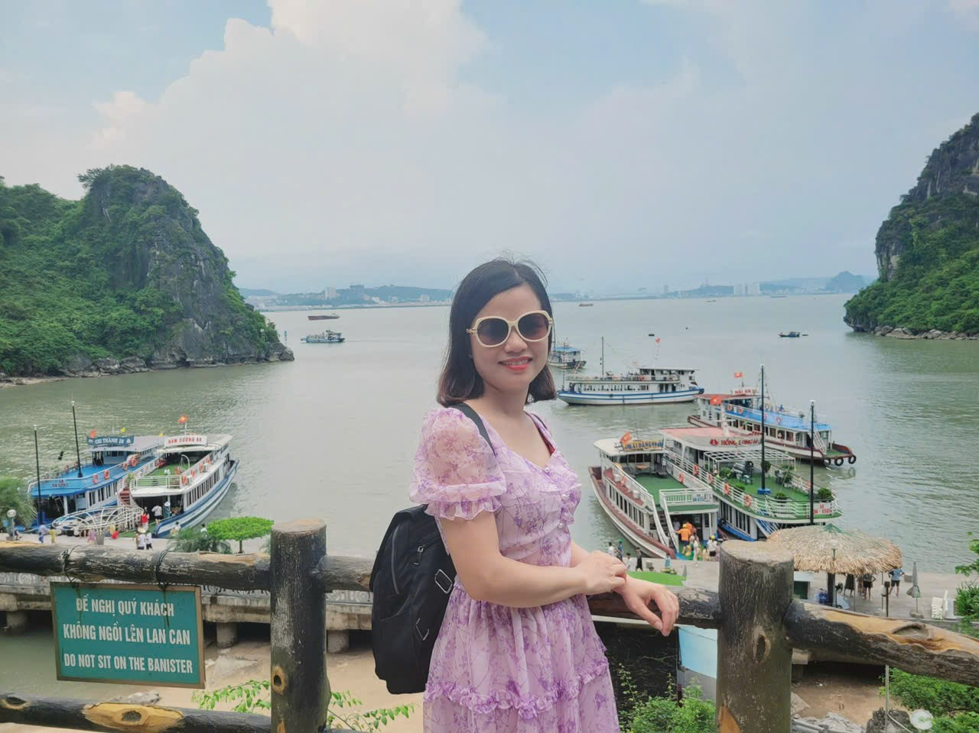
My summer holiday
I went to the beach.
I didn’t go to the river.

Slide 19
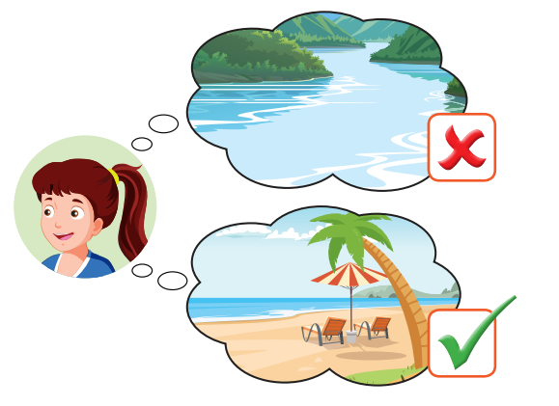

Slide 20
I didn’t go to the_______.
I went to the_______.
Notes:
Click vào hình A. 1. Listen and point. Repeat để cho cả audio full chạy

Slide 21
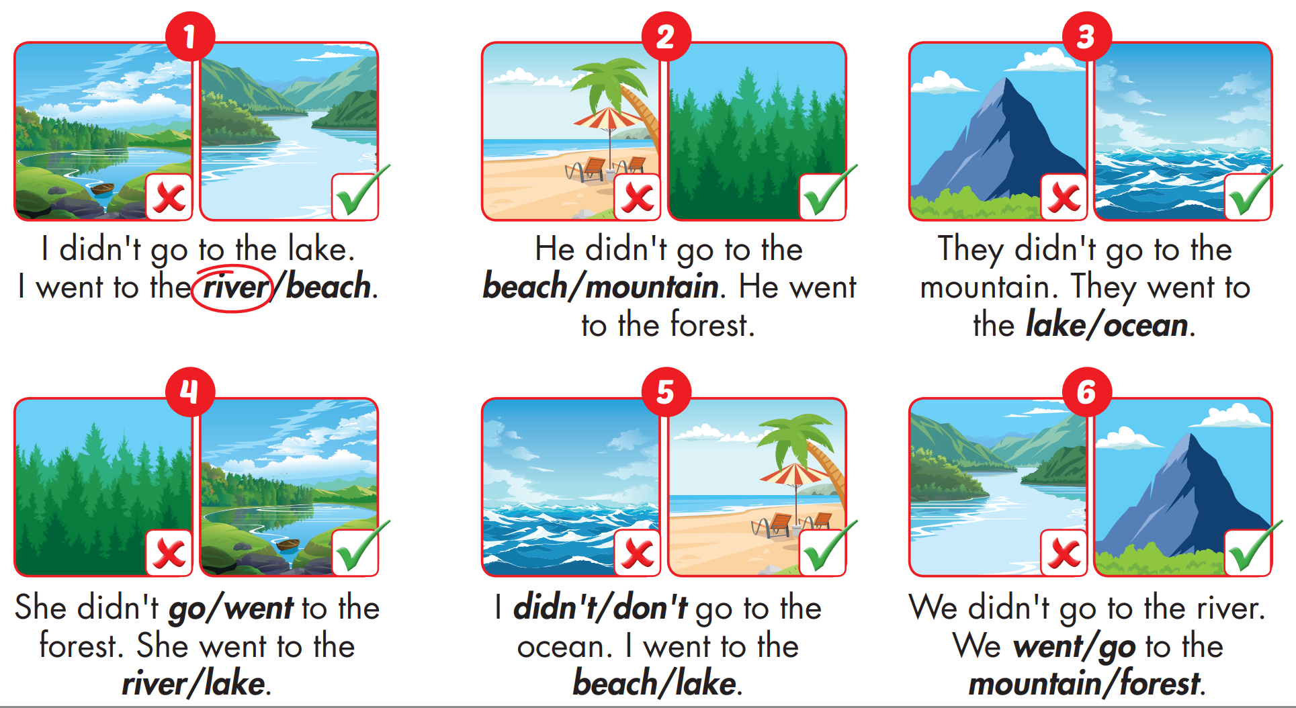

Slide 22
Today’s lesson
Vocabularies
mountain, lake, river, beach, ocean, forest
Structures/ Sentence patterns
I didn't go to the river.
I went to the beach.

Slide 23
Lesson 3
Stay positive and have a nice day!

