Slide 1





Welcome to
Class 4D
Teacher: Phung Thi Dau

Slide 2
Warm – up:

Slide 3
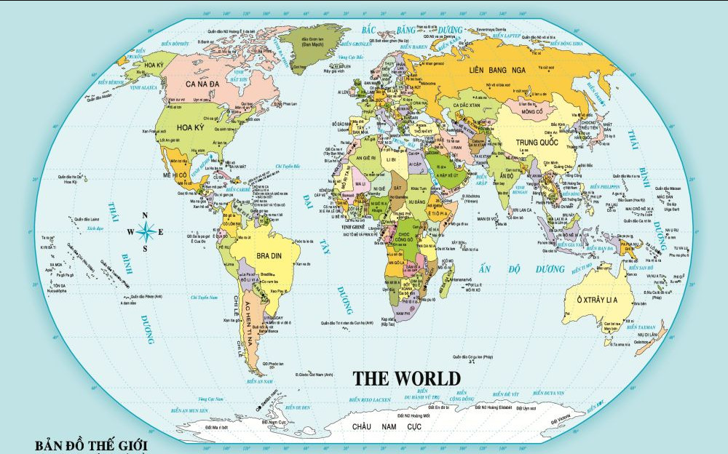

Slide 4

Friday, November 3rd, 2025
Extension activities

Slide 5
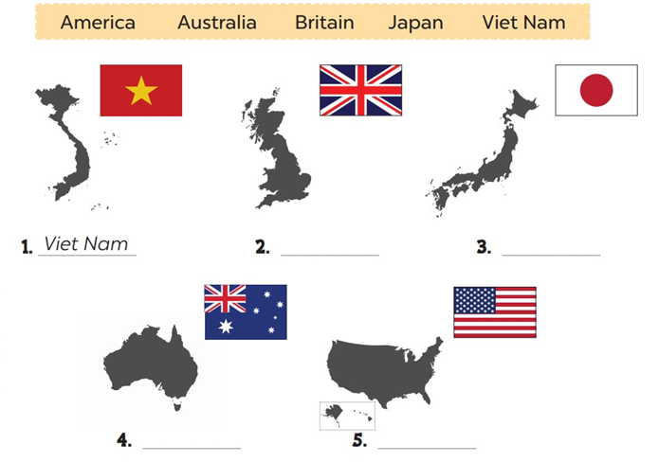
1. Look and write.
2. Britain
3. Japan
4. Australia
5. America

Slide 6
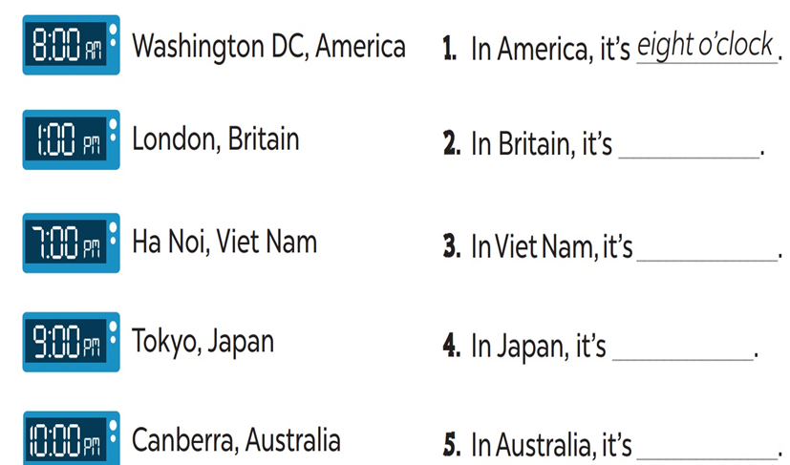
2. Look and write.
one o’clock.
seven o’clock.
nine o’clock.
ten o’clock.

Slide 7
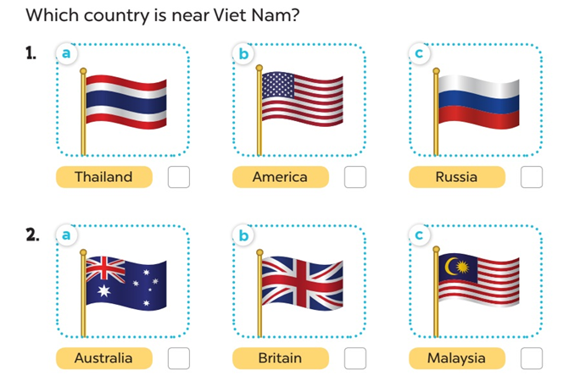
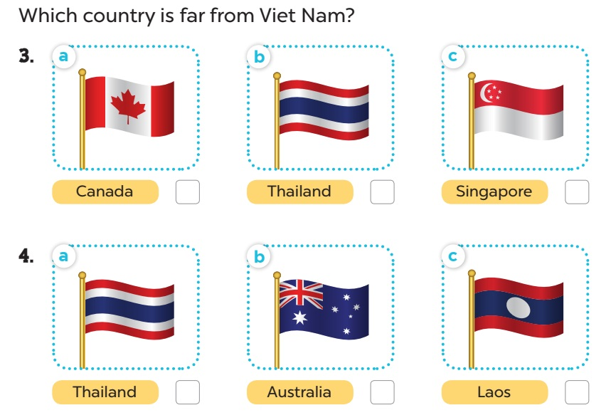
3. Read the questions. Then tick the answers.

Slide 8
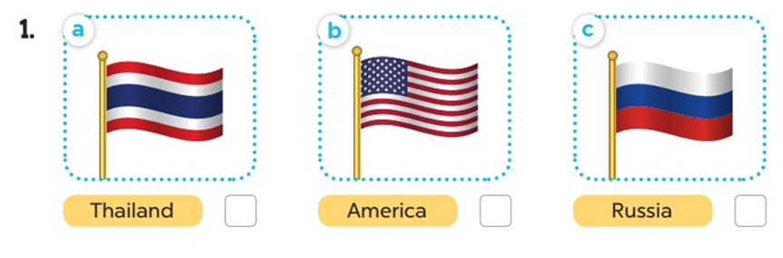
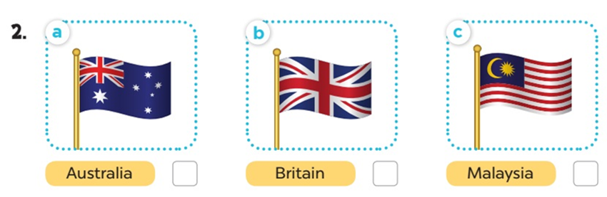
Which country is near Viet Nam?

Slide 9
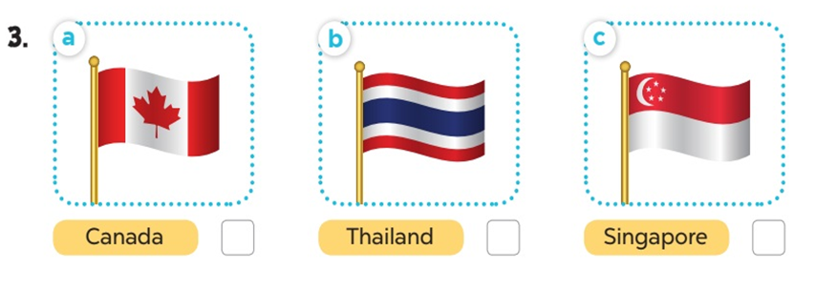
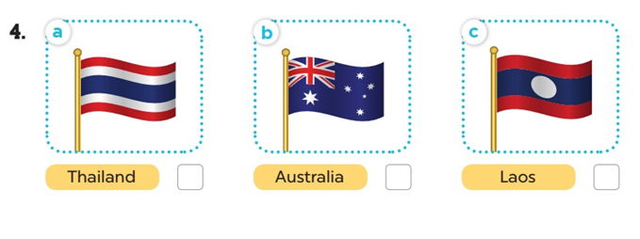
Which country is far from Viet Nam?

Slide 10
Which country is near Viet Nam?

Slide 11
Where’s Viet Nam?
Where’s Russia?
Where’s Thailand?
Where’s America?

Slide 12

Which country is near Viet Nam?

Slide 13
Which country is near Viet Nam?

Slide 14
Where’s Australia?
Where’s Malaysia ?
Where’s Britain?

Slide 15
Which country is near Viet Nam?

Slide 16
Which country is far from Viet Nam?

Slide 17
Where’s Canada?
Where’s Thailand?
Where’s Singapore?

Slide 18
Which country is far from Viet Nam?

Slide 19
Which country is far from Viet Nam?

Slide 20
Where’s Thailand?
Where’s Australia?
Where’s Laos?

Slide 21
Which country is far from Viet Nam?

Slide 23


Home-link:
+ Review from Unit 1 to Unit 5
+ Prepare for Unit 6

Slide 24



Thank you very much
Good bye! See you again!

