Slide 1








Unit 3
My foreign friends
Period 3 – Part 4, 5, 6

Slide 2

Table of contents
Warm-up and review
1
Read and complete
2
Read and complete
3
Let’s play
4
Wrap-up
5

Slide 3

1
Warm-up
and review

Slide 4
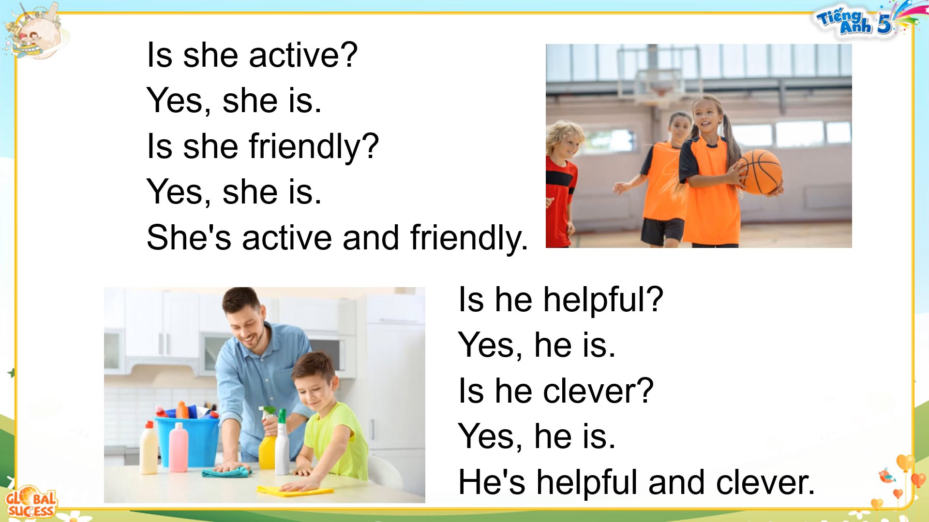




Slide 5


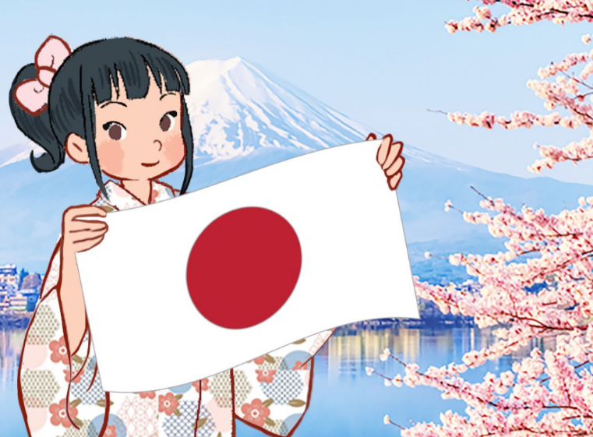
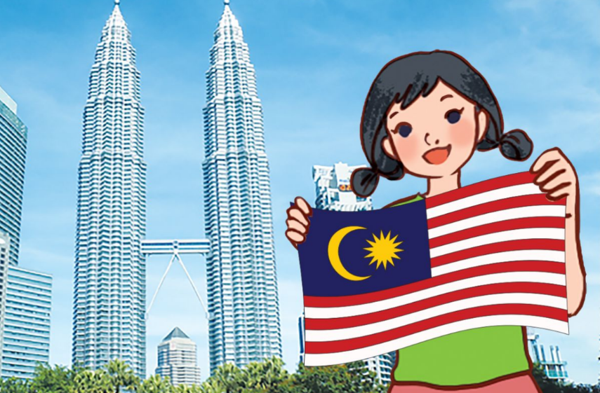

Review
What nationality is he/she?
He/she is ___________.
Australian
Japanese
Malaysian
American

Slide 6
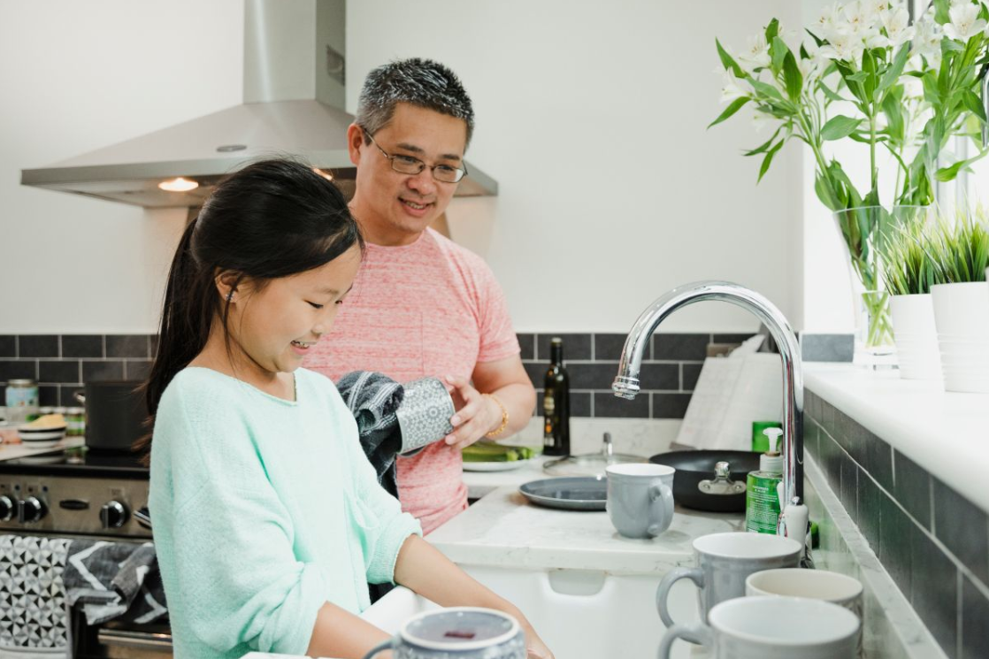


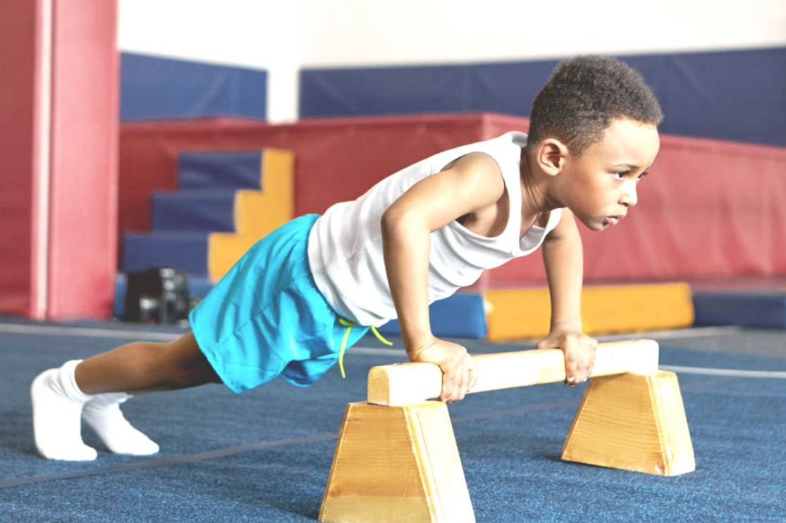
Review
What is he/she like?
He/she is ___________.
helpful
clever
friendly
active

Slide 7
2
Read and complete

Slide 8
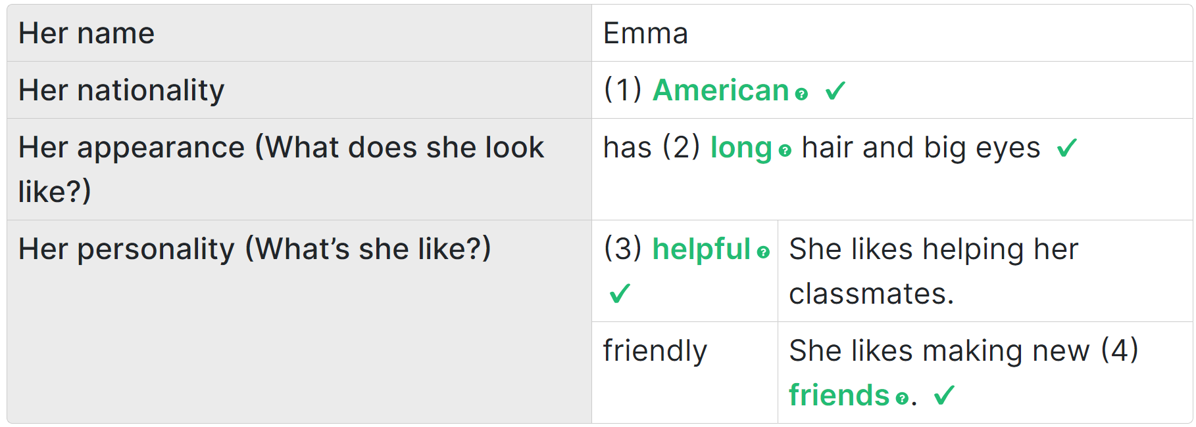
Read and guess your answer
______________
Malaysian / American/ Vietnamese …
_____
long / short / brown / black ….
active / clever / helpful …
__________
__________
friends / kites / a cake

Slide 9
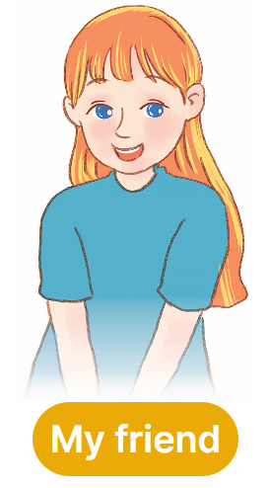
Read
I have a new friend. Her name is Emma. She is American. She is in Grade 5. She has long hair and big eyes.
She is a helpful girl. At school, she likes helping her classmates.
At home, she cooks with her mother and washes the dishes.
She is very friendly, too. She likes making new friends, and she invites others to play. She has a lot of friends. Everyone loves Emma.

Slide 10
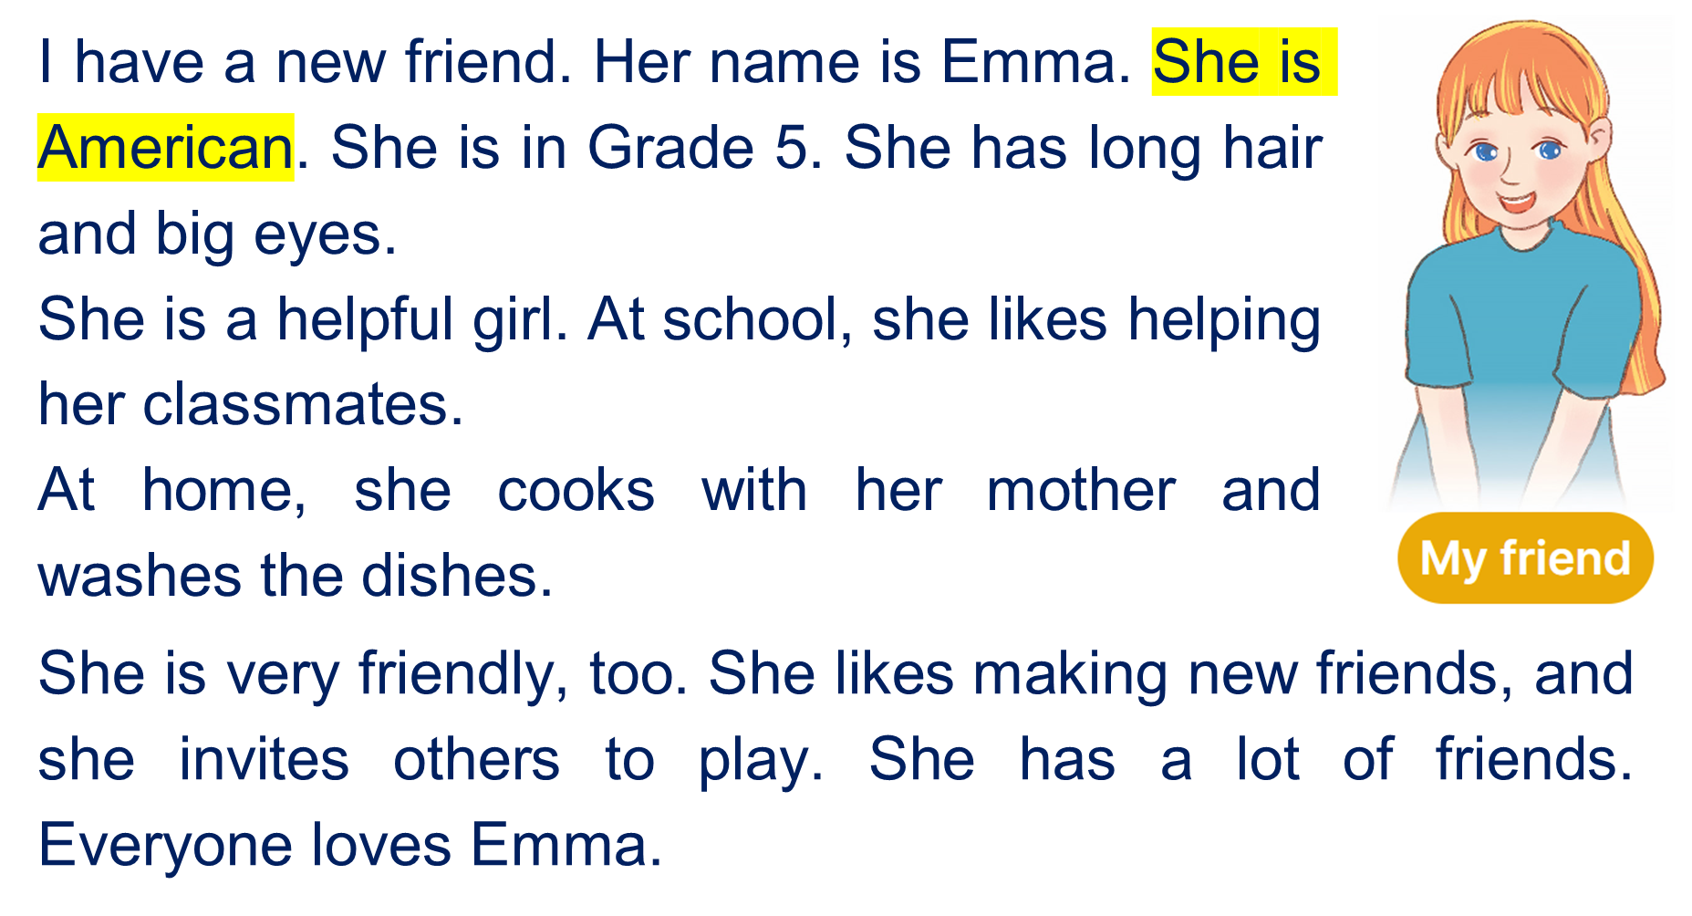
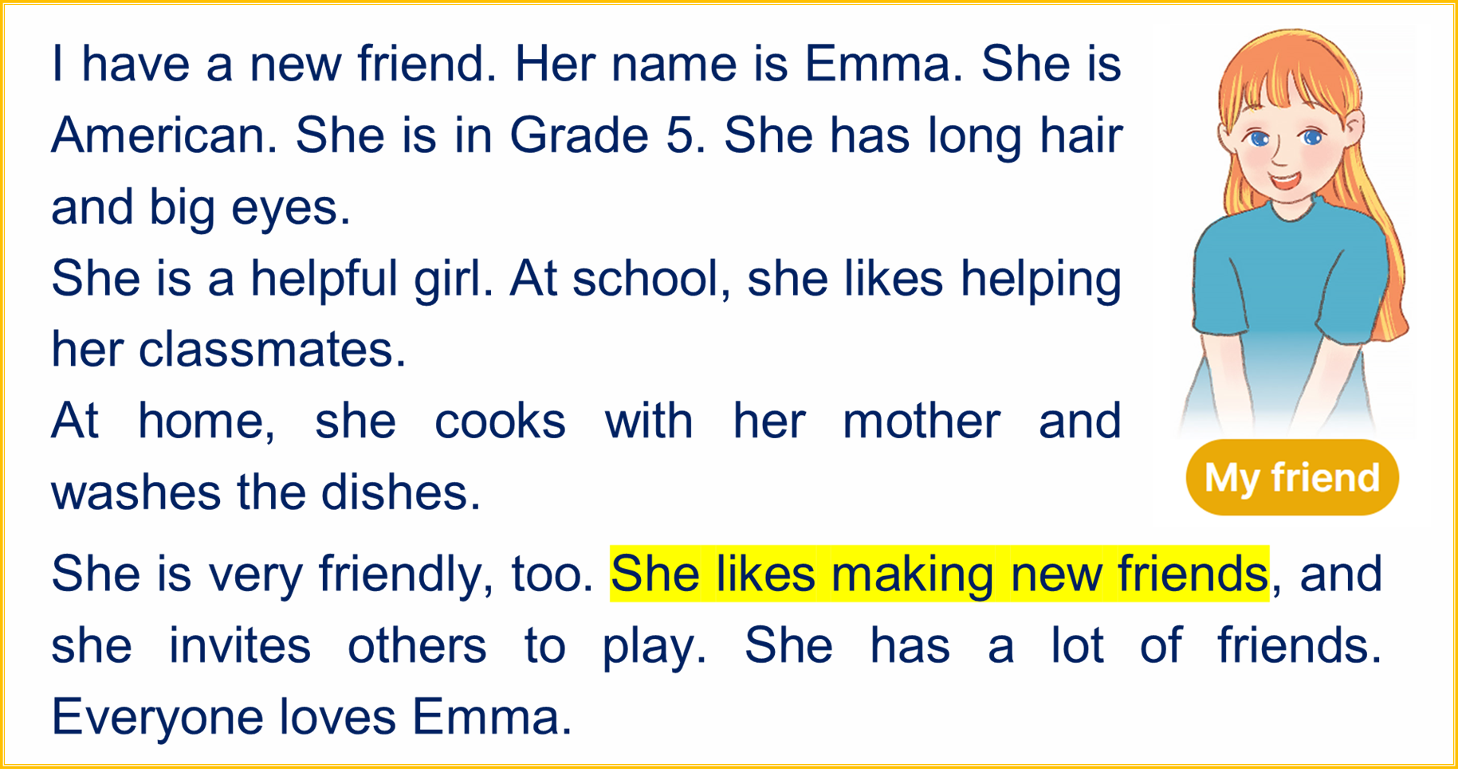
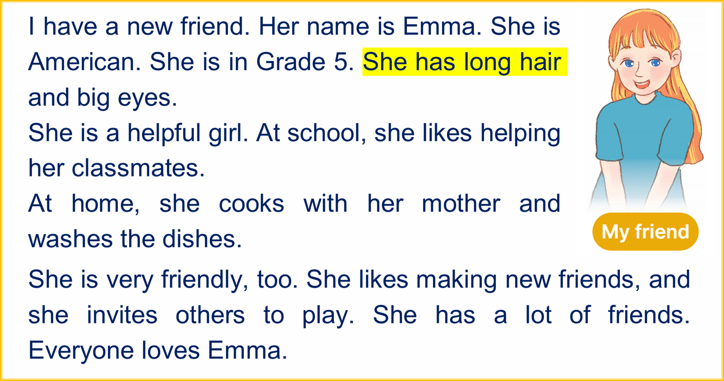
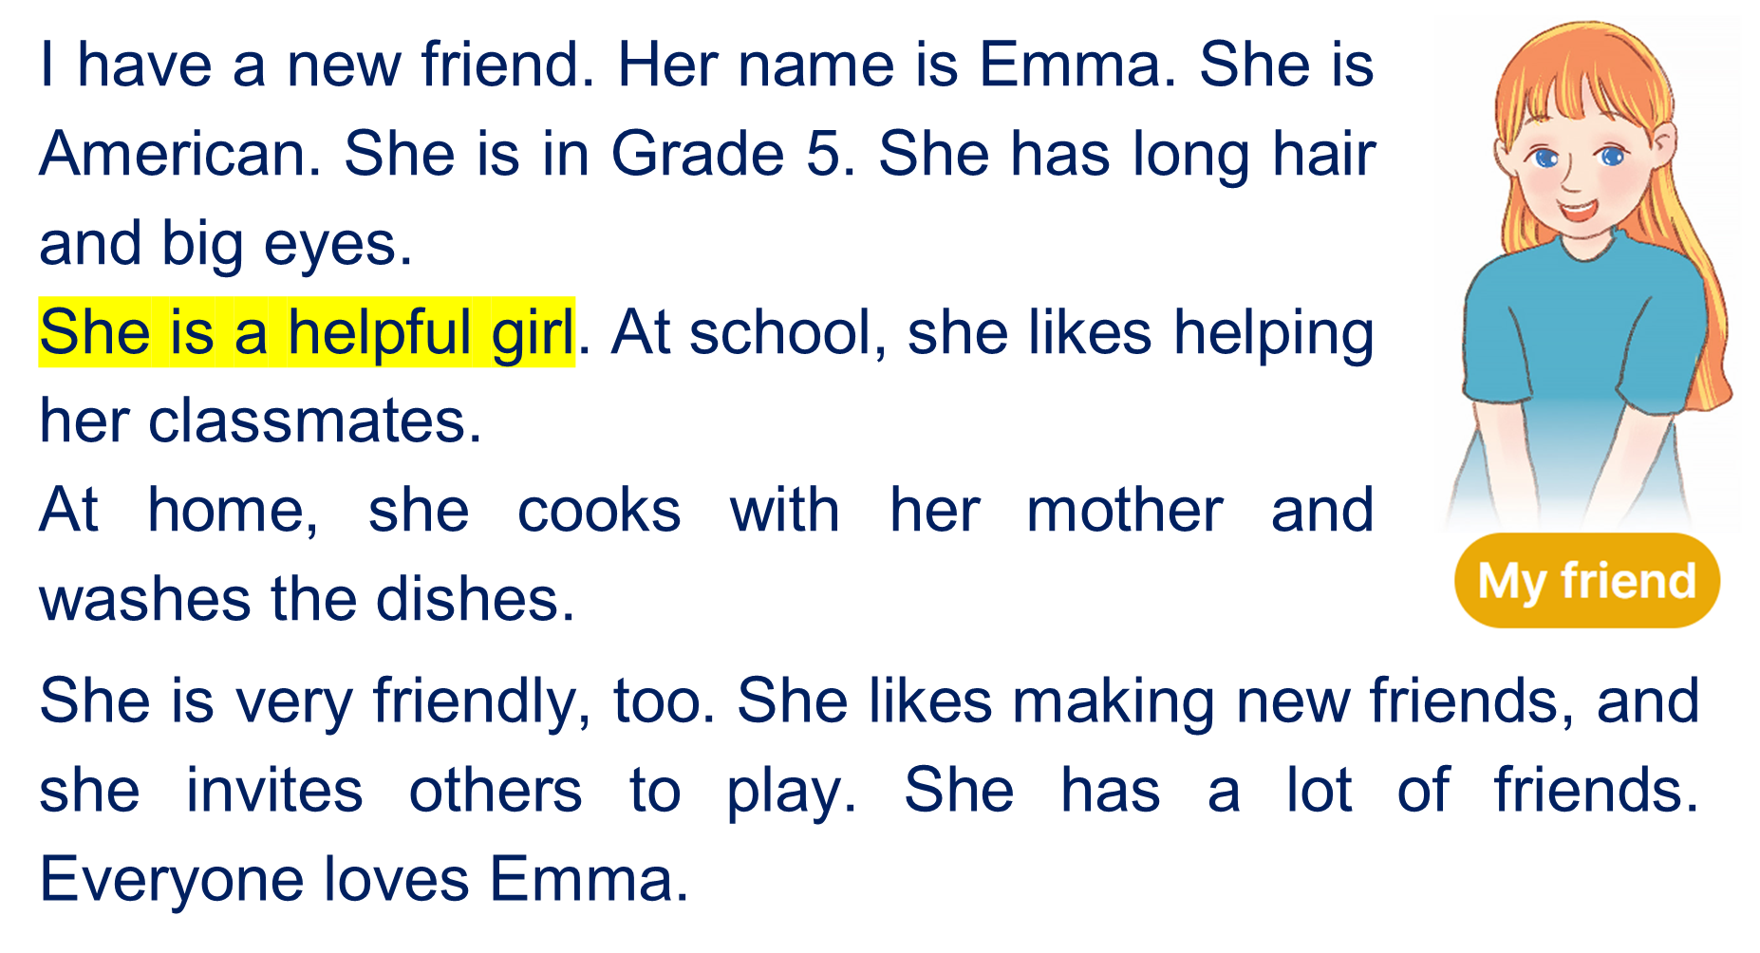

Complete and check
______________
American
_____
long
__________
helpful
__________
friends

Slide 11
3
Let’s write

Slide 12
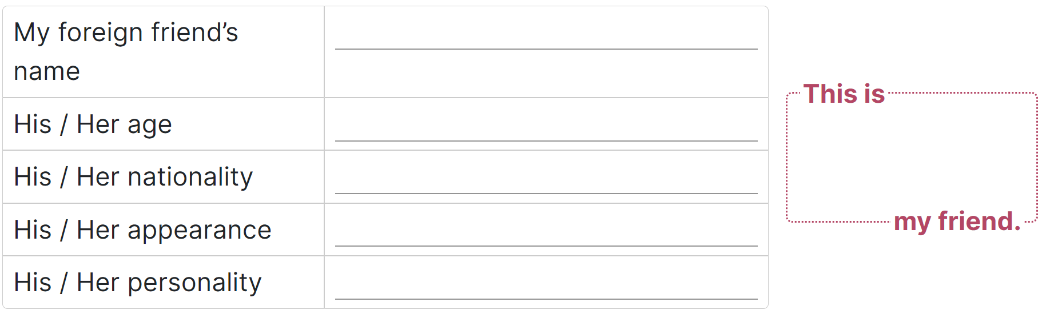

Draw your friend and write about him/her.

Slide 13

Example
Her name is Mary.
She is eleven years old.
She is American.
She is tall and she has blond hair.
She is active. She likes dancing.

Slide 14
You write about your friend
Her/His name is _________.
She/ He is _______ years old.
She/ He is __________.
She/ He is ___. / She/ He has __.
She/ He is ___. She/ He likes ____.

Slide 15
4
Project

Slide 16
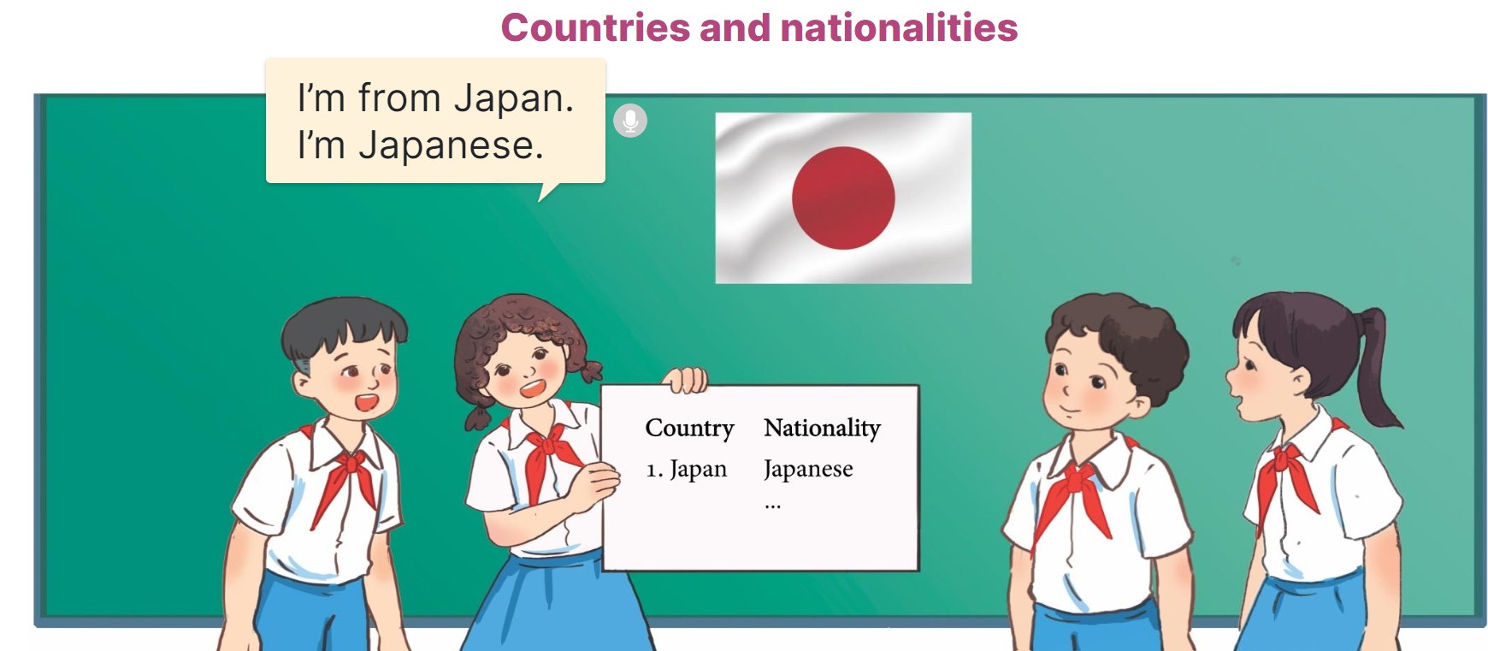
Countries and nationalities

Slide 17






Countries and nationalities
Flag | Country | Nationality
Japan
Japanese
Malaysia
Malaysian
Vietnam
Vietnamese
America
American
Australia
Australian
Britain
British

Slide 18
5
Fun corner and wrap-up

Slide 19






Click hình chú Thỏ hoặc chú Rùa khi chọn đáp án.

Slide 20

Japan
Country
Nationality

Slide 21
Malaysia
Country
Nationality

Slide 22
Japanese
Country
Nationality

Slide 23
Malaysian
Country
Nationality

Slide 24
Vietnam
Country
Nationality

Slide 25
American
Country
Nationality

Slide 26
Australia
Country
Nationality

Slide 27
America
Country
Nationality

Slide 28
Vietnamese
Country
Nationality

Slide 29
Australian
Country
Nationality

Slide 30



Slide 31

Thank you
For joining!

