Slide 1








Unit 3
My foreign friends
Period 2 – Part 4, 5, 6

Slide 2

Table of contents
Warm-up and review
1
Listen and number
2
Read and complete
3
Let’s play
4
Wrap-up
5

Slide 3

1
Warm-up
and review

Slide 4

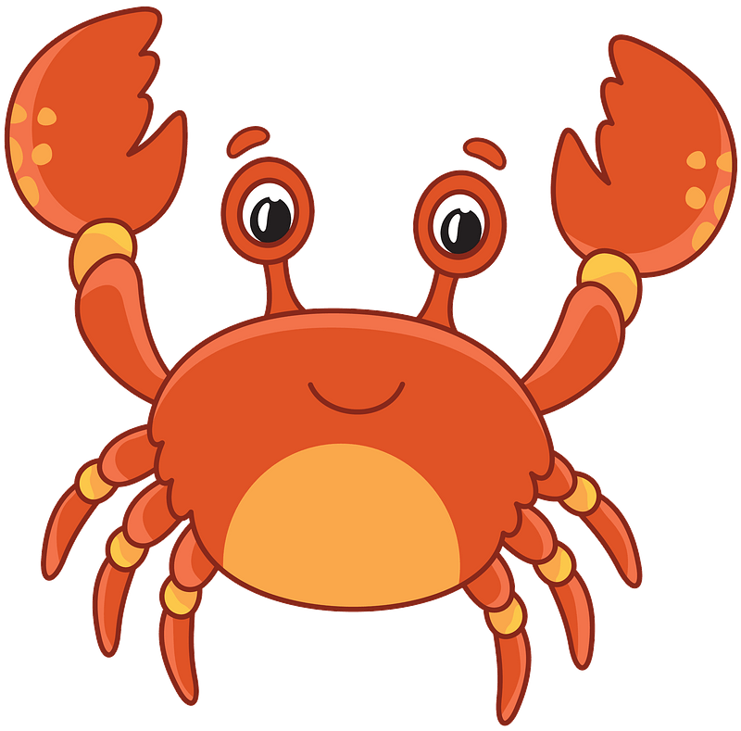


THE FUNNY CRAB
-
START

Slide 5
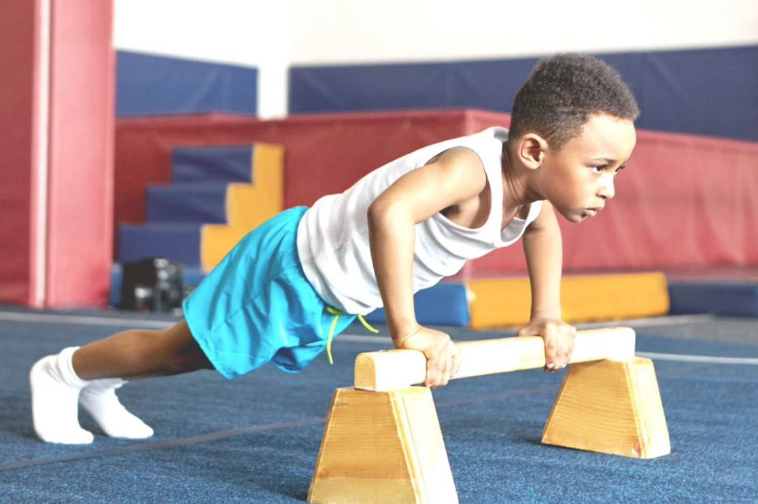

-
active
Can you write the word
that you see?
Next
Check

Slide 6
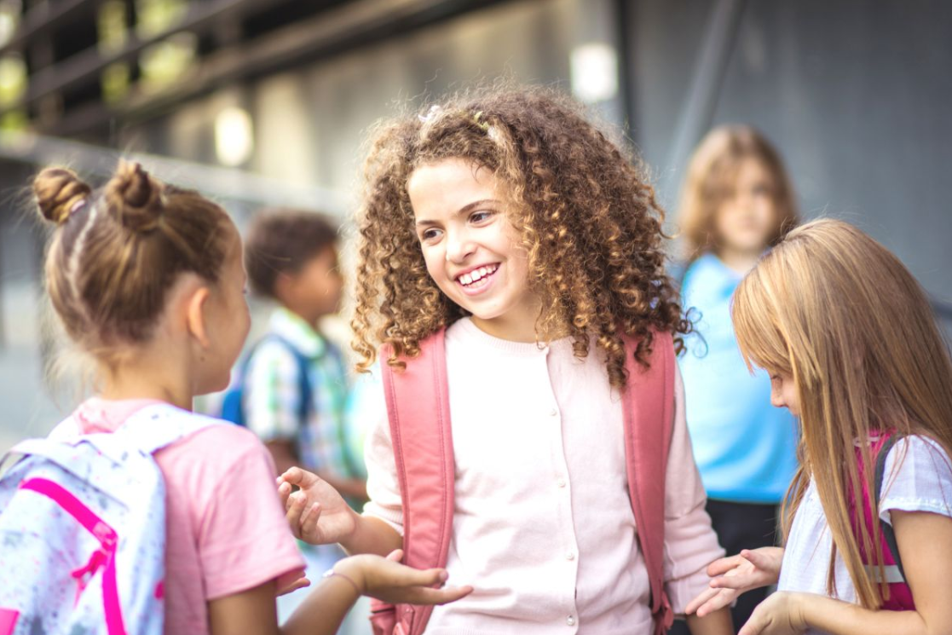
-
friendly
Can you write the word
that you see?
Next
Check

Slide 7
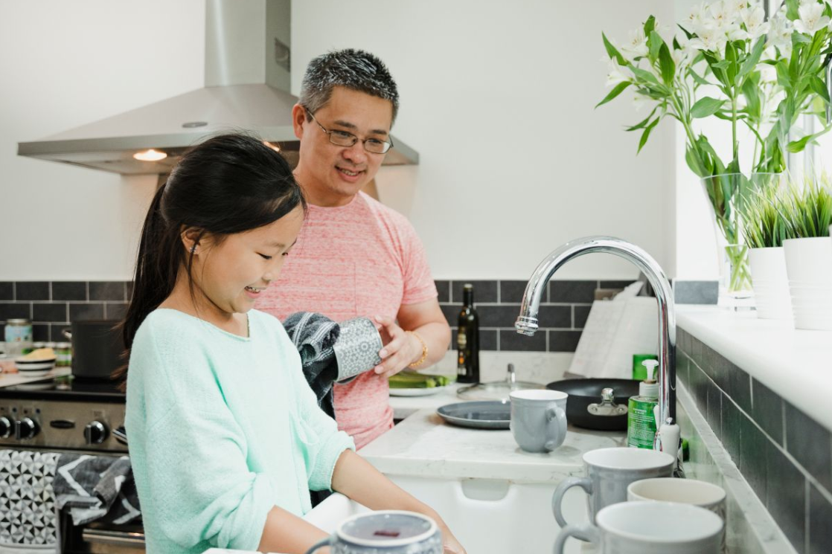
-
helpful
Can you write the word
that you see?
Next
Check

Slide 8

-
clever
Can you write the word
that you see?
Next
Check

Slide 9
Goodjob!
-
Exit

Slide 10

Review
What is he/she like?
He/she is ___________.
helpful
clever
frendly
active

Slide 11
2
Listen and number

Slide 12
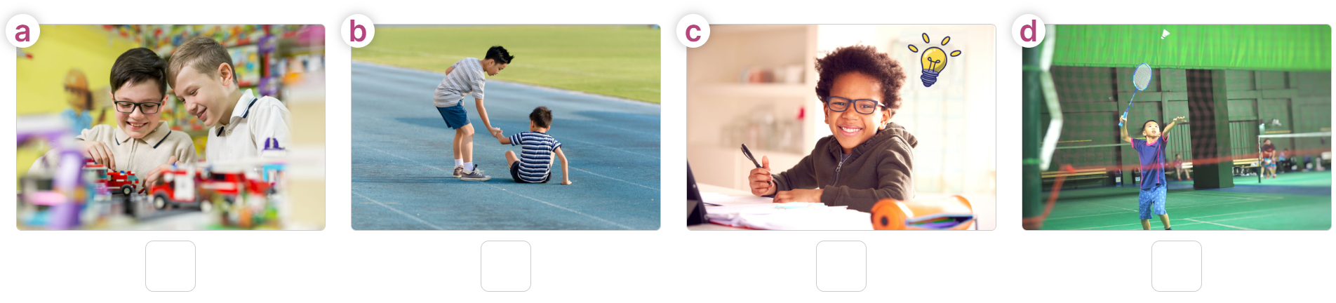


Listen and number
2
1
4
3
1
2
3
4

Slide 13
3
Read and circle

Slide 14
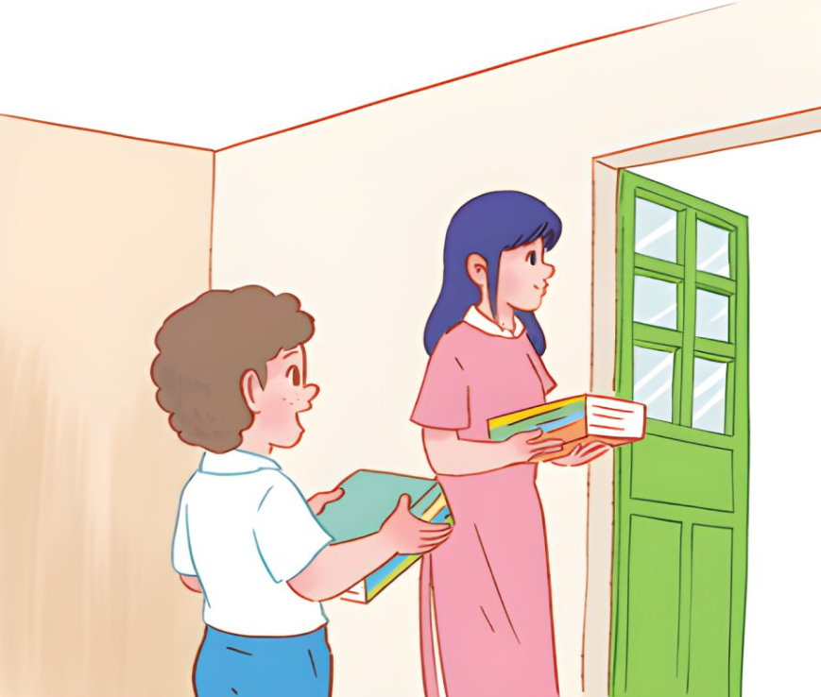
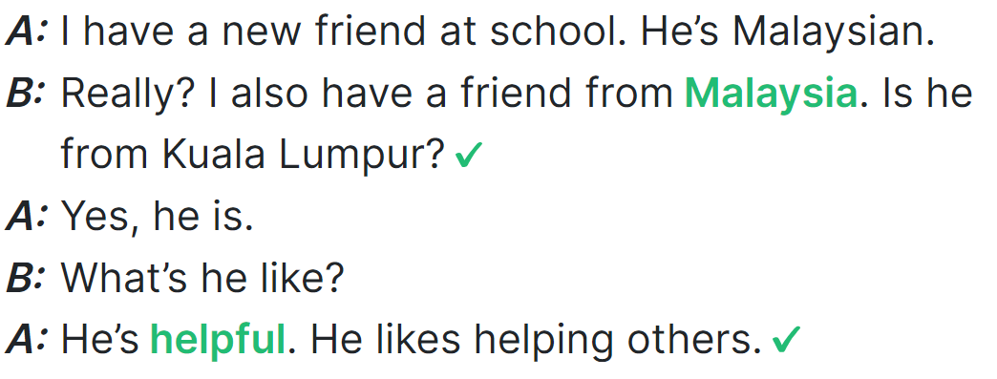
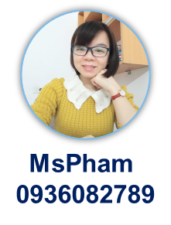
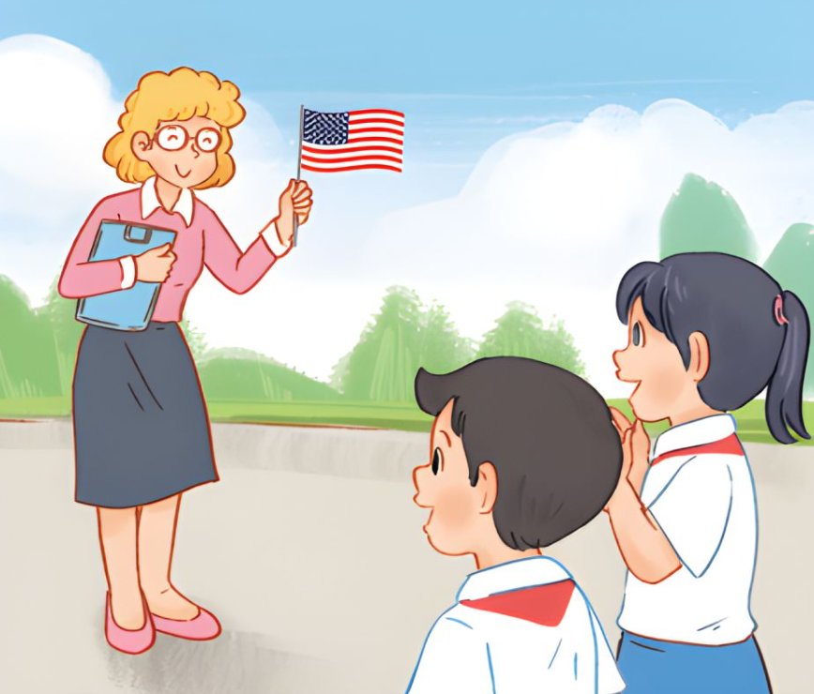
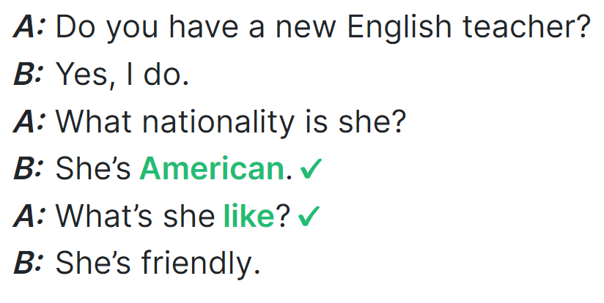
Read and complete
1.
_______.
_____.
2.
_____.
_____?

Slide 15

4
Let’s play!

Slide 16
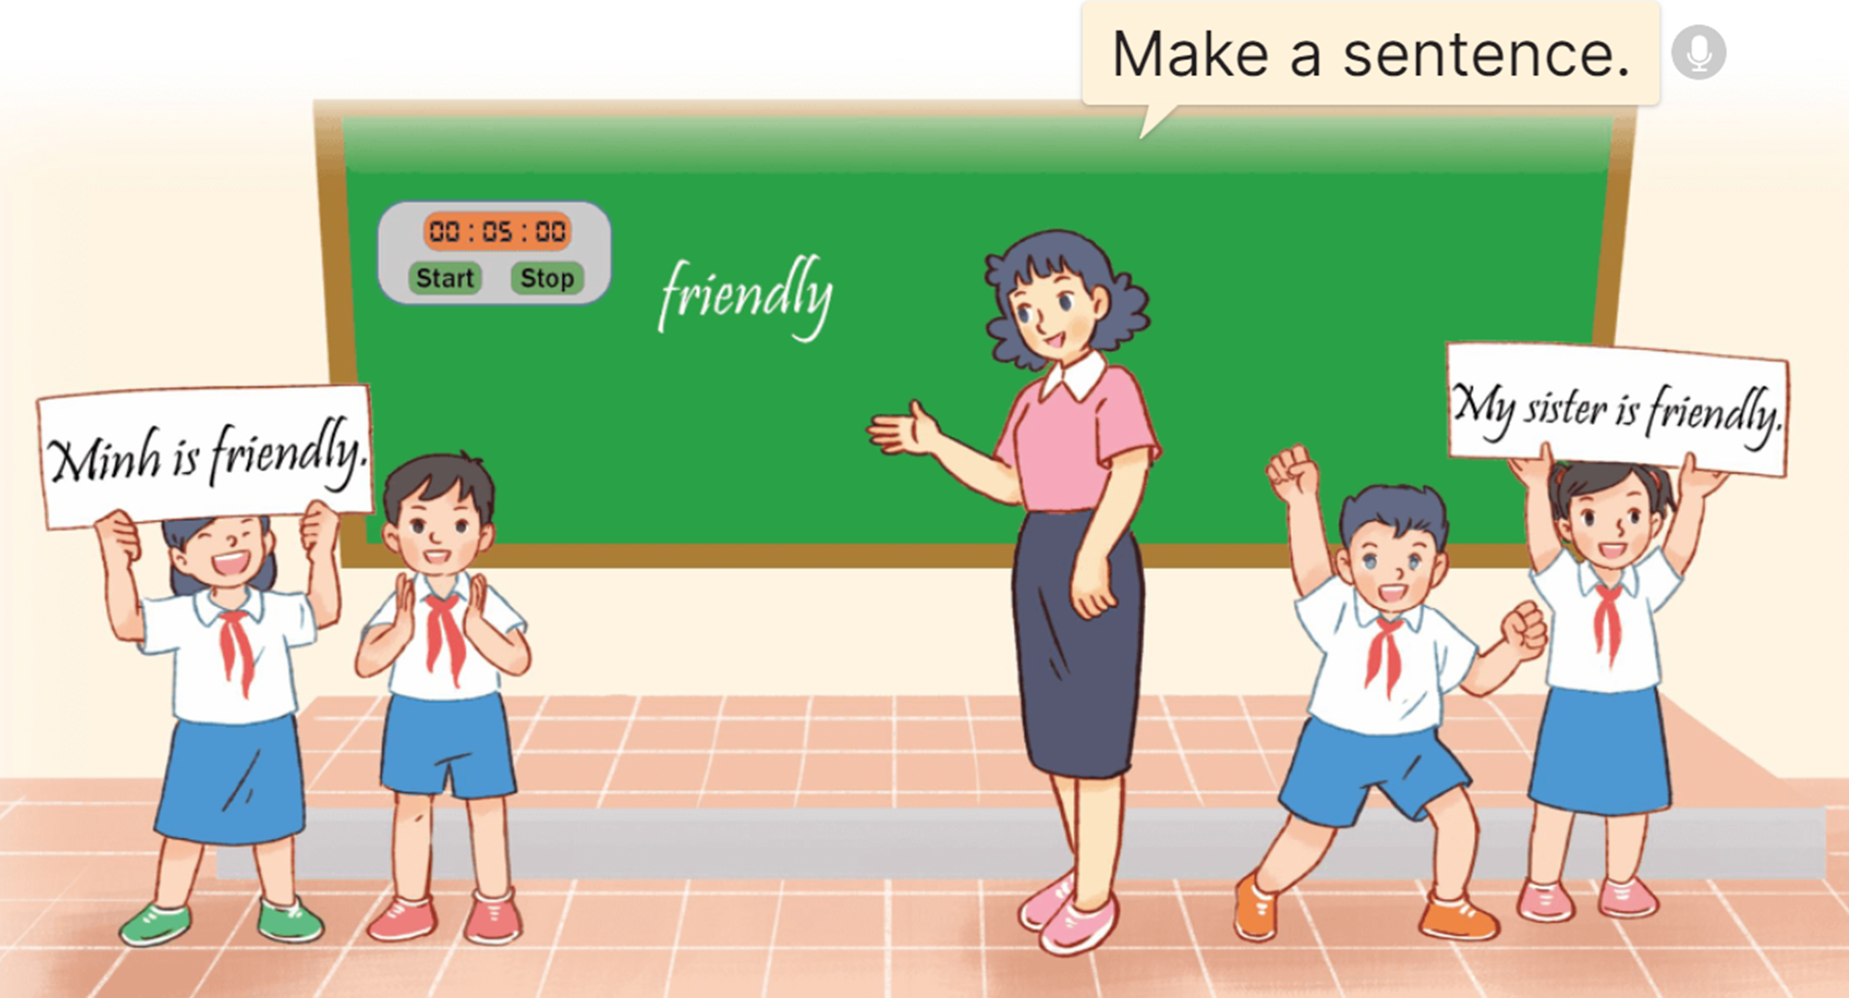
The longest sentence
Start

Slide 17
The longest sentence
30s
active
Start

Slide 18
The longest sentence
30s
clever
Start

Slide 19
The longest sentence
30s
helpful
Start

Slide 20
The longest sentence
30s
tall
Start

Slide 21
The longest sentence
30s
big eyes
Start

Slide 22
The longest sentence
30s
Malaysian
Start

Slide 23
The longest sentence
30s
America
Start

Slide 24
5
Wrap-up

Slide 25


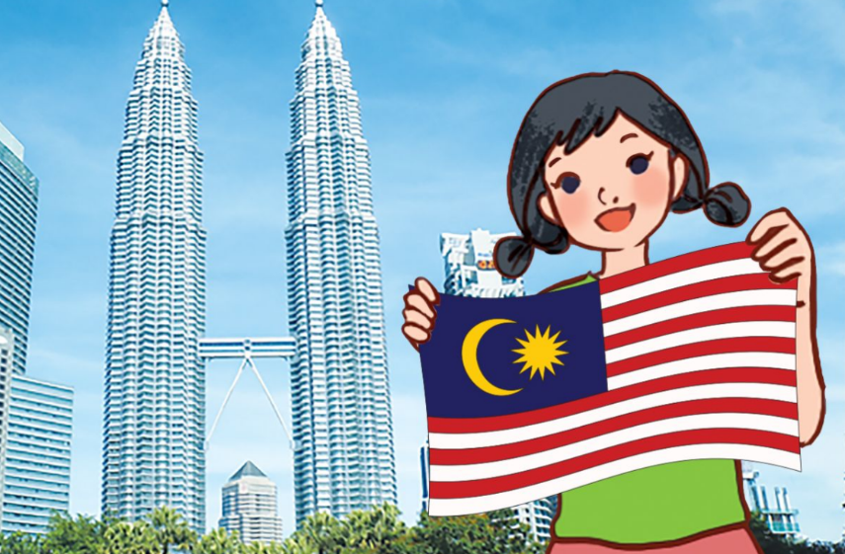

Review
What nationality is he/she?
He/she is ___________.
Australian
Japanese
Malaysian
American

Slide 26
Review
What is he/she like?
He/she is ___________.
helpful
clever
frendly
active

Slide 27

Thank you
For joining!

