Slide 1





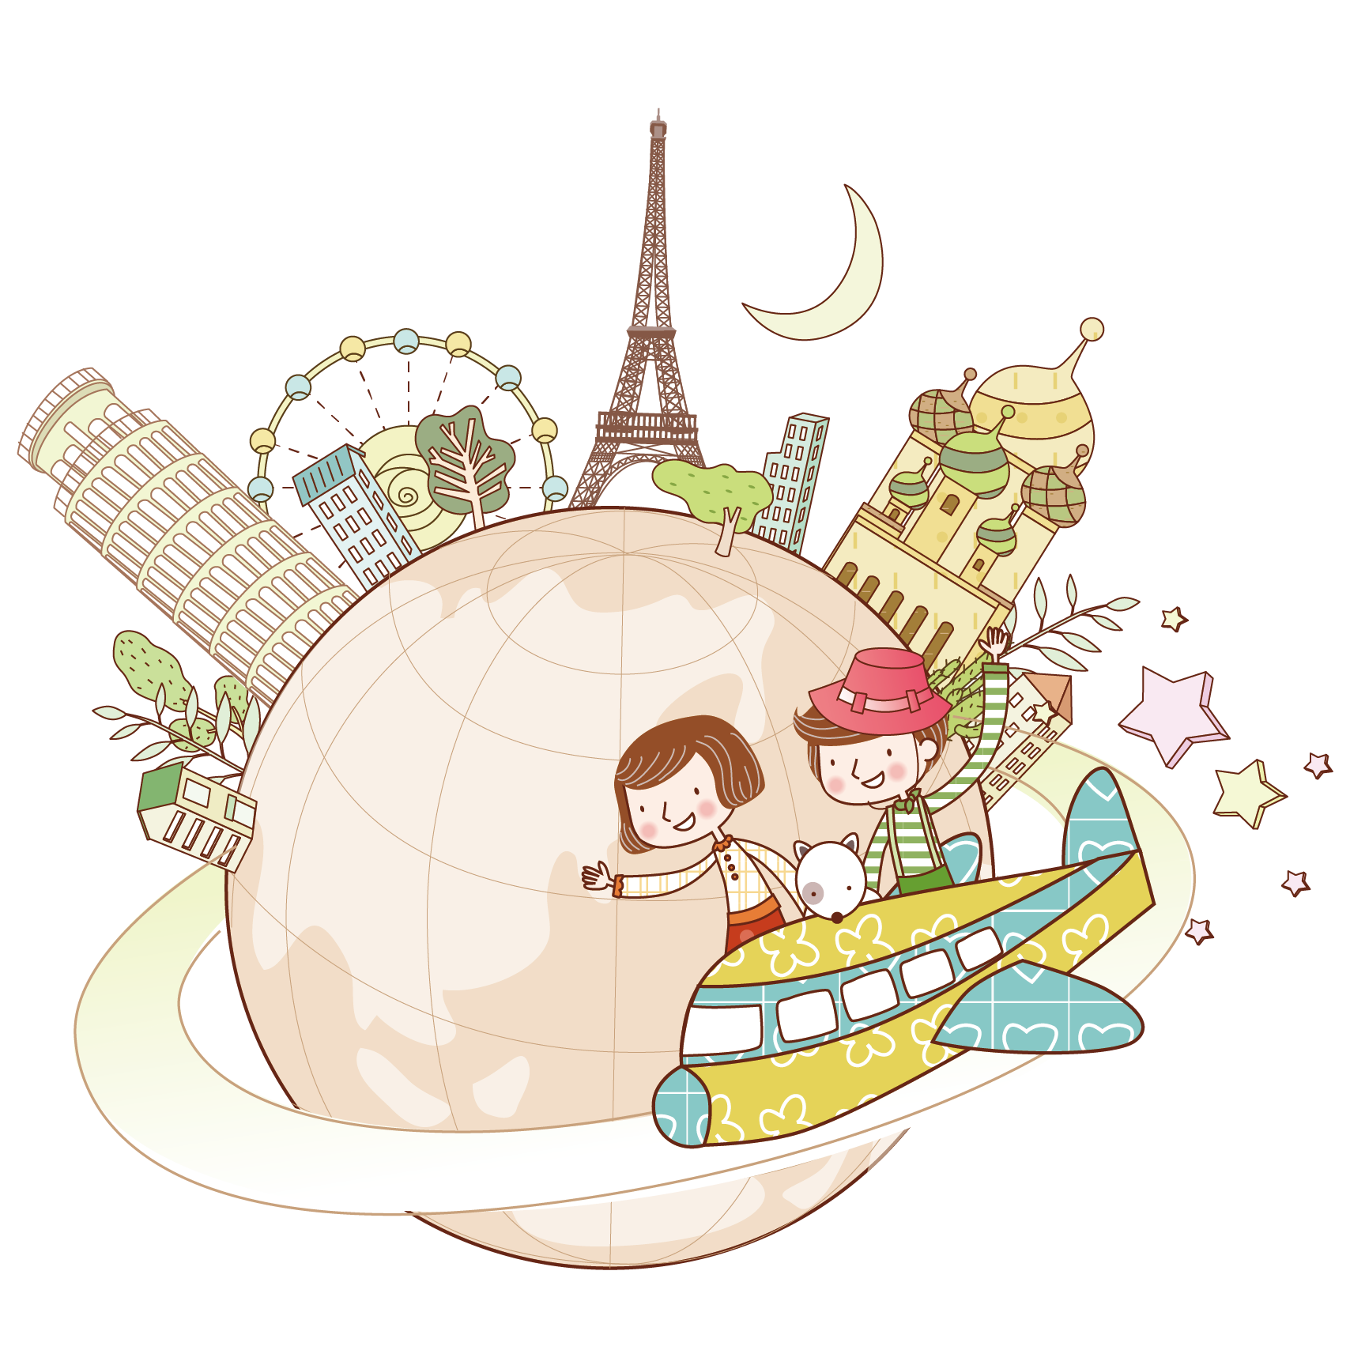


Unit 3
My foreign friends
Period 2 – Part 1, 2 3

Slide 2

Table of contents
Warm-up and review
1
Look, listen and repeat
2
Listen, point and say
3
Let’s talk.
4
Fun corner and wrap-up
5

Slide 3

1
Warm-up
and review

Slide 4

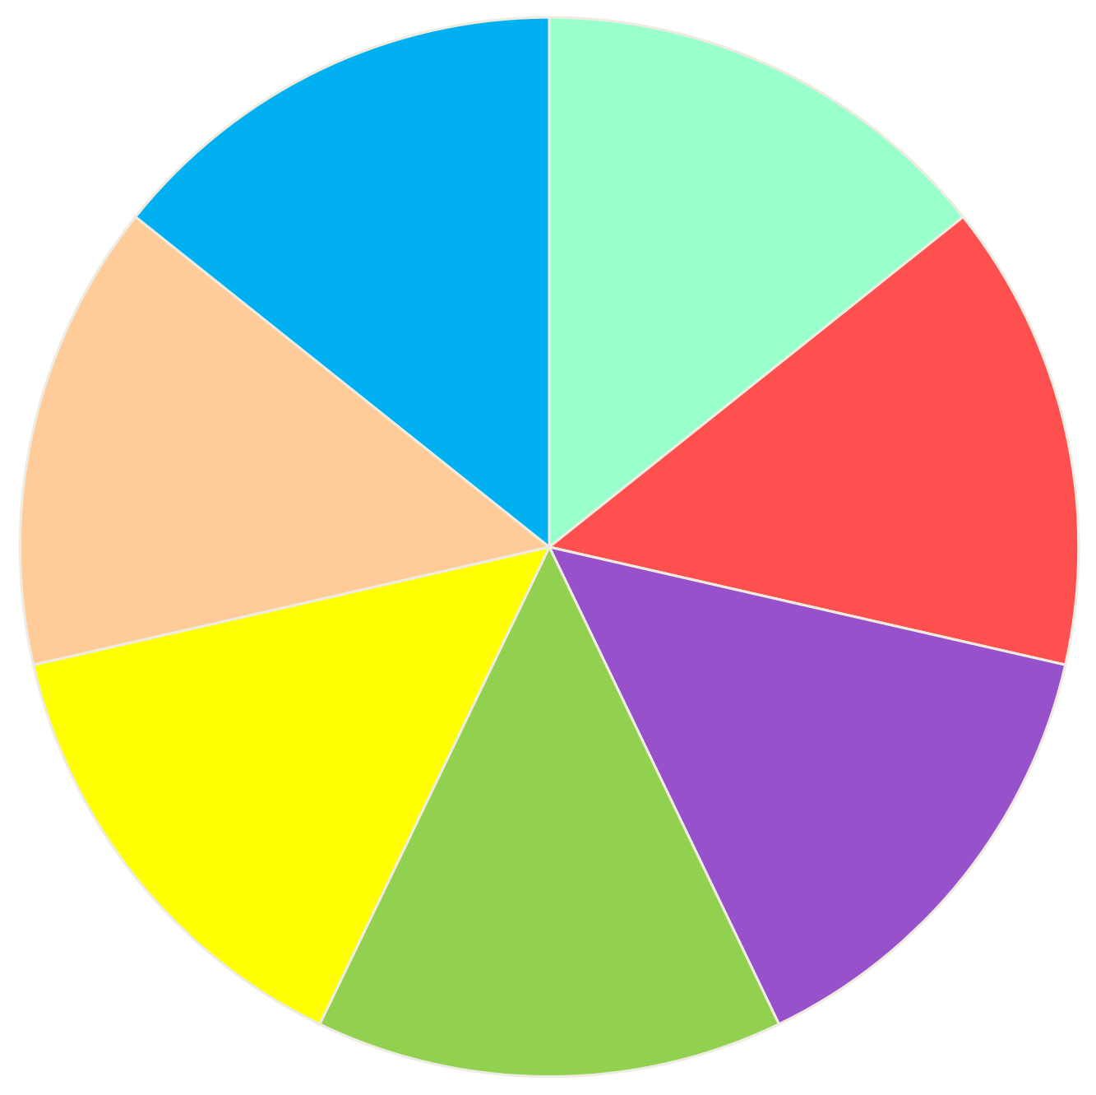

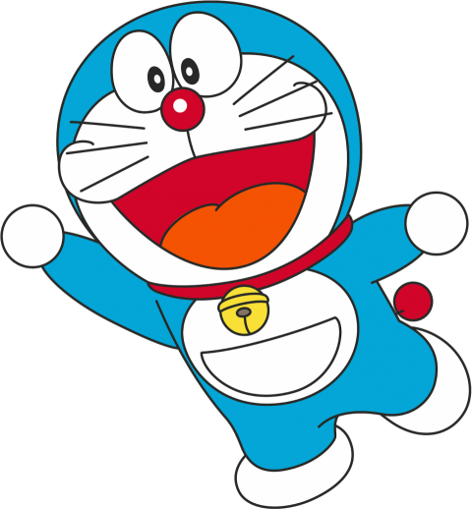











Luật chơi:
- Chia lớp thành các đội và đặt tên đội.
- Các đội lần lượt quay vòng quay để chọn số điểm được cộng
- Mở lần lượt những chiếc bánh số 1-9 để trả lời câu hỏi.
- Đội nào trả lời đúng và nhanh nhất sẽ được cộng số điểm vừa quay.
- Đội chiến thắng là đội dành được nhiều điểm nhất, được nhận phần thưởng từ thầy/cô giáo.
+ 20
+ 10
+ 20
+ 10
Spin/
Stop
x2
+ 0
+10
End

Slide 5
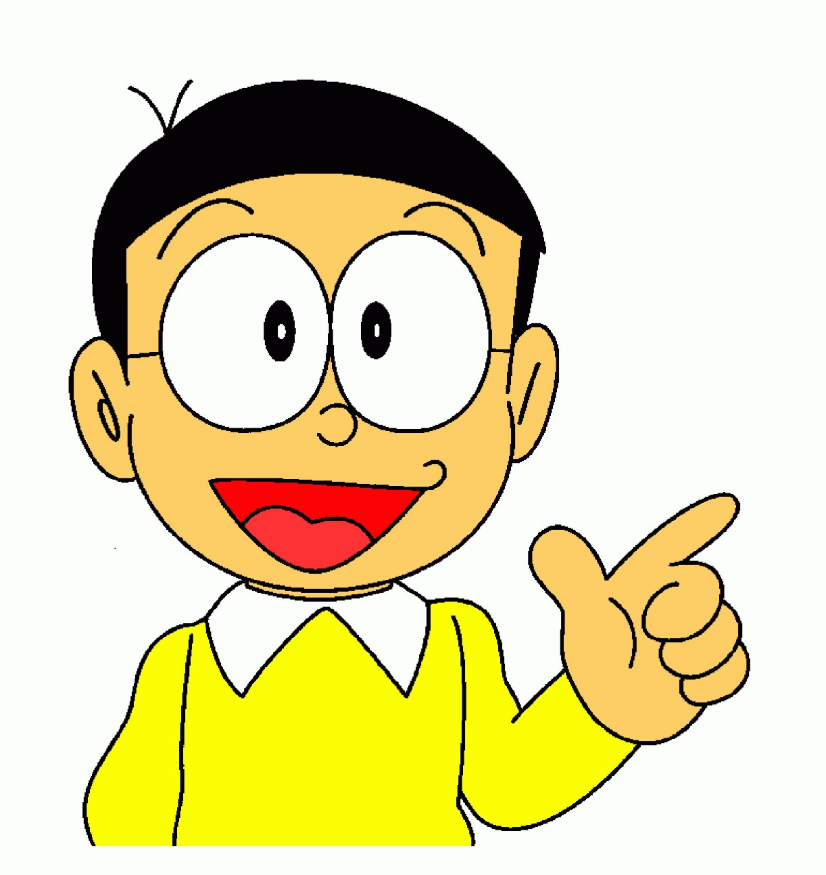
Nobita ___ big eyes.
A. is
B. has
C. look
Back
Notes:
Go to next slide for the scores.

Slide 6
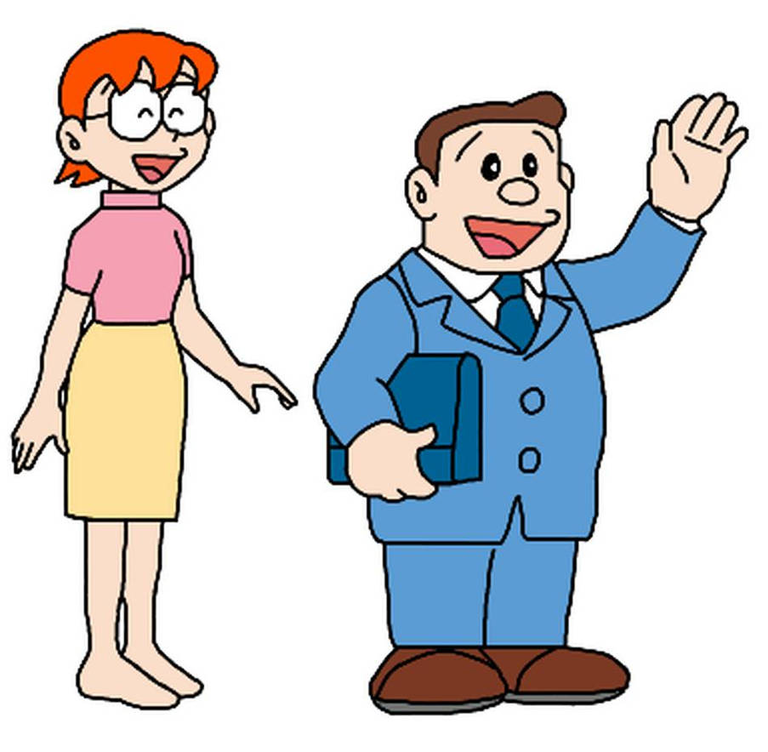
Nobita's mother _____.
A. is slim
B. has slim
C. is short
Back
Notes:
Go to next slide for the scores.

Slide 7
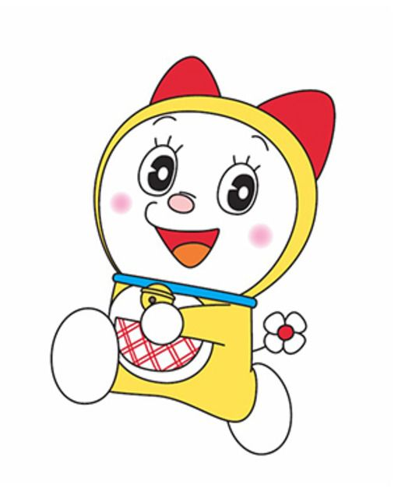
Dorami ______ .
A. is short
B. has short
C. has long hair
Back
Notes:
Go to next slide for the scores.

Slide 8
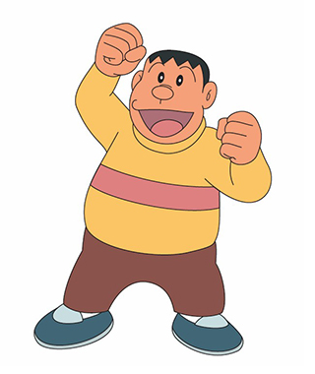
Jaian ________ .
A. has tall
B. is big
C. look short
Back
Notes:
Go to next slide for the scores.

Slide 9
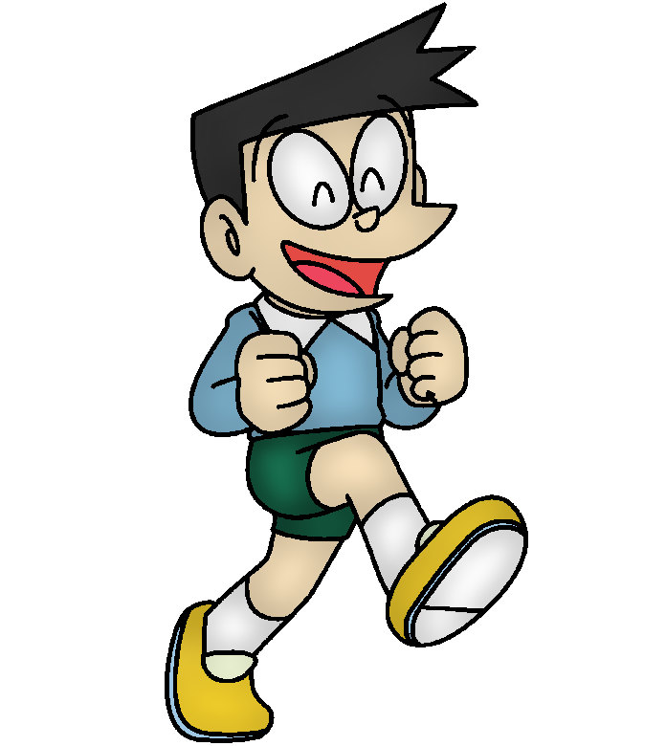
Suneo _______ .
A. has short hair
B. is short hair
C. has short
Back
Notes:
Go to next slide for the scores.

Slide 10
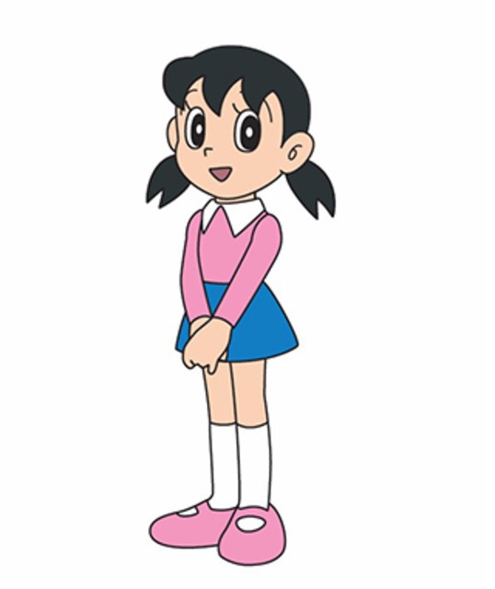
Shizuka ___ long ___.
A. has - eyes
B. is - hair
C. has - hair
Back
Notes:
Go to next slide for the scores.

Slide 11
Nobita's father ___ big and short.
A. look
B. has
C. is
Back
Notes:
Go to next slide for the scores.

Slide 12
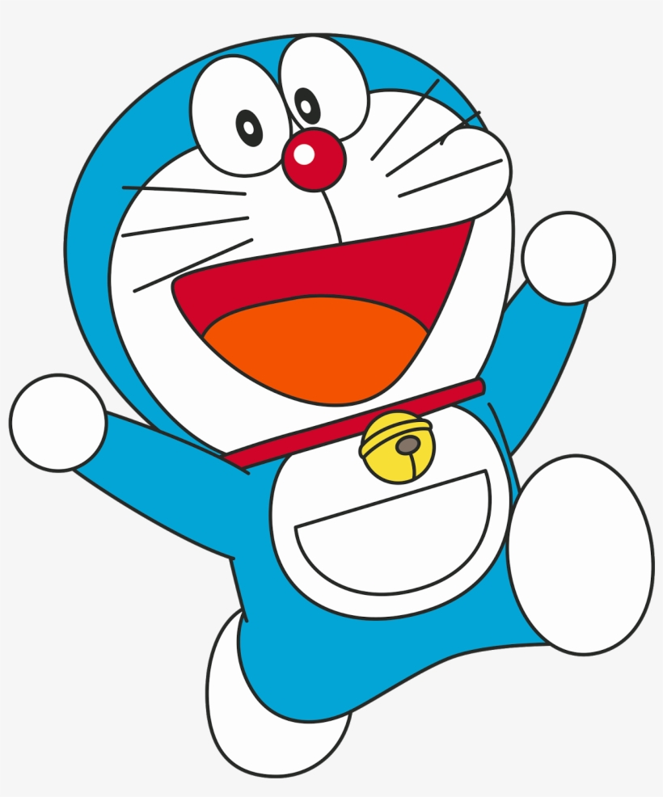
Doraemon __ a round __.
A. is - face
B. has - hair
C. has - face
Back
Notes:
Go to next slide for the scores.

Slide 13
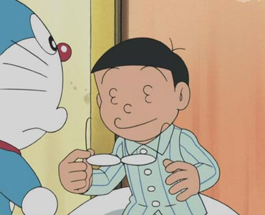
Nobita has _____.
A. long hair
B. short hair
C. big nose
Back
Notes:
Go to next slide for the scores.

Slide 14




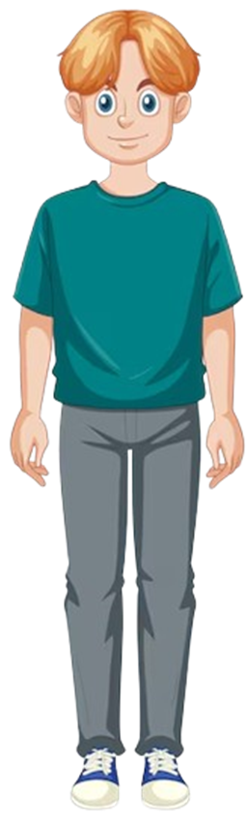
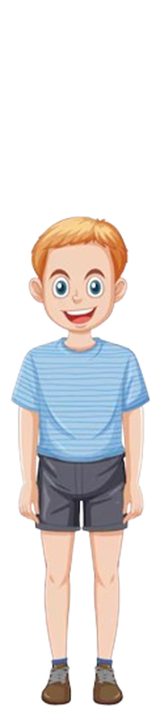
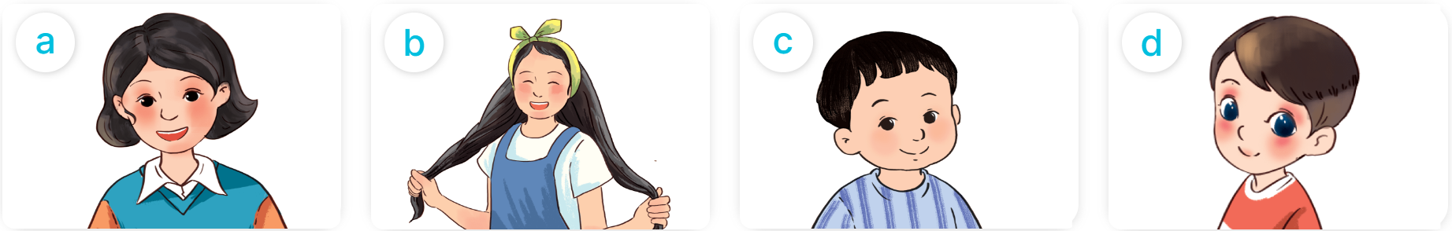

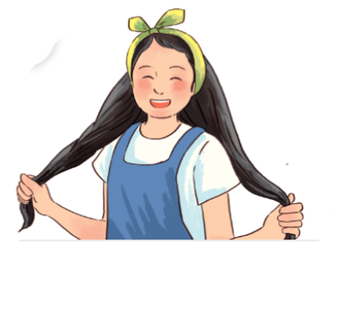
He is_____.
Appearance
He has _____.
What does he/she look like?
a round face
big eyes
short
tall
She is _____.
She has _____.
slim
big
short hair
long hair

Slide 15
2
Look, listen
and repeat.

Slide 16

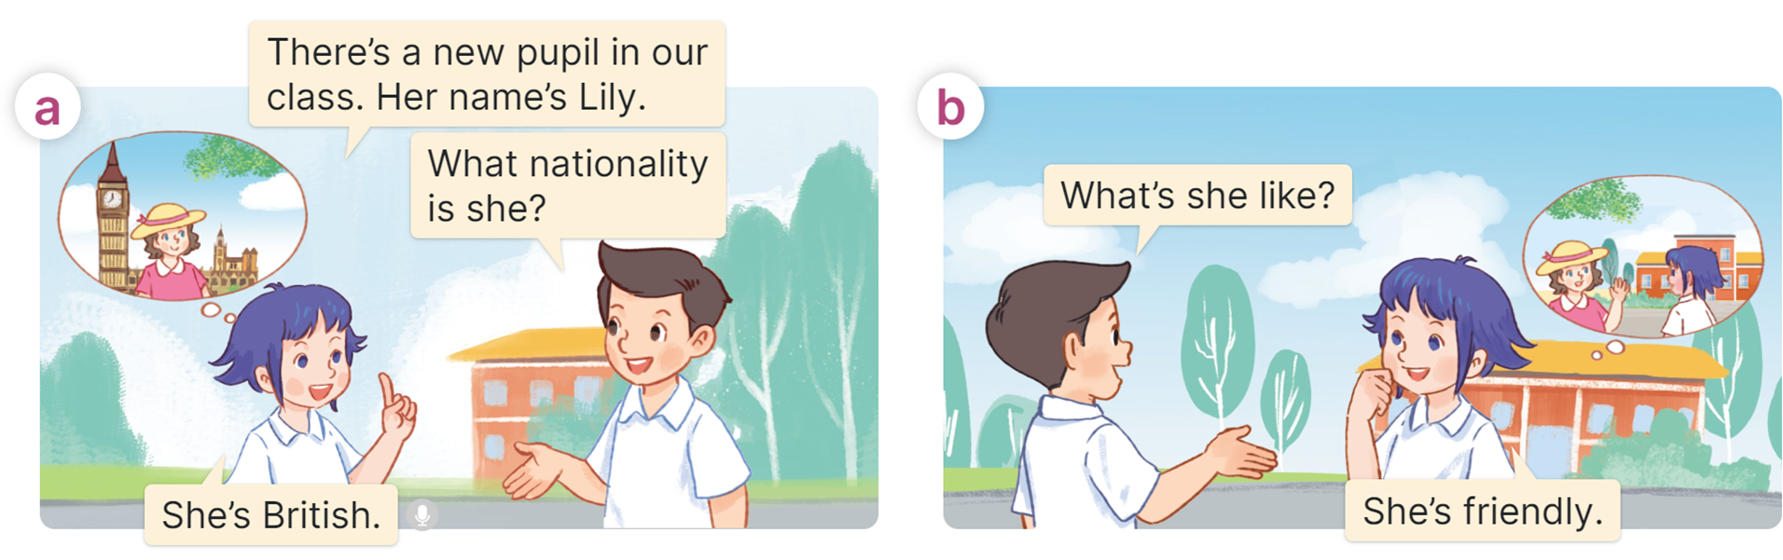
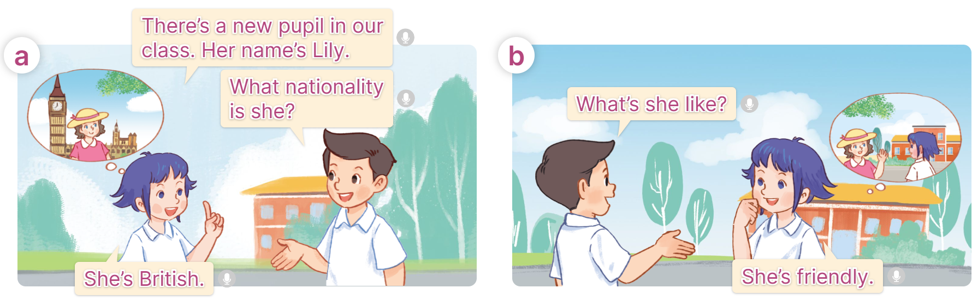
Look and listen

Slide 17
Listen and repeat

Slide 18
Listen and repeat

Slide 19
Structure
Cách hỏi và trả về tính cách của một người nào đó?
What is he/she like?
(Anh ấy/chị ấy như thế nào?)
He/she is ___________.
(Anh ấy/chị ấy thì _______)
(+ personality)

Slide 20
3
Listen, point
and say.

Slide 21
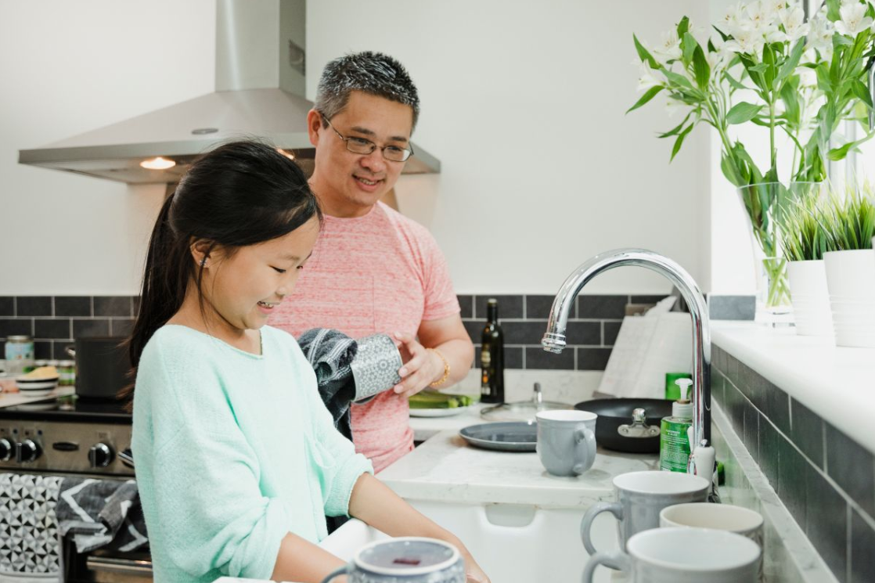
Vocabulary
helpful
/ˈhelpfl/
Hay giúp đỡ,
tốt bụng

Slide 22
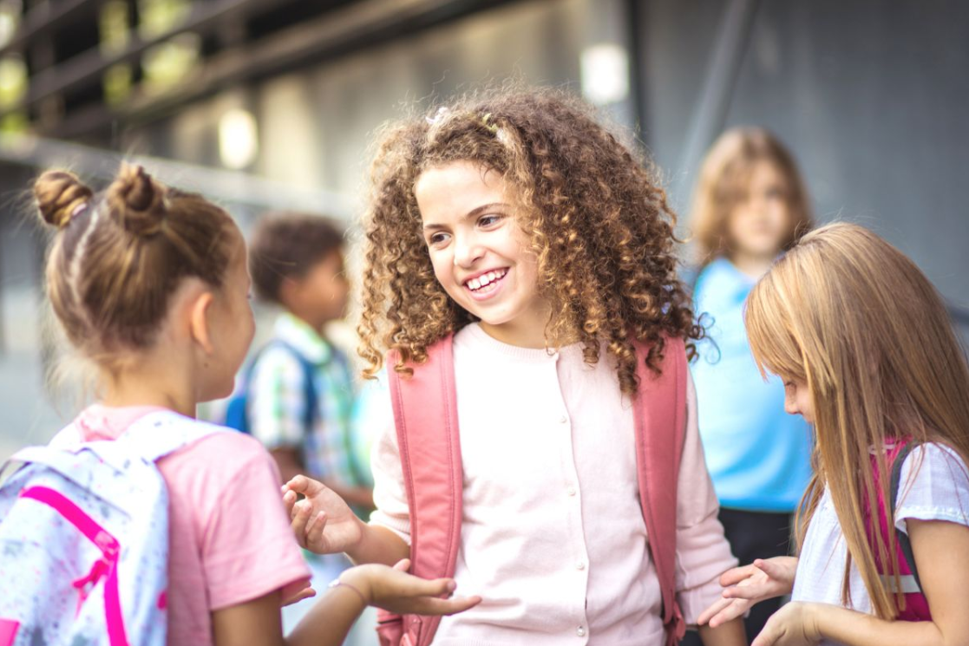
Vocabulary
friendly
/ˈfrendli/
Thân thiện

Slide 23
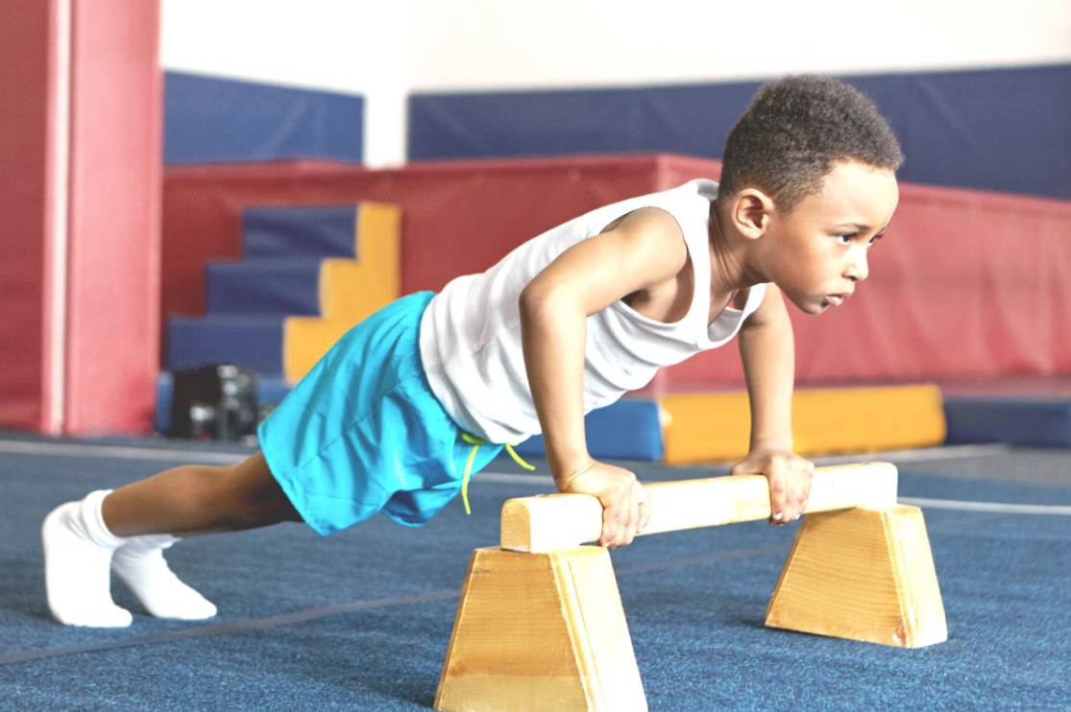
Vocabulary
active
/ˈæktɪv/
Năng động

Slide 24

Vocabulary
clever
/ˈklevə(r)/
Thông mình

Slide 25
Vocabulary
helpful
: Hay giúp đỡ, tốt bụng
friendly
: Thân thiện
active
: Năng động
clever
: Thông mình

Slide 26
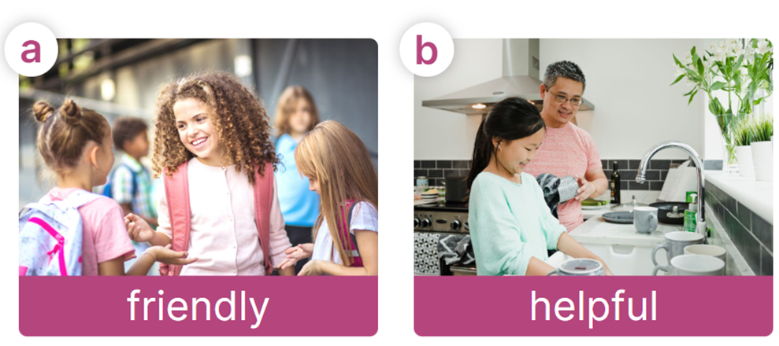
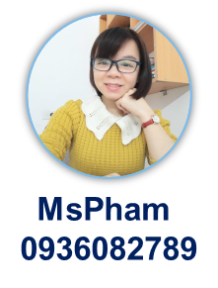

Look, listen and say
What is he/she like?
He/she is ___________.

Slide 27
Look, listen and say
What is he/she like?
What is she like?
He/she is ________.
She is friendly.

Slide 28
Look, listen and say
What is he/she like?
What is she like?
He/she is ________.
She is helpful.

Slide 29
Look, listen and say
What is he/she like?
What is he like?
He/she is ________.
He is clever.

Slide 30
Look, listen and say
What is he/she like?
What is he like?
He/she is ________.
He is active.

Slide 31
Look, listen and say
What is he/she like?
He/she is ___________.

Slide 32

4
Let’s talk!

Slide 33
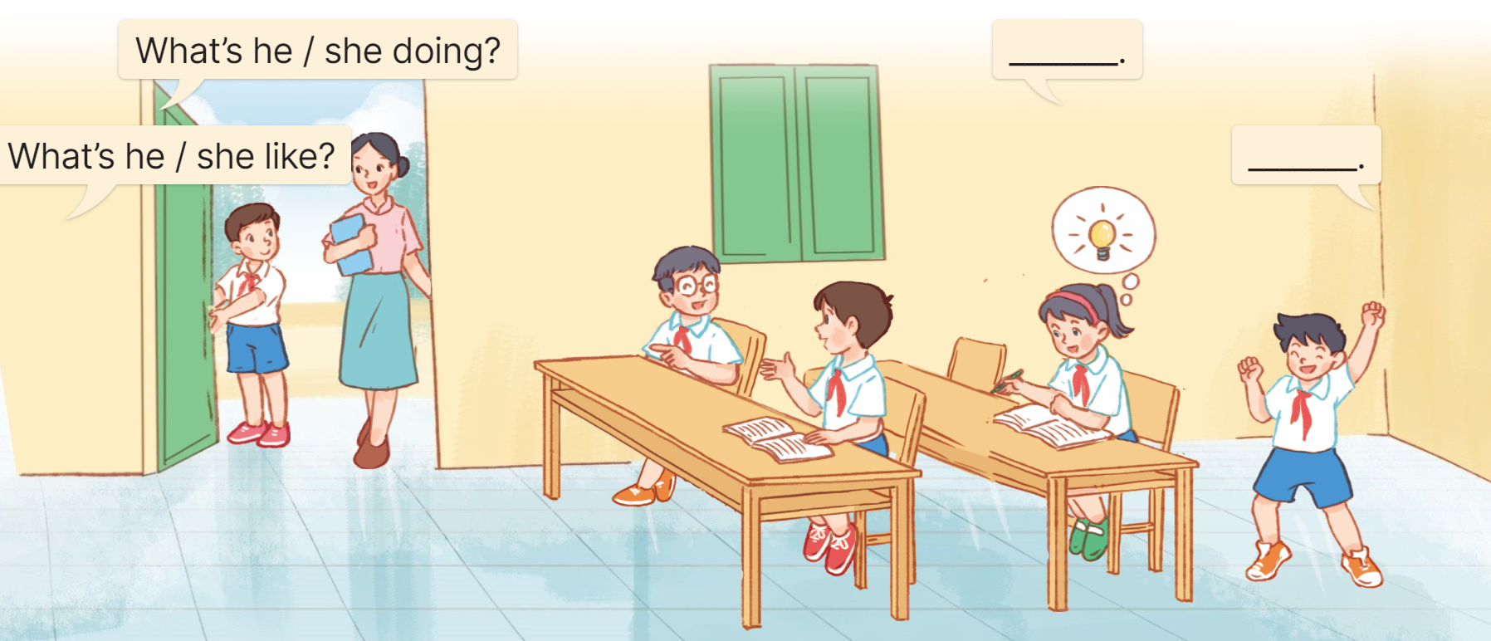

Let’s talk
He's opening the door for the teacher.
What is he doing?
What is he like?
He's helpful.

Slide 34
Let’s talk
He’s talking with his friend.
What is he doing?
What is he like?
He’s friendly.

Slide 35
Let’s talk
She’s doing exercise.
What is she doing?
What is she like?
She’s clever.

Slide 36
Let’s talk
He’s dancing.
What is she doing?
What is he like?
He’s active.

Slide 37
5
Fun corner and wrap-up

Slide 38
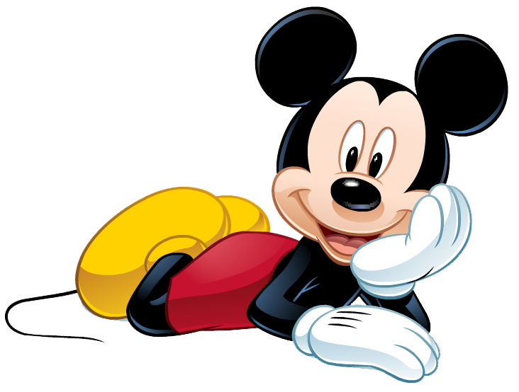
MICKEY CHECK
START

Slide 39
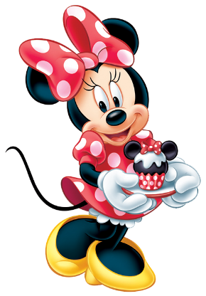


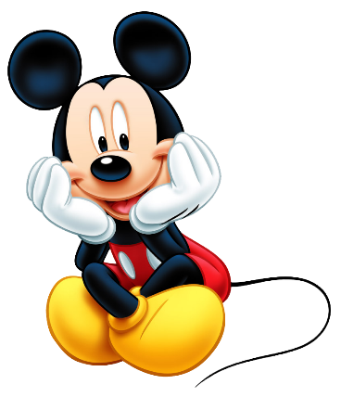
A
active
What is he like?
He is ____.
B
friendly
C
clever
Next

Slide 40
A
clever
What is she like?
She is ____.
B
friendly
C
active
Next

Slide 41
A
helpful
What is she like?
She is ____.
B
active
C
clever
Next

Slide 42
A
friendly
What is he like?
He is ____.
B
active
C
clever
Next

Slide 43
A
is
What _____he like?
He is friendly.
B
does
C
can
Next

Slide 44
A
look
What is she _____?
She is clever.
B
look like
C
like
Next

Slide 45
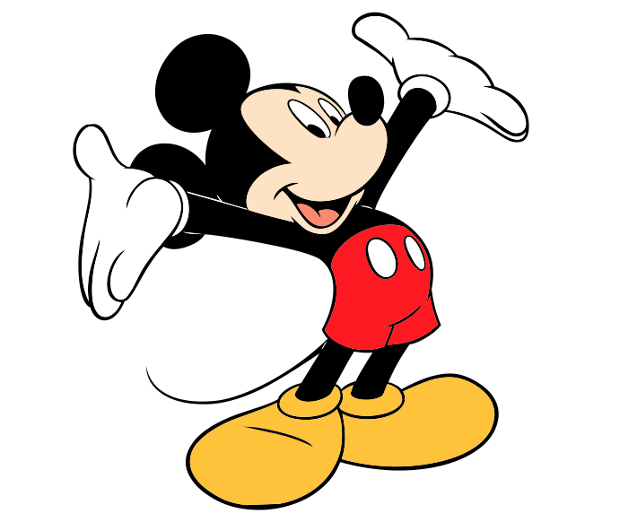
Excellent!
end

Slide 46

Review
What is he/she like?
He/she is ___________.
helpful
clever
friendly
active

Slide 47

Thank you
For joining!

