Slide 1







Unit 3
My foreign friends
Period 1 – Part 1, 2 3

Slide 2

Table of contents
Warm-up and review
1
Look, listen and repeat
2
Listen, point and say
3
Let’s talk
4
Fun corner and wrap-up
5

Slide 3

1
Warm-up
and review

Slide 4




NUTCRACKER
RIDDLES
START

Slide 5


Where’s he from?
He’s from Malaysia.
Open
Check

Slide 6

Where’s she from?
She’s from Japan.
Open
Check

Slide 7

Where’s she from?
She’s from Australia.
Open
Check

Slide 8

Where’s she from?
She’s from America.
Open
Check

Slide 9

Where’s he from?
He’s from Vietnam.
Open
Check

Slide 10

Well done!
End

Slide 11
Review
Japan
/dʒəˈpæn/
: Nước Nhật Bản
America
/əˈmerɪkə/
: Nước Mĩ
Malaysia
/məˈleɪʒə/
: Nước Ma-lai-si-a
Australia
/ɒˈstreɪliə/
: Nước Úc

Slide 12
2
Look, listen
and repeat.

Slide 13

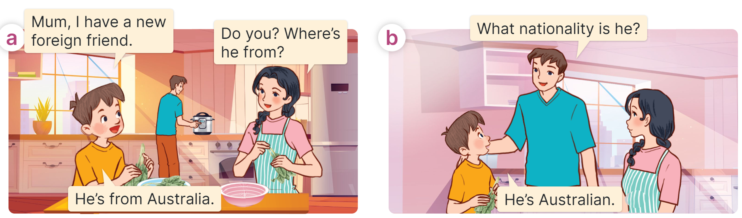
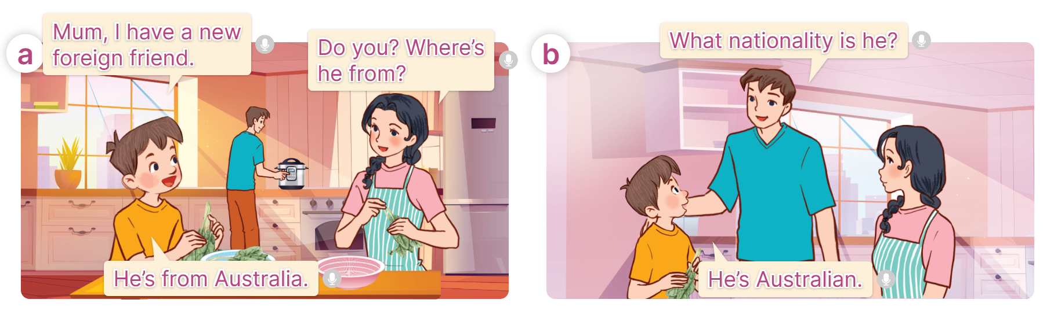
Look and listen

Slide 14
Listen and repeat

Slide 15
Listen and repeat

Slide 16
Structure
Cách hỏi và trả lời về quốc tịch của một người nào đó?
What nationality is he/she?
(Anh ấy/chị ấy là quốc tịch nào?)
He/she is ___________.
(Anh ấy/chị ấy là người _______)
(+ nationality)

Slide 17
2
Listen, point
and say.

Slide 18

Vocabulary
Australian
/ɑːˈstreɪliən/
: Người Úc

Slide 19
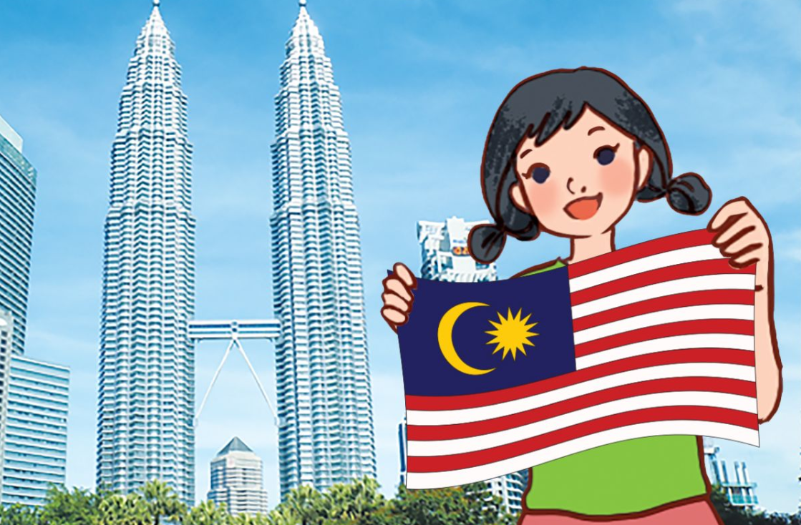
Vocabulary
Malaysian
/məˈleɪzɪən/
: Người Ma-lay-xi-a

Slide 20

Vocabulary
American
/əˈmerɪkən/
: Người Mĩ

Slide 21

Vocabulary
Japanese
/ˌdʒæpəˈniːz/
: Người Nhật

Slide 22




Vocabulary
Australian
: Người Úc
Malaysian
: Người Ma-lay-xi-a
American
: Người Mĩ
Japanese
: Người Nhật

Slide 23
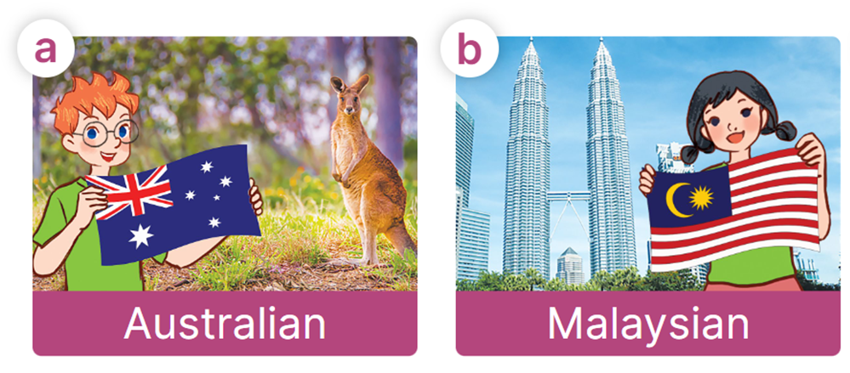

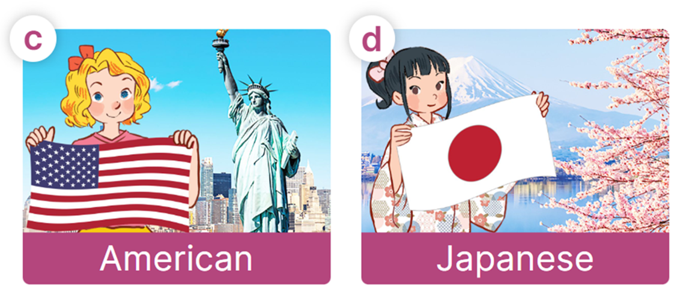
Look, listen and say
What nationality is he/she?
He/she is ___________.

Slide 24
Look, listen and say
What nationality is he/she?
What nationality is he?
He/she is ___________.
He is Australia.

Slide 25
Look, listen and say
What nationality is he/she?
What nationality is she?
He/she is ___________.
She is Malaysian.

Slide 26

Look, listen and say
What nationality is he/she?
What nationality is she?
He/she is ___________.
She is American.

Slide 27
Look, listen and say
What nationality is he/she?
What nationality is she?
He/she is ___________.
She is Japanese.

Slide 28
Look, listen and say
What nationality is he/she?
He/she is ___________.

Slide 29

2
Let’s talk!

Slide 30
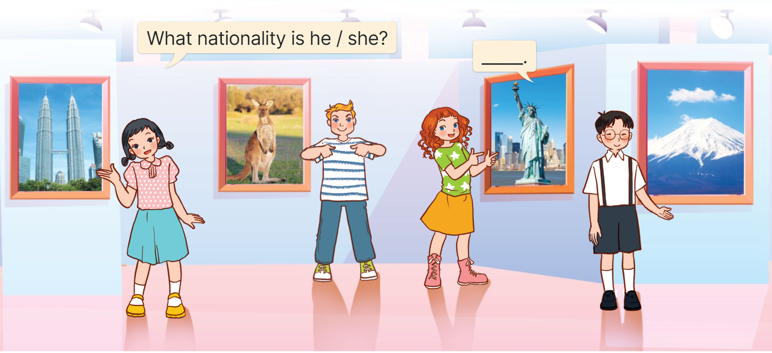

Let’s talk
What nationality is she?
She is Malaysian.

Slide 31
Let’s talk
What nationality is he?
He is Australian.

Slide 32
Let’s talk
What nationality is she?
She is American.

Slide 33
Let’s talk
What nationality is he?
He is Japanese.

Slide 34
2
Fun corner and wrap-up

Slide 35







Slide 36









What nationality is he?
He is ______.
Malaysian
Australian
Japanese

Slide 37
What nationality is she?
She is ______.
Malaysian
American
Australian

Slide 38
What nationality is she?
She is ______.
Japanese
Malaysian
American

Slide 39
What nationality is she?
She is ______.
Australian
American
Japanese

Slide 40
_______ is he?
He is Japanese.
What nationality
Where
What

Slide 41
____ is she from?
She is from Vietnam.
What
where
What nationality

Slide 42

GOOD JOB!

Slide 43





Review
What nationality is he/she?
He/she is ___________.
Australian
Japanese
Malaysian
American

Slide 44


Thank you
For joining!

