Slide 1


Welcome to our class
Lang Phong primary and secondary school
Teacher: Le Thi Thuy Hang
Class: 5B

Slide 2
Game: Guessing game

Slide 3
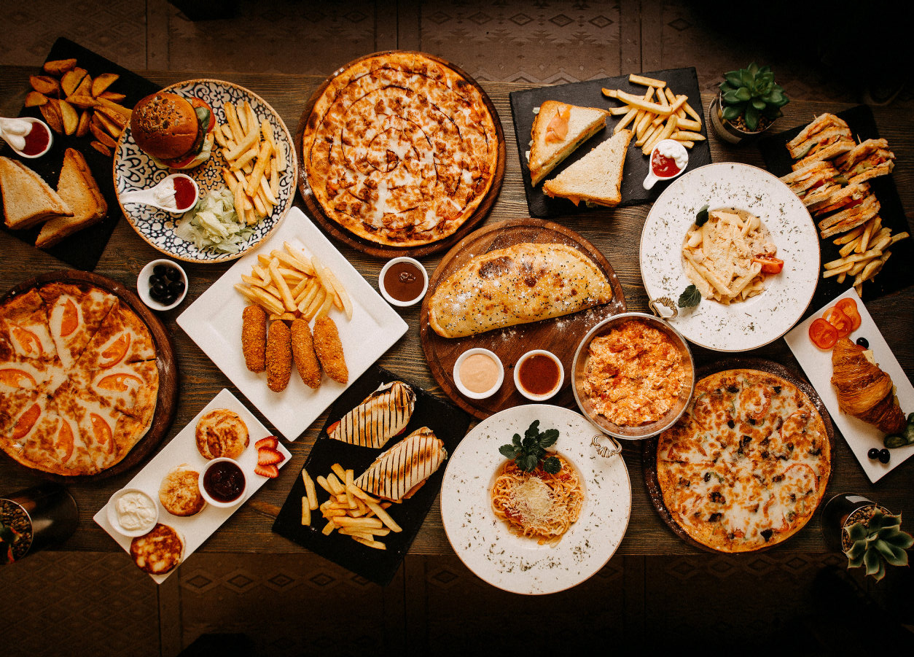

1
2
3
4
5
6
7
8
9
10
11
12
13
14
15
16
17
18
19
20
21
22
23
24

Slide 5
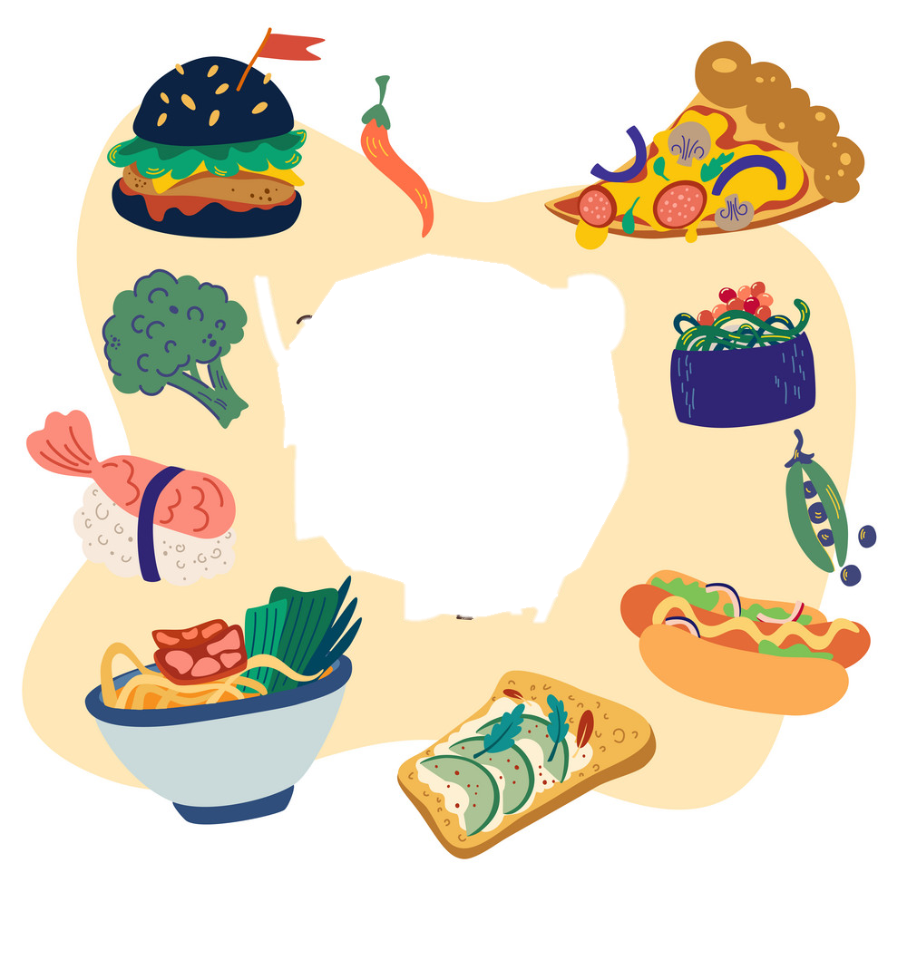



Unit 6
FOOD
Lesson 2 – Part 1, 2, 3

Slide 6
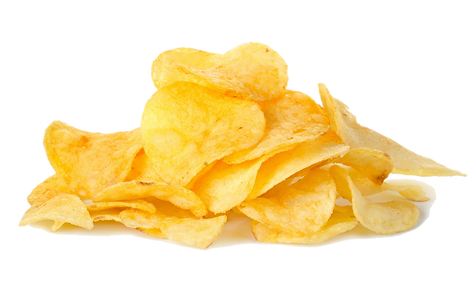

crispy
/ˈkrɪspi/

Slide 7
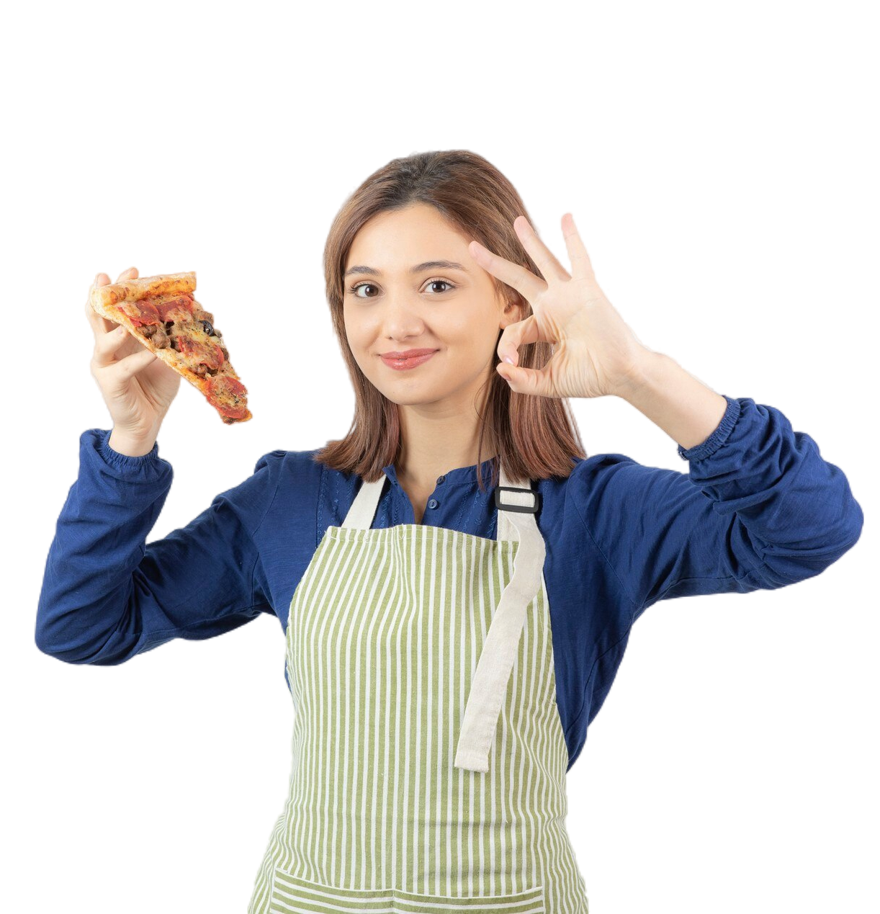
delicious
/dɪˈlɪʃəs/

Slide 8
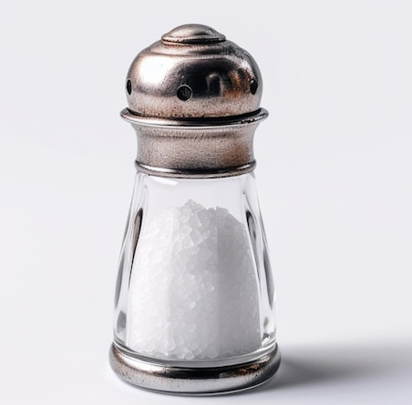
salty
salt
/ˈsɔːlti/

Slide 9
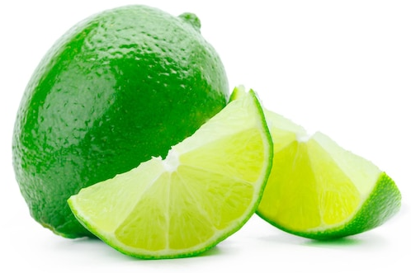
sour
/ˈsaʊə(r)/

Slide 10
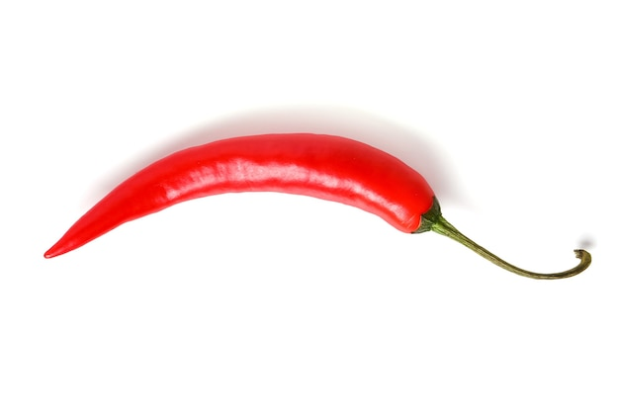
spicy
/ˈspaɪsi/

Slide 11
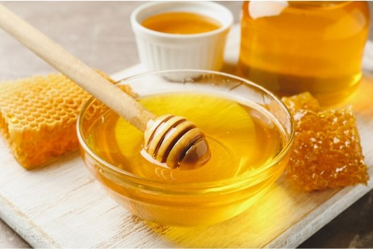
sweet
/swiːt/

Slide 12
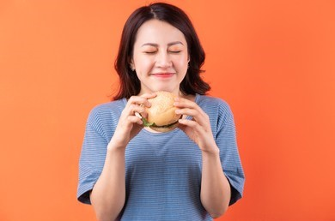
tasty
/ˈteɪsti/

Slide 13
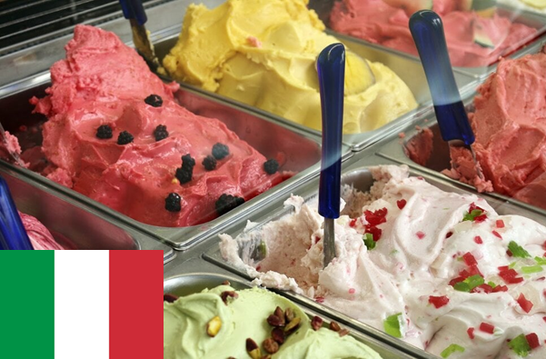
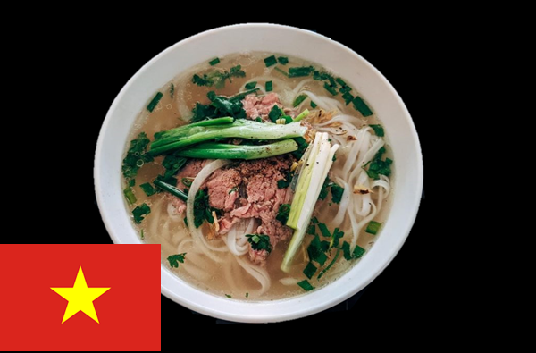
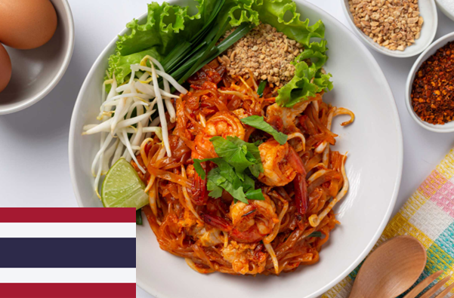
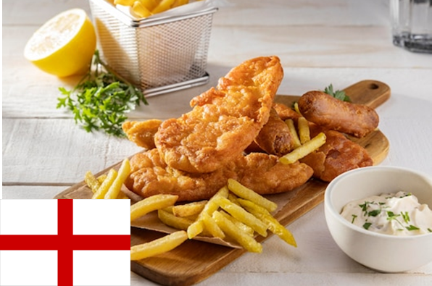

Listen.

Slide 14
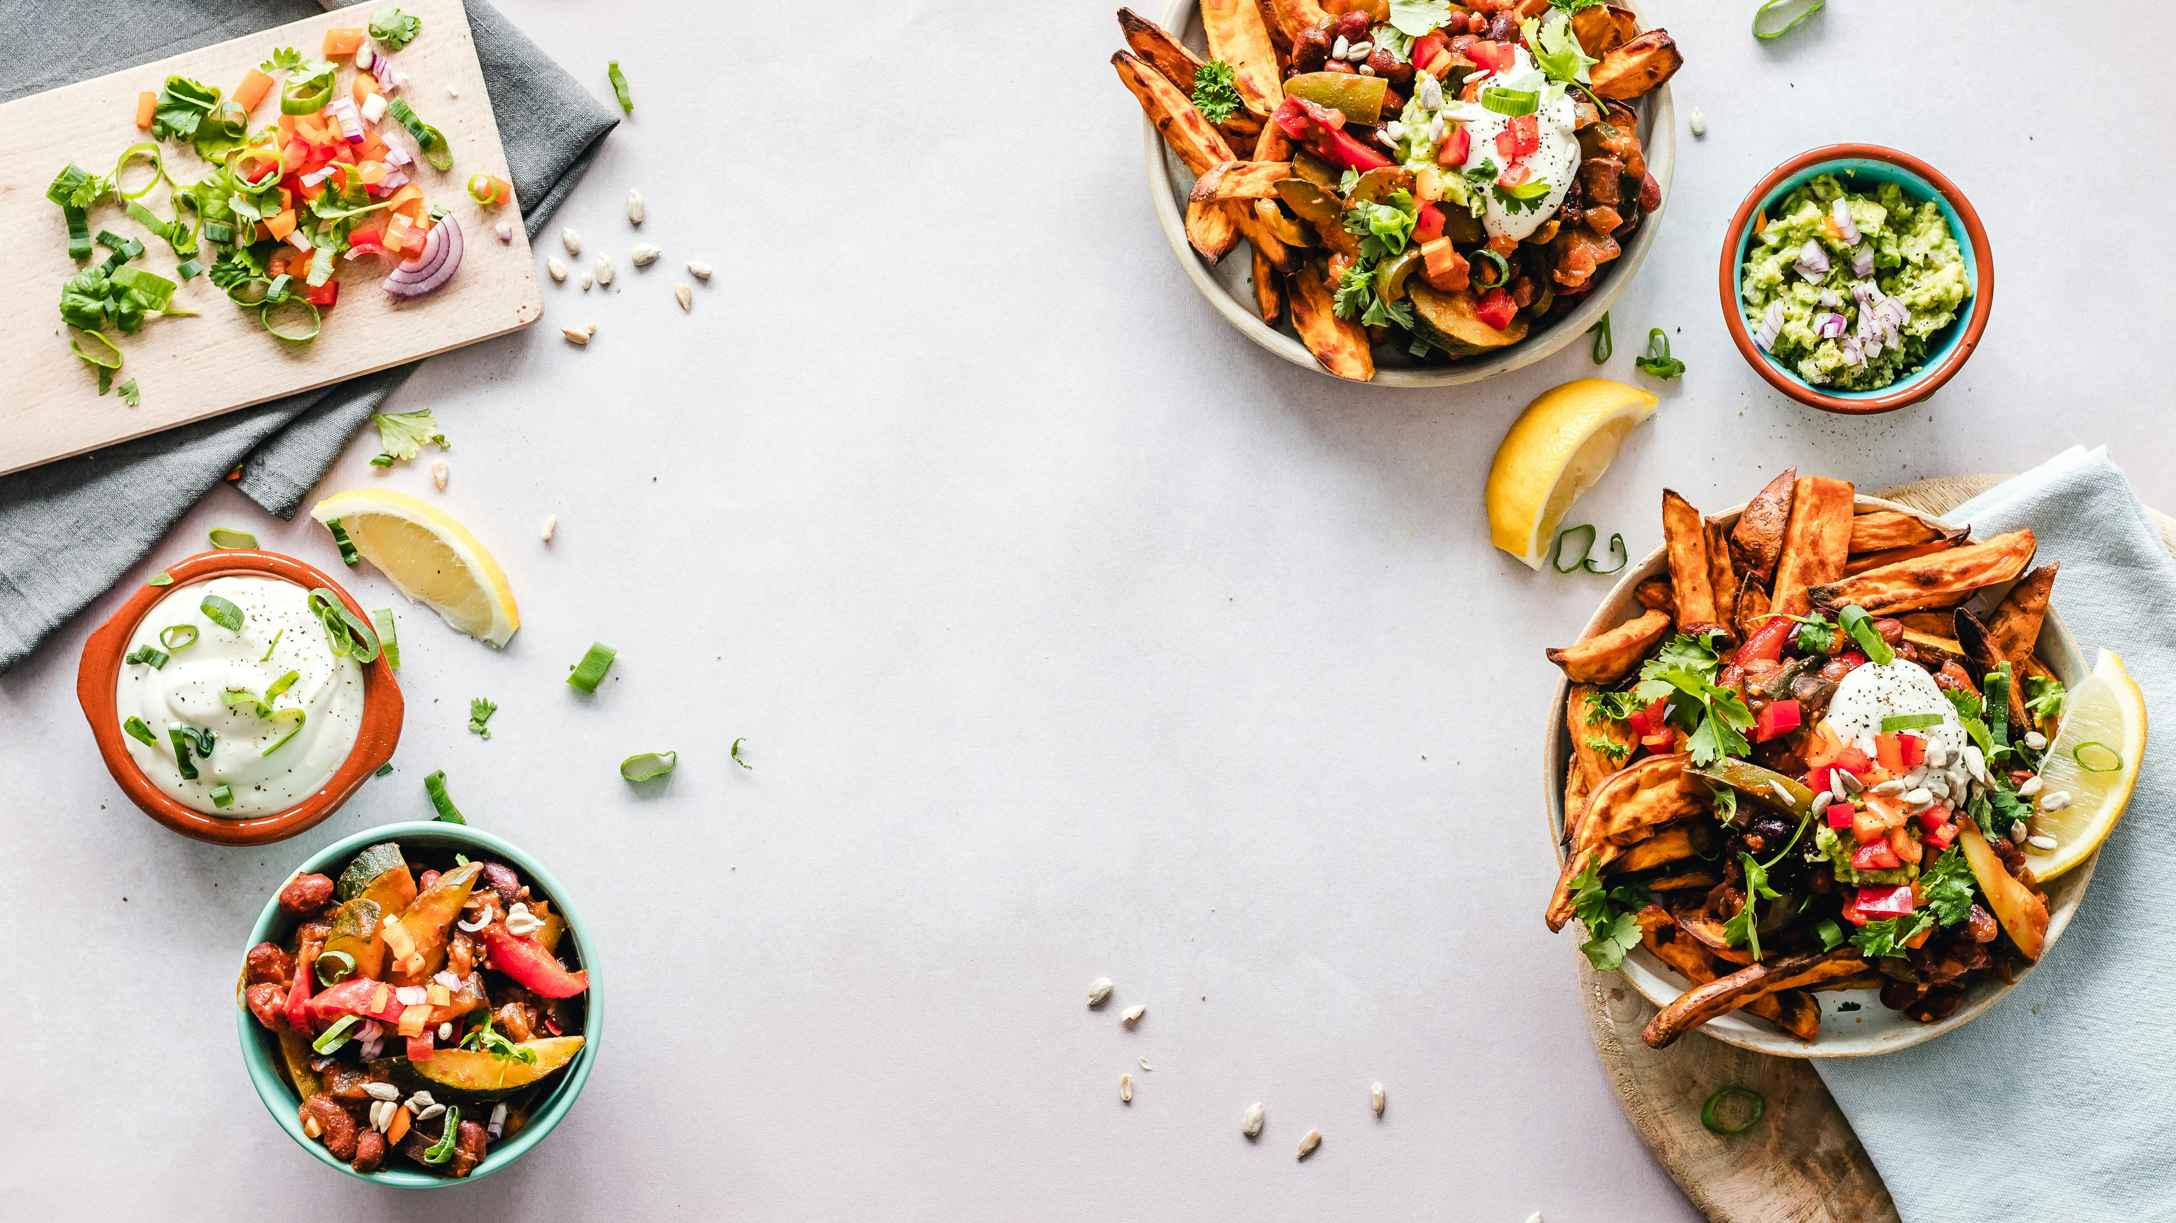
Listen and read.
Hi, I’m Elio. I’m from Italy. My favourite food is gelato. Gelato is an Italian ice cream.
Hello, I’m Mai. I’m from Vietnam. My favourite food is pho because it’s delicious.
My favourite flavour is chocolate. I love sweet things. But you can only have a few sweet things. They aren’t good for you.
It has noodles, a little beef and a lot of tasty herbs. I often eat pho in winter because it makes me feel warm.
I’m Mali. I’m from Thailand. I really like pad thai! It’s a delicious dish with noodles, shrimp,
I’m John. I’m from England. I love fish and chips. The fish is crispy, and the chips are so
tofu and a lot of peanuts. It tastes spicy, sweet and sour, too.
delicious. I often add a little lemon juice to make it tasty. Yum!

Slide 15
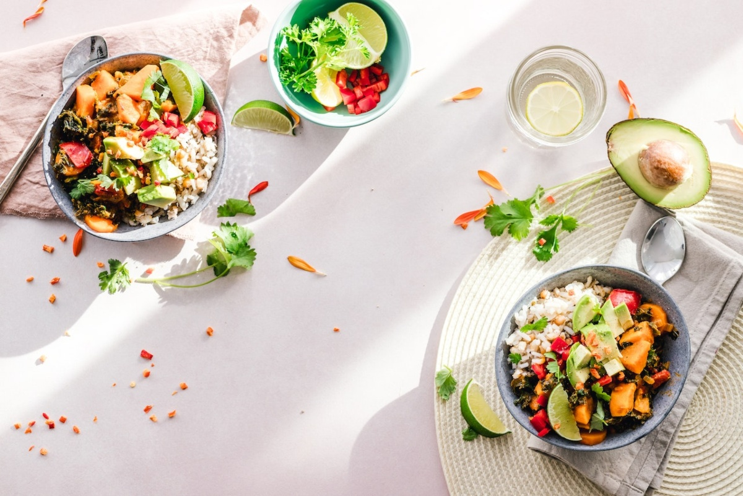




1 Listen and read. Then fill in the table.
 | Elio | Mai | Mali | John
Country
Favourite food
Taste of the food
Italy
Vietnam
Thailand
England
Gelato
Pho
Pad Thai
Fish and chips
Spicy, sweet and sour
Crispy and delicious
Sweet
Delicious

Slide 16
Write
What is your favourite food?
- My favourite food is __________.
- It has ____________________.
- It tastes __________________.

Slide 17
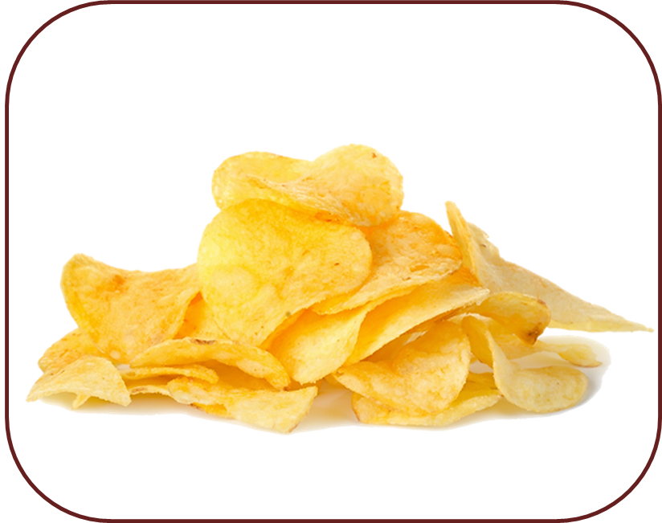
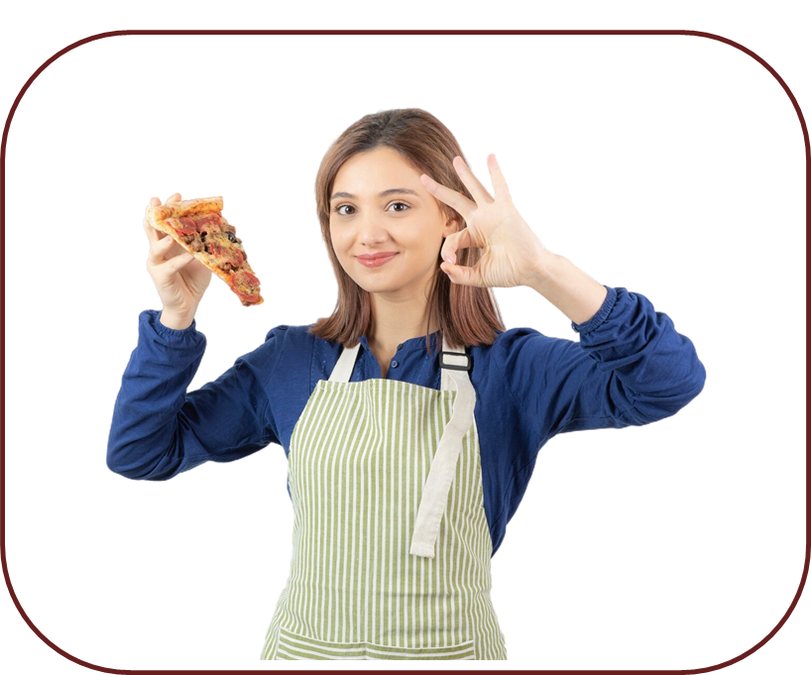
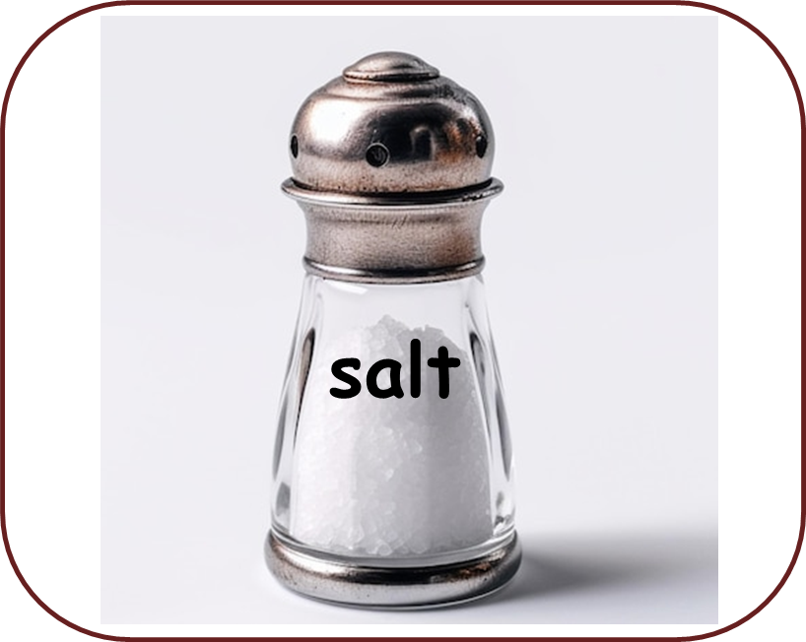
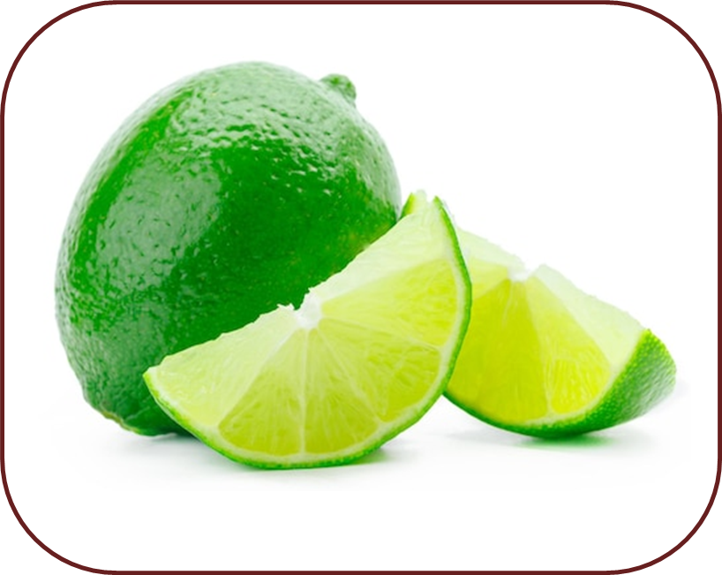
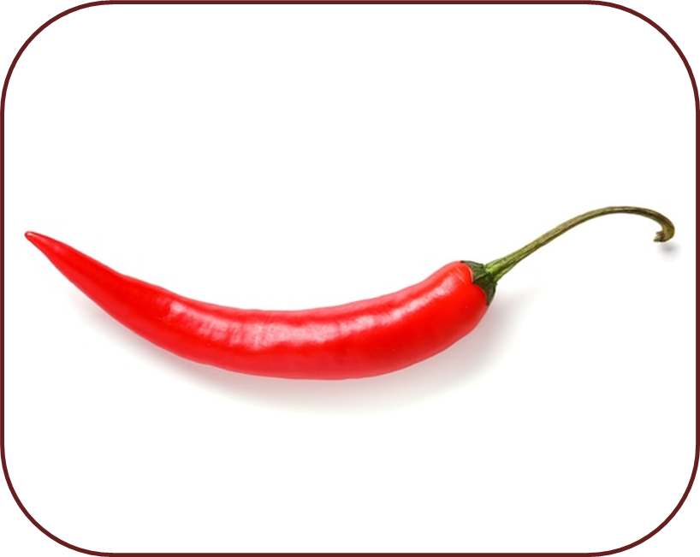
Look and match.
sour
crispy
spicy
sweet
delicious
tasty
salty

Slide 18


Unit 6: Food
Lesson 2 – Part 1,2,3
What have we learnt today?
Vocabulary:
crispy, delicious, sour, sweet, salty, tasty, spicy
Structure:
What is your favourite food?
- My favourite food is __________.
- It has ____________________.
- It tastes __________________.

Slide 19



Thank you
& goodbye!

