Slide 1
UNIT 9: FESTIVALS AROUND THE WORLD
Lesson 5: Skills 1

Slide 2
Unit
9
FESTIVALS AROUND THE WORLD
LESSON 5: SKILLS 1
Unit
HOBBIES

Slide 3
Lesson 5: Skills 1
WARM-UP
Game: Who is faster?
Notes:
Teacher divides the class into 2 teams.
Give each team a set of paper including names of festivals, their symbols and meanings.
Each team has to run in a relay to the board to stick the correct types of festivals and their symbols and meaning under the posters.
The team with more correct answers will be the winner.

Slide 4
Who is faster?
Mid-Autumn Festival
It is the symbol of a new life because it has a lot of babies.

Slide 5
Who is faster?
Halloween
It is the symbol of bad luck.

Slide 6
Who is faster?
Cannes Film Festival
It is the symbol of the winner’s prize.

Slide 7
Who is faster?
Easter
It is the symbol of the moon, prosperity and family reunion.

Slide 8
PRE-READING
1
Work in pairs. Look at the pictures. Which events do you think happen at the Twins Day Festival?

Slide 9
1
Now quickly read the email below and check your answers.

Slide 10
VOCABULARY TEACH
2
Match each word from the email in 1 with its meaning.
1. gathering | a. two children born to the same mother at the same time
2. featured | b. meeting
3. twins | c. the act of entertaining other people by singing, dancing, and playing music, etc.
4. performance | d. showed something as the most important part
1 - b
2 - d
3 -a
4 - c

Slide 11
VOCABULARY CHECK
gathering
/ˈɡæð.ər.ɪŋ/
cuộc hội họp

Slide 12
VOCABULARY CHECK
twin
/twɪn/
song sinh

Slide 13
VOCABULARY CHECK
feature
/ˈfiː.tʃər/
trình diễn đặc biệt

Slide 14
VOCABULARY CHECK
performance
/pəˈfɔː.məns/
màn biểu diễn

Slide 15
WHILE-READING
3
Read the email again. Complete each sentence with no more than TWO words.
People hold the festival in Twinsburg on the ____________ every August.
There are twins from many ____________.
In the Double Take Parade, twins in uniforms _____________.
Mark enjoyed the ____________ by the Korean twins the most.
Mark and his twin sister ran in the ____________.
In his opinion, the festival was very ____________.

Slide 16
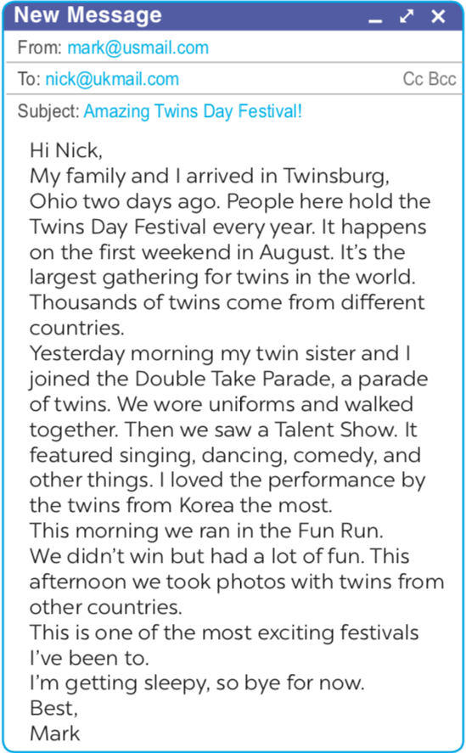
Activity 3:
3
Read the email again. Complete each sentence with no more than TWO words.
1. People hold the festival in Twinsburg on the _______ every August.
2. There are twins from many _______.
3. In the Double Take Parade, twins in uniforms _______.
4. Mark enjoyed the _______ by the Korean twins the most.
5. Mark and his twin sister ran in the _______.
6. In his opinion, the festival was very _______.
first weekend
countries
walked together
performance
Fun Run
exciting

Slide 17
PRE-SPEAKING
4
Match the questions and answers about a festival someone joined.
1
1. What festival did you join? | a. Yes, very much because there was a lot to do.
2. Where and when did you join it? | b. I joined the festival in Phu Yen last March.
3. Why do people celebrate it? | c. I watched people play drums, sing traditional songs, and dance. I also played traditional games with the children there.
4. What did you do there? | d. I joined the Hoi Mua Festival.
5. Did you like the festival? Why or why not? | e. They celebrate it to thank the Rice God and pray for a better new crop.
1 - d
2 - b
3 - e
4 - c
5 - a

Slide 18
4.Match the questions and answers about a festival someone joined .
1. What festival did you join?
d. I joined the Hoi Mua Festival
2. Where and when did you join it?
b. I joined the festival in Phu Yen last March
3. Why do people celebrate it?
e. They celebrate it to thank the Rice God and pray for a better new crop.
4. What did you do there?
c. I watched people play drums, sing traditional songs, and dance. I also played traditional games with the children there.
5. Did you like the festival? Why or why not?
a. Yes, very much because there was a lot to do.

Slide 19
WHILE-SPEAKING
5
Work in pairs. Ask and answer about a festival you and your friend joined, using the questions in 4 as cues. Tell the class about the festival your partner joined.
1

Slide 20
CONSOLIDATION
1
WRAP UP
In this lesson, we have learnt to
read skill for specific information about an unusual festival
talk about a festival you enjoy

Slide 21
CONSOLIDATION
2
HOMEWORK
Video your presentation about a festival you enjoy
Prepare for the next lesson: Skills 2

