Slide 1
UNIT 5 : OUR CUSTOMS AND TRADITIONS
Lesson 6: Skills 2

Slide 2
Unit
5
OUR CUSTOMS AND TRADITIONS
Unit
ETHNIC GROUPS OF VIET NAM
LESSON 6: SKILLS 2
LESSON 3: A CLOSER LOOK 2
Unit
HOBBIES
LISTENING
WRITING

Slide 3
WARM-UP
LUNAR NEW YEAR / TET HOLIDAY

Slide 4
WARM-UP
FULL MOON FESTIVAL / MID-AUTUMN FESTIVAL

Slide 5
WARM-UP
HUNG KING TEMPLE FESTIVAL

Slide 6
WARM-UP
BUDDHA’S BIRTHDAY

Slide 7
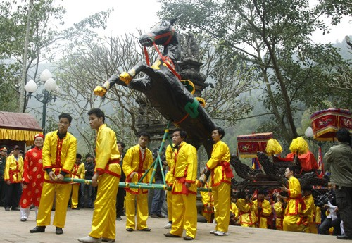
WARM-UP
GIONG FESTIVAL

Slide 8
WARM-UP
OK OM BOK FESTIVAL

Slide 9
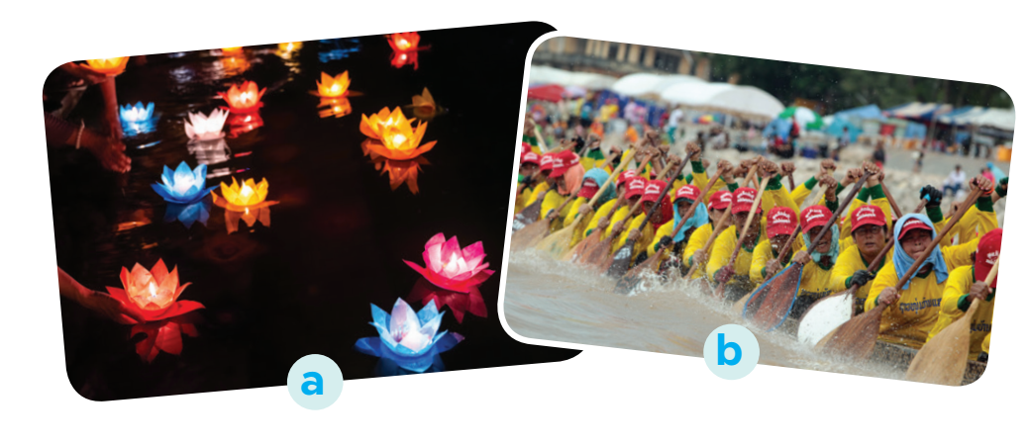
LISTENING
1
Work in pairs. Look at the picture and answer the following questions.
1. What can you see in the photos?
2. In which part of Viet Nam might the festival occur?

Slide 10
LISTENING
2
Listen to part of the programme “Charming Viet Nam”. Fill in each blank with no more than TWO words.
Ok Om Bok Festival
Purposes | - to thank the Moon God - to mark the (1) ______ of the Khmer year
Time | mid-October (lunar calendar)
Offerings | (2) ___________ and fruits
Activities | - singing and dancing - games and traditional (3) ______________ - Ngo Boat (4) ______
end
young rice
fashion shows
Race

Slide 11
LISTENING
3
Listen again and tick T (True) or F (False).
 | T | F
1. Ok Om Bok is the Moon Worshipping Festival.
2. On the night of the festival, the elders talk about their wishes.
3. There are lantern contests at the festival.
4. Tourists should wear informal clothes when attending the worshipping ceremony.

Slide 12
WRITING
4
Work in groups. Read the following pieces of advice for tourists at the Ok Om Bok Festival. Put them in the correct column.
a. dress up for the Moon God oﬀerring ceremony
Dos | Don’ts
a | f
a. dress up for the Moon God oﬀerring ceremony
b
e
d
c
a. dress up for the Moon God oﬀerring ceremony
a. dress up for the Moon God oﬀerring ceremony
a. dress up for the Moon God oﬀerring ceremony
a. dress up for the Moon God oﬀerring ceremony

Slide 13
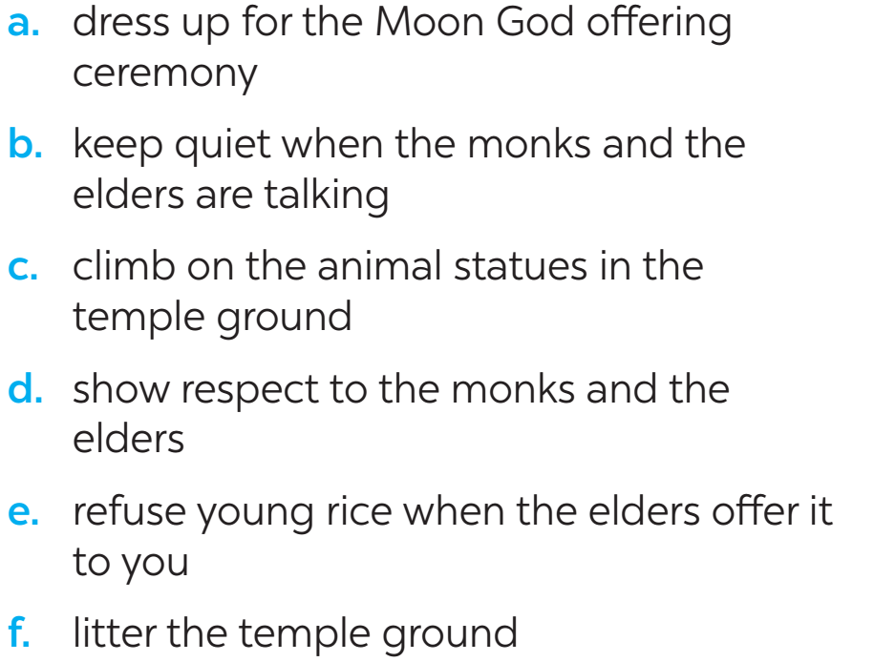
WRITING
4
Work in groups. Read the following pieces of advice for tourists at the Ok Om Bok Festival. Put them in the correct column.
Dos | Don’ts
a | f
b
c
d
e

Slide 14
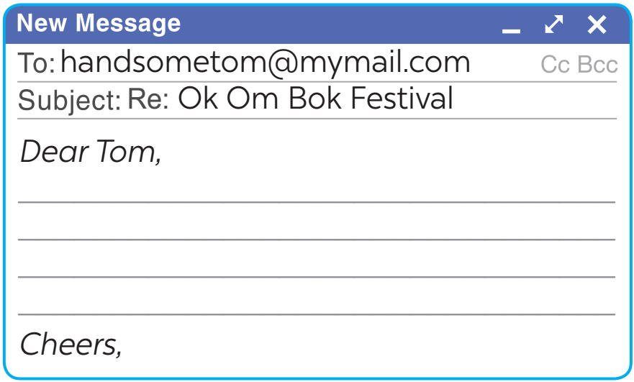
WRITING
5
Tom sent you an email. Read part of his email below.
“… Guess what! My dad is taking me with him to Soc Trang Province. We will be there during the Ok Om Bok Festival. What are some dos and don’ts at this festival? ...”
Write an email (80 - 100 words) to advise Tom about participating in the Ok Om Bok Festival.

Slide 15
Dear Tom,
Glad to hear you are coming to Soc Trang. You can’t miss the Ok Om Bok Festival. Here are a few things for you to remember when joining the festival.
First, you should wear polite clothes when attending the Moon God offering ceremony.Always show respect to monks and elderly people. Remember to keep quiet when the monks and the elders are talking.
Besides, there are many animal statues in the temple ground. Don’t climb on them. The young rice represents the hope for luck in the new year. Don’t refuse when the elders give you some.Send me an email if you need more information.

Slide 16
CONSOLIDATION
1
Wrap-up
In this lesson, we have learnt to:
listen about a festival;
write an email to give advice on participating in a traditional festival.

Slide 17
CONSOLIDATION
2
Homework
Rewrite the passage on the notebook.
Prepare for Lesson 7 – Looking back & project.

