Slide 1

Unit 4: My neighbourhood
Period 29 - Lesson 4: Communication (p.43)

Slide 2








Everyday English
An audio guide to a place
Asking for and giving directions
Listen and read the conversations.
Nick is listening to an audio guide to Hoi An. Listen and fill the blanks.
Work in pairs. Make similar conversations to ask for and give directions to places near your school.
Look at the map below and create an audio guide for District 1 of Ho Chi Minh City.
Now present your audio guide to your class.

Slide 3
Unit 4: My neighbourhood
Period 29 - Lesson 4: Communication (p.43)
I. Pre - speaking:

Slide 4

Vocabulary:
1. direction (n)
: phương hướng, sự chỉ dẫn
2. audio guide (phr)
: thuyết minh tự động
3. workshop (n)
: xưởng
4 . present (n)
: món quà
5. culture (n)
: văn hóa
6. go along (v)
: đi dọc theo

Slide 5
Unit 4: My neighbourhood
Period 29 - Lesson 4: Communication (p.43)
A. Pre - speaking:
I. Vocabulary:
direction (n) : phương hướng, sự chỉ dẫn
audio guide (phr) : thuyết minh tự động
workshop (n) : xưởng
present (n) : món quà
culture (n) : văn hóa
go along (phr v) : đi dọc theo
II. Everyday English:

Slide 6

Listen and read the conversations.
A: Excuse me. Could you tell me the way to the cinema,
please?
B: Go along this street. It’s on your left.
=> Could you tell me the way to .............(nơi chốn), please?
(Làm ơn chỉ cho tôi đường đến .......?)
A: Excuse me. Where’s the nearest post office, please?
B: Go out of the station. Take the first turning on the right.
=> Where’s the nearest .............(nơi chốn), please?
(Xin hỏi .......... gần nhất là ở đâu?)
Notes:
Slide này không đúng.

Slide 7
Friday, November 11th , 2023
Unit 4: My neighbourhood
Period 29 - Lesson 4: Communication (p.43)
A. Pre - speaking:
I. Vocabulary:
1. direction (n) : phương hướng, sự chỉ dẫn
2. audio guide (phr) : thuyết minh tự động
3. workshop (n) : xưởng
4. present (n) : món quà
5. culture (n) : văn hóa
6. go along (phr v) : đi dọc theo
II. Everyday English: Asking for and giving directions
1. Could you tell me the way to .............(nơi chốn), please?
(Làm ơn chỉ cho tôi đường đến .......?)
2. Where’s the nearest .............(nơi chốn), please?
    (Xin hỏi .......... gần nhất là ở đâu?)

Slide 8

Friday, November 11th , 2023
Unit 4: My neighbourhood
Period 29 - Lesson 4: Communication (p.43)
A. Pre - speaking:
I. Vocabulary:
1. direction (n) : phương hướng, sự chỉ dẫn
2. audio guide (phr) : thuyết minh tự động
3. workshop (n) : xưởng
4. present (n) : món quà
5. culture (n) : văn hóa
6. go along (phr v) : đi dọc theo
II. Everyday English: Asking for and giving directions
1. Could you tell me the way to .............(nơi chốn), please?
(Làm ơn chỉ cho tôi đường đến .......?)
2. Where’s the nearest .............(nơi chốn), please?
    (Xin hỏi .......... gần nhất là ở đâu?)
B. While - speaking:
I. Work in pairs.
Make similar conversations to ask for and give directions to places near your school.

Slide 9
PAIR WORK

Slide 10
Friday, November 11th , 2023
Unit 4: My neighbourhood
Period 29 - Lesson 4: Communication (p.43)
A. Pre - speaking:
I. Vocabulary:
1. direction (n) : phương hướng, sự chỉ dẫn
2. audio guide (phr) : thuyết minh tự động
3. workshop (n) : xưởng
4. present (n) : món quà
5. culture (n) : văn hóa
6. go along (phr v) : đi dọc theo
II. Everyday English: Asking for and giving directions
1. Could you tell me the way to .............(nơi chốn), please?
(Làm ơn chỉ cho tôi đường đến .......?)
2. Where’s the nearest .............(nơi chốn), please?
    (Xin hỏi .......... gần nhất là ở đâu?)
B. While - speaking:
I. Work in pairs.
II. Listening.
Nick is listening to an audio guide to Hoi An. Listen and fill the blanks.

Slide 11

Nick is listening to an audio guide to Hoi An. Listen and fill the blanks.
Let’s start our tour in Hoi An. We are in Tran Phu Street now. First, go to Ong Pagoda. To get there, go (1) along the street for five minutes. It’s on your left. Next, go to the Museum of Sa Huynh Culture. Take the (2) turning on your left. Turn (3) and it’s on your right. Finally, go to Hoa Nhap Workshop to buy some presents. Turn left and then right. It’s (4) Tan Ky House.
straight
second
right
next to
Notes:
City landmarks phải ở trên mục 3

Slide 12

Friday, November 11th , 2023
Unit 4: My neighbourhood
Period 29 - Lesson 4: Communication (p.43)
A. Pre - speaking:
C. Post - speaking:
I. Vocabulary:
1. direction (n) : phương hướng, sự chỉ dẫn
2. audio guide (phr) : thuyết minh tự động
3. workshop (n) : xưởng
4. present (n) : món quà
5. culture (n) : văn hóa
6. go along (phr v) : đi dọc theo
I. Work in group.
II. Everyday English: Asking for and giving directions
1. Could you tell me the way to .......(nơi chốn), please?
(Làm ơn chỉ cho tôi đường đến .......?)
2. Where’s the nearest .........(nơi chốn), please?
    (Xin hỏi .......... gần nhất là ở đâu?)
B. While - speaking:
I. Work in pairs.
II. Listening.
1. straight
2. second
3. right
4. next to

Slide 13
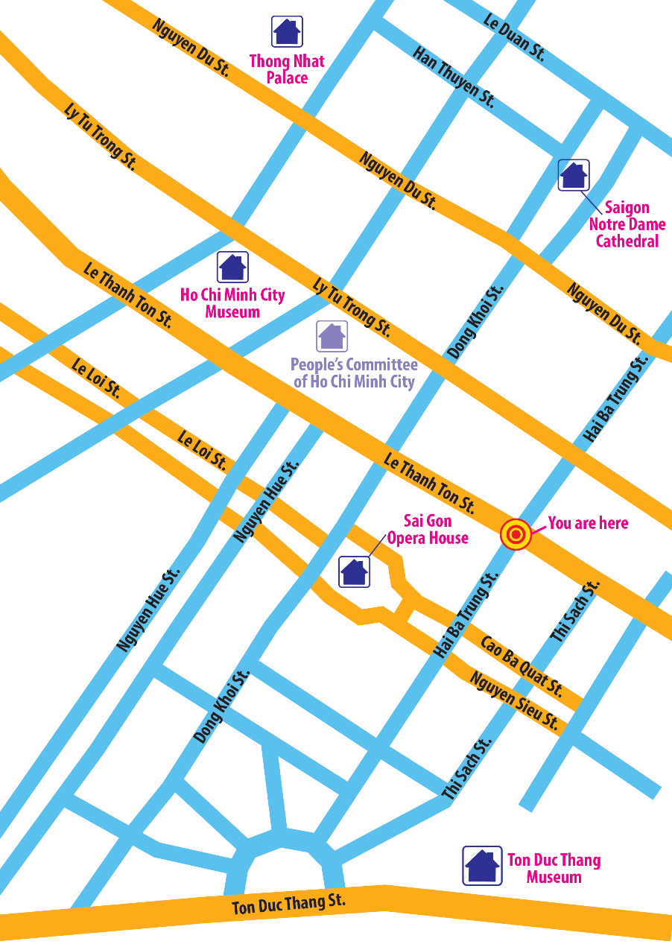
GROUP WORK
Let’s start our tour in Ho Chi Minh City. We are in Hai Ba Trung street now. First, go to……………… …………………………
Remember to:
give directions to at least three different places;
use first, then, after that and finally to link your directions.
Look at the map below and create an audio guide for District 1 of Ho Chi Minh City.

Slide 14
Friday, November 11th , 2023
Unit 4: My neighbourhood
Period 29 - Lesson 4: Communication (p.43)
A. Pre - speaking:
C. Post - speaking:
I. Vocabulary:
1. direction (n) : phương hướng, sự chỉ dẫn
2. audio guide (phr) : thuyết minh tự động
3. workshop (n) : xưởng
4. present (n) : món quà
5. culture (n) : văn hóa
6. go along (phr v) : đi dọc theo
I. Work in group.
II. Ss’ work.
II. Everyday English: Asking for and giving directions
1. Could you tell me the way to .......(nơi chốn), please?
(Làm ơn chỉ cho tôi đường đến .......?)
2. Where’s the nearest .........(nơi chốn), please?
    (Xin hỏi .......... gần nhất là ở đâu?)
B. While - speaking:
I. Work in pairs.
II. Listening.
1. straight
2. second
3. right
4. next to

Slide 15
STUDENTS’ PRESENTATION

Slide 16

Unit 4: My neighbourhood
Period 29 - Lesson 4: Communication (p.43)
A. Pre - speaking:
C. Post - speaking:
I. Vocabulary:
1. direction (n) : phương hướng, sự chỉ dẫn
2. audio guide (phr) : thuyết minh tự động
3. workshop (n) : xưởng
4. present (n) : món quà
5. culture (n) : văn hóa
6. go along (phr v) : đi dọc theo
I. Work in group.
II. Ss’ work.
D. Homework:
1. Make your own audio guide.
2. Do all exercises 1, 2, 3 in part C in WB p.29 - 30.
3. Prepare the new lesson: Lesson 5 - Skills 1.
II. Everyday English: Asking for and giving directions
1. Could you tell me the way to .......(nơi chốn), please?
(Làm ơn chỉ cho tôi đường đến .......?)
2. Where’s the nearest .........(nơi chốn), please?
    (Xin hỏi .......... gần nhất là ở đâu?)
B. While - speaking:
I. Work in pairs.
II. Listening.
1. straight
2. second
3. right
4. next to

Slide 17
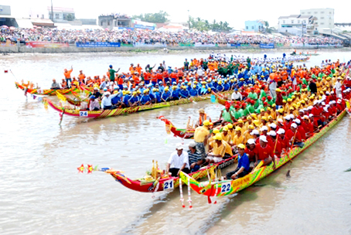

HAPPY TEACHER'S DAY

