Slide 1














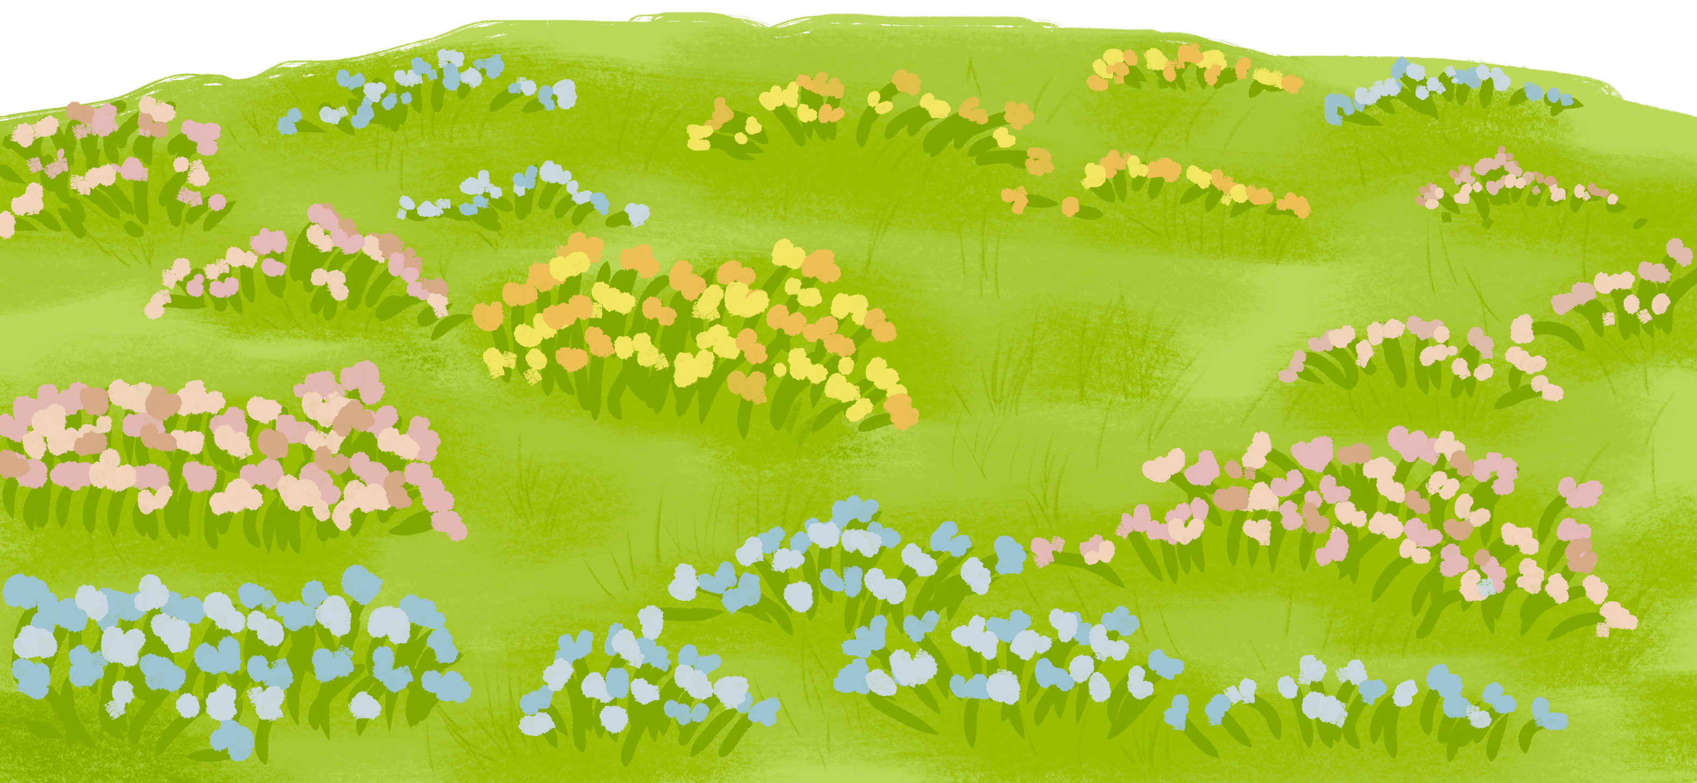

ENGLISH 6
WELCOME
TO OUR CLASS

Slide 2








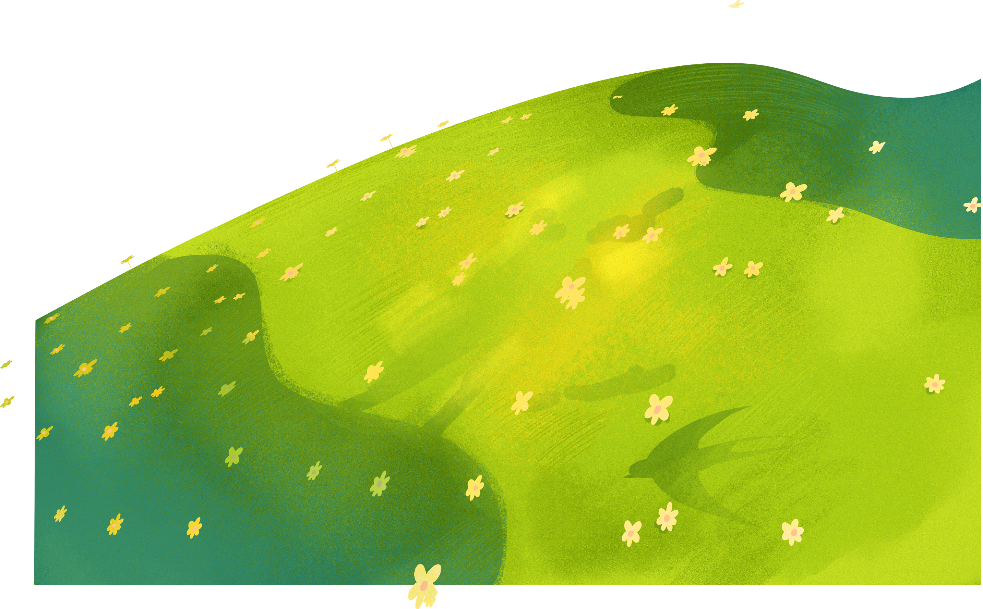


UNIT 4:
MY NEIGHBOURHOOD
LESSON 2: A CLOSER LOOK 1

Slide 3
WARM-UP
Rearrange the letters:
APCLES
PLACES
JUMBLE WORDS
Work in groups
Unscramble the words

Slide 4
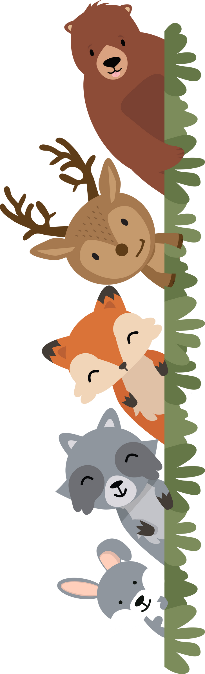
takmre
2. oslhoc
3. aiencm
4. knab
5. petmle
6. ooz
7. apkr
1. market
2. school
3. cinema
4. bank
5. temple
6. zoo
7. park

Slide 5


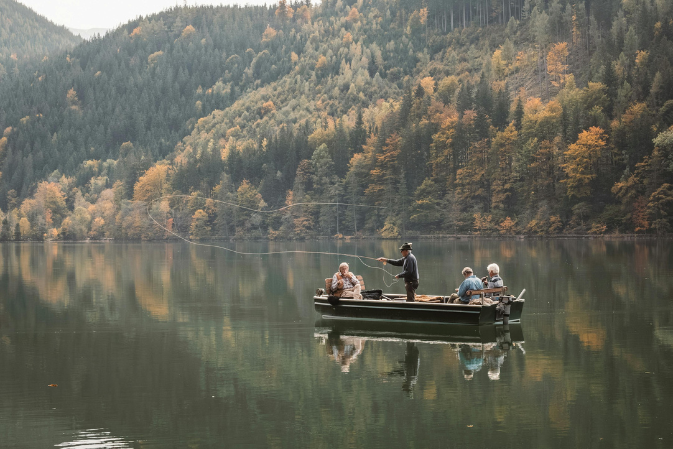
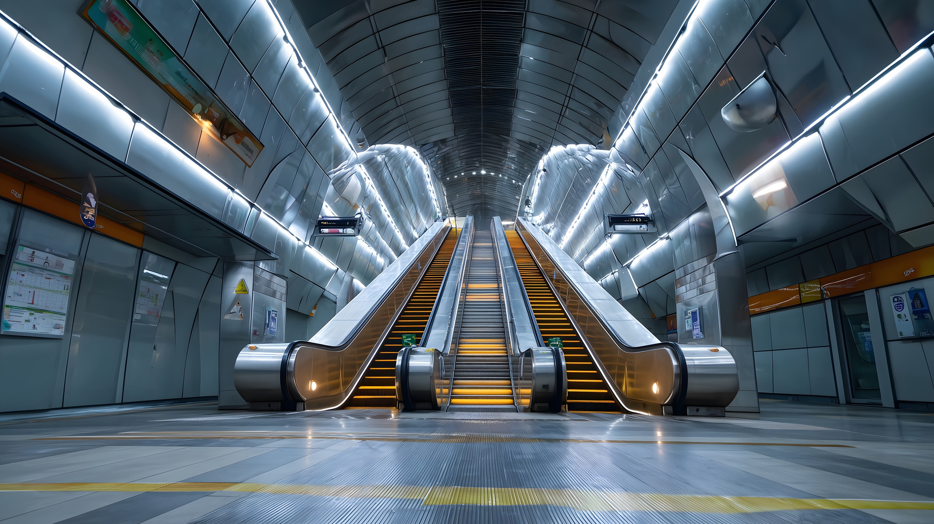
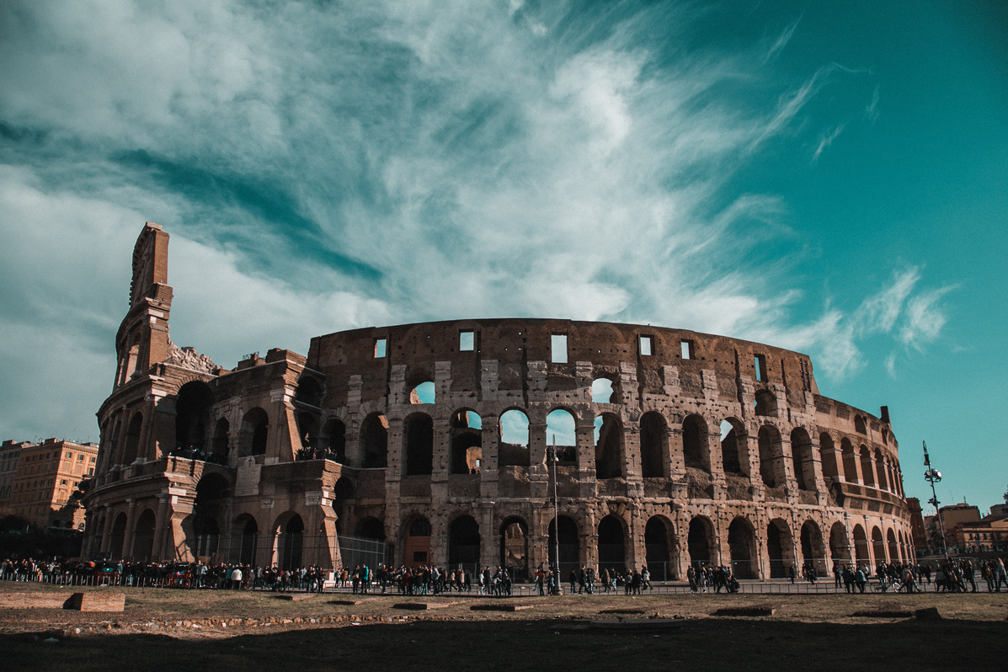
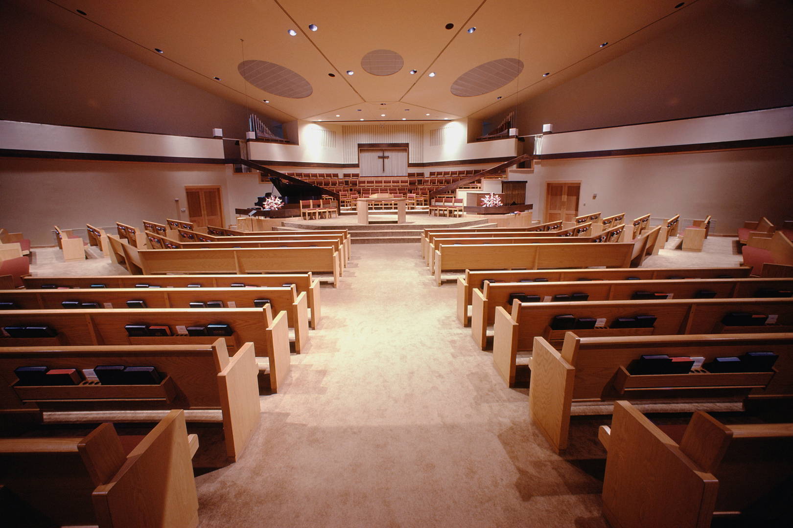
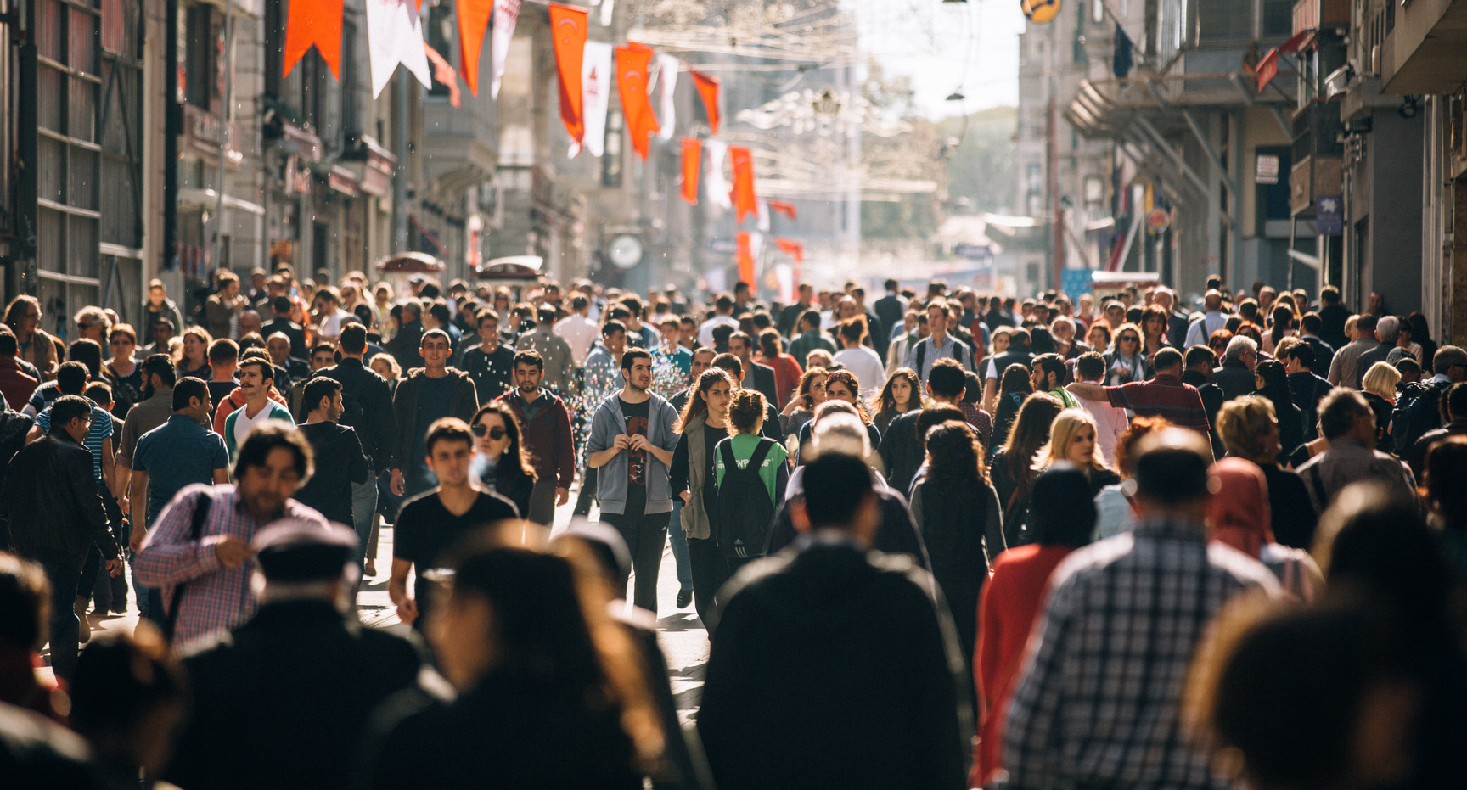
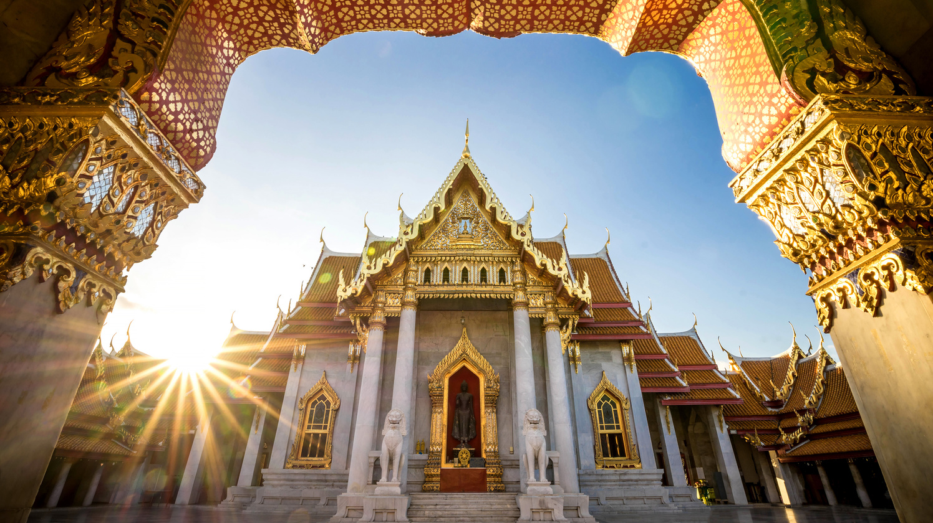
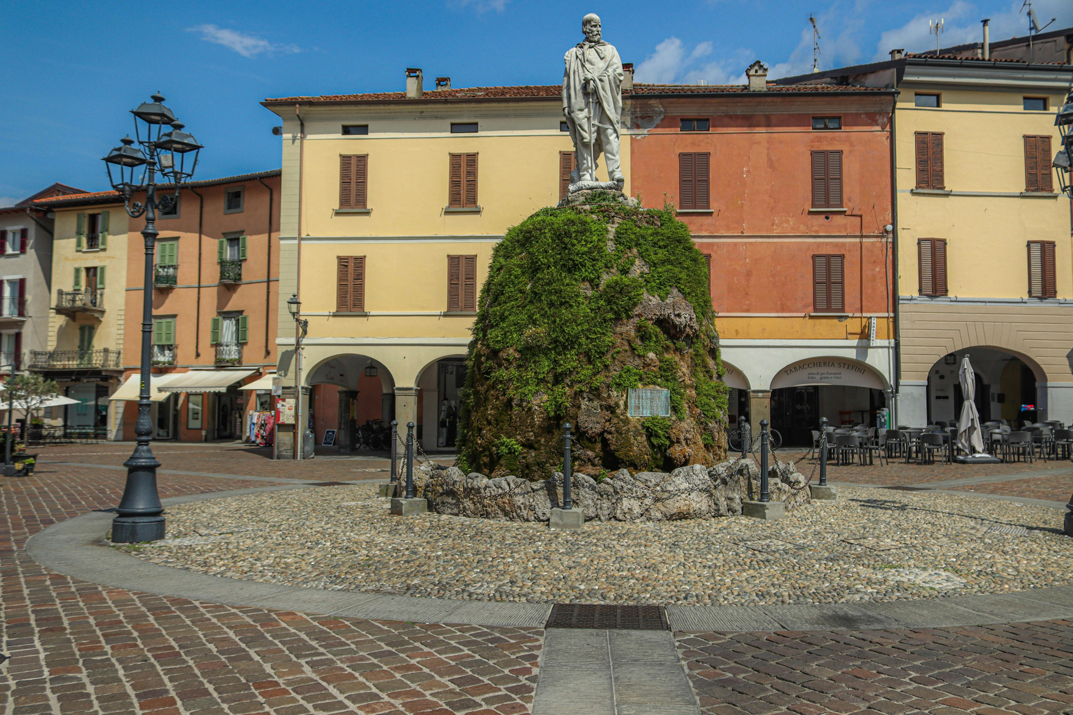
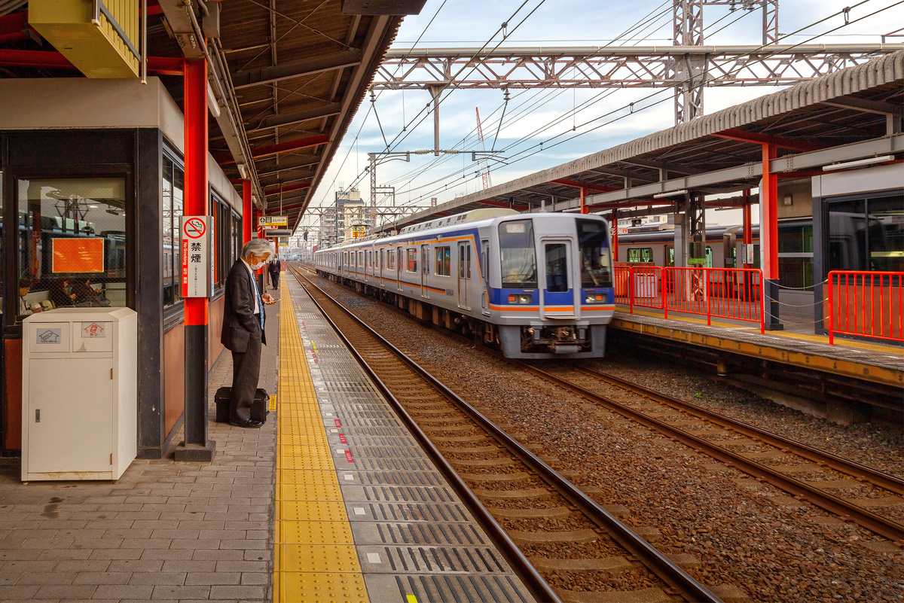
* Vocabulary
- square (n):
quảng trường
- cathedral (n):
thánh đường
- railway station (n):
nhà ga xe lửa
- temple (n):
ngôi đền
- crowded (adj):
đông đúc
- peaceful (adj)
= quiet
- modern (adj) ><
historic
- interesting(adj) ><
boring

Slide 6

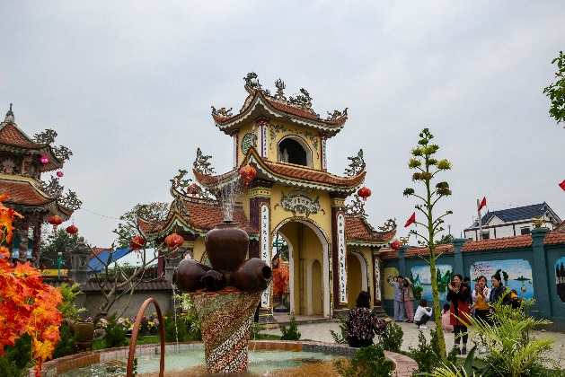
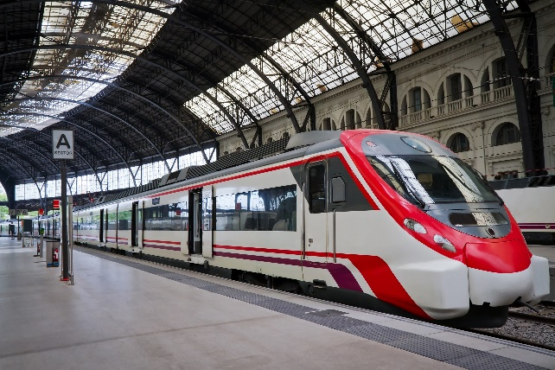
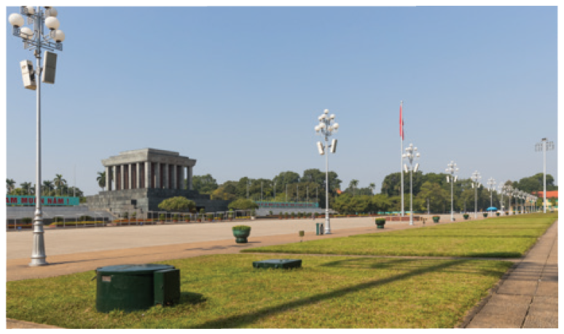
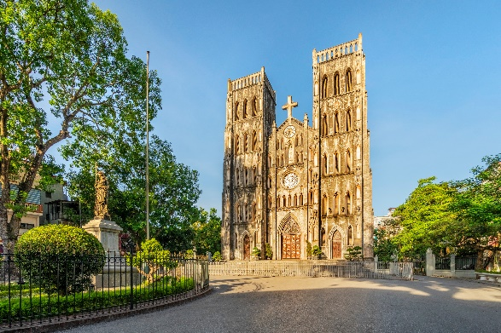
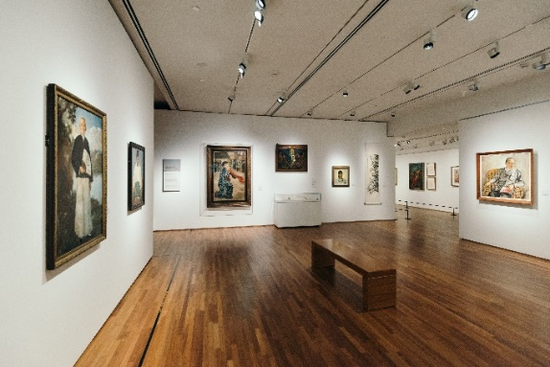
1. square
3. cathedral
4. temple
VOCABULARY
2. art gallery
5. railway station
1
Match the places below with the pictures. Then listen, check and repeat the words.
a
b
c
d
e

Slide 7
Name some other places in your neighbourhood.
VOCABULARY
market
bank
hospital
school
park
hotel

Slide 8
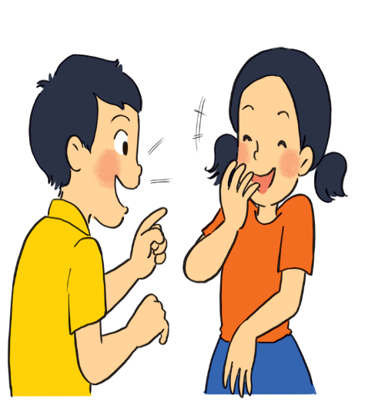
VOCABULARY
2
Work in pairs. Ask and answer questions about where you live.
Example:
A: Is there a square in your neighbourhood?
B: Yes, there is. / No, these isn’t.

Slide 9
VOCABULARY
3
Work in groups. Ask and answer about your neighbourhood. You can use the adjectives below.
noisy
busy
modern
peaceful
quiet
crowded
boring
beautiful
Example:
A: Is your neighbourhood quiet?
B: Yes, it is. / No, it’s noisy.

Slide 10
PRONUNCIATION
4
Listen and repeat the words. Pay attention to the sounds /ɪ/ and /i:/.
4
noisy
cheap
peaceful
expensive
noisy
cheap
peaceful
expensive
clean
exciting
friendly
convenient
clean
exciting
friendly
convenient
Now, in pairs put the words in the correct column.
/ɪ/ | /i:/
noisy
convenient
expensive
cheap
exciting
peaceful
friendly
clean

Slide 11
PRONUNCIATION
5
Listen and practise the chant. Notice the sounds /ɪ/ and /i:/.
MY NEIGHBOURHOOD
My city is very noisy.
There are lots of trees growing. The people here are busy.
It’s a lively place to live in.
My village is very pretty.
There are lots of places to see.
The people here are friendly.
It’s a fantastic place to be.
Notes:
Video link: https://www.youtube.com/watch?v=wA0m8Ixv7s4&list=PL8_ETpRL2xNbMMSCSok5UNHcQOpjKgvAn&index=4

Slide 12

EXTRA ACTIVITY
TOUNGE TWISTER
Let’s practise these following sentences.
1. He took a chilly dip six feet deep in the sea.
He says it keeps him fit.
2. He thinks he's slick in his sleek wheels meeting and greeting the elite.

Slide 13

CONSOLIDATION
1
Wrap-up
What have we learnt in this lesson?
Vocabulary of the unit
Identify the sounds /ɪ/ and /i:/

Slide 14

CONSOLIDATION
2
Homework
- Do exercises in the workbook.
- Find 5 more words with the sound /ɪ/ and 5 more words with the sound /i:/. Write them down and practise pronouncing the words.

Slide 15







THANK
YOU

