Slide 1



WELCOME TO CLASS
GIA PHUONG SECONDARY SCHOOL
Teacher: Nguyen Bich Thao

Slide 2
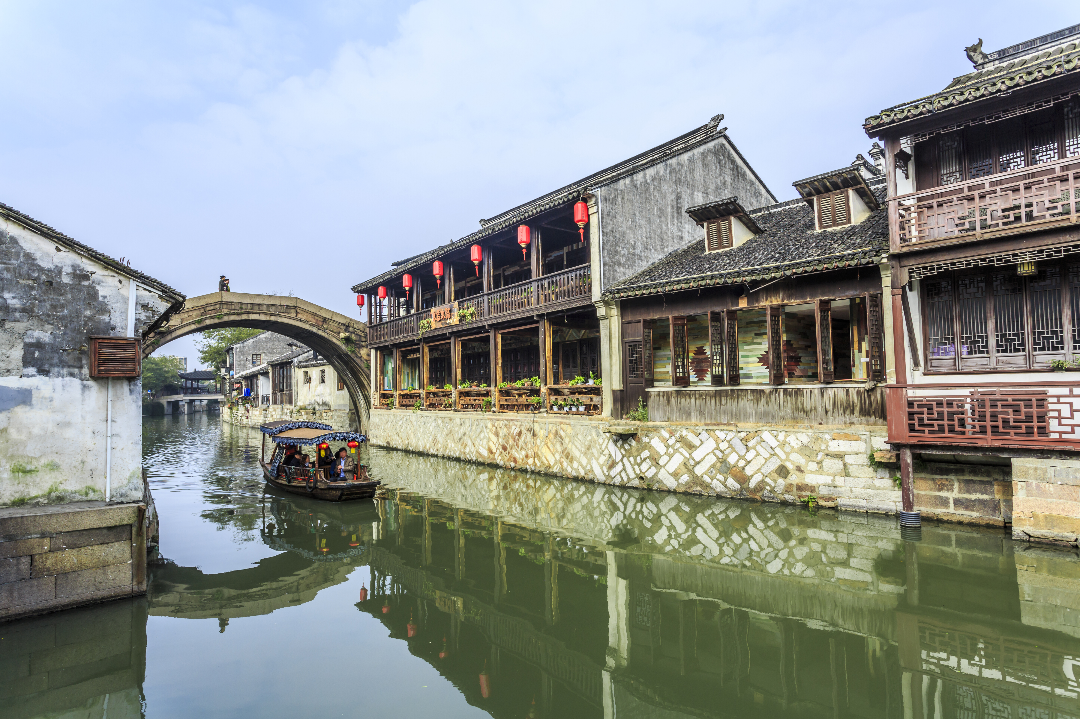


Unit
4
REMEMBERING THE PAST
LESSON 5: SKILLS 1

Slide 3
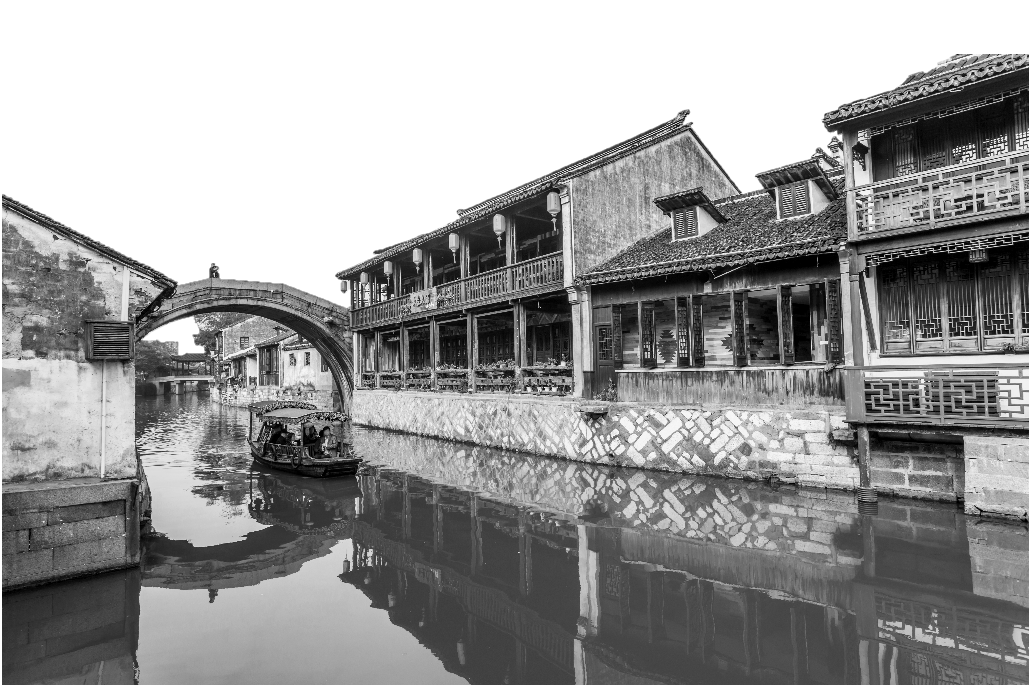
Unit
4
REMEMBERING THE PAST
LESSON 5: SKILLS 1

Slide 4
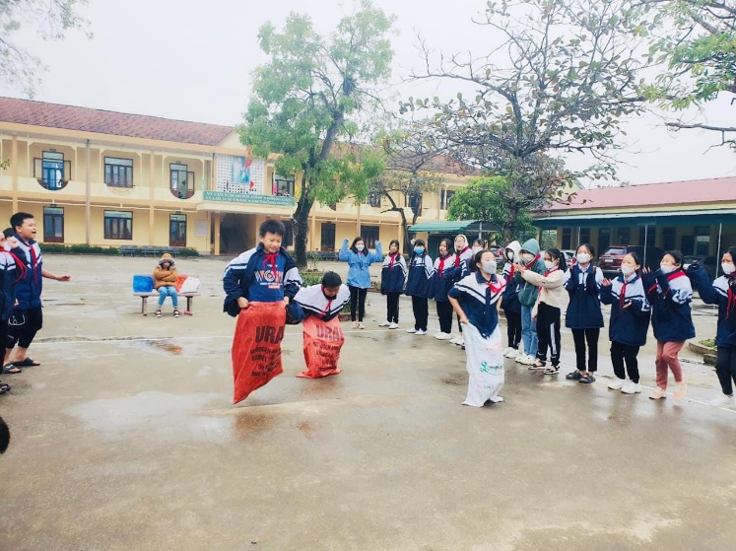
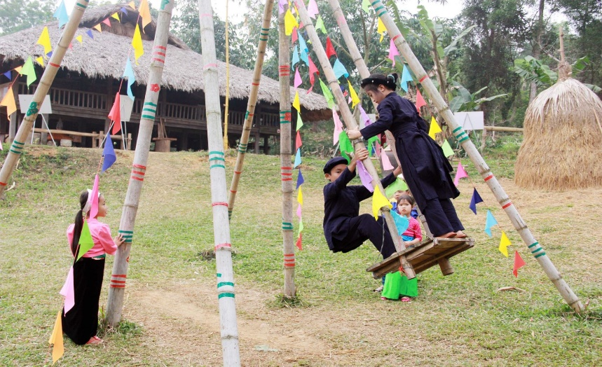
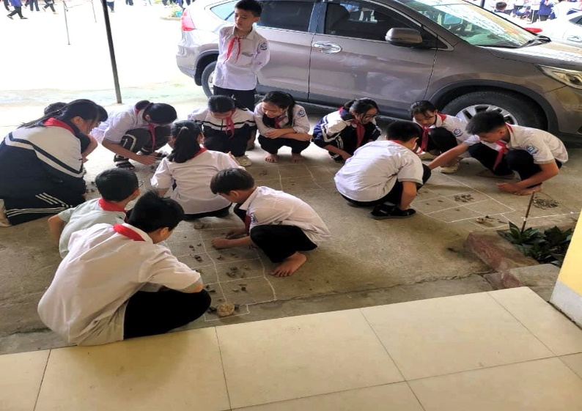
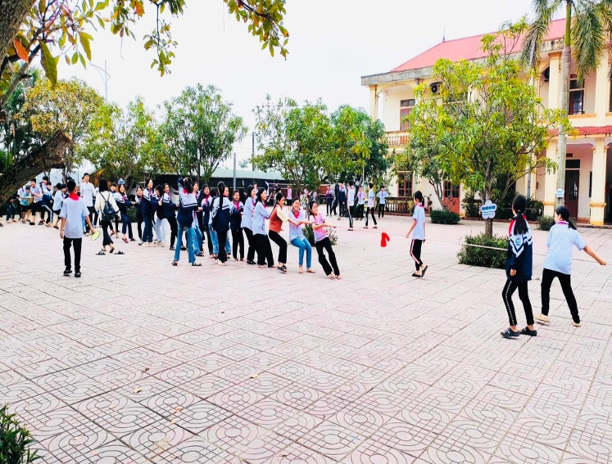
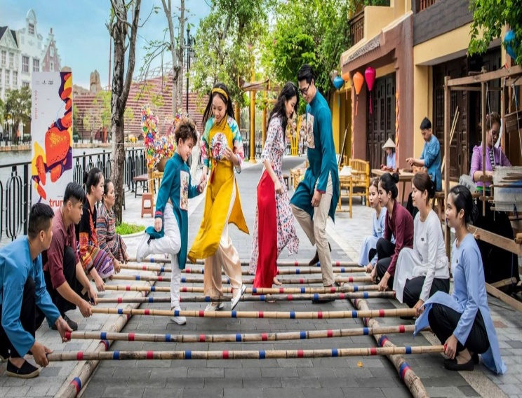
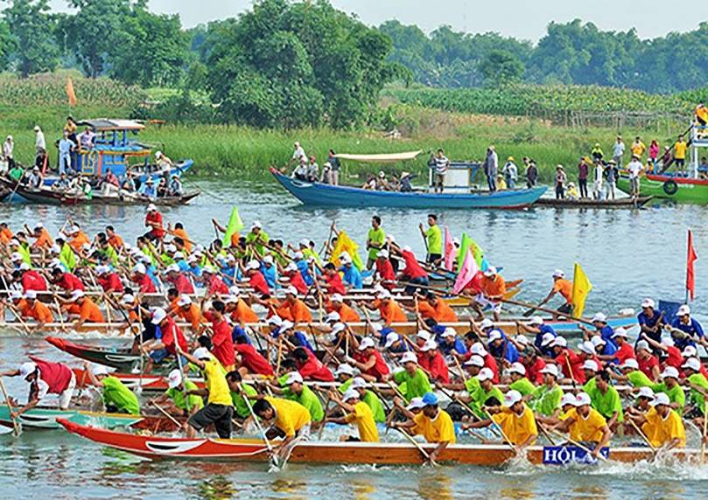
WARM-UP
Look at the pictures and guess the names of the traditional games.
1
2
3
4
5
6

Slide 5
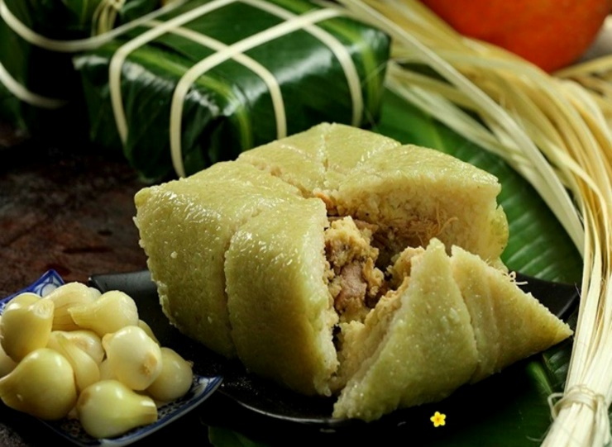
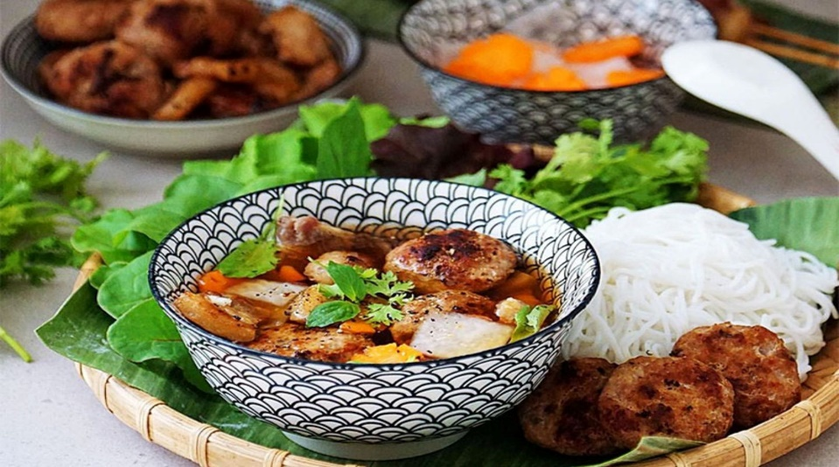
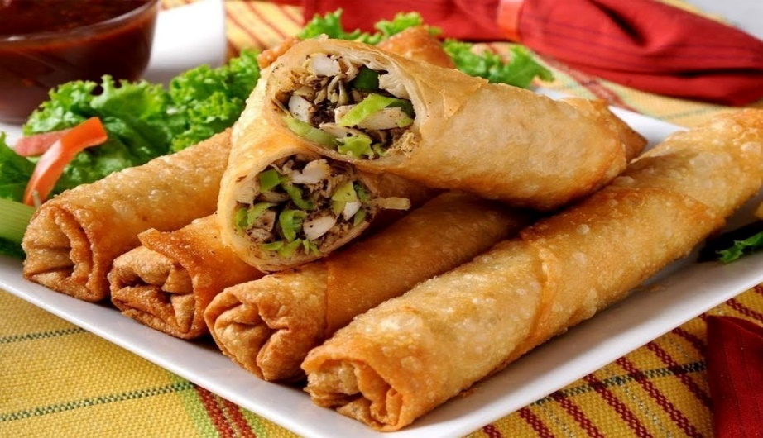
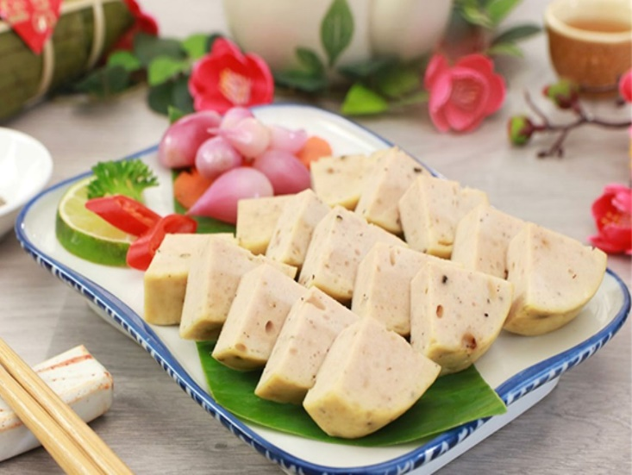
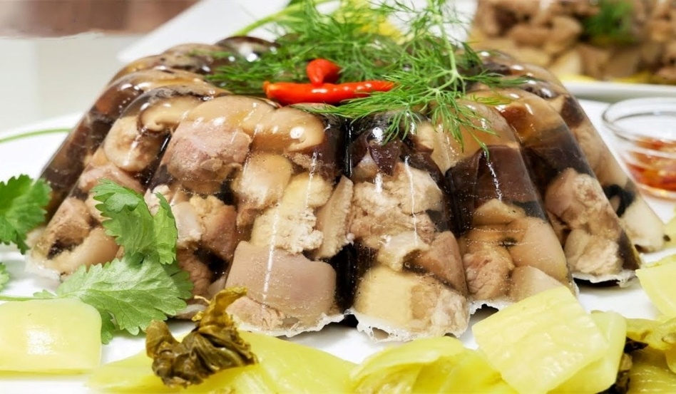
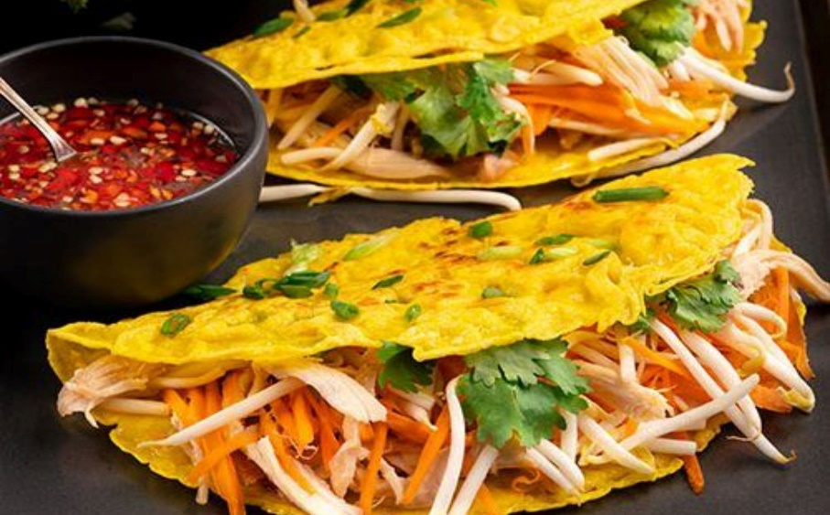
WARM-UP
Look at the pictures and guess the names of the traditional dishes.
1
2
3
4
5
6

Slide 6


VOCABULARY
deep-rooted (adj)
/ˌdiːp ˈruːtɪd/
lâu đời, ăn sâu bén rễ.

Slide 7
VOCABULARY
associated (adj)
/əˈsəʊsieɪtɪd/
liên kết

Slide 8
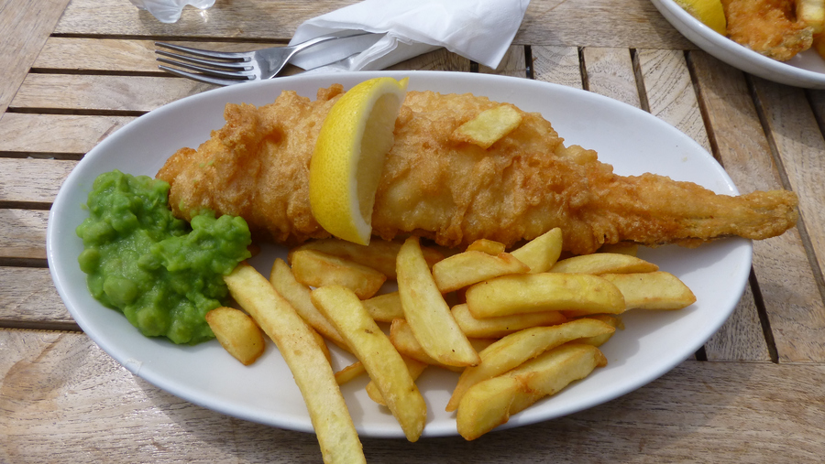
VOCABULARY
fish and chips ( n)
/ˌfɪʃ en ˈtʃɪps/
cá và khoai tây chiên
( món ăn truyền thống của người Anh)

Slide 9
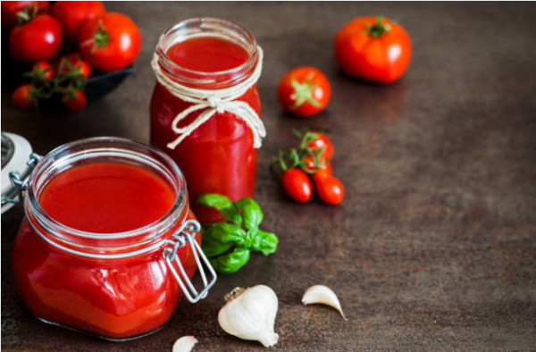
VOCABULARY
ketchup (n)
/ˈketʃəp/
nước sốt cà chua chấm

Slide 10
VOCABULARY
Carbohydrate (n)
/ˌkɑː.bəʊˈhaɪ.dreɪt/
khí các bon

Slide 11
VOCABULARY
a meal cooked and bought at a shop or restaurant but taken somewhere else, often home, to be eaten, or the shop or restaurant itself
takeaway (v)
/ˈteɪk.ə.weɪ/
mua mang về

Slide 12
PRESENTATION
New words | Pronunciation | Meaning
1. deep-rooted (adj) | /ˌdiːp ˈruːtɪd/ | lâu đời, ăn sâu bén rễ.
2. associated (adj) | /əˈsəʊsieɪtɪd/ | liên kết
3. fish and chips ( n) | /ˌfɪʃ en ˈtʃɪps/ | cá và khoai tây chiên ( món ăn truyền thống của người Anh)
4. ketchup (n) | /ˈketʃəp/ | nước sốt cà chua chấm
5. Carbohydrate (n) | /ˌkɑː.bəʊˈhaɪ.dreɪt/ | khí các bon
6. takeaway (v) | /ˈteɪk.ə.weɪ/ | mua mang về

Slide 13

READING
1
Work in groups of four. Discuss the following questions.
What do you know about England?
Suggested answer:
+ England: one of the 4 parts of the UK ( United Kingdom): (England, Scotland, Wales, the Northern Ireland)
+ Capital:
+ Population:
+ Area:
+ Official language:
+ National dishes:
+ ...

Slide 14
READING
2
Read the text and write the underlined words in the box.
England’s traditions have been around for hundreds, even thousands of years. English cuisine is among the deep-rooted traditions that English people are proud to keep alive.
Typical English cuisine has developed over many centuries, and people say that fish and chips is the most English dish of all. It is believed that fish and chips appeared in England in the 19th century. The earliest fish and chip shop opened in London during the 1860s. Since then people have considered fish and chips to be England’s national dish, and it is now a common takeaway in the United Kingdom.
The basic ingredients of the dish are fried fish served with chips. People in different places may add peas, vinegar, lemon, or ketchup. Fish and chips is served hot as the main dish in England. Although there is oil and carbohydrates in fish and chips, it is healthier than other takeaway dishes.
Now there are fish and chip shops in many countries, and it is becoming more and more popular in other countries too. Preserving and promoting fish and chips is the way English people keep themselves associated with the past

Slide 15
READING
- Use the contexts in which these words appear to predict their meaning, and then do the matching.
Meaning / Explanation | Word
1. linked or connected
2. difficult to change or destroy
3. started to be seen
4. necessary and important

Slide 16
READING
3
Read the text again and tick (√) T (True) or F (False) for each sentence.
Meaning/Explanation | T | F
1. English people take great pride in their traditions.
2.Fish and chips has been around for hundreds of years.
3. The earliest fish and chip shop opened in London in 1860.

Slide 17
READING
3
Read the text again and tick (√) T (True) or F (False) for each sentence.
Meaning/Explanation | T | F
4. Peas, vinegar, lemon, or ketchup are necessary for fishand chips.
5.Fish and chips is not healthy as it has a lot of oil.
6. Fish and chips is sold in many countries now.

Slide 18
READING – EXTRA EXERCISE
3
Read the text again and answer the questions.
1. How long have England’s traditions been?
2. Which cuisine has developed over many centuries?
3. When did the earliest fish and chip shop open in London?
4. What are the basic ingredients of the dish “ fish and chips?
5. How do English people feel about the dish “ fish and chips”?

Slide 19
Transition from Reading to Speaking
- Work in pairs to ask and answer the questions.
1. Do the Vietnamese people feel proud of their traditions and customs?
2. Is Vietnamese cuisine famous? Do foreigners like it?
3. What are some popular Vietnamese dishes?

Slide 20
SPEAKING
4
Work in pairs. Match 1 - 5 in column A with a - e in column B.
A | B
1. name of the dish | a. glutinous rice, green beans, pork | 1.
2. history | b. at Tet, on the Hung Kings’ anniversary | 2.
3. basic ingredients | c. banh chung | 3.
4. on what occasion it’s eaten | d. traditional dish | 4.
5. type of dish | e. originated in 6th Hung King’s time | 5.

Slide 21
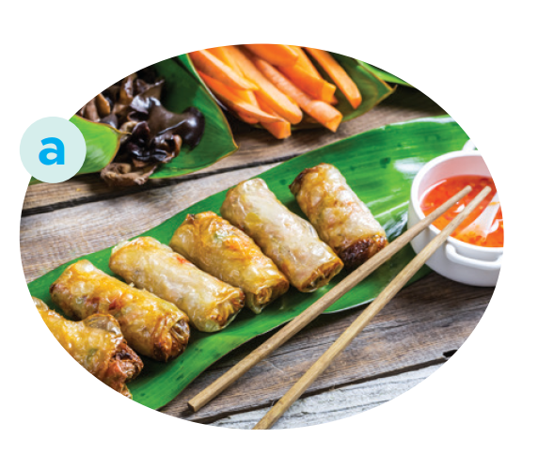
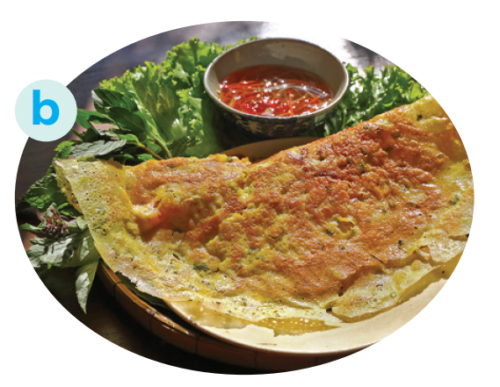
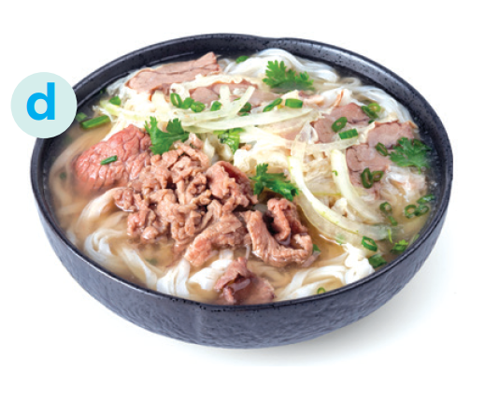
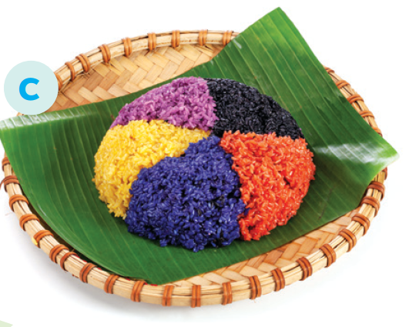
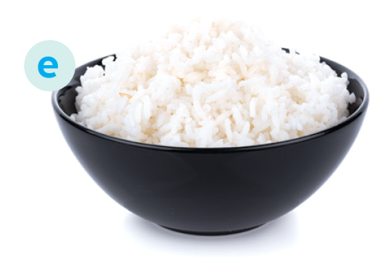
5
Work in groups. Match the Vietnamese dishes with their names in English.
1. pancake
2. five-colour sticky rice
3. beef noodle soup
4. white rice
5. spring rolls

Slide 22
SPEAKING
- Think about one traditional dish and prepare to talk about it.
Your talk should include:
– the name of the dish
– the basic ingredients
– when / on what occasion it is eaten
– whether you like it or not
Well… One of Vietnamese dishes that I like is Fried rice (Cơm rang). It’s a kind of popular street food. We can make and eat it every day, but I’d like to have it at the weekend. The main ingredients of this dish are cooked rice, meat or sausage and colourful vegetables chopped up into small pieces and mixed together. Then we fry the ingredients slowly with cooking oil and one or two eggs. When you fry the rice, you must stir it constantly with a wooden spoon.

Slide 23
Your talk should include:
– the name of the dish
– the basic ingredients
– when / on what occasion it is eaten
– whether you like it or not
SPEAKING
Sample:
Well … One of Vietnamese dishes that I like is fried rice (cơm rang). It’s a kind of popular street food. We can make and eat it every day, but I’d like to have it at the weekend. The main ingredients of this dish are cooked rice, meat or sausage and colourful vegetables chopped up into small pieces and mixed together. Then we fry the ingredients slowly with cooking oil and one or two eggs. When you fry the rice, you must stir it constantly with a wooden spoon.

Slide 24
EXTRA ACTIVITY
- Summarise the reading text in 50 – 70 words.
- There are some clues:
- English cuisine …
- Fish and chips …
- The earliest fish and chip shop …
- Basic ingredients …
- People sell it in many countries now

Slide 25
EXTRA ACTIVITY
Example:
English cuisine is one of the traditions that English people are proud to keep alive. Traditional English cuisine, fish and chips, has developed for many centuries. The earliest fish and chip shop opened in London during the 1860s. The basic ingredients of the dish are fried fish served with chips. People sell fish and chips in many countries now.

Slide 26

CONSOLIDATION
1
Wrap-up
What have we learnt in this lesson?
- Read for specific information about how English people continue their culinary traditions;
- Talk about a typical traditional Vietnamese dish.

Slide 27

CONSOLIDATION
2
Homework
- Do exercises in the workbook.

Slide 28
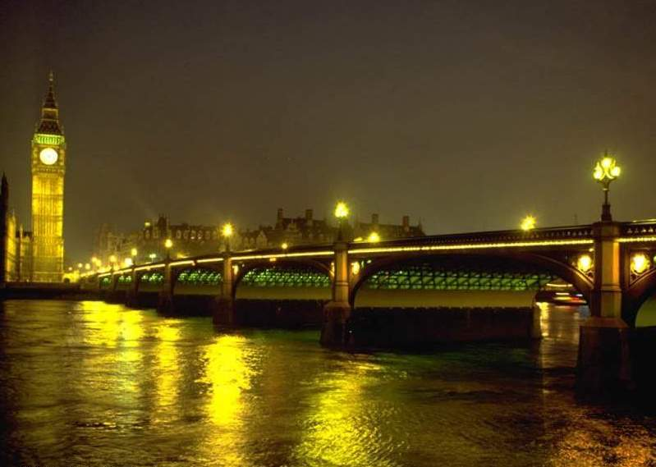
Thanks for your attention !

Slide 29

OBJECTIVES
By the end of the lesson, students will be able to:
- Read for specific information about how English people continue their culinary traditions;
- Talk about a typical traditional Vietnamese dish.

Slide 30
LESSON 5: SKILLS 1
Brainstorm
WARM-UP
Vocabulary
Task 1: Work in groups. Discuss the following
questions.
Task 2: Read the text and write the underlined
words in the box.
Task 3: Read the text again and tick (√) T (True) or F (False) for each sentence.
READING
SPEAKING
Task 4: Work in pairs. Match 1 - 5 in column A with
a - e in column B.
Task 5: Work in groups. Match the Vietnamese
dishes with their names in English.
CONSOLIDATION
Wrap-up
Homework

Slide 31
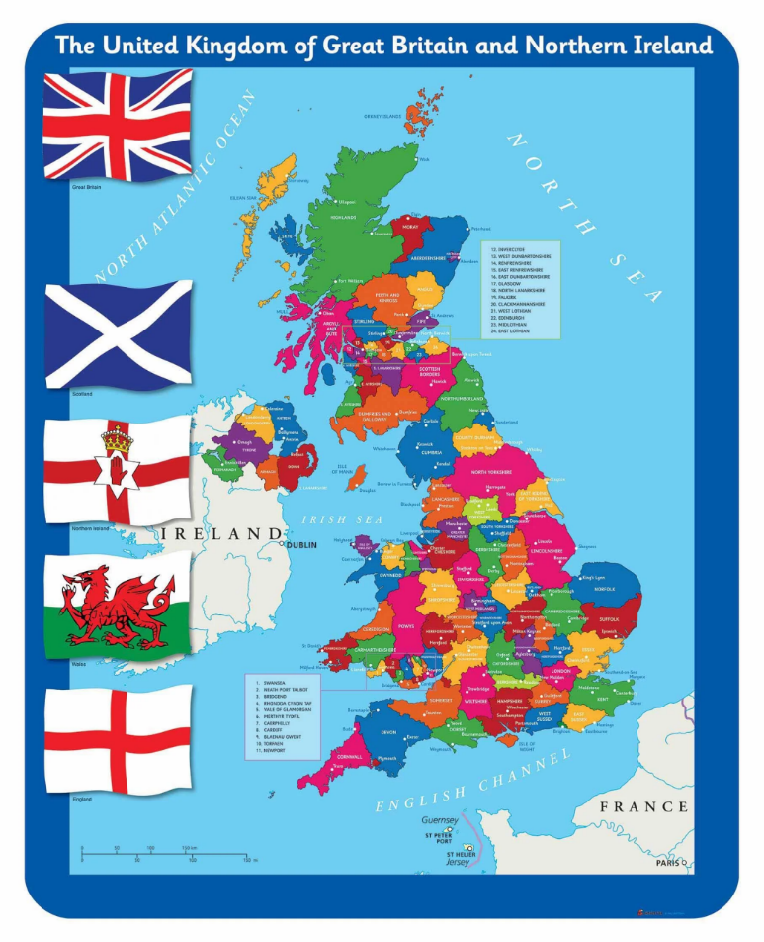
WARM-UP
Question:
What do you know about interesting / strange lifestyles / ways of cooking in the UK?
Suggested answer:
Interesting / strange lifestyles: Morris dancing, Punch and Judy shows, Maypole dancing, ...
Ways of cooking: Slow roast, Braising, stewing, ...

